Slide 1
GIT Chapter 2:
Basics
This presentation was prepared by Robert J. Garner, and is based on Pro Git by Scott Chacon and Ben Straub available at http://git-scm.com/book/en/
This work is licensed under the Creative Commons AttributionNonCommercial-ShareAlike
3.0 Unported License. To view a copy of this license,
visit http://creativecommons.org/licenses/by-nc-sa/3.0/ or send a letter
to Creative Commons, 171 Second Street, Suite 300, San Francisco, California,
94105, USA.

Slide 2
Summary
This chapter covers basic commandS you need to do the vast majority of the things you’ll eventually spend your time doing with Git.
By the end of the chapter, you should be able to :
  configure and initialize a repository
  begin and stop tracking files
  stage and commit changes.
We’ll also show you how to:
  set up Git to ignore certain files and file patterns
  undo mistakes quickly and easily
  browse the history of your project and view changes between commits
  push and pull from remote repositories.

Slide 3
Getting a Git Repository
You can get a Git project using two main approaches:
Initialize a Repository in an Existing Directory
Clone an existing Git repository from another server.

Slide 4
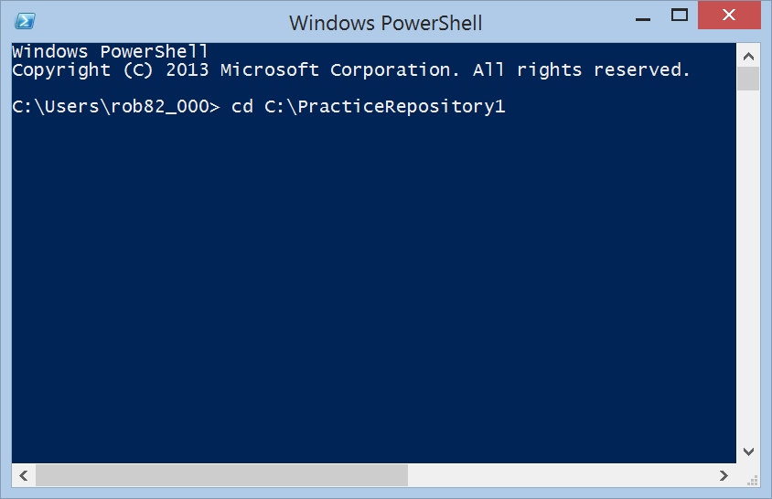
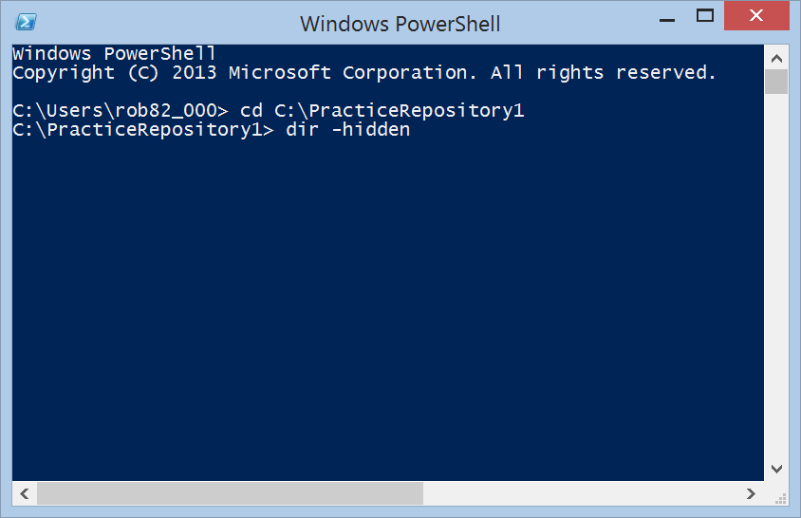
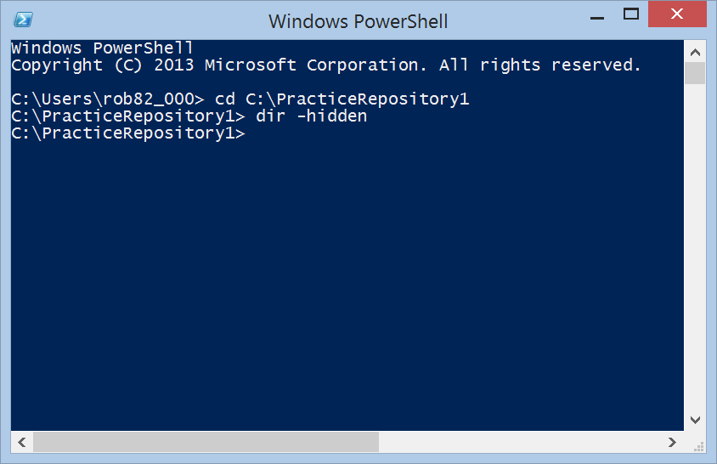
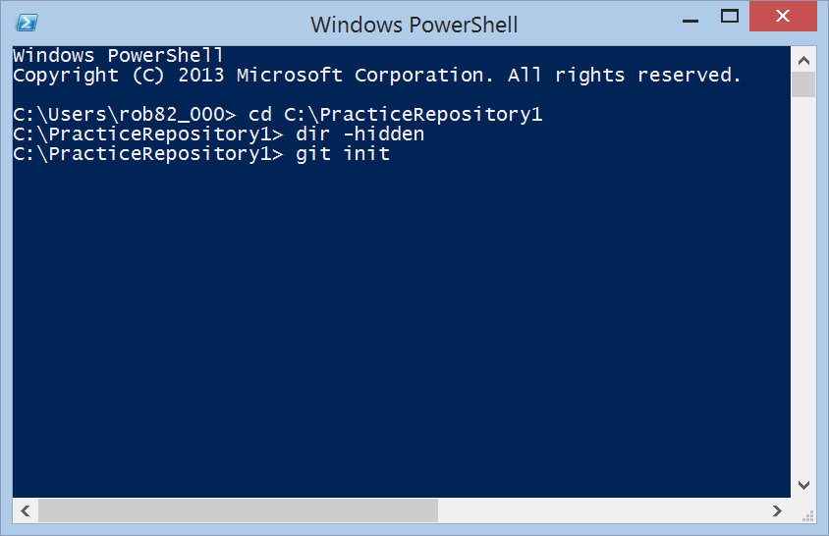
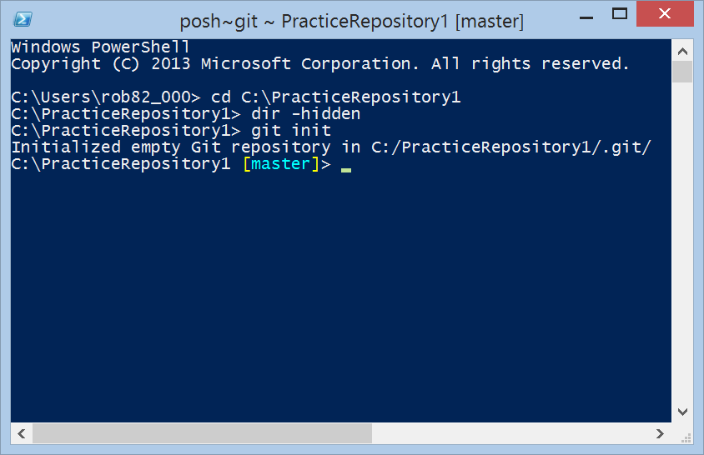

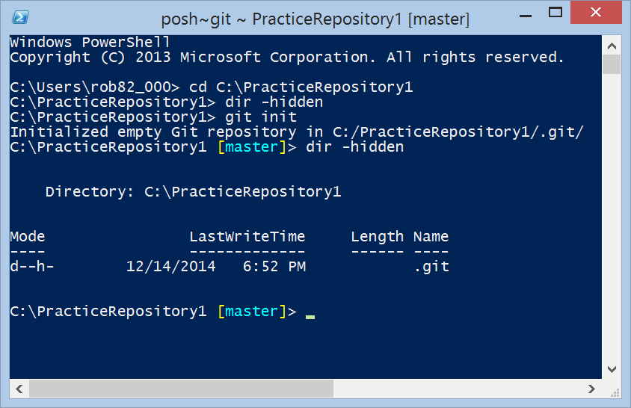
Initializing a Repository in an Existing Directory
If you’re starting to track an existing project in Git, you need to go to the project’s directory and type git init.
Notice empty directory.
git init adds this .git directory!

Slide 5
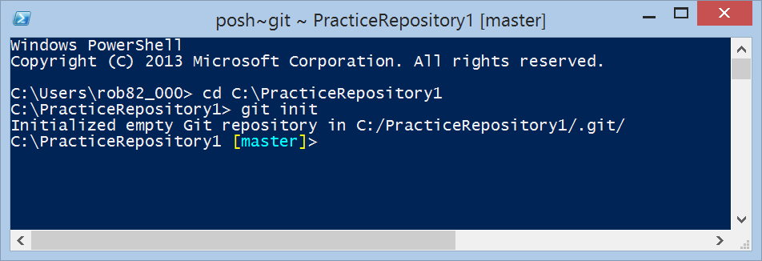
Initializing a Repository in an Existing Directory
Normally don’t do dir commands.
Typically looks like:
Use cd to change to repo directory.
Use git init to setup directory as git repository.

Slide 6
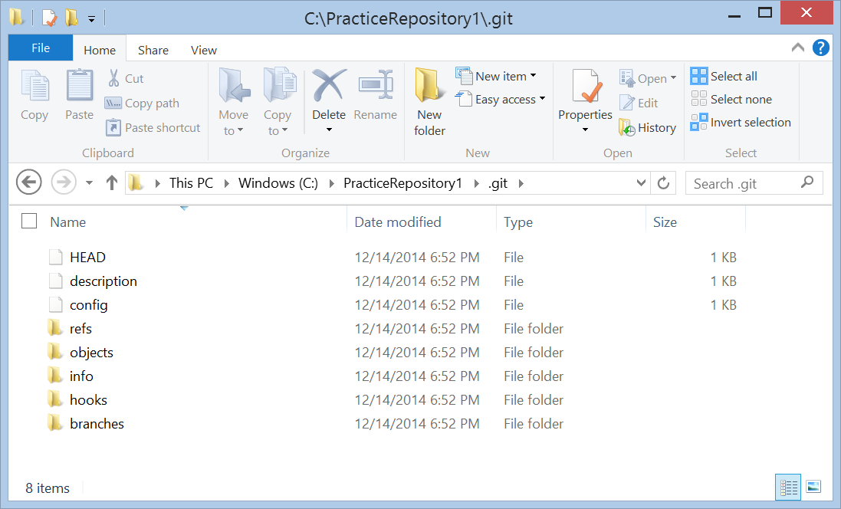
.git directory
Contains all of your necessary repository files – a Git repository skeleton.
At this point, nothing in your project is tracked yet. (See Chapter 10 for information about what files are contained in the .git directory.)

Slide 7
Initializing a Repository in an Existing Directory
If you want to start version-controlling existing files (as opposed to an empty directory), you should probably begin tracking those files and do an initial commit.
You can accomplish that with a few git add commands that specify the files you want to track, followed by a git commit:
    $ git add *.c
    $ git add LICENSE
    $ git commit -m 'initial project version'
We’ll go over what these commands do in just a minute.
At this point, you have a Git repository with tracked files and an initial commit.

Slide 8
Cloning an Existing Repository
To get a copy of an existing Git repository use git clone.
If you’re familiar with other VCS systems notice that the command is “clone” and not “checkout”.
Instead of getting just a working copy, Git receives a full copy of nearly all data that the server has.

Slide 9
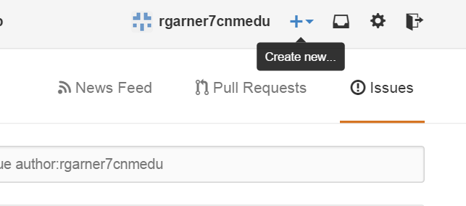
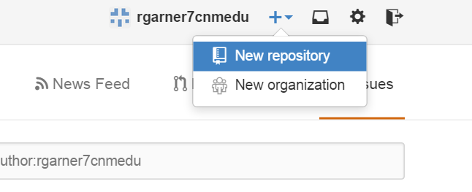
Create a New Repository in GitHub
Create an account on GitHub and sign in to it.
Click on create new repository button:

Slide 10
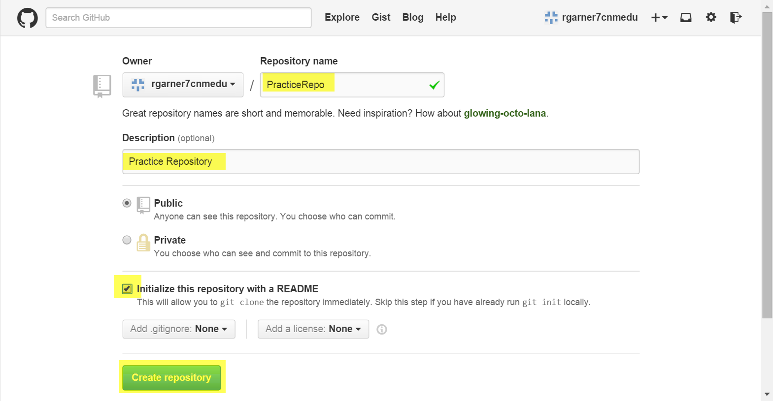
Create a New Repository in GitHub

Slide 11
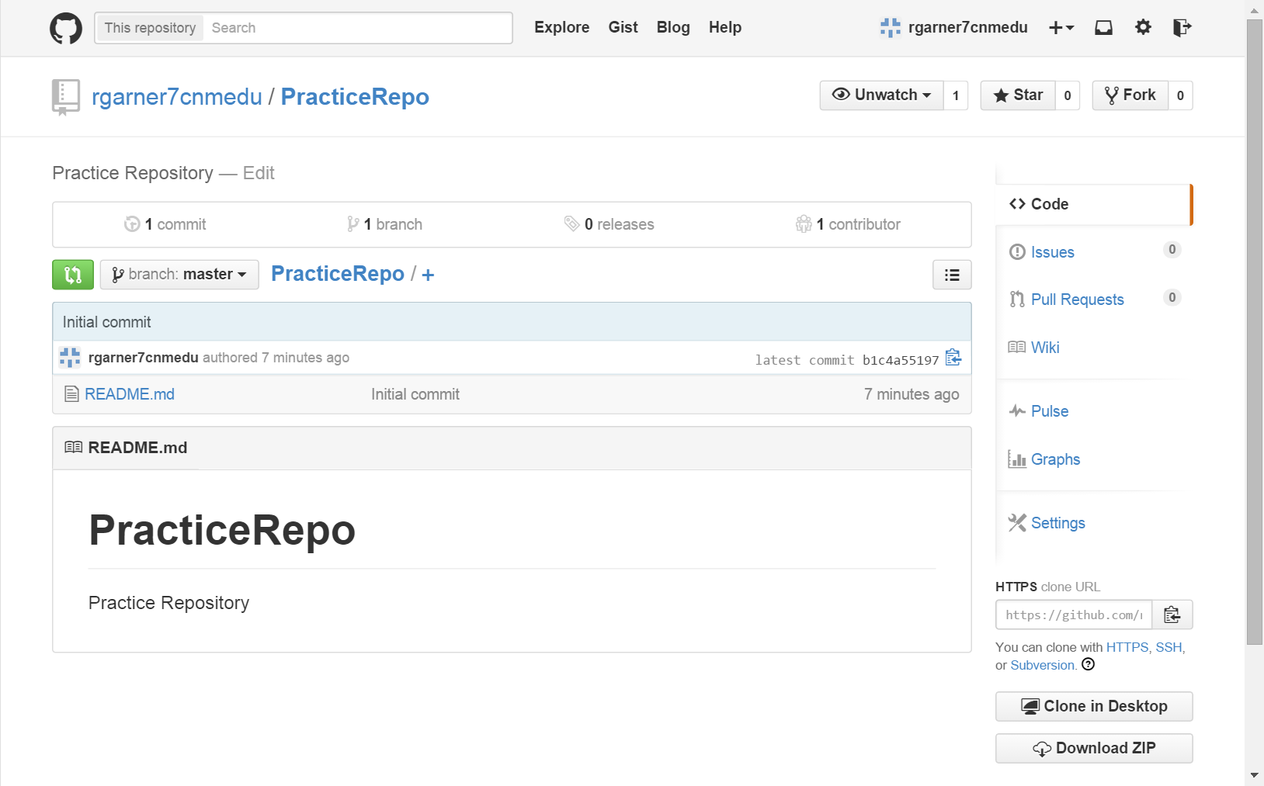
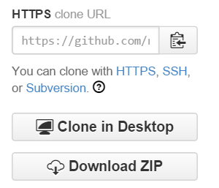
Create a New Repository in GitHub
Use this URL to clone from command line.
Use this to clone directly from GitHub

Slide 12
Create a New Repository in GitHub
You clone a repository with git clone [url].
For example, if you want to clone the Git linkable library called libgit2, you can do so like this:
$ git clone https://github.com/libgit2/libgit2
Accomplishes following:
  creates a directory named “libgit2”
  initializes a .git directory inside it
  pulls down all the data for that repository
  checks out a working copy of the latest version

Slide 13
Create a New Repository in GitHub
If you want to clone the repository into a directory named something other than “libgit2”, you can specify that as the next command-line option:
$ git clone https://github.com/libgit2/libgit2 mylibgit
That command does the same thing as the previous one, but the target directory is called mylibgit.

Slide 14
Recording Changes to the Repository
2.2 Git Basics

Slide 15
Recording Changes to the Repository
You have a Git repository
A checkout or working copy of the files for that project.
You need to make some changes and commit snapshots of those changes into your repository each time the project reaches a state you want to record.

Slide 16
Recording Changes to the Repository
Remember that each file in your working directory can be in one of two states:
  Tracked: files that were in the last snapshot; they can be unmodified, modified, or staged.
  Untracked: Everything else – any files in your working directory that were not in your last snapshot and are not in your staging area.
When you first clone a repository, all of your files will be tracked and unmodified because you just checked them out and haven’t edited anything.

Slide 17
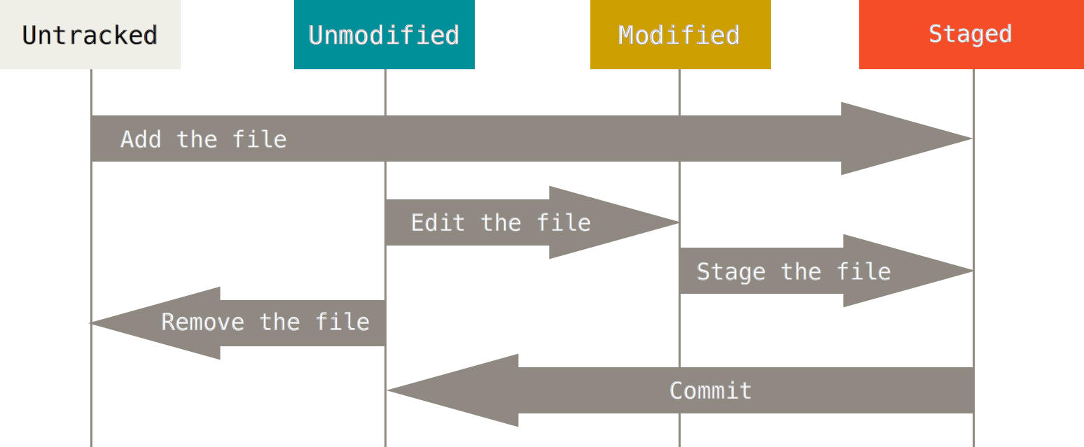
Lifecycle Status of Files
As you edit files, Git sees them as modified, because you’ve changed them since your last commit. You stage these modified files and then commit all your staged changes, and the cycle repeats.

Slide 18
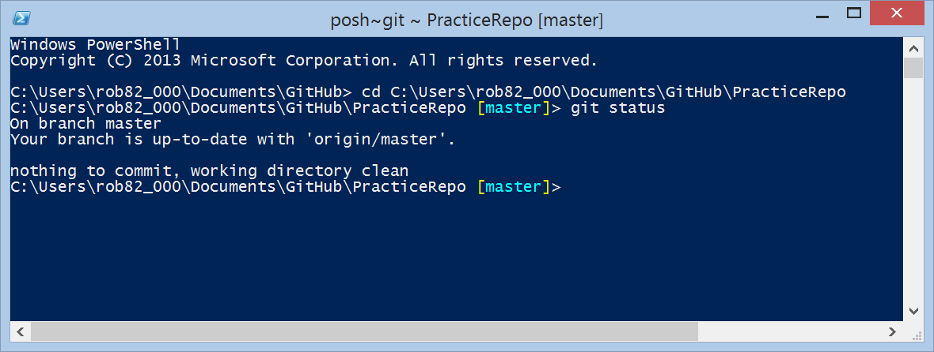
Checking the Status of Your Files
The main tool you use to determine which files are in which state is the git status command.
If you run this command directly after a clone, you should see something like this:

Slide 19
Checking the Status of Your Files
This means you have a clean working directory – in other words, there are no tracked and modified files.
Git also doesn’t see any untracked files, or they would be listed here.
Finally, the command tells you which branch you’re on and informs you that it has not diverged from the same branch on the server.
For now, that branch is always “master”, which is the default; you won’t worry about it here.
Chapter 3 will go over branches and references in detail.

Slide 20
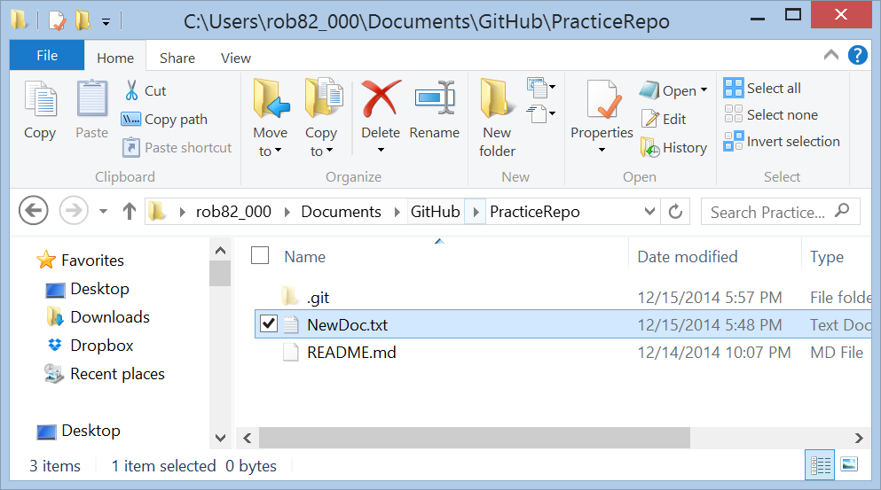
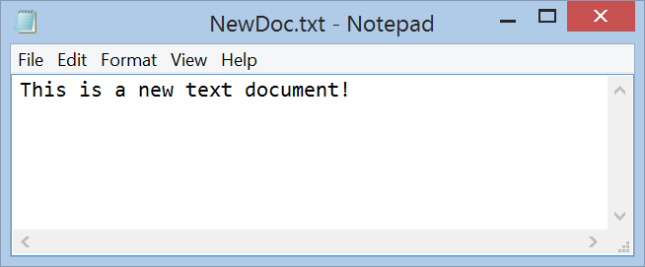
Add a New Text Document

Slide 21
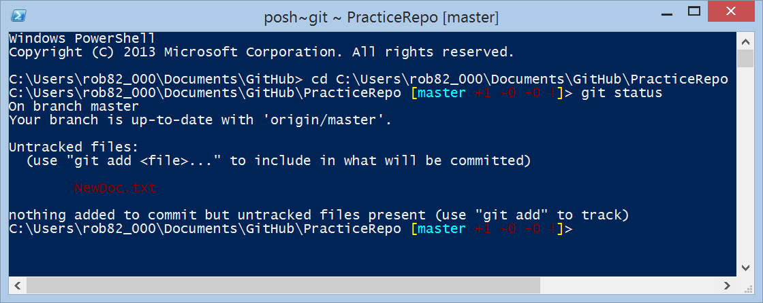
Add a New Text Document
Execute git status
Command git status.
NewDoc.txt is untracked.

Slide 22
Add a New Text Document
NewDoc.txt is untracked, because it’s under the “Untracked files” heading in your status output.
Untracked basically means that Git sees a file you didn’t have in the previous snapshot (commit);
Git won’t start including it in your commit snapshots until you explicitly tell it to do so.
It does this so you don’t accidentally begin including generated binary files or other files that you did not mean to include.
You do want to start including NewDoc.txt, so let’s start tracking the file.

Slide 23
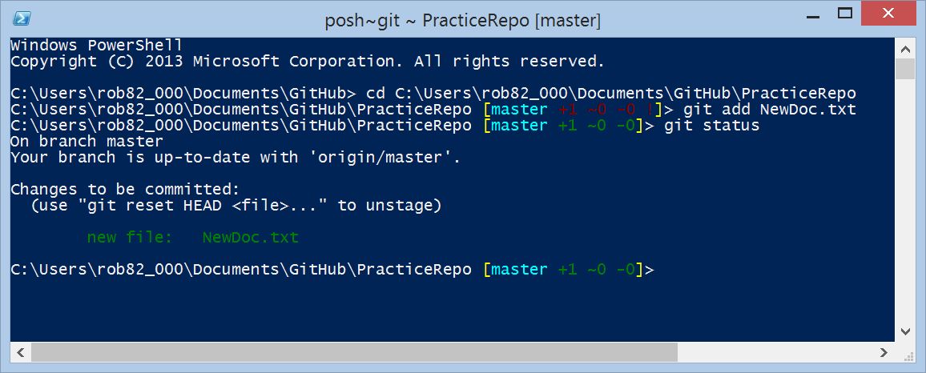
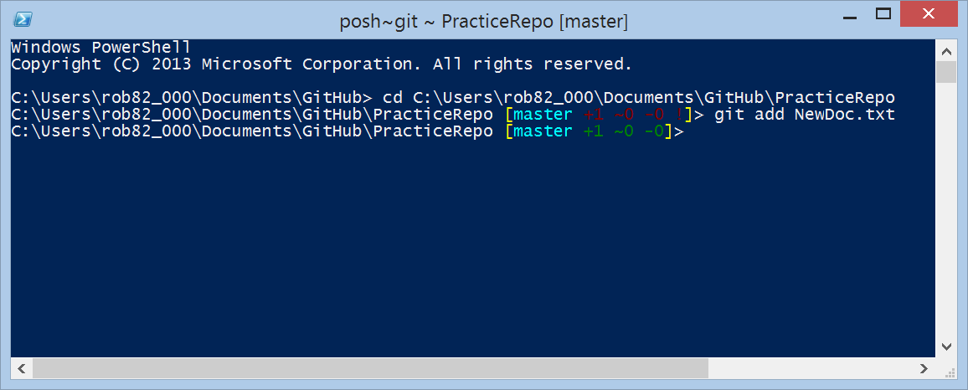
Tracking New Files
In order to begin tracking a new file, you use the command git add.
To begin tracking the README file, you can run this:
NewDoc.txt is now ready to be committed.

Slide 24
Tracking New Files
You can tell that it’s staged because it’s under the “Changes to be committed” heading.
If you commit at this point, the version of the file at the time you ran git add is what will be in the historical snapshot.
The git add command takes a path name for either a file or a directory; if it’s a directory, the command adds all the files in that directory recursively.

Slide 25
Exercises
Add another file to the directory
Create a sub directory with at least two files in it.

Slide 26
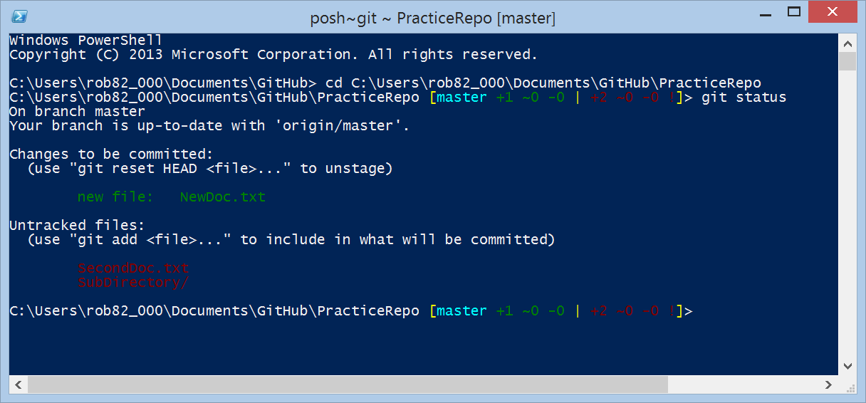
Git Status
New documents and directory untracked.

Slide 27
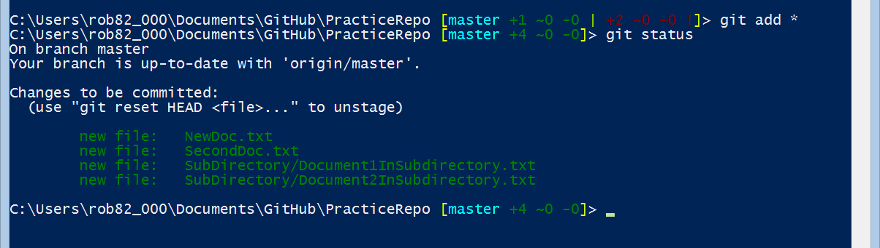
git *
Use git * to add everything:
Everything is now ready to be commited.

Slide 28
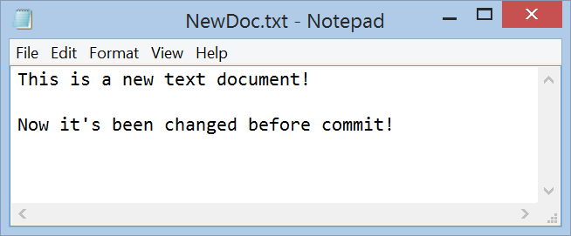
Making Changes Before Commit
Modify our original file and save it.

Slide 29
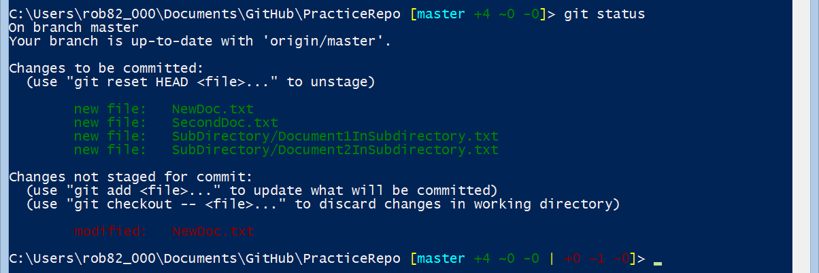
Git Status
Original NewDoc.txt is still in committed.
This NewDoc.txt is your modified one!
When you change a file, it does not affect the version that is ready to be committed!
You must git add the modified file to make the modified version part of the next commit.

Slide 30
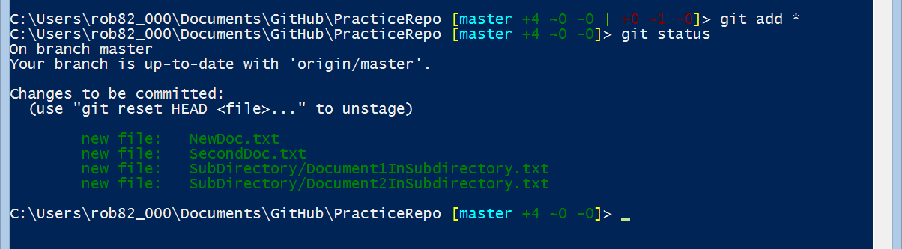
Do another git add *
This NewDoc.txt is your modified one!
Doing another git add will add the modified file to the staged files and replace the previous one.

Slide 31
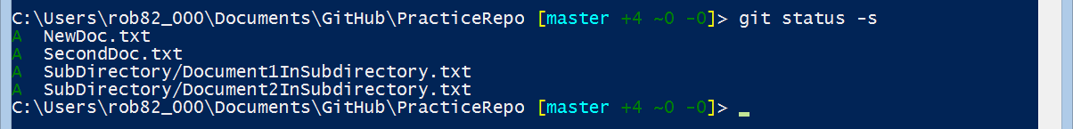
Short Status
Shorter format for status
  git status –short
  git status –s
Legend:
  New files that aren’t tracked have a ?? next to them.
  New files that have been added to the staging area have an A.
  Modified files have an M and so on.

Slide 32
git diff
The git diff command provides more detail than git status
Answers these two questions:
  What have you changed but not yet staged?
  What have you staged that you are about to commit?
Although git status answers those questions very generally by listing the file names, git diff shows you the exact lines added and removed – the patch, as it were.

Slide 33
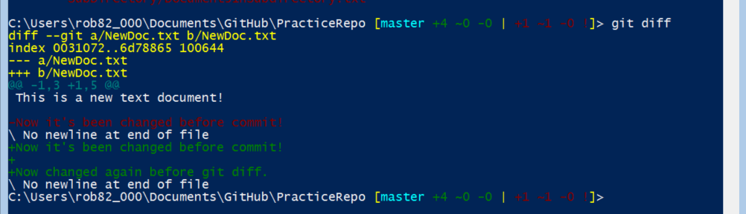
Exercise
Change NewDoc.txt one more time
Add another text file to the sub directory
Run git diff

Slide 34
Exercise
Do a git add * then another git diff
Notice nothing to report after git add

Slide 35
Committing Your Changes
Now that your staging area is set up the way you want it, you can commit your changes.
Remember that anything that is still unstaged – any files you have created or modified that you haven’t run git add on since you edited them – won’t go into this commit.
They will stay as modified files on your disk.
In this case, the last time you ran git status, you saw that everything was staged, so you’re ready to commit your changes.
The simplest way to commit is to type git commit

Slide 36
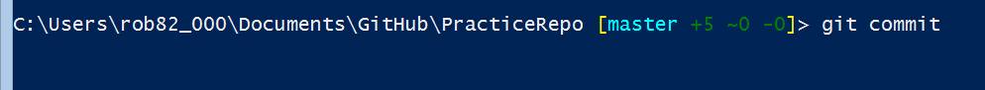
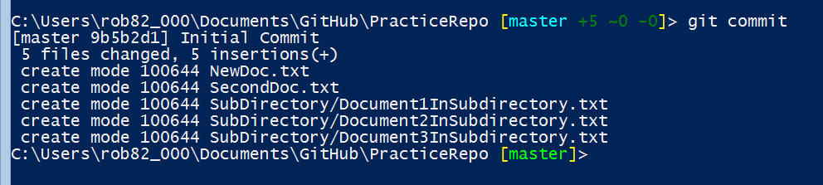
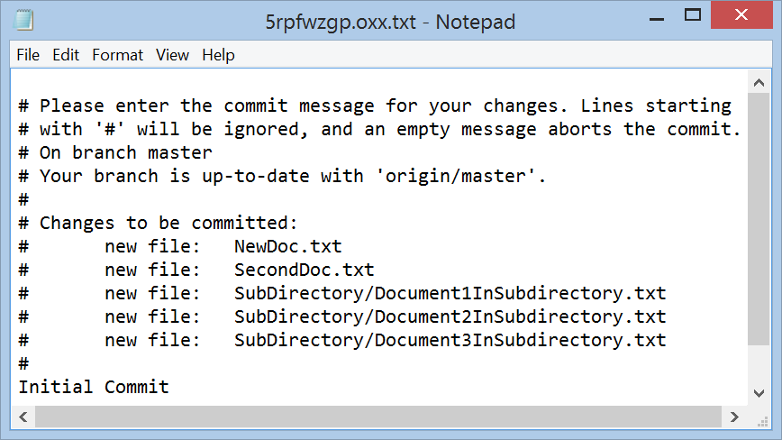
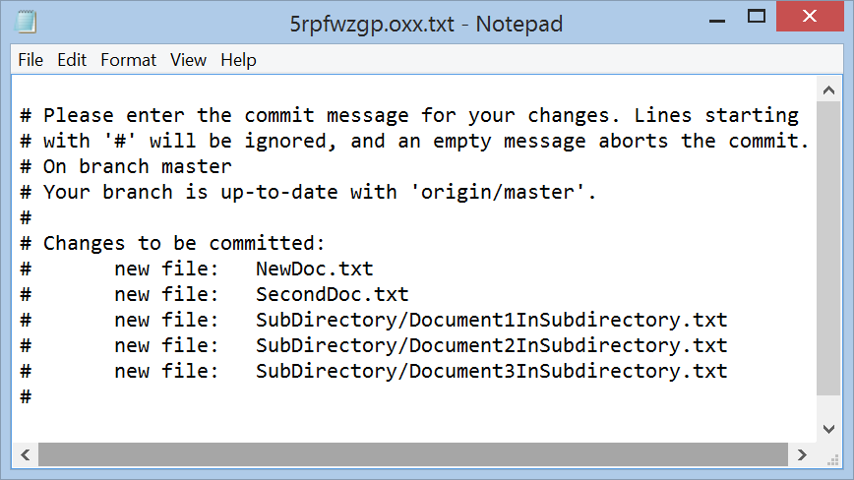
git commit
Save and close the text file and hit enter to complete the commit.
git commit opens a new text file and asks you to add a commit message.

Slide 37
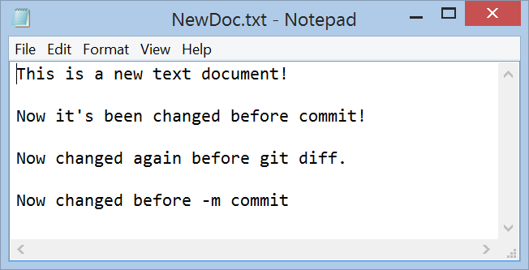
-m flag
Alternatively, you can type your commit message inline with the commit command by specifying it after a -m flag
Make a change to newdoc.txt:

Slide 38
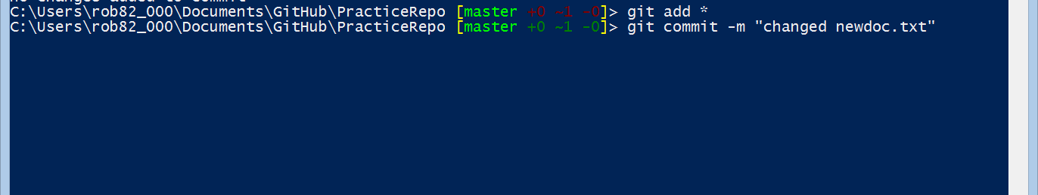
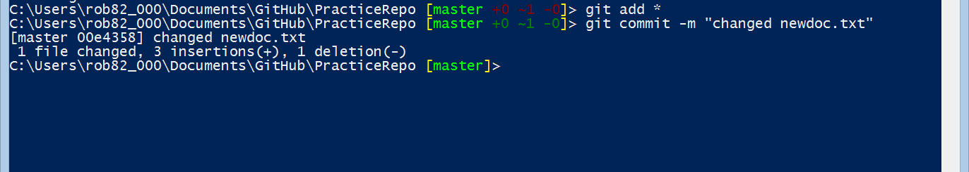
commit -m
git add all then git commit –m
Notice text editor does not show up. Instead string is used.

Slide 39
Commits
After a commit can see that the commit has given you some output about itself:
  branch you committed to
  what SHA-1 checksum the commit has
  how many files were changed
  statistics about lines added and removed in the commit

Slide 40
Commits
Remember that the commit records the snapshot you set up in your staging area.
Anything you didn’t stage is still sitting there modified; you can do another commit to add it to your history.
Every time you perform a commit, you’re recording a snapshot of your project that you can revert to or compare to later.

Slide 41
Skipping the Staging Area
Although it can be amazingly useful for crafting commits exactly how you want them, the staging area is sometimes a bit more complex than you need in your workflow.
If you want to skip the staging area, Git provides a simple shortcut.
Adding the -a option to the git commit command makes Git automatically stage every file that is already tracked before doing the commit, letting you skip the git add part.

Slide 42
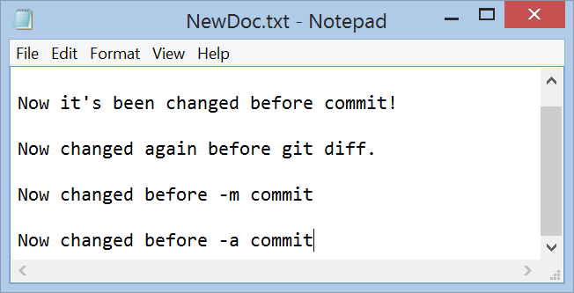
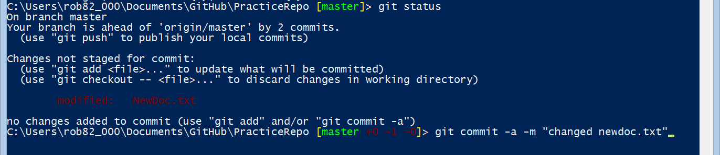
git commit -a
Change NewDoc.txt then git commit –a -m

Slide 43
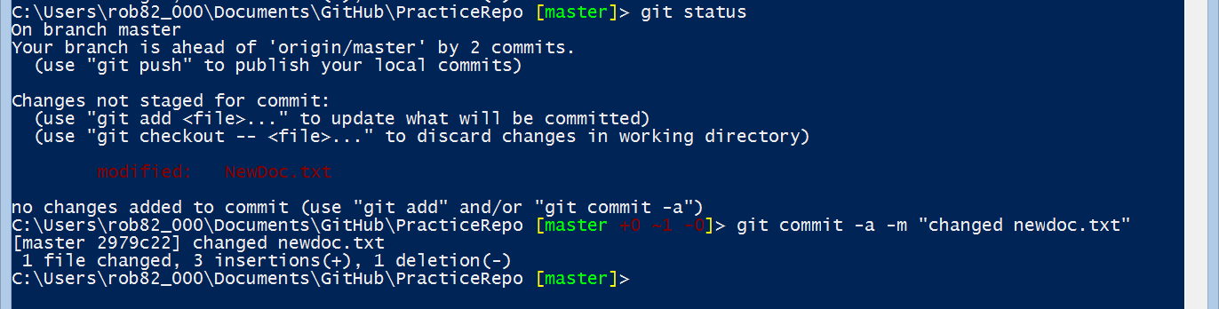
git commit -a
git add and git commit done in one step.

Slide 44
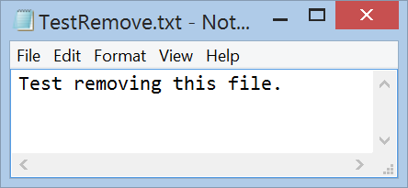
Removing Files
To remove a file from Git, you have to remove it from your tracked files (more accurately, remove it from your staging area) and then commit.
If you simply remove the file from your working directory, it shows up under the “Changed but not updated” (that is, unstaged) area of your git status output.
Exercise
  Add a file to your directory
  Execute git add *
  Delete the file
  Execute git status

Slide 45
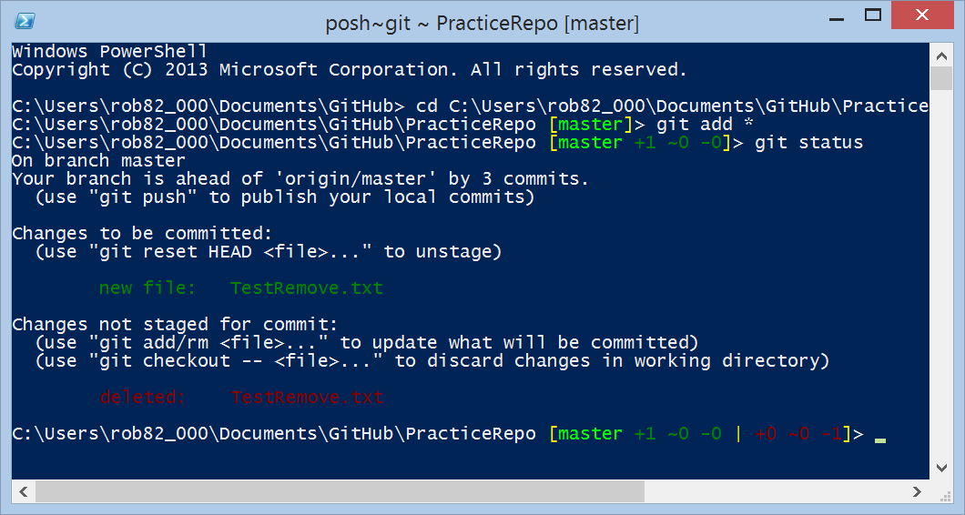
Exercise
The file is deleted from file explorer here after git add is completed.
Notice the file is still in the current commit because of the add!
Do another git add * to incorporate this change.

Slide 46
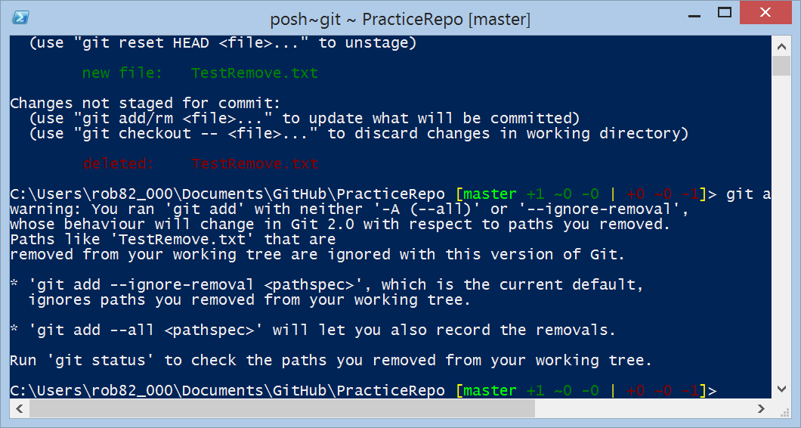
git add *
Git needs a -A or – ignore to deal with the removal.

Slide 47
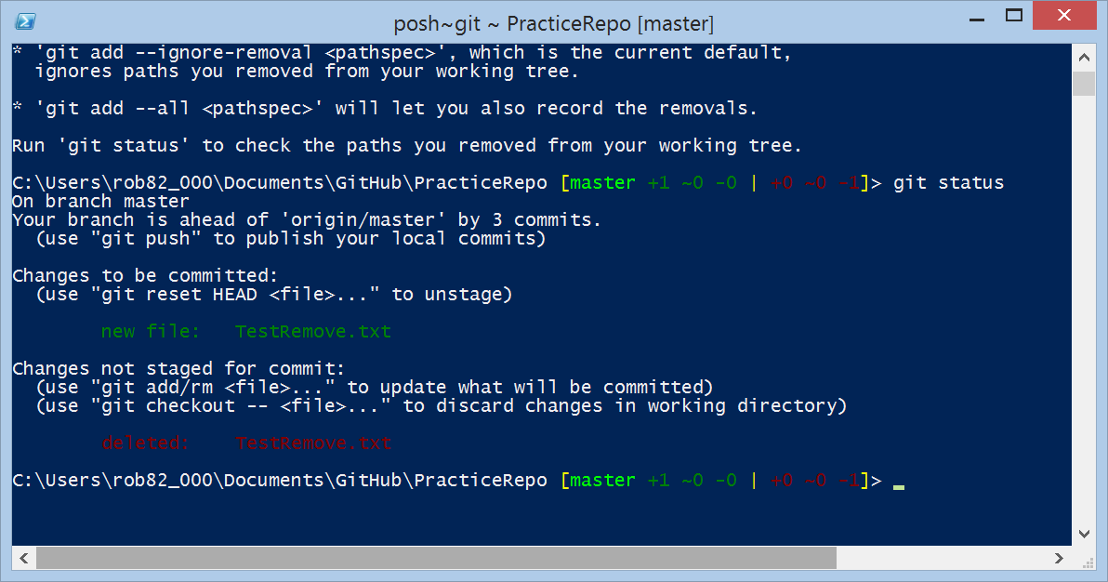
git status
Notice nothing changed.

Slide 48
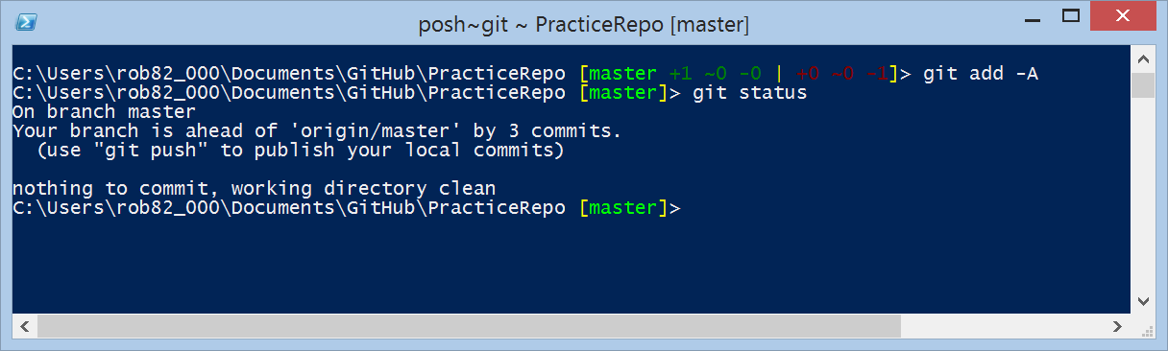
git add -A and git status
Processes the removal.

Slide 49
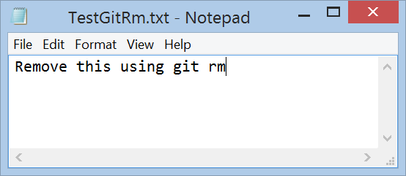
git rm
Then, if you run git rm, it stages the file’s removal:
The git rm command:
  Removes it from your tracked files (more accurately, remove it from your staging area)
  Executes a commit
  Removes the file from your working directory so you don’t see it as an untracked file the next time around.
Exercise
  Add a new file.
  Remove it using git rm
  Execute git status

Slide 50
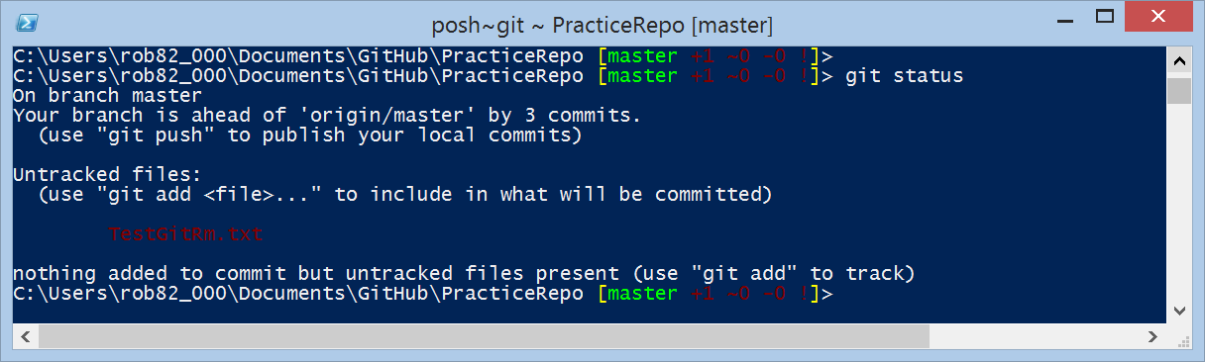
git status after adding file

Slide 51
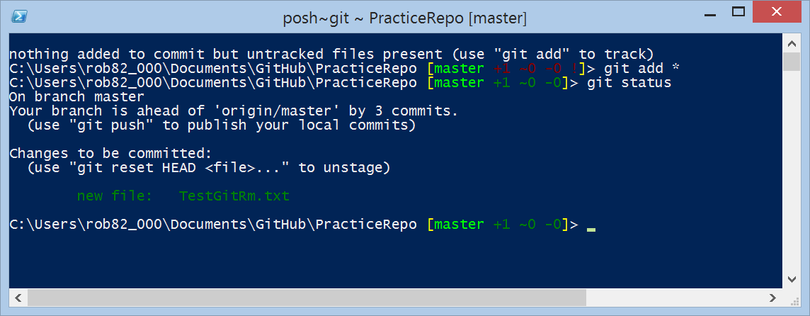
git status after git add *

Slide 52
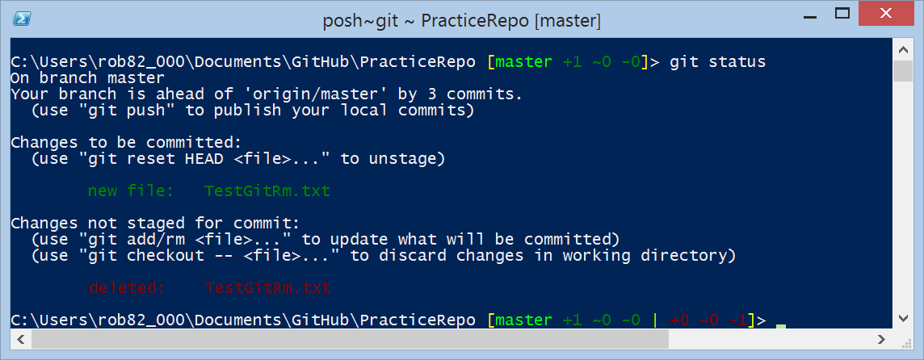
git status after deleting file

Slide 53
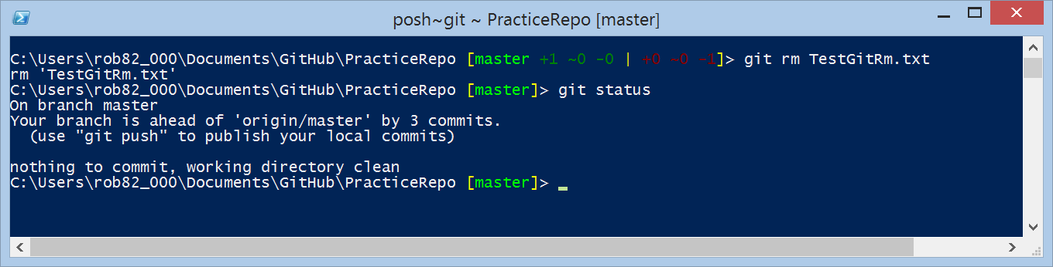
git rm and git status
File removed from staging area.

Slide 54
Moving Files
Unlike many other VCS systems, Git doesn’t explicitly track file movement.
If you rename a file in Git, no metadata is stored in Git that tells it you renamed the file.

Slide 55
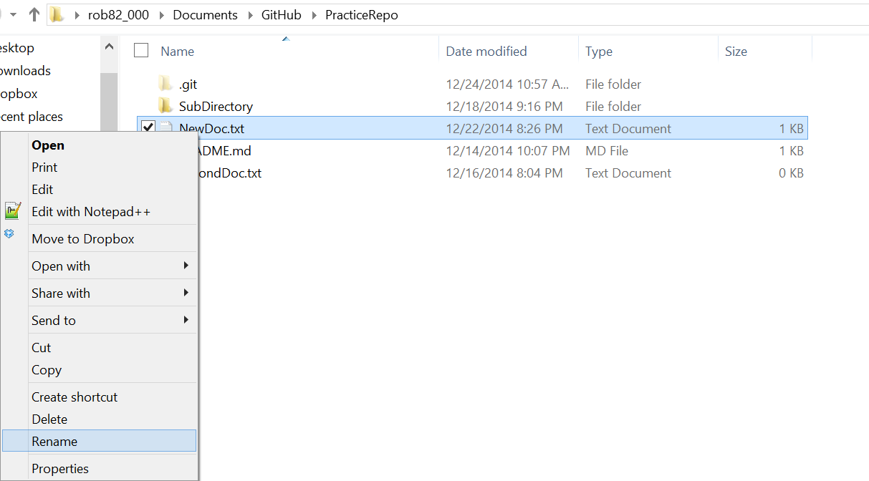
Renaming Files

Slide 56
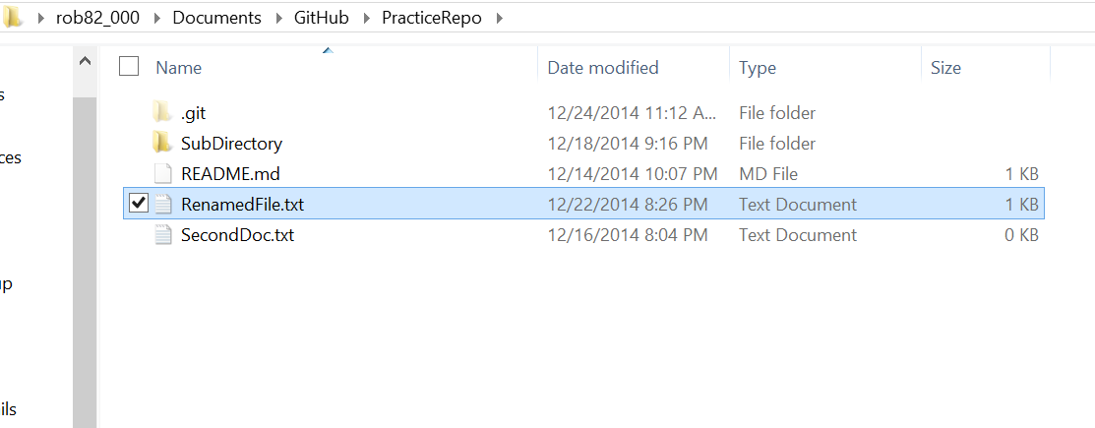
Renaming Files

Slide 57
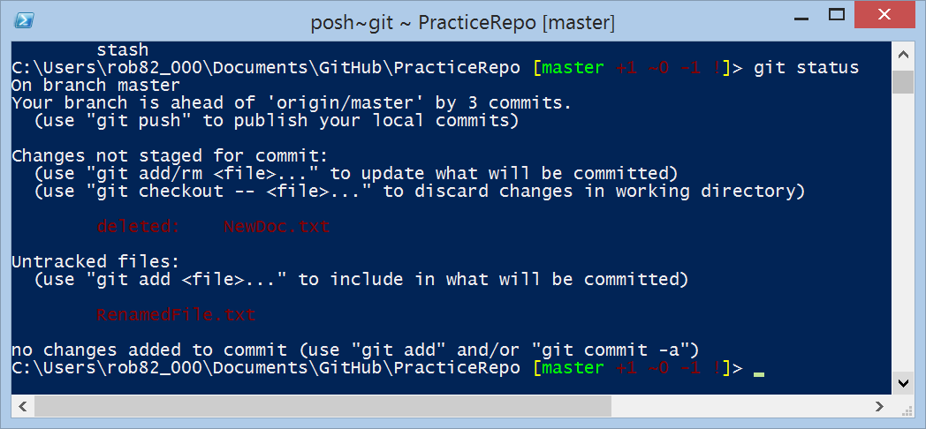
git status after rename
Notice rename treated as delete and add.

Slide 58

git add *

Slide 59

git status after add
Notice does not handle the delete!

Slide 60

Try git add -A

Slide 61
Moving Files git mv Command
If you want to rename a file in Git, you can run something like
git mv file_from file_to
Exercise
  Rename a file using git mv
  Execute git status
  View file in file manager

Slide 62


git rm

Slide 63
Viewing the Commit History
2.3 Git Basics

Slide 64
Viewing the Commit History
After you have created several commits, or if you have cloned a repository with an existing commit history, you’ll probably want to look back to see what has happened.
The most basic and powerful tool to do this is the git log command.
These examples use a very simple project called “simplegit”.
To get the project, ru
git clone https://github.com/schacon/simplegit-progit
When you run git log in this project, you should get output that looks something like this:

Slide 65


git clone

Slide 66

git log

Slide 67
git log options
See http://git-scm.com/book/en/v2/Git-Basics-Viewing-the-Commit-History

Slide 68
Undoing Things
2.4 Git Basics

Slide 69
Undoing Things
At any stage, you may want to undo something.
Here, we’ll review a few basic tools for undoing changes that you’ve made.
Be careful, because you can’t always undo some of these undos.
This is one of the few areas in Git where you may lose some work if you do it wrong.

Slide 70
--amend option
One of the common undos takes place when you commit too early and possibly forget to add some files, or you mess up your commit message.
If you want to try that commit again, you can run commit with the --amend option:
git commit --amend

Slide 71
--amend option
This command takes your staging area and uses it for the commit.
  If you’ve made no changes since your last commit (for instance, you run this command immediately after your previous commit), then your snapshot will look exactly the same, and all you’ll change is your commit message.
The same commit-message editor fires up, but it already contains the message of your previous commit.
You can edit the message the same as always, but it overwrites your previous commit.
You end up with a single commit – the second commit replaces the results of the first.

Slide 72

Exercise
Add a file with git add *
git commit -m “first commit”
Add a second file
git commit --amend

Slide 73

git status

Slide 74

git add and git commit

Slide 75

Add another file

Slide 76

git add the new file

Slide 77




git commit --amend

Slide 78
Unstaging a Staged File
Let’s say you’ve changed two files and want to commit them as two separate changes, but you accidentally type git add * and stage them both.
How can you unstage one of the two?
git reset HEAD <file>...

Slide 79
Unmodifying a Modified File
What if you realize that you don’t want to keep your changes to a file?
How can you easily unmodify it – revert it back to what it looked like when you last committed?
git checkout -- <file>...

Slide 80
Dangers of git checkout
It’s important to understand that git checkout -- [file] is a dangerous command.
Any changes you made to that file are gone – you just copied another file over it.
Don’t ever use this command unless you absolutely know that you don’t want the file.

Slide 81
Dangers of git checkout
If you would like to keep the changes you’ve made to that file but still need to get it out of the way for now, we’ll go over stashing and branching in Chapter 3; these are generally better ways to go.

Slide 82
Dangers of git checkout
Anything that is committed in Git can almost always be recovered.
Even commits that were on branches that were deleted or commits that were overwritten with an --amend commit can be recovered (see “Data Recovery” for data recovery).
However, anything you lose that was never committed is likely never to be seen again.

Slide 83
Working with Remotes
2.5 Git Basics

Slide 84
Working with Remotes
Remote repositories are versions of your project that are hosted on the Internet or network somewhere.
You can have several of them, each of which generally is either read-only or read/write for you.
Collaborating with others involves managing these remote repositories and pushing and pulling data to and from them when you need to share work.

Slide 85
Managing Remote Repositories
Knowing how to:
Add remote repositories
Remove remotes that are no longer valid
Manage various remote branches and define them as being tracked or not

Slide 86

Showing Your Remotes
To see which remote servers you have configured, you can run the git remote command.
It lists the shortnames of each remote handle you’ve specified.
If you’ve cloned your repository, you should at least see origin – that is the default name Git gives to the server you cloned from.

Slide 87

git remote -v
You can also specify -v, which shows you the URLs that Git has stored for the shortname to be used when reading and writing to that remote:

Slide 88

Adding Remote Repositories
To add a new remote Git repository as a shortname you can reference easily, run git remote add [shortname] [url]:
Now you can use the string pb on the command line in lieu of the whole URL

Slide 89
Fetching and Pulling from Your Remotes
To get data from your remote projects, you can run:
git fetch [remote-name]
The command goes out to that remote project and pulls down all the data from that remote project that you don’t have yet.
After you do this, you should have references to all the branches from that remote, which you can merge in or inspect at any time.

Slide 90
Cloning a Repository
If you clone a repository, the command automatically adds that remote repository under the name “origin”.
So, git fetch origin fetches any new work that has been pushed to that server since you cloned (or last fetched from) it.
It’s important to note that the git fetch command pulls the data to your local repository – it doesn’t automatically merge it with any of your work or modify what you’re currently working on.
You have to merge it manually into your work when you’re ready.

Slide 91
git pull
If you have a branch set up to track a remote branch (see the next section and Chapter 3 for more information), you can use the git pull command to automatically fetch and then merge a remote branch into your current branch.
This may be an easier or more comfortable workflow for you; and by default, the git clone command automatically sets up your local master branch to track the remote master branch (or whatever the default branch is called) on the server you cloned from.
Running git pull generally fetches data from the server you originally cloned from and automatically tries to merge it into the code you’re currently working on.

Slide 92
Pushing to Your Remotes
When you have your project at a point that you want to share, you have to push it upstream.
The command for this is simple:
git push [remote-name] [branch-name].
If you want to push your master branch to your origin server (again, cloning generally sets up both of those names for you automatically), then you can run this to push any commits you’ve done back up to the server:
git push origin master

Slide 93

Pushing to Your Remotes

Slide 94

View Results on GitHub

Slide 95

Inspecting a Remote
If you want to see more information about a particular remote, you can use the git remote show [remote-name] command.
If you run this command with a particular shortname, such as origin, you get something like this:

Slide 97
Summary
You should have a basic understanding of what Git is.
How it’s different from the centralized version control systems.
You should also now have a working version of Git on your system that’s set up with your personal identity.
Next: learn some Git basics.

