Slide 1
GIT Chapter 3:
Branching
This presentation was prepared by Robert J. Garner, and is based on Pro Git by Scott Chacon and Ben Straub available at http://git-scm.com/book/en/
This work is licensed under the Creative Commons AttributionNonCommercial-ShareAlike
3.0 Unported License. To view a copy of this license,
visit http://creativecommons.org/licenses/by-nc-sa/3.0/ or send a letter
to Creative Commons, 171 Second Street, Suite 300, San Francisco, California,
94105, USA.

Slide 2
Summary
This chapter covers basic commandS you need to do the vast majority of the things you’ll eventually spend your time doing with Git.
By the end of the chapter, you should be able to :
  configure and initialize a repository
  begin and stop tracking files
  stage and commit changes.
We’ll also show you how to:
  set up Git to ignore certain files and file patterns
  undo mistakes quickly and easily
  browse the history of your project and view changes between commits
  push and pull from remote repositories.

Slide 3
3.1 Git Branching - Branches in a Nutshell
Nearly every VCS has some form of branching support.
Branching means you diverge from the main line of development and continue to do work without messing with that main line.
In many VCS tools, this is a somewhat expensive process, often requiring you to create a new copy of your source code directory, which can take a long time for large projects.

Slide 4
Branches in a Nutshell
Git doesn’t store data as a series of changesets or differences, but instead as a series of snapshots.
When you make a commit, Git stores a commit object that contains a pointer to the snapshot of the content you staged.
Commit` object contains
  the author’s name and email
  the message
  pointers to the commit or commits that directly came before this commit (its parent or parents): zero parents for the initial commit, one parent for a normal commit, and multiple parents for a commit that results from a merge of two or more branches.

Slide 5
What Git does during a Commit
git checksums each subdirectory
stores those tree objects in the Git repository
creates a commit object that has the metadata
creates and a pointer to the root project tree so it can re-create that snapshot when needed.

Slide 6
Objects in Git Repository after a Commit
one blob for the contents of each of your files
one tree that lists the contents of the directory and specifies which file names are stored as which blobs
one commit with the pointer to that root tree and all the commit metadata.

Slide 7
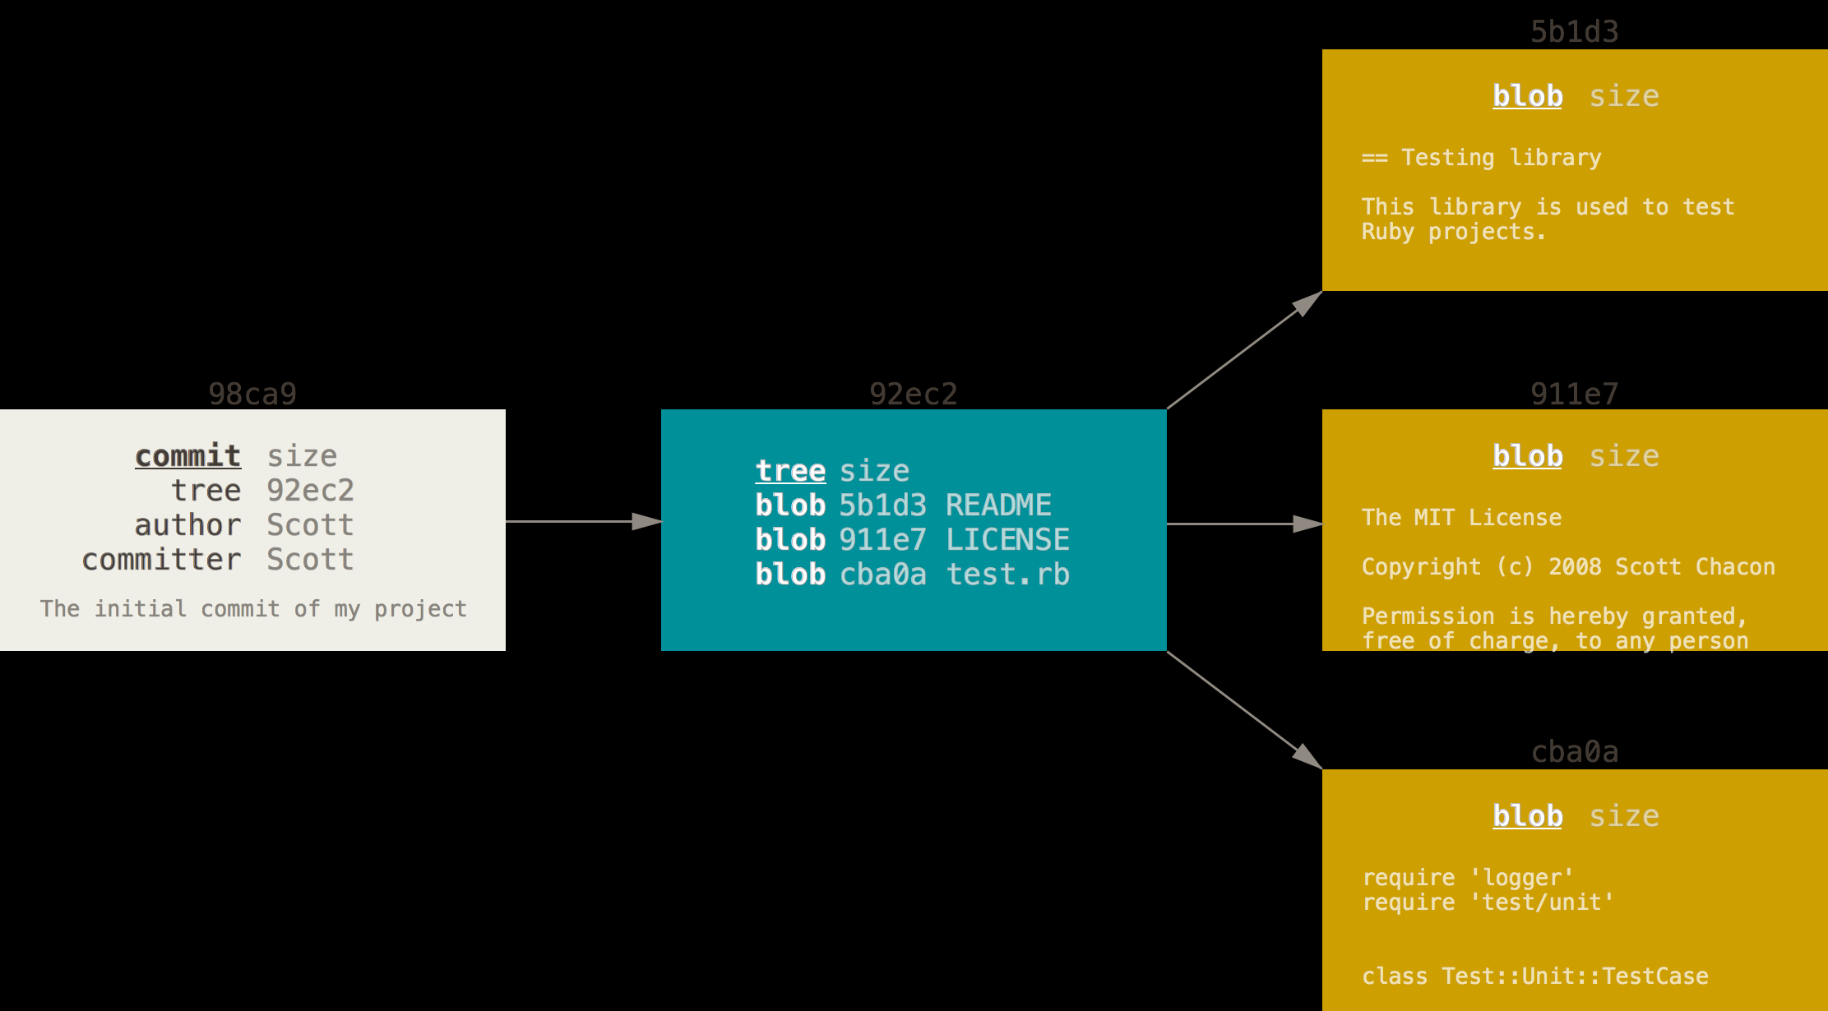
A commit and its tree

Slide 8
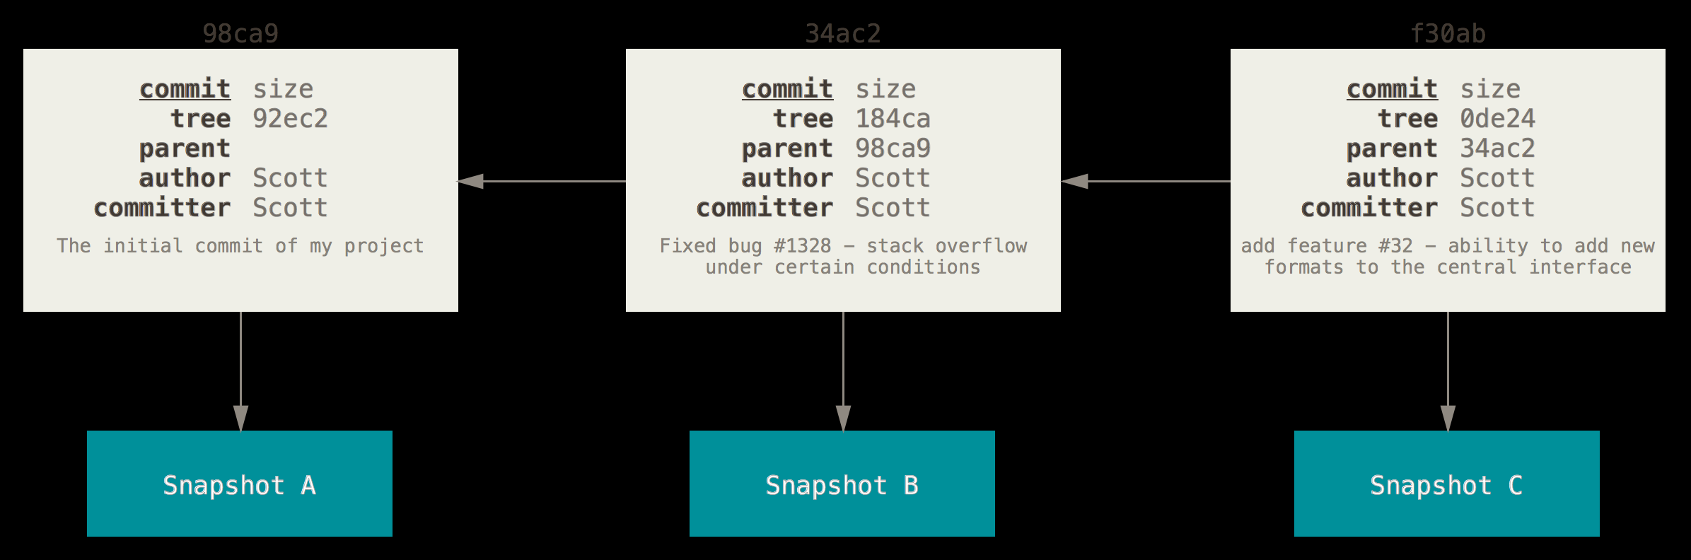
Subsequent Commits
If you make some changes and commit again, the next commit stores a pointer to the commit that came immediately before it.

Slide 9
Branches
A branch in Git is simply a lightweight movable pointer to one of these commits.
The default branch name in Git is master.
As you start making commits, you’re given a master branch that points to the last commit you made.
Every time you commit, it moves forward automatically.
The “master” branch in Git is not a special branch. It is exactly like any other branch. The only reason nearly every repository has one is that the git init command creates it by default and most people don’t bother to change it.

Slide 10
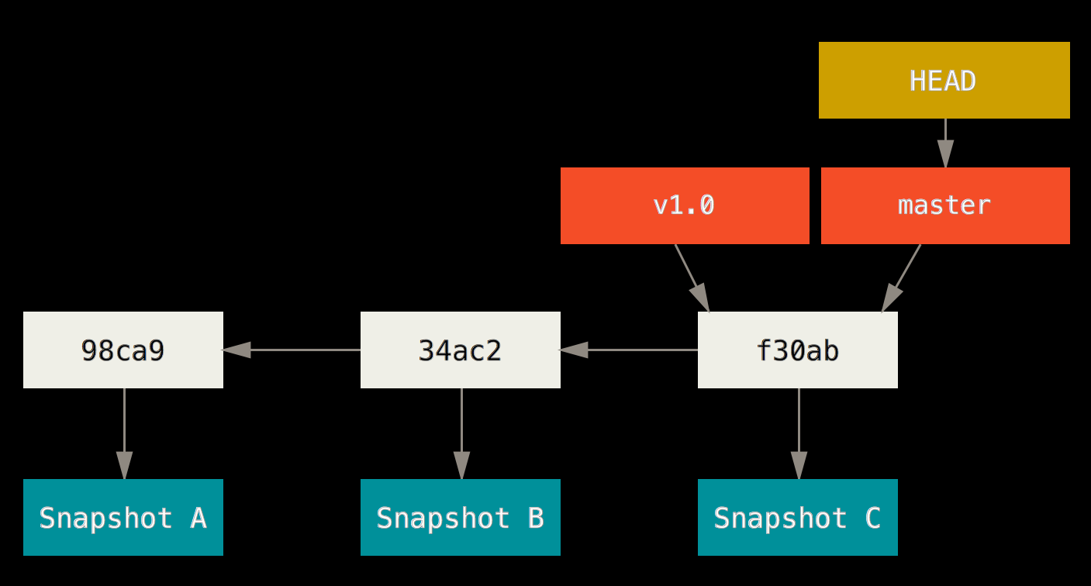
A branch and its commit history

Slide 11
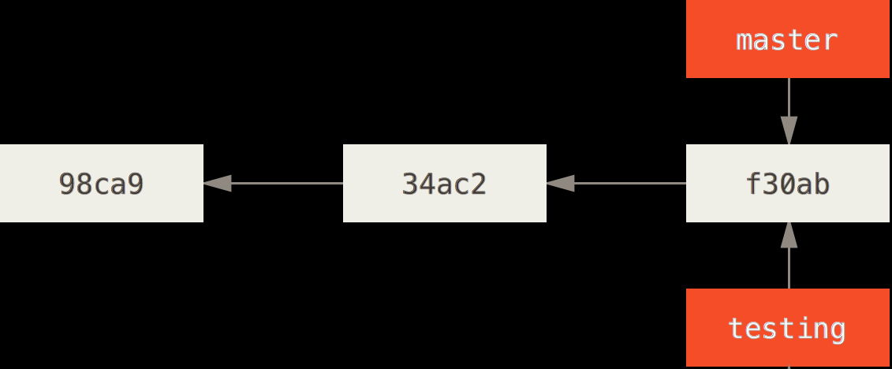
Creating a New Branch
What happens if you create a new branch? Doing so creates a new pointer for you to move around. Let’s say you create a new branch called testing. You do this with the git branch command:
git branch testing
This creates a new pointer at the same commit you’re currently on.

Slide 12
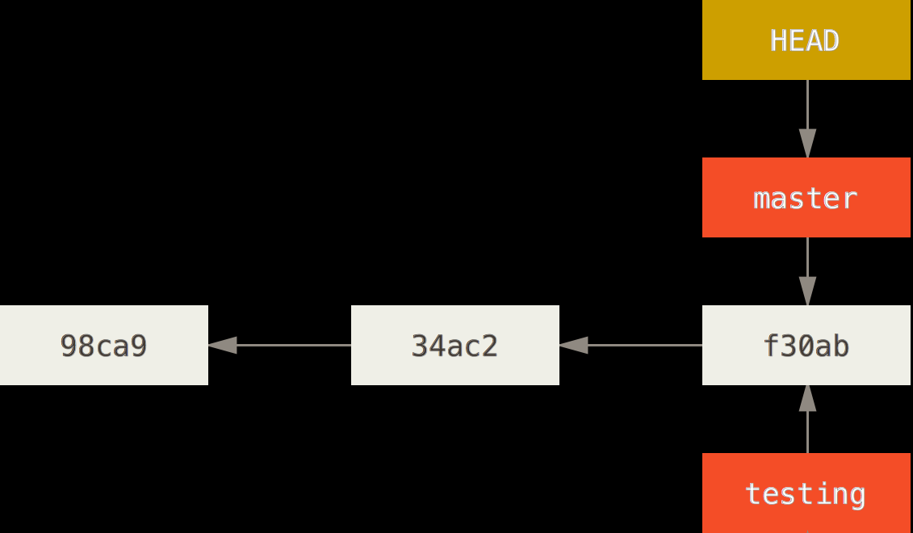
HEAD
How does Git know what branch you’re currently on? It keeps a special pointer called HEAD.
The git branch command only created a new branch – it didn’t switch to that branch.

Slide 13
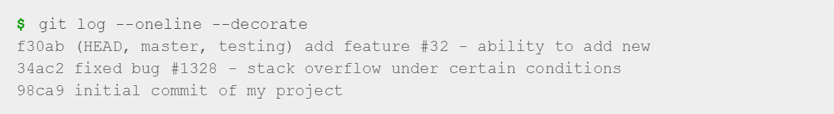
git log
You can easily see this by running a simple git log command that shows you where the branch pointers are pointing. This option is called --decorate.
You can see the “master” and “testing” branches that are right there next to the f30ab commit.

Slide 14
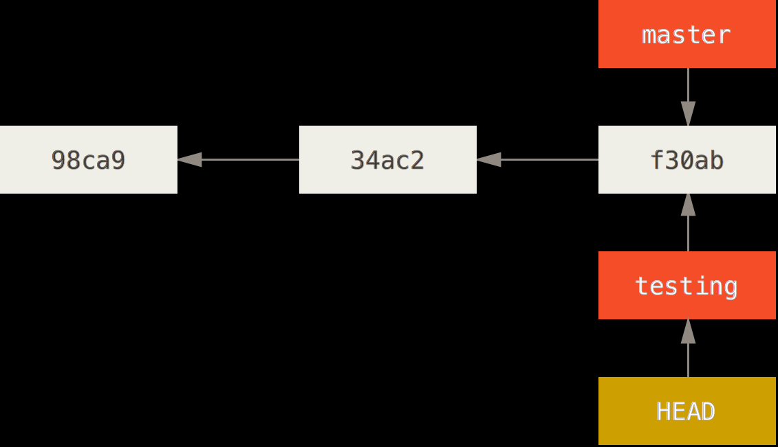
Switching Branches
(git checkout)
To switch to an existing branch, you run the git checkout command. Let’s switch to the new testing branch:
git checkout testing
Moves HEAD to point to the testing branch.

Slide 15
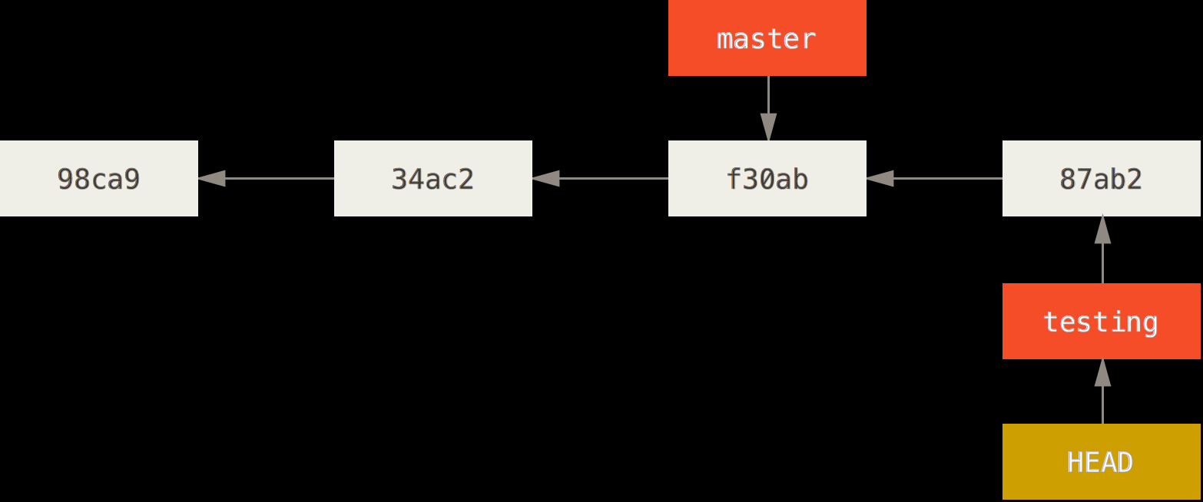
Subsequent Commits
Do another commit:
git commit -a -m 'made a change'
Master branch still points to commit when you ran git checkout to switch branches.
The HEAD branch moves forward when a commit is made

Slide 16
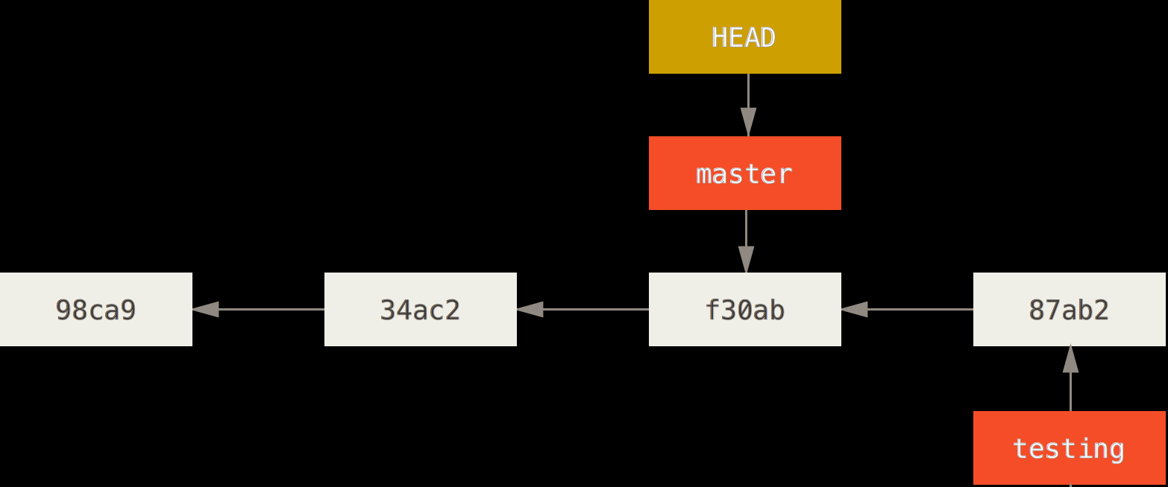
Switching Back to Previous Commit
Switch back to the master branch:
git checkout master
HEAD branch moved back to master.

Slide 17
The git checkout command
Does two things.
  Moves HEAD pointer to point to branch specified
  Reverts files in your working directory back to the snapshot of that branch.
Changes you make from this point forward will diverge from that version of the project.

Slide 18
Switching branches changes files in your working directory
It’s important to note that when you switch branches in Git, files in your working directory will change.
If you switch to an older branch, your working directory will be reverted to look like it did the last time you committed on that branch.
If Git cannot do it cleanly, it will not let you switch at all.
Make sure you commit your current work before switching branches!

Slide 19
Make changes and commit again:
git commit -a -m 'made other changes'
Now your project history has diverged.
You created and switched to a branch, did some work on it, and then switched back to your main branch and did other work.
Both of those changes are isolated in separate branches: you can switch back and forth between the branches and merge them together when you’re ready.
And you did all that with simple branch, checkout, and commit commands.

Slide 20
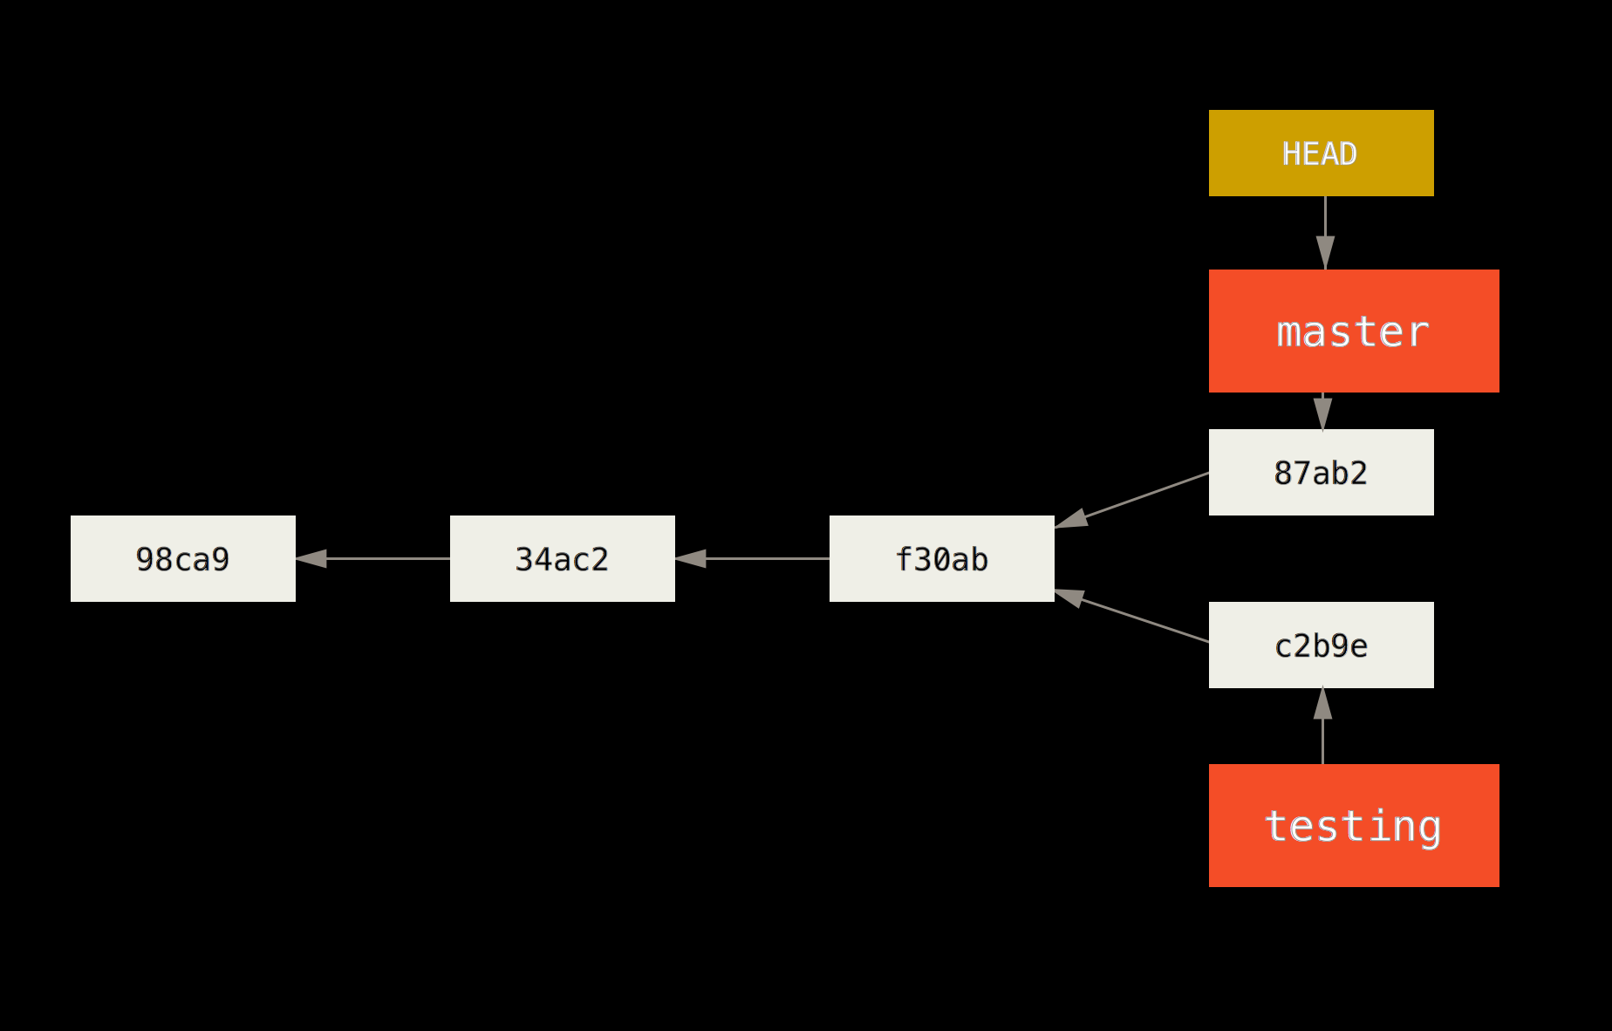
Divergent History

Slide 21
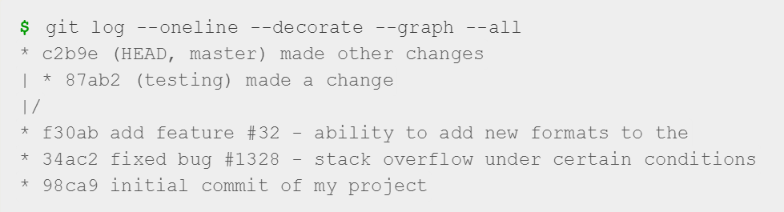
Divergent History
You can also see this easily with the git log command.
If you run git log --oneline --decorate --graph --all it will print out the history of your commits, showing where your branch pointers are and how your history has diverged.

Slide 22
About Branches
A branch in Git is in actuality a simple file that contains the 40 character SHA-1 checksum of the commit it points to
Branches are cheap to create and destroy.
Creating a new branch is as quick and simple as writing 41 bytes to a file (40 characters and a newline).

Slide 23
Older VCS Branching vs GIT
Most older VCS tools branch, which involves copying all of the project’s files into a second directory.
This can take several seconds or even minutes, depending on the size of the project,
In Git the process is always instantaneous.
Also, because we’re recording the parents when we commit, finding a proper merge base for merging is automatically done for us and is generally very easy to do.
These features help encourage developers to create and use branches often.

Slide 24
Basic Branching and Merging
3.2 itG Branching

Slide 25
Basic Branching and Merging
Typical workflow:
Do work on a web site.
Create a branch for a new story you’re working on.
Do some work in that branch.
Typical work flow when a change to a previous branch is needed:
Switch to your production branch.
Create a branch to add the hotfix.
After it’s tested, merge the hotfix branch, and push to production.
Switch back to your original story and continue working.

Slide 26
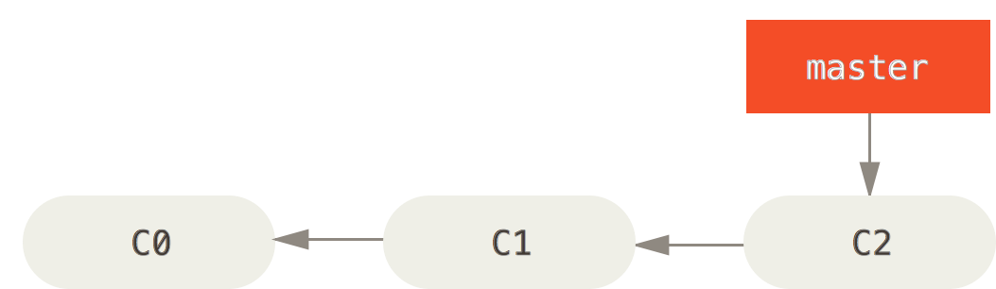
Basic Branching
First, let’s say you’re working on your project and have a couple of commits already.

Slide 27
Basic Branching
You’ve decided that you’re going to work on issue #53 in whatever issue-tracking system your company uses.
To create a branch and switch to it at the same time, you can run the git checkout command with the -b switch:
git checkout -b iss53
Switched to a new branch "iss53"
This is shorthand for:
git branch iss53
git checkout iss53

Slide 28
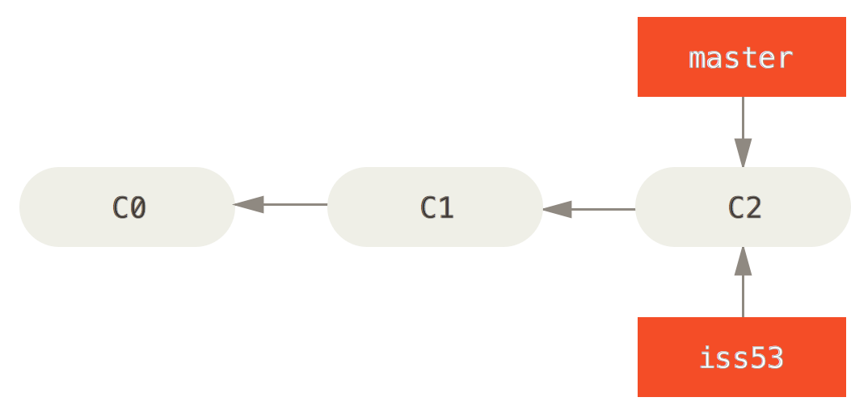
Creating a new branch pointer

Slide 29
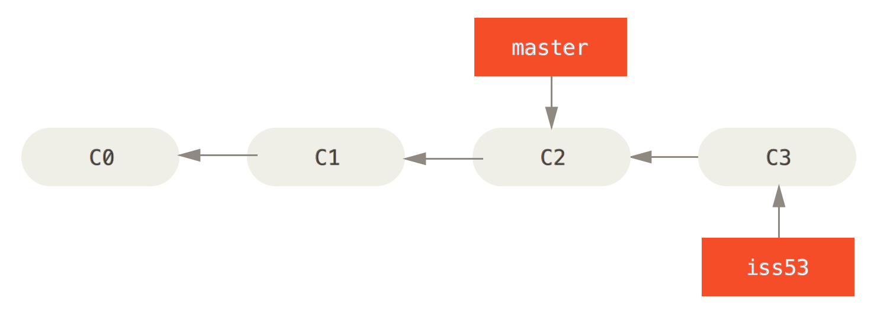
work on your web site and do some commits
git commit -a -m 'added a new footer [issue 53]‘
Doing so moves the iss53 branch forward, because you have it checked out (that is, your HEAD is pointing to it):

Slide 30
Scenario: Hot Fix
Now you get the call that there is an issue with the web site, and you need to fix it immediately.
With Git, you don’t have to deploy your fix along with the iss53 changes you’ve made, and you don’t have to put a lot of effort into reverting those changes before you can work on applying your fix to what is in production.
All you have to do is switch back to your master branch.

Slide 31
Before switching branches:
If your working directory or staging area has uncommitted changes that conflict with the branch you’re checking out, Git won’t let you switch branches.
It’s best to have a clean working state when you switch branches.
Commit all your changes, so you can switch back to your master branch:
git commit
git checkout master
Project working directory is exactly the way it was before you started working on issue #53, and you can concentrate on your hotfix.

Slide 32
Important point to remember:
When you switch branches, Git resets your working directory to look like it did the last time you committed on that branch.
It adds, removes, and modifies files automatically to make sure your working copy is what the branch looked like on your last commit to it.

Slide 33
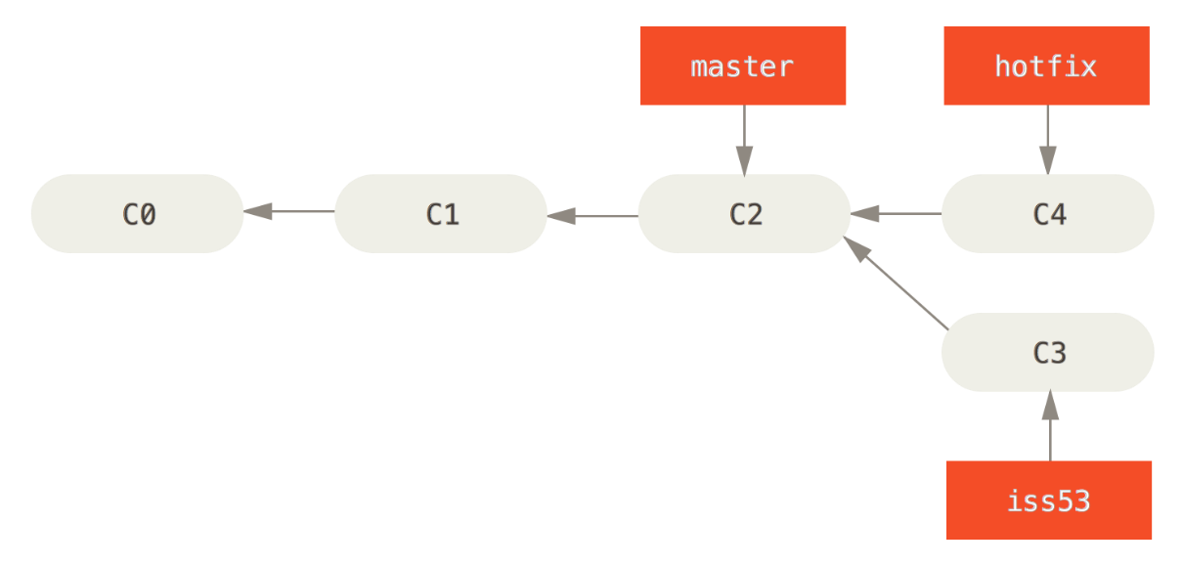
Hotfix branch based on master
Hotfix branch based on master
Next, you have a hotfix to make. Let’s create a hotfix branch on which to work until it’s completed:
git checkout -b hotfix
Make changes then commit the changes in the hotfix branch:
git commit -a -m 'fixed the broken email address'

Slide 34
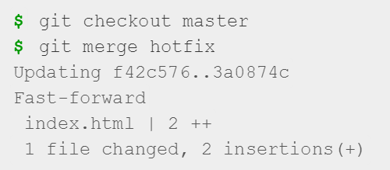
Merge Command
You can run your tests, make sure the hotfix is what you want, and merge it back into your master branch to deploy to production. You do this with the git merge command:
You’ll notice the phrase “fast-forward” in that merge.
Because the commit pointed to by the branch you merged in was directly upstream of the commit you’re on, Git simply moves the pointer forward
First switch to branch to merge into.
Second execute merge command specifying branch to merge into current branch.

Slide 35
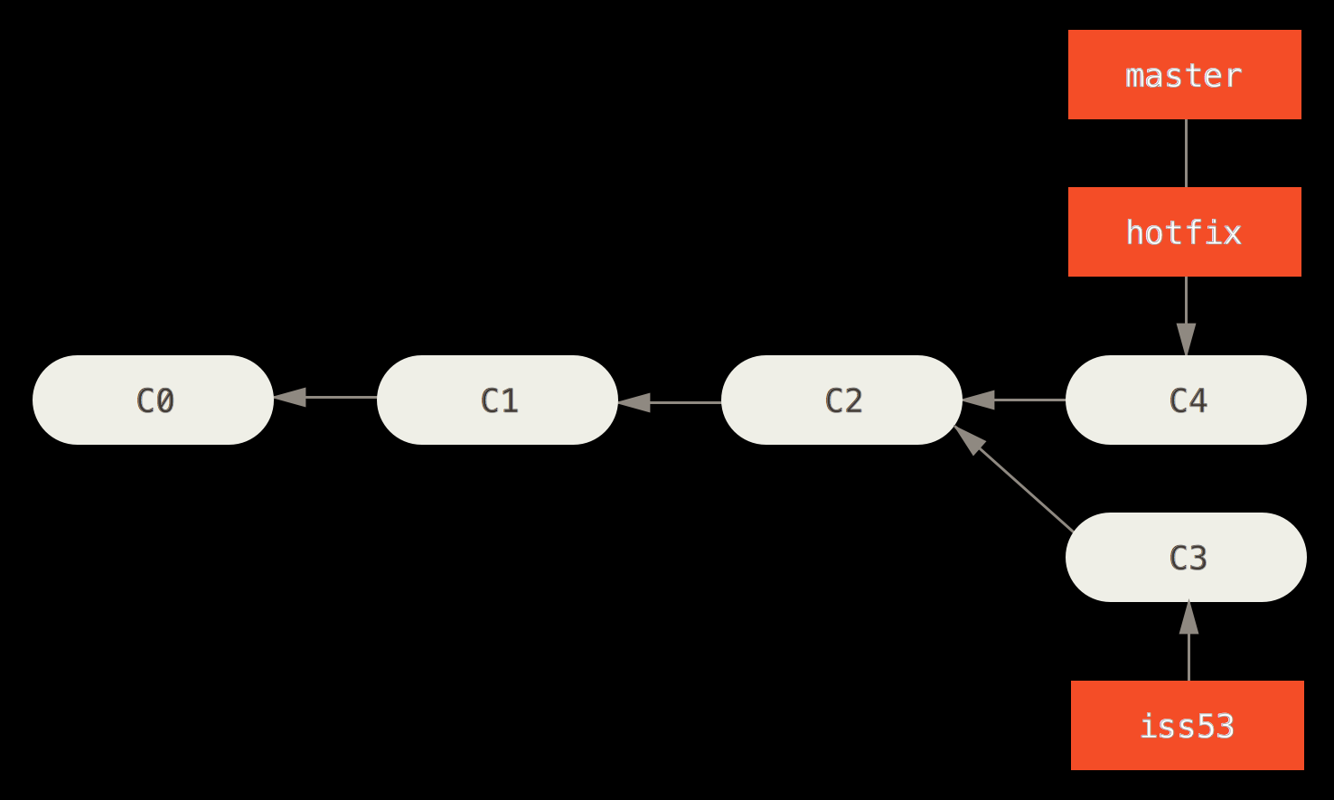
Master is fast-forwarded to hotfix
Your change is now in the snapshot of the commit pointed to by the master branch, and you can deploy the fix.

Slide 36

Deleting Branches
After your super-important fix is deployed, you’re ready to switch back to the work you were doing before you were interrupted.
However, first you’ll delete the hotfix branch, because you no longer need it – the master branch points at the same place.
You can delete it with the -d option to git branch:

Slide 37
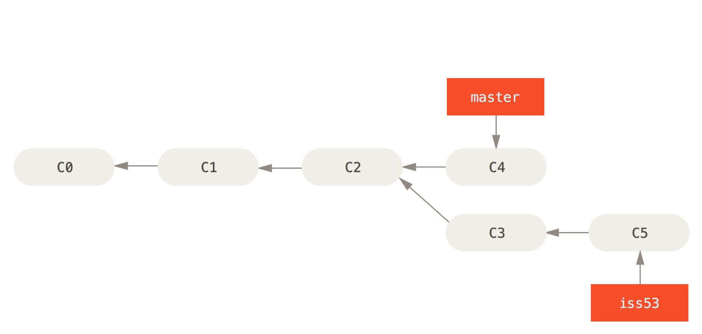
Work continues on iss53
Switch back to work-in-progress branch on issue #53:
git checkout iss53
Complete issue 53 then commit the change:
git commit -a -m 'finished the new footer [issue 53]'

Slide 38
To Merge Hotfix or Not?
It’s worth noting here that the work you did in your hotfix branch is not contained in the files in your iss53 branch.
If you need to pull it in, you can merge your master branch into your iss53 branch by running git merge master, or you can wait to integrate those changes until you decide to pull the iss53 branch back into master later.

Slide 39
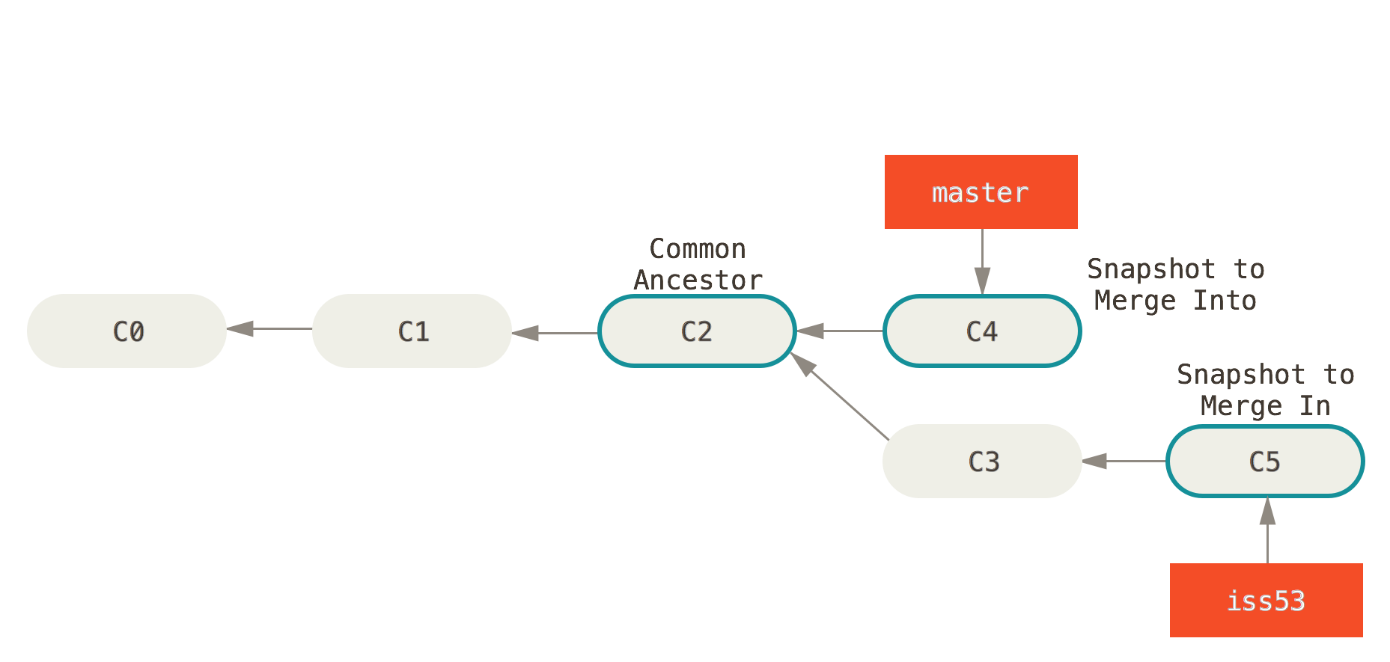
Three snapshots used in a merge
Suppose you’ve decided that your issue #53 work is complete and ready to be merged into your master branch.
git checkout master
git merge iss53
Snapshot to merge into.
Common Ancestor
Snapshot to merge from.

Slide 40
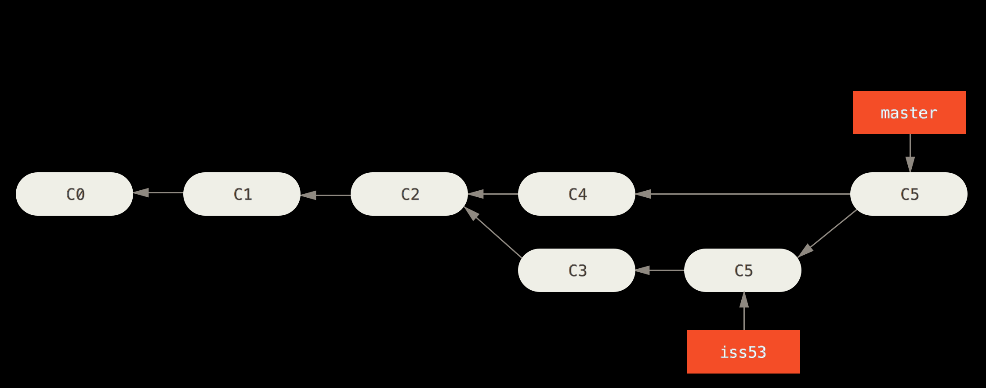
A merge commit
Instead of just moving the branch pointer forward, Git creates a new snapshot that results from this three-way merge and automatically creates a new commit that points to it.
This is referred to as a merge commit, and is special in that it has more than one parent.

Slide 41
Merge Ancestor
Git determines the best common ancestor to use for its merge base
This is different than older tools like CVS or Subversion (before version 1.5), where the developer doing the merge had to figure out the best merge base for themselves.
This makes merging a heck of a lot easier in Git than in these other systems.

Slide 42
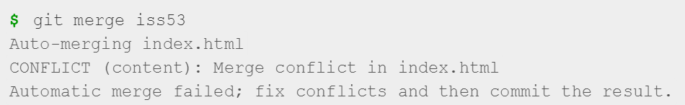
Basic Merge Conflicts
Occasionally, this process doesn’t go smoothly.
If you changed the same part of the same file differently in the two branches you’re merging together, Git won’t be able to merge them cleanly.
If your fix for issue #53 modified the same part of a file as the hotfix, you’ll get a merge conflict that looks something like this:

Slide 43
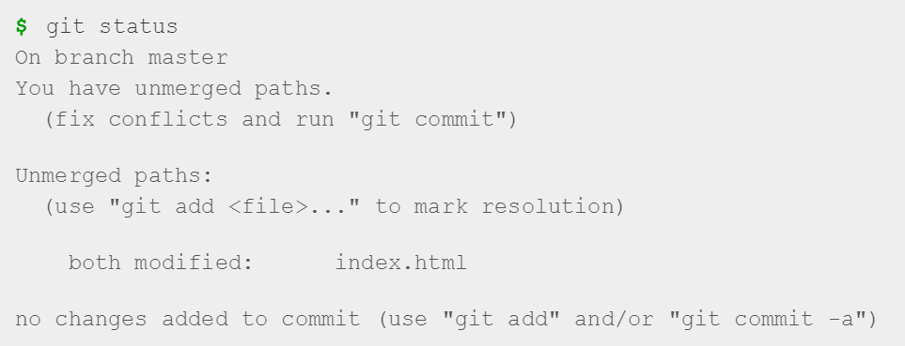
Basic Merge Conflicts
Git hasn’t automatically created a new merge commit. It has paused the process while you resolve the conflict.
If you want to see which files are unmerged at any point after a merge conflict, you can run git status:

Slide 44
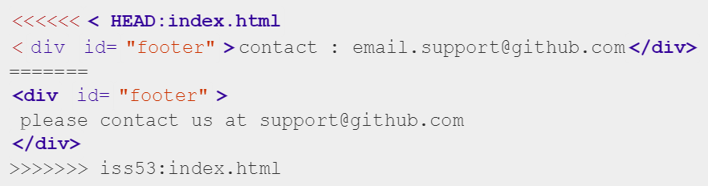
Basic Merge Conflicts
Anything that has merge conflicts and hasn’t been resolved is listed as unmerged.
Standard conflict-resolution markers to the files that have conflicts, so you can open them manually and resolve those conflicts.
Your file contains a section that looks something like this:
Version in HEAD (Master Branch).
Version in iss53 Branch.

Slide 45
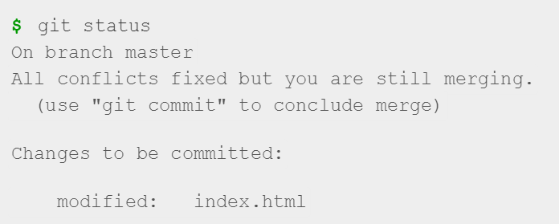
Basic Merge Conflicts
After you’ve resolved each of these sections in each conflicted file, run git add on each file to mark it as resolved.
Staging the file marks it as resolved in Git.
You can run git status again to verify that all conflicts have been resolved:

Slide 46
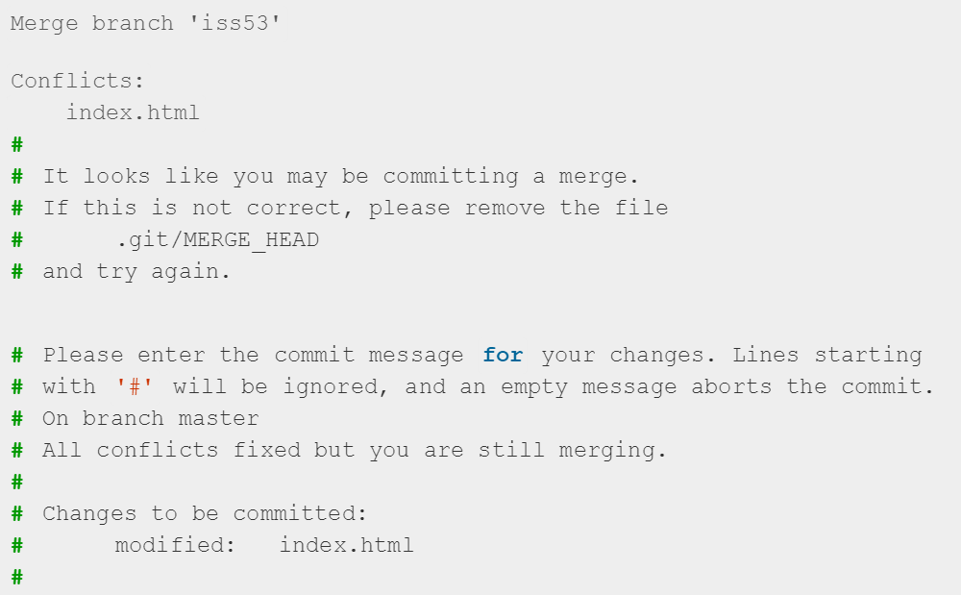
Basic Merge Conflicts
If everything that had conflicts has been staged, you can type git commit to finalize the merge commit. The commit message by default looks something like this:
Add details about how you resolved the merge – why you did what you did, if it’s not obvious.

Slide 47
Branch Management
3.3 Git Branching

Slide 48
Branch Management
Now that you’ve created, merged, and deleted some branches, let’s look at some branch-management tools that will come in handy when you begin using branches all the time.

Slide 49

git branch command
The git branch command does more than just create and delete branches.
If you run it with no arguments, you get a simple listing of your current branches:
Notice the * character that prefixes the master branch: it indicates the branch that you currently have checked out (i.e., the branch that HEAD points to).
This means that if you commit at this point, the master branch will be moved forward with your new work.

Slide 50
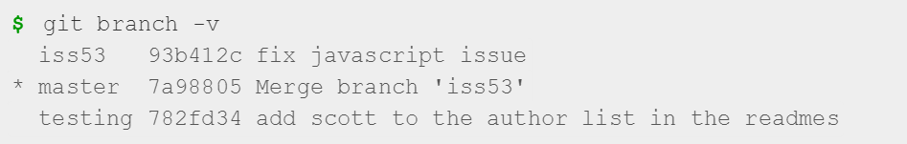
git branch -v
To see the last commit on each branch, you can run git branch -v:

Slide 51
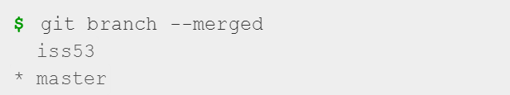
git branch --merged
The --merged option can filter this list to branches that you have merged into the branch you’re currently on.
To see which branches are already merged into the branch you’re on, you can run git branch --merged:

Slide 52

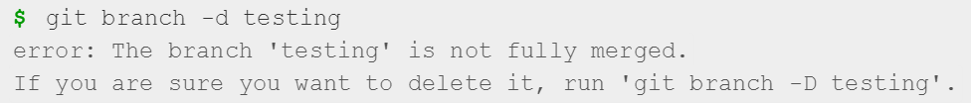
git branch –no-merged
To see all the branches that contain work you haven’t yet merged in, you can run git branch --no-merged:
This shows your other branch. Because it contains work that isn’t merged in yet, trying to delete it with git branch -d will fail:
If you really do want to delete the branch and lose that work, you can force it with -D, as the helpful message points out.

Slide 53
Branching Workflows
3.4 Git Branching

Slide 54
Branching Workflows
Now that you have the basics of branching and merging down, what can or should you do with them?
In this section, we’ll cover some common workflows that this lightweight branching makes possible, so you can decide if you would like to incorporate it into your own development cycle.

Slide 55
Long-Running Branches
You can have several branches that are always open and that you use for different stages of your development cycle; you can merge regularly from some of them into others.
Master branch only has code that is entirely stable
Develop branch isn’t necessarily always stable, but whenever it gets to a stable state, it can be merged into master.
Develop branch is used to pull in topic branches (short-lived branches, like your earlier iss53 branch) when they’re ready, to make sure they pass all the tests and don’t introduce bugs.

Slide 56
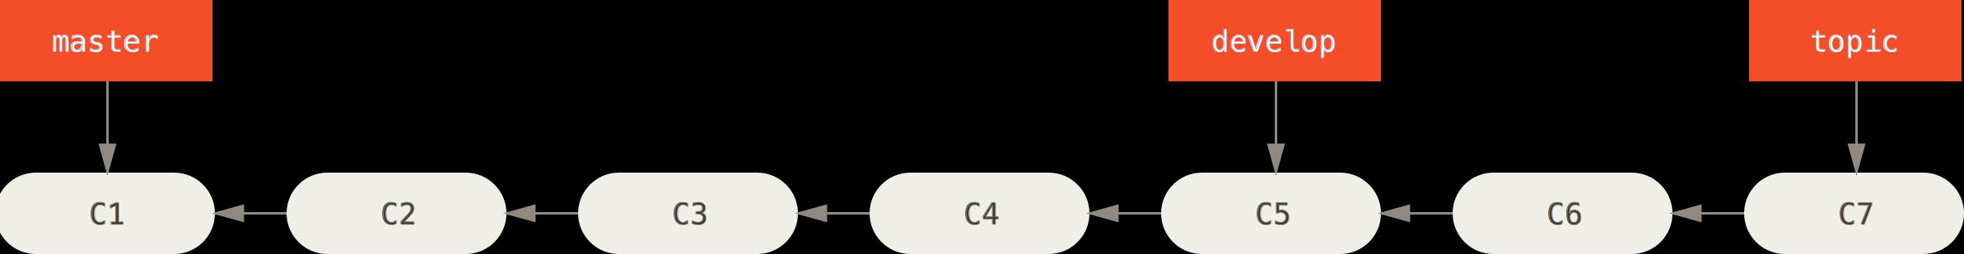
A linear view of progressive-stability branching
In reality, we’re talking about pointers moving up the line of commits you’re making.
The stable branches are farther down the line in your commit history, and the bleeding-edge branches are farther up the history.

Slide 57
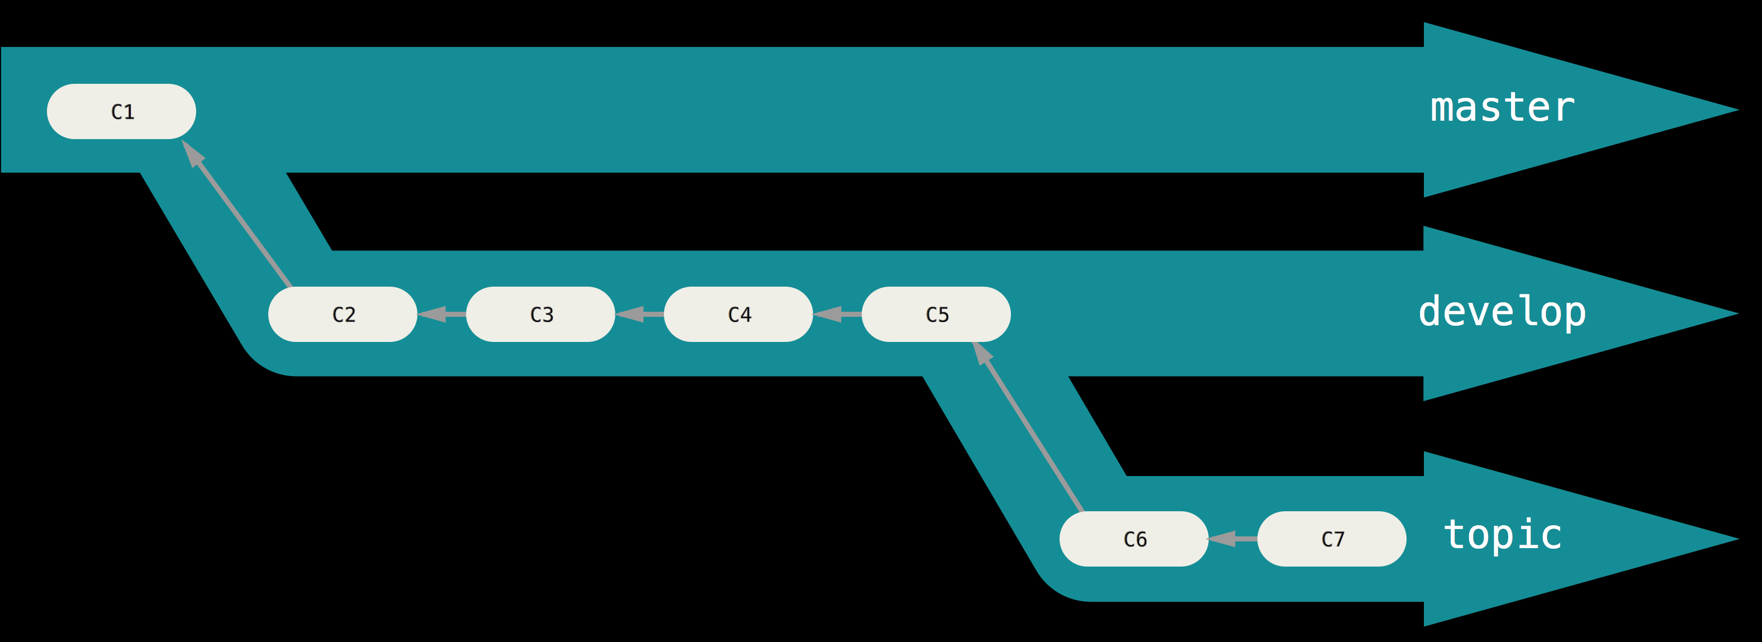
A “silo” view of progressive-stability branching
It’s generally easier to think about them as work silos, where sets of commits graduate to a more stable silo when they’re fully tested.

Slide 58
Long-Running Branches
You can keep doing this for several levels of stability.
Some larger projects also have a proposed or pu (proposed updates) branch that has integrated branches that may not be ready to go into the next or master branch.
The idea is that your branches are at various levels of stability; when they reach a more stable level, they’re merged into the branch above them.
Again, having multiple long-running branches isn’t necessary, but it’s often helpful, especially when you’re dealing with very large or complex projects.

Slide 59
Topic Branches
A a short-lived branch that you create and use for a single particular feature or related work.
You complete a few commits on them and deleted them directly after merging them into your main branch.
You can keep the changes there for minutes, days, or months, and merge them in when they’re ready.

Slide 60
Example
Consider an example of doing some work (on master),
Branching off for an issue (iss91), working on it for a bit
Branching off the second branch to try another way of handling the same thing (iss91v2),
Going back to your master branch and working there for a while,
Branching off there to do some work that you’re not sure is a good idea (dumbidea branch).

Slide 61
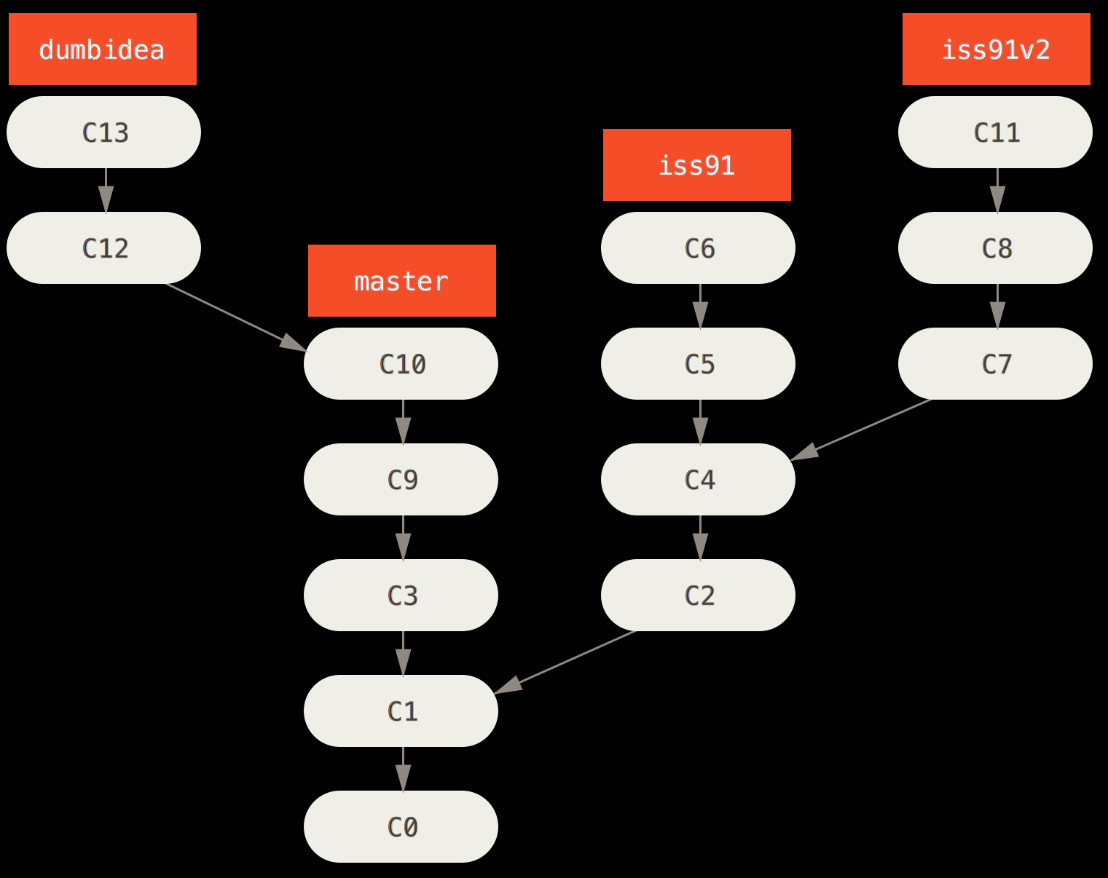
Multiple topic branches
Your commit history will look something like this:

Slide 62
Scenario
You decide you like the second solution to your issue best (iss91v2)
You showed the dumbidea branch to your coworkers, and it turns out to be genius.
You can throw away the original iss91 branch (losing commits C5 and C6) and merge in the other two.

Slide 63
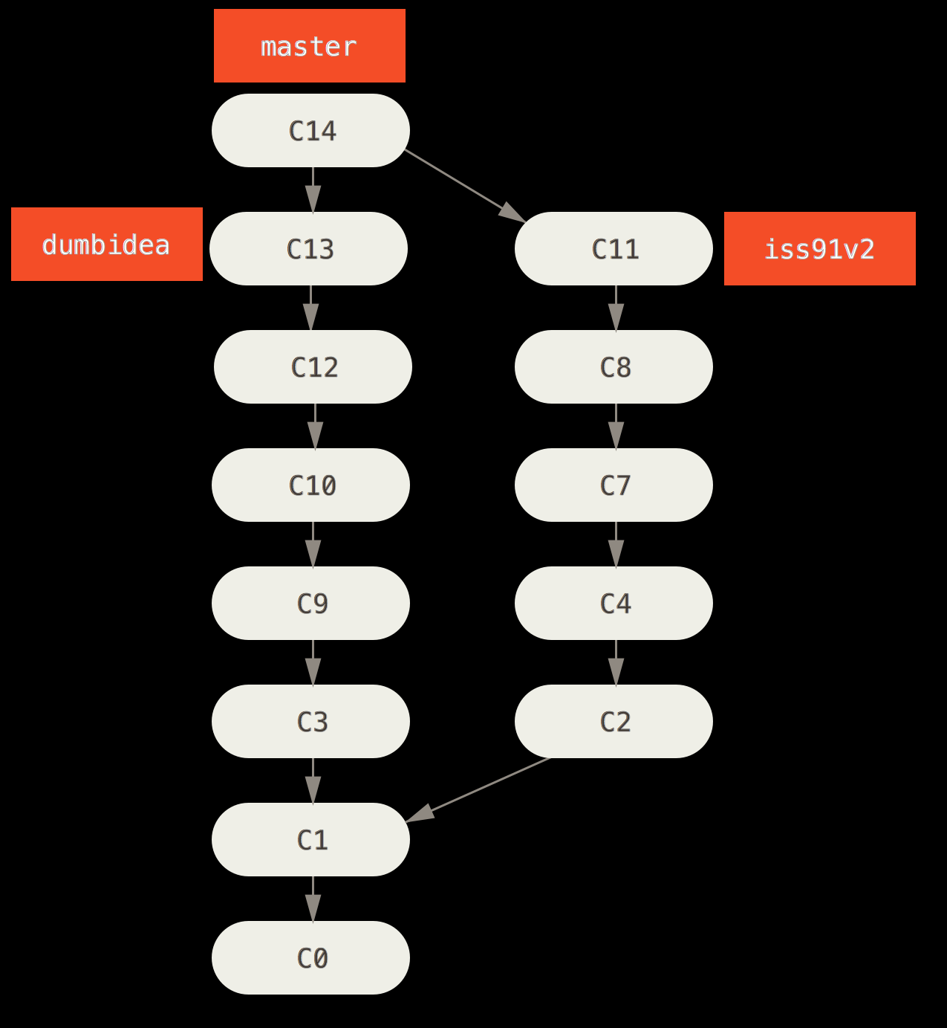
History after merging dumbidea and iss91v2
Your history then looks like this:

Slide 64
Branching and Merging is Local!
It’s important to remember when you’re doing all this that these branches are completely local.
When you’re branching and merging, everything is being done only in your Git repository – no server communication is happening.

Slide 65
Remote Branches
3.5 Git Branching

Slide 66
Remote Branches
Remote branches are references (pointers) to the state of branches in your remote repositories.
They’re local branches that you can’t move; they’re moved automatically for you whenever you do any network communication.
Remote branches act as bookmarks to remind you where the branches on your remote repositories were the last time you connected to them.

Slide 67
Remote branch Namespaces
Take the form (remote)/(branch).
For instance, if you wanted to see what the master branch on your origin remote looked like as of the last time you communicated with it, you would check the origin/master branch.
If you were working on an issue with a partner and they pushed up an iss53 branch, you might have your own local iss53 branch; but the branch on the server would point to the commit at origin/iss53.

Slide 68
Example
Let’s say you have a Git server on your network at git.ourcompany.com.
If you clone from this, Git’s clone command automatically names it origin for you, pulls down all its data, creates a pointer to where its master branch is, and names it origin/master locally.
Git also gives you your own local master branch starting at the same place as origin’s master branch, so you have something to work from.

Slide 69
“origin” is not special
Just like the branch name “master” does not have any special meaning in Git, neither does “origin”.
“master” is the default name for a starting branch when you run git init which is the only reason it’s widely used,
“origin” is the default name for a remote when you run git clone.
If you run git clone -o booyah instead, then you will have booyah/master as your default remote branch.

Slide 70
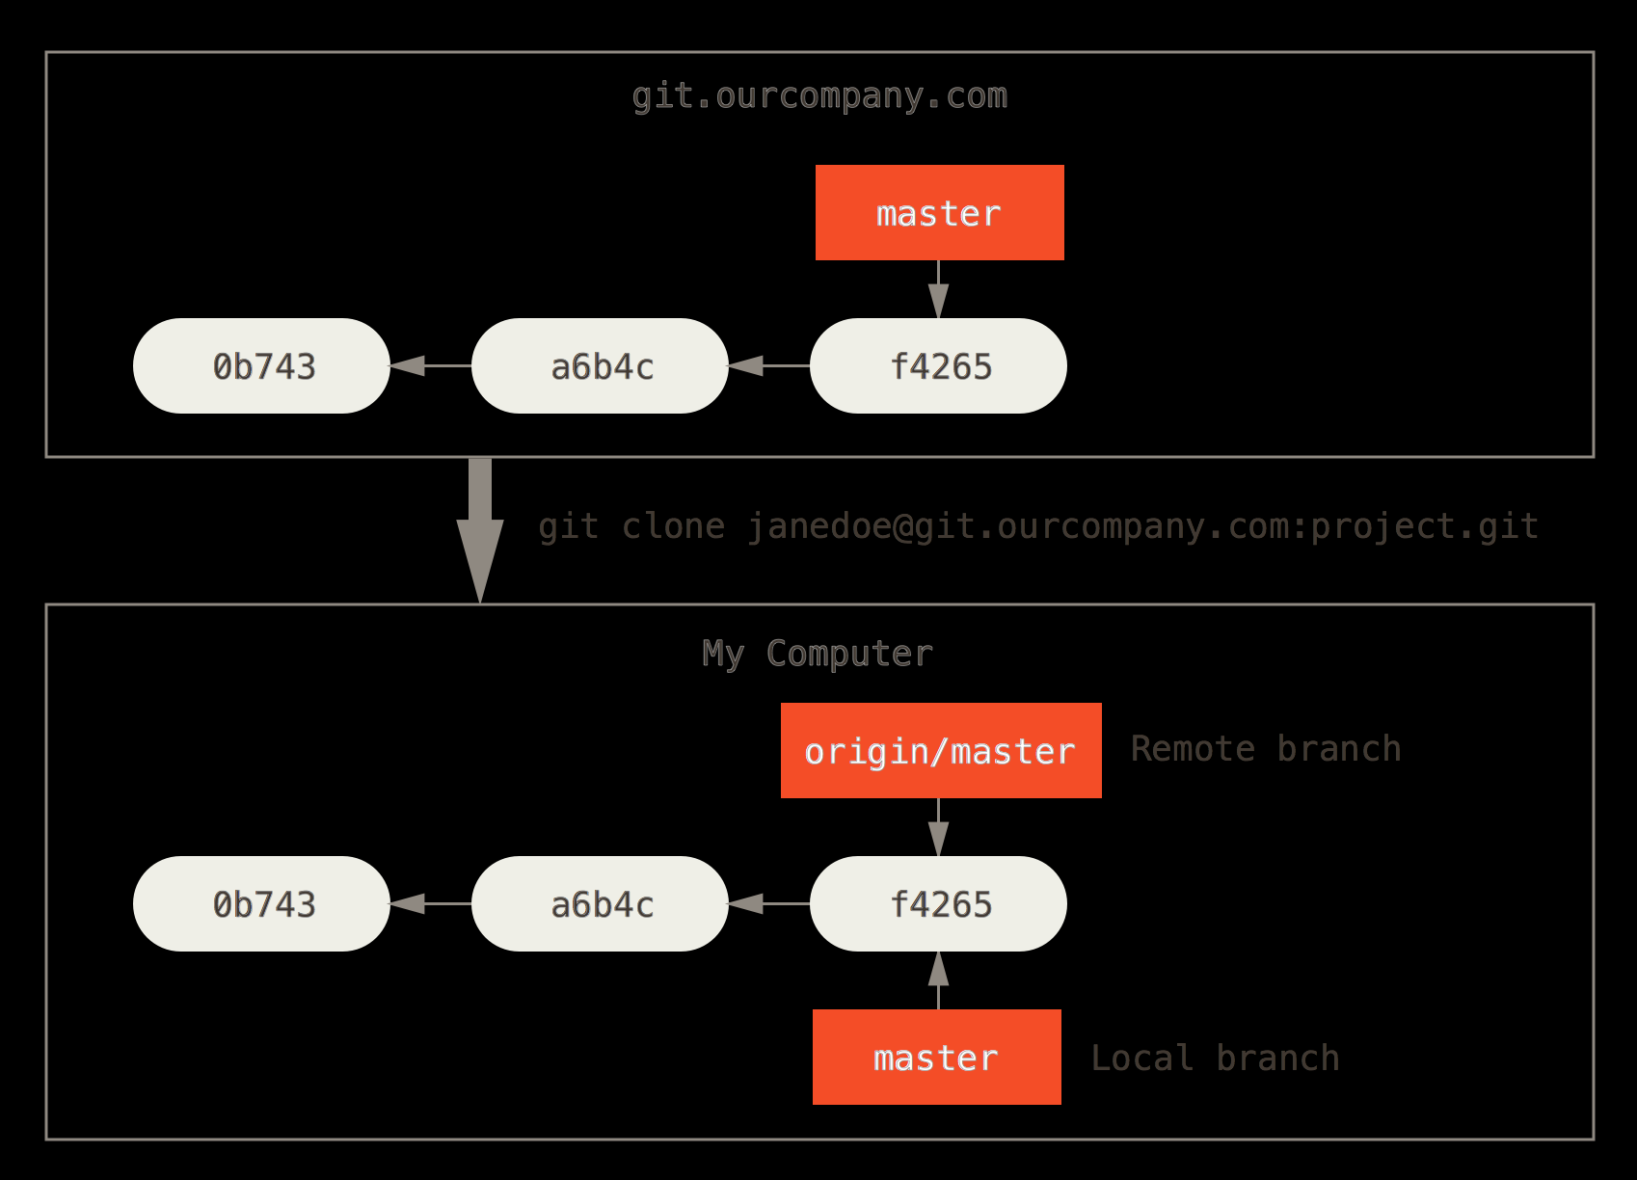
Server and local repositories after cloning

Slide 71
Making Changes
If you do some work on your local master branch
If in the meantime, someone else pushes to git.ourcompany.com and updates its master branch, then your histories move forward differently.
Also, as long as you stay out of contact with your origin server, your origin/master pointer doesn’t move.

Slide 72
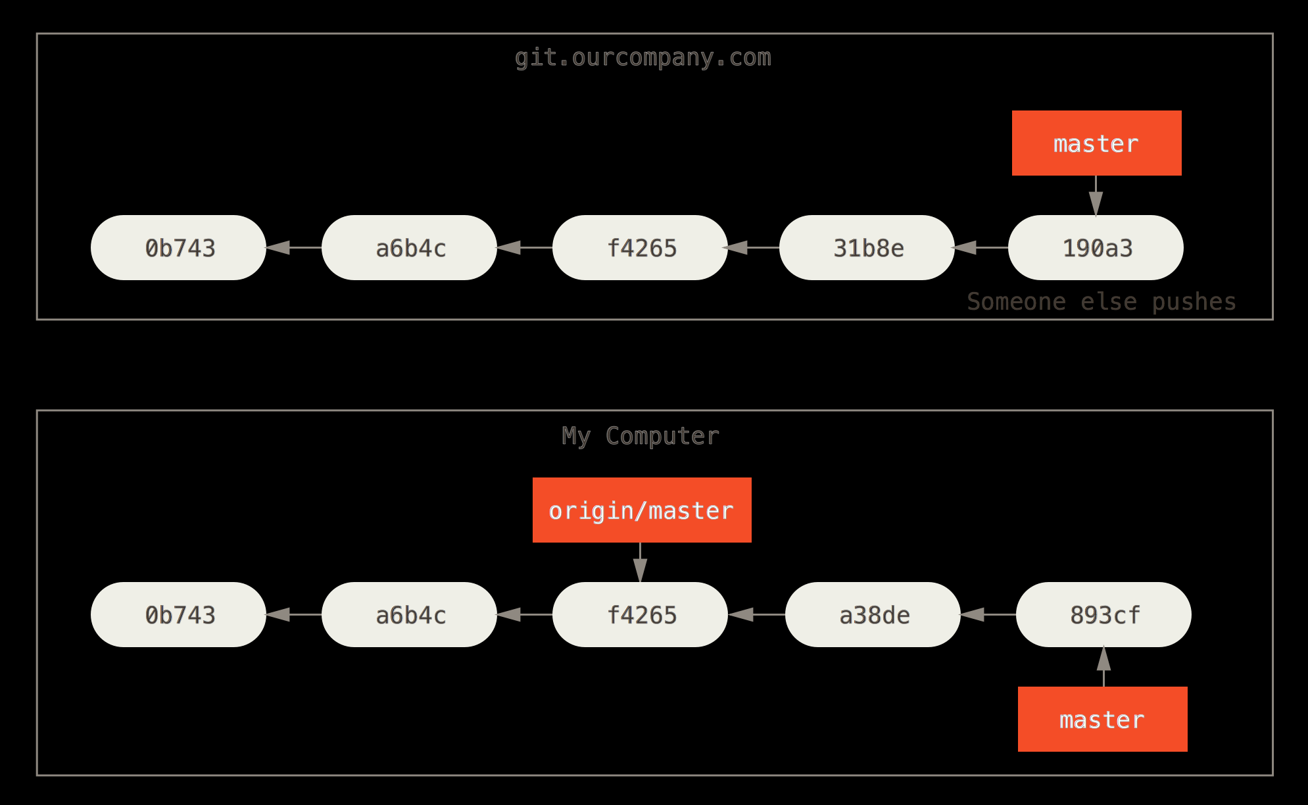
Local and remote work can diverge

Slide 73
git fetch origin command
Looks up which server “origin” is (in this case, it’s git.ourcompany.com)
Fetches any data from it that you don’t yet have.
Updates your local database, moving your origin/master pointer to its new, more up-to-date position.

Slide 74
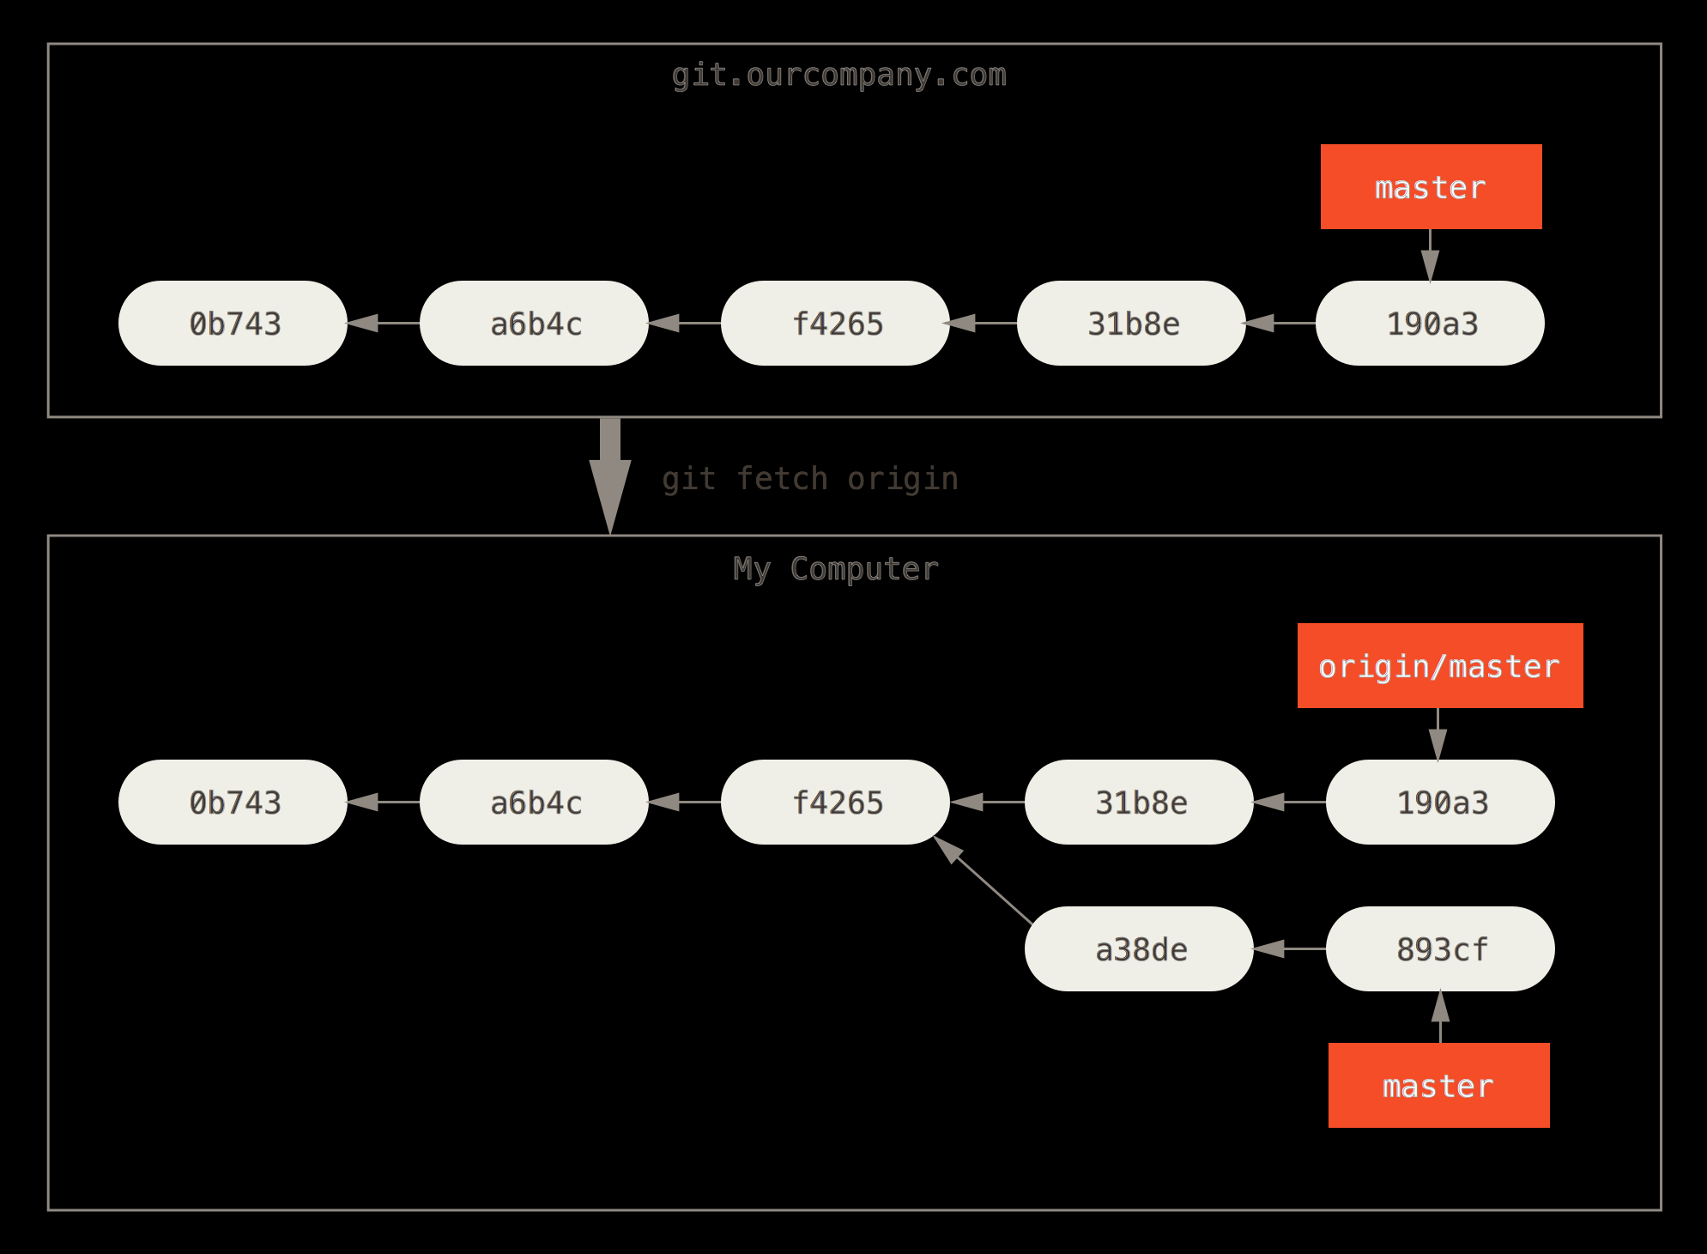
git fetch updates your remote references

Slide 75
git fetch
Now, you can run git fetch teamone to fetch everything the remote teamone server has that you don’t have yet.
Because that server has a subset of the data your origin server has right now, Git fetches no data but sets a remote branch called teamone/master to point to the commit that teamone has as its master branch.

Slide 76
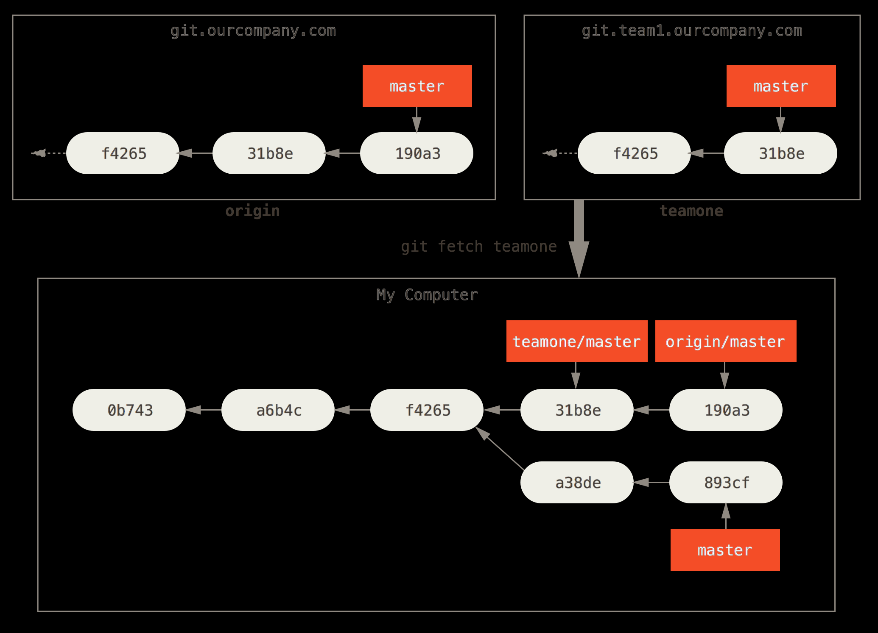
Remote tracking branch for teamone/master

Slide 77
Pushing
When you want to share a branch with the world, you need to push it up to a remote that you have write access to.
Your local branches aren’t automatically synchronized to the remotes you write to – you have to explicitly push the branches you want to share.
That way, you can use private branches for work you don’t want to share, and push up only the topic branches you want to collaborate on.

Slide 78
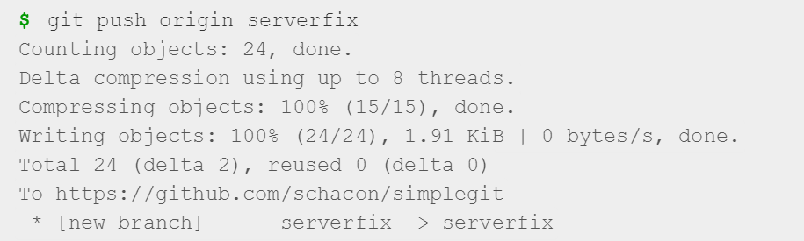
Pushing
If you have a branch named serverfix that you want to work on with others, you can push it up the same way you pushed your first branch. Run git push (remote) (branch):

Slide 79
Pushing
Git automatically expands the serverfix branchname out to refs/heads/serverfix:refs/heads/serverfix, which means, “Take my serverfix local branch and push it to update the remote’s serverfix branch.”
We’ll go over the refs/heads/ part in detail in Chapter 10, but you can generally leave it off.
You can also do git push origin serverfix:serverfix, which does the same thing – it says, “Take my serverfix and make it the remote’s serverfix.”
You can use this format to push a local branch into a remote branch that is named differently.
If you didn’t want it to be called serverfix on the remote, you could instead run git push origin serverfix:awesomebranch to push your local serverfix branch to the awesomebranch branch on the remote project.

Slide 80
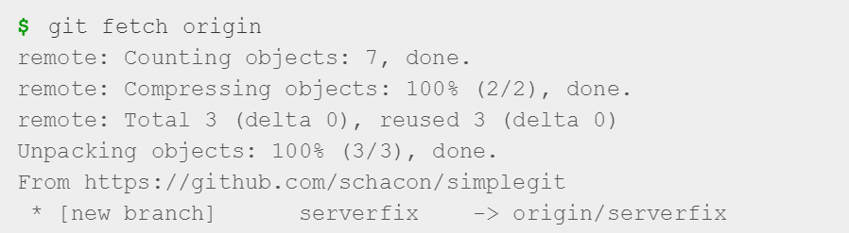
Pushing
The next time one of your collaborators fetches from the server, they will get a reference to where the server’s version of serverfix is under the remote branch origin/serverfix:

Slide 81
Pushing
It’s important to note that when you do a fetch that brings down new remote branches, you don’t automatically have local, editable copies of them.
In other words, in this case, you don’t have a new serverfix branch – you only have an origin/serverfix pointer that you can’t modify.

Slide 82
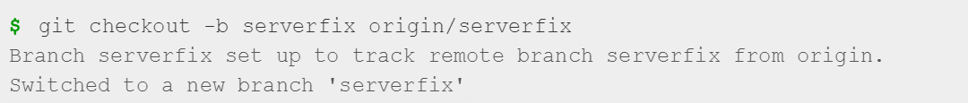
Pushing
To merge this work into your current working branch, you can run git merge origin/serverfix.
If you want your own serverfix branch that you can work on, you can base it off your remote branch:
This gives you a local branch that you can work on that starts where origin/serverfix is.

Slide 83
Git Fetch
While the git fetch command will fetch down all the changes on the server that you don’t have yet, it will not modify your working directory at all.
It will simply get the data for you and let you merge it yourself.

Slide 84

Deleting Remote Branches
You can delete a remote branch using the --delete option to git push.
If you want to delete your serverfix branch from the server, you run the following:
Basically all this does is remove the pointer from the server.
The Git server will generally keep the data there for a while until a garbage collection runs, so if it was accidentally deleted, it’s often easy to recover.

Slide 85
Git Pull
However, there is a command called git pull which is essentially a git fetch immediately followed by a git merge in most cases.
Git pull will look up what server and branch your current branch is tracking, fetch from that server and then try to merge in that remote branch.
Generally it’s better to simply use the fetch and merge commands explicitly as the magic of git pull can often be confusing.

Slide 86
Summary
We’ve covered basic branching and merging in Git.
You should feel comfortable creating and switching to new branches, switching between branches and merging local branches together.
You should also be able to share your branches by pushing them to a shared server, working with others on shared branches and rebasing your branches before they are shared.

