Slide 1
程式設計一
IO Stream

Slide 2
Console Input/Output
Console input/output -> #include <iostream>
Includes <istream>
Includes <ostream>
I/O objects: cin, cout, cerr
File input/output -> #include <fstream>
Incudes <ifstream>
Includes <ofstream>

Slide 3
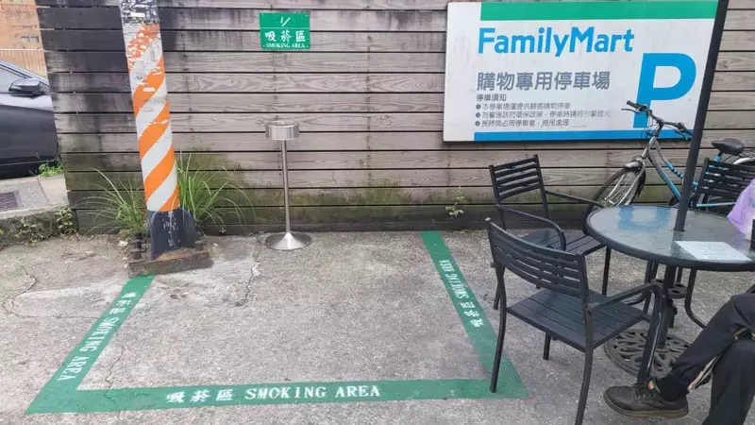
cerr
cout
https://udn.com/news/story/7328/5490709

Slide 4
Console Output
variables, constants, literals, expressions
New lines in output:
‘\n’
std::endl
Cascading
std::cout << “hello” << “ “ << world” << std::endl;
(user-friendly) do not forget `std::endl;` or ‘\n’

Slide 5
Stream Buffer
Buffer Size
std:cout
H | e | l | l | o | \n | w | o | r | d | \n
Screen
H | e | l | l | o | \n | w | o | r | d | \n
03-iostream/01-buffer.cpp

Slide 6
Stream Buffer
Buffer Size
std:cout
H | e | l | l | o | \n | w | o | r | d | \n
Screen
H | e | l | l | o | \n
Buffer Size
std:cout
w | o | r | d | \n
std:flush
Screen
H | e | l | l | o | \n
w | o | r | d | \n

Slide 7
Formatting Output
Q: std::cout << 1.0 / 2.0 << std::endl;
❓ 0.5
❓ 0.50
❓ other?
Can we explicitly format the output?

Slide 8
Formatting Output
Require another library <iomanip>
<iomanip> includes
setw
left/ right align
fill
setprecision
fixed/ scientific

Slide 9
Console Input
(user-friendly) using cout prompt (no newline) before every cin
Var1
Var2
Var3
std:cin
1 | 2 | 3 | ⏎ | 4 | 5 | ⏎ | 6 | 7 | 8 | ⏎

Slide 10

Questions

