Slide 1
程式設計一
Relational/Logical Operators

Slide 2
C++ Operator Precedence
Precedence | Operator | Description | Associativity
1 | +a -a | Unary plus and minus | Right-to-left
 | ! ~ | Logical NOT and bitwise NOT
 | (type) | C-style cast
2 | a*b a/b a%b | Multiplication, division, and remainder | Left-to-right
3 | a+b a-b | Addition and subtraction
4 | < <= > >= | For relational operators < and ≤ and > and ≥ respectively
5 | == != | For equality operators = and ≠ respectively
6 | & | Bitwise AND
7 | ^ | Bitwise XOR (exclusive or)
8 | | | Bitwise OR (inclusive or)
9 | && | Logical AND
10 | || | Logical OR
11 | = | Direct assignment (provided by default for C++ classes) | Right-to-left
https://en.cppreference.com/w/cpp/language/operator_precedence

Slide 3
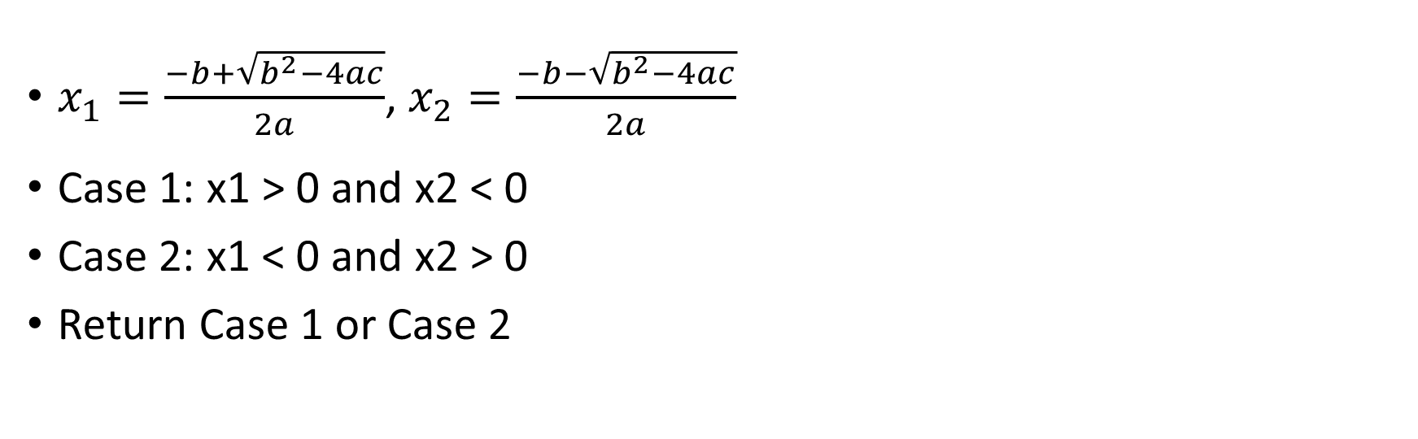
Q: Suppose x1 and x2 be the roots of the quadratic equation ax + by + c = 0.
Return “true” if product of the roots is negative.
$x_{1}=\frac{−b+\sqrt{b^{2}−4ac}}{2a}$, $x_{2}=\frac{−b−\sqrt{b^{2}−4ac}}{2a}$
Case 1: x1 > 0 and x2 < 0
Case 2: x1 < 0 and x2 > 0
Return Case 1 or Case 2

Slide 4
Arithmetic Operators
Precedence | Operator | Description | Associativity
1 | +a -a | Unary plus and minus | Right-to-left
 | ! ~ | Logical NOT and bitwise NOT
 | (type) | C-style cast
2 | a*b a/b a%b | Multiplication, division, and remainder | Left-to-right
3 | a+b a-b | Addition and subtraction
4 | < <= > >= | For relational operators < and ≤ and > and ≥ respectively
5 | == != | For equality operators = and ≠ respectively
6 | & | Bitwise AND
7 | ^ | Bitwise XOR (exclusive or)
8 | | | Bitwise OR (inclusive or)
9 | && | Logical AND
10 | || | Logical OR
11 | = | Direct assignment (provided by default for C++ classes) | Right-to-left

Slide 5
Relational Operators
Precedence | Operator | Description | Associativity
1 | +a -a | Unary plus and minus | Right-to-left
 | ! ~ | Logical NOT and bitwise NOT
 | (type) | C-style cast
2 | a*b a/b a%b | Multiplication, division, and remainder | Left-to-right
3 | a+b a-b | Addition and subtraction
4 | < <= > >= | For relational operators < and ≤ and > and ≥ respectively
5 | == != | For equality operators = and ≠ respectively
6 | & | Bitwise AND
7 | ^ | Bitwise XOR (exclusive or)
8 | | | Bitwise OR (inclusive or)
9 | && | Logical AND
10 | || | Logical OR
11 | = | Direct assignment (provided by default for C++ classes) | Right-to-left
Caveats: = and == are different.

Slide 6
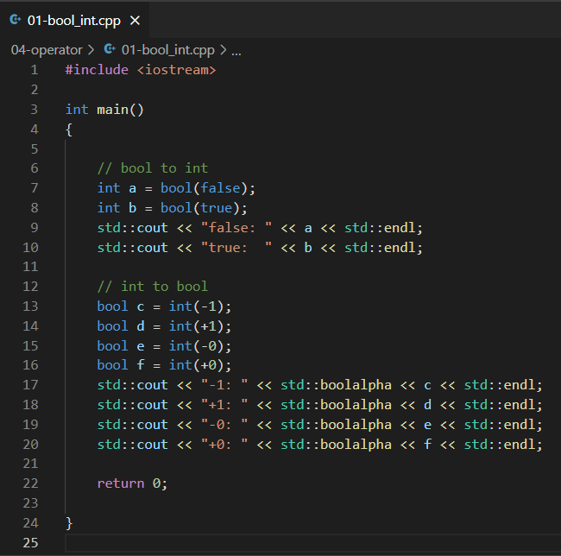

Relational Operators
Boolean and integer converter

Slide 7
Logical Operators
Precedence | Operator | Description | Associativity
1 | +a -a | Unary plus and minus | Right-to-left
 | ! ~ | Logical NOT and bitwise NOT
 | (type) | C-style cast
2 | a*b a/b a%b | Multiplication, division, and remainder | Left-to-right
3 | a+b a-b | Addition and subtraction
4 | < <= > >= | For relational operators < and ≤ and > and ≥ respectively
5 | == != | For equality operators = and ≠ respectively
6 | & | Bitwise AND
7 | ^ | Bitwise XOR (exclusive or)
8 | | | Bitwise OR (inclusive or)
9 | && | Logical AND
10 | || | Logical OR
11 | = | Direct assignment (provided by default for C++ classes) | Right-to-left
Caveats: (|, ||) and (&, &&) are different.

Slide 8
Bitwise Operators (Do not cover)
Precedence | Operator | Description | Associativity
1 | +a -a | Unary plus and minus | Right-to-left
 | ! ~ | Logical NOT and bitwise NOT
 | (type) | C-style cast
2 | a*b a/b a%b | Multiplication, division, and remainder | Left-to-right
3 | a+b a-b | Addition and subtraction
4 | < <= > >= | For relational operators < and ≤ and > and ≥ respectively
5 | == != | For equality operators = and ≠ respectively
6 | & | Bitwise AND
7 | ^ | Bitwise XOR (exclusive or)
8 | | | Bitwise OR (inclusive or)
9 | && | Logical AND
10 | || | Logical OR
11 | = | Direct assignment (provided by default for C++ classes) | Right-to-left

Slide 9
C++ Operator Precedence (Again)
Unary -> Arithmetic -> Relational -> Logical -> Assignment
Precedence | Operator | Description | Associativity
1 | +a -a | Unary plus and minus | Right-to-left
 | ! ~ | Logical NOT and bitwise NOT
 | (type) | C-style cast
2 | a*b a/b a%b | Multiplication, division, and remainder | Left-to-right
3 | a+b a-b | Addition and subtraction
4 | < <= > >= | For relational operators < and ≤ and > and ≥ respectively
5 | == != | For equality operators = and ≠ respectively
6 | & | Bitwise AND
7 | ^ | Bitwise XOR (exclusive or)
8 | | | Bitwise OR (inclusive or)
9 | && | Logical AND
10 | || | Logical OR
11 | = | Direct assignment (provided by default for C++ classes) | Right-to-left

Slide 10
C++ Operator Precedence (Again)
std::cout << !0+1 << std::endl;
std::cout << !(0+1) << std::endl;
int a = 5 * 10 % 3 + 1 % 2 >= 3 || ! + 4 - 9 <= -1;

Slide 11

Questions

