Slide 1
程式設計一
Function

Slide 2
The Purpose of Functions
Remove duplicated source code
Separate source into different files
Reduce the compiling time
C++ function requires
function declaration
function definition
function caller

Slide 3
function in C++
A sequence of statements with a name and a list of parameters.
A function can terminate by returning or by throwing an exception.
In a function-call expression, the parameters are initialized from the arguments and the statements in the function body are executed.
https://en.cppreference.com/w/cpp/language/functions

Slide 4
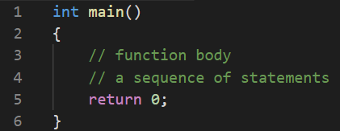
The main Function
A C++ program must contain one and only one function named main.
int -> type of returned value
main -> function name
() -> argument (empty)
https://en.cppreference.com/w/cpp/language/main_function

Slide 5
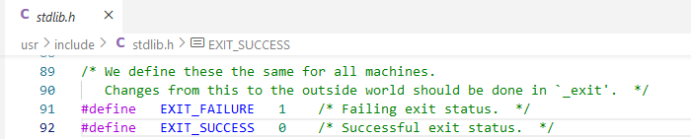
return Statement in main Function
Execution status are defined in header <cstdlib>
EXIT_SUCCESS: successful execution of a program
EXIT_FAILURE: unsuccessful execution of a program
Both EXIT_SUCCESS and the value zero indicate successful program execution status, although it is not required that EXIT_SUCCESS equals zero.
https://en.cppreference.com/w/cpp/utility/program/EXIT_status
https://en.cppreference.com/w/cpp/language/return

Slide 6
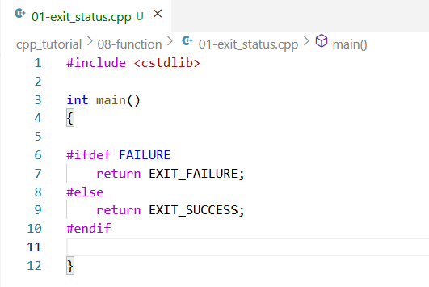
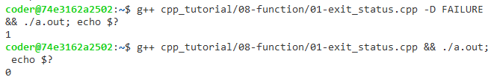
return Statement in main Function

Slide 7
return Statement
Terminates the current function and returns the specified value.
A function can terminate by returning or by throwing an exception.
Implicit conversion to the function return type to the caller.
void means no returned value
void f1()
{
std::cout << __func__ << "\n";
// implied return;
}
void f3()
{
std::cout << __func__ << "\n";
return;
std::cout << “skip";
}
https://en.cppreference.com/w/cpp/language/return

Slide 8

return Statement
int f4()
{
std::cout << __func__ << "\n";
return 1;
}
int main()
{
int a = f4();
double b = f5();
std::cout << a << "\n";
std::cout << b << "\n";
return 0;
}
double f5()
{
std::cout << __func__ << "\n";
return 1.2;
}
https://en.cppreference.com/w/cpp/language/return

Slide 9
Function Arguments
Function arguments in C++ are similar to the function inputs in mathematics.
The function output may depend on the function inputs.
In C++, a function can be called without providing one or more trailing arguments.
void f1();
void f2(void);
void f3(double a);
void f4(double a, int b);
double f5(double a, double b, int c = 2, int d = 2);
https://en.cppreference.com/w/cpp/language/default_arguments

Slide 10
Function Arguments
argc and argv are special variable for main function.
argc represents the number of arguments passed to the program from the environment in which the program is run.
argv stores each command-line arguments in a 2D array.
//The following two representations are valid
int main(int argc, char *argv[])
int main(int argc, char **argv)
https://en.cppreference.com/w/cpp/language/main_function

Slide 11
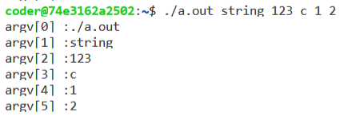
Function Arguments
int main(int argc, char *argv[])
{
for(int ii = 0; ii < argc; ii = ii + 1)
{
std::cout << "argv[" << ii << "] :"<< argv[ii] << "\n";
}
return 0;
};

Slide 12
Function Declaration (Prototype)
A function declaration may appear in any scope before any calls.
A function declaration introduces
returned type
function name
arguments
Syntax:
<return type> func_name (arguments);
Although variable name in arguments are not required in function declaration, putting variable name can improve readability.
https://en.cppreference.com/w/cpp/language/function

Slide 13
Function Definition
The detailed implementation of function.
A function definition may appear at namespace scope only
i.e., there are no nested functions.
For example, you cannot put a function definition in the main function.
https://en.cppreference.com/w/cpp/language/function

Slide 14
Function Definition
// function declaration (prototype)
// it should appear before any calls
// default arguments should list in declaration
void f1();
void f2(int, double);
void f3(double, int = 2);
/*******************/
int main()
{
f1();
f2(1, 2);
f3(0);
f3(0, 4);
return 0;
}
// function definition
void f1()
{
std::cout << __func__ << "\n";
} void f2(int a, double b)
{
std::cout << a << "\n";
std::cout << b << "\n";
std::cout << __func__ << "\n";
} void f3(double a, int b)
{
std::cout << a << "\n";
std::cout << b << "\n";
std::cout << __func__ << "\n";
}

Slide 15

Function Caller
Send actual variables to function
The argument's name in the declaration can be different from the actual variable’s name.
void f1(int a = 3);
int main()
{
int c = 100;
f1();
f1(c);
return 0;
}
void f1(int b)
{
std::cout << b << "\n";
std::cout << __func__ << "\n";
}

Slide 16
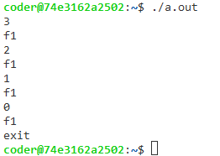
Function Caller
Function can be called by itself (recursive function)
void f1(int);
int main()
{
f1(3);
return 0;
}
void f1(int b)
{
std::cout << b << "\n";
std::cout << __func__ << "\n";
if(b == 0)
{
std::cout << "exit\n";
}
else
{
f1(b - 1);
}
}

Slide 17
Overloaded Function
Some functions have same name, but arguments are different.
Do not declare different tasks with same function name.
Before overload resolution begins, the functions selected by name lookup are combined to form the set of candidate.
Ranking of implicit conversion sequences
Exact match: no conversion required,
Promotion: integral promotion, floating-point promotion
Conversion: standard conversion, user-defined conversion, … …
https://en.cppreference.com/w/cpp/language/overload_resolution

Slide 18
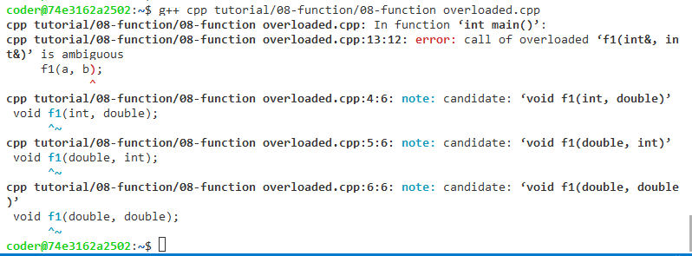
Overloaded Function
void f1(int, double);
void f1(double, int);
void f1(double, double);
int main()
{
int a = 0;
int b = 1;
f1(a, b);
return 0;
}

Slide 19
Variadic Function
Variadic functions are functions which take a variable number of arguments.
// variadic function with default arguments
void f1(double, int =3, ...);
int main()
{
// skipping default argument may cause
// ambiguous function call
f1(5.0, 2.0, 4.0, 6.0);
return 0;
}
void f1(double m, int n, ...)
{
double sum = 0.0;
va_list args;
va_start(args, n);
for(int ii = 0; ii < n; ii = ii + 1)
{
sum = sum + va_arg(args, double);
}
sum = sum * 5;
std::cout << sum << "\n"; }
https://en.cppreference.com/w/c/variadic

Slide 20
Variable Scope
Local variable is declared inside
if statement
for/while statement
function body
The caller only knows function’s usage instead of the implementation details
Global variable is declared outside function body
It can be accessed by any function
In general, global variable should be avoided
Namespaces provide a method for preventing name conflicts
https://en.cppreference.com/w/cpp/language/namespace

Slide 21
Namespace
Namespaces provide a method for preventing name conflicts.
Multiple namespace blocks with the same name are allowed.
https://en.cppreference.com/w/cpp/language/namespace

Slide 22
namespace Q
{
// original-namespace-definition for V
namespace V
{
void f(); // declaration of Q::V::f
}
// OK
void V::f()
{
std::cout << __func__ << "\n";
}
// Error: g() is not yet a member of V
//void V::g() {}
// extension-namespace-definition for V
namespace V
{
// declaration of Q::V::g
void g();
}
}
// not an enclosing namespace for Q
namespace R
{
// Error: cannot define Q::V::g inside R
//void Q::V::g() {}
}
// OK: global namespace encloses Q
void Q::V::g()
{
std::cout << __func__ << "\n";
}

Slide 23
// defines ::(unique)::i
namespace
{
int i = 0;
}
void f()
{
// increments ::(unique)::i
i = i + 1;
std::cout << i << "\n";
std::cout << __func__ << "\n";
}
namespace A
{
namespace
{
int i = 10; // A::(unique)::i
int j = 10; // A::(unique)::j
}
void g()
{
// A::(unique)::i++
i = i + 1;
std::cout << i << "\n";
std::cout << __func__ << "\n";
}
}

Slide 24
Reference Declaration
Declare a named variable as a reference.
an alias to an already-existing object or function.
Function arguments can be passed by value or by reference.
Protect arguments by modifier const
Allow multiple objects are returned by arguments.
https://en.cppreference.com/w/cpp/language/reference

Slide 25

Application - Fibonacci
$$\left\{\begin{matrix}F_{n}=F_{n−1}+F_{n−2}, n>1 \\ 1 , n=1 \\ 0, n=0\end{matrix}\right.$$
F(0) | F(1) | F(2) | F(3) | F(4) | F(5) | F(6) | F(7) | F(8) | F(9)
0 | 1 | 1 | 2 | 3 | 5 | 8 | 13 | 21 | 34
https://en.wikipedia.org/wiki/Fibonacci_number

Slide 26
Application - Fibonacci
1
F(5)
F(4) + F(3)
2
F(4)
F(3) + F(2)
F(3)
F(2) + F(1)
3
F(3)
F(2) + F(1)
4
F(2)
F(1) + F(0)
7
F(1)
1
F(2)
0
5
6

Slide 27
Application - Merge Sort
1 X 8
-1 | -10 | -4 | -6 | -9 | -3 | -15 | -7
2 X 4
-1 | -10 | -4 | -6 | -9 | -3 | -15 | -7
4 X 2
-1 | -10 | -4 | -6 | -9 | -3 | -15 | -7
1 X 8
-1 | -10 | -4 | -6 | -9 | -3 | -15 | -7

Slide 28
Application - Merge Sort
8 X 1
-1 | -10 | -4 | -6 | -9 | -3 | -15 | -7
4 X 2
-10 | -1 | -6 | -4 | -9 | -3 | -15 | -7
2 X 4
-10 | -6 | -4 | -2 | -15 | -9 | -7 | -3
8 X 1
-15 | -10 | -9 | -7 | -6 | -4 | -3 | -2

Slide 29

Application - Merge Sort
Complexity :
$$\sum_{i=0}^{log n}{\sum_{j=1}^{n/2^{i}}{2^{i}}}=\sum_{i=1}^{log n}{n}=n log n$$

Slide 30
Lambda Function (optional)
Lambda function can be defined inside a function and use some variables stored in the current function.
Syntax:
[captures](params) exception -> return type {body}
https://en.cppreference.com/w/cpp/language/lambda
https://docs.microsoft.com/en-us/cpp/cpp/lambda-expressions-in-cpp?view=msvc-170

Slide 31

Lambda Function (optional)
#include <iostream>
int main()
{
int i = 0;
auto f = [=](int a, int b) -> int
{
return i + a + b;
}; auto g = [&](int a, int b) -> int
{
i = i + a + b;
return i;
}; std::cout << f(10, 5) << ", i=" << i << "\n";
std::cout << g(10, 5) << ", i=" << i << "\n";
return 0;
}

Slide 32

Questions

