Slide 1
Roots of Quadratic Equation
HW1

Slide 2

Quadratic Equation
$f\left(x\right)=\left(x −{ans}_{1}\right)×\left(x −{ans}_{2}\right)= ax^{2}+bx+c$
$a=1$
$b=−\left({ans}_{1}+{ans}_{2}\right)$
$c={ans}_{1}×{ans}_{2}$
float ans1 = 10000000;
float ans2 = 0.5;
float a = 1.0;
float b = -(ans1 + ans2);
float c = ans1 * ans2;

Slide 3

Roots of Quadratic Equation
$f\left(x\right)= ax^{2}+bx+c$
$x_{1}=\frac{−b+\sqrt{b^{2}−4ac}}{2a}$
$x_{2}=\frac{−b−\sqrt{b^{2}−4ac}}{2a}$
float s, x1, x2;
s = b * b - 4 * a * c;
s = std::sqrt(s);
x1 = (-b + s) / (2 * a);
x2 = (-b - s) / (2 * a);

Slide 4

Relative Error
$E\left(ans, x\right)=\left|\frac{x−ans}{ans}\right|×100\%$
float err1, err2;
err1 = std::abs( (x1 - ans1) / ans1 ) * 100;
err2 = std::abs( (x2 - ans2) / ans2 ) * 100;
std::cout << "ans[#], root[#], error[%]\n";
std::cout << ans1 << "\t" << x1 << "\t" << err1 << std::endl;
std::cout << ans2 << "\t" << x2 << "\t" << err2 << std::endl;

Slide 5



Results
float ans1 = 10000000;
float ans2 = 0.5;
float ans1 = 10000000;
float ans2 = 0.4;
float ans1 = 10000000;
float ans2 = 0.2;

Slide 6
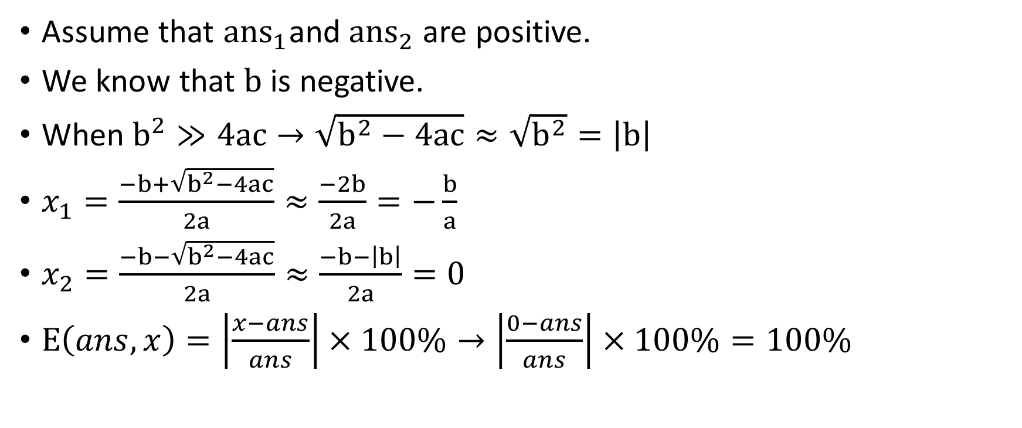
Hints
Assume that ${ans}_{1}$and ${ans}_{2}$ are positive.
We know that $b$ is negative.
When $b^{2}≫4ac→\sqrt{b^{2}−4ac}≈\sqrt{b^{2}}=\left|b\right|$
$x_{1}=\frac{−b+\sqrt{b^{2}−4ac}}{2a}≈\frac{−2b}{2a}=−\frac{b}{a}$
$x_{2}=\frac{−b−\sqrt{b^{2}−4ac}}{2a}≈\frac{−b−\left|b\right|}{2a}=0$
$E\left(ans, x\right)=\left|\frac{x−ans}{ans}\right|×100\%→\left|\frac{0−ans}{ans}\right|×100\%=100\%$

Slide 7
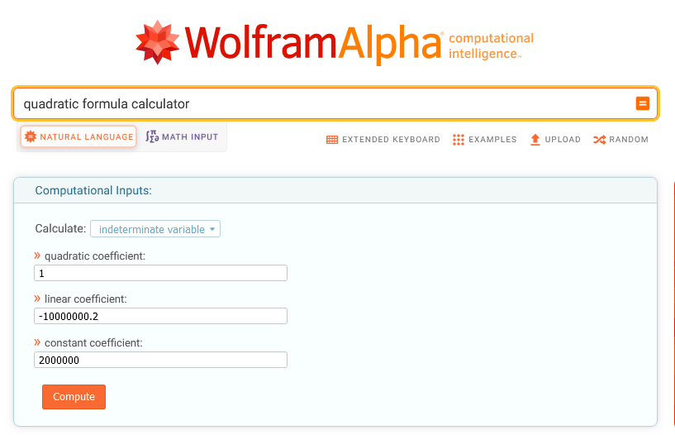
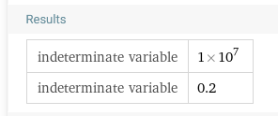
Resources
https://www.wolframalpha.com/input/?i=quadratic+formula+calculator

Slide 8
Homework
Implement a robust quadratic equation solver.
Explain the mathematical principles behind your solver.
The relative error of the two roots should be less than 1e-6.
Inputs : ans1= 10000000, ans2={0.5, 0.4, 0.2}
Source code:
https://github.com/CNOCycle/cpp_tutorial/tree/main/hw01/ hw01.cpp

