Slide 1
程式設計一
Vector & String

Slide 2
Definition of vector in C++
Defined in header <vector>
The elements are stored contiguously, which means that elements can be accessed not only through iterators, but also using offsets to regular pointers to elements.
https://en.cppreference.com/w/cpp/container/vector

Slide 3
Complexity of Operations on vector
Random access - constant 𝓞(1)
Insertion or removal of elements - linear in the distance to the end of the vector 𝓞(n)
Insertion or removal of elements at the end - amortized constant 𝓞(1)

Slide 4
Vector in C++
capacity()
size()
Idx
0 | 1 | 2 | 3 | 4
Val
3 | 5 | 7 | 11 | 30
begin()
at(2)
end()
https://en.cppreference.com/w/cpp/container/vector

Slide 5
Vector in C++
Idx
0 | 1 | 2 | 3 | 4 | 5
Val
3 | 5 | 7 | 11 | 30 | ?
Val
3 | 8 | 5 | 7 | 11 | 30
https://en.cppreference.com/w/cpp/container/vector

Slide 6
Vector in C++
insert
Idx
0 | 1 | 2 | 3 | 4
Val
3 | 5 | 7 | 11 | 30 | 8
- | - | - | - | -
3 | 5 | 7 | 11 | 30 | 8
new address
https://en.cppreference.com/w/cpp/container/vector

Slide 7
Definition of string in C++
Arrays of characters terminated by a special null character.
capacity()
size()
Idx
0 | 1 | 2 | 3 | 4
Val
3 | 5 | 7 | 11 | 30 | \0
begin()
at(2)
end()
https://en.cppreference.com/w/cpp/string

Slide 8
ASCII CODE
Type | Size in bytes | Format | Value range (Approximate)
character | 1 | signed | -128 to 127
 |  | unsigned | 0 to 255
 | 2 | UTF-16 | 0 to 65535
 | 4 | UTF-32 | 0 to 1114111 (0x10ffff)
https://en.wikipedia.org/wiki/ASCII

Slide 9
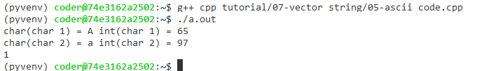
ASCII CODE
char char_1 = 'A';
char char_2 = 'a';
std::cout << "char(char_1) = " << char_1 << " ";
std::cout << "int(char_1) = " << int(char_1) << "\n";
std::cout << "char(char_2) = " << char_2 << " ";
std::cout << "int(char_2) = " << int(char_2) << "\n";
std::cout << (char_1 < char_2) << "\n";

Slide 10
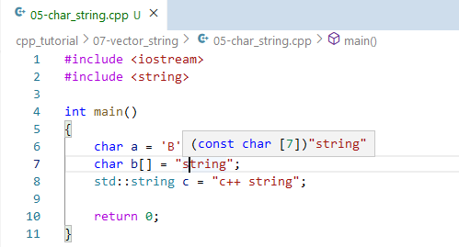
Char and String
The single quotes means a single character.
The double quotes means a string literal containing a null char at the end of the string.

Slide 11
C-Style Array/String
const size_t SIZE = 5;
double a[SIZE];
int b[] = {-1, -2, -3, -4, -5};
// do not forget the null character '\0'
char c[] = {'H', 'e', 'l', 'l', 'o', '\0'};
char d[] = "Hello";
size_t c_size = 6; //(!?)
std::string s = "Hello";
std::cout << "s.size() = " << s.size() << "\n";
std::cout << "s.capacity() = " << s.capacity() << "\n";

Slide 12
C-Style Array/String
// do not forget the null character '\0'
char c[] = {'H', 'e', 'l', 'l', 'o', '\0'};
char d[] = "Hello";
// the null character signals end of string
int ii = 0;
while(c[ii] != '\0')
{
std::cout << "d[" << ii << "]= " << d[ii] << "\n";
ii = ii + 1;
}

Slide 13
Common Pitfalls
// assign one string to another string
char a[] = "hello";
char b[] = "world";
a = b;
// modify multiple characters
a = "world";
std::string a = "hello";
std::string b = "world";
a = b;
std::cout << "a= " << a << "\n";
std::cout << "b= " << b << "\n";
a = "hello";
std::cout << "a= " << a << "\n";
std::cout << "b= " << b << "\n";

Slide 14
Common Pitfalls
// out of range - c-array
int a[] = {-0, -1, -2, -3, -4, -5};
std::cout << a[-1] << "\n";
std::cout << a[8] << "\n";
// out of range - vector/string
std::vector<int> b = {-0, -1, -2, -3, -4, -5};
std::cout << b[-1] << "\n";
std::cout << b[8] << "\n";
std::cout << b.at(-1) << "\n";
std::cout << b.at(8) << "\n";
std::string c = "c++ string";
std::cout << c[-1] << "\n";
std::cout << c[100] << "\n";
std::cout << c.at(100) << "\n";
std::cout << c.at(-1) << "\n";
https://en.cppreference.com/w/cpp/error/out_of_range

Slide 15
2D Vector
// a normal 1-D vector
std::vector<double>a = {-1, -2, -3, -4};
// 2-D vector
std::vector<std::vector<double>> c;
std::vector<std::vector<int>> d(3, std::vector<int> (4, 0));
std::vector<std::vector<double>> b = { {-1, -2, -3, -4},
{-100, -200, -300, -400},
{100, 200, 300}
};

Slide 16
2D Vector
std::vector<std::vector<int>> c(3, std::vector<int> (4, -1));
for(size_t ii = 0; ii < c.size(); ii = ii + 1)
{
std::cout << "c[" << ii << "].size() = " << c[ii].size() << "\n";
for(size_t jj = 0; jj < c[ii].size(); jj = jj + 1)
{
std::cout << "c[" << ii << "] = " << c[ii][jj] << " ";
}
std::cout << "\n";
}
 | c[][0] | c[][0] | c[][0] | c[][0]
c[0] | -1 | -1 | -1 | -1
c[1] | -1 | -1 | -1 | -1
c[2] | -1 | -1 | -1 | -1

Slide 17
2D Vector
std::vector<std::vector<double>> b = { {-1, -2, -3, -4},
{-100, -200, -300, -400},
{100, 200, 300}
};
for(size_t ii = 0; ii < b.size(); ii = ii + 1)
{
std::cout << "b[" << ii << "].size() = " << b[ii].size() << "\n";
for(size_t jj = 0; jj < b[ii].size(); jj = jj + 1)
{
std::cout << "b[" << ii << "] = " << b[ii][jj] << " ";
}
std::cout << "\n";
}
 | b[][0] | b[][0] | b[][0] | b[][0]
b[0] | -1 | -2 | -3 | -4
b[1] | -100 | -200 | -300 | -400
b[2] | 100 | 200 | 300 | X

Slide 18
Sorting Algorithm
The most frequently used orders:
numerical
lexicographical order
The most frequently used algorithms:
insertion sort
bubble sort
merge sort
quicksort

Slide 19
Insertion Sort
-1 | -10 | -4 | -6 | -9
Step 1
-1
 | -10 | -4 | -6 | -9
Step 2
-10 | -1
 |  | -4 | -6 | -9
Step 3
-10 | -4 | -1

Slide 20
Insertion Sort
 |  |  | -6 | -9
Step 4
-10 | -9 | -6 | -1
 |  |  |  | -9
Step 5
-10 | -9 | -6 | -4 | -1
Result
-10 | -9 | -6 | -4 | -1

Slide 21
Bubble Sort
-1 | -10 | -4 | -6 | -9
-10 | -1 | -4 | -6 | -9
-10 | -4 | -1 | -6 | -9
-10 | -4 | -6 | -1 | -9
-10 | -4 | -6 | -9 | -1

Slide 22
Bubble Sort
-10 | -4 | -6 | -9 | -1
-10 | -4 | -6 | -9 | -1
-10 | -6 | -4 | -9 | -1
-10 | -6 | -9 | -4 | -1

Slide 23
Bubble Sort
-10 | -6 | -9 | -4 | -1
-10 | -6 | -9 | -4 | -1
-10 | -9 | -6 | -4 | -1

Slide 24
Bubble Sort
-10 | -9 | -6 | -4 | -1
-10 | -9 | -6 | -4 | -1
-10 | -9 | -6 | -4 | -1
-10 | -9 | -6 | -4 | -1

Slide 25
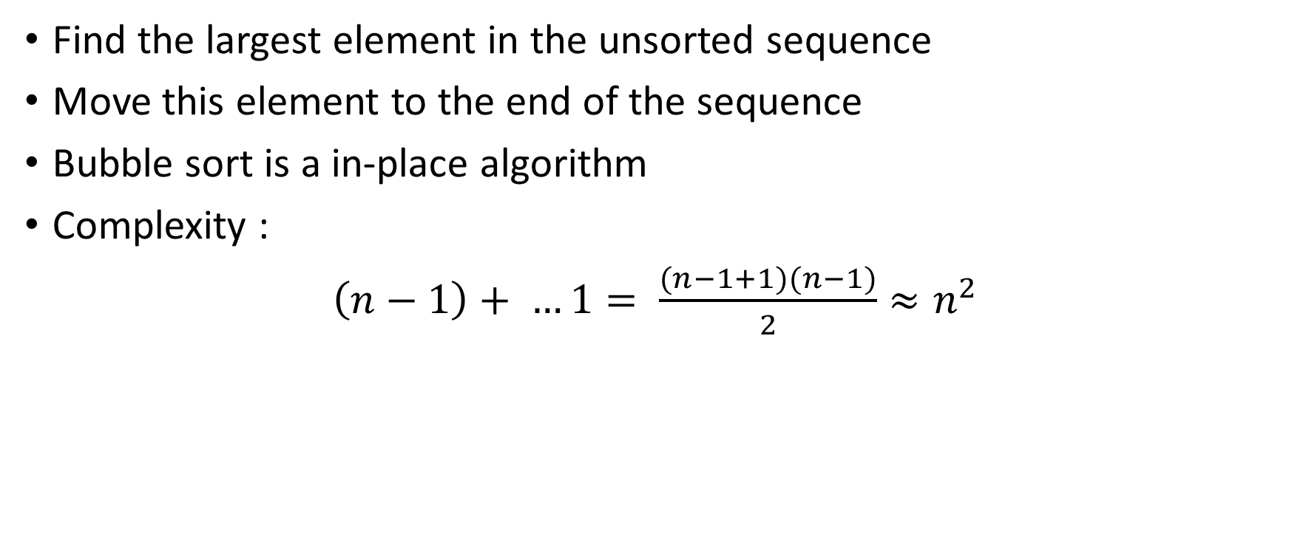
Bubble Sort
Find the largest element in the unsorted sequence
Move this element to the end of the sequence
Bubble sort is a in-place algorithm
Complexity :
$\left(n−1\right)+ …1= \frac{(n−1+1)(n−1)}{2}≈n^{2}$

Slide 26

Questions

