Slide 1
程式設計一
Coding Style

Slide 2
Indentation Style
Indenting is used to clarify the link between control flow constructs.
conditions
loops
code contained within and outside of them.
Indentation is not a requirement and whitespace is insignificant in C.
However, Python uses indentation to determine the structure instead of using braces or keywords
https://en.wikipedia.org/wiki/Indentation_style

Slide 3
K & R Style
It was the style used in the original Unix kernel.
Each function has its opening brace at the next line on the same indentation level as its header.
The statements within the braces are indented, and the closing brace at the end is on the same indentation level as the header of the function at a line of its own.
Multi-line blocks inside a function have their opening braces at the same line as their respective control statements and closing braces remain in a line of their own.
https://en.wikipedia.org/wiki/Indentation_style#K&R_style

Slide 4
K & R Style
int main(int argc, char *argv[])
{
...
while (x == y) {
something();
somethingelse();
if (some_error)
do_correct(); // In K&R a single-statement block does not have braces.
else
continue_as_usual();
}
finalthing();
...
}

Slide 5
Allman Style
Allman puts the brace associated with a control statement on the next line, indented to the same level as the control statement.
int main(int argc, char *argv[])
{
while (x == y)
{ // the position of the opening brace
something();
somethingelse();
if (some_error)
do_correct();
else
continue_as_usual();
}
}
https://en.wikipedia.org/wiki/Indentation_style#Allman_style

Slide 6
Comparison
https://gist.github.com/jesseschalken/0f47a2b5a738ced9c845

Slide 7

Google C++ Style Guide
https://google.github.io/styleguide/cppguide.html

Slide 8
Header Files
In general, every .cpp file should have an associated .h file.
All header files should be self-contained.
If a source or header file refers to a symbol defined elsewhere, the file should directly include a header file which properly intends to provide a declaration or definition of that symbol.
https://google.github.io/styleguide/cppguide.html

Slide 9
Forward Declarations
Avoid using forward declarations.
A "forward declaration" is a declaration of an entity without an associated definition.
Technically, the following code can be compiled properly, but you may not find the exact function definition of axb and It would cause linking error.
// in 03-forward_declaration.cpp
// g++ -c cpp_tutorial/10-coding_style/03-forward_declaration.cpp double axb(double a, double b);
double func(double a, double b, double c)
{
return c * axb(a, b);
}

Slide 10
Names and Order of Includes
Include headers in the following order:
related header
C system headers
C++ standard library headers
other libraries' headers
your project's headers.

Slide 11
Header Guard
A header should have header guards and include all other headers it needs.
// protect header by `ifndef`
#ifndef HEADER_NAME_H_
#define HEADER_NAME_H_
int func(int a);
double axb(double a, double b)
{
return a * b;
}
#endif // HEADER_NAME_H_
// protect header by #pragma once`
#pragma once
int func(int a);
double axb(double a, double b)
{
return a * b;
}

Slide 12
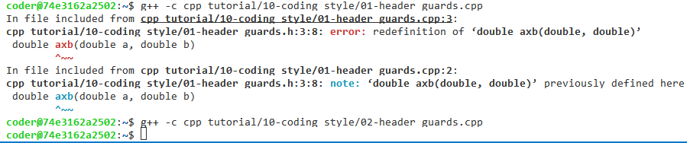
Header Guard
// include same header file twice
#include "02-header_guards.h"
#include "02-header_guards.h"
// g++ -c cpp_tutorial/10-coding_style/02-header_guards.cpp
int main()
{
int b = func(1);
return 0;
}

Slide 13
Namespaces
Place code in a namespace.
Namespaces should have unique names based on the project name.
Namespaces provide a method for preventing name conflicts in large programs while allowing most code to use reasonably short names.

Slide 14
Casting
Use C++-style casts like
static_cast<double>(2.0)
or brace initialization for conversion of arithmetic types like
int64_t y = int64_t{1}
Do not use cast formats like (int) x unless the cast is to void.

Slide 15
Naming
Filenames should be all lowercase and can include underscores (_) or dashes (-). (no whitespaces)
In general, make your filenames very specific.
For example, use http_server_logs.h rather than logs.h.
Ordinarily, functions should start with a capital letter and have a capital letter for each new word.
AddTableEntry()
Type names start with a capital letter and have a capital letter for each new word, with no underscores
using PropertiesMap = hash_map<UrlTableProperties *, std::string>;

Slide 16
Naming
The names of variables (including function parameters) and data members are all lowercase, with underscores between words.
a_local_variable, a_struct_data_member, a_class_data_member_
Variables declared const are named with a leading "k" followed by mixed case.
const int kDaysInAWeek = 7;
Namespace names are all lower-case, with words separated by underscores.
Top-level namespace names are based on the project name . Avoid collisions between nested namespaces and well-known top-level namespaces.

Slide 17
Formatting
Each line of text in your code should be at most 80 characters long.
Use only spaces, and indent 2 spaces at a time. (No tabs)

Slide 18
Misc
Do single statement or task in one line.
Reserve whitespaces after keywords and no space after functions.
Reserve whitespace between binary operators and no space between unary operators.
Add a new line between two functions.

Slide 19
Formatting in code-server
Install tool by the command `sudo apt install clang-format`

Slide 20
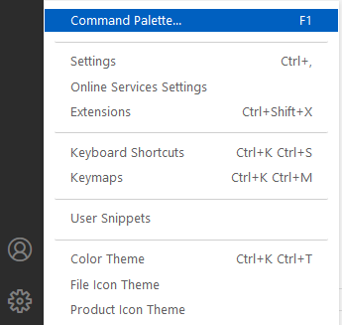
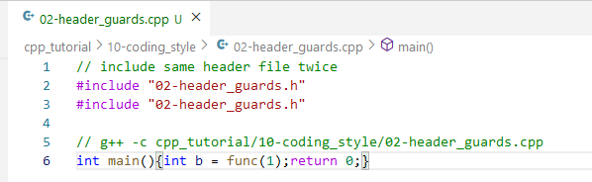
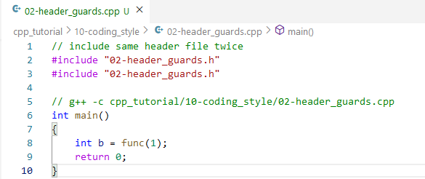
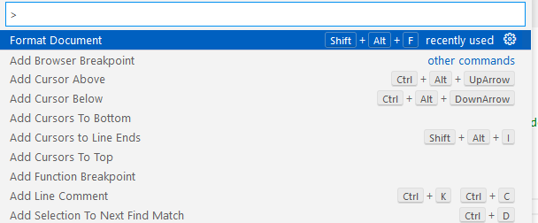
Formatting in code-server

Slide 21

Questions

