Slide 1

Lab 2: GoogleTest
C++ test framework

Slide 2
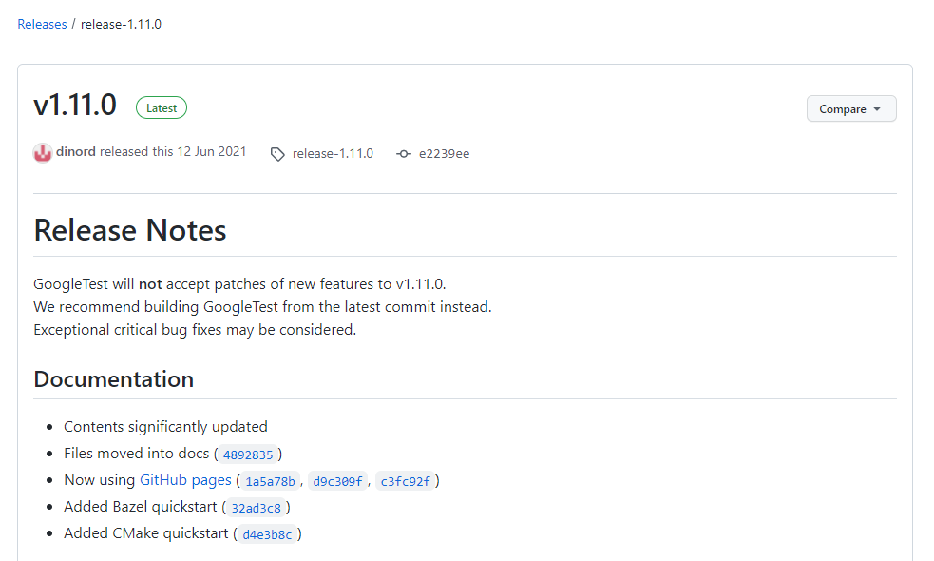
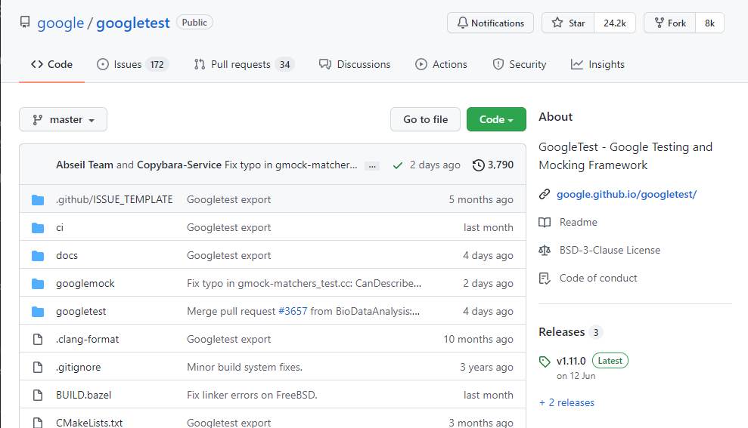
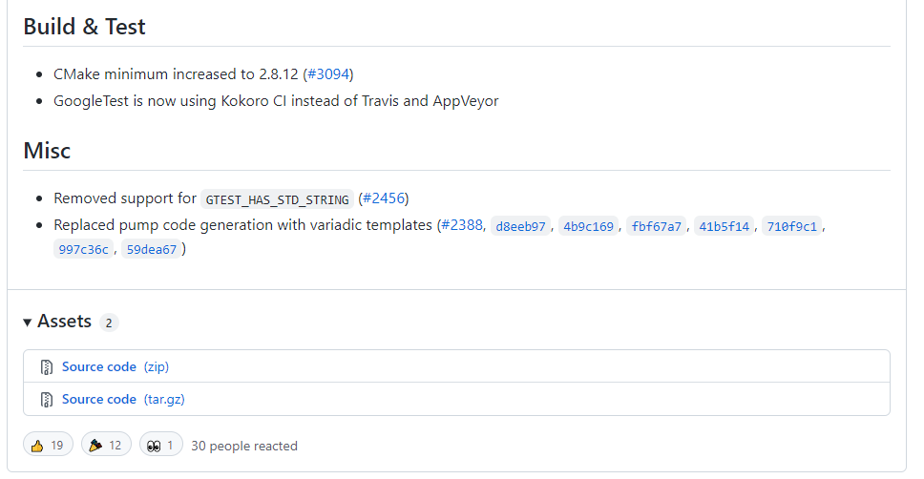
INSTALL googletest
https://github.com/google/googletest

Slide 3
INSTALL Googletest
sudo apt update
sudo apt install -y cmake
cd googletest-release-1.11.0
mkdir build && cd build
cmake -DCMAKE_INSTALL_PREFIX=../../gtest ..
make -j && make install
cd googletest-release-1.11.0
mkdir build
cd build
cmake -G "MinGW Makefiles" -DCMAKE_INSTALL_PREFIX=../../gtest ..
mingw32-make -j && mingw32-make -j install
https://github.com/google/googletest/blob/master/googletest/README.md

Slide 4

INSTALL GOOGLETEST in code-server
GoogleTest have been installed in code-server
All files can be found in folder `/shared/`

Slide 5
Add makefile
gtest_main.o: gtest_main.cpp
g++ -I/shared/include/ -c -o $@ $<
01-simple.o: 01-simple.cpp 01-simple.h
g++ -g -I/shared/include/ -c -o $@ $<
01-test_assert.o: 01-test_assert.cpp 01-simple.h
g++ -g -I/shared/include/ -c -o $@ $<
01-test_assert: gtest_main.o 01-simple.o 01-test_assert.o
g++ -L/shared/lib -o $@ $^ -lgtest -lpthread
clean:
rm -rf *.o *.out
.PHONY: clean

Slide 6
Add launch.json
Use default configuration.
You can copy file from `cpp_tutorial/lab02/.vscode/launch.json`

Slide 7
Add tasks.json
{
"tasks": [
{
"type": "shell",
"label": "C/C++: g++ build active file",
"command": "make",
"args": [
"${fileBasenameNoExtension}"
],
"options": {
"cwd": "${fileDirname}"
},
"problemMatcher": [
"$gcc"
],
"group": {
"kind": "build",
"isDefault": true
},
"detail": "Task generated by Debugger."
}
],
"version": "2.0.0"
}

Slide 8
Add c_cpp_properties.json
{
"configurations": [
{
"name": "Linux",
"includePath": [
"${workspaceFolder}/**",
"/shared/include/"
],
"defines": [],
"compilerPath": "/usr/bin/gcc",
"cStandard": "gnu17",
"cppStandard": "gnu++14",
"intelliSenseMode": "linux-gcc-x64"
}
],
"version": 4
}

Slide 9
Basic concept - Assertion
ASSERT will abort the testing and generate a fatal failure when an error is detected
ASSERT_TRUE
ASSERT_FALSE
ASSERT_EQ
ASSERT_NE
ASSERT_LT
ASSERT_LE
ASSERT_GT
ASSERT_GE
ASSERT_STREQ
ASSERT_STRNE
ASSERT_STRCASEEQ
ASSERT_STRCASENE
ASSERT_FLOAT_EQ
ASSERT_DOUBLE_EQ
ASSERT_NEAR
https://github.com/google/googletest/blob/master/docs/reference/assertions.md

Slide 10
Basic concept - Except
EXCEPT will continue the testing and generate non-fatal failures when errors are detected
EXPECT_TRUE
EXPECT_FALSE
EXPECT_EQ
EXPECT_NE
EXPECT_LT
EXPECT_LE
EXPECT_GT
EXPECT_GE
EXPECT_STREQ
EXPECT_STRNE
EXPECT_STRCASEEQ
EXPECT_STRCASENE
EXPECT_FLOAT_EQ
EXPECT_DOUBLE_EQ
EXPECT_NEAR
https://github.com/google/googletest/blob/master/docs/reference/assertions.md

Slide 11
Application – sorting algorithm
Generate an unsorted vector
Sort the vector with a verified algorithm
Get the sorted vector with our algorithm
Verify two sorted vectors are identical

