Slide 1

Lab 3: compilation
Compiling multiple files
& Makefile

Slide 2
c++ compilation process
#include <iostream>
#include "spdlog/spdlog.h"
Header *.h
Source
*.cpp
Preprocessor & Compiler
"args": [
"-g",
"-I{SPD_PATH}/spdlog/include",
"-L{SPD_PATH}/spdlog/lib",
"${file}",
"-o",
"${workspaceFolder}/a.out“
“-lspdlog",
],

Slide 3

c++ compilation process
Object
*.o
Library
*.a, *.so
Linker
"args": [
"-g",
"-I{SPD_PATH}/spdlog/include",
"-L{SPD_PATH}/spdlog/lib",
"${file}",
"-o",
"${workspaceFolder}/a.out“
“-lspdlog",
],

Slide 4

c++ compilation process
*.cpp *.h
Preprocessor (g++ -E)
*.ii
Compiler (g++ -S)
*.s
Linker (g++/ld )
*.o *.a *.so
Assembler (g++ -c)

Slide 5
c++ compilation process
#include "spdlog/spdlog.h" int main()
{
spdlog::info("{} {}", "Hello", "World");
return 0;
}

Slide 6
c++ compilation process
/**
* # Preprocessor
* > g++ -E -I/shared/include/ -o 01-compilation.ii 01-compilation.cpp
* # Compiler
* > g++ -S 01-compilation.ii
* # Assembler
* > g++ -c 01-compilation.s
* # Linker
* > g++ -L/shared/lib/ -o ./a.out 01-compilation.o -lspdlog
* # run
* > ./a.out
* > [2021-11-05 05:58:20.181] [info] Hello World
**/

Slide 7
c++ compilation process
/**
* For a simple project, we can combine 4 steps into a command
* > g++ -I/shared/include/ -L/shared/lib/ 01-compilation.cpp -lspdlog
* # run
* > ./a.out
* > [2021-11-05 06:07:49.683] [info] Hello World
**/

Slide 8
Example for Compiling multiple files
initializer.o: initializer.cpp initializer.h
g++ $(CPPFLAGS) -c -o $@ $<
utils.o: utils.cpp utils.h
g++ $(CPPFLAGS) -I/shared/include/ -c -o $@ $<
main.o: main.cpp
g++ $(CPPFLAGS) -c -o $@ $<
a.out: initializer.o utils.o main.o
g++ -L/shared/lib $^ -lspdlog
b.out: initializer.cpp utils.cpp main.cpp
g++ $(CPPFLAGS) -I/shared/include/ -L/shared/lib -o b.out $^ -lspdlog
clean:
rm -rf *.o *.out
.PHONY: clean
cpp_tutorial/lab03/02-vector_initializer

Slide 9
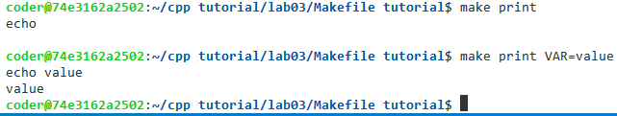
Makefile tutorial
# define variable on the top
VAR := # define a variable `VAR` and its value is empty
# > make print
# > echo
# >
# set VAR from the command line
# > make VAR=value
# > echo value
# > value
print:
echo $(VAR)

Slide 10
Makefile tutorial
The targets are file names
A recipe is an action that make carries out.
Please note: you need to put a tab character at the beginning of every recipe line.
If any of the prerequisites change, make will re-generate targets.
b.out: initializer.cpp utils.cpp main.cpp
g++ $(CPPFLAGS) -I/shared/include/ -L/shared/lib -o b.out $^ -lspdlog
https://www.gnu.org/software/make/manual/make.html#Rule-Syntax

Slide 11
Makefile tutorial
A phony target is one that is not really the name of a file.
The recipe will be executed every time the target comes up for remaking.
.PHONY is to avoid a conflict with a file of the same name
clean:
rm -rf *.o *.out
.PHONY: clean

Slide 12
Makefile tutorial
$@ is the file name of the target.
$< is the name of the first prerequisites
$^ is the names of all prerequisites
utils.o: utils.cpp utils.h
g++ $(CPPFLAGS) -I/shared/include/ -c -o $@ $<
main.o: main.cpp
g++ $(CPPFLAGS) -c -o $@ $<
a.out: initializer.o utils.o main.o
g++ -L/shared/lib $^ -lspdlog
https://www.gnu.org/software/make/manual/html_node/Automatic-Variables.html

Slide 13
CUSTOM tasks in vscode
{
"type": "cppbuild",
"label": "C/C++: g++ build active file",
"command": "/usr/bin/g++",
"args": ["${file}"],
"options": {"cwd": "${fileDirname}"},
"problemMatcher": ["$gcc"],
"group": {
"kind": "build",
"isDefault": true
},
"detail": "Task generated by Debugger."
}
{
"type": "shell",
"label": "build project: all",
"command": "make",
"args": ["a.out",],
"options": {"cwd": "${workspaceFolde}"},
"group": {
"kind": "build",
"isDefault": true
},
"detail": "build project(Release)."
},

Slide 14
CUSTOM tasks in vscode
{
"type": "shell",
"label": "build project: main",
"command": "make",
"args": ["main.o",],
"options": {"cwd": "${workspaceFolder}"},
"detail": "build project(Release)."
},
{
"type": "shell",
"label": "build project: all",
"command": "make",
"args": ["a.out",],
"options": {"cwd": "${workspaceFolde}"},
"group": {
"kind": "build",
"isDefault": true
},
"detail": "build project(Release)."
},

Slide 15
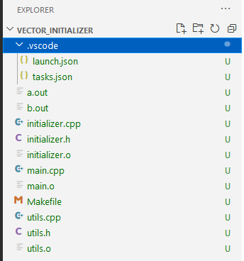
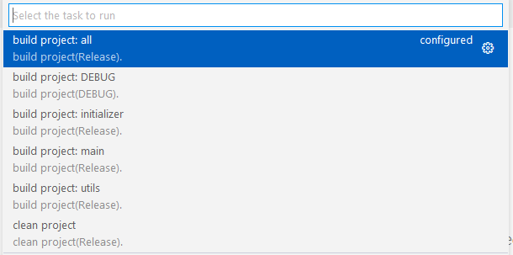
CUSTOM tasks in vscode

Slide 16
Pass command line arguments
#include <stdlib.h>
#include <iostream>
#include <vector>
int main(int argc, char *argv[])
{
// convert char/string to int
unsigned n = std::atoi(argv[1]);
std::cout << "length: " << n << "\n";
// convert char/string to floating point
double val = std::atof(argv[2]);
std::cout << "val: " << val << "\n";
return 0;
}

Slide 17
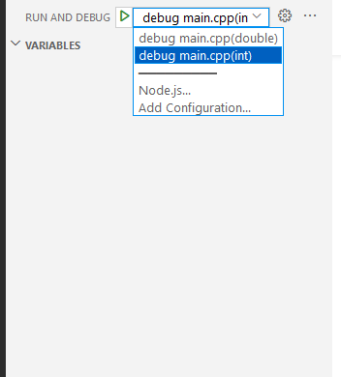
{
"name": "debug main.cpp(int)",
"type": "cppdbg",
"request": "launch",
"program": "${workspaceFolder}/a.out",
"args": ["5", “20", “i"],
"stopAtEntry": false,
"cwd": "${workspaceFolder}",
"environment": [],
"externalConsole": false,
"MIMode": "gdb",
"setupCommands": [
{
"description": "Enable pretty-printing for gdb",
"text": "-enable-pretty-printing",
"ignoreFailures": true
}
],
"preLaunchTask": "build project: DEBUG",
"miDebuggerPath": "/usr/bin/gdb"
},

Slide 18
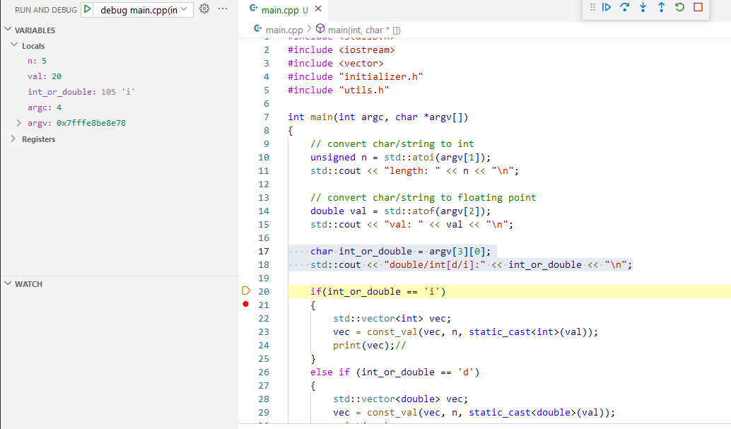
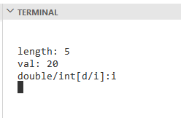

Slide 19
step-in and step-OUT in Debugger
int main(int argc, char *argv[])
{ if(int_or_double == 'i')
{
std::vector<int> vec;
print(vec);
std::cout << "\n";
} return 0;
}
Step Into: move into function
void print(std::vector<int> &vec)
{
for(size_t ii = 0; ii < vec.size(); ii = ii + 1)
{
spdlog::info("vec[{:03d}] = {:d}", ii, vec[ii]);
}
}
Step Out: exit function immediately

Slide 20
step-OVER in Debugger
int main(int argc, char *argv[])
{ if(int_or_double == 'i')
{
std::vector<int> vec;
print(vec);
std::cout << "\n";
} return 0;
}
int main(int argc, char *argv[])
{ if(int_or_double == 'i')
{
std::vector<int> vec;
print(vec);
std::cout << "\n";
} return 0;
}
Step Over: run next statement

Slide 21
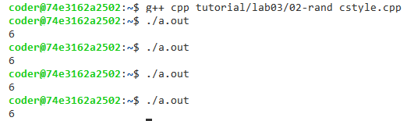
Random Generator – C-style
int main()
{
// return a random integer between 0 and RAND_MAX inclusive.
int r = std::rand();
// get a random value between [a, b]
int a = 5;
int b = 10;
int s = (r % (b - a + 1)) + a;
std::cout << s << "\n";
return 0;
}

Slide 22
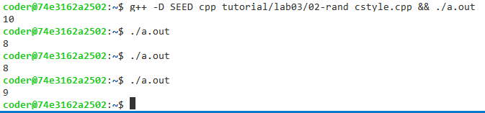
Random Generator – C-style
#ifdef SEED
// initialize random seed by system time
srand (time(NULL));
#endif

Slide 23
Common Pitfalls
// return a random integer between 0 and RAND_MAX inclusive.
int r = std::rand();
// get a random value between [a, b]
int a = 10;
int b = 14;
int s = (r % (b - a + 1)) + a;
Let RAND_MAX = 12
Let RAND_MAX = 12
Bucket = int(12 / 5) = 2
10 | 11 | 12 | 13 | 14
0 | 1 | 2 | 4 | 5
6 | 7 | 8 | 9 | 10
11 | 12
10 | 11 | 12 | 13 | 14
0 | 1 | 2 | 4 | 5
6 | 7 | 8 | 9 | 10
11 (reject) | 12 (reject)

Slide 24
Random Generator in C++
Uniform distributions
Bernoulli distributions
Poisson distributions
Normal distributions
Sampling distributions
https://en.cppreference.com/w/cpp/header/random

Slide 25

Random Generator in C++
#include <random>
#include <iostream>
int main()
{
std::random_device rd;
std::mt19937 gen(rd());
std::uniform_int_distribution<> distrib(1, 6);
for (int n=0; n<10; ++n)
{
std::cout << distrib(gen) << ' ';
}
std::cout << '\n';
return 0;
}
random number generator
https://en.cppreference.com/w/cpp/numeric/random/uniform_int_distribution

