Slide 1
程式設計一
Bitwise Operator

Slide 2
Bitwise Operators
Precedence | Operator | Description | Associativity
1 | +a -a | Unary plus and minus | Right-to-left
 | ! ~ | Logical NOT and bitwise NOT
 | (type) | C-style cast
2 | a*b a/b a%b | Multiplication, division, and remainder | Left-to-right
3 | a+b a-b | Addition and subtraction
4 | < <= > >= | For relational operators < and ≤ and > and ≥ respectively
5 | == != | For equality operators = and ≠ respectively
6 | & | Bitwise AND
7 | ^ | Bitwise XOR (exclusive or)
8 | | | Bitwise OR (inclusive or)
9 | && | Logical AND
10 | || | Logical OR
11 | = | Direct assignment (provided by default for C++ classes) | Right-to-left

Slide 3
Unary Operations
There are 4 unary operations:
Logical True
p | T
T | T
F | T
Logical False
p | F
T | F
F | F
Logical Identity
p | p
T | T
F | F
Logical Negation
p | ¬p
T | F
F | T

Slide 4
Binary Operations
There are 3 binary operations:
Logical AND
p | q | AND
T | T | T
T | F | F
F | T | F
F | F | F
Logical XOR
p | q | XOR
T | T | F
T | F | T
F | T | T
F | F | F
Logical OR
p | q | OR
T | T | T
T | F | T
F | T | T
F | F | F

Slide 5
Binary Operations
Implement unary operators by masks and binary operators
Logical True
p | T | p OR T
T | T | T
F | T | T
Logical False
p | F | P AND F
T | F | F
F | F | F
Logical Identity
p | F | p OR F
T | F | T
F | F | F
Logical Identity
p | F | p XOR F
T | F | T
F | F | F

Slide 6
Bitwise Shift Operators
Left shift and Right shift
 | 2³ | 2² | 2¹ | 2⁰
p | 1 | 0 | 1 | 1 | 11
p << 1 | 0 | 1 | 1 | 0 | 6
p << 2 | 1 | 1 | 0 | 0 | 12
p << 3 | 1 | 0 | 0 | 0 | 8
p >> 1 | 0 | 1 | 0 | 1 | 5
p >> 2 | 0 | 0 | 1 | 0 | 2
p >> 3 | 0 | 0 | 0 | 1 | 1

Slide 7
Bitwise Shift Operators
Left shift and Right shift should not be applied on negative value
 | ± / (-2³) | 2² | 2¹ | 2⁰
p | 1 | 0 | 1 | 1 | -5
p << 1 | 0 | 1 | 1 | 0 | 6
p << 2 | 1 | 1 | 0 | 0 | -4
p << 3 | 1 | 0 | 0 | 0 | -8
p >> 1 | 0 | 1 | 0 | 1 | 5
p >> 2 | 0 | 0 | 1 | 0 | 2
p >> 3 | 0 | 0 | 0 | 1 | 1

Slide 8
C++ Operator Precedence
Precedence | Operator | Description | Associativity
1 | :: | Scope resolution | Left-to-right
2 | a() | Function call
 | a[] | Subscript
3 | +a -a | Unary plus and minus | Right-to-left
 | ! ~ | Logical NOT and bitwise NOT
 | (type) | C-style cast
 | &a | Address-of
4 | a*b a/b a%b | Multiplication, division, and remainder | Left-to-right
5 | a+b a-b | Addition and subtraction
6 | << >> | Bitwise left shift and right shift
7 | < <= > >= | For relational operators < and ≤ and > and ≥ respectively
8 | == != | For equality operators = and ≠ respectively
9 | & | Bitwise AND
10 | ^ | Bitwise XOR (exclusive or)
11 | | | Bitwise OR (inclusive or)
12 | && | Logical AND
13 | || | Logical OR
14 | = | Direct assignment (provided by default for C++ classes) | Right-to-left
https://en.cppreference.com/w/cpp/language/operator_precedence

Slide 9
Application: Josephus Problem
1
1
5
5
6
2
5
3
5
3
4
1

Slide 10
Josephus Problem
Case one: the length of sequence is even
1 | 2 | 3 | 4 | 5 | 6 | 7 | 8
1 | 3 | 5 | 7
Repeat the strategy again

Slide 11
Josephus Problem
Case two: the length of sequence is odd
1 | 2 | 3 | 4 | 5 | 6 | 7
1 | 3 | 5 | 7
Kill persons whose positions are odd
3 | 7
Apply the strategy again

Slide 12
Josephus Problem
Case two: the length of sequence is odd
1 | 2 | 3 | 4 | 5 | 6 | 7
7 | 1 | 3 | 5
Or you can rearrange indices and apply the strategy for case one immediately

Slide 13
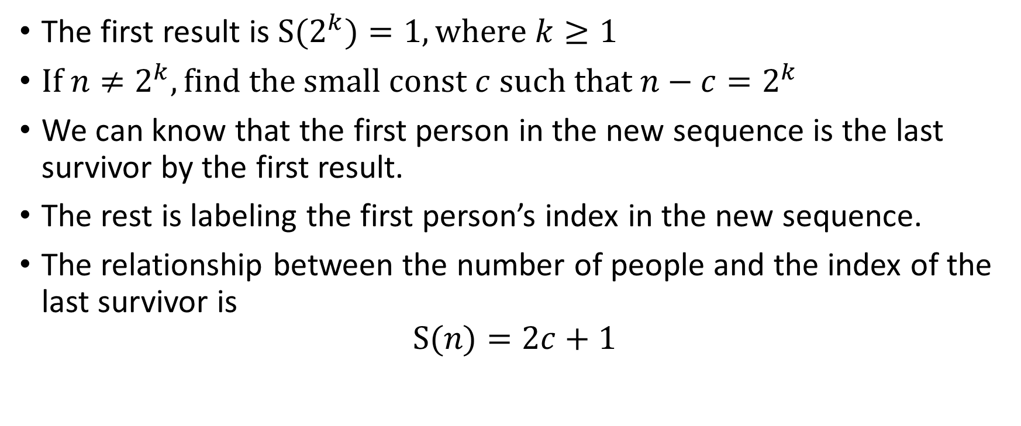
Josephus Problem
The first result is $\text{S}\text{(}2^{k}\text{)}=1, \text{where} k≥1$
$If n≠2^{k}, \text{find} \text{the} \text{small} \text{const} c \text{such} \text{that} n−c=2^{k}$
We can know that the first person in the new sequence is the last survivor by the first result.
The rest is labeling the first person’s index in the new sequence.
The relationship between the number of people and the index of the last survivor is
$$\text{S}\text{(}n\text{)}=2c+1$$

Slide 14
Josephus Problem
n= | 1 | 2 | 3 | 4 | 5 | 6 | 7 | 8 | 9 | 10 | 11 | 12
c | 0 | 0 | 1 | 0 | 1 | 2 | 3 | 0 | 1 | 2 | 3 | 4
2c+1 | 1 | 1 | 3 | 1 | 3 | 5 | 7 | 1 | 3 | 5 | 7 | 9
S(n) | 1 | 1 | 3 | 1 | 3 | 5 | 7 | 1 | 3 | 5 | 7 | 9

Slide 15
Josephus Problem by bitwise operators
 | 2⁵ | 2⁴ | 2³ | 2² | 2¹ | 2⁰
n | 0 | 1 | a | b | x | y
mask | 0 | 1 | 0 | 0 | 0 | 0
n = n ^ mask | 0 | 0 | a | b | x | y
n << 1 (x2) | 0 | a | b | x | y | 0
+1 | 0 | a | b | x | y | 1
Logical XOR
p | q | p XOR q
T | T | 0
T | F | T
F | F | F

Slide 16
Josephus Problem by bitwise operators
// get the leading one in bit representation
unsigned pos = 0;
while(true)
{
if((n >> pos) == 1)
{
break;
}
pos = pos + 1;
}
unsigned mask = (1 << pos);
n = (n ^ mask) << 1;
n = n + 1;

Slide 17

Josephus Problem
Complexity of the native solver:
$$n+\frac{n}{2^{0}}+\frac{n}{2^{1}}+…+1≈2n$$
Complexity of the bitwise solver
$$log⁡(n)$$

Slide 18

Questions

