Slide 1

程式設計一

Slide 2
Time and Place
Lecture: W7W8W9 / GEN III綜三315 Online courses
Office Hour: TBA
Course Website:
https://github.com/CNOCycle/cpp_tutorial
https://eeclass.nthu.edu.tw/

Slide 3
Grading Policy
In-class Assignment: lab assignments
Homework: 5~6 6↑ no late homework.
Plagiarism not allowed
Test: midterm and final.
Grade = Lab15% + Homework 45% ↑ + Final 40%

Slide 4
Syllabus
Basic Concept of C++ Programming
Data Type
Formatted Input/Output
Operator
Branch Statement
Loop Statement
Array and String
Bit Manipulation
Function and Reference
File
Structure
Preprocessor
Exception
Debugger and Vscode

Slide 5
Class Objectives
Basics Concept of Computer Programming
C++ Basic Syntax
Algorithm Implementation in C++

Slide 6

Basics Concept of Computer Programming

Slide 7
Procedures
Inputs
Texts
Procedures
Step1
Outputs
Correctness
Numbers
Step2

Slide 8
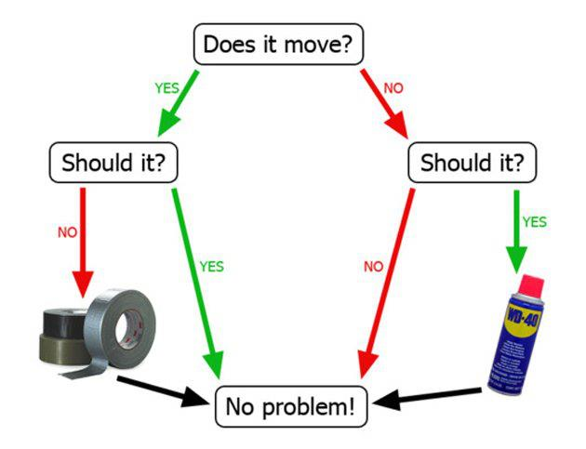
Procedures

Slide 9
Algorithms
Q: calculate sum of integers from 1 to 5.
✔ Input: [1, 2, 3, 4, 5] (integers)
❌ Input: [1.0, 2.0, 3.0, 4.0, 5.0] (real numbers)
✔ Procedures: 1 + 2 + 3 + 4 + 5 = 15
✔ Procedures: (1 + 5) * 5 / 2 = 15

Slide 10

Basic Concepts of C++

Slide 11
Translation
Source code: human readable instructions
Executables: machine readable files
Compiler: translate from source codes into executables
Source code
test.cpp
Compiler
g++
Outputs
a.out

Slide 12
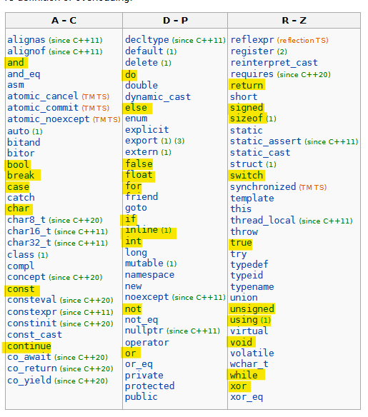
C++ keyword
https://en.cppreference.com/w/cpp/keyword

Slide 13
C++ Identifiers
Identifier: an arbitrarily long sequence of digits, underscores, lowercase and uppercase.
Rules:
The first character must be a non-digit character.
Cannot be C++ keyword
case-sensitive
Should be meaningful or mnemonic
✔a_plus_b, get_cost, get_elapsed_time
❌52ab, a+b, if, while
https://en.cppreference.com/w/cpp/language/identifiers

Slide 14
Function
Q: calculate sum of integers from 1 to 5.
inputs
a = 1
function
(a+b)*n/2
Outputs
result = 15
n = b-a+1
b = 5

Slide 15
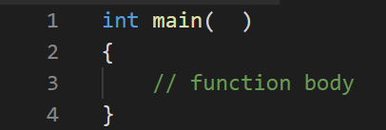
The main function
A C++ program must contain one and only one function named main.
int -> type of returned value
main -> function name
() -> argument (empty)
https://en.cppreference.com/w/cpp/language/main_function

Slide 16
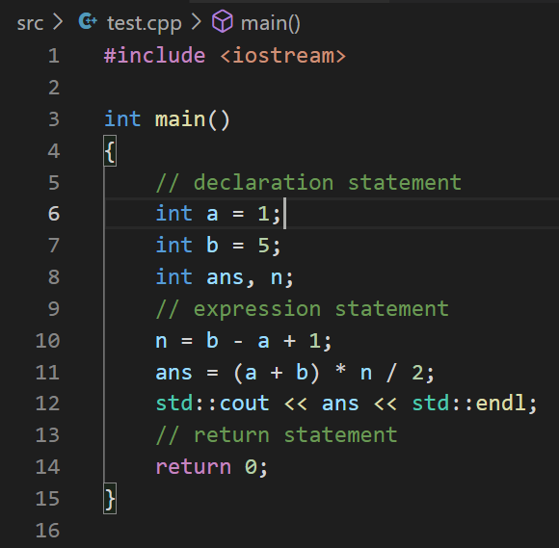
Statements
Statements are fragments of the C++ program that are executed in sequence.
Rules:
An expression followed by a semicolon is a statement.
https://en.cppreference.com/w/cpp/language/statements

Slide 17
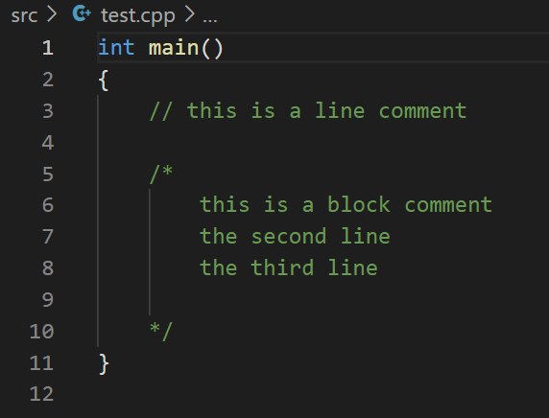
Comment
Line comment
Block comment

Slide 18
Preprocessor
The preprocessor is executed before the compilation.
#include -> includes other file into current source file.
https://en.cppreference.com/w/cpp/preprocessor
https://en.cppreference.com/w/cpp/preprocessor/include

Slide 19
Input and Output Library
<iostream> -> is part of the Input/output library.
std::cout -> writes to the standard C output stream stdout.
std::endl -> insert a newline character.
https://en.cppreference.com/w/cpp/header/iostream

Slide 20
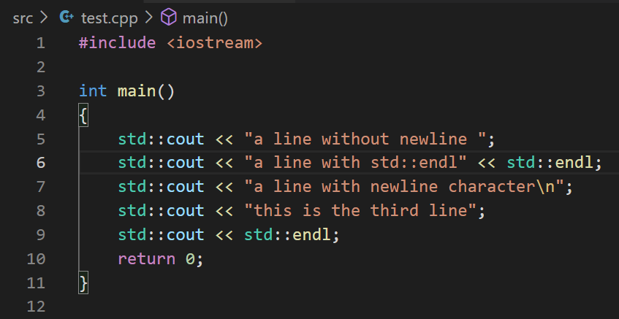

Input and Output Library

Slide 21
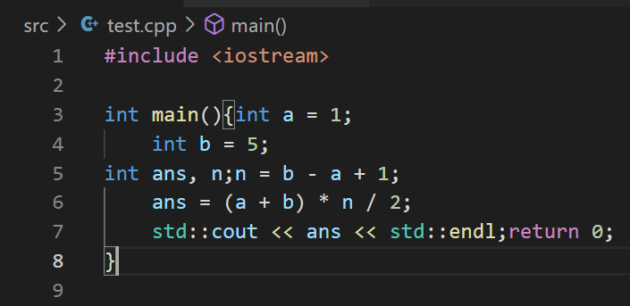
Coding Style

Slide 22

Questions

