Slide 1

Lab 4: GoogleTest
C++ test framework

Slide 2
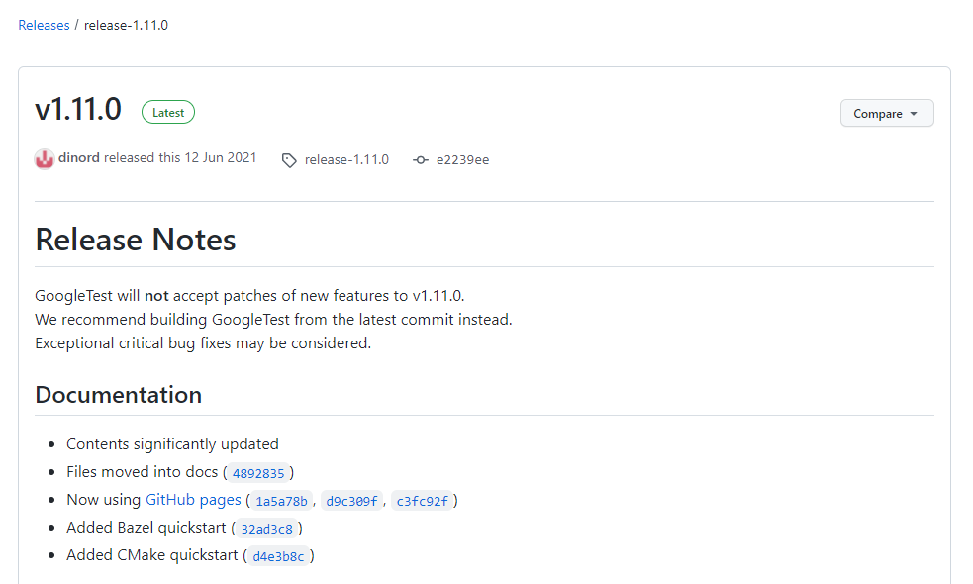
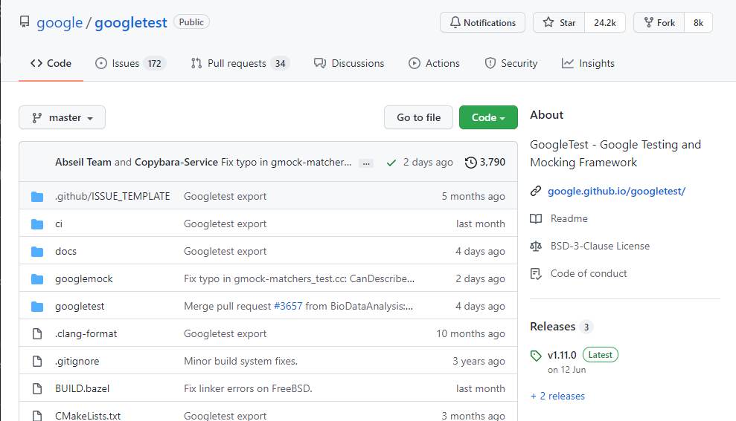
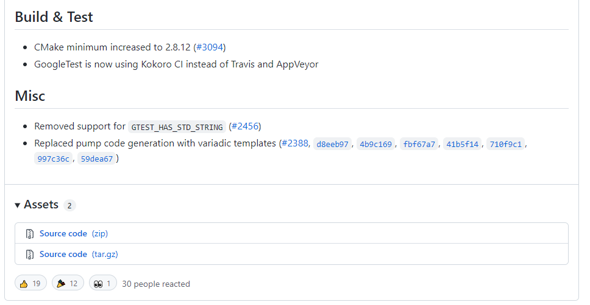
INSTALL googletest
https://github.com/google/googletest

Slide 3
INSTALL Googletest
Install instructions on Linux
sudo apt update
sudo apt install -y cmake
cd googletest-release-1.11.0
mkdir build && cd build
cmake -DCMAKE_INSTALL_PREFIX=../../gtest ..
make -j && make install
Install instructions with MinGW on Windows
cd googletest-release-1.11.0
mkdir build
cd build
cmake -G "MinGW Makefiles" -DCMAKE_INSTALL_PREFIX=../../gtest ..
mingw32-make -j && mingw32-make -j install
https://github.com/google/googletest/blob/master/googletest/README.md

Slide 4

INSTALL GOOGLETEST On code-server
GoogleTest has been installed on code-server
All files can be found in the folder `/shared/`

Slide 5
Add makefile
gtest_main.o: gtest_main.cpp
g++ -I/shared/include/ -c -o $@ $<
01-simple.o: 01-simple.cpp 01-simple.h
g++ -g -I/shared/include/ -c -o $@ $<
01-test_assert.o: 01-test_assert.cpp 01-simple.h
g++ -g -I/shared/include/ -c -o $@ $<
01-test_assert: gtest_main.o 01-simple.o 01-test_assert.o
g++ -L/shared/lib -o $@ $^ -lgtest -lpthread
clean:
rm -rf *.o *.out
.PHONY: clean

Slide 6
Add launch.json
Use default configurations.
You can copy the file from `cpp_tutorial/lab02/.vscode/launch.json`

Slide 7
Add tasks.json
{
"tasks": [
{
"type": "shell",
"label": "C/C++: g++ build active file",
"command": "make",
"args": [
"${fileBasenameNoExtension}"
],
"options": {
"cwd": "${fileDirname}"
},
"problemMatcher": [
"$gcc"
],
"group": {
"kind": "build",
"isDefault": true
},
"detail": "Task generated by Debugger."
}
],
"version": "2.0.0"
}

Slide 8
Add c_cpp_properties.json
{
"configurations": [
{
"name": "Linux",
"includePath": [
"${workspaceFolder}/**",
"/shared/include/"
],
"defines": [],
"compilerPath": "/usr/bin/gcc",
"cStandard": "gnu17",
"cppStandard": "gnu++14",
"intelliSenseMode": "linux-gcc-x64"
}
],
"version": 4
}

Slide 9
Basic concept - Assertion
ASSERT will abort the testing and generate a fatal failure when an error is detected
ASSERT_TRUE
ASSERT_FALSE
ASSERT_EQ
ASSERT_NE
ASSERT_LT
ASSERT_LE
ASSERT_GT
ASSERT_GE
ASSERT_STREQ
ASSERT_STRNE
ASSERT_STRCASEEQ
ASSERT_STRCASENE
ASSERT_FLOAT_EQ
ASSERT_DOUBLE_EQ
ASSERT_NEAR
https://github.com/google/googletest/blob/master/docs/reference/assertions.md

Slide 10
Basic concept - Except
EXPECT will continue the testing and generate non-fatal failures when errors are detected
EXPECT_TRUE
EXPECT_FALSE
EXPECT_EQ
EXPECT_NE
EXPECT_LT
EXPECT_LE
EXPECT_GT
EXPECT_GE
EXPECT_STREQ
EXPECT_STRNE
EXPECT_STRCASEEQ
EXPECT_STRCASENE
EXPECT_FLOAT_EQ
EXPECT_DOUBLE_EQ
EXPECT_NEAR
https://github.com/google/googletest/blob/master/docs/reference/assertions.md

Slide 11
Application – sorting algorithm
Generate an unsorted vector
Sort the vector with a verified algorithm
Get the sorted vector with our algorithm
Verify two sorted vectors are identical

Slide 12
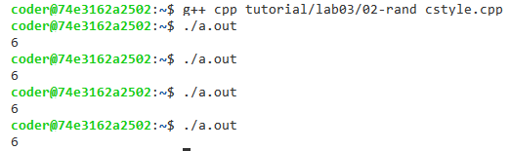
Random Generator – C-style
int main()
{
// return a random integer between 0 and RAND_MAX inclusive.
int r = std::rand();
// get a random value between [a, b]
int a = 5;
int b = 10;
int s = (r % (b - a + 1)) + a;
std::cout << s << "\n";
return 0;
}

Slide 13
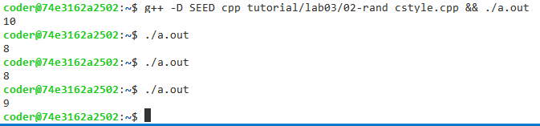
Random Generator – C-style
#ifdef SEED
// initialize random seed by system time
srand (time(NULL));
#endif
The seed is like a random table. The initialization with different seeds will generate different random tables.
https://www.cplusplus.com/reference/cstdlib/srand/

Slide 14
Common Pitfalls
// return a random integer between 0 and RAND_MAX inclusive.
int r = std::rand();
// get a random value between [a, b]
int a = 10;
int b = 14;
int s = (r % (b - a + 1)) + a;
Let RAND_MAX = 12
Let RAND_MAX = 12
Bucket = int(12 / 5) = 2
s | 10 | 11 | 12 | 13 | 14
r | 0 | 1 | 2 | 3 | 4
 | 5 | 6 | 7 | 8 | 9
 | 10 | 11
s | 10 | 11 | 12 | 13 | 14
r | 0 | 1 | 2 | 3 | 4
 | 5 | 6 | 7 | 8 | 9
 | 10 (reject) | 11 (reject)
The purpose of the bucket is to make a uniform distribution between [10, 14]. Therefore, r will be discarded when r is equal to 10 or 11.

Slide 15
Random Generator in C++
Uniform distributions
Bernoulli distributions
Poisson distributions
Normal distributions
Sampling distributions
https://en.cppreference.com/w/cpp/header/random

Slide 16

Random Generator in C++
#include <random>
#include <iostream>
int main()
{
std::random_device rd;
std::mt19937 gen(rd());
std::uniform_int_distribution<> distrib(1, 6);
for (int n=0; n<10; ++n)
{
std::cout << distrib(gen) << ' ';
}
std::cout << '\n';
return 0;
}
random number generator
https://en.cppreference.com/w/cpp/numeric/random/uniform_int_distribution

