Slide 1

Lab 2: Spdlog
Fast C++ logging library

Slide 2
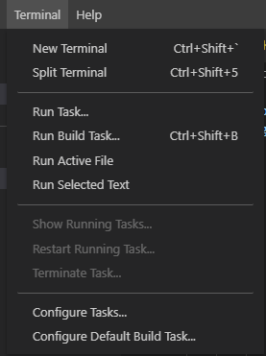
Build source code by task.json
{
"version": "2.0.0",
"tasks": [
{
"type": "cppbuild",
"label": "C/C++: g++ build active file",
"command": "/usr/bin/g++",
"args": [
"-g",
"${file}",
"-o",
"${workspaceFolder}/a.out"
],
"options": {
"cwd": "${fileDirname}"
},
"problemMatcher": [
"$gcc"
],
"group": "build",
"detail": "compiler: /usr/bin/g++"
}
]
}

Slide 3

The failures of iomanip
#include <iostream>
#include <iomanip>
int main()
{
// setprecision
double b = 15.12;
std::cout << std::scientific << b << std::endl;
std::cout << b << std::endl;
std::cout << std::fixed << b << std::endl;
return 0;
}
Forget to reset the flag.

Slide 4
Format String Syntax
replacement_field ::= "{" [arg_id] [":" format_spec] "}"
"First, thou shalt count to {0}" // References the first argument
"Bring me a {}" // Implicitly references the first argument
"From {} to {}" // Same as "From {0} to {1}"
https://fmt.dev/latest/syntax.html

Slide 5
Format String Syntax
format_spec ::= [[fill]align][sign]["#"]["0"][width]["." precision]["L"][type]
fill ::= <a character other than '{' or '}’>
align ::= "<" | ">" | "^"
sign ::= "+" | "-" | " "
width ::= integer | "{" [arg_id] "}"
precision ::= integer | "{" [arg_id] "}"
type ::= "a" | "A" | "b" | "B" | "c" | "d" | "e" | "E" | "f" | "F" | "g" | "G"
| "o" | "p" | "s" | "x" | "X"

Slide 6

Type Reference
Type | Meaning
'c' | Character format. Outputs the number as a character.
'd' | Decimal integer. Outputs the number in base 10.
'f' | Fixed point. Displays the number as a fixed-point number.
'F' | Fixed point. Same as 'f', but converts nan to NAN and inf to INF.
'e' | Exponent notation. Prints the number in scientific notation using the letter ‘e’ to indicate the exponent.
'E' | Exponent notation. Same as 'e' except it uses an upper-case 'E' as the separator character.

Slide 7

Format String Syntax
#include <iostream>
#include "spdlog/spdlog.h"
int main()
{
double a = 21.456;
double b = 13.3;
spdlog::info("Hello, {}!", "World");
spdlog::info("|0123456789|0123456789|0123456789|");
spdlog::info("|{0:0>10.2f}|{1:*^10.2f}|{0:-<10.2f}|", a, b);
return 0;
}

Slide 8
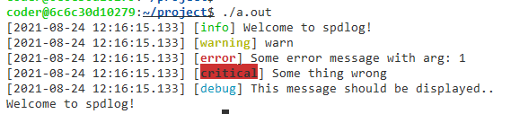
Logging level
#include "spdlog/spdlog.h"
int main()
{ // spdlog level
spdlog::trace("trace level");
spdlog::debug("debug level");
spdlog::info("Welcome to spdlog!");
spdlog::warn("warn");
spdlog::error("Some error message with arg: {}", 1);
spdlog::critical("Some thing wrong");
// Set global log level to debug
spdlog::set_level(spdlog::level::debug);
spdlog::trace("trace level");
spdlog::debug("This message should be displayed..");
// change log pattern
spdlog::set_pattern("%v");
spdlog::info("Welcome to spdlog!");
return 0;
}

Slide 9
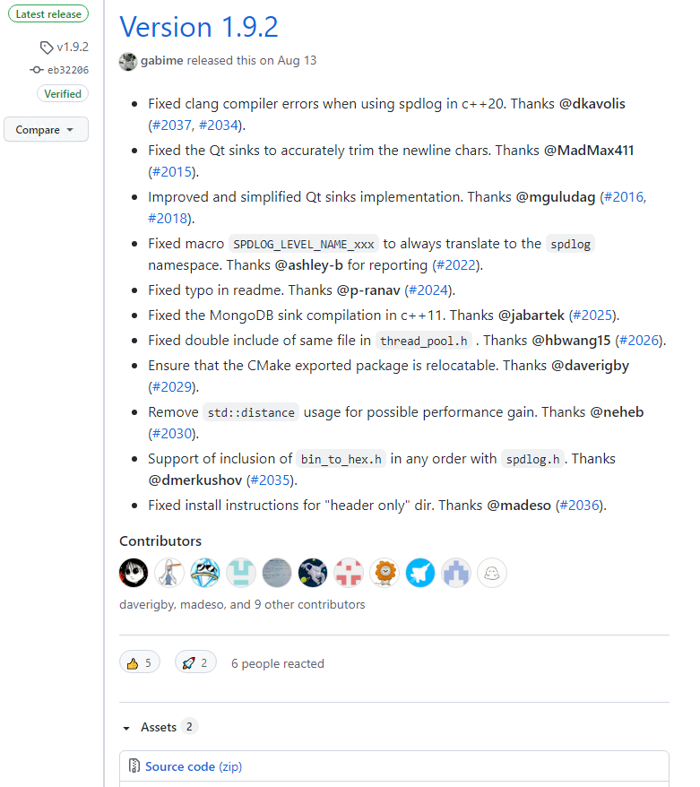
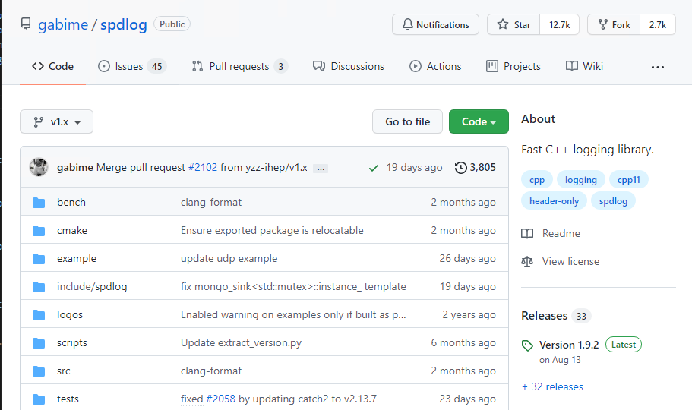
INSTALL SPDLOG
https://github.com/gabime/spdlog

Slide 10
INSTALL SPDLOG
{
"version": "2.0.0",
"tasks": [
{
"type": "cppbuild",
"label": "C/C++: g++ build active file",
"command": "/usr/bin/g++",
"args": [
"-g",
"-I{SPD_PATH}/spdlog/include",
"${file}",
"-o",
"${workspaceFolder}/a.out“,
"-L{SPD_PATH}/spdlog/lib",
“-lspdlog",
],
"options": {
"cwd": "${fileDirname}"
},
"problemMatcher": [
"$gcc"
],
"group": "build",
"detail": "compiler: /usr/bin/g++"
}
]
}
sudo apt update
sudo apt install -y cmake
cd spdlog
mkdir build && cd build
cmake .. && make –j
cd ..
mkdir ../lib
mv libspdlog.a ../lib/
mkdir build
cd build
cmake -G "MinGW Makefiles" ..
mingw32-make -j
cd ..
mkdir lib
mv build/libspdlog.a lib

Slide 11
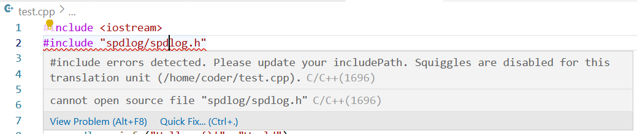
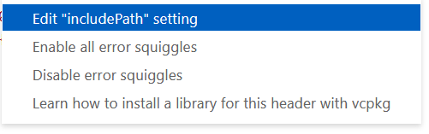
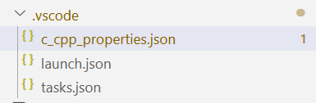
Add c_cpp_properties.json

Slide 12
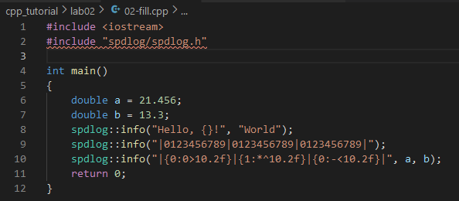
Add c_cpp_properties.json
{
"configurations": [
{
"name": "Linux",
"includePath": [
"-I{SPD_PATH}/spdlog/include/"
],
"defines": [],
"compilerPath": "/usr/bin/g++",
"cStandard": "gnu17",
"cppStandard": "gnu++14",
"intelliSenseMode": "linux-gcc-x64"
}
],
"version": 4
}

Slide 13
c++ compilation process
#include <iostream>
#include "spdlog/spdlog.h"
Header *.h
Source
*.cpp
Preprocessor
"args": [
"-g",
"-I{SPD_PATH}/spdlog/include",
"-L{SPD_PATH}/spdlog/lib",
"${file}",
"-o",
"${workspaceFolder}/a.out“
“-lspdlog",
],

Slide 14

c++ compilation process
Object
*.o
Library
*.a, *.so
Linker
"args": [
"-g",
"-I{SPD_PATH}/spdlog/include",
"-L{SPD_PATH}/spdlog/lib",
"${file}",
"-o",
"${workspaceFolder}/a.out“
“-lspdlog",
],

Slide 15
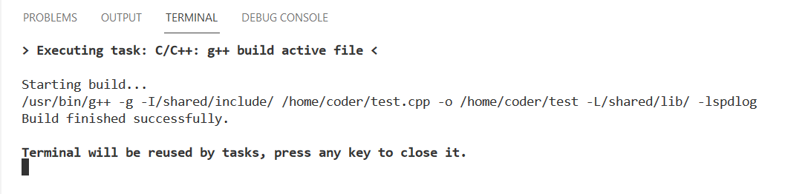
c++ compilation process

Slide 16
Code-server
sudo apt update
sudo apt install -y cmake
wget https://github.com/gabime/spdlog/archive/refs/tags/v1.9.2.tar.gz
tar xvf v1.9.2.tar.gz
cd spdlog-1.9.2
mkdir build && cd build
cmake .. && make
mkdir lib
mv libspdlog.a ../lib/

