Slide 1
程式設計一
Branch Statement

Slide 2
Flow of Execution
Start
Start
Start
statement1
condition
Stop=True
condition
statement2
False
True
Stop=False
statement A
Statement B
statement1
statement3
End
End
End

Slide 3
Selection: One-Way if
Start
Start
Start
statement1
con_A
con_B
statement2
False
True
False
True
Statement B
Statement B
statement3
End
End
End

Slide 4
Selection: Two-Way if
Start
Start
Start
statement1
con_A
condition
statement2
False
True
False
True
Statement B
statement A
Statement B
statement3
End
End
End

Slide 5
Formal Syntax
/* one-way if */
bool cond;
if(cond) // NOTE: no semicolon here
{
// statement }
/* two-way if */
bool cond;
if(cond) // NOTE: no semicolon here
{
// statement }
else
{
// statement
}

Slide 6
Formal Syntax
/* one-way if */
bool cond;
if(cond) // NOTE: no semicolon here
{
// statement }
/* get absolute value */
double a;
if(a < 0)
{
a = -a; }
/* pass of failed */
double score;
if(score < 60)
{
std::cout << "Fail" << std::endl; }

Slide 7
Formal Syntax
/* two-way if */
bool cond;
if(cond) // NOTE: no semicolon here
{
// statement }
else
{
// statement
}
/* pass of failed */
double score;
if(score < 60)
{
std::cout << "Fail" << std::endl; }
else
{
std::cout << "Pass" << std::endl;
}

Slide 8
Formal Syntax
/* one-way if */
bool cond;
if(!cond)
{
// statement }
/* two-way if */
bool cond;
if(cond)
{
// do not thing }
else
{
// statement
}
Start
con_B
False
True
bool cond;
if(cond == false)
{
// statement }
Statement B
End

Slide 9
Compound Statement
if ( condition ) statement
if ( condition ) statement else statement
Compound statements or blocks are brace-enclosed sequences of statements.
{ statement...(optional) }
https://en.cppreference.com/w/cpp/language/statements#Compound_statements
https://en.cppreference.com/w/cpp/language/if

Slide 10
Compound Statement
if(true)
int i = 1;
// i is not longer in scope
if(true)
{
int i = 1;
}
// i is not longer in scope
if(true)
int i = 1;
std::cout << “i " << i << std::endl;
if(true)
{
int i = 1;
std::cout << “i " << i << std::endl;
}
if(true)
int i = 1;
std::cout << “i " << i << std::endl;
if(true)
{
int i = 1;
}
std::cout << “i " << i << std::endl;
Lab

Slide 11
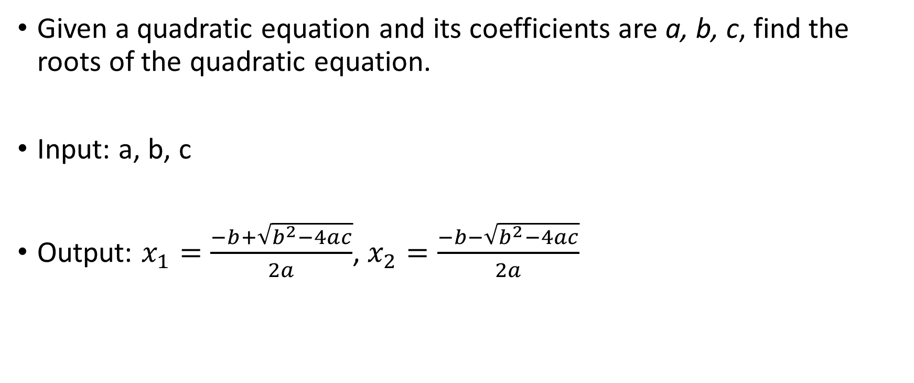
Roots of Quadratic Equation
Given a quadratic equation and its coefficients are a, b, c, find the roots of the quadratic equation.
Input: a, b, c
Output: $x_{1}=\frac{−b+\sqrt{b^{2}−4ac}}{2a}$, $x_{2}=\frac{−b−\sqrt{b^{2}−4ac}}{2a}$

Slide 12
Roots of Quadratic Equation
float a = 1;
float b = -1000;
float c = 1;
float s;
s = b * b - 4 * a * c;
s = sqrt(s);
float x1, x2;
x1 = (-b + s) / (2 * a);
x2 = (-b - s) / (2 * a);
if(x1 > x2)
{
std::cout << "case for x1 > x2 \n";
std::cout << "x1:" << x1 << std::endl;
std::cout << "x2:" << x2 << std::endl;
}
else
{
std::cout << "case for x2 > x1 \n";
std::cout << "x1:" << x2 << std::endl;
std::cout << "x2:" << x1 << std::endl;
}

Slide 13
Roots of Quadratic Equation(Nested if)
if(a == 0.0)
{
std::cout << "liner equation\n";
std::cout << "x: " << - b / c << "\n";
}
else
{
/* statement ... */ if (x1 > x2)
{
// statement ...
}
else
{
// statement ...
}
}
float a = 0;
float b = -1000;
float c = 1;
float s;
s = b * b - 4 * a * c;
s = sqrt(s);
float x1, x2;
x1 = (-b + s) / (2 * a);
x2 = (-b - s) / (2 * a);

Slide 14
Roots of Quadratic Equation(if Chain)
if(s < 0)
{
s = sqrt(-s);
float x_real, x_imag;
x_real = -b / (2 * a);
x_imag = s / (2 * a);
}
else if (s == 0)
{
float x;
x = -b / (2 * a);
}
else
{
float x1, x2;
s = sqrt(s);
x1 = (-b + s) / (2 * a);
x2 = (-b - s) / (2 * a);
}
if(s < 0)
{
s = sqrt(-s);
float x_real, x_imag;
x_real = -b / (2 * a);
x_imag = s / (2 * a);
}
if (s == 0)
{
float x;
x = -b / (2 * a);
}
if (s > 0)
{
float x1, x2;
s = sqrt(s);
x1 = (-b + s) / (2 * a);
x2 = (-b - s) / (2 * a);
}

Slide 15
if Chain or Multiple if
float score = 90;
char grad;
if (score <= 60)
{grad='F';}
if (score >= 60)
{grad='C';}
if (score >= 70)
{grad='B';}
if (score >= 80)
{grad='A';}
std::cout << grad;
std::cout << std::endl;
float score = 90;
char grad;
if (score >= 80)
{grad='A';}
if (score >= 70)
{grad='B';}
if (score >= 60)
{grad='C';}
if (score <= 60)
{grad='F';}
std::cout << grad;
std::cout << std::endl;
float score = 90;
char grad;
if (score >= 80)
{grad='A';}
else if (score >= 70)
{grad='B';}
else if (score >= 60)
{grad='C';}
else
{grad='F';}
std::cout << grad;
std::cout << std::endl;

Slide 16
Switch and if-else-if
int month;
std::cout << "please enter month: ";
std::cin >> month;
if (month == 1)
{std::cout << "Jan\n";}
else if (month == 2)
{std::cout << "Feb\n";}
else
{std::cout << "...\n";}
switch (month)
{
case 1:
std::cout << "Jan\n";
break;
case 2:
std::cout << "Feb\n";
break;
default:
std::cout << "...\n";
break;
}

Slide 17
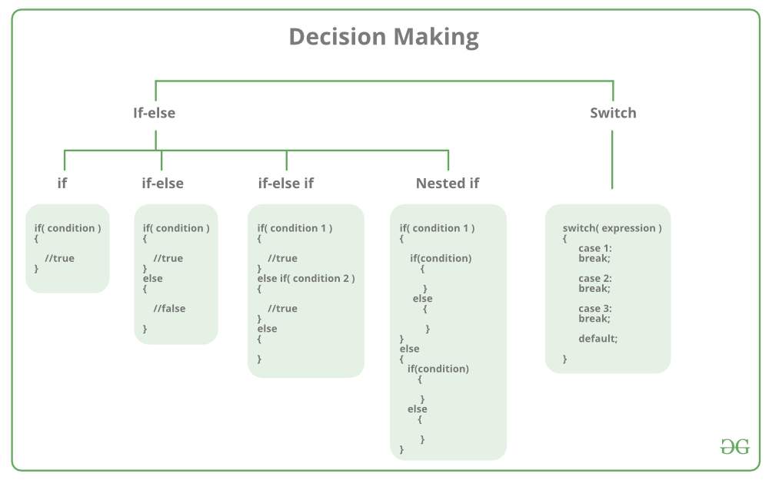
Switch
https://www.geeksforgeeks.org/decision-making-c-c-else-nested-else/

Slide 18
Common Pitfalls
Operator “=” is assignment and “==” is comparison of equality.
int a = 20;
if(a = 30)
{
std::cout << "a = 20(?)\n";
}
else
{
std::cout << "a != 20 (?)\n";
}
std::cout << a << "\n";
int a = 20;
if(a == 30)
{
std::cout << "a = 20\n";
}
else
{
std::cout << "a != 20\n";
}
std::cout << a << "\n";

Slide 19
Common Pitfalls
Forgetting break on switch.
switch (month)
{
case 1:
std::cout << "Jan\n";
break;
case 2:
std::cout << "Feb\n";
break;
default:
std::cout << "...\n";
break;
}
switch (month)
{
case 1:
std::cout << "Jan\n";
//break;
case 2:
std::cout << "Feb\n";
break;
default:
std::cout << "...\n";
break;
}

Slide 20

Questions

