Slide 1
程式設計一
Basic Data type

Slide 2
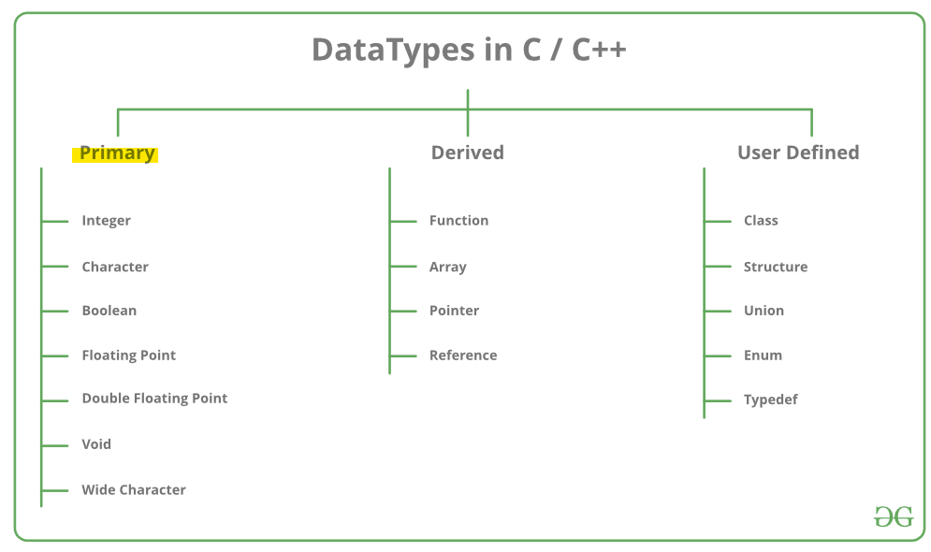
https://www.geeksforgeeks.org/c-data-types/

Slide 3
Primitive Built-in Types
Boolean (case-sensitive)
true / false
Character
‘a’, ‘b’, ‘c’, ‘1’, ‘2’, ‘3’
Integer
-3, -2, -1, 0, 1, 2, 3
Floating point/ Double floating point (real numbers)
-3.0, -2.5, -0.5, 0.0, 1.0, 100.5

Slide 4
C++ Variables
C++ requires you to declare all variables before you use them.
The normal syntax:
<type> <identifier> = {<initializer>};
Operations:
+, - *, / , > , >>, <, <<
Assignment:
L_value − refer to a memory location.
R_value − refers to a data value that is stored at some address in memory.
L_value (variable) = R_value (expression);
✔ a = 10;
❌ 10 = 20;
https://en.cppreference.com/book/intro/variables

Slide 5
Primitive Built-in Types
Type | Keyword
Boolean | bool
Character | char
Integer | int
Floating point | float
Double floating point | double
Valueless | void
Wide character | wchar_t

Slide 6
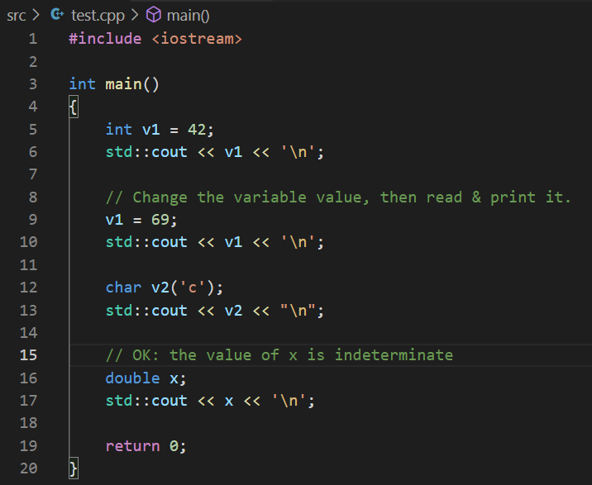
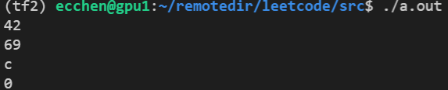
C++ Variables
https://en.cppreference.com/w/cpp/language/initialization
https://en.cppreference.com/w/cpp/language/default_initialization

Slide 7
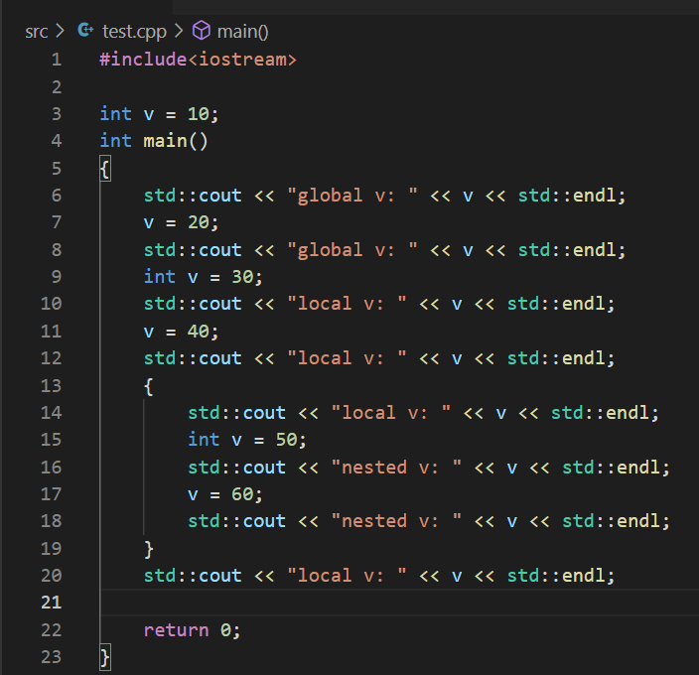
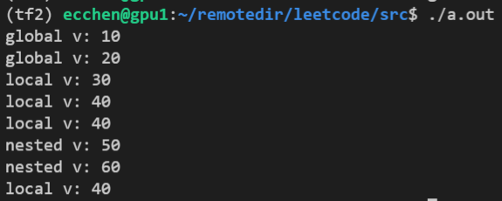
Variable Scope

Slide 8
Literals and Constants
Literals refer to fixed values which cannot be changed in programs.
Examples:
(bool) true, false
(char) ‘a’, ‘b’, ‘c’
(int) 1, 2, 3
(float, double) 3.0, 2.0
Or
const <type> <identifier> = {<initializer>};
✔ const int a = 10;

Slide 9
Escape sequences
Escape sequence | Description
Simple escape sequences
\' | single quote
\" | double quote
\? | question mark
\\ | backslash
\a | audible bell
\b | backspace
\f | form feed - new page
\n | line feed - new line
\r | carriage return
\t | horizontal tab
\v | vertical tab
✔
✔
✔
✔
https://en.cppreference.com/w/cpp/language/escape

Slide 10
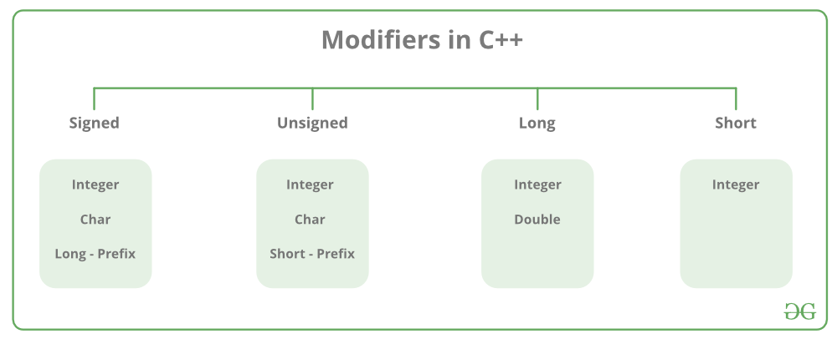
https://www.geeksforgeeks.org/c-data-types/

Slide 11
Type | Size in bytes | Format | Value range (Approximate)
character | 1 | signed | -128 to 127
 |  | unsigned | 0 to 255
 | 2 | UTF-16 | 0 to 65535
 | 4 | UTF-32 | 0 to 1114111 (0x10ffff)
integer | 2 | signed | -32768 to 32767
 |  | unsigned | 0 to 65535
 | 4 | signed | -2,147,483,648 to 2,147,483,647
 |  | unsigned | 0 to 4,294,967,295
 | 8 | signed | ± 9.22 · 10¹⁸
 |  | unsigned | 0 to 1.84 · 10¹⁹
binary floating point | 4 | IEEE-754 | min subnormal: ± 1.401,298,4 · 10⁻⁴⁵ min normal: ± 1.175,494,3 · 10⁻³⁸ max: ± 3.402,823,4 · 10³⁸
 | 8 | IEEE-754 | min subnormal: ± 4.940,656,458,412 · 10⁻³²⁴ min normal: ± 2.225,073,858,507,201,4 · 10^{-﻿308} max: ± 1.797,693,134,862,315,7 · 10³⁰⁸
https://en.cppreference.com/w/cpp/language/types

Slide 12
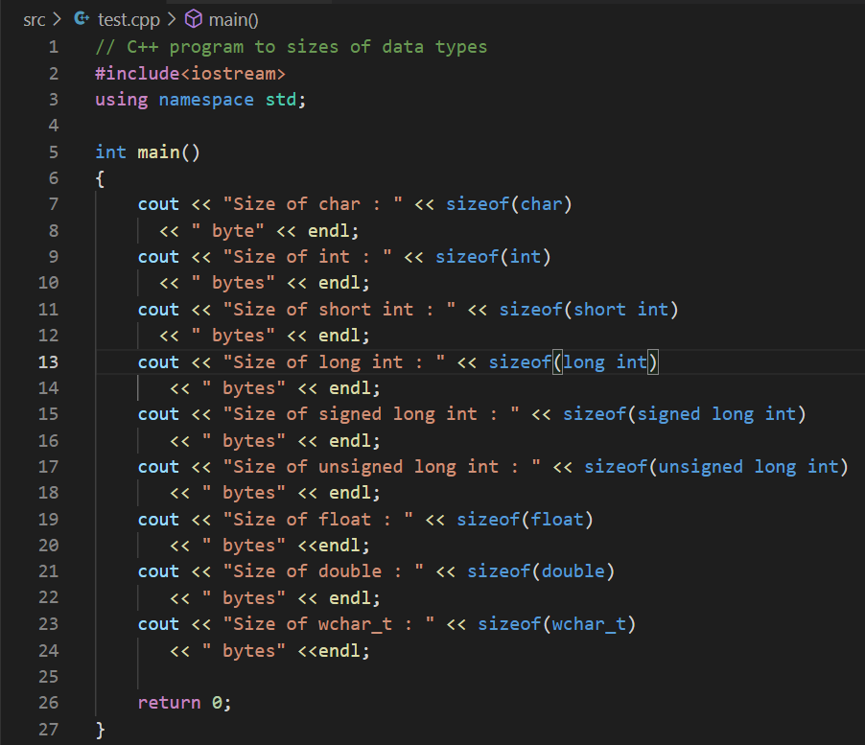
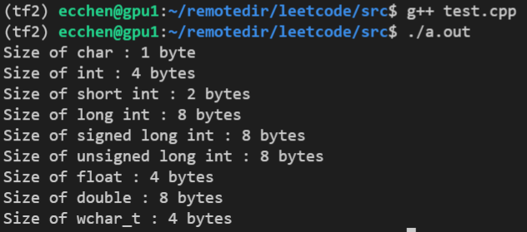
NOTE: the size of variable may depend on the complier and the machine.
https://www.geeksforgeeks.org/c-data-types/

Slide 13
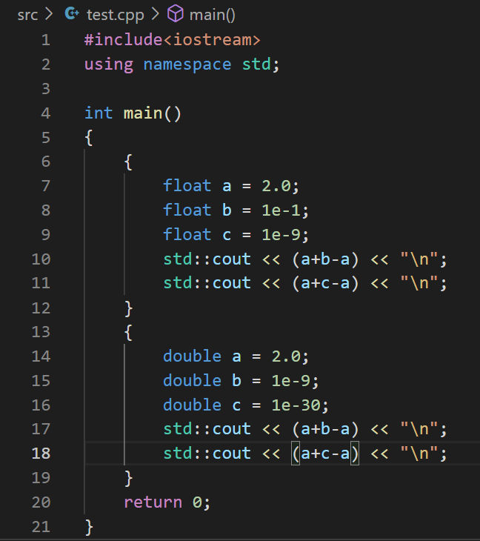
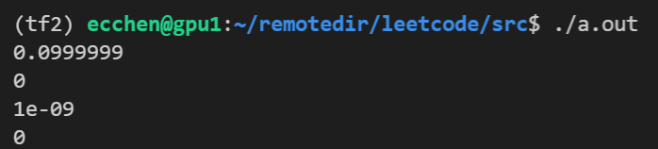
Precision

Slide 14
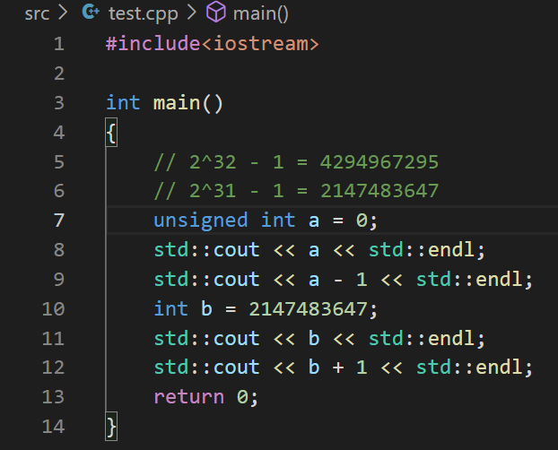
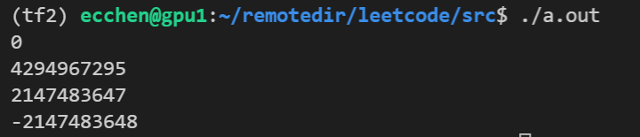
Overflow

Slide 15
Overflow
 | 2³ | 2² | 2¹ | 2⁰
 | 0 | 0 | 0 | 0
 | 0 | 0 | 0 | 1
 | 0 | 0 | 1 | 0
 | 0 | 0 | 1 | 1
 | 0 | 1 | 0 | 0
 | 0 | 1 | 0 | 1
 | 0 | 1 | 1 | 0
 | 1 | 0 | 0 | 0
 | 1 | 1 | 1 | 1
1 | 0 | 0 | 0 | 0
Val
0
1
2
3
4
5
6
8
15
0

Slide 16
Arithmetic Operators
Standard arithmetic operators
+, -, *, /, %
Unary operator: -5, +5
Binary operator: a-b, a+b
Standard priority
unary plus and minus
multiplication, division, and remainder
addition and subtraction
https://en.cppreference.com/w/cpp/language/operator_precedence

Slide 17
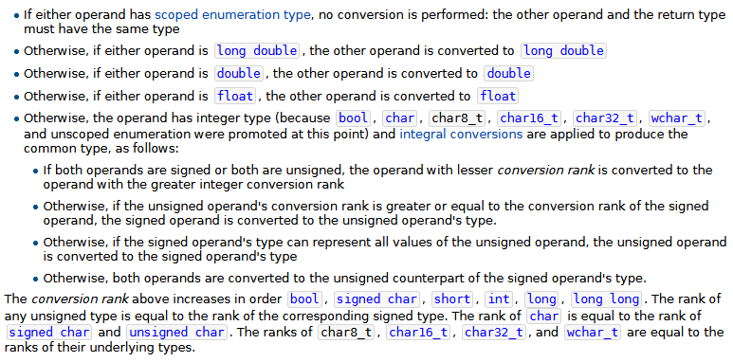
Arithmetic Operators
Q: (type 1) a + (type 2) b -> (?)
TL;DR
https://en.cppreference.com/w/cpp/language/operator_arithmetic

Slide 18
Arithmetic Operators
Q: (type 1) a + (type 2) b -> (?)
Examples:
21 / 5
21 / 5.0
21.0 / 5
21.0 / 5.0
1/3*2.0
https://en.cppreference.com/w/cpp/language/operator_arithmetic

Slide 19
Casting
complex number -> real number (?)
❌ (complex number) 2 + 5i -> (real number) ?
real number -> complex number
✔ (real number) 2 -> (complex number) 2 + 0i
Implicit casting or automatic casting
(type 1) a = (type 2) b;
Example: int <-> float

Slide 20
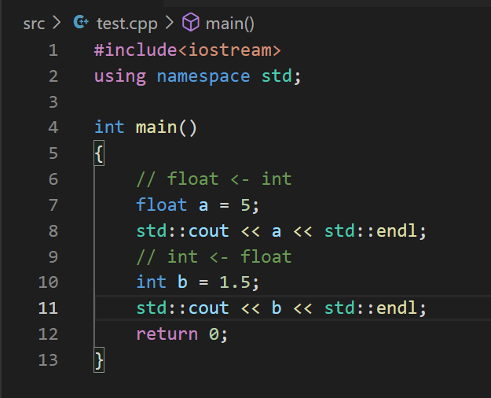

Casting

Slide 21
Explicit Casting
The normal syntax:
(type) expression;
type (expression);
static_cast<type>(expression);
double(1)/3
static_cast<double>(1)/3
https://en.cppreference.com/w/cpp/language/explicit_cast

Slide 22

Questions

