Slide 1
程式設計一
Stream & Files

Slide 2
Console Input/Output
Console input/output -> #include <iostream>
Includes <istream>
Includes <ostream>
I/O objects: cin, cout, cerr
File input/output -> #include <ftream>
Incudes <ifstream>
Includes <ofstream>

Slide 3
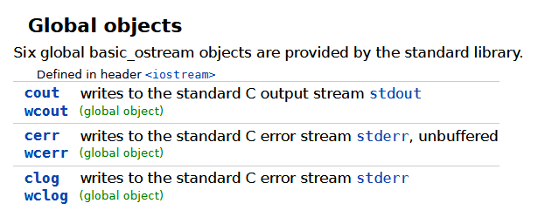
Output stream
Screen
std::cout
std::cerr
std::clog
https://en.cppreference.com/w/cpp/io/basic_ostream

Slide 4
Stream Buffer
Buffer Size
std:cout
F | i | r | s | t | \n | f | i | l | e | \n
Screen
F | i | r | s | t | \n | f | i | l | e | \n
03-iostream/01-buffer.cpp

Slide 5
Console Input
(user-friendly) using cout prompt (no newline) before every cin
Var1
Var2
Var3
std:cin
1 | 2 | 3 | ⏎ | 4 | 5 | ⏎ | 6 | 7 | 8 | ⏎

Slide 6
Get a Line From Stream into C++ String
std::getline(std::cin, var1, ' ');
std::getline(std::cin, var1, '\n');
Var1
std:cin
1 | 2 | 3 |  | 4 | 5 |  | 6 | 7 | 8 | ⏎

Slide 7
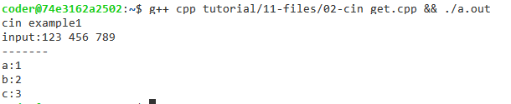
Get a character From Stream
Var1
Var2
Var3
std:cin
1 | 2 | 3 |  | 4 | 5 |  | 6 | 7 | 8 | ⏎
std::cout << "cin example1\n";
std::cout << "input:";
std::cin.get(a);
std::cin.get(b);
std::cin.get(c);
std::cout << "-------\n";
std::cout << "a:" << a << "\n";
std::cout << "b:" << b << "\n";
std::cout << "c:" << c << "\n";

Slide 8
Put a character Into Stream
#include <iostream>
#include <string>
int main()
{
std::string a = "Hello world";
for(size_t ii = 0; ii < a.size(); ii = ii + 1)
{
std::cout.put(a[ii]);
}
std::cout << "\n";
return 0;
}

Slide 9
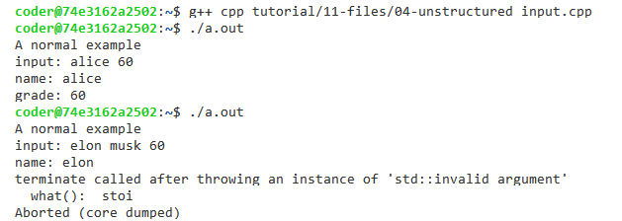
Read Unstructured Input
// input example: alice 60
// input example: elon musk 80
std::string name, grade;
std::cout << "A normal example\n";
std::cout << "input: ";
std::cin >> name >> grade;
std::cout << "name: " << name << "\n";
std::cout << "grade: " << std::stoi(grade) << "\n";

Slide 10
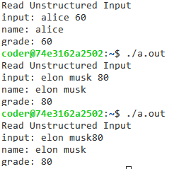
Read Unstructured Input
std::string name, grade;
std::cout << "Read Unstructured Input\n";
std::cout << "input: ";
while(true)
{
char c = std::cin.peek();
bool cond1 = (c == '\n');
bool cond2 = (c >= '0' && c <= '9');
if(cond1 || cond2)
{
break;
}
c = std::cin.get();
name = name + c;
}
std::cin >> grade;
std::cout << "name: " << name << "\n";
std::cout << "grade: " << std::stoi(grade) << "\n";

Slide 11
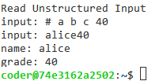
Read Unstructured Input
while(true)
{
char c = std::cin.peek();
if((c == '\n') || (c >= '0' && c <= '9'))
{
break;
}
if(c == '#')
{
int MAX_LENGTH = 80;
std::cin.ignore(MAX_LENGTH, '\n');
std::cout << "input: " << std::flush;
continue;
}
c = std::cin.get();
name = name + c;
}

Slide 12
Character Comparison
#include <cctype>
#include "spdlog/spdlog.h"
int main()
{
for(int ii = 32; ii <=126; ii = ii + 1)
{
char c = ii;
spdlog::info("char({})={:3d}|{}|{}|{}|{}",
c,
ii,
bool(isalpha(c)),
bool(isdigit(c)),
bool(isalnum(c)),
bool(isspace(c)));
}
}

Slide 13
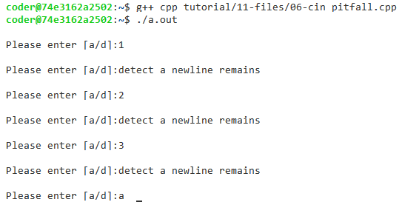
Pitfall: Leading Whitespace Issue
char c;
while(true)
{
std::cout << "\nPlease enter [a/d]:";
c = std::cin.get();
if(c == '\n')
{
std::cout << "detect a newline remains\n";
continue;
}
if(c == 'a' || c == 'd')
{
break;
}
}

Slide 14

Pitfall: Leading Whitespace Issue
#include <iostream>
#include <string>
int main()
{
char c;
std::string s;
std::cout << "read a sentence [y/n]:";
std::cin >> c;
std::cout << "next int(char) = " << int(std::cin.peek()) << "\n";
std::getline(std::cin, s);
std::cout << s.size() << "\n";
return 0;
}

Slide 15
Parse Strings with StringStream
std::string name, grade;
std::stringstream normalized_string;
std::cout << "Read Unstructured Input\n";
std::cout << "input: " << std::flush;
while(!std::cin.eof())
{
char c = std::cin.peek();
// parse string ...
}
while(normalized_string >> name >> grade)
{
std::cout << "name: " << name << ", grade: " << grade << "\n";
}

Slide 16
Newline (End of line, EOL) Issue
Operating system | Character encoding | Abbreviation | Escape sequence
Unix and Unix-like systems | ASCII | LF | \n
Microsoft Windows, DOS |  | CR LF | \r\n
the classic Mac OS |  | CR | \r
IBM mainframe systems, including z/OS | EBCDIC | NL | \025
https://en.wikipedia.org/wiki/Newline
https://stackoverflow.com/questions/2613800/how-to-convert-dos-windows-newline-crlf-to-unix-newline-lf-in-a-bash-script

Slide 17
File I/O
File input/output -> #include <ftream>
Incudes <ifstream>
Includes <ofstream>

Slide 18
Open a File
Constant | Explanation
in | open for reading
out | open for writing
app | seek to the end of stream before each write
ate | seek to the end of stream immediately after open
binary | open in binary mode
trunc | discard the contents of the stream when opening

Slide 19
Read Data From a File
#include <iostream>
#include <fstream>
#include <string>
int main()
{
std::ifstream f;
f.open("cpp_tutorial/11-files/example1.csv");
while(!f.eof())
{
std::string line;
std::getline(f, line);
std::cout << line << "\n";
}
f.close();
return 0;
}

Slide 20
Write Data to a File
std::vector<std::string> vec_filename = {"cpp_tutorial/11-files/example1.csv",
"cpp_tutorial/11-files/example2.csv"};
std::ofstream of;
for(s size_t ii = 0; ii < vec_filename.size(); ii = ii + 1)
{
of.open("outfile.txt", std::ios::app);
std::ifstream f;
f.open(vec_filename[ii]);
while(!f.eof())
{
std::string line;
std::getline(f, line);
of << line << "\n";
}
f.close();
of.close();
}

Slide 21
Check File’s State
good -> returns true if the most recent I/O operation on the stream completed successfully.
eof -> returns true if the associated stream has reached end-of-file.
fail -> returns true if an error has occurred on the associated stream.
bad -> returns true if non-recoverable error has occurred on the associated stream.
https://en.cppreference.com/w/cpp/io/basic_ios/good
https://en.cppreference.com/w/cpp/io/basic_ios/eof
https://en.cppreference.com/w/cpp/io/basic_ios/fail
https://en.cppreference.com/w/cpp/io/basic_ios/bad

Slide 22
Check File’s State
ios_base::iostate flags |  |  | basic_ios accessors
eofbit | failbit | badbit | good() | fail() | bad() | eof() | operator bool | operator!
false | false | false | true | false | false | false | true | false
false | false | true | false | true | true | false | false | true
false | true | false | false | true | false | false | false | true
false | true | true | false | true | true | false | false | true
true | false | false | false | false | false | true | true | false
true | false | true | false | true | true | true | false | true
true | true | false | false | true | false | true | false | true
true | true | true | false | true | true | true | false | true
https://en.cppreference.com/w/cpp/io/ios_base/iostate

Slide 23
if(!f.good())
{
std::cout << "Cannot find file: " << vec_filename[ii] << "\n";
}
else
{
while(!f.eof())
{
int val;
f >> val;
if(f.fail())
{
std::cout << "Non-integer data encountered\n";
f.clear();
std::string s;
f >> s;
}
else
{
std::cout << val << "\n";
}
}
}
https://en.cppreference.com/w/cpp/io/basic_ios/good

Slide 24
Random File Access
tell[g/p]() -> returns the input/output position indicator.
seek[g/p](offset, dir) -> sets the input/output position indicator
offset -> relative position (positive or negative) to set the input position indicator to.
dir -> defines base position to apply the relative offset to.
Constant | Explanation
beg | the beginning of a stream
end | the ending of a stream
cur | the current position of stream position indicator
https://en.cppreference.com/w/cpp/io/basic_istream/tellg
https://en.cppreference.com/w/cpp/io/basic_istream/seekg

Slide 25
Random File Access
std::ifstream f;
f.open("cpp_tutorial/11-stream_file/example3.csv");
// move the pointer to the end of file and get the length of the file
f.seekg(0, std::ios::end);
long unsigned file_length = f.tellg();
long unsigned LINE_LENG = 4;
// missing a newline at the end of file
long unsigned num_rows = (file_length + 1) / LINE_LENG;
std::cout << "num_rows:" << num_rows << "\n";
// move the opinter to the 4th row
f.seekg(3 * LINE_LENG, std::ios::beg);
int v;
f >> v;
std::cout << v << "\n";
f.close();

Slide 26
Binary File
f.open("outfile.bin", std::ios::out | std::ios::binary);
for (int n = 0; n < NUM_VEC; n = n + 1)
{
double val = distrib(gen);
f.write(reinterpret_cast<char *>(&val), sizeof(val));
}
f.flush();
f.close();
f.open("outfile.bin", std::ios::in | std::ios::binary);
for (int n = 0; n < NUM_VEC; n = n + 1)
{
f.seekg(-(n + 1) * sizeof(double), std::ios::end);
double f_val;
f.read(reinterpret_cast<char *>(&f_val), sizeof(f_val));
}
f.close();

Slide 27
reinterpret_cast
Converts between types by reinterpreting the underlying bit pattern.
 | 2³ | 2² | 2¹ | 2⁰
p | 1 | 0 | 1 | 1 | 11
p << 1 | 0 | 1 | 1 | 0 | 6
p << 2 | 1 | 1 | 0 | 0 | 12
p << 3 | 1 | 0 | 0 | 0 | 8
p >> 1 | 0 | 1 | 0 | 1 | 5
p >> 2 | 0 | 0 | 1 | 0 | 2
p >> 3 | 0 | 0 | 0 | 1 | 1
 | ± / (-2³) | 2² | 2¹ | 2⁰
p | 1 | 0 | 1 | 1 | -5
p << 1 | 0 | 1 | 1 | 0 | 6
p << 2 | 1 | 1 | 0 | 0 | -4
p << 3 | 1 | 0 | 0 | 0 | -8
p >> 1 | 0 | 1 | 0 | 1 | 5
p >> 2 | 0 | 0 | 1 | 0 | 2
p >> 3 | 0 | 0 | 0 | 1 | 1
https://en.cppreference.com/w/cpp/language/reinterpret_cast

Slide 28
Regular Expression
Special pattern characters
Quantifiers
Groups
Assertions
Alternatives
Character classes
https://en.cppreference.com/w/cpp/language/string_literal
https://en.cppreference.com/w/cpp/regex/ecmascript
https://www.cplusplus.com/reference/regex/ECMAScript/
https://docs.microsoft.com/en-us/cpp/standard-library/regular-expressions-cpp?view=msvc-170

Slide 29

Questions

