Slide 1
程式設計一
Enum & Typedef & Struct & Union

Slide 2
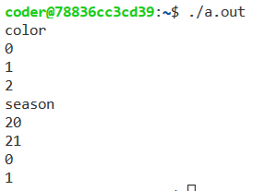
Enumeration
An enumeration is a distinct type whose value is restricted to a range of values.
enum Color { red, green, blue };
enum season {spring = 20, summer, fall = 0, winter};
std::cout << "color\n";
std::cout << Color::red << "\n";
std::cout << Color::green << "\n";
std::cout << Color::blue << "\n";
std::cout << "season\n";
std::cout << season::spring << "\n";
std::cout << season::summer << "\n";
std::cout << season::fall << "\n";
std::cout << season::winter << "\n";
https://en.cppreference.com/w/cpp/language/enum

Slide 3
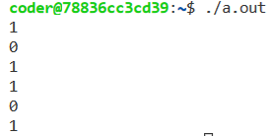
Enumeration - Comparison
enum season {spring = 20, summer, fall = 0, winter};
season a = spring;
season b = fall;
std::cout << (a > b) << "\n";
std::cout << (b == spring) << "\n";
std::cout << (b == fall) << "\n";
std::cout << (b == 0) << "\n";
std::cout << (a == 0) << "\n";
std::cout << (a == 20) << "\n";

Slide 4
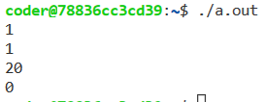
Enumeration - Casting
enum season {spring = 20, summer, fall = 0, winter};
season a = static_cast<season>(20);
season b = static_cast<season>(0);
int c = static_cast<int>(a);
int d = static_cast<int>(b);
std::cout << (a == season::spring) << "\n";
std::cout << (b == season::fall) << "\n";
std::cout << c << "\n";
std::cout << d << "\n";

Slide 5
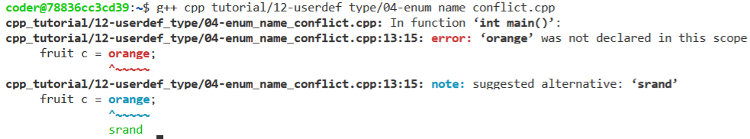
Enumeration - Name Conflict
enum class fruit { orange, apple };
enum class color { red, orange };
fruit a = fruit::apple;
color b = color::red;
std::cout << static_cast<int>(a) << "\n";
std::cout << static_cast<int>(b) << "\n";
// ambiguous: fruit::orange or color::orange
fruit c = orange;

Slide 6
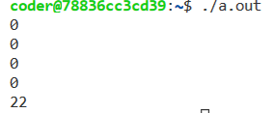
Enumeration - Manipulation
enum season {spring = 20, summer, fall = 0, winter};
season a = static_cast<season>(20);
season b = static_cast<season>(0);
// illegal: season = season + int
//season c = a + 1;
// legal: int = int + int
int d = static_cast<int>(a) + 2;
season e = static_cast<season>(d);
std::cout << (e == season::spring) << "\n";
std::cout << (e == season::summer) << "\n";
std::cout << (e == season::fall) << "\n";
std::cout << (e == season::winter) << "\n";
std::cout << static_cast<int>(e) << "\n";

Slide 7

Enumeration - Manipulation
If the source value is out of range, the result is
unspecified (until C++17) / the behavior is undefined (since C++17).
enum season {spring = 0, summer = 1, fall = 3, winter = 4}; season init(int source)
{
int SEASON_MAX = 4;
if(source > SEASON_MAX || source < 0)
{
std::string err_msg = "received illegal value: " + std::to_string(source);
throw std::invalid_argument(err_msg);
} return static_cast<season>(source);
}

Slide 8
Typedef
Creates an alias that can be used anywhere in place of a (possibly complex) type name.
typedef std::vector<int> INT_VEC;
INT_VEC init(std::vector<int> vec)
{
for(size_t ii = 0; ii < vec.size(); ii = ii + 1)
{
vec[ii] = ii;
}
return vec;
}
https://en.cppreference.com/w/cpp/language/typedef
https://en.cppreference.com/w/c/language/typedef

Slide 9
Struct
A struct is a type consisting of a sequence of members whose storage is allocated in an ordered sequence.
As opposed to union, which is a type consisting of a sequence of members whose storage overlaps
https://en.cppreference.com/w/c/language/struct

Slide 10

Struct - Declaration
Struct is a data type declaration, so please do not forget the semicolon(;) at the end of declaration.
typedef struct
{
double rel;
double img;
} MyComplex;
struct Complex
{
double rel;
double img;
};
MyComplex a = {2.0, 3.0};
std::cout << a.rel << " + " << a.img << "i\n";
Complex b;
b.rel = 4.0;
b.img = 5.0;
std::cout << b.rel << " + " << b.img << "i\n";
https://en.cppreference.com/w/c/language/struct

Slide 11
Struct - Initialization
Give default value in declaration is acceptable but not preferred.
struct NotRreferred
{
double rel = 1.0;
double img = 2.0;
};
struct Complex
{
double rel;
double img;
// declare a constructor
Complex();
};
Complex::Complex()
{
this->rel = 3.0;
this->img = 4.0;
};
https://en.cppreference.com/w/c/language/struct_initialization

Slide 12

struct NotRreferred
{
double rel = 1.0;
double img = 2.0;
}; struct Complex
{
double rel;
double img; // declare a constructor
Complex();
}; Complex::Complex()
{
this->rel = 3.0;
this->img = 4.0;
}; Complex init(double _rel = 5.0, double _img = 6.0)
{
Complex t;
t.rel = _rel;
t.img = _img;
return t;
}
int main()
{
NotRreferred a;
std::cout << a.rel << " + " << a.img << "i\n";
Complex b;
std::cout << b.rel << " + " << b.img << "i\n";
Complex c = init();
std::cout << c.rel << " + " << c.img << "i\n";
return 0;
}

Slide 13

struct Complex
{
double rel;
double img;
};
Complex add(Complex a, Complex b)
{
Complex c;
c.rel = a.rel + b.rel;
c.img = a.img + b.img;
return c;
}
void mul(Complex& val, const double a)
{
val.rel = a * val.rel;
val.img = a * val.img;
}
int main()
{
Complex a = {1.0, 2.0};
Complex b = {3.0, 4.0};
Complex c = add(a, b);
std::cout << c.rel << " + " << c.img << "i\n";
mul(c, 2.0);
std::cout << c.rel << " + " << c.img << "i\n";
return 0;
}

Slide 14
AoS and SoA
struct person
{
std::string name;
int age;
};
struct AoS
{
std::vector<person> p;
};
struct SoA
{
std::vector<std::string> vec_name;
std::vector<int> vec_age;
};
https://en.wikipedia.org/wiki/AoS_and_SoA

Slide 15
AoS and SoA
int MAX = 5;
std::vector<std::string> arr_name = {"alice",
"bob",
"sheldon",
"leonard",
"penny"};
std::vector<int> arr_age = {30, 40, 50, 60, 70};
SoA var_SoA = {arr_name, arr_age};
std::vector<person> arr_person(MAX);
for(int ii = 0; ii < MAX; ii = ii + 1)
{
arr_person[ii].name = arr_name[ii];
arr_person[ii].age = arr_age[ii];
}
AoS var_AsO = {arr_person};

Slide 16
Struct - Manipulation
SoA var_SoA = {arr_name, arr_age};
std::vector<person> arr_person(MAX);
for(int ii = 0; ii < MAX; ii = ii + 1)
{
arr_person[ii].name = arr_name[ii];
arr_person[ii].age = arr_age[ii];
}
AoS var_AsO = {arr_person};
AoS copy_AsO = var_AsO;
for(int ii = 0; ii < MAX; ii = ii + 1)
{
if(copy_AsO.p[ii].name != var_AsO.p[ii].name ||
copy_AsO.p[ii].age != var_AsO.p[ii].age)
{
std::cout << "mismatch\n";
}
}

Slide 17

Union
A union is a special class type that can hold only one of its non-static data members at a time.
union reward
{
int i_val;
double d_val;
};
int main()
{
reward a;
std::cout << "sizeof(double):" << sizeof(double) << "\n";
std::cout << "sizeof(int):" << sizeof(int) << "\n";
std::cout << "sizeof(reward):" << sizeof(reward) << "\n"; return 0;
}
https://en.cppreference.com/w/cpp/language/union

Slide 18

Union
It's undefined behavior to read from the member of the union that wasn't most recently written.
Many compilers implement, as a non-standard language extension, the ability to read inactive members of a union.
reward a;
a.i_val = 5;
std::cout << a.i_val << "\n";
a.d_val = 6.3;
std::cout << a.d_val << "\n";
std::cout << "undefined behavior when accessing the inactive member\n";
std::cout << a.i_val << "\n";

Slide 19
Union
You should record the active variable by an additional variable
union reward
{
int i_val;
double d_val;
};
struct MyUnion
{
int active;
reward u;
};
void getactive(MyUnion _u)
{
if(_u.active == 1)
{
std::cout << "i\n";
}
else if(_u.active == 2)
{
std::cout << "d\n";
}
else
{
std::cout << "unknown case\n";
}
}

Slide 20
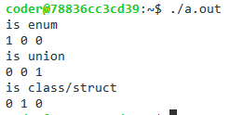
Check type
#include <iostream>
#include <type_traits>
enum Color { red, green, blue };
struct Complex
{
double rel;
double img;
};
union reward
{
int i_val;
double d_val;
std::cout << "is_enum\n";
std::cout << std::is_enum<Color>::value << "\n";
std::cout << std::is_enum<Complex>::value << "\n";
std::cout << std::is_enum<reward>::value << "\n";
std::cout << "is_union\n";
std::cout << std::is_union<Color>::value << "\n";
std::cout << std::is_union<Complex>::value << "\n";
std::cout << std::is_union<reward>::value << "\n";
std::cout << "is_class/struct\n";
std::cout << std::is_class<Color>::value << "\n";
std::cout << std::is_class<Complex>::value << "\n";
std::cout << std::is_class<reward>::value << "\n";
https://en.cppreference.com/w/cpp/header/type_traits

Slide 21

Questions

