Slide 1

Lab 1: Hello WORLD
Using C++ on Linux in VS Code

Slide 2
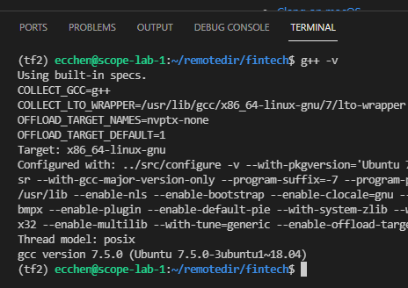

Ensure GCC is installed
sudo apt update
sudo apt install -y build-essential g++ gdb
g++ -v

Slide 3
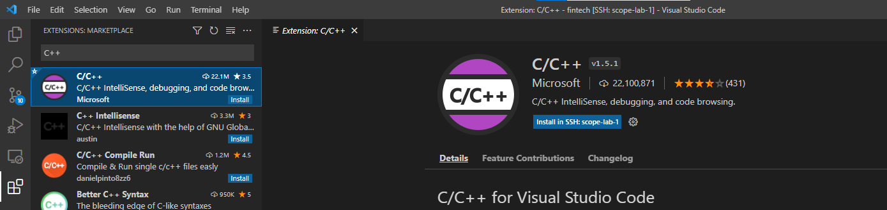
install VSCode
install VSCode (https://code.visualstudio.com/docs/setup/linux)
Install the C++ extension for VS Code.
2
1
3

Slide 4
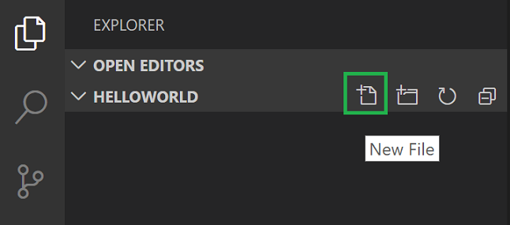
Create Hello World
mkdir projects
cd projects
code .

Slide 5
#include <iostream>
#include <vector>
#include <string>
using namespace std;
int main()
{
vector<string> msg {"Hello", "C++", "World", "from", "VS Code", "and the C++ extension!"};
for (const string& word : msg)
{
cout << word << " ";
}
cout << endl;
}
https://raw.githubusercontent.com/CNOCycle/cpp_tutorial/main/lab01/hello_world.cpp

Slide 6
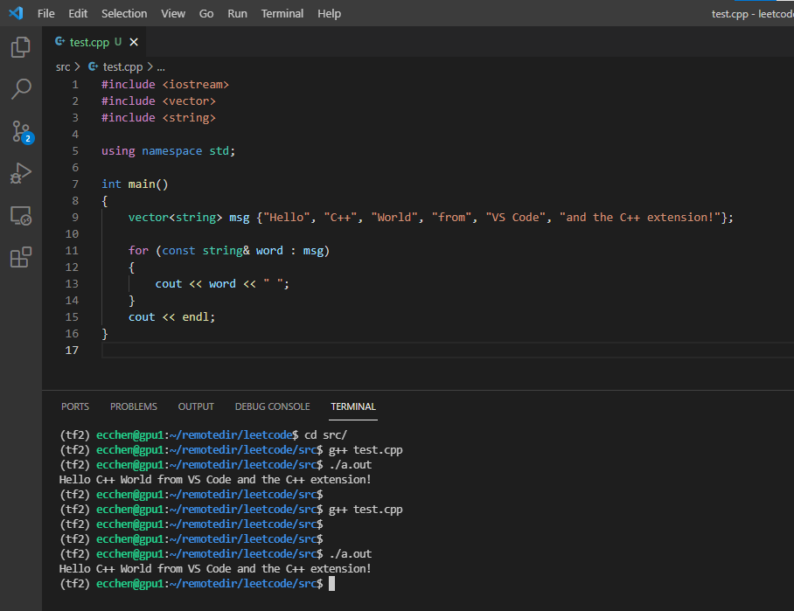
1
2
3

Slide 7
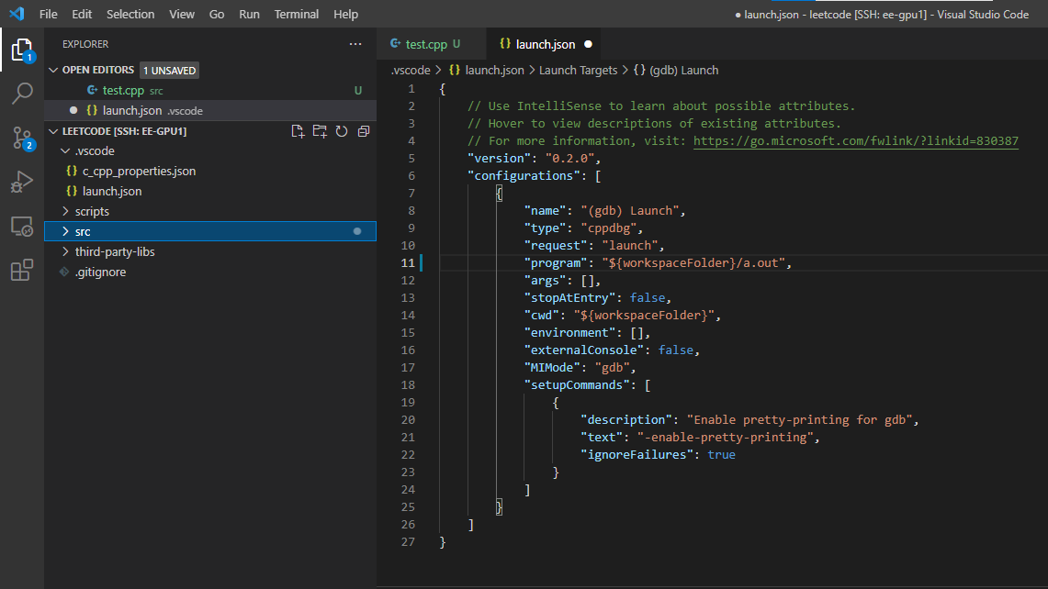
CREATE launch.json

Slide 8
{
"version": "0.2.0",
"configurations": [
{
"name": "(gdb) Launch",
"type": "cppdbg",
"request": "launch",
"program": "${workspaceFolder}/a.out",
"args": [],
"stopAtEntry": false,
"cwd": "${workspaceFolder}",
"environment": [],
"externalConsole": false,
"MIMode": "gdb",
"setupCommands": [
{
"description": "Enable pretty-printing for gdb",
"text": "-enable-pretty-printing",
"ignoreFailures": true
}
]
}
]
}
https://raw.githubusercontent.com/CNOCycle/cpp_tutorial/main/lab01/launch.json

Slide 9
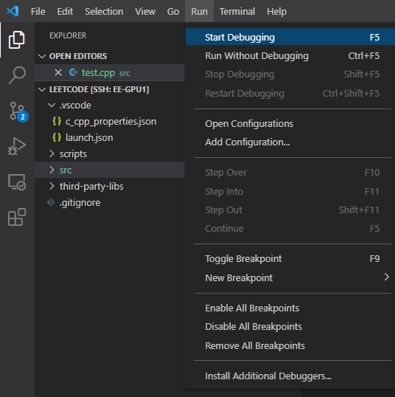
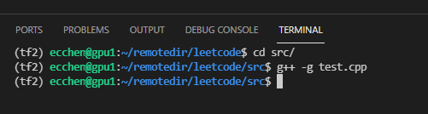
Start a debugging session
Using `g++ -g test.cpp`

Slide 10
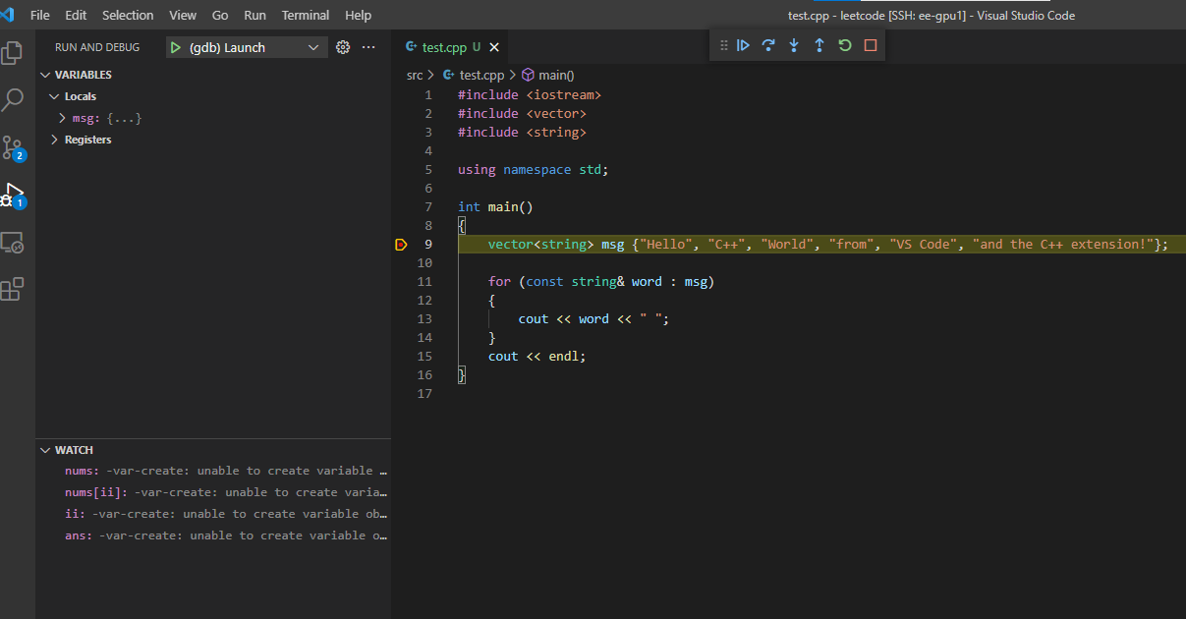

Slide 11
Exit debug mode
1

Slide 12
Reference
https://code.visualstudio.com/docs/cpp/config-linux

Slide 13
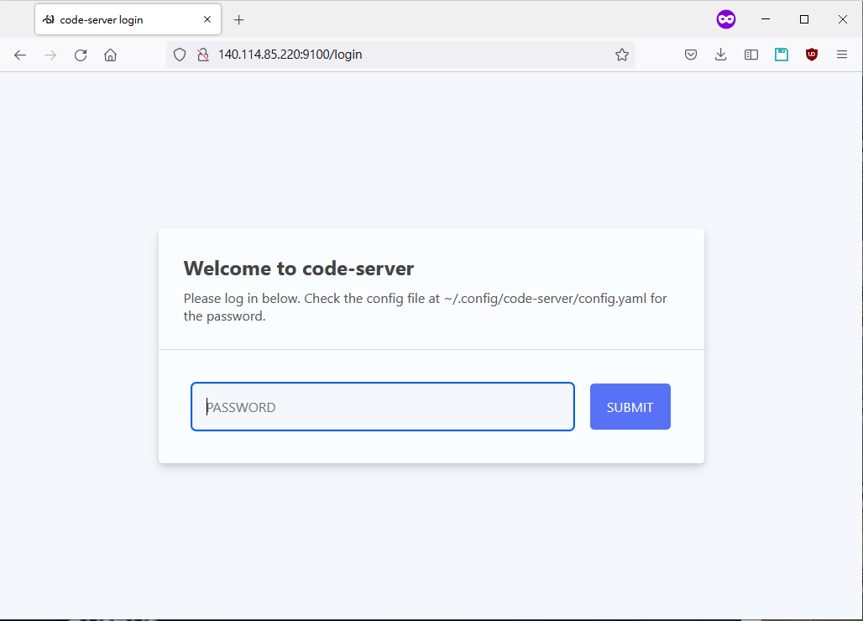
Run VSCODE in coder

Slide 14
Install G++ and vscode extensions
sudo apt update
sudo apt install -y build-essential g++ gdb
g++ -v
curl -L https://github.com/microsoft/vscode-cpptools/releases/download/1.5.1/cpptools-linux.vsix --output cpptools-linux.vsix
code-server --install-extension cpptools-linux.vsix
https://raw.githubusercontent.com/CNOCycle/cpp_tutorial/main/lab01/install_code_server.sh

Slide 15
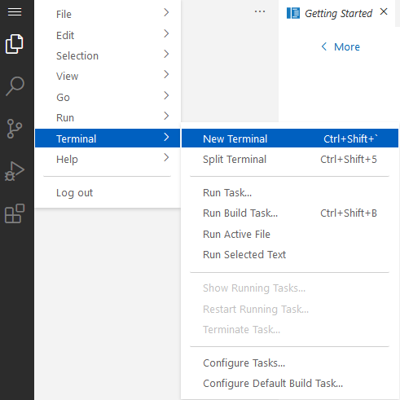
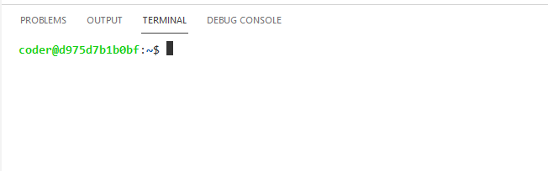
Install G++ and vscode extensions

Slide 16
Install G++ and vscode extensions
sudo apt update
sudo apt install -y build-essential g++ gdb
g++ -v
curl -L https://github.com/microsoft/vscode-cpptools/releases/download/1.5.1/cpptools-linux.vsix --output cpptools-linux.vsix
code-server --install-extension cpptools-linux.vsix

Slide 17
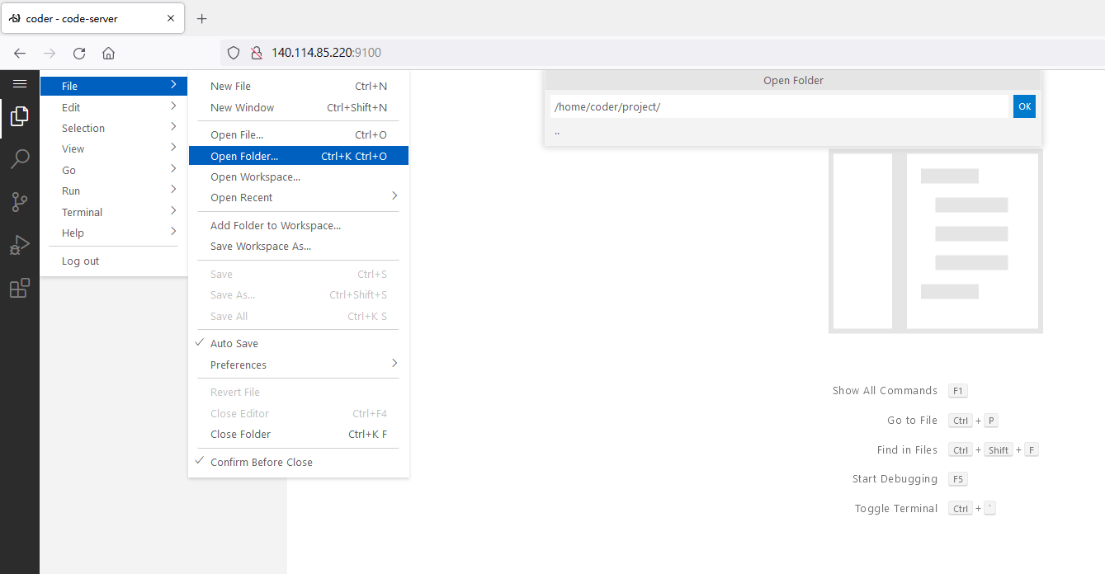
Create Hello World

Slide 18
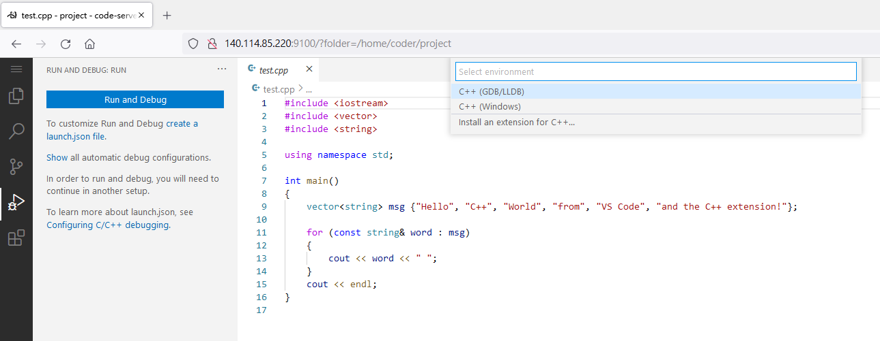
CREATE launch.json

Slide 19
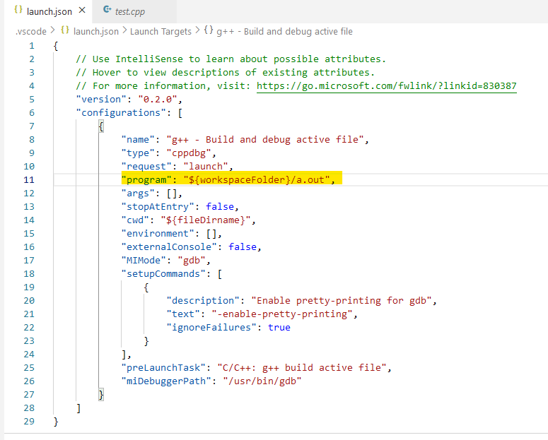
CREATE launch.json

Slide 20
