Slide 1

Git Tutorial

Slide 2
Scenario
thesis_v1 thesis_v2 thesis_v3 thesis_v4
thesis_v1_rev thesis_v2_rev thesis_v3_rev thesis_v4_rev
Student
Advisor

Slide 3
What is Version Control
Version control software keeps track of every modification to the code in a special kind of database.
If a mistake is made, developers can turn back the clock and compare earlier versions of the code to help fix the mistake while minimizing disruption to all team members.
Version control helps teams solve these kinds of problems, tracking every individual change by each contributor and helping prevent concurrent work from conflicting.
https://www.atlassian.com/git/tutorials/what-is-version-control

Slide 4
What is Git
The most widely used modern version control system in the world today is Git.
Git is a mature, actively maintained open source project originally developed in 2005 by Linus Torvalds, the famous creator of the Linux operating system kernel.
in Git, every developer's working copy of the code is also a repository that can contain the full history of all changes.
https://www.atlassian.com/git/tutorials/what-is-git

Slide 5
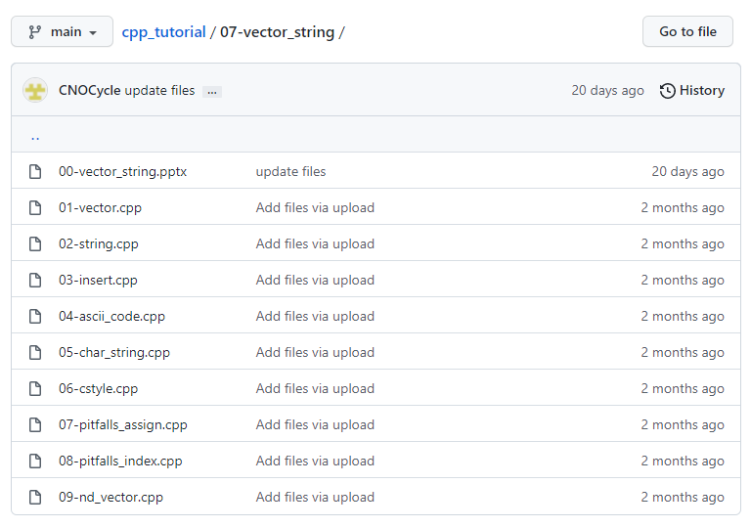
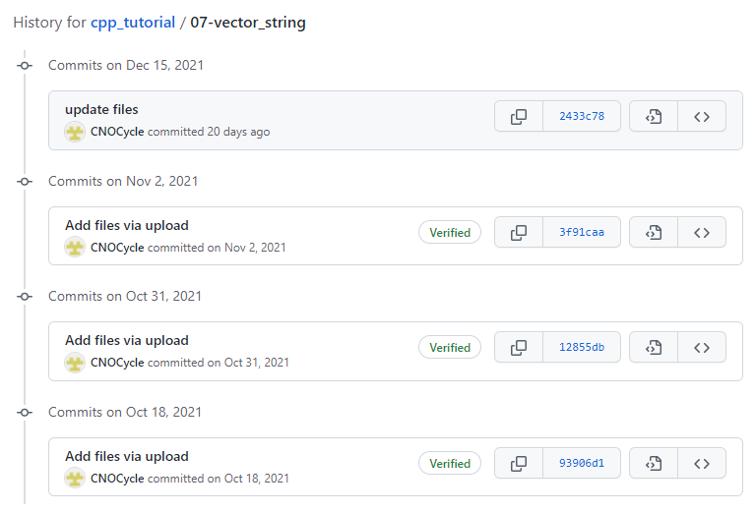
File History

Slide 6
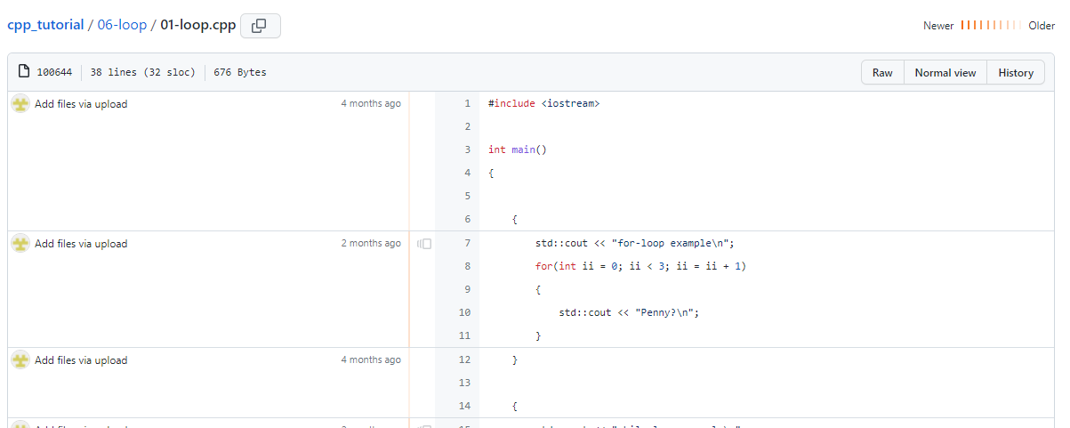
File History

Slide 7
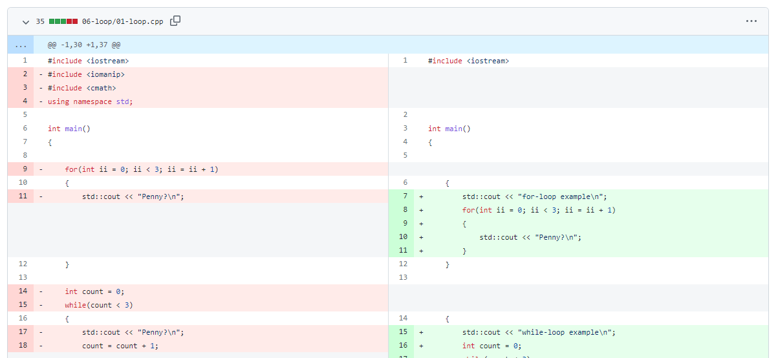
File History

Slide 8

Git Workflow
https://docs.gitlab.com/ee/topics/gitlab_flow.html

Slide 9
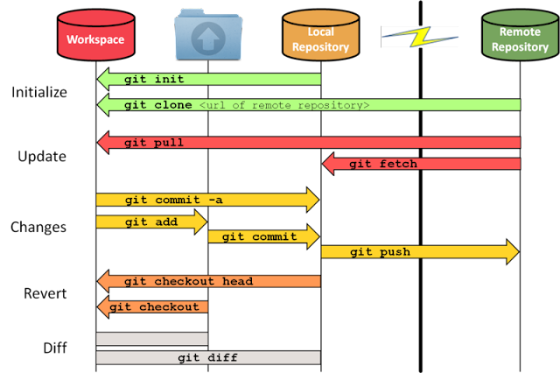
Git commands
https://www.cidevops.com/2018/01/git-workflow-and-commands.html

Slide 10
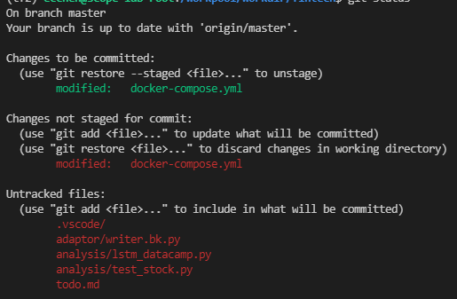
File Status
Untracked files
Changes not staged for commit
Changes to be committed

Slide 11
Comparison
git diff
git diff --staged

Slide 12
Live Demo

Slide 13
Reference
https://www.atlassian.com/git/tutorials/what-is-version-control
https://backlog.com/git-tutorial/tw/

