Slide 1

Presentation of IWS Training
I-STORMS 4th project Meeting Bari, 13rd of June 2019
Notes:
<number>
<number>

Slide 2
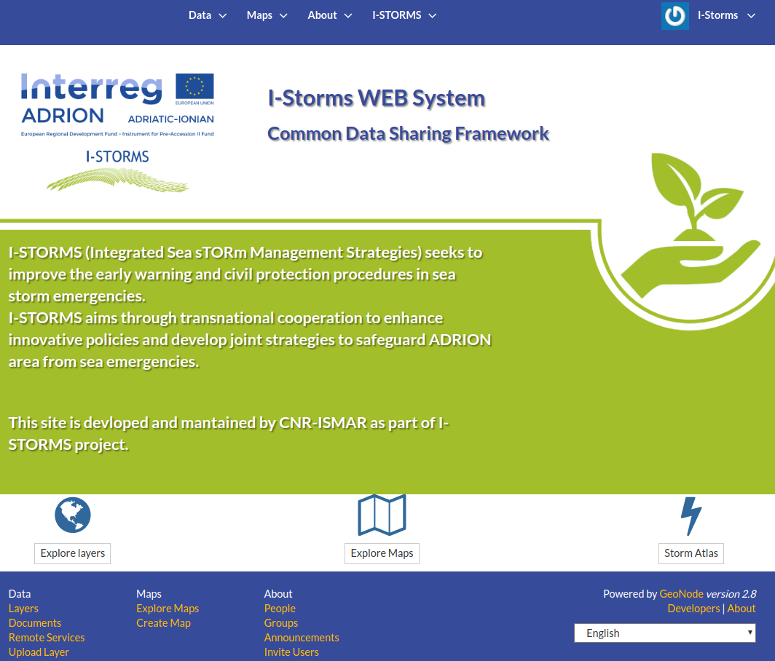
IWS
Development and test
iws.ismar.cnr.it
A new domain has been registered to host the official IWS implementation
seastorms.eu
Notes:
<number>

Slide 3














IWS - TECHNOLOGICAL STACK
Notes:
<number>

Slide 4
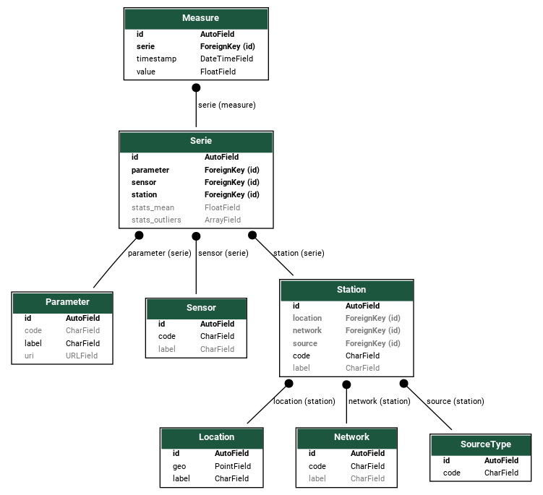
Common Data Sharing System
Measurements Data Model
A common data model to collect and harmonize time series from multiple monitoring networks
PostgreSQL/PostGIS implementation
Adoption of BODC parameter codes
Notes:
<number>

Slide 5
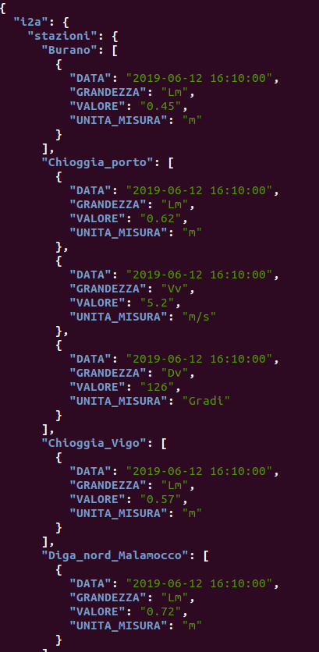
Common Data Sharing System
Measurements Data Model
Source types:
City of Venice monitoring network (JSON)
Notes:
<number>

Slide 6
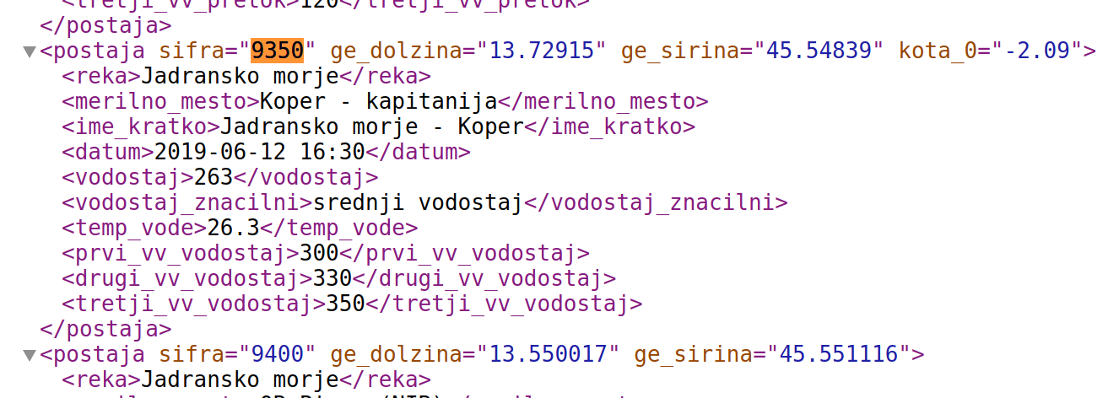
Common Data Sharing System
Measurements Data Model
Source types:
ARSO download service (XML)
http://www.arso.gov.si/xml/vode/hidro_podatki_zadnji.xml
Notes:
<number>

Slide 7
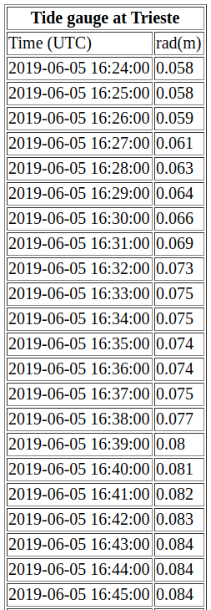
Common Data Sharing System
Measurements Data Model
Source types:
IOC Sea Level Station Monitoring Facility HTML + REST services
http://www.ioc-sealevelmonitoring.org/
Notes:
<number>

Slide 8
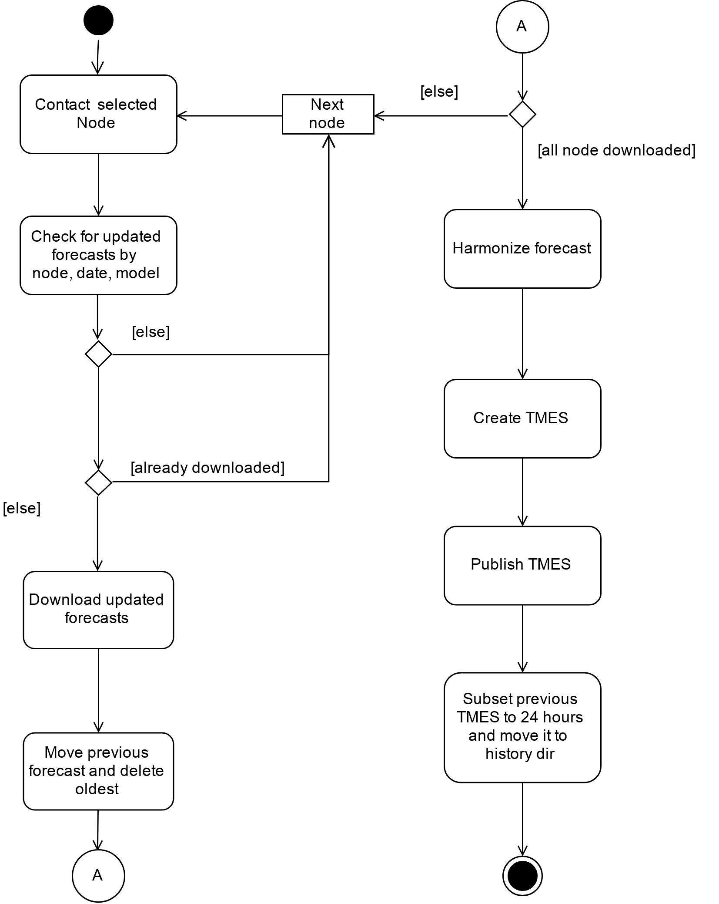
Common Data Sharing System
Forecast collector and aggregator
overall schema
Notes:
<number>

Slide 9
Common Data Sharing System
Forecast collector and aggregator
Partner nodes:
TDS endpoint for LP PP2 and
FTP servers for PP4 and PP9
PP3 will upload on IWS FTP
Other providers TBD
The system contact each node check if updated file exists, download and store it on filesystem.
If one or more updated forecasts are not ready, the system will retry the download cycle after a predefined time interval.
Notes:
<number>

Slide 10
TMES
TMES handler
TMES creation:
Check to have all (or almost all) files downloaded
Process each forecast
Create TMES
TMES publication:
TDS catalog publish new TMES when new file is available
TMES archive:
after publication previous TMES is sliced to first 24h and archived
history is also published by TDS
Notes:
<number>

Slide 11
TMES
TMES Gap filling
Processed forecast for each provider will be stored in the system as long as space amount it will consent.
One or more forecasts could be calculated by provider but not collected from the system due to connectivity or technical issue.
In such cases the TMES will be (manually) recreated ex post using the preprocessed files, when the missing forecasts are available
Notes:
<number>

Slide 12
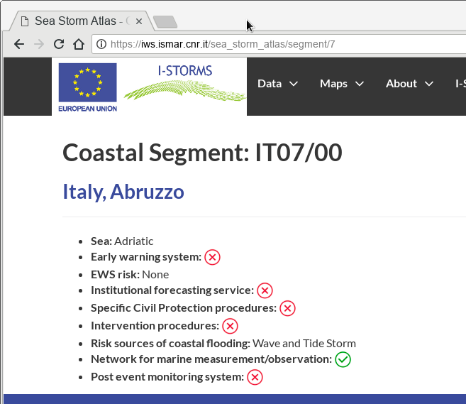
Sea Storm Atlas
Registered users will be enabled to edit data
insert events
georeference events
add documents to events
complete coastal segments informations
Bulk insert from existing databases is always possible
Notes:
<number>

Slide 13
Training Outline
GeoNode introduction
User registration
Upload resources
Share resources
Data access through interoperable services
Sea Storm Atlas
TMES
Measurement dashboards
Notes:
<number>

