Slide 1

Automated Testing Tool
Presenter: Samir Patel
July3, 2017

Slide 2
HISTORY
Developed in 2004 by Jason Huggins as a JavaScript library used to automate his manual testing routines
Selenium Core is born whose functionality underlies the Selenium RC (Remote Control) and Selenium IDE tools
The Limitation of having a JavaScript based automation engine and browser security restricted Selenium to specific functionality
Google, who has been a long time user of Selenium, had a developer named Simon Stewart who developed WebDriver. This tool circumvented Selenium’s JavaScript sandbox to allow it to communicate with the Browser and Operating System directly using native methods
In 2008, Selenium and WebDriver merged technologies and intellectual intelligence to provide the best possible test automation framework

Slide 3
INTRODUCTION
Selenium is a suite of testing automation tools used for Web-Base applications: Selenium IDE, Selenium RC, Selenium WebDriver and Selenium Grid
These tools provide a rich set of testing functions specifically geared to varied testing scenarios of all types of Web applications
The operations provided by these tools are highly flexible and afford many options for comparing UI elements to expected application behavior
Selenium tests can be executed on multiple browser platforms

Slide 4
WHY USE/LEARN SELENIUM
Increases you marketability
Has a lot of Java planks
Growing Industry standard
Assist with the deployment of defective-free code
Open source, web-based testing automation tool and cross-browser compliant
Muti-language backend support (Java, Ruby, Python, C#, PHP, ect…)

Slide 5
SELENIUM TOOLS
Selenium IDE
    Rapid prototyping tool for building test scripts
    Firefox plugin
    Can be used by developers with little to no programming experience to write simple tests quickly and gain familiarity with the Selenese commands
    Has a recording feature that records a user’s live actions that can be exported in one of many programming languages
    Does not provide iteration or conditional statements for test scripts
    Can only run tests against FireFox
    Developed tests can be run against other browsers, using a simple command-line interface that invokes the Selenium RC server
    Can export WebDriver or Remote Control scripts (these scripts should be in PageObject structure)
    Allows you the option to select a language for saving and displaying test cases

Slide 6
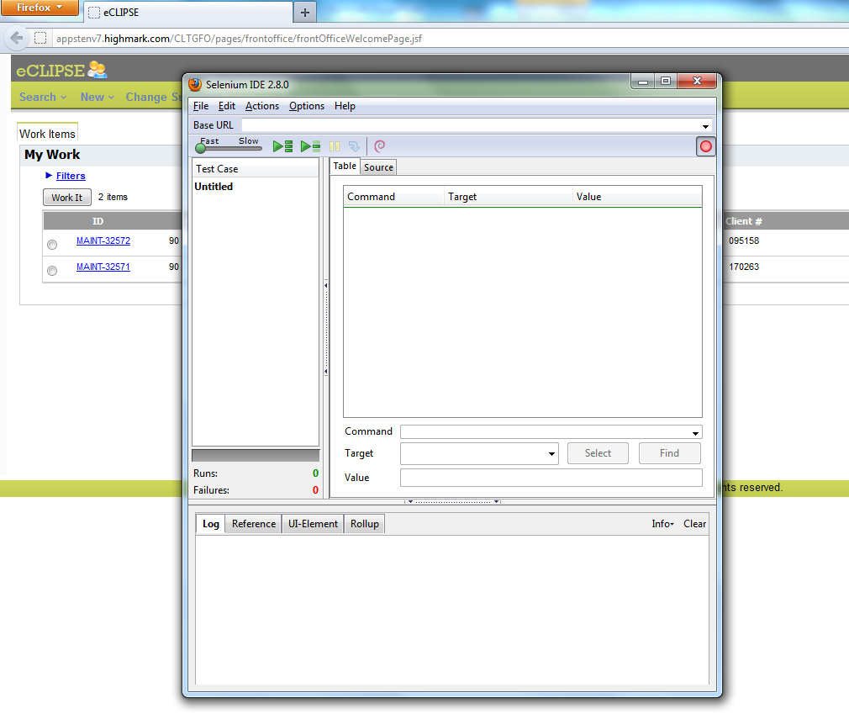
SELENIUM IDE

Slide 7
SELENIUM TOOLS
Selenium RC aka Selenium 1
    It ‘inject’ JavaScript functions into the browser when the browser is loaded and then uses its JavaScript to drive the AUT within the browser
    Mainly supported in maintenance mode
    Provides support for several programming languages
Selenium WebDriver
    Designed to provide a simpler, more concise programming interface in addition to addressing some limitations in the Selenium-RC API
    Support multiple programming language:Java, C#, Python, Ruby, PHP, Perl…
    Developed to better support dynamic web pages where elements of a page may change without the page itself being reloaded
    Not tied to any particular test framework, so it can be used equally well in unit testing or from a plain old “main” method.

Slide 8
SELENIUM IDE
Commonly Used Selenium Commands
  open
  click/clickAndWait
  verifyTitle/assertTitle
  verifyTextPresent
  verifyElementPresent
  verifyText
  verifyTable
  waitForPageToLoad
  waitForElementPresent

Slide 9
SELENIUM IDE
Locators
  By Identifier
    Used by default
    Locator type is “identifier”
    First element with id attribute value matching the location will be used
    First element with a name attribute matching the location will be used if there are no id matches
  By ID
    More limited than the “identifier” type
    Locator type is “id”
    Use this type when you know the element’s id
  By Name
    Locates an element with a matching name attribute
    Filters can be applied for elements with the same name attribute
    Locator type is “name”

Slide 10
SELENIUM IDE
  X-Path
    Used for locating nodes in an XML document
    Elements can be located in regards to absolute terms or a relative position to an element that has a specified id or name attribute
    Can locate elements via attributes other than id or name
    Starts with “//”
  By DOM
    Can be accessed using Javascript
    Locator type is “document”
  By CSS
    Uses the style binding of selectors to elements in a document as a locating strategy
    Faster than X-Path and can find the most complicated objects in an intrinsic HTML document
    Locator type is “css”

Slide 11
SELENIUM IDE
Java Test Script Example
public void testGoogleTestSearch() throws Exception
{
      selenium.open("http://www.google.com/webhp");
      assertEquals("Google", selenium.getTitle());
      selenium.type("q", "Selenium OpenQA");
      selenium.click("btnG");
      selenium.waitForPageToLoad("5000");
      assertEquals("Selenium OpenQA - Google Search",
      selenium.getTitle());
}

Slide 12
SELENIUM WEBDRIVER
Project Setup
  Java
    The easiest way is use Maven. Maven will download the java bindings (the Selenium 2.0 java client library) and all its dependencies, and will create the project for you, using a maven pom.xml (project configuration) file
    You can then import the maven project into your preferred IDE, IntelliJ IDEA or Eclipse.
    From a command-line, CD into the project directory and run maven as follows: mvn clean install

Slide 13
DEMO: VERIFY PAGE TITLE
public static void main( String[] args )
{
// Create a new instance of the Firefox driver
WebDriver driver = new FirefoxDriver();
// (1) Go to a page
driver.get("http://www.google.com");
// (2) Locate an element
WebElement element = driver.findElement(By.name("q"));
// (3-1) Enter something to search for
element.sendKeys("Purdue Univeristy");
// (3-2) Now submit the form. WebDriver will find the form for us from the element
element.submit();
// (3-3) Wait up to 10 seconds for a condition
WebDriverWait waiting = new WebDriverWait(driver, 10);
waiting.until( ExpectedConditions.presenceOfElementLocated( By.id("pnnext") ) );
// (4) Check the title of the page
if( driver.getTitle().equals("purdue univeristy - Google Search") )
System.out.println("PASS");
else
System.err.println("FAIL");
//Close the browser
driver.quit();
}

Slide 14
Input and Navigation
  Select select = new Select(driver.findElement(By.tagName("select"))); select.deselectAll(); select.selectByVisibleText("Edam");
  driver.findElement(By.id("submit")).click();
  driver.switchTo().window("windowName");
  for (String handle : driver.getWindowHandles()) { driver.switchTo().window(handle); }
  driver.switchTo().frame("frameName");
  Alert alert = driver.switchTo().alert();
  driver.navigate().to("http://www.example.com");
  driver.navigate().forward(); driver.navigate().back();

Slide 15

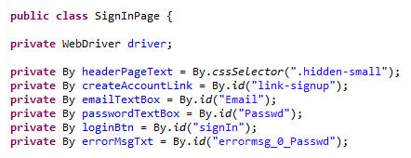
SELENIUM WEBDRIVER FRAMEWORK
Page Object Model Framework
    Page Object model is writing all the functionalities / reusable components of a page that we want to automate in a separate class. Say now if we consider four pages as Home page, Login page, Create Account and Forgot password page etc.
    The main advantage of Page Object Model is that if the UI changes for any page, it don’t require us to change any tests, we just need to change only the code within the page objects (Only at one place). Many other tools which are using selenium, are following the page object model.

Slide 16
PAGE OBJECT MODEL FRAMEWORK
public class LoginPage {
private static final By byTxtUserName = By.id("txtUserNameOREmail");
private static final By byTxtPassword = By.id("txtLoginPwd");
public static WebElement getUserNameTextBox(WebDriver driver){
return new WebDriverWait(driver, 10).until(ExpectedConditions.presenceOfElementLocated(byTxtUserName));
}
public static WebElement getPasswordTextBox(WebDriver driver){
return new WebDriverWait(driver, 10).until(ExpectedConditions.presenceOfElementLocated(byTxtPassword));
}
public class Login{
LoginPage.getUserNameTextBox(driver).sendKeys(username);
LoginPage.getPasswordTextBox(driver).sendKeys(password);
}

Slide 17
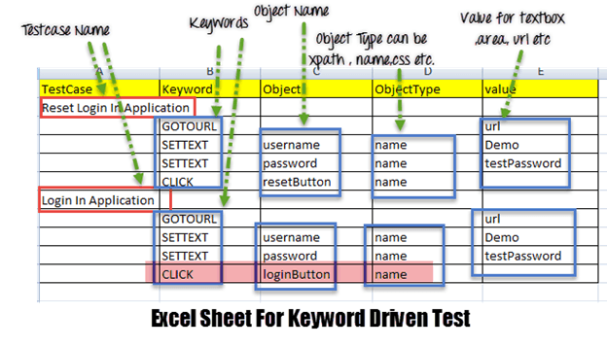
SELENIUM WEBDRIVER FRAMEWORK
Hybrid(Data+Keyword driven) Framework
    Hybrid Framework which is the combination of Keyword driven and Data driven framework.
Data Driven Test Framework
In data driven framework all of our test data is generated from some external files like Excel, CSV, XML or some database table. We already learned about Data Driven Testing in our previous tutorial
Keyword Driven Test Framework:
In keyword driven test framework, all the operations and instructions are written in some external file like Excel worksheet. Here is how the complete framework looks like

Slide 18
SELENIUM WEBDRIVER
Example Java Implementation
  LoginPage.java
  HomePage.java
  LoginTest.java

Slide 19
SELENIUM RC
In Selenium RC, the Selenium Server launches and kills browsers, interprets and runs the Selenese commands passed from the test program, and acts as an HTTP proxy, intercepting and verifying HTTP messages passed between the browser and the AUT
Client libraries which provide the interface between each programming language and the Selenium RC Server.
The primary task for using Selenium RC is to convert your Selenese into a programming language

Slide 20
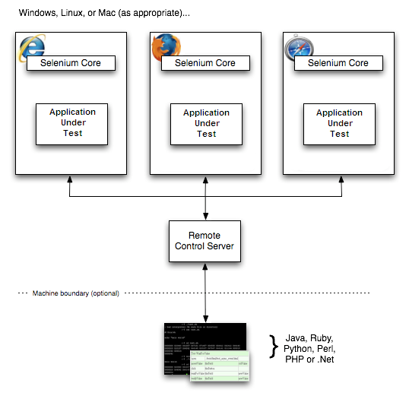
SELENIUM RC

Slide 21
SELENIUM RC
Sample Test Script
open | /
type | q | selenium rc
clickAndWait | btnG
assertTextPresent | Results * for selenium rc

Slide 22
SELENIUM RC
/** Add JUnit framework to your classpath if not already there
* for this example to work
*/
package com.example.tests;
import com.thoughtworks.selenium.*;
import java.util.regex.Pattern;
public class NewTest extends SeleneseTestCase {
public void setUp() throws Exception {
setUp("http://www.google.com/", "*firefox");
}
public void testNew() throws Exception {
selenium.open("/");
selenium.type("q", "selenium rc");
selenium.click("btnG");
selenium.waitForPageToLoad("30000");
assertTrue(selenium.isTextPresent("Results * for selenium rc"));
}
}

Slide 23
SELENIUM RC
Learning the API
    setUp("http://www.google.com/", "*firefox");
    The Browser is manipulated by a Browser Instance that is assigned to a program variable
    This program variable is then used to call methods from the browser
    Selenese commands are then ran by calling the respective methods from the browser variable - selenium.type(“field-id”,”string to type”)
    To utilize iteration and conditional logic, Selenium RC uses program language specific methods in conjunction with Selenese commands
    Use the getEval method of selenium API to execute JavaScript from selenium RC

Slide 24
SELENIUM RC
Server, Security and Browers Configurations
  Command line options can be used to change the default server behaviour.
  If your AUT is behind an HTTP proxy which requires authentication then you should configure http.proxyHost, http.proxyPort, http.proxyUser and http.proxyPassword
  You can run Selenese html files directly within the Selenium Server by passing the html file to the server’s command line
  When launching selenium server the -log option can be used to record valuable debugging information reported by the Selenium Server to a text file
  When dealing with HTTPS in a Selenium RC test, there is a run mode that supports handling security pop-ups and processes the security certificate for you
  When a browser is not directly supported, you may still run your Selenium tests against a browser of your choice by using the “*custom” run-mode (i.e. in place of *firefox or *iexplore) when your test application starts the browser.

Slide 25
SELENIUM GRID
A Grid consists of a single Hub, and one or more Nodes. Both are started using a selenium-server.jar executable.
The Hub receives a test to be executed along with information on which browser and ‘platform’ (i.e. WINDOWS, LINUX, etc) where the test should be run.
Since the Hub knows the configuration for each registered Node, it selects an available Node that has the requested browser-platform combination
Selenium commands initiated by the test are sent to the Hub, which passes them to the Node assigned to that test
The Node runs the browser, and executes the Selenium commands within that browser against the application under test

Slide 26
SELENIUM REFERENCES
PushToTest.com
SelenuiumHQ

