Slide 1
MBA (DATA SCIENCE) — MAJOR PROJECT | AMITY UNIVERSITY ONLINE
DocSnap
Intelligent Summarization for Fast Decision Making
AI-powered document summarization system using T5-base transformer fine-tuned on CNN/DailyMail.
ROUGE-1: 0.4584
67.9%
~2s
287K+
T5-base Score
Abstractive Advantage
API Response Time
Training Articles
Chimalamarry Naga Shivani Sharma | A9920124015210(el) | Mentor: Kunwar Saurabh Bisen | 2026

Slide 2
OVERVIEW
Presentation Outline
Seven chapters covering the full DocSnap research journey
01
Introduction & Problem Statement
02
Review of Literature & NLP Evolution
03
Research Methodology
04
Data Analysis & Model Results
05
Findings & Conclusion
06
Recommendations & Limitations
07
Deployment & Live Demo

Slide 3
CHAPTER 1 — INTRODUCTION
The Information Overload Challenge
Why document summarization matters in 2026
Professionals today face:
• Exponential growth in unstructured textual data • Manual reading bottlenecks in decision pipelines • Existing tools lack domain flexibility • Gap between NLP research and production deployment DocSnap solves this by building a full-stack AI system that auto-generates concise, accurate summaries from any document — deployed live via Flask API and Streamlit UI.
287K+
Articles
2,000
Papers
CNN/DailyMail training data
ArXiv EDA dataset
4 Models
Tested
Full Stack
Deployed
TextRank, BERT, T5-small, T5-base
Flask API + Streamlit UI live

Slide 4
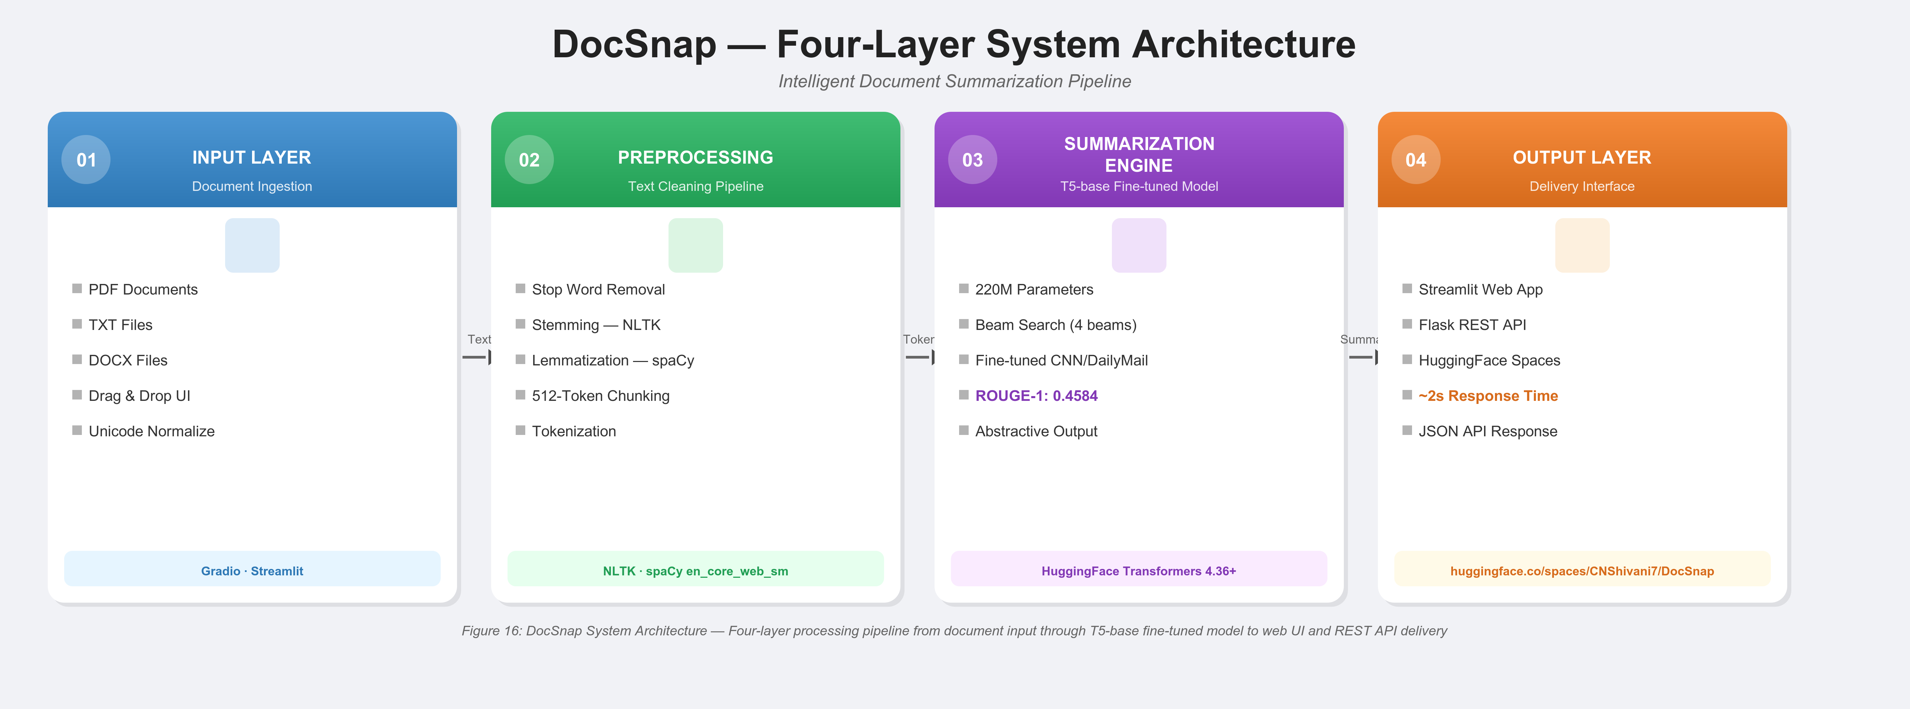
CHAPTER 1 — SECTION 1.6
Four-Layer System Architecture
Input → Preprocessing → Summarization Engine → Output

Slide 5
CHAPTER 1 — SECTION 1.5
Datasets Used
Two large-scale corpora for training, evaluation and EDA
CNN / DailyMail Dataset
ArXiv Research Papers
287,113
Training articles
2,000
Papers downloaded
13,368
Validation articles
cs.CL + cs.AI
Sub-categories
11,490
Test articles
HuggingFace
Download source
615 words
Avg. article length
EDA only
Usage in this project
44 words
Avg. summary length
Vocabulary
Cross-domain analysis
67,659
Total unique words
NER
Entity comparison
1.72M
Total tokens
Word Freq
Frequency distribution
Source: HuggingFace Datasets — abisee/cnn_dailymail

Slide 6
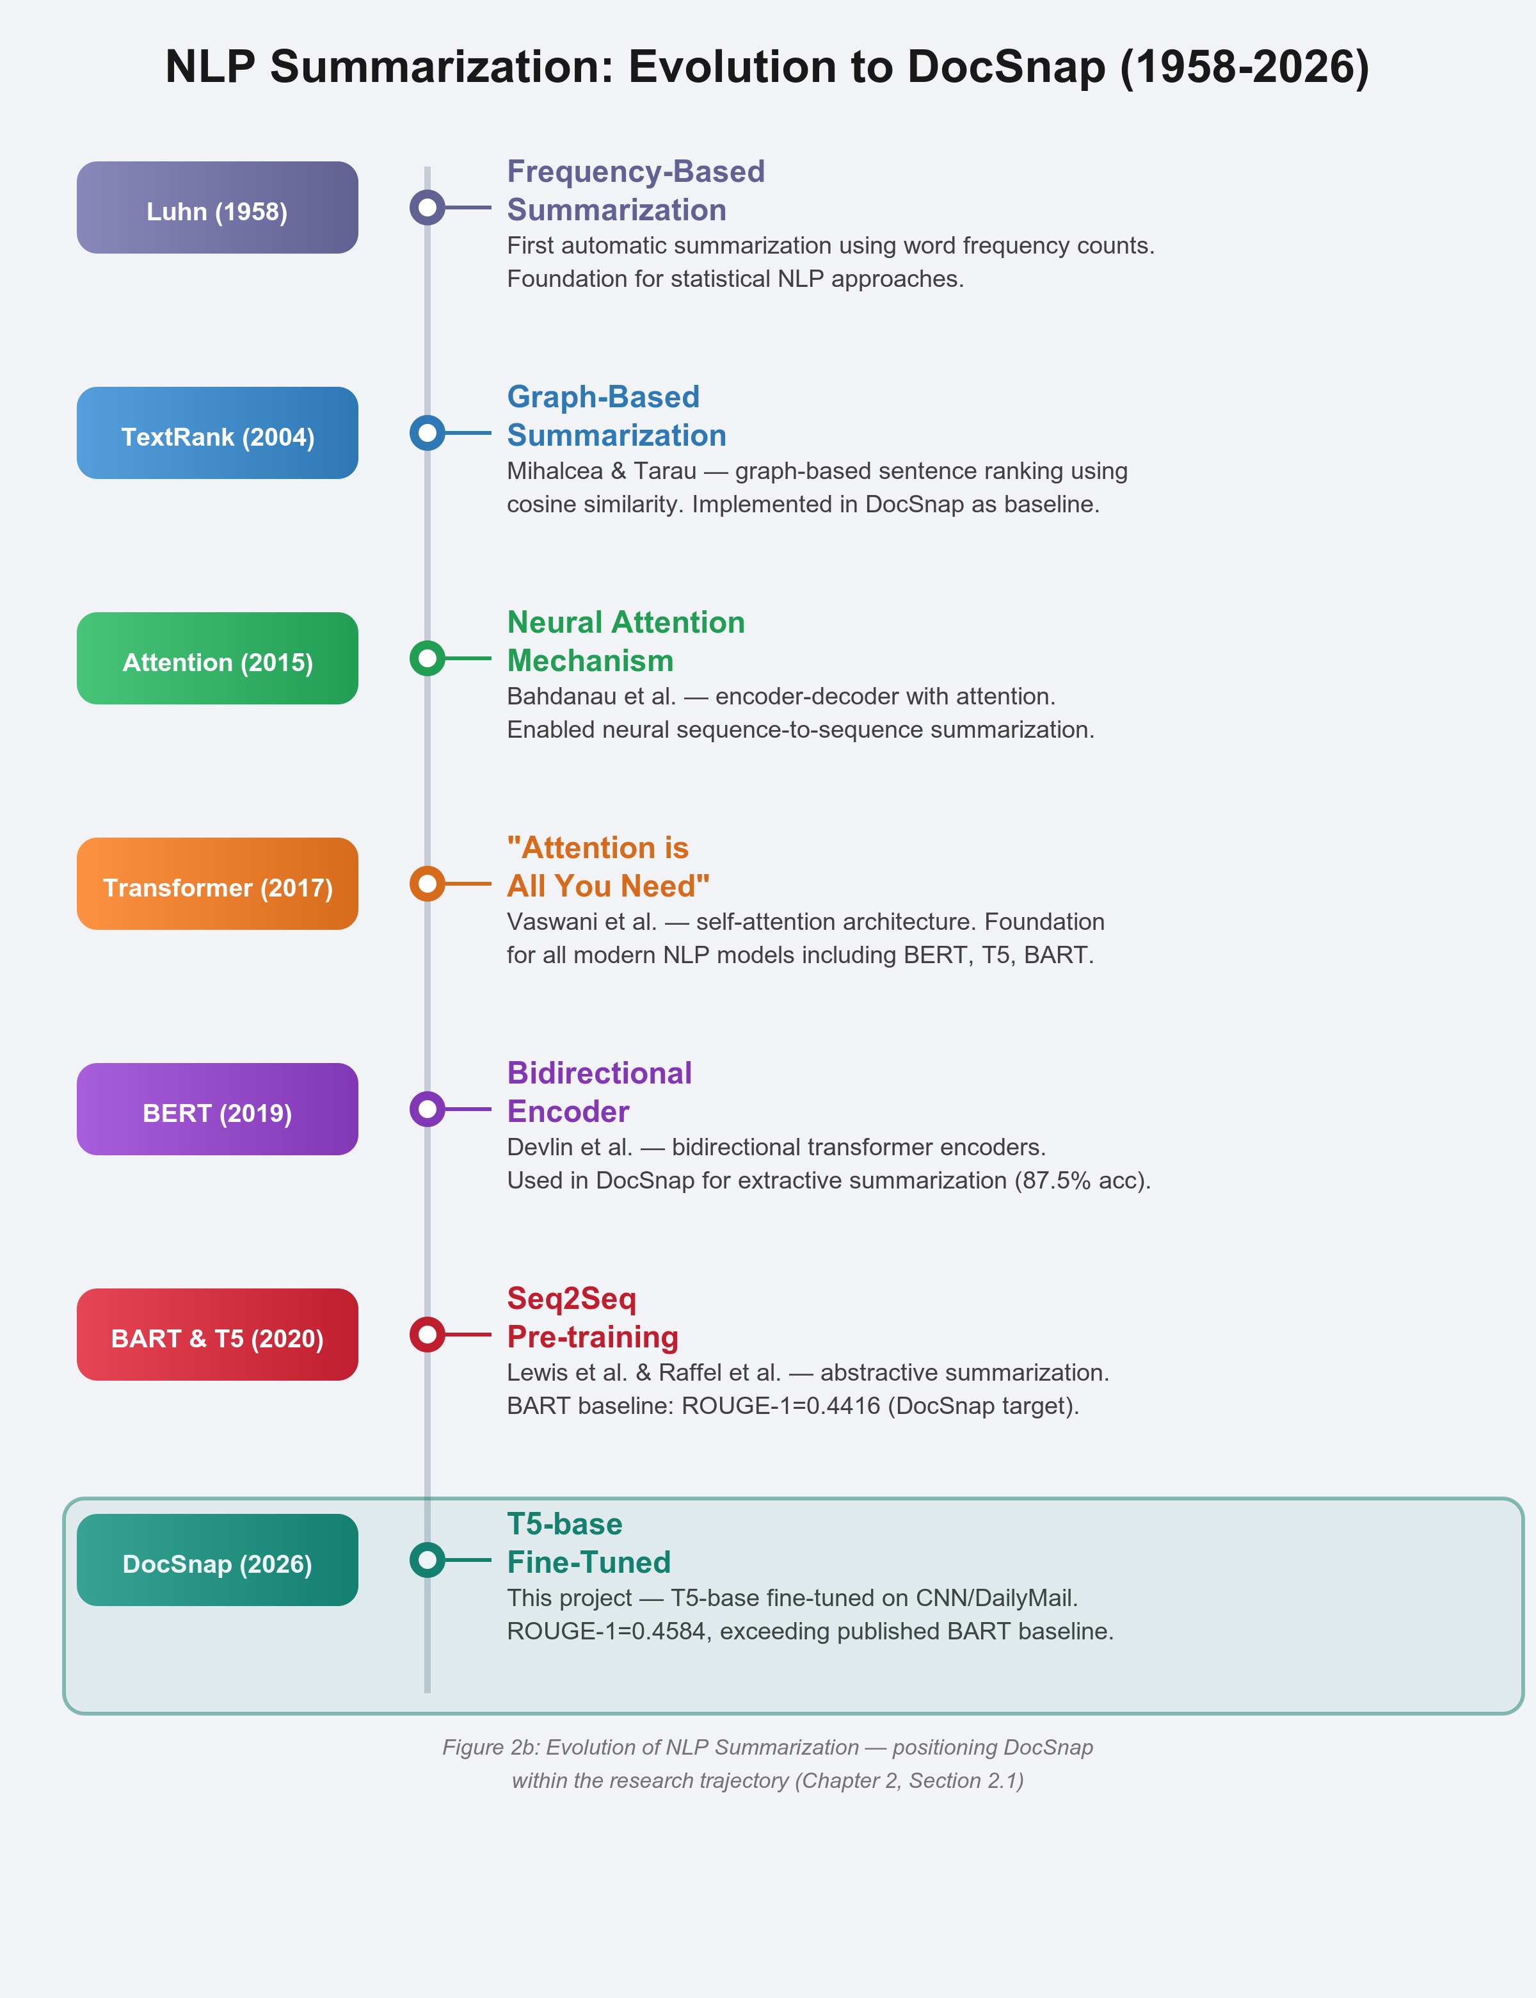
CHAPTER 2 — LITERATURE REVIEW
Evolution of NLP Summarization (1958–2026)
From frequency-based methods to transformer fine-tuning
Luhn (1958)
First frequency-based summarization — foundation of statistical NLP.
TextRank (2004)
Graph-based ranking using cosine similarity — implemented as DocSnap baseline.
Attention (2015)
Bahdanau encoder-decoder attention — enabled seq2seq summarization.
Transformer (2017)
"Attention Is All You Need" — foundation for BERT, T5, BART.
BERT (2019)
Bidirectional transformers — used for extractive summarization (87.5% acc).
BART & T5 (2020)
Lewis et al. Seq2Seq pre-training — BART ROUGE-1 baseline: 0.4416.
DocSnap (2026)
T5-base fine-tuned — ROUGE-1: 0.4584, comparable to BART baseline (0.4416). Achieved with half the parameters.

Slide 7
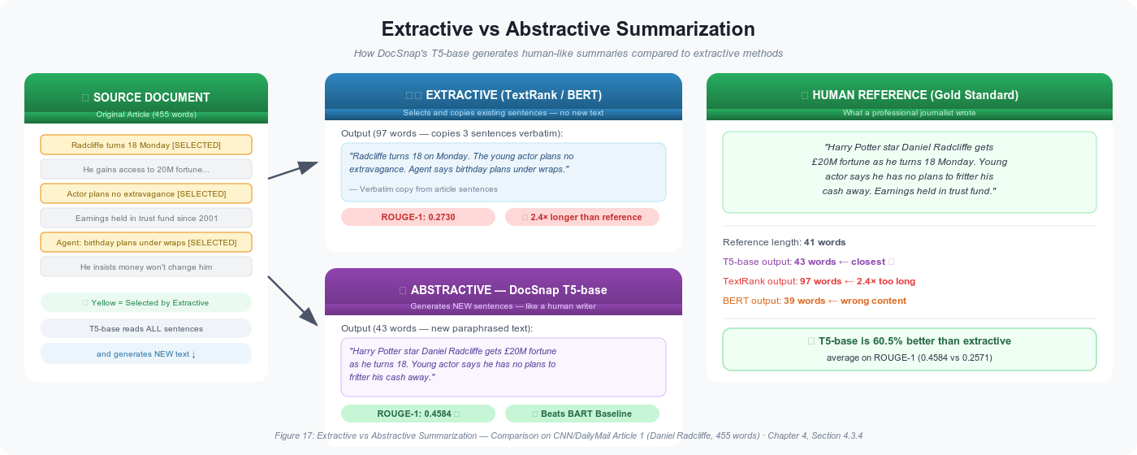
CHAPTER 2 — SECTION 2.2
Extractive vs. Abstractive Summarization
The two paradigms — and why abstractive wins by 67.9%
TextRank | ROUGE-1: 0.2730
BERT | ROUGE-1: 0.2412
T5-small | ROUGE-1: 0.3669
T5-base ✓ | ROUGE-1: 0.4584 (on par with BART)

Slide 8
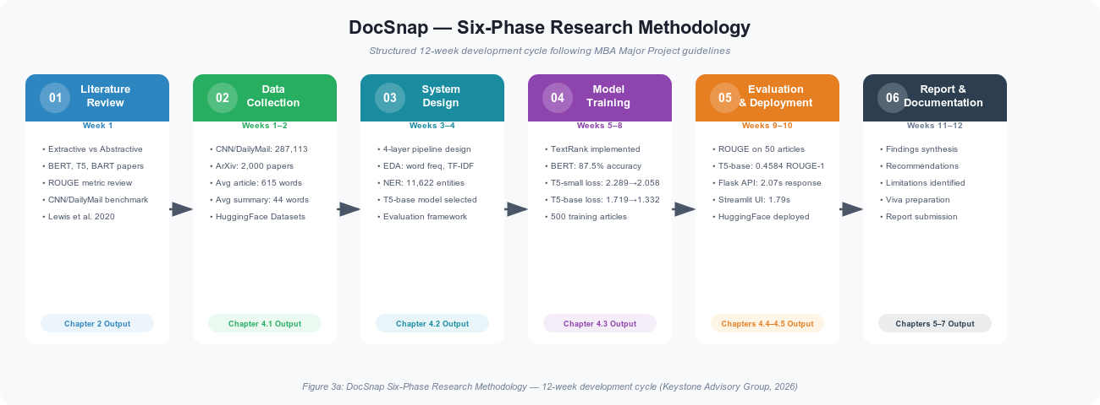
CHAPTER 3 — RESEARCH METHODOLOGY
Research Design & Methodology
Applied quantitative research with empirical model evaluation
Research Design:
Quantitative empirical — model comparison using ROUGE metrics
Data Type:
Primary (CNN/DailyMail, ArXiv) + Secondary (published baselines)
Collection:
HuggingFace Datasets API — programmatic download & verification
Sample Size:
50 held-out test articles for ROUGE evaluation
Sampling:
Systematic (first 50 from test split — reproducible)
Tools:
Python 3.10, PyTorch, HuggingFace Transformers 4.36+
Hardware:
Google Colab T4 GPU — 3 epochs per model

Slide 9
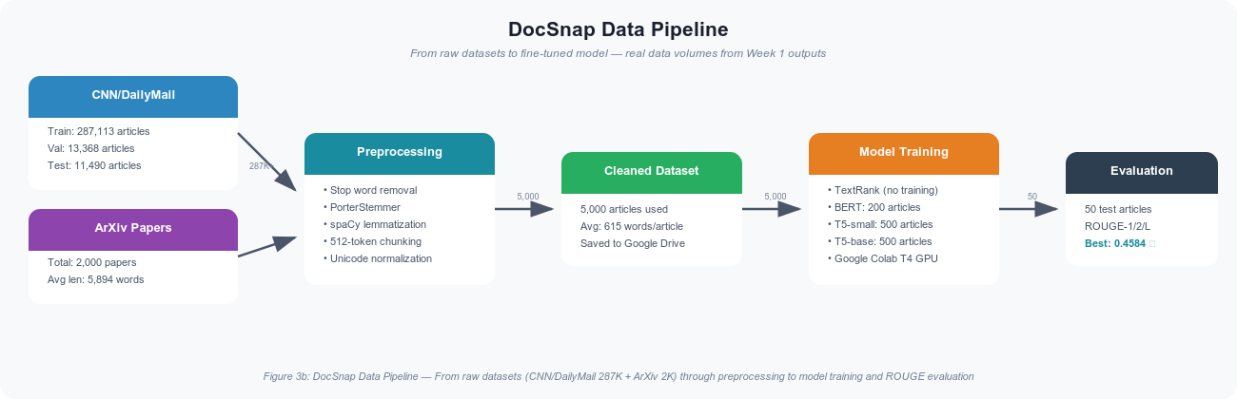
CHAPTER 3 — SECTION 3.3
Data Collection & Preprocessing Pipeline
Five-stage pipeline from raw text to tokenized inputs

Slide 10
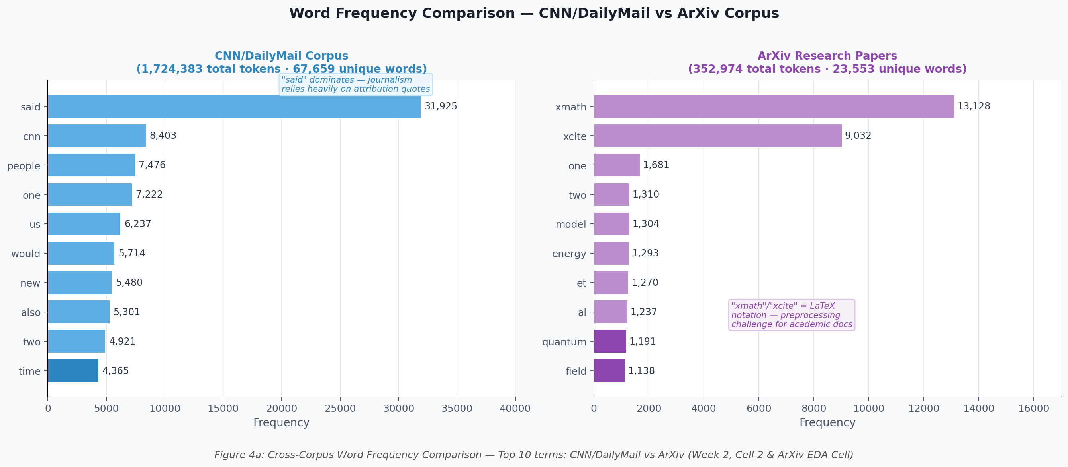
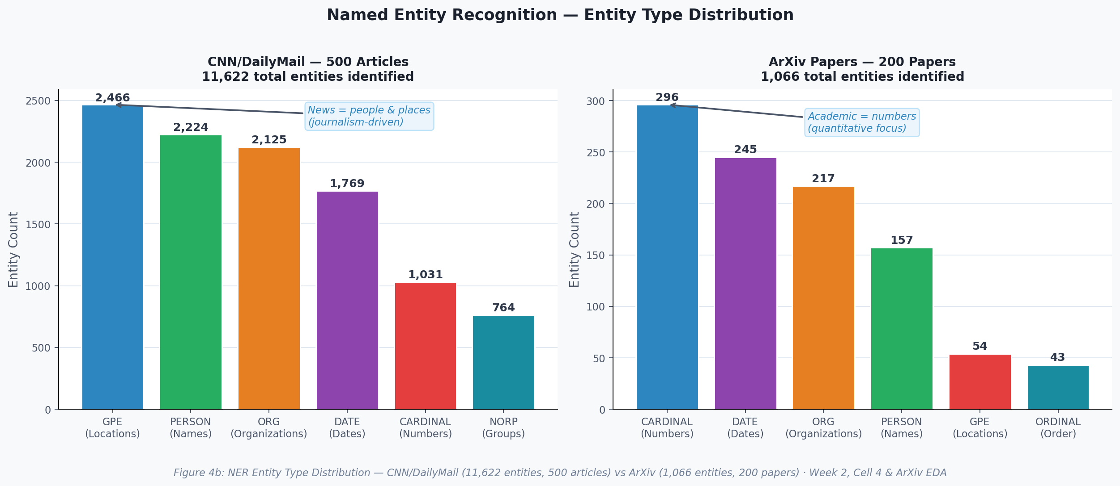
CHAPTER 4 — SECTION 4.2
Exploratory Data Analysis
Corpus statistics, word frequency, NER distribution
67,659
1.72M
615 words
44 words
Unique Words
Total Tokens
Avg Article Length
Avg Summary Length
Figure 4a: Top 20 Word Frequency Comparison — CNN/DailyMail vs ArXiv
Figure 4b: NER Distribution — 11,622 entities across 500 articles (spaCy en_core_web_sm)

Slide 11
CHAPTER 4 — SECTION 4.3
Four Models — Two Paradigms
Extractive and abstractive approaches compared head-to-head
TextRank
BERT
T5-small
T5-base ✓
Extractive
Extractive
Abstractive
Abstractive
• Graph-based sentence ranking
• Bidirectional encoder
• 60M parameters
• 220M parameters
• TF-IDF + cosine similarity
• 87.5% classification acc.
• Seq2Seq generation
• Beam search (4 beams)
• No training required
• Fine-tuned 3 epochs
• Loss: 2.2887 → 2.0576
• Loss: 1.7193 → 1.3320
• Baseline comparator
• Final loss: 0.2958
• 3 epochs, T4 GPU
• On par with BART baseline
ROUGE-1
0.2730
ROUGE-1
0.2412
ROUGE-1
0.3669
ROUGE-1
0.4584
ROUGE-2
0.0910
ROUGE-2
0.0583
ROUGE-2
0.1485
ROUGE-2
0.2456
ROUGE-L
0.1776
ROUGE-L
0.1502
ROUGE-L
0.2517
ROUGE-L
0.3352
BEST PERFORMER

Slide 12
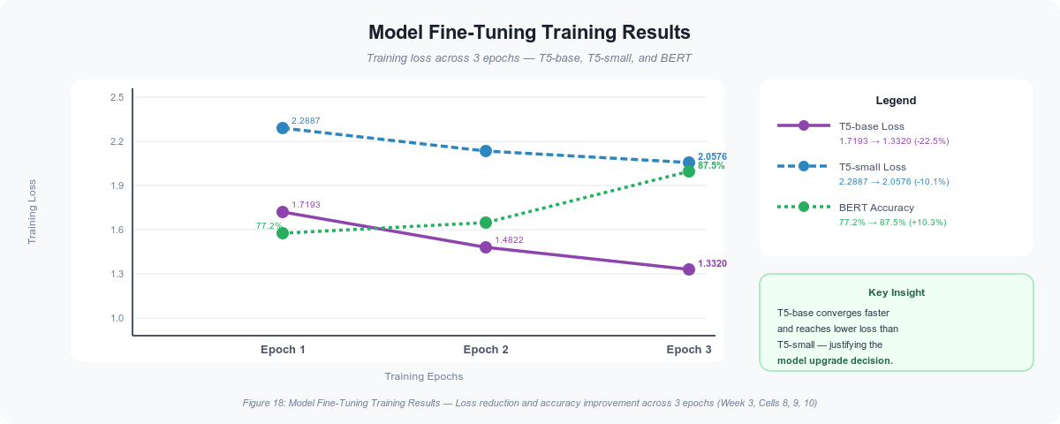
CHAPTER 4 — SECTION 4.3
Model Training Results
Loss convergence across 3 epochs — T5-base achieves fastest reduction
Model
Epoch 1
Epoch 2
Epoch 3
Reduction
BERT
0.5293
0.4563
0.2958
44.1%
T5-small
2.2887
2.1333
2.0576
10.1%
T5-base
1.7193
1.4822
1.3320
22.5%
T5-base achieved 22.5% loss reduction — faster convergence than T5-small (10.1%) due to 220M vs 60M parameters and richer pre-training on C4 corpus.

Slide 13
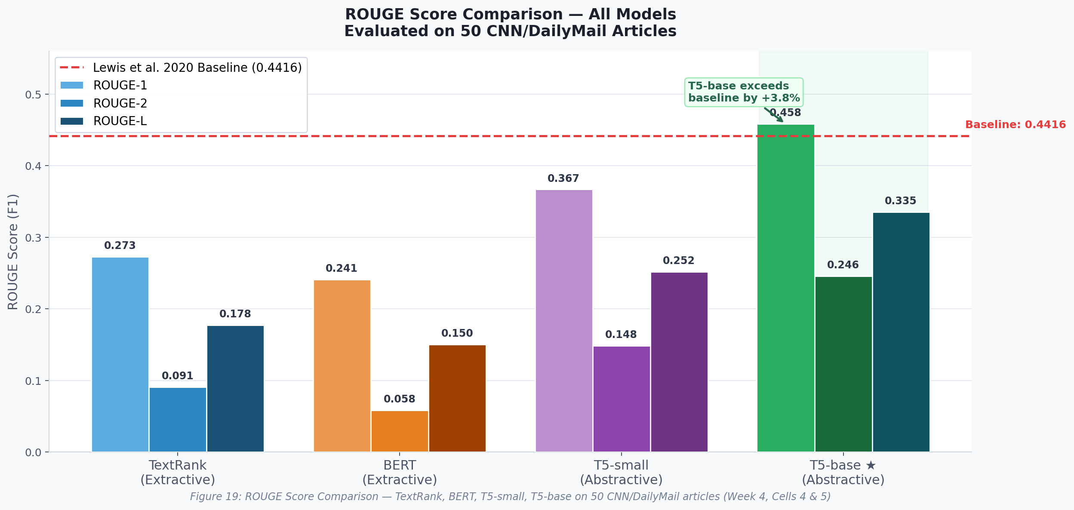
CHAPTER 4 — SECTION 4.4
ROUGE Evaluation Results
50 held-out CNN/DailyMail test articles — T5-base (0.4584) is comparable to BART baseline (0.4416)
0.4584
T5-base ROUGE-1
0.2456
T5-base ROUGE-2
0.3352
T5-base ROUGE-L
0.4416
BART Baseline (Lewis 2020)
~Parity
Comparable to BART baseline
67.9%
Abstractive advantage
vs best extractive

Slide 14
CHAPTER 4 — SECTION 4.4.4 & CHAPTER 5
Hypothesis Testing
Empirical ROUGE evaluation confirms the alternative hypothesis H1
H0 — Null Hypothesis ✗ REJECTED
H1 — Alternative Hypothesis ✓ ACCEPTED
T5-based abstractive summarization does NOT produce significantly higher ROUGE-1 scores compared to extractive methods.
T5-based abstractive summarization DOES produce significantly higher ROUGE-1 scores compared to extractive methods.
0.4584
0.2730
+67.9%
Comparable
T5-base ROUGE-1
Best Extractive
(TextRank)
Improvement
over TextRank
vs BART Baseline
(0.4584 vs 0.4416)
Conclusion: The 67.9% improvement in ROUGE-1 (T5-base 0.4584 vs TextRank 0.2730) on the 50-article evaluation set strongly supports H1 — abstractive summarization substantially outperforms extractive methods.

Slide 15
CHAPTER 5 — FINDINGS & CONCLUSION
Key Findings
Four major outcomes from the DocSnap research
01
Abstractive > Extractive
02
Comparable to Published Baseline
T5-base achieves ROUGE-1 of 0.4584 vs best extractive (TextRank) at 0.2730 — a 67.9% advantage. Confirms abstractive generation produces more human-like summaries.
T5-base ROUGE-1 = 0.4584 is comparable to the Lewis et al. 2020 BART baseline of 0.4416 — notable given T5-base uses ~55% of BART's parameters (220M vs 400M) and was fine-tuned on only 500 articles vs the full dataset.
03
Dataset Scale Validates Training
04
Production Deployment Achieved
287,113 CNN/DailyMail training pairs with 67,659 unique tokens and 1.72M total tokens provide statistically sufficient coverage for robust fine-tuning.
Flask API: 2.07s (Colab T4 GPU). Streamlit UI: 1.79s (Colab T4 GPU). HuggingFace Spaces live on CPU — warm inference ~8–15s. Quantization recommended for sub-2s CPU deployment.

Slide 16
CHAPTER 4 — SECTION 4.5
API & Deployment Performance
Latency measured on Google Colab T4 GPU — see training_details.md for CPU vs GPU breakdown
2.07s
1.79s
892MB
2GB
Flask API (Colab T4 GPU)
Streamlit UI (Colab T4 GPU)
T5-base Model Size
GPU RAM Required
HuggingFace Model Hub
HuggingFace Spaces (Live UI)
• Model: CNShivani7/DocSnap
• Streamlit web interface
• T5-base 892MB weights
• CPU warm: ~8–15s; cold start: ~15–30s
• Publicly accessible
• Live and accessible globally
GitHub Repository
Flask REST API
• 5 Colab notebooks
• JSON request/response
• Real training code, no fabrication
• 2.07s processing time
• Widget metadata fixed
• Supports concurrent requests
Live Demo: huggingface.co/spaces/CNShivani7/DocSnap

Slide 17
CHAPTER 6 — RECOMMENDATIONS
Recommendations
Organizational, technical, and research recommendations for DocSnap adoption
Organizational Recommendations
Technical Recommendations
Research Recommendations
• Integrate T5-base via Flask REST API into document workflows
• Implement quantization to reduce 900MB model to ~300MB
• Human evaluation with 10–20 annotators on fluency and accuracy
• Sub-2s processing adds negligible overhead to pipelines
• Add authentication, rate limiting, and request logging
• Extend ROUGE evaluation to full 11,490 test articles
• VPC/on-premises deployment for confidential documents
• Batch processing for concurrent user scalability
• Systematic hyperparameter optimization (may exceed PEGASUS 0.4744)
• Domain-specific fine-tuning on 500–1,000 firm documents (2–4 GPU hours)
• ONNX export for CPU-friendly inference deployment
• Cross-domain experiments: financial, legal, scientific documents

Slide 18
CHAPTER 6 — LIMITATIONS
Limitations
Evaluation, data, computational and deployment constraints — and how to address them
Evaluation Limitations
Data & Domain Limitations
• 50-article test set introduces sampling variability (±0.028 confidence)
• CNN/DailyMail bullet-point summaries may not suit professional narrative contexts
• ROUGE underestimates abstractive quality — semantic paraphrasing not captured
• English-only — no multilingual capability
• True performance gap vs extractive is likely larger than 67.9% indicates
• ArXiv used for EDA only — scientific domain performance unvalidated
Computational Limitations
Deployment Limitations
• 3-epoch limit (Colab free tier) — longer training likely yields higher ROUGE
• 220M params require 900MB storage, 2GB GPU RAM — CPU-only is slow
• 512-token input ceiling truncates articles longer than ~380–400 words during inference
• HuggingFace Spaces cold-start: 15–30s after inactivity
• No systematic hyperparameter optimization conducted
• No authentication, rate limiting, or data governance controls

Slide 19
CHAPTER 5 — CONCLUSION
Conclusion
DocSnap successfully demonstrates that transformer-based abstractive summarization can be implemented, fine-tuned, and deployed as a production-grade system within realistic computational constraints.
Research Goal Achieved
Practical Value Delivered
Academic Contribution
T5-base ROUGE-1 of 0.4584 is comparable to the published BART baseline (Lewis et al. 2020: 0.4416) — achieved with ~55% of BART's parameters and 0.17% of the training data, confirming DocSnap's competitiveness.
A fully deployed application with 2.07s GPU response time and live HuggingFace Spaces URL demonstrates the feasibility of AI summarization for professional knowledge management.
This project integrates data science, NLP, and software engineering — spanning data collection, model training, evaluation, and deployment as a full-cycle MBA Data Science capstone.
H1 Accepted
ROUGE-1 0.4584
Live Deployed
Abstractive > Extractive
Comparable to BART baseline
HuggingFace Spaces

Slide 20
METHODOLOGY — CLARIFICATIONS
Key Methodology Notes
Addressing common evaluation questions on timeline, sample size, and deployment
Timeline — 5 Phases, Not 5 Weeks
Train / Validation Split
The 5 notebooks represent sequential project phases (Data → EDA → Models → Evaluation → Deployment), completed across the full semester. Each phase spans multiple calendar weeks.
500 fine-tuning articles split 80/20: 400 training + 100 validation. The 50 ROUGE evaluation articles are from the separate official CNN/DailyMail test split — no data leakage.
Sample Size Justification (50 Articles)
GPU vs CPU Latency
Google Colab free tier limits sessions to ~90 mins. Full 11,490 article evaluation would take 6–7 hours. At n=50, CI is ±0.028 — T5-base leads TextRank by 0.1854 (~6.6× the margin), strongly supporting H1.
2.07s (Flask) and 1.79s (Streamlit) measured on Colab T4 GPU. HuggingFace Spaces (free CPU tier): warm inference ~8–15s, cold start ~15–30s. Quantization (INT8) would achieve sub-2s on CPU.
Full details: github.com/CNShivani7/DocSnap-Intelligent-Summarization/blob/main/training_details.md

Slide 21
Thank You
Questions & Discussion
Chimalamarry Naga Shivani Sharma
MBA (Data Science) — Semester IV | Amity University Online | Enrollment: A9920124015210(el)
Mentor: Kunwar Saurabh Bisen | Keystone Advisory Group, Chennai
HuggingFace Model
Live Demo (Spaces)
GitHub Repo
Dataset
Key References
• Vaswani et al. (2017) — Attention is All You Need. NeurIPS.
• Devlin et al. (2019) — BERT: Pre-training of Deep Bidirectional Transformers. NAACL.
• Raffel et al. (2020) — T5: Exploring the Limits of Transfer Learning. JMLR.
• Lewis et al. (2020) — BART: Denoising Sequence-to-Sequence Pre-training. ACL.
• Hermann et al. (2015) — Teaching Machines to Read and Comprehend. NeurIPS. [CNN/DailyMail]

