Slide 1
Proposal Presentation
Matting based on Bayesian algorithm
Lingyu Gong, Changhong Li, Qiwen Tan
E3 School
Date 15/02/2024

Slide 2
Group Introduction
Members and Roles
Algorithm Engineer – Tan
- Algorithm Research
- Algorithm Function Encapsulation
Reliability Engineer – Gong
- Unit Test
- E2E Test
Integration Engineer – Li
- System Integration
- Code Lint and Review

Slide 3
Presentation
Content
Group Introduction
Mathematical Algorithm
Function Blocks
Testing Plan
Flow of Implementation
Milestones and timeline

Slide 4
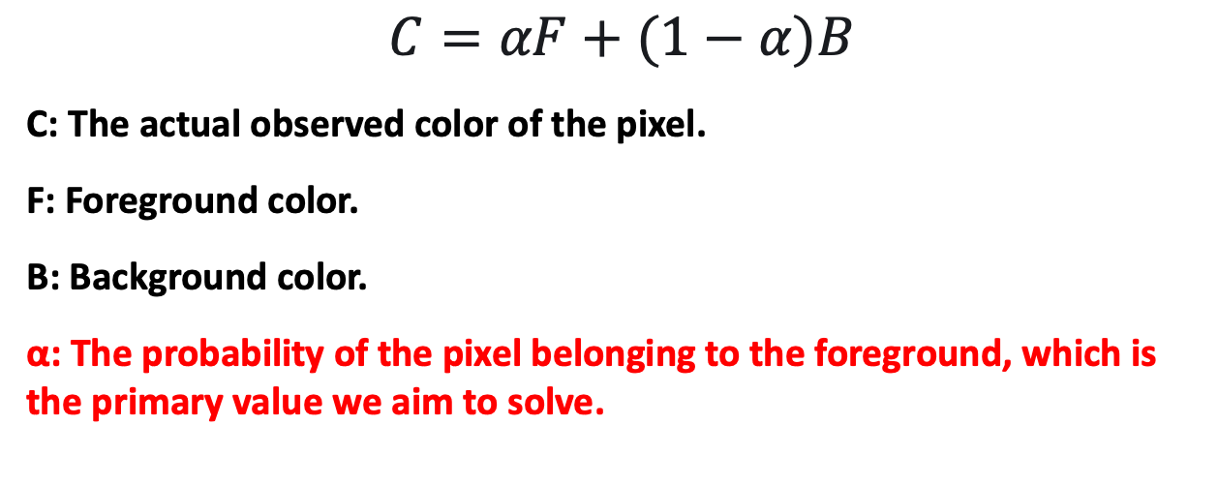
Mathematics
Corner Stone
$$C=αF+(1−α)B$$
C: The actual observed color of the pixel.
F: Foreground color.
B: Background color.
α: The probability of the pixel belonging to the foreground, which is the primary value we aim to solve.

Slide 5









Mathematics
Challenge
$$F_{R}$$
$$F_{G}$$
$$F_{B}$$
$$C_{R}$$
$$B_{R}$$
$$C=αF+(1−α)B$$
Three Equations
$$C_{G}$$
$$B_{R}$$
Seven Unknows
$$C_{B}$$
$$B_{R}$$
How do we solve seven unknowns with three equations?

Slide 6
Mathematics
Maximum Likelihood
User input / Trimap
⬇️
F and B value estimation
⬇️
α value estimation
One iteration

Slide 7
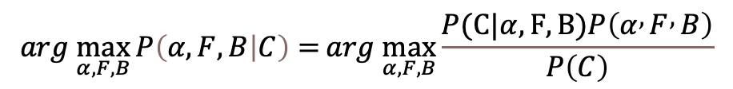
Mathematics
Maximum A Posteriori
$$arg \max_{α,F,B}{P\left(α,F,B | C\right)=}arg \max_{α,F,B}{\frac{P(C|α,F,B)P\left(α , F , B\right)}{P\left(C\right)}}$$
Log Likelihood
$$L\left(α,F,B | C\right)=arg{\max_{α,F,B}{L(C|α,F,B)+L\left(F\right)+L\left(B\right)+L(α)}}$$
Constant(omitted)
Let’s solve each terms one by one

Slide 8
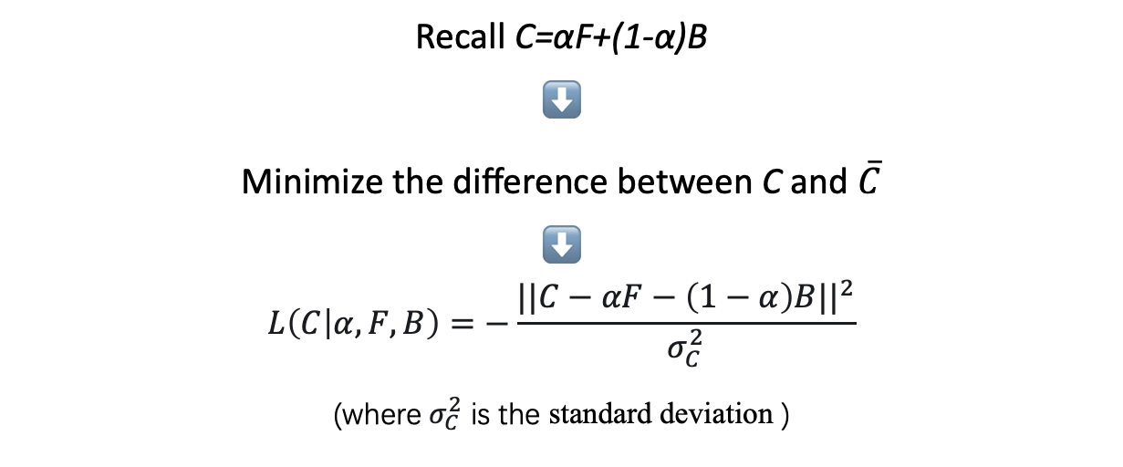
Mathematics
$$\arg{max}L\left(C | α,F,B\right)$$
Recall C=αF+(1-α)B
⬇️
Minimize the difference between C and $\overline{C}$
⬇️
$$L\left(C | α,F,B\right)=−\frac{||C−αF−\left(1−α\right)B||^{2}}{σ_{C}^{2}}$$
(where $σ_{C}^{2}$ is the standard deviation )

Slide 9
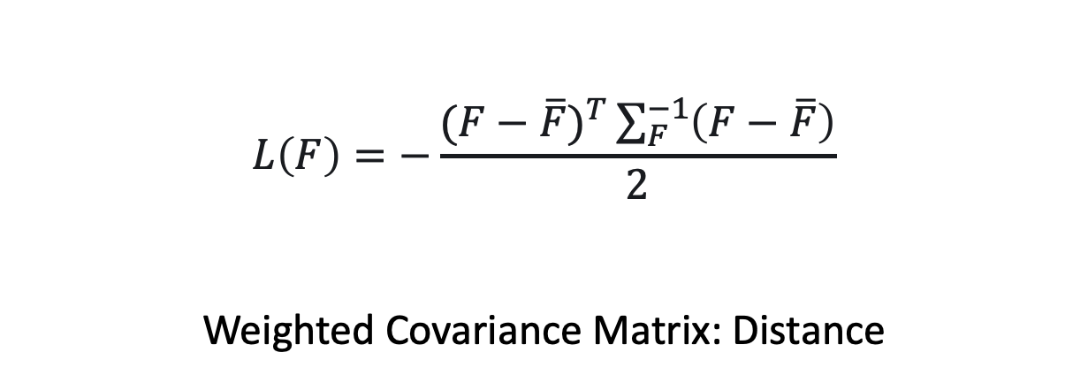
Mathematics
$$L\left(F\right)$$
$$L\left(F\right)=−\frac{(F−\overline{F})^{T}\sum_{F}^{−1}{\left(F−\overline{F}\right)}}{2}$$
Weighted Covariance Matrix: Distance

Slide 10
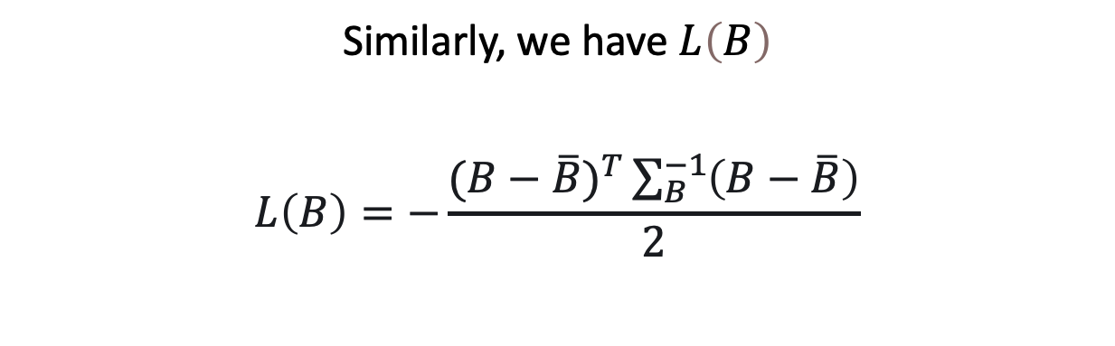
Mathematics
$$L\left(B\right)$$
Similarly, we have$L\left(B\right)$
$$L\left(B\right)=−\frac{(B−\overline{B})^{T}\sum_{B}^{−1}{\left(B−\overline{B}\right)}}{2}$$

Slide 11
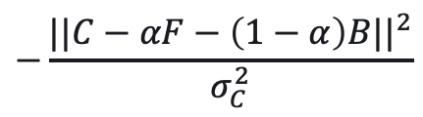
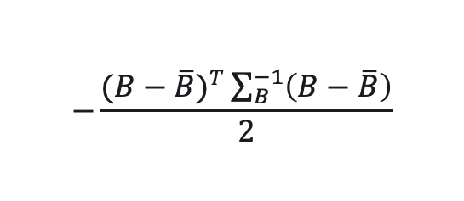
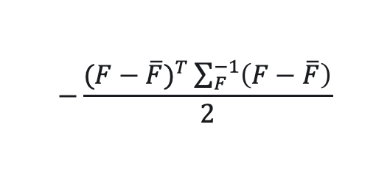
Mathematics
Log Likelihood
$$L\left(α,F,B | C\right)=arg{\max_{α,F,B}{L(C|α,F,B)+L\left(F\right)+L\left(B\right)}}$$
$$−\frac{||C−αF−\left(1−α\right)B||^{2}}{σ_{C}^{2}}$$
$$−\frac{(F−\overline{F})^{T}\sum_{F}^{−1}{\left(F−\overline{F}\right)}}{2}$$
$$−\frac{(B−\overline{B})^{T}\sum_{B}^{−1}{\left(B−\overline{B}\right)}}{2}$$

Slide 12
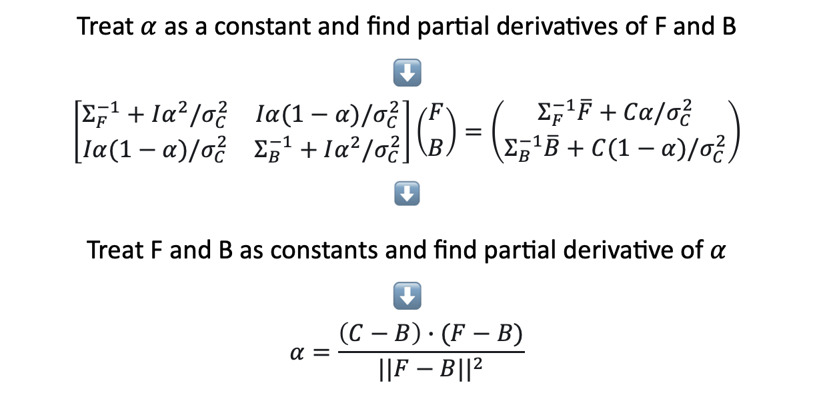
Mathematics
Iteration
Treat$α$as a constant and find partial derivatives of F and B
⬇️
$$\left[\begin{matrix}Σ_{F}^{−1}+Iα^{2}/σ_{C}^{2} & Iα(1−α)/σ_{C}^{2} \\ Iα(1−α)/σ_{C}^{2} & Σ_{B}^{−1}+Iα^{2}/σ_{C}^{2}\end{matrix}\right]\left({F \atop B}\right)=\left({Σ_{F}^{−1}\overline{F}+Cα/σ_{C}^{2} \atop Σ_{B}^{−1}\overline{B}+C(1−α)/σ_{C}^{2}}\right)$$
⬇️
Treat F and B as constants and find partial derivative of$α$
⬇️
$$α=\frac{\left(C−B\right)∙(F−B)}{||F−B||^{2}}$$

Slide 13
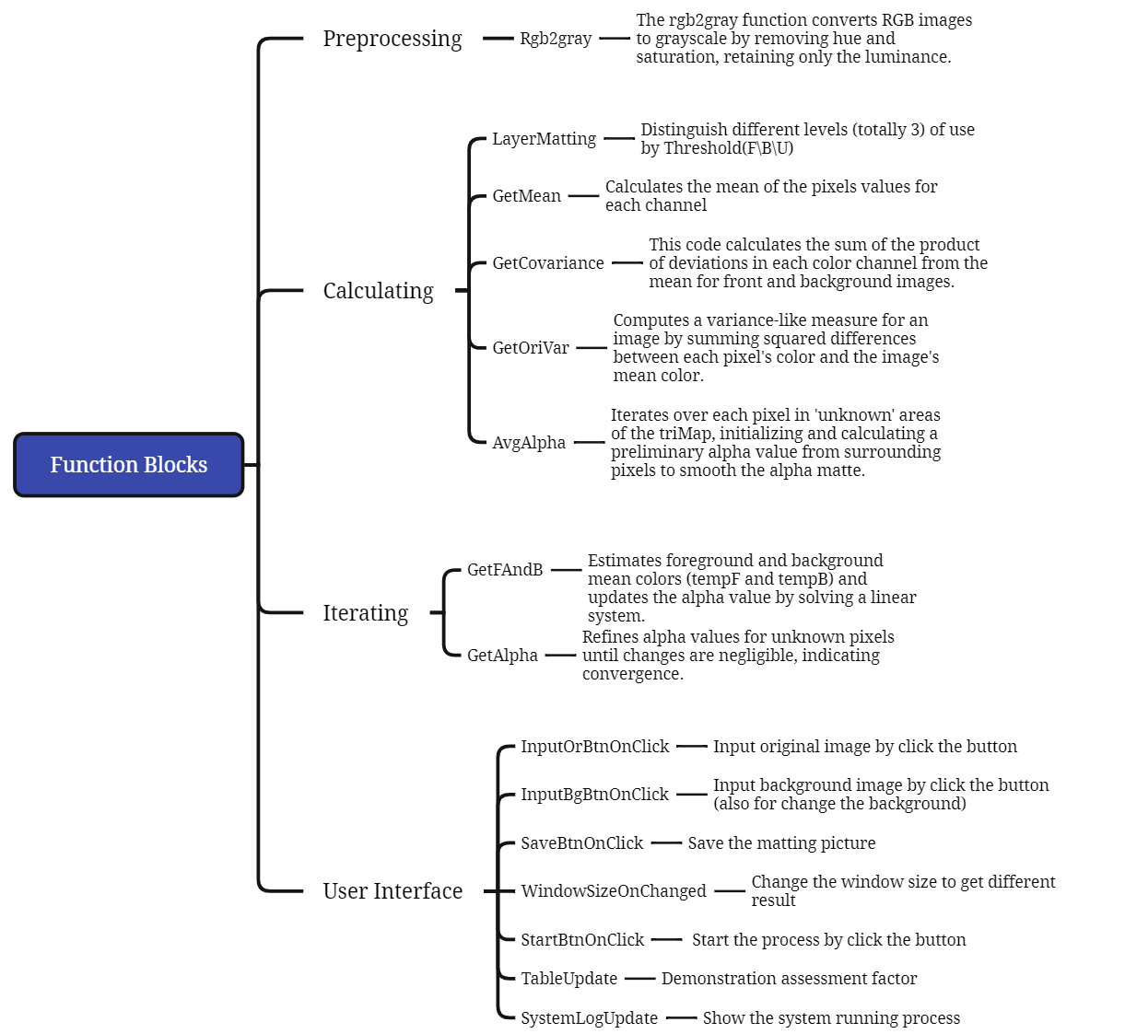
Function Blocks
Preprocessing
Simplification: Efficiency, Streamlining, Single Intensity.
Threshold Consistency: Predefined Thresholds, Intensity Classification.
Standard Matting Practice: Image Matting, Grayscale Guide.
Compatibility with Logic: Processing Consistency, Intensity-based Logic.

Slide 14
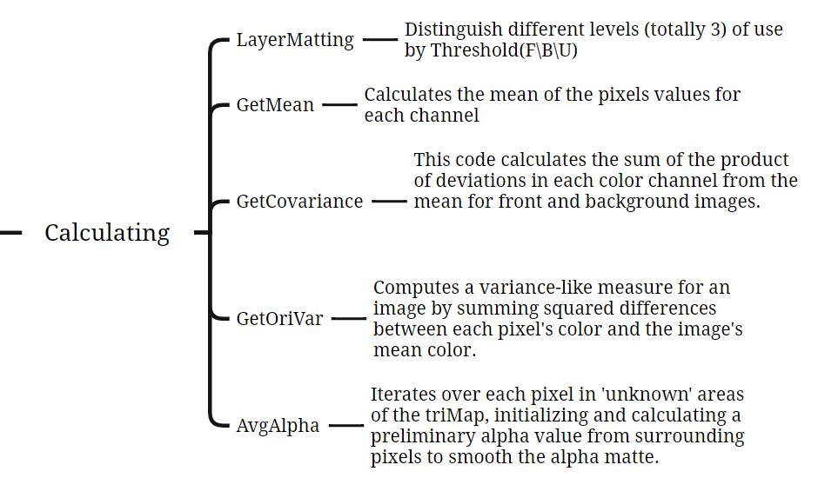
Function Blocks
Calculating
The calculations provide key color insights for distinguishing the foreground from the background, crucial for areas with unclear boundaries like hair or fur.
Mean Calculation: Color Averaging, RGB Channels, Region Centrality
Covariance Matrix: Color Variation, Channel Relationship, Texture Analysis
Normalization: Scale Adjustment, Pixel Count Relevance, Average Representation
Variance Calculation: Noise Estimation, Texture Characterization, Color Deviation Measurement

Slide 15
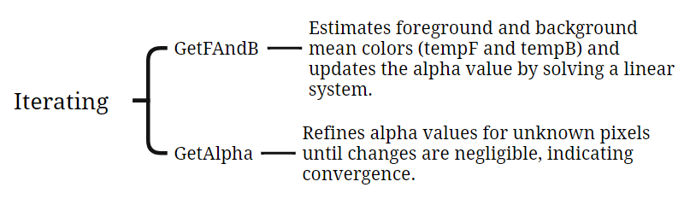
Function Blocks
Iterating
This part will refine the alpha matte in complex image areas (such as edges, hair, fur) by iteratively adjusting transparency and color for precise foreground-background separation.
Alpha Matte Refinement: Precise Transparency Adjustment
Complex Area Focus: Edge, Hair, Fur Detailing
Iterative Calculations: Repeated Fine-Tuning
Foreground-Background Separation: Accurate Color Segregation
Transparency Calculation: Alpha Value Determination
Color Matching: Foreground-Background Color Alignment
Convergence Check: Optimal Alpha Value Assessment

Slide 16
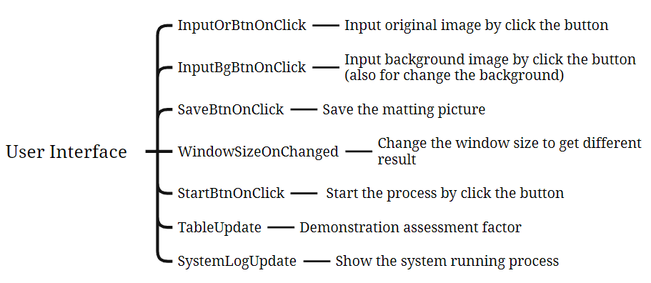
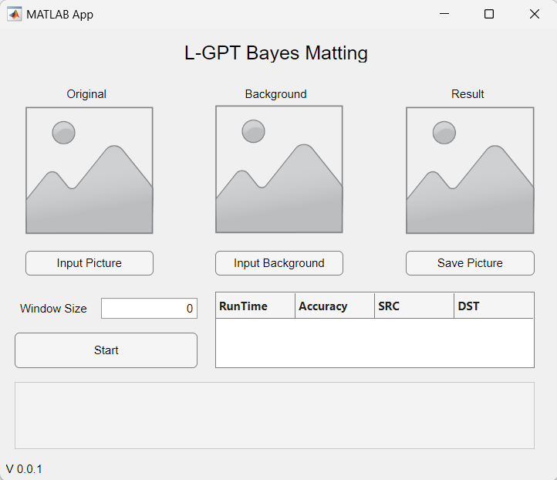
Function Blocks
User Interface
Data visualization capabilities
Easy integration with MATLAB's computational functions
User-friendly interface for creating and customizing GUIs without needing extensive programming skills.

Slide 17
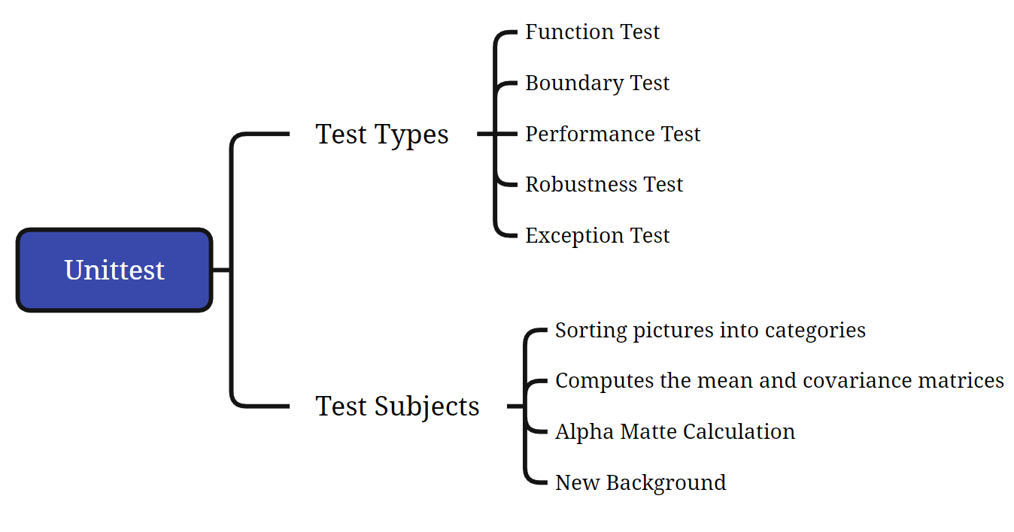
Unittest

Slide 18
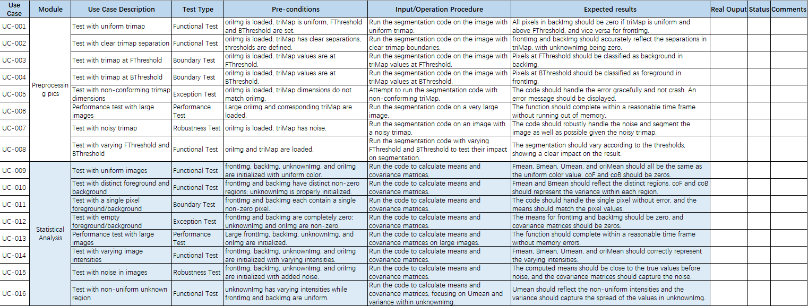
Unittest

Slide 19
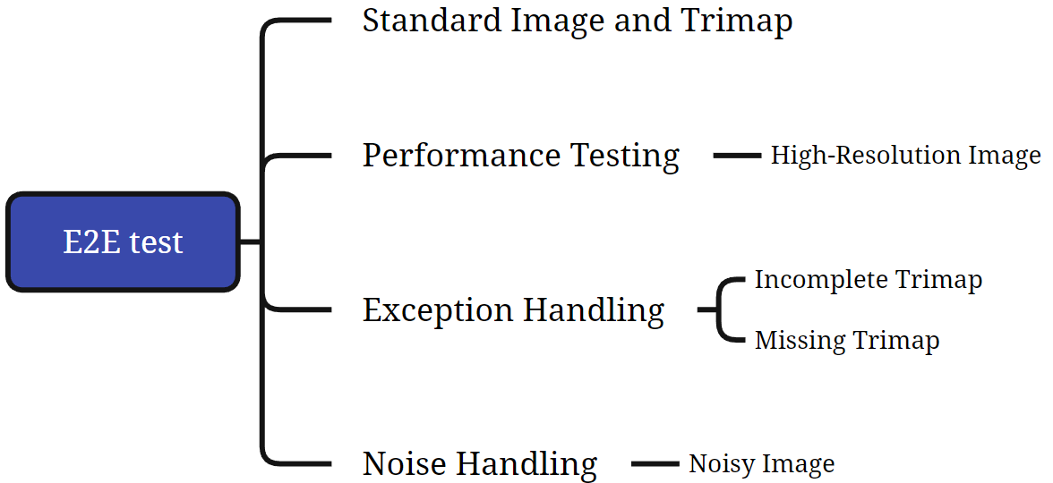
E2E test

Slide 20
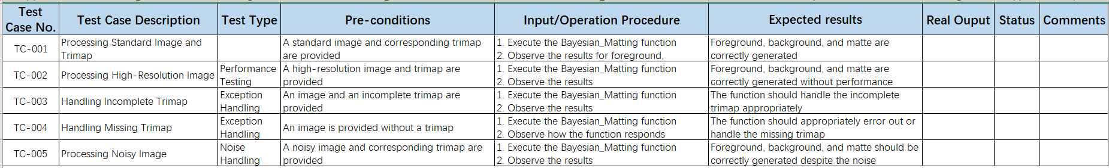
E2E test

Slide 21
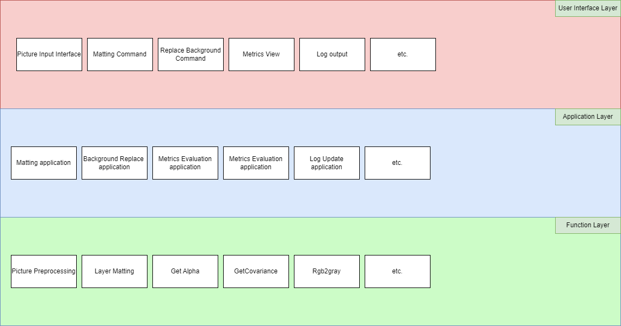
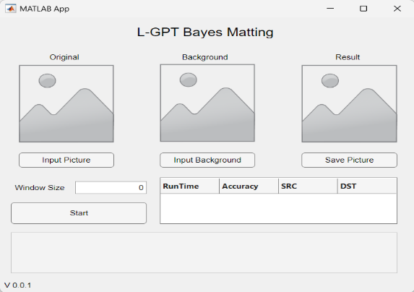
Flow of Implementation
Project Structure Overview
Multiple Layer Project Structure
Isolate Users from underlying algorithms
Modular Integration
Notes:
1. As the Integration Engineer, I am responsible for the System Integration and Code Lint and Review
2. In this presentation, I will show you the flow of the implementation and the milestones and timeline of this project
3. The first thing we need to do before building our implementation flow is to set the structure of the whole system
4. We will divide the system to three layers, as User Interface layer, application layer and function layer. In Each layer, we package different functions as a module.
5.For example, when we push the matting command button on the user interface, this will call the matting application in the app layer and then call the algorithm functions in the function layer.
6.With this multiple layer and module divided program structure, we could isolate the users from the underlying layers and make it a truly application not only original code.
7.With module design, we could improve the robust of the program, make the test and implement much easier.

Slide 22
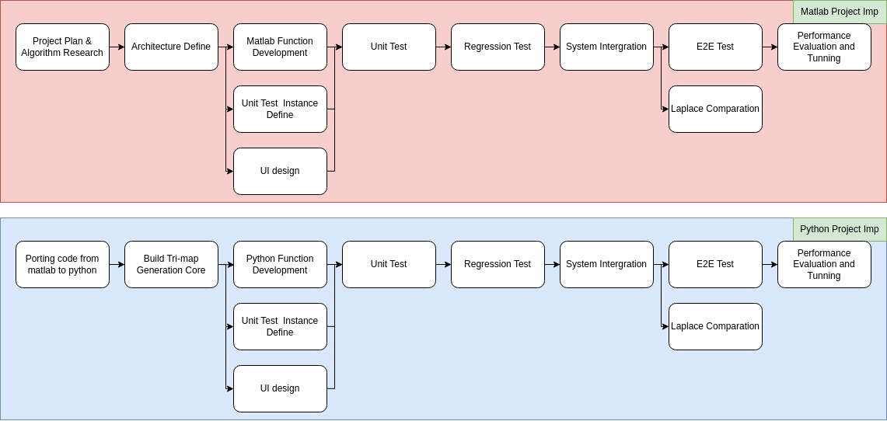
Flow of Implementation
Implementation flow
Algorithm and Architecture
Develop
Integration & Test
Tunning
Notes:
As mentioned in the assignment, in the end, we need to implement two applications at last as a matlab version and a python version.
1.In each implementation flow, we have four part as the …
2.The implementation flow of python project is similar to matlab, a little difference is that we will try to implement some AI tech on building the tri-map instead of manually marking.

Slide 23
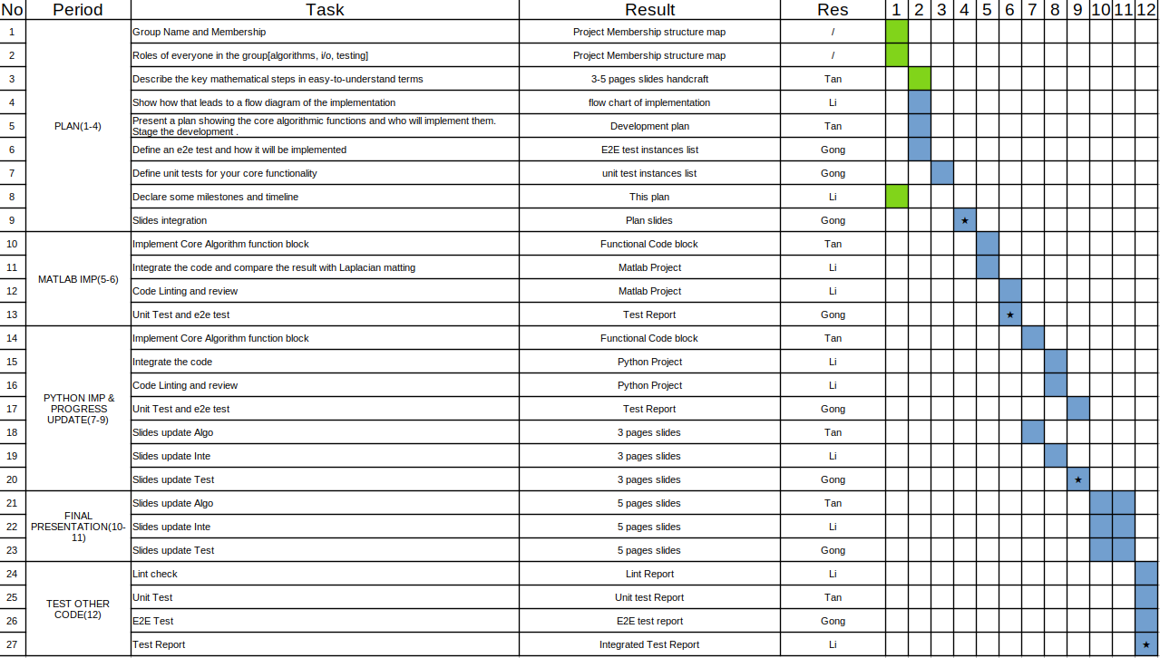
Milestones and timeline
Project implementation Gantt chart
Gantt Plan Format
Task Description
Expected Result
Responsibility
Weekly Node
Gantt Plan(5 parts)
Plan And Presentation(4w)
Matlab Implementation(2w)
Python Implementation(3w)
Final Presentation(2w)
Test Other Code(1w)
Notes:
To build up these applications on time, we need a timeline and milestones.
We use Gantt plan to build up the timeline and mark the milestone of the project.
We split the tasks to small ones and mark the description…
With this Gantt chart, we can clearly find out what we need to do weekly and easily manage the project process.

Slide 24
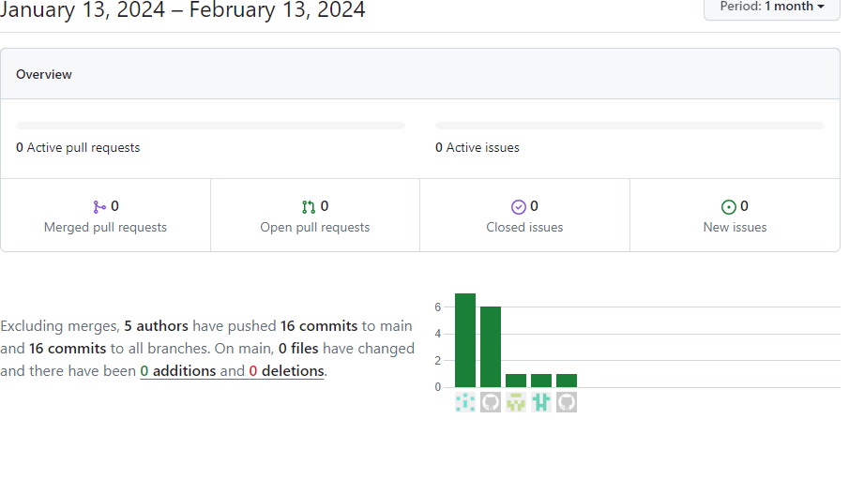
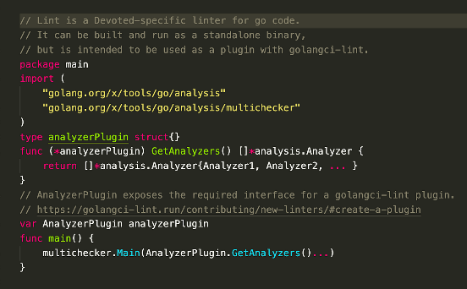
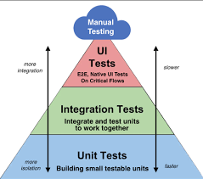

Milestones and timeline
How to achieve this…
flow control
Code quality control
Flow control
Version control
Document control
Code Review
Code Linting
Code Tuning
Progress Control
Reliability Testing
Unit Test
E2E Test
Cycle benchmarking
Week nodes plan
2 meetings / week
In-time
High-quality
Project

Slide 25
Thank You

