Slide 1
Hardware In Loop Project Report
M1W1

Slide 2
Current Progress
Work | Description | Status
Build Risc-V Core | Build Risc-V Core on the Nexys Vedio Board | Built two cores on the board, verified the gpio driver, uart driver, xsdb debug of the cores.
Build CAN Controller | Build two CAN controllers for each core | Built CAN controllers with open-core code, using 8051 interface
Build CAN Transceiver | Because the CAN controller will verify the data it has already transmitted in a fixed time, to implement the transmission between two CAN nodes on one board without any physical transceivers, we need to build a software transceiver. | Finished
Build Bare-metal code for cores | Build bare-metal software code to make the RISC-V IP possible to controll the CAN controller, then process the communication | Finished GPIO driver, uart driver, CAN init, transimit and receive driver
Verify CAN communication on board | Verify the driver code and the software IP we have already built | Finished the testbench simulation of CAN controller and transceiver, finished the bare metal software of RISC-V to transmit and recerive an extened format CAN pack
Notes:
Analyse the output of a large memory block, or a stream of video data by eye?
We want defined systematic testing to ensure functionality and coverage.

Slide 3
Next Step
Work | Description | Deadline
Build 8-cores Project | Because we need to simulate at least four ECUs at the same time ,current project with 2-cores is not enough, we need to rebuild the vivado project as a 8-core version | 14, Jan
Check the Main Structure of the Project | Make an asumption of the structure of the whole project and check | 14, Jan
Midterm Report | Make an outlilne of the midterm report and confirm after finished the structure of the whole system | Outline: 14, Jan Report:21, Jan
Verify physical CAN bus comm with a ZYNQ board | Get an pysical CAN transceiver and let the RISC-V core talk with the ZYNQ board with CAN bus | 28, Jan
Build Ethernet interface | Buill up an ethernet interface for the board, for transmitting the status and command for the cores and PC | 21, Jan
Notes:
Analyse the output of a large memory block, or a stream of video data by eye?
We want defined systematic testing to ensure functionality and coverage.

Slide 4
Needed Support
Support | Description
Check the main structure and main ideas | Could you please help me check the main structure and the main points of the system followed in the next slides and give me some advices
Hardware support | To check the communication between the ZYNQ board and the Nexys board, we need some hareware CAN transceivers and a ZYNQ board
Software download and data monitoring problems | At last, I think it will be necessary to monitor the status and send command and download the software to each RISC-V core with the scripts on the PC. I can only download the software of the core using xsdb command, I have no idea how to transmit these monitoring data and finish the programming automatically with PC software, could you please give me some advices
ZYNQ and desktop software demo | We discussed the software of ZYNQ and desktop before, and I want to know if there is a demo code for these two parts to excute a standard CAN test

Slide 5
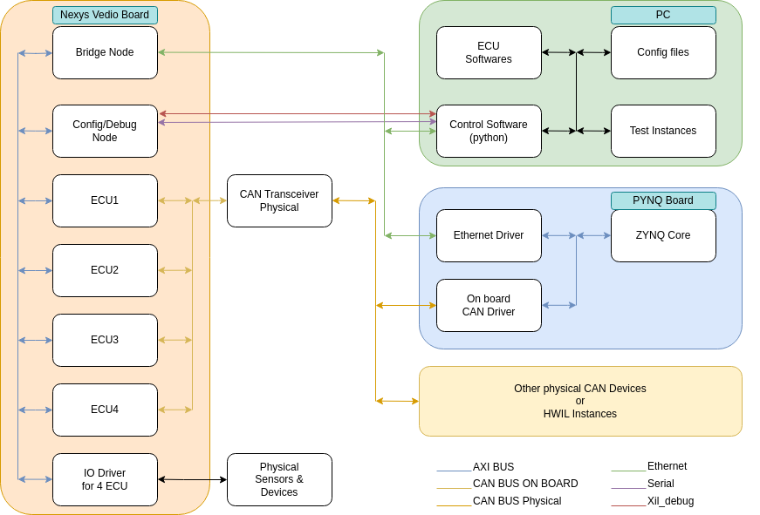
Main Structure of the System

Slide 6
Main Ideas of the project
Ideas | Description
Build up the CAN communication between RISC-V cores | Build the main communication structure on the Nexys Vedio board and simulate
Build a ZYNQ core to monitoring and inject errors to the can bus line | Make it possible to inject errors to the CAN bus, and connect the Nexys board data to the PC, make it possible to use python scripts on the PC
Build desktop software | Build an UI desktop software to download program, monitor data, inject errors, excute auto testbench
Error injection and Speed up test | Use ZYNQ board to simulate error injections to the CAN bus like (DOS, Replay and Spoofting)
Error detection and solution | Use encryption algorithm or other methods to defeat the erros injection attact, maybe use some AI method to detect and predict the error status by monitoring the CAN bus data

