Slide 1
Hardware-In-The-Loop Emulator For In-Vehicle Controller Area Networks
Changhong Li
Supervisor: Shreejith Shanker
Date 17/05/2024

Slide 2
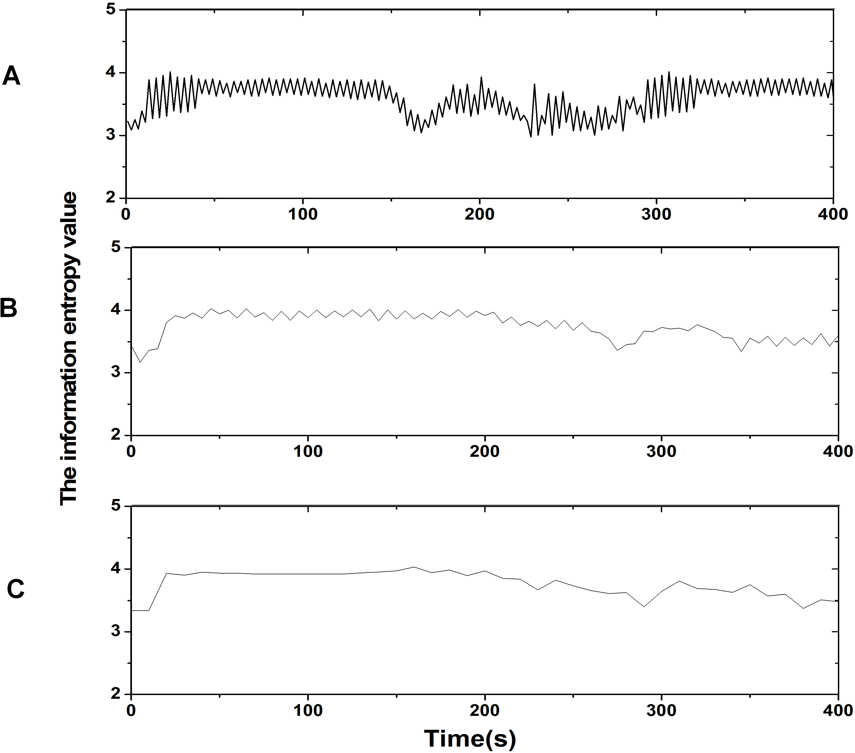
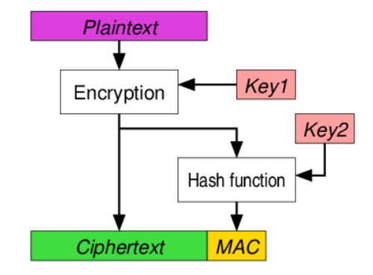
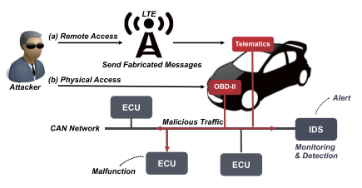
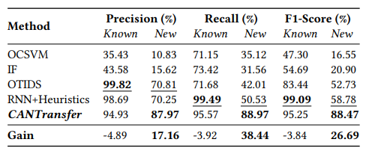
Background & Project goals
Problem Recap
Traditional Detection & Encryption
IDS & DNN detection
Neural networks have greatly improved attack detection performance,
But how to deal with flexible system changes and long development cycle

Slide 3
Background & Project goals
Project goals
Traditional Detection & Encryption
IDS & DNN detection
Neural networks have greatly improved attack detection performance,
But how to deal with flexible system changes and long development cycle

Slide 4
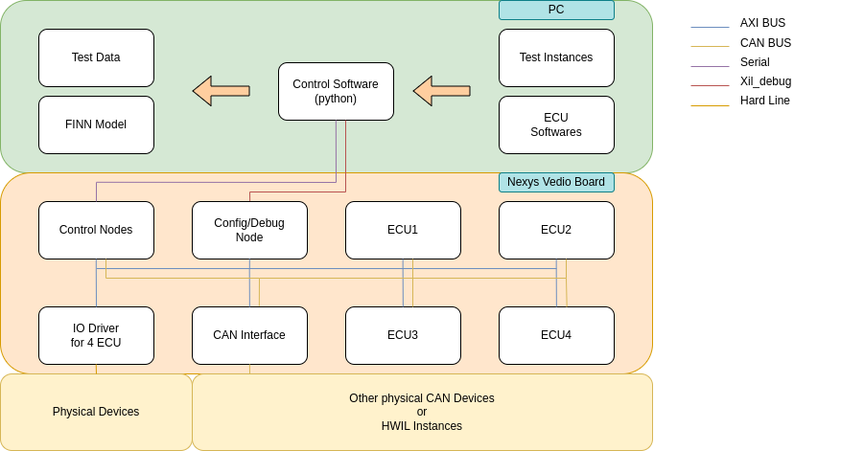
System Structure
Structure and features
Flexible nodes(type, scale)
Physical device access
Automatic testing
Complete tool chain
Network
Change
Test&Data
Model Deployment
Software
Define
Auto
Annotation
FINN
Tool chain
System Structue
Accelerate Deployment

Slide 5
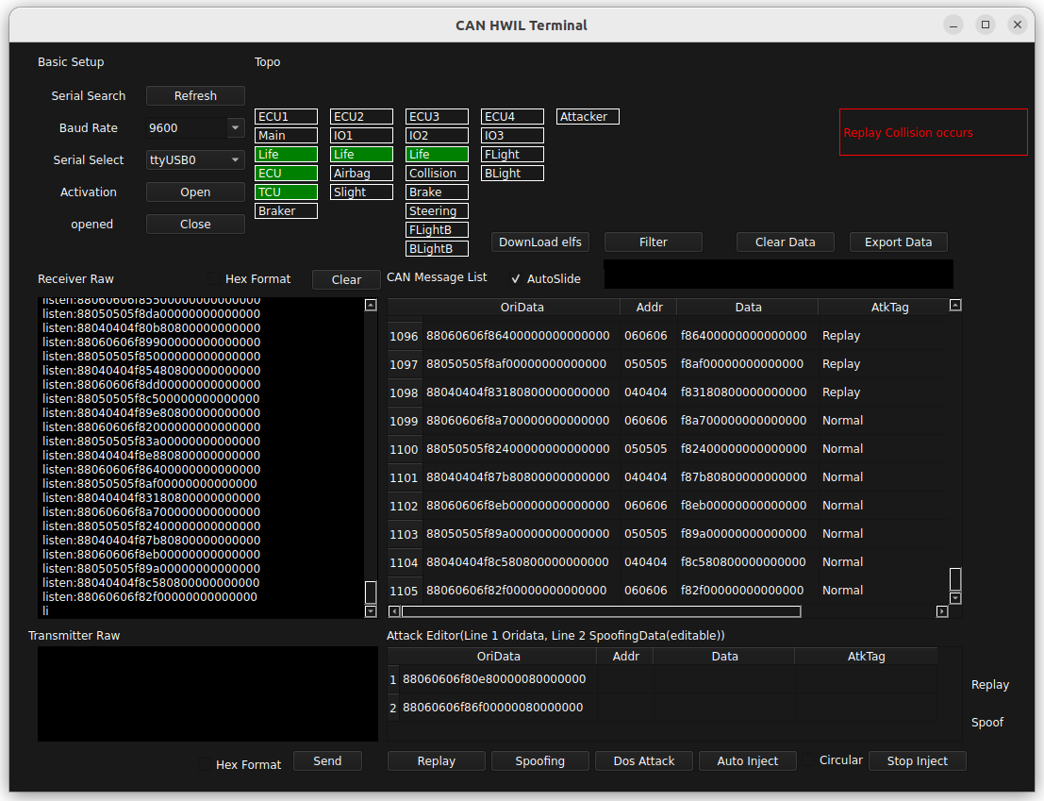
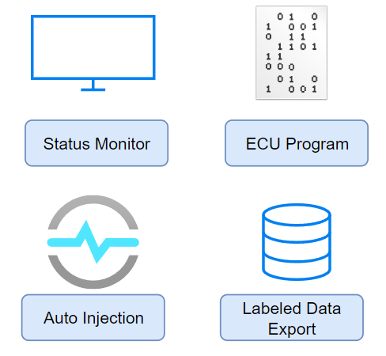
Software Platform
Functions and features

Slide 6
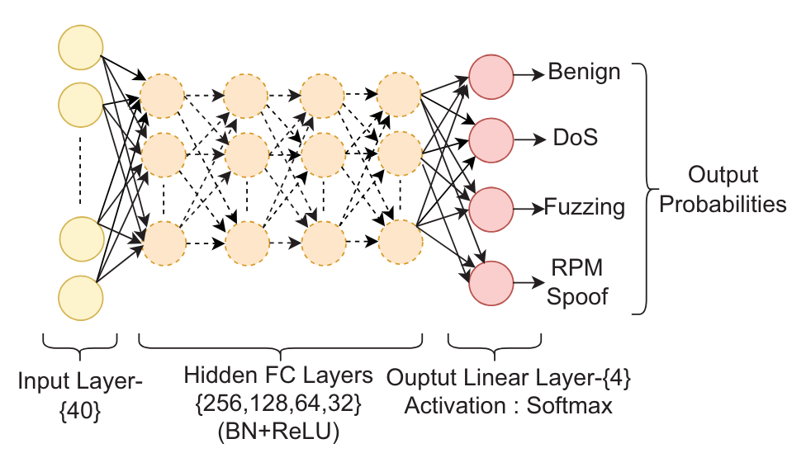
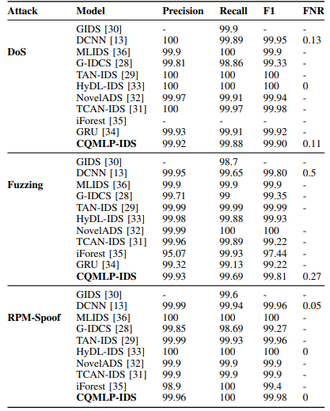




Complete Solution
Empower the Automotive safety
Flexible
HWIL Emulator
High-Performance
QNN Accelerators
Deployable
Stitched IP for Edge
Flexibly Changeable System Structure
Complete CAN bus
Test & Detection Solution
Empower
Automotive Safety
Model Performance

Slide 7
Group Introduction
Members and Roles
Flexible & Deployable & High-performance
Attack detection

Slide 8
Thank You

