Slide 1
Ergodicity Economics
Jiacheng Li, MinShuai Jiang, Changhong Li
Date 04/05/24

Slide 2
Introduction
What is Ergodicity Economics?
Ergodic System:
Time Average = Expected Value
Traditional Economics
Ergodicity Economics
Ergodic system Assumption
Many economic systems are non-ergodic
Consider a non-Ergodic system

Slide 3
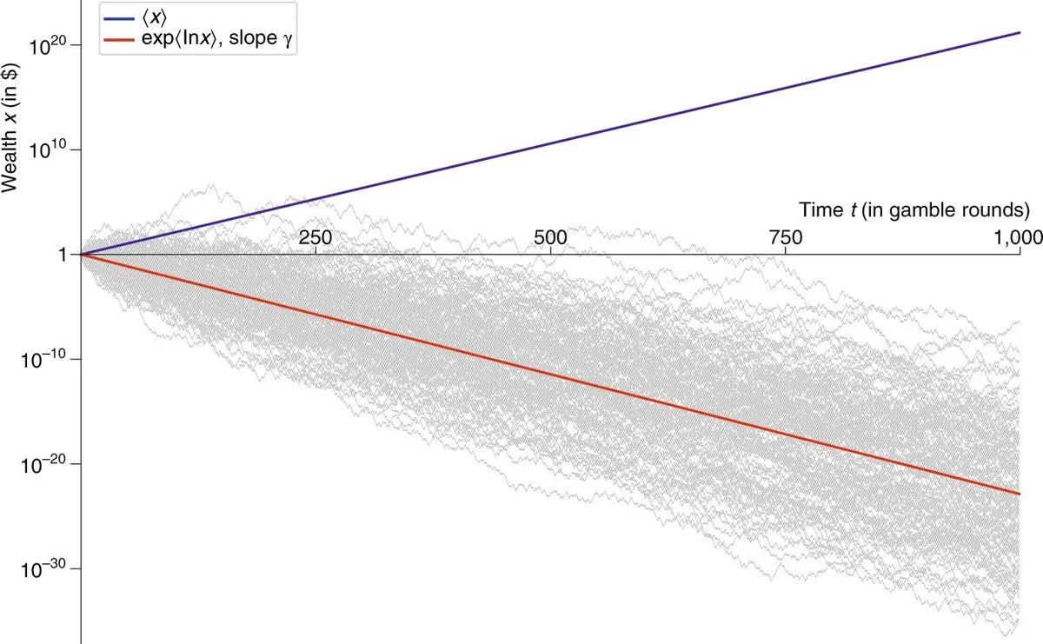
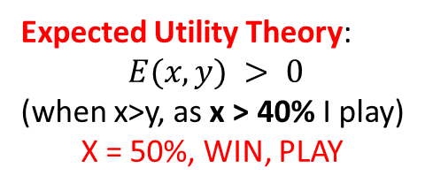
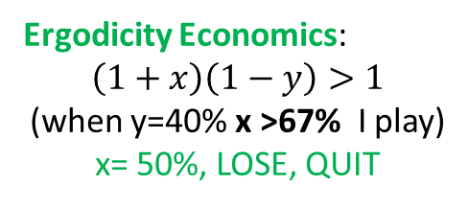
The infamous coin toss
The Peters coin toss
Heads: Add 50%
Tails : Reduce 40%
How could we win(with different theory)?
EUT
Expected Utility Theory:
$E(x,y) > 0$
(when x>y, as x > 40% I play)
X = 50%, WIN, PLAY
EE(What really happen)
Ergodicity Economics:
$$\left(1+x\right)\left(1−y\right)>1$$
(when y=40% x >67% I play)
x= 50%, LOSE, QUIT
Notes:
The blue line is the average. This average is also called the expected value, and for the Peters coin toss, it grows by 5% in every round of the gamble. (per people)
As T grows, again the proportions of heads and tails converge to 1/2. We have lost 10% over two rounds, or approximately 5% per round. Since we lose 5% per round. (long-time limit)
The grey line is all the long-time limit individuals’ wealth which is guaranteed to approach zero.

Slide 4
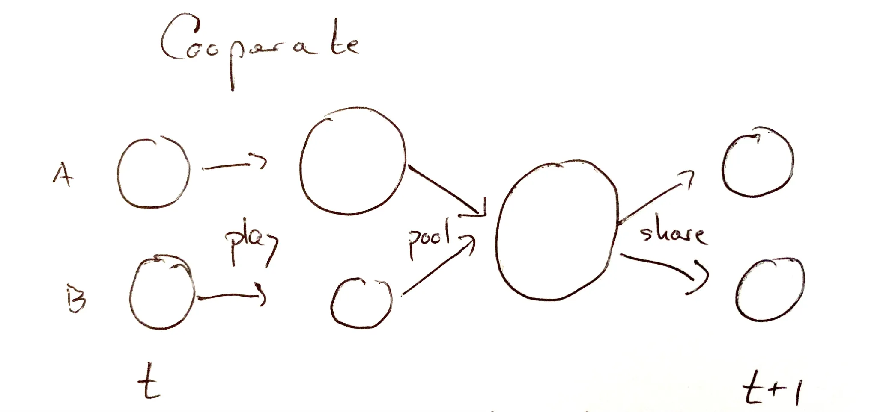
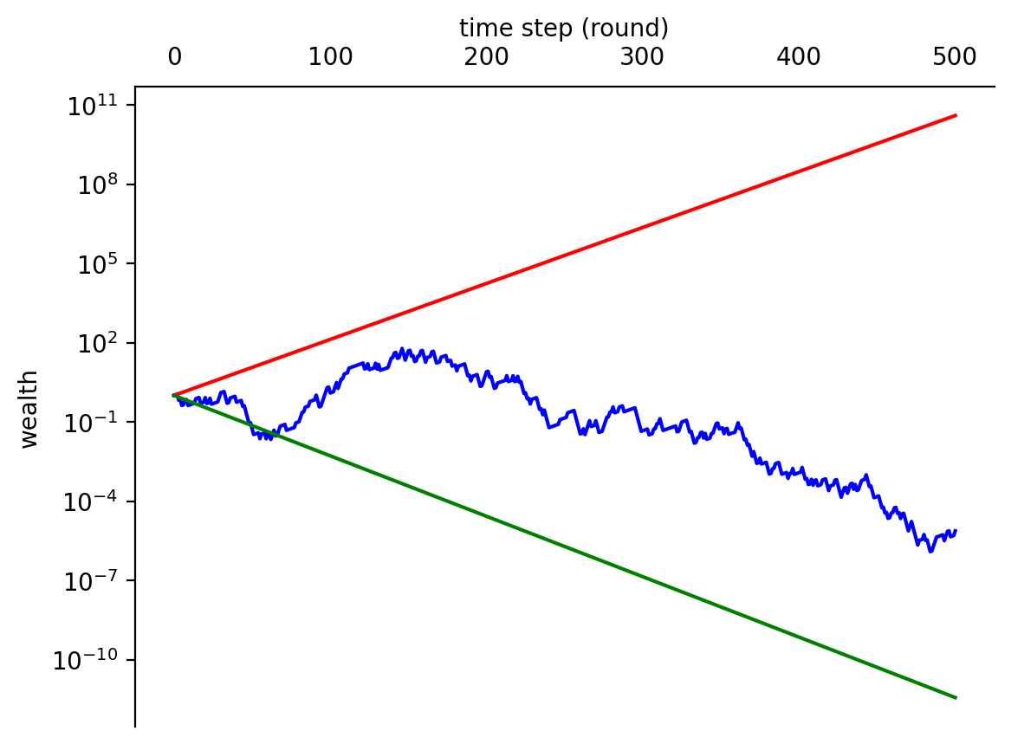
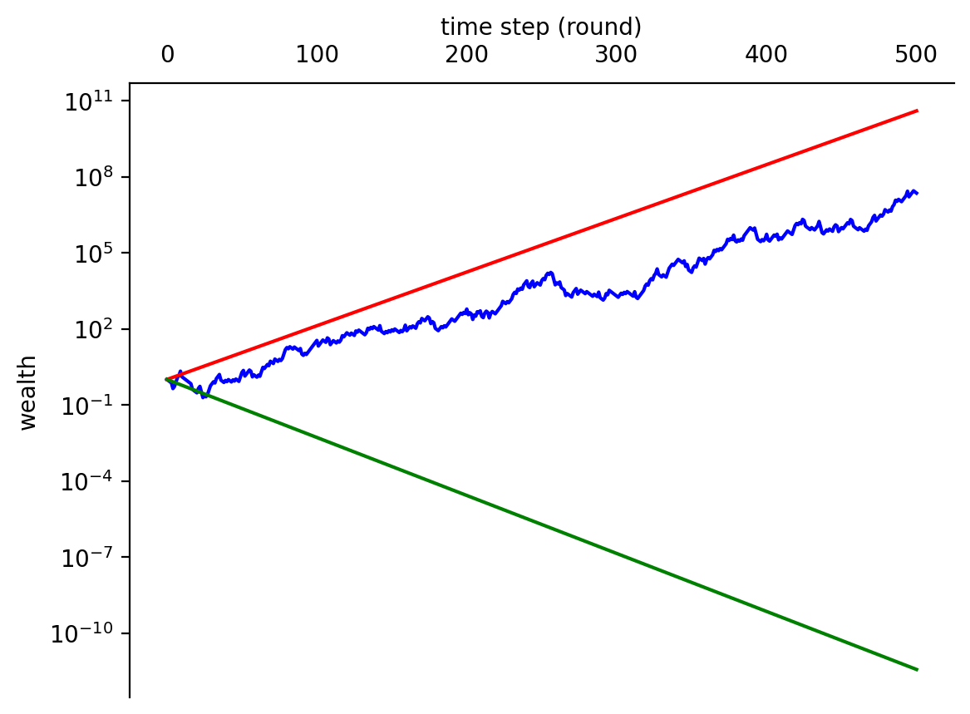
Solution for the infamous coin toss
Cooperation instead of a lonesome coin
One instance: find a partner, independently play one round each, then pool your wealth and split it evenly. Then play the next round independently, as illustrated in the figure.
For two cooperators: leads to a time-average growth rate of the wealth of the cooperating pair of -0.2% per round
For three cooperators: The time-average growth rate of the cooperating triumvirate is +1.5% per round.

Slide 5
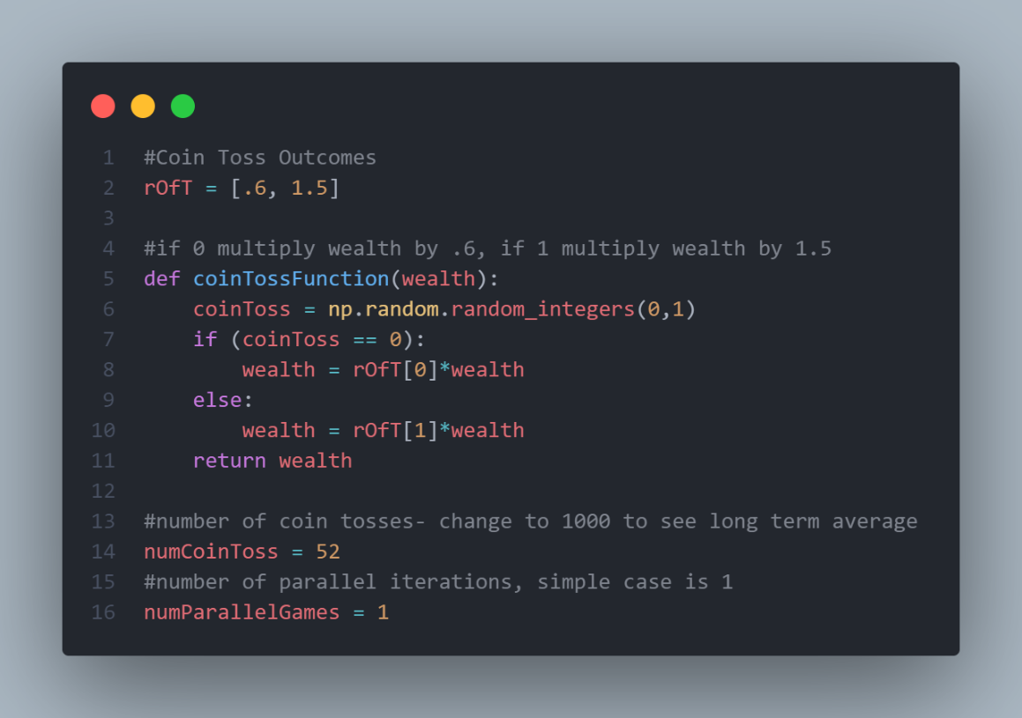
Coin toss implementation
Win Outcome = 150%
Lose Outcome = 60%
Toss time = 52 (independent)
Parallel Gamer = 1(independent)

Slide 6
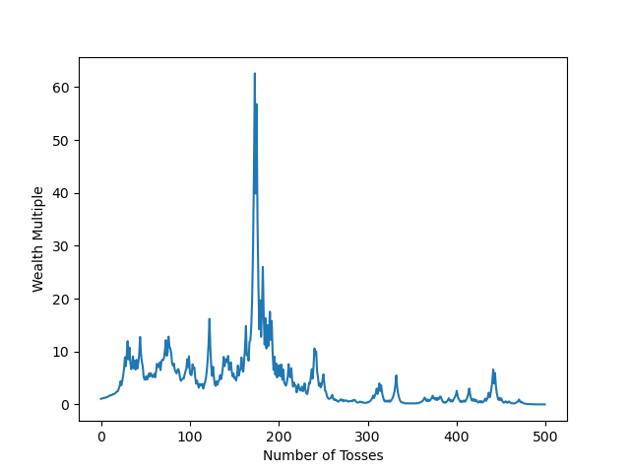
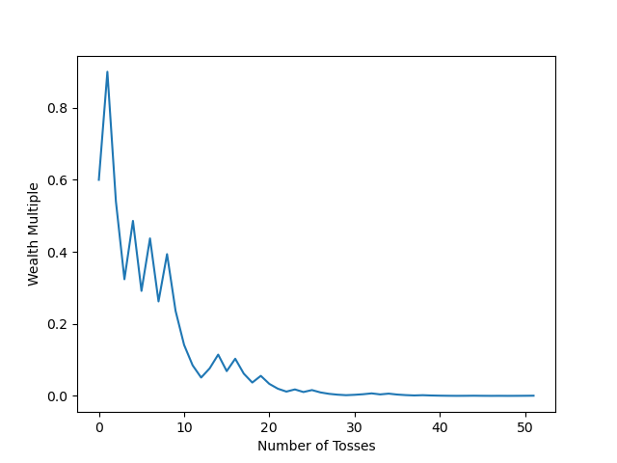
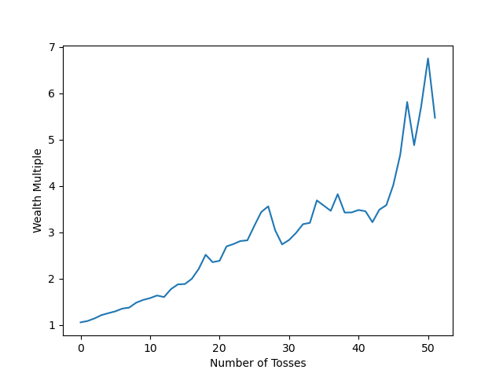
Coin toss implementation
1000 gamers, 500 tosses
1 gamer, 52 tosses
1000 gamers, 52 tosses
LOSE
Less Player
WIN
More time
CHAOS
Players↑ -> System Ergodicity ↑
Time↑ -> System Ergodicity ↓

Slide 7
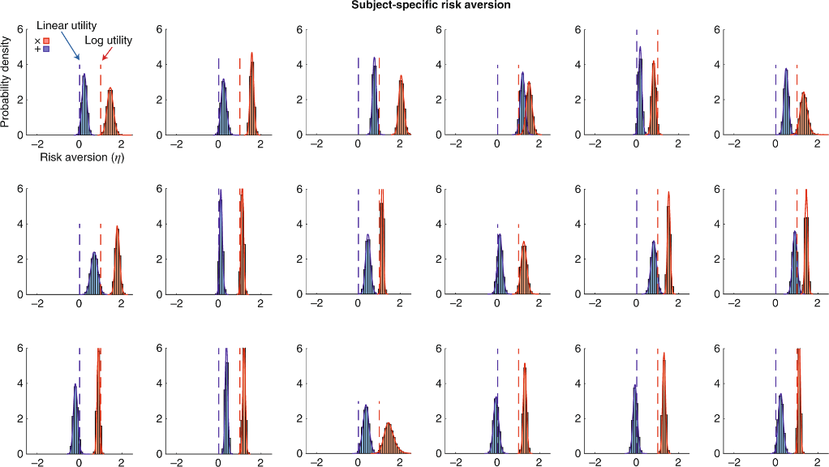
Copenhagen experiment
Additive and Multiplicative
In all cases, the multiplicative environment did not lead to the expected value(EUT) but shifted to the right(More conservative)(EE).
EE is better than EUT with the empirical phenomenon.

Slide 8
Ergodicity ＆ SOTN
Nonlinear: They both focus on the nonlinear system and the changes in the dynamics. (Multiplicative in Ergodicity Theory and Complex System in SOTN Theory)
Emergence: Changes in the number of individuals will add a non-Ergodic influence on the performance of the whole system.
Complex System: Chaos is shown in the Ergodicity Economic game; thus, it is represented as a complex system.

Slide 9
Thank You

