Slide 1
Advanced Testbenches
Lecture 2

Slide 2
Up to now…
Manipulated DUT inputs from testbench
“Stimulus only” testing
Observed output in waveforms
No automated checking
Ok for small number of inputs & outputs and in early stage of development
Problems arise in larger designs:
Error prone
Unmanageable with larger IO
Not systematic
Does not support random testing
Slow
Notes:
Analyse the output of a large memory block, or a stream of video data by eye?
We want defined systematic testing to ensure functionality and coverage.

Slide 3
Verification In Industry
Standardised testbench structure
ASIC verification: UVM (Universal Verification Methodology) structure via SV
Separation of testbench and test cases
Testbench instantiations “Device Under Test” (DUT) or “Device Under Verification” (DUV)
Test case provides stimulus for particular use-case / feature
Test plan lists required testcases
Constrained randomisation
Automatic pass/fail derived from model of DUT
Coverage metrics used to ensure testing is sufficient
100% coverage expected
Types of coverage: toggle, condition, branch
Notes:
Verification large part of chip design today
Very important in ASIC, cost of errors extremely high
Design complexity has greatly increased

Slide 4
Designer Testing in Industry
Used by designer from very beginning of development process
Structure is more simple than full verification environment
Self-checking options:
Software model producing “golden vectors”, use File IO methods for comparison
Verilog model to compute expected output for given stimulus
Directed testing with defined expected output
Key: Provide pass/fail results without needing to inspect waveforms
Log-file should be produced to record pass/fail per feature

Slide 5
Example: Counter Test Plan
In-Class Whiteboard:
Write up ideas for test plan for counter with…
4-bit counter
Enable pin
Reset pin
Up/Down pin

Slide 6
Useful Testbench Constructs
Advanced testbenches will require using new features of Verilog
Note these features are primarily non-synthesizable, testbench only
Notes:
Contrary to writing Verilog for design where we are directly describing the circuits we want to implement. For verification, we have no such restrictions. We can write procedural testbenches, and even use object oriented features of system Verilog in more advanced cases.

Slide 7
Useful Testbench Constructs
Four loop constructs in Verilog:
for, while, repeat, forever
Three time control constructs
#, @, wait
System tasks for controlling simulation
System tasks for displaying text and variable values
File IO system tasks
Custom functions and tasks
Notes:
# is a fixed delay
Wait is a conditional delay
@ is triggered

Slide 8
for loop
for (initial_assignment;end_condition;step_assignment) begin
procedural statement;
procedural statement;
…
end
Example: Initialise 16-word register bank
integer i;
…
for (i=0; i<16; i=i+1) begin
reg_file[i] = 8’(i);
end
Notes:
What is 8’(i) doing?

Slide 9
while loop
while (end_condition) begin
procedural statement;
procedural statement;
…
end
Previous example redone as while loop:
integer i;
…
i=0;
while(i<16) begin
reg_file[i]= 8’(i);
i=i+1;
end
Notes:
For example only, for loop should be done when number of iterations known (like C)

Slide 10
repeat loop
repeat (number) begin
procedural statement;
procedural statement;
…
end
Example repeat loop:
repeat(16) begin
count_en = 1;
#100;
count_en = 0;
#100;
end
Notes:
Repeat stimulus pattern
Very useful when used in conjunction with tasks also

Slide 11
forever loop
forever begin
procedural statement;
procedural statement;
…
end
Example forever loop
initial begin
clk = 1’b0;
forever
#20 clk = ~clk;
end
Notes:
Clock stimulus

Slide 12
Useful Testbench Constructs
Four loop constructs in Verilog:
for, while, repeat, forever
Three time control constructs
#, @, wait
System tasks for controlling simulation
System tasks for displaying text and variable values
File IO system tasks
Custom functions and tasks

Slide 13
Timing Control
Three different time control constructs:
Delay control
#delay_time
Event control, edge sensitive
@(event1, event2…)
Wait statement, level sensitive
wait(boolean_expression)
Waits for specific condition to become true
Subsequent statements not executed until that condition filled, e.g.
wait(counter == 4’d15) // waits until counter is 15
… // then rest gets executed
Notes:
NB Difference between event control and wait control
Also `timescale 1ns/1ps method (units / precision)

Slide 14
Useful Testbench Constructs
Four loop constructs in Verilog:
for, while, repeat, forever
Three time control constructs
#, @, wait
System tasks for controlling simulation
System tasks for displaying text and variable values
File IO system tasks
Custom functions and tasks

Slide 15
System Functions and Tasks
System-related operations
Simulation control and file access
Begin with $, e.g. $monitor
Full list in Verilog-2001 reference book
We’ll use
$finish, $stop,
Also:
$display, $write, $strobe, $monitor
Notes:
Finish vs stop

Slide 16
Display Tasks
$display
$display(format_string, arg,arg,…);
$display(“At %d; signal x = %b”, $time, x)
At 5100; signal x = 00111100
$write same as display but no new line
$strobe similar syntax but executes later
Executes at end of current simulation time step
$monitor
Prints updated values at end of time step

Slide 17
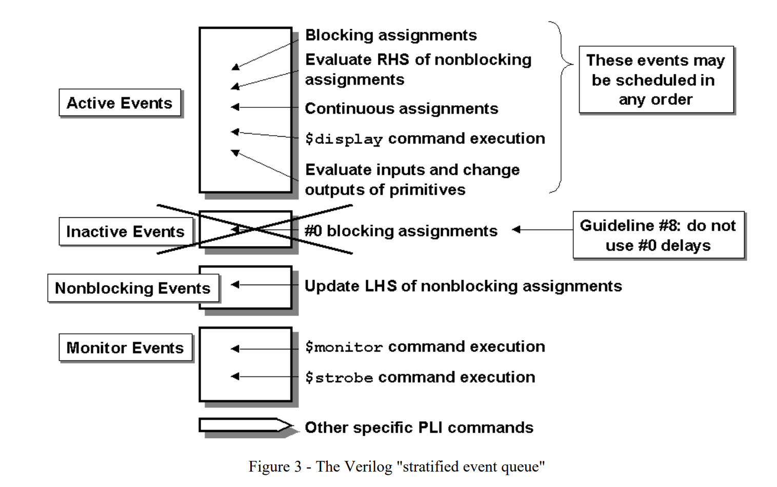
Rememer: Verilog Simulator Event Queue

Slide 18
Demo: Printing to Tcl Console
reg [3:0] a,b;
integer i;
initial begin
$monitor( "monitor a:%h b:%h @ %0t" , a, b, $time);
for(i=0; i<4; i=i+1) begin
$strobe( "strobe a:%h b:%h @ %0t" , a, b, $time);
$display( "display a:%h b:%h @ %0t" , a, b, $time);
case(i)
0 : a = 4;
1 : b = 1;
2 : begin end // Do nothing
3 : {a,b} = 9;
endcase
$display( "display a:%h b:%h @ %0t", a, b, $time);
#1;
end
end
Notes:
Take 5 mins to decide what order you expect outputs to get printed, what values and when, then will run a simulation and use the debugger to check this
Tcl console output from example…
Load example, show code for several minutes and ask what order the statements will be activated in
initial – what does this mean?
Note, also final in SV

Slide 19
Useful Testbench Constructs
Four loop constructs in Verilog:
for, while, repeat, forever
Three time control constructs
#, @, wait
System tasks for controlling simulation
System tasks for displaying text and variable values
File IO system tasks
Custom functions and tasks

Slide 20
File IO Tasks
Access external data files
Open file
$fopen, e.g.
Syntax: mcd_name = $fopen(“file_name”);
Example: log_file = $fopen(“logfile.txt”);
mcd: 32b int with one NZ bit for file, zero on failure
OR combination of mcd can be used to output to multiple files
Close file
$fclose, e.g.
Syntax: $fclose(mcd_name);
Example: $fclose(log_file);
Write to file with
$fdisplay, $fwrite, $fstrobe, $fmonitor

Slide 21
File IO Tasks
Two system tasks which don’t use $fopen:
$readmemh
$readmemb
Assume external file content is stored as a memory array.
Read the array into a variable, mem_var
$readmemb(“file_name”, mem_var);
$readmemh(“file_name”, mem_var);
$fscanf
Read in one line at a time
Provides text format flexibility,
Requires $fopen, $fclose and check for $feof
Notes:
Fscanf will return the number of assignments it has made based on what it has read in for that line
If attempts to read past the end of the file then feof will go high
Should have while loop checking that fscanf returns high, var assigned, and checking that feof isn’t high. Would have $finish after get $feof to end simulation.

Slide 22
File Format For $readmemb
reg [3:0] v_mem [0:7]; $readmemb(“vector.txt”, v_mem);
Just contains text as:
00_00
01_00
01_11
10_10
10_00
11_11
11_01
00_10
Notes:
Note, this reads in full file as single variable in testbench… What if vector is very long?

Slide 23
Useful Testbench Constructs
Four loop constructs in Verilog:
for, while, repeat, forever
Three time control constructs
#, @, wait
System tasks for controlling simulation
System tasks for displaying text and variable values
File IO system tasks
Custom functions and tasks

Slide 24
Custom Functions and Tasks
Useful in testbenches
Can be synthesizable in the right conditions
Improve readability of code
Avoid code repetition
Examine syntax now…

Slide 25
User-Defined Functions
Takes one or more inputs
Returns single output
Completes in single time step
No #, wait, @ allowed
Can call another function
Returns a value which may be used in an expression
Can be synthesizable if computed at compile time
e.g. calculate vector width from parameter

Slide 26
Function Syntax
// Function definition
function result_type func_id (input_arg);
statements;
endfunction
Difference in SystemVerilog, Verilog-2001 requires begin-end pair inside function-endfunction
Statements inside need to assign value to func_id (return variable name)
Void type may be used if no return value desired

Slide 27
Example Use of Function
// Listing 7.16
module eq2_function (input wire [1:0] a, input wire [1:0] b, output reg aeqb);
// Local variables
reg e0, e1;
// Combinational logic
always @(*) begin
#2 e0 = equ_fnc(a[0], b[0]);
#2 e1 = equ_fnc(a[1], b[1]);
aeqb = e0 & e1;
end
// function definition
function equ_fnc(input i0, input i1);
equ_fnc = (~i0 & ~i1) | (i0 & i1);
endfunction
endmodule
Notes:
Chu book
Model of desired behaviour
Non-synthesizable verilog, quickly write and get value of expected result, compare and report in your log file
#2 to mimic clock cycle, not real hardware!
No output type on function, assumed to be 1 bit

Slide 28
User-Defined Tasks
More flexibility than function
Can take zero or more inputs
Multiple values can be returned through output or inout arguments
Allows time control constructs, may execute in non-zero simulation time
Can call other tasks as well as other functions

Slide 29
Task Syntax
// Task definition
task task_id (arg);
statements;
endtask
SV removes begin-end inside task-endtask
No need to assign a value to task_id, all inputs, outputs defined in arg
Notes:
Should be very comfortable with task and function definitions, should know their differences in requirements and usage

Slide 30
Example Use of Task
// Listing 7.15
module eq2_task (
input wire [1:0] a,
input wire [1:0] b,
output reg aeqb
);
// Local Variables
reg e0, e1;
// Combinational Logic
always @ (*) begin
equ_tsk(2, a[0], b[0], e0);
equ_tsk(2, a[1], b[1], e1);
aeqb = e0 & e1;
end
// task definition
task equ_tsk (
input integer delay,
input i0, i1,
output eq1
);
#delay eq1 = (~i0 & ~i1) | (i0 & i1);
end
endmodule
Notes:
Not synthesizable

Slide 31
Example Use of Function
// Listing 7.16
module eq2_function (input wire [1:0] a, input wire [1:0] b, output reg aeqb);
// Local variables
reg e0, e1;
// Combinational logic
always @(*) begin
#2 e0 = equ_fnc(a[0], b[0]);
#2 e1 = equ_fnc(a[1], b[1]);
aeqb = e0 & e1;
end
// function definition
function equ_fnc(input i0, input i1);
equ_fnc = (~i0 & ~i1) | (i0 & i1);
endfunction
endmodule
Notes:
Comparison:
Time of execution
Usage of time delay / wait constructs
Return values

Slide 32
Task vs Function: Comparison
Task | Function
May execute on non-zero simulation time | Must execute on zero simulation time
May have delay, event or timing control constructs | Can’t use time control constructs as it executes on zero simulation time
Cannot return a value | Always return a single value
Pass values (can be multiple) through output or inout arguments | Cannot have output or inout arguments
Can enable other functions and tasks | Can enable other functions but not tasks
Can have input, output or inout | Must have at least one input. Cannot have output or inout

