Slide 1
FIR Filters
Lecture 4
Notes:
So now, we’ve larned about how to handle fixed point arithmetic, where do we apply our new knowledge.
Well one place where we can use almost everything from the last set of slides is in Digital filters.

Slide 2
Digital Filters
Filtering of digitised data is one of the oldest and most fundamental concepts of DSP
System of arithmetic hardware used to modify data
Removal of noise
Averaging
Multi-rate systems: decimation and interpolation
Analog filters use physical components (R, L, C) that present different impedance to different frequencies
A digital filter implements a mathematical function
Notes:
Decimation reduces the sampling frequency and interpolation increases

Slide 3
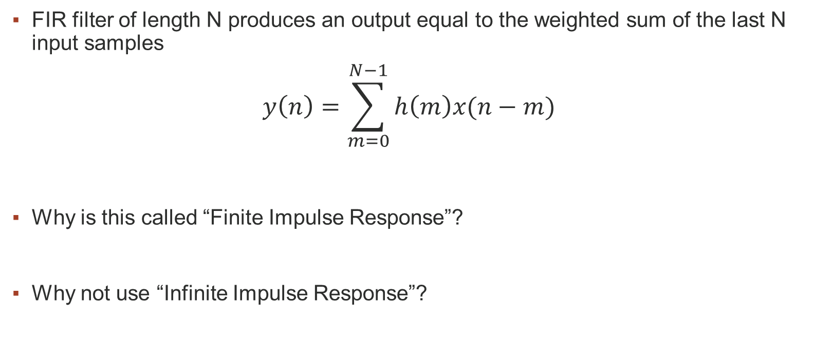
FIR Filters
FIR filter of length N produces an output equal to the weighted sum of the last N input samples
$$y\left(n\right)=\sum_{m=0}^{N−1}{h\left(m\right)x(n−m)}$$
Why is this called “Finite Impulse Response”?
Why not use “Infinite Impulse Response”?
Notes:
The n-th output of a length N filter is defined as
Definition of impulse response, contrast with IIR. NB FIR, taps ARE impulse response
IIR less common in implementation because… Even though typically same freq response with half as many taps
Stability is an issue, as in non linear phase response. Design effort is lower.
Much mathematical theory and analysis…
Implementation, system considerations…
Don’t want to distract from the fact that an FIR is a simple concept!

Slide 4

FIR Filters
Time domain behaviour given by convolution equation
$$y\left(n\right)=\sum_{m=0}^{N−1}{h\left(m\right)x(n−m)}$$
Difference equation, can get equivalent in Z transform:
$$H\left(z\right)= \sum_{n=0}^{N−1}{h\left(n\right)z^{−n}}$$
Notes:
THIS SLIDE:
Interpret the transversal structure on the whiteboard, we want to get y(10) what does that mean… lets say N = 5
What happens if y=0? What is sample values past h(0)?
(equivalence to DFT?)
System function, polynomial in z. Recall Z transform… (Laplace, Fourier, Z, DTFT… DFT has discrete amplitude, FFT computes DFT)
capital letter and z domain, frequency domain
Expand to show what how it looks with four tap filter
2. Z-1 = 1 cc delay
3. Time domain, difference equation… Convolution (brief, see wiki)
Expand to show for 4 tap filter
Last point: Frequency response is the DFT of the impulse response… i.e. DFT of taps, calculate using FFT

Slide 5
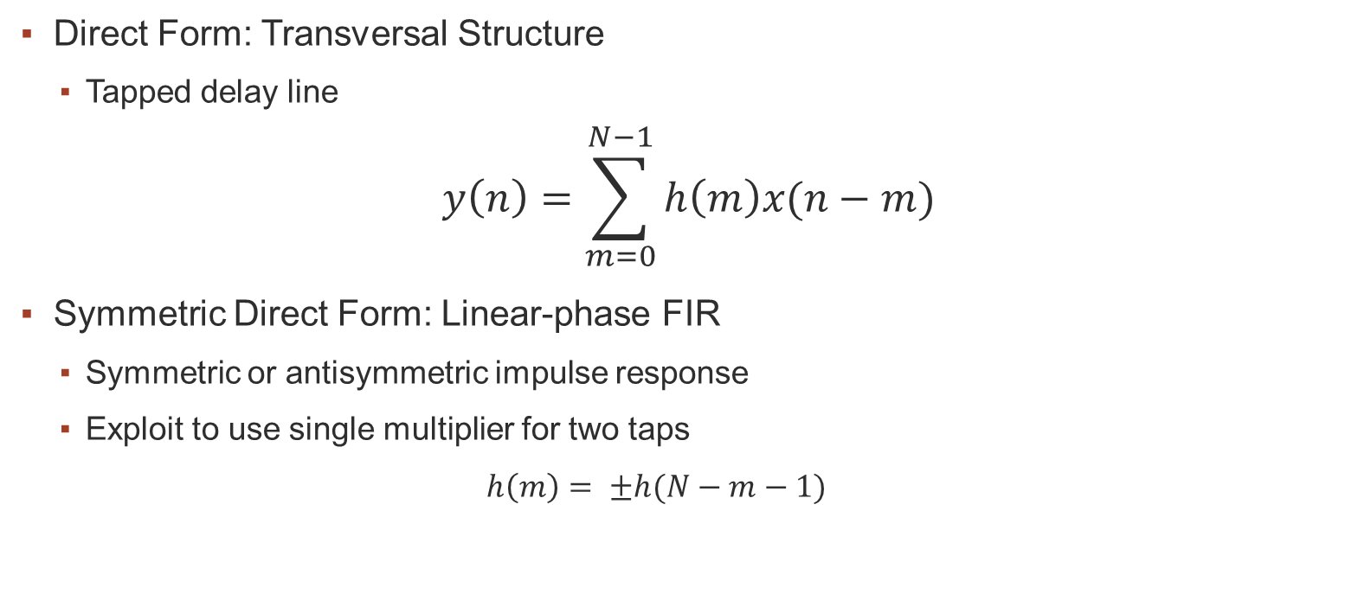
FIR Structures
Direct Form: Transversal Structure
Tapped delay line
$$y\left(n\right)=\sum_{m=0}^{N−1}{h\left(m\right)x(n−m)}$$
Symmetric Direct Form: Linear-phase FIR
Symmetric or antisymmetric impulse response
Exploit to use single multiplier for two taps
$$h\left(m\right)= ±h(N−m−1)$$
Notes:
Many many different structures, different properties. Discussing the most common subset.
Note that linear phase is by far and away the more common, cheap and linear phase is important quality (more on this later)
If you’re shifting the phase of a signal it’s quite likely you will need to spend resources to account for that shift later on.

Slide 6
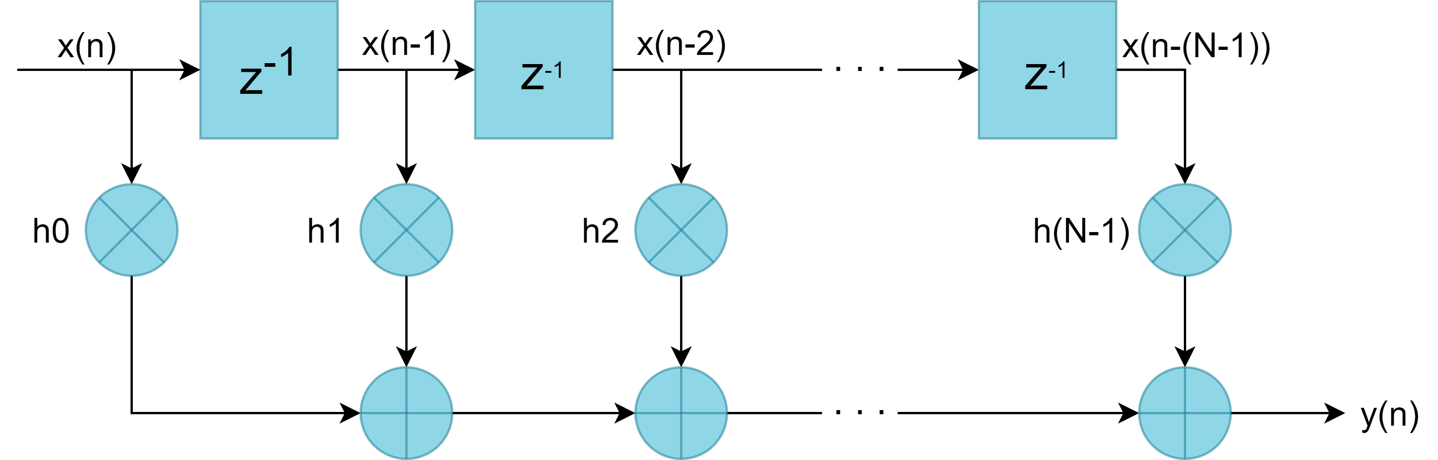
Transversal FIR
Notes:
Mention that z^-1 is 1 cc delay… What device would we use to delay a sample by 1 cc?
Hardware cost estimation… Number of registers? Number of adders? Number of multipliers?

Slide 7

FIR Structures: Linear Phase (N even)
Linear Phase System Function:
$$H\left(z\right)=\sum_{n=0}^{N/2−1}{h\left(n\right)\left[z^{−n}+z^{−\left(N−1−n\right)}\right]}$$
Linear Phase Difference Equations:
$$y\left(n\right)=\sum_{k=0}^{N/2−1}{h\left(k\right)\left\{x\left(n−k\right)+x\left(n−\left(N−1−k\right)\right)\right\}}$$
Notes:
Lots of apparent complexity with different indices, but concept is very very simple
Look at a symmetric impulse response, know we want weighted sum***
Go to next slide, then come back
Have two samples that are going to be multiplied by same tap
Add beforehand, only multiply once… Lets look at example structure

Slide 8
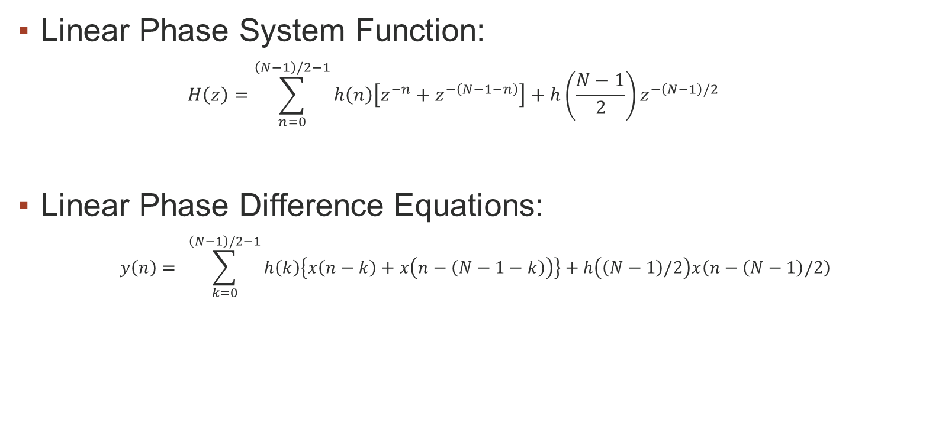
FIR Structures: Linear Phase (N odd)
Linear Phase System Function:
$$H\left(z\right)=\sum_{n=0}^{\left(N−1\right)/2−1}{h\left(n\right)\left[z^{−n}+z^{−\left(N−1−n\right)}\right]}+h\left(\frac{N−1}{2}\right)z^{−\left(N−1\right)/2}$$
Linear Phase Difference Equations:
$$y\left(n\right)= \sum_{k=0}^{\left(N−1\right)/2−1}{h\left(k\right)\left\{x\left(n−k\right)+x\left(n−\left(N−1−k\right)\right)\right\}}+h\left(\left(N−1\right)/2\right)x\left(n−\left(N−1\right)/2\right)$$
Notes:
Note the extra term ((n-1)/2) implies it’s the middle term in the sequence.

Slide 9
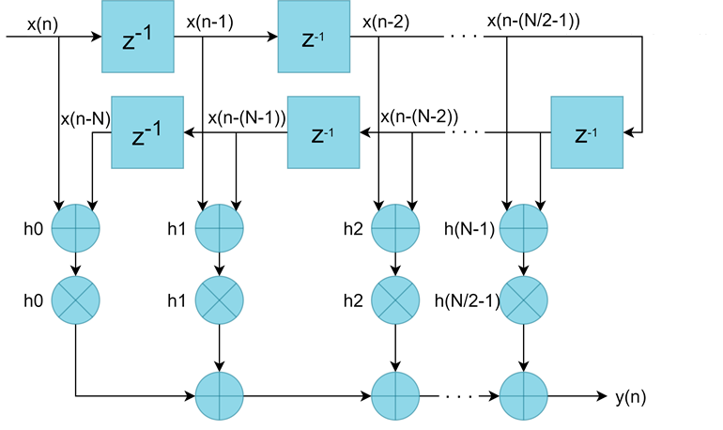
Linear Phase (N even)
Notes:
Discuss difference in cost of implementation half the multipliers
What if N odd? Do on whiteboard. h[0]Xn + h[1]Xn-1 + h[2]Xn-2 + h[3]Xn-3 + h[4]Xn-4
h[0] = h[4]
h[1] = h[3]
h[2] = h[2]
h[0] (Xn + Xn-4) + h[1](Xn-1 + Xn-3) + h[2]Xn-2

Slide 10
FIR Filter Properties
Discussed at impulse response, frequency response
How can we compute gain?
Design properties:
Order, length
Stopband attenuation
Passband ripple
Transition band width
Notes:
Draw example response and mark these properties
Differentiate between order and length

Slide 11
FIR Filter Design
Different approaches exist, two common options:
Window method
Parks McClellan / Remez
Note order estimation is a heuristic guideline only
Both are easily applied in Matlab
Can script this process
May also use the fdatool
Quick to generate filter tap values, but can we practically implement them?

Slide 12
Effects of Finite Word Length in FIR Filters
ADC noise
ADC quantisation at filter input
Limits achievable SNR
Coefficient quantisation
Coefficients represented with finite number of bits
Desired frequency response changed
Rounding errors
May be internal rounding after MAC operations, or only at output
Arithmetic Overflow / Saturation
Partial sums exceed max magnitude after rounding
Unavoidable loss of data, must send warning to user
Notes:
Block diagram, show where noise enters system…
High level FFT result for each point…
Diagram of filter with word widths marked on branches… Recall minimum word widths from previous lecture

Slide 13
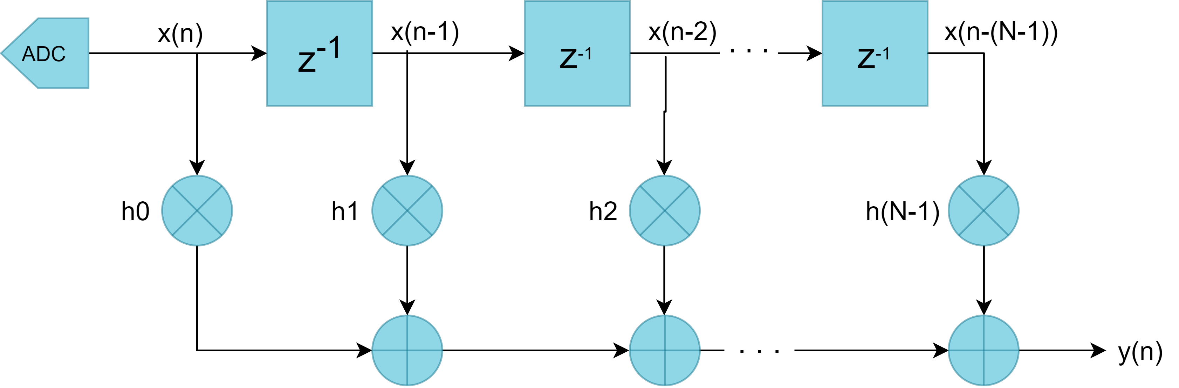
Effects of Finite Word Length in FIR Filters

Slide 14
FIR Example
Determine effects of quantising by rounding the following filter to 8 bits
Stopband attenuation >90dB
Passband ripple <0.002dB
Passband edge frequency 3.375kHz
Stopband edge frequency 5.625kHz
Sampling frequency 20kHz
Use fdatool in Matlab, or use Matlab filter design functions (firpm, fir1 etc)

Slide 15
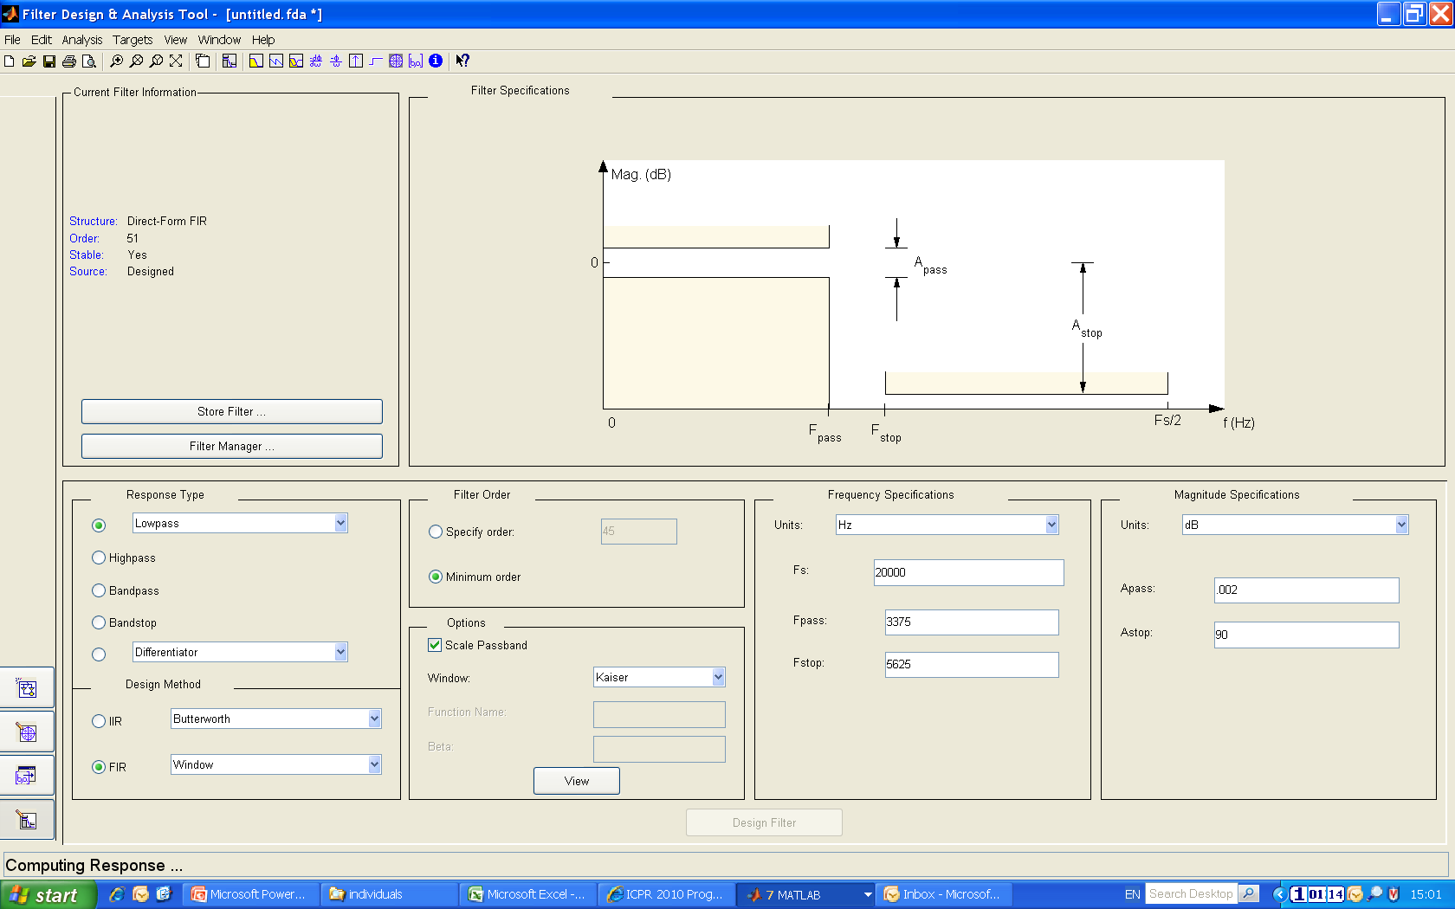
Matlab fdatool

Slide 16
No Quantisation

Slide 17
Quantise Coefficients to s(9,8)
Notes:
Note change in y axis…. Actually much worse stop band attenuation
Also increased ripple in passband

Slide 18
Compare
What do you notice?
Impact on stopband attenuation?
Impact on ripple in passband?
How will this translate to SNR
Purpose of simulation
Bottom line:
Coefficient quantisation will make your frequency response deviate from the ideal response

Slide 19
Phase Response
Impact due to coefficient quantisation?
Altered, but still linear
Why is linear phase so important?
Notes:
definition: Frequency response, both magnitude and phase
Calculation of phase response…
Note wrapping.
Why is linear phase response important?
Impact from quantisation… Changes, as zeros are changing. (Drops down in magnitude, wraps in phase response)
But still linear, which is what we care about.
Group delay is d(phi)/dw. Linear, then delay is constant across frequencies. Otherwise, some frequencies pass through more quickly than others… All pass filters.
Phase delay is phi/w
Remind them that this is not the case for IIR filters
State: You should know group delay, should know why linear phase is important

Slide 20

Formal Treatment
Unquantised and quantised coeffs:
$$h\left(n\right),h_{q}\left(n\right)$$
Related as
$$h_{q}\left(n\right)=h\left(n\right)+e\left(n\right), n=0,1,⋯,N−1$$
Frequency domain:
$$H_{q}\left(ω\right)=H\left(ω\right)+E\left(ω\right)$$
$$E\left(ω\right)= \sum_{m=0}^{N−1}{e(m)e^{−jωm}}$$
Notes:
Additive! Linearity property of dft
Additive in time domain is additive in frequency domain
Frequency response of error

Slide 21
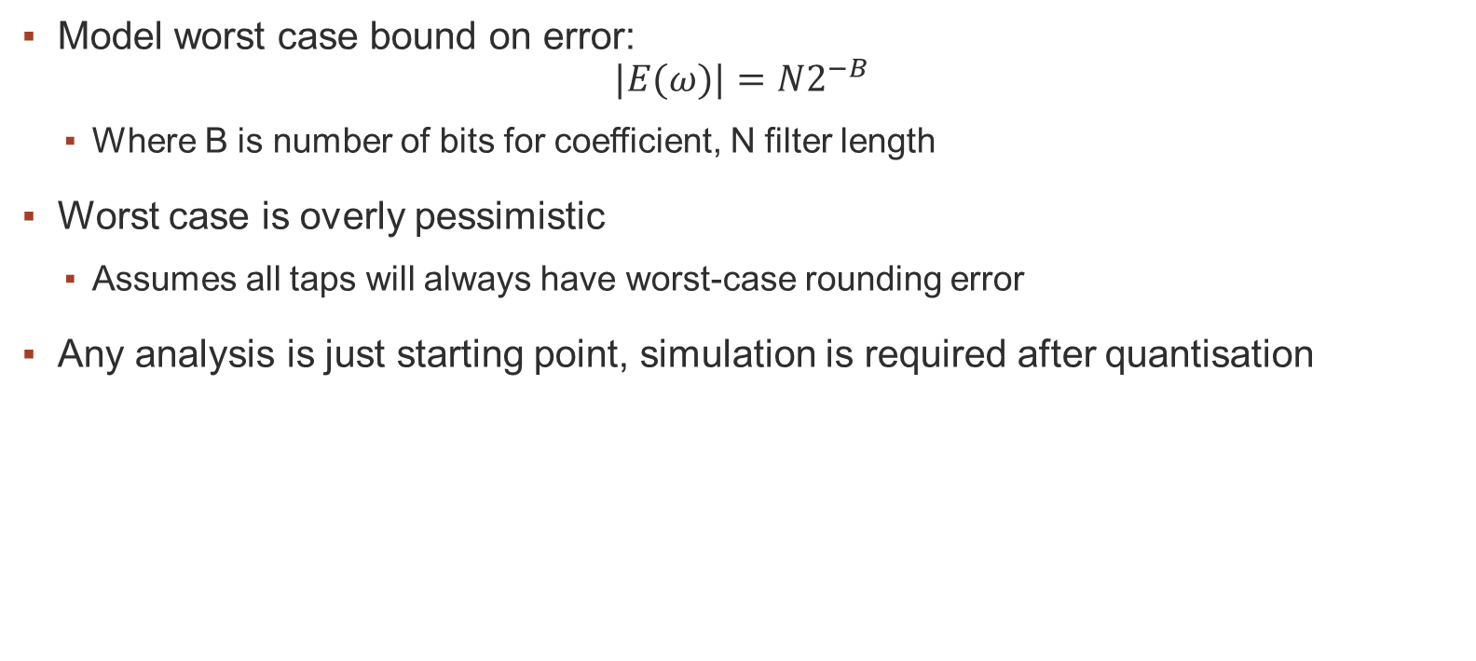
Bounds on Error
Model worst case bound on error:
$$|E(ω)|=N2^{−B}$$
Where B is number of bits for coefficient, N filter length
Worst case is overly pessimistic
Assumes all taps will always have worst-case rounding error
Any analysis is just starting point, simulation is required after quantisation
Notes:
Quantisation error distribution
Spurs (SFDR, SNDR)
Bound for truncation or rounding?
What if rounding?

Slide 22
FIR Filters: Implementation Decisions
Quantisation affects…
Quality of data
Power consumption
ASIC area (cost) or FPGA utilisation
How much is too much, too little?
Data flow and Timing considerations
Latency
Throughput
Fmax
Pipelining
Parallelism
Understand FIR concepts, how can we use this for system level design decisions?

Slide 23
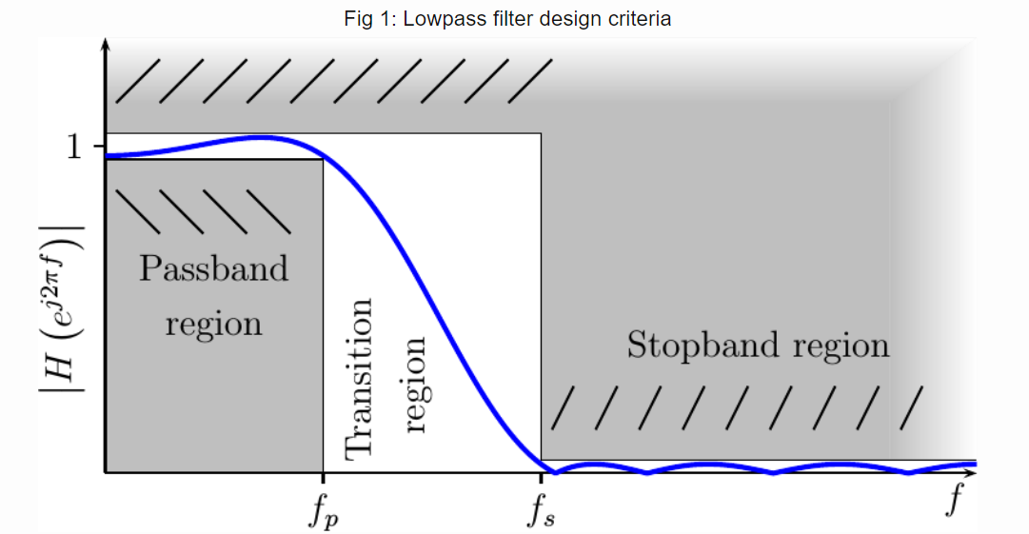
Quantisation Impact on Spectral Performance
Notes:
Diagram showing passband ripple, stopband attenuation, transition bandwidth
Impact each have on order
How each is impacted by quantisation…

Slide 24
Quantisation
How to choose appropriate level of quantisation?
Under quantised
PB ripple << max, SB attenuation >> min, TB width << max
Over quantised
PB ripple > max, SB attenuation < min, TB width > max
Appropriate quantisation
PB ripple ~max, SB attenuation ~ min, TB width ~max
Still within limits, but by small margin
Notes:
Levels of quantisation explained (over, under, appropriately)
NB need to leave a little margin when choosing number of taps
Seems odd to increase length in order to quantise… Trade-off!
e.g. 21 tap 64 bit, vs 25 tap 16 bit.

Slide 25
Other System Considerations
ASIC hardware complexity (area, cost) estimation
When have system RTL, can run synthesis flow for somewhat realistic figures
Flow still may not include everything
For architectural decisions we want something quick to compute
NAND count, comparative only, must understand how filter multiplication is implemented
FPGA utilization is reported by synthesis and implementation flow
Power estimation
High level estimations for architectural decisions
May use guideline figures from similar designs
With netlist, power estimation can be vectorless or vectored
Notes:
NB Early stage. System model. Wouldn’t be used when you have RTL.
We’re talking about FIR, but this would be done for any design
Adder count: FA is 9 NAND, HA is 5 NAND
0.18um: 10nW/MHz, if fclk = 300 MHz, alpha/activity level = 30%, power in 10000 NAND gates…
Ngates * Power per gate per MHz * cllk freq in MHz * scale by activity level
Just gives dynamic power. Only one source of power… More advanced nodes & more complex design, wouldn’t use this kind of figure.

Slide 26
Filter Timing Considerations
Latency
Latency
Group delay
Transient response length
Throughput
Fmax
Pipelining
Register retiming
Parallelism

Slide 27
Latency
Time it takes for an input change to produce an output change
Example: Shift register of N FFs:
Units of time, or clock cycles

Slide 28
Filter Delay and Transient
Filter Latency
Time to wait for input change to cause change on output
Filter Transient Response
Time to wait for filter polynomial to be fully applied
Length for FIR?
Filter Group Delay
Time between amplitude envelope at input and output
Length for symmetric/linear phase FIR?
Notes:
Measurement
Time from when first data sample enters the system until system produces full response…
Example, if we send a step response into the system…
Filter latency for FIR filter is N samples where N is the number of taps in the system

Slide 29
Throughput
The rate at which data can be processed
Example: Shift register of N FFs:
Units of data per second, samples per clock cycle
Impacted by Fmax…
Notes:
Hosepipe
Rate of data from system
Faster you can push data through, the higher the throughput. Depends on physical implementation and clock frequency…
Let’s look first at what determines the max clock frequency…

Slide 30
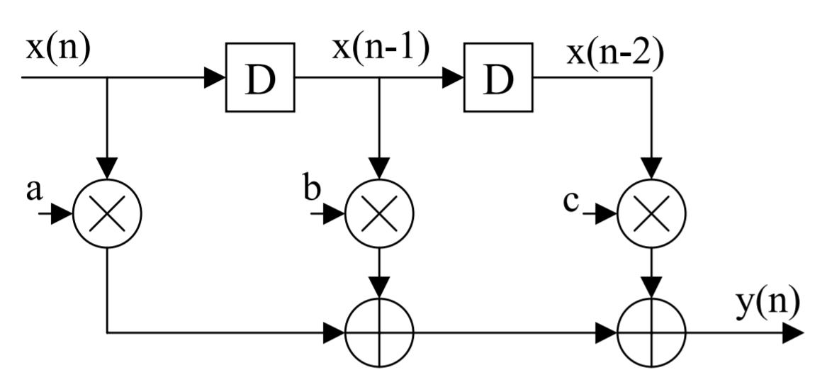
Fmax
[VLSI Digital Signal Processing, Keshab K. Parhi]
Notes:
Assign as 5 min question

Slide 31
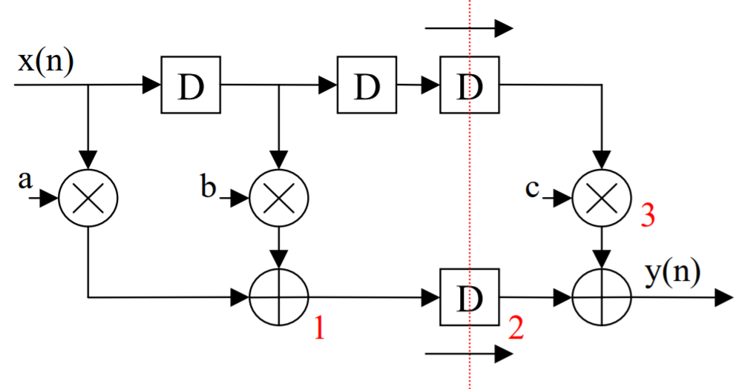
Pipelining
[VLSI Digital Signal Processing, Keshab K. Parhi]

Slide 32
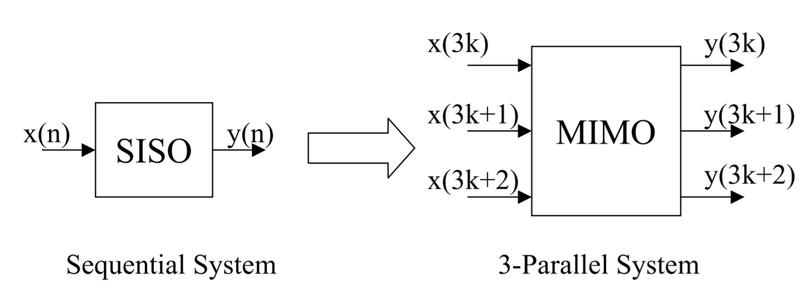
Parallelism
[VLSI Digital Signal Processing, Keshab K. Parhi]
Notes:
Improving throughput
Fmax is constant
BUT Tsample is no longer Tclock, Tsample >= Tclock/N
Not odd samples and even samples… Must have same filter response, so all samples go through both systems. But one filter is offset by 1 clock cycle, and two samples are drawn into the delay line at a time
Draw delay line

Slide 34
Piplined FIR filter

Slide 35
Other System Considerations
Notes:
NB Early stage. System model. Wouldn’t be used when you have RTL.
We’re talking about FIR, but this would be done for any design
Adder count: FA is 9 NAND, HA is 5 NAND
0.18um: 10nW/MHz, if fclk = 300 MHz, alpha/activity level = 30%, power in 10000 NAND gates…
Ngates * Power per gate per MHz * cllk freq in MHz * scale by activity level
Just gives dynamic power. Only one source of power… More advanced nodes & more complex design, wouldn’t use this kind of figure.

