Slide 1

Artificial Neural Networks
Building an ANN from scratch
Dr. Andrea Staino
School of Engineering, Trinity College Dublin
Alstom Digital and Integrated Systems
Artificial Neural Networks
Computation for Transportation Engineering – Hilary Term 2024

Slide 2

Today’s plan
Look at the mathematics behind Artificial Neural Networks
Implement basic metrics to evaluate the classification performance
Create a python class to build a shallow neural network
Train and test the network on sample datasets
Artificial Neural Networks
Computation for Transportation Engineering – Hilary Term 2024

Slide 3
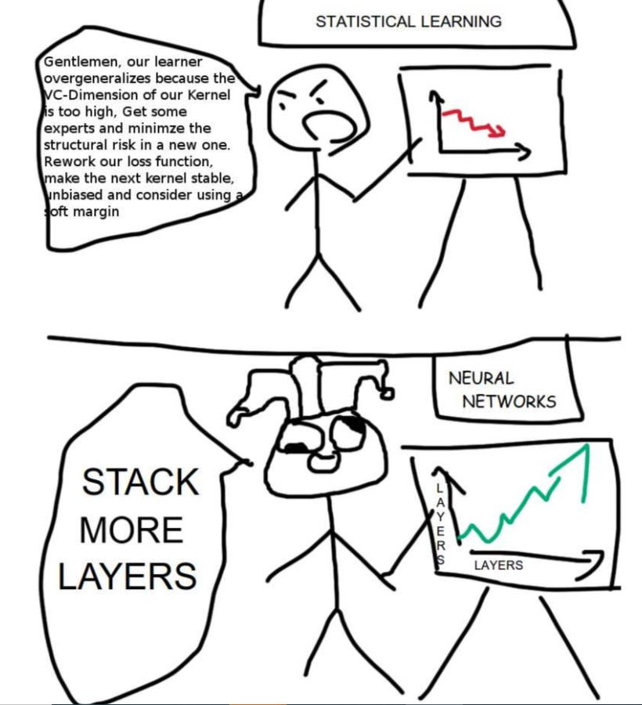
Rationale
You should not use deep learning if you don’t know how a (shallow) artificial neural network works!!!
Artificial Neural Networks
Computation for Transportation Engineering – Hilary Term 2024

Slide 4

Artificial Neural Network concept
Main idea: create a mathematical model that simulates the behaviour of human brain.
Human brain characteristics:
  Highly complex*
  Non-linear
  Massively parallel
  *how you define a “complex system”?
Artificial Neural Networks
Computation for Transportation Engineering – Hilary Term 2024

Slide 5
Artificial Neural Network concept
ANN: computing paradigm that attempts to process information by mimicking human brain:
  inspired by biological neural networks;
  perform a function that emerges out of the interaction of highly interconnected simple processing units → ’neurons’ or ‘nodes’;
  connections between nodes are associated with weights; these are tuned by a learning algorithm (supervised and unsupervised)
  knowledge is coded into the weights between nodes
Artificial Neural Networks
Computation for Transportation Engineering – Hilary Term 2024

Slide 6


Artificial Neurons
Receive signals from other neurons in the network.
Multiply each signal by the corresponding connection strength.
Compute the sum of the weighted signals and send them to an activation function.
Send output to other neurons in the network.
x_{i}: i-th input
w_{i}: connection strength (synaptic weight)
b: bias
f : activation function
y_{N} : output (spiking rate)
b
x₁
w₁
x₂
w₂
y_{N}
$$f\left(\sum_{i=1}^{n}{w_{i} x_{i}}+b\right)$$
….
f = nonlinear (e.g. sigmoid, Heaviside, ReLU)
w_{n}
x_{n}
$$f(z)=max⁡(0,z)$$
Artificial Neural Networks
Computation for Transportation Engineering – Hilary Term 2024
Notes:
Xor

Slide 7
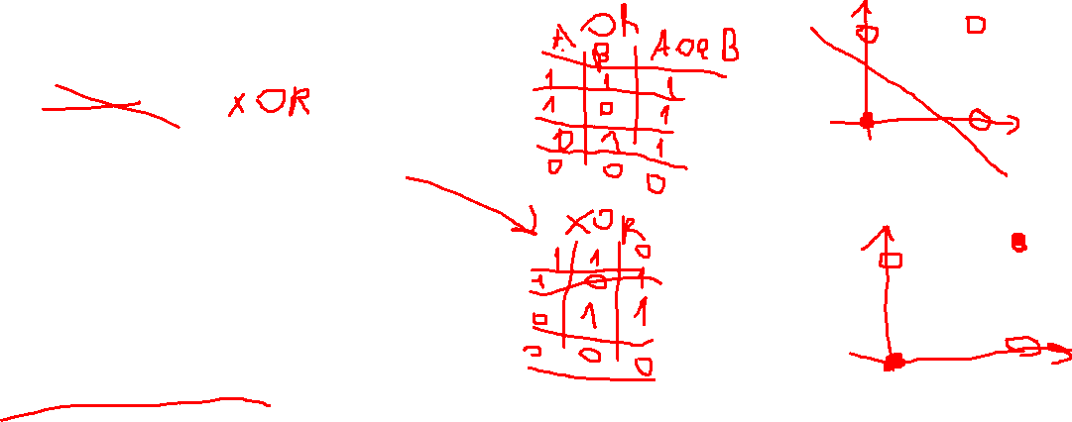
ANN architectures
Several configurations are possible:
  Feed-forward networks
    Perceptron
    MultiLayer Perceptron (MLP)
    Radial Basis Function
  Recurrent Networks (RNN)
    feedback loops
    Suitable for sequences of data
Artificial Neural Networks
Computation for Transportation Engineering – Hilary Term 2024

Slide 8
ANN layers
Feed-forward network
  num. input nodes → num. features
  num. hidden nodes → ???
  num. output nodes → num. of classes/values
  Empirical rule: n_{hidden} = log(n_{in} + n_{out})
Input layer
Output layer
Hidden layer
Artificial Neural Networks
Computation for Transportation Engineering – Hilary Term 2024

Slide 9
ANN learning
Learning → find the weights that allows to perform a desired task
Supervised learning: provide examples to the network under the form of input/output pairs, and determine the weights by minimizing some error function
Unsupervised learning: cluster based on similarity and self-organizing properties.
Artificial Neural Networks
Computation for Transportation Engineering – Hilary Term 2024

Slide 10
ANN with 1 hidden layer and binary output
Input layer
import numpy as np
class NeuralNetwork:
def __init__(self, hidden_layer_size=5):
self.hidden_layer_size=hidden_layer_size
Output layer
y_{NN}
Hidden layer
Artificial Neural Networks
Computation for Transportation Engineering – Hilary Term 2024

Slide 11
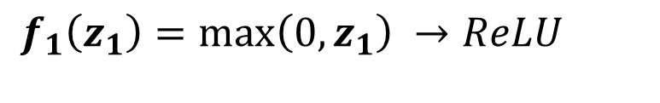

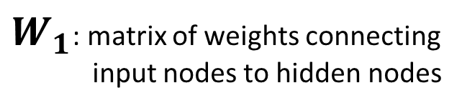
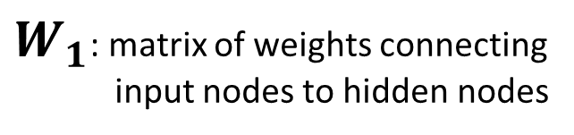

Feed-forward propagation
$$z_{1}=W_{1}x+b_{1}$$
$$a_{1}=f_{1}(z_{1})$$
Input layer
Output layer
$W_{1}$: matrix of weights connecting
input nodes to hidden nodes
$W_{1}$: matrix of weights connecting
input nodes to hidden nodes
y_{NN}
$f_{1}$: activation function of hidden nodes
$$f_{1}\left(z_{1}\right)=max\left(0,z_{1}\right) →ReLU$$
Hidden layer
Artificial Neural Networks
Computation for Transportation Engineering – Hilary Term 2024

Slide 12
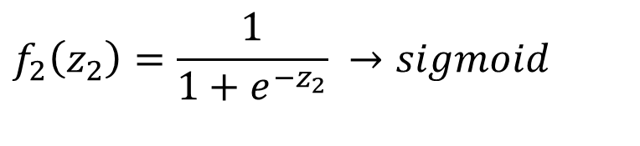

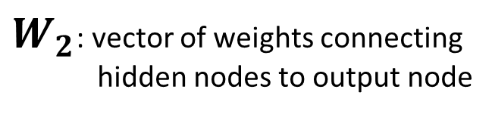

Feed-forward propagation
$$z_{2}=W_{2}a_{1}+b_{2}$$
$$a_{2}=f_{2}(z_{2})$$
Input layer
Output layer
$W_{2}$: vector of weights connecting
hidden nodes to output node
y_{NN}
$f_{2}$: activation function of output node
$$f_{2}\left(z_{2}\right)=\frac{1}{1+e^{−z_{2}}} →sigmoid$$
Hidden layer
Artificial Neural Networks
Computation for Transportation Engineering – Hilary Term 2024

Slide 13

Feed-forward propagation
def _forward_propagation(self, X):
Z1 = np.dot(X,self._W1)+self._b1
A1 = self._relu(Z1)
Z2 = np.dot(A1,self._W2)+self._b2
A2 = self._sigmoid(Z2)
self._forward_cache = (Z1, A1, Z2, A2)
return A2.ravel()
Input layer
Output layer
y_{NN}
def _relu(self, Z):
return np.maximum(Z, 0)
def _sigmoid(self, Z):
return 1/(1+np.power(np.e,-Z))
Hidden layer
Artificial Neural Networks
Computation for Transportation Engineering – Hilary Term 2024

Slide 14
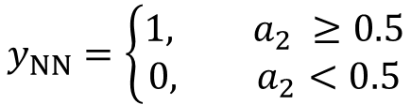

Classification
$a_{2}$ -> probability input sample in ‘1’
$$y_{NN}=\left\{\begin{matrix}{1, a}_{2} ≥0.5 \\ 0, a_{2}<0.5\end{matrix}\right.$$
Input layer
def predict(self, X):
prob = self._forward_propagation(X)
ynn = np.zeros(X.shape[0])
ynn[prob>=0.5]=1
ynn[prob<0.5]=0
return ynn
Output layer
y_{NN}
Hidden layer
Artificial Neural Networks
Computation for Transportation Engineering – Hilary Term 2024

Slide 15
Supervised Learning
Initialize the weights with random values
Using the provided examples (training set), compute the error as the difference between the prediction (network output) and the target.
Reassign weights by correcting them according to their impact on the error variation and to a given factor (learning rate).
Minimize the error based on gradient descent technique → study the derivative of the error function
Artificial Neural Networks
Computation for Transportation Engineering – Hilary Term 2024

Slide 16
Gradient descent
Compute the negative gradient to know in which direction the search should move to minimize the loss function.
In the general case, the gradient is a vector of containing partial derivatives with respect to the weights, i.e. it has a direction and a magnitude. Its direction points towards the steepest increase in the loss function.
New point
Loss function
The gradient descent algorithm takes a step in the direction of the negative gradient in order to reduce loss as quickly as possible. The size of the step depends on the magnitude of the gradient, and it is adjusted by the learning rate hyperparameter.
Weight
The process is iterated until an exit condition is reached.
Artificial Neural Networks
Computation for Transportation Engineering – Hilary Term 2024

Slide 17
Gradient descent learning rate
Small learning rate
Large learning rate
Loss function
Loss function
Overshooting the minimum!
Weight
Weight
Artificial Neural Networks
Computation for Transportation Engineering – Hilary Term 2024

Slide 18

Gradient descent implementation
def fit(self, X, y, epochs=200, lr=0.01):
self._init_weights(X.shape[1], self.hidden_layer_size)
for _ in range(epochs):
Y = self._forward_propagation(X)
dW1, db1, dW2, db2 = #to_do compute the partial derivatives
self._W1-=lr*dW1
self._b1-=lr*db1
self._W2-=lr*dW2
self._b2-=lr*db2
How to compute partial derivatives of the loss function with respect to the parameters of the network?
$$a_{2}=f_{2}\left(W_{2}∙f_{1}\left(W_{1}x+b_{1}\right)+b_{2}\right)$$
Artificial Neural Networks
Computation for Transportation Engineering – Hilary Term 2024

Slide 19
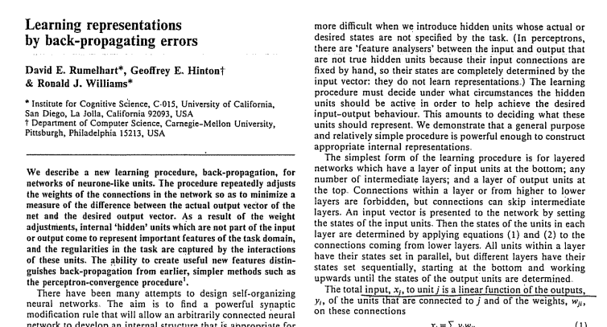
Backpropagation
“repeatedly adjusts the weights of the connections in the network so as to minimize a measure of the difference between the actual output vector of the net and the desired output vector”
Artificial Neural Networks
Computation for Transportation Engineering – Hilary Term 2024

Slide 20

Backpropagation
Let
  ${x=a}_{0}=\left[\begin{matrix}a_{1}^{(0)}, & a_{2}^{(0)}, & \begin{matrix}…, & a_{ni}^{(0)}\end{matrix}\end{matrix}\right], n_{i}=num. input nodes$
  $W_{1}=\left[\begin{matrix}w_{11}^{(1)} & w_{12}^{(1)} & \begin{matrix}… & w_{1n_{i}}^{(1)}\end{matrix} \\ w_{21}^{(1)} & . & \begin{matrix}. & .\end{matrix} \\ \begin{matrix}⋮ \\ w_{n_{h}1}^{(1)}\end{matrix} & \begin{matrix}. \\ .\end{matrix} & \begin{matrix}\begin{matrix}. & .\end{matrix} \\ \begin{matrix}. & w_{n_{h}n_{i}}^{(1)}\end{matrix}\end{matrix}\end{matrix}\right],{ n}_{h}=num. hidden nodes$
$W_{2}=\left[\begin{matrix}w_{11}^{(2)} & … & w_{1n_{h}}^{(2)}\end{matrix}\right], L=L\left(y,a_{2}\right)=loss function$ , y=given “true” sample,
Artificial Neural Networks
Computation for Transportation Engineering – Hilary Term 2024

Slide 21

Backpropagation
Chain rule:
$$\frac{d}{dx}\left[f\left(g\left(x\right)\right)\right]=f^{′}\left(g\left(x\right)\right)∙g^{′}\left(x\right).$$
Gradient wrt weight $w_{jk}^{(l)}$
$\frac{∂L}{∂w_{jk}^{(l)}}= \frac{∂L}{∂z_{j}^{(l)}}\frac{∂z_{j}^{(l)}}{∂w_{jk}^{(l)}}$
$$z_{j}^{(l)}=\sum_{k}{{w_{jk}^{(l)} a}_{k}^{(l−1)}}+b_{j}^{(l)}, → \frac{∂z_{j}^{(l)}}{∂w_{jk}^{(l)}}=a_{k}^{(l−1)}→ \frac{∂L}{∂w_{jk}^{(l)}}=\frac{∂L}{∂z_{j}^{(l)}}a_{k}^{(l−1)}$$
Artificial Neural Networks
Computation for Transportation Engineering – Hilary Term 2024

Slide 22


Backpropagation
Similarly, gradient wrt bias $b_{j}^{(l)}$
$$\frac{∂L}{∂b_{j}^{(l)}}= \frac{∂L}{∂z_{j}^{(l)}}\frac{∂z_{j}^{(l)}}{∂b_{j}^{(l)}}$$
$$z_{j}^{(l)}=\sum_{k}{{w_{jk}^{(l)} a}_{k}^{(l−1)}}+b_{j}^{(l)}, → \frac{∂z_{j}^{(l)}}{∂b_{j}^{(l)}}=1→ \frac{∂L}{∂b_{j}^{(l)}}=\frac{∂L}{∂z_{j}^{(l)}}$$
Update of network parameters:
  $$w:=w −lr\frac{∂L}{∂w}$$
  $$b≔b −lr\frac{∂L}{∂b}$$
Artificial Neural Networks
Computation for Transportation Engineering – Hilary Term 2024

Slide 23



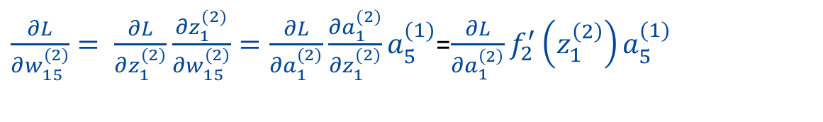










Backpropagation
$$\frac{∂a_{1}^{(2)}}{∂z_{1}^{(2)}}$$
$$\frac{∂L}{∂a_{1}^{\left(2\right)}}$$
How to update the weight $\frac{∂L}{∂w_{15}^{(2)}}$ ?
$$\frac{∂z_{1}^{(2)}}{∂w_{15}^{(2)}}$$
y_{NN}
$$z_{1}^{(2)},{ a}_{1}^{(2)}$$
$$w_{15}^{(2)}$$
$$b_{1}^{(2)}$$
Forward propagation
$$a_{3}^{(0)}$$
Backward propagation
$$w_{53}^{(1)}$$
$$z_{5}^{(1)},{ a}_{5}^{(1)}$$
$$b_{5}^{(1)}$$
$\frac{∂L}{∂w_{15}^{(2)}}= \frac{∂L}{∂z_{1}^{(2)}}\frac{∂z_{1}^{(2)}}{∂w_{15}^{(2)}}=\frac{∂L}{∂a_{1}^{(2)}}\frac{∂a_{1}^{(2)}}{∂z_{1}^{(2)}}a_{5}^{(1)}$=$\frac{∂L}{∂a_{1}^{\left(2\right)}}f_{2}^{′}\left(z_{1}^{\left(2\right)}\right)a_{5}^{(1)}$
$L=L({ a}_{1}^{(2)}$)
Artificial Neural Networks
Computation for Transportation Engineering – Hilary Term 2024

Slide 24
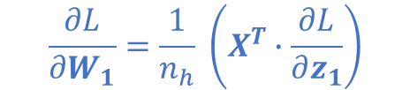

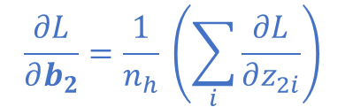
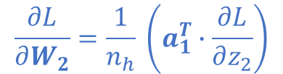

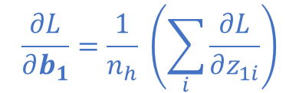
Backpropagation
def fit(self, X, y, epochs=200, lr=0.01):
self._init_weights(X.shape[1], self.hidden_layer_size)
for _ in range(epochs):
Y = self._forward_propagation(X)
dW1, db1, dW2, db2 = self._back_propagation(X, y)
self._W1-=lr*dW1
self._b1-=lr*db1
self._W2-=lr*dW2
self._b2-=lr*db2
$$\frac{∂L}{∂z_{2}}=a_{2} −y$$
$$\frac{∂L}{∂W_{2}}=\frac{1}{n_{h}} \left(a_{1}^{T}∙\frac{∂L}{∂z_{2}}\right)$$
$$\frac{∂L}{∂b_{2}}=\frac{1}{n_{h}} \left(\sum_{i}{\frac{∂L}{∂z_{2i}}}\right)$$
def _back_propagation(self, X, y):
Z1, A1, Z2, A2 = self._forward_cache
m = A1.shape[1]
dZ2 = A2-y.reshape(-1,1)
dW2 = np.dot(A1.T, dZ2)/m
db2 = np.sum(dZ2, axis=0)/m
dZ1 = np.dot(dZ2, self._W2.T)*self._relu_derivative(Z1)
dW1 = np.dot(X.T, dZ1)/m
db1 = np.sum(dZ1, axis=0)/m
return dW1, db1, dW2, db2
$$\frac{∂L}{∂z_{1}}=\frac{∂L}{∂z_{2}}∙W_{2}^{T}∗f_{1}^{′}(z_{1})$$
$$\frac{∂L}{∂W_{1}}=\frac{1}{n_{h}} \left(X^{T}∙\frac{∂L}{∂z_{1}}\right)$$
$$\frac{∂L}{∂b_{1}}=\frac{1}{n_{h}} \left(\sum_{i}{\frac{∂L}{∂z_{1i}}}\right)$$
def _relu_derivative(self, Z):
dZ = np.zeros(Z.shape)
dZ[Z>0] = 1
return dZ
Artificial Neural Networks
Computation for Transportation Engineering – Hilary Term 2024

Slide 25

Initialization of weights
Vanishing gradient problem:
Chain of small partial derivatives → weights value doesn’t change anymore, hence training is effectively stopping
Use of ReLU mitigates vanishing gradients
def _init_weights(self, input_size, hidden_size):
self._W1 = np.random.randn(input_size, hidden_size)
self._b1 = np.zeros(hidden_size)
self._W2 = np.random.randn(hidden_size,1)
self._b2 = np.zeros(1)
Exploding gradient problem:
Gradients are large→ weights become larger and larger → training might become unstable
Gradient clipping, learning rate, regularization techniques
Artificial Neural Networks
Computation for Transportation Engineering – Hilary Term 2024

Slide 26
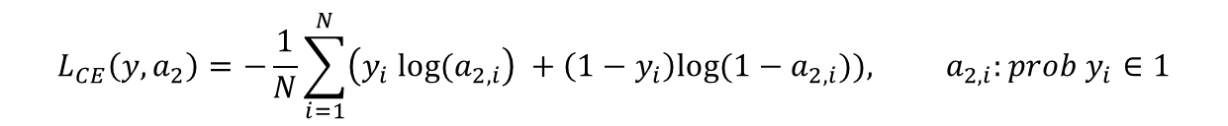
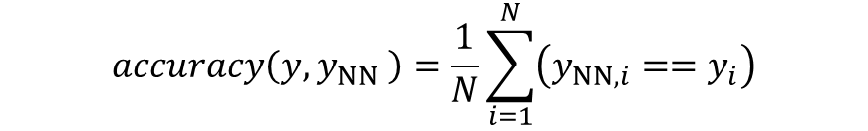
Evaluation metrics
Accuracy
$$accuracy\left(y,y_{NN} \right)=\frac{1}{N}\sum_{i=1}^{N}{\left(y_{NN,i}==y_{i}\right)}$$
(nb. classification problem)
def _accuracy(self, y, y_pred):
return np.sum(y==y_pred)/len(y)
Binary cross-entropy (log loss)
$$L_{CE}\left(y, a_{2}\right)=−\frac{1}{N}\sum_{i=1}^{N}{\left(y_{i} log⁡(a_{2,i}\right) }+\left(1−y_{i}\right)log⁡(1−a_{2,i})), a_{2,i}:prob y_{i}∈1$$
Nb. the lower, the better
def _log_loss(self, y_true, y_proba):
return -np.sum(np.multiply(y_true,np.log(y_proba))+np.multiply((1-y_true),np.log(1-y_proba)))/len(y_true)
Artificial Neural Networks
Computation for Transportation Engineering – Hilary Term 2024

Slide 27

Feature scaling
Goal: transform features to be on a comparable scale, to improve the performance and training stability of the model.
Meaningful for multiple features problems
Benefits:
  helps gradient descent converge more quickly.
  mitigate biases in learning weights
  Several approaches:
    min-max scaling
    z-score
    ….
Artificial Neural Networks
Computation for Transportation Engineering – Hilary Term 2024

Slide 28
Testing the NeuralNetwork class
https://rstudio-pubs-static.s3.amazonaws.com/329390_c397ce255b364013a933c34ba63c2db2.html
from NeuralNetwork import NeuralNetwork
model = NeuralNetwork()
Artificial Neural Networks
Computation for Transportation Engineering – Hilary Term 2024

Slide 29
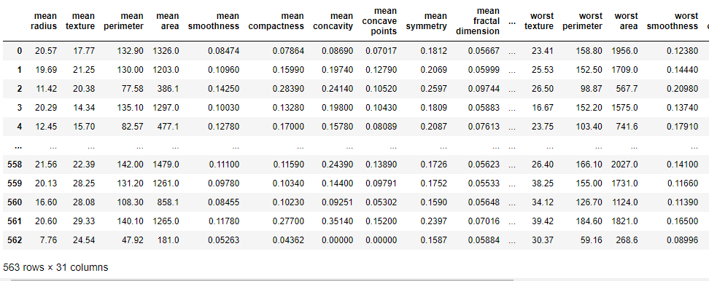
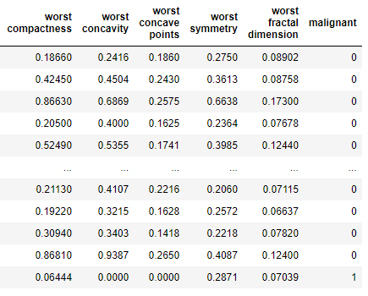
Testing the NeuralNetwork class
Dataset: Breast cancer data analysis
https://rstudio-pubs-static.s3.amazonaws.com/329390_c397ce255b364013a933c34ba63c2db2.html
Artificial Neural Networks
Computation for Transportation Engineering – Hilary Term 2024

