Slide 1

Unsupervised learning
Dimensionality reduction and clustering
Dr. Andrea Staino
School of Engineering, Trinity College Dublin
Alstom Digital and Integrated Systems
Unsupervised learning
Computation for Transportation Engineering – Hilary Term 2024

Slide 2

Today’s plan
Understand Principal Component Analysis and its application for dimensionality reduction
See some python example about application of PCA
Understanding K-means algorithm
Implement K-means algorithm from scratch
Unsupervised learning
Computation for Transportation Engineering – Hilary Term 2024

Slide 3
Today’s plan
Understand Principal Component Analysis and its application for dimensionality reduction
See some python example about application of PCA
Understanding K-means algorithm
Implement K-means algorithm from scratch
Unsupervised learning
Computation for Transportation Engineering – Hilary Term 2024

Slide 4
Sample uses of Machine Learning
SUPERVISED LEARNING
UNSUPERVISED LEARNING
CLASSIFICATION | CLUSTERING
REGRESSION | DIMENSIONALITY REDUCTION
DISCRETE DATA
CONTINOUS DATA
Unsupervised learning
Computation for Transportation Engineering – Hilary Term 2024

Slide 5
Sample uses of Machine Learning
SUPERVISED LEARNING
UNSUPERVISED LEARNING
CLASSIFICATION | CLUSTERING
REGRESSION | DIMENSIONALITY REDUCTION
DISCRETE DATA
CONTINOUS DATA
Unsupervised learning
Computation for Transportation Engineering – Hilary Term 2024

Slide 6
Dimensionality Reduction
Issue: create low dimensional representation of high dimensional data
Regularization: discard some features by bringing the associated coefficients of the model to zero.
When to use it: mitigating model’s overfitting
Applies to features in the original space
PCA-based dimensionality reduction: reduce the number of variables by identifying the dominant modes of variability from the dataset
When to use it: data in the original n-dimensional space mostly lie in a k-dimension subspace, k<<n
Transform the original features into new ones better representing the structure of the data
In the features representation, it is easier to identify the k important dimensions.
Unsupervised learning
Computation for Transportation Engineering – Hilary Term 2024

Slide 7
Dimensionality Reduction
Issue: create low dimensional representation of high dimensional data
Regularization: discard some features by bringing the associated coefficients of the model to zero.
When to use it: mitigating model’s overfitting
Applies to features in the original space
PCA-based dimensionality reduction: reduce the number of variables by identifying the dominant modes of variability from the dataset
When to use it: data in the original n-dimensional space mostly lie in a k-dimension subspace, k<<n
Transform the original features into new ones better representing the structure of the data
In the features representation, it is easier to identify the k important dimensions.
Supervised Learning
Unsupervised Learning
Unsupervised learning
Computation for Transportation Engineering – Hilary Term 2024

Slide 8
Principal Component Analysis (PCA)
x₂
v
v
The data mostly lie along a line
v
x₁
Unsupervised learning
Computation for Transportation Engineering – Hilary Term 2024

Slide 9
Principal Component Analysis (PCA)
x₂
z₂
The data mostly lie along a line
z₁
How to automatically compute the direction z₁ ?
v
v
Note: z₁ is the direction along which the variability of the data is largest
The variation along z₂ is less important, hence this feature can be excluded from the analysis
v
x₁
Unsupervised learning
Computation for Transportation Engineering – Hilary Term 2024

Slide 10
Principal Component Analysis (PCA)
x₂
z₁
x₁
Unsupervised learning
Computation for Transportation Engineering – Hilary Term 2024

Slide 11
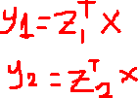
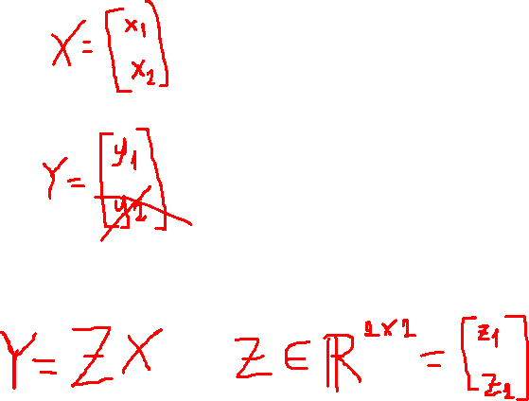
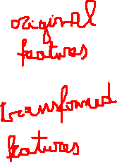
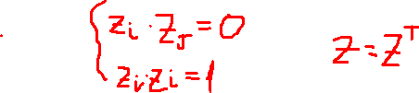
Principal Component Analysis (PCA)
x₂
z₁
x₁
Transformed features corresponds to coordinates with respect to the new basis → linear combination of original features
Orthonormal basis
Orthogonal vectors with unit norm
Orthogonal matrix
Unsupervised learning
Computation for Transportation Engineering – Hilary Term 2024

Slide 12
Principal Component Analysis (PCA)
x₂
z₁
Project the data along the axis that better captures their underlying structure
x₁
Unsupervised learning
Computation for Transportation Engineering – Hilary Term 2024

Slide 13
Principal Component Analysis (PCA)
x₂
Project the data along the axis that better captures their underlying structure
The axis z₁
is the direction of maximum variance of the data, or first principal component.
x₁
Most of the variance is along z₁ ; Most of the remainder of the variance (i.e. not explained by z₁ ) is along z₂;
Most of the remainder of the variance (not explained by z₁ and z₂)
is along z₃;
......
z₁
Unsupervised learning
Computation for Transportation Engineering – Hilary Term 2024

Slide 14
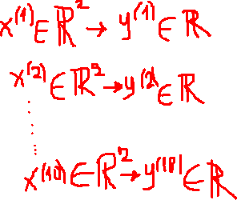
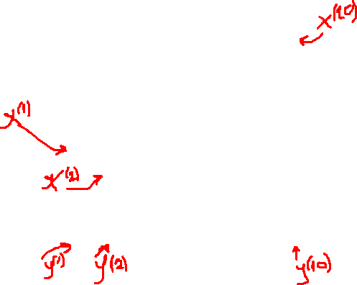
Principal Component Analysis (PCA)
x₂
Reduce data from 2D to 1D by retaining only the projections along z₁
and discarding lowest-variance dimension z₂
x₁
z₁
Unsupervised learning
Computation for Transportation Engineering – Hilary Term 2024

Slide 15



PCA: 2D to 1D
Projection of point x^{(i)} on z₁
x₂
$$x^{\left(i\right)T}z_{1}$$
z₁
Z={z_{1,} z₂} orthonormal basis in $ℝ^{2}$
$$x^{\left(i\right)T}z_{2}$$
Projection of point x^{(i)} on z₂
z₂
x₁
PCA formulation: maximize variance along the direction z₁ or, equivalently, minimize projection error (summation of distances along z₂ over the data points)
Equivalence derives from the orthonormal property of transformed basis
Unsupervised learning
Computation for Transportation Engineering – Hilary Term 2024

Slide 16
PCA: 2D to 1D
Projection of point x^{(i)} on z₁
x₂
$$x^{\left(i\right)T}z_{1}$$
z₁
Z={z_{1,} z₂} orthonormal basis in $ℝ^{2}$
$$x^{\left(i\right)T}z_{2}$$
Projection of point x^{(i)} on z₂
z₂
x₁
Let’s focus on the direction z₁
Objective: find z₁ that maximizes variance of projected data
Covariance matrix S (note: normalized features)
$$\max{\frac{1}{2m}}\sum_{i=1}^{m}{{\left(x^{\left(i\right)T}z_{1}\right)}^{2}=max}\frac{1}{2m}\sum_{i=1}^{m}{{z_{1}}^{T}x^{\left(i\right)}x^{\left(i\right)T}z_{1}=\max{{z_{1}}^{T}}\left(\frac{1}{2m}\sum_{i=1}^{m}{x^{\left(i\right)}x^{\left(i\right)T}}\right)}z_{1}=\max{{z_{1}}^{T}}S{ z}_{1}$$
Unsupervised learning
Computation for Transportation Engineering – Hilary Term 2024

Slide 17







PCA: 2D to 1D
$$\max_{z_{1}}{{z_{1}}^{T}S{ z}_{1}}{}$$
x₂
In general, principal components are the eigenvectors of the covariance matrix S, corresponding to the eigenvalues $λ_{1}$, $λ_{2,}$.. $λ_{n}$
By construction, $λ_{1}$ is the largest eigenvector, $λ_{2}$ the second largest, $λ_{n}$ the smallest.
Correspondingly, z₁ is the first principal component (PC1), z₂ the second principal component PC2, etc.
z₁
$$s.t. \left\|z_{1}\right\|=1$$
Unit norm vector (identifies direction)
Lagrange’s multipliers approach
$${z_{1}}^{T}S{ z}_{1}−λ_{1}({z_{1}}^{T}{ z}_{1}−1)$$
x₁
Taking derivative wrt to z₁ and setting to zero
$$S{ z}_{1}−λ_{1}{ z}_{1}=0$$
$$S{ z}_{1}=λ_{1}{ z}_{1}$$
z₁ is an eigenvector of S, with eigenvalue $λ_{1}$
Since it maximizes the objective, z₁ is the eigenvector of S corresponding to the maximum eigenvalue, $λ_{1}$
Unsupervised learning
Computation for Transportation Engineering – Hilary Term 2024

Slide 18








Example: determining PC2
PC2 satisfies:
$$\max_{z_{2}}{{z_{2}}^{T}S{ z}_{2}}{}$$
$$s.t. \left\|z_{2}\right\|=1$$
$${z_{2}}^{T}{ z}_{1}=0$$
Orthogonality
z₂ is an eigenvector of S, with eigenvalue $λ_{2 }$
Lagrangian expression:
$$S{ z}_{2}−λ_{2}{ z}_{2}=0$$
Second largest eigenvalue
$${z_{2}}^{T}S{ z}_{2}−λ_{2}\left({z_{2}}^{T}{ z}_{2}−1\right)−κ{z_{2}}^{T}{ z}_{1}$$
Taking derivative wrt to z₂ and setting to zero
$$S{ z}_{2}−λ_{2}{ z}_{2 }−κ{ z}_{1}=0$$
$${z_{1}}^{T}S{ z}_{2}−λ_{2}{{z_{1}}^{T}z}_{2 }−κ{{z_{1}}^{T}z}_{1}=0$$
$$λ_{1} {z_{1}}^{T}{ z}_{2}−λ_{2}{{z_{1}}^{T}z}_{2 }−κ{{z_{1}}^{T}z}_{1}=0$$
$$κ=0$$
0
0
1
Unsupervised learning
Computation for Transportation Engineering – Hilary Term 2024

Slide 19

PCA application
Reduce from 2-dimension to 1-dimension: find a direction z₁ (vector with unit norm) by choosing the principal eigenvector of the covariance matrix of the data.
Reduce from n-dimension to k-dimension: find k orthonormal vectors by choosing the top-k eigenvectors of the covariance matrix of the data. These vectors form an orthonormal basis for the space.
$$y^{(i)}=\left[\begin{matrix}{z_{1}}^{T}x^{(i)} \\ {z_{2}}^{T}x^{(i)} \\ \begin{matrix}⋮ \\ {z_{k}}^{T}x^{(i)}\end{matrix}\end{matrix}\right]εℝ^{k}$$
Projections of the data point along the axis of the “reduced” space (first-k principal components)
Transformed features are uncorrelated, why?
Unsupervised learning
Computation for Transportation Engineering – Hilary Term 2024
Notes:
PCA itself is designed to maximize the variance of the first k components, and minimize the variance of the last n-k components, compared to all other orthogonal transformations.

Slide 20

Number of components
In general, the covariance matrix is associated with n eigenvectors/eigenvalues.
As such, application of PCA does not reduce the dimensionality of the data.
The reduction is operated by choosing a number k<n of principal components that we deem sufficient for retaining enough information/variance for our application.
Considering the eigendecomposition of the covariance matrix $S=U^{T}Λ U$, with
$Λ=diag(λ_{1},λ_{2}, …$, $λ_{n})$ $U$=orthogonal matrix of eigenvectors of n-dimension space
the total variance is given by the sum of all the eigenvalues:
$$tr\left(S\right)=tr\left(U^{T}ΛU \right)=tr\left(U^{T}UΛ\right)=tr\left(Λ\right)=λ_{1}+λ_{2}+…\text{+} λ_{n}$$
Diagonal elements of S corresponds to variances
When projecting on k-principal components, the total variance of the reduced data is: $λ_{1}+λ_{2}+…\text{+} λ_{k}$
Unsupervised learning
Computation for Transportation Engineering – Hilary Term 2024

Slide 21
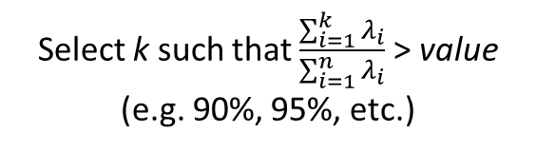

Number of components
Proportion of variance explained by the reduced data:
$$\frac{\sum_{i=1}^{k}{λ_{i}}}{\sum_{i=1}^{n}{λ_{i}}}$$
1
Select k such that $\frac{\sum_{i=1}^{k}{λ_{i}}}{\sum_{i=1}^{n}{λ_{i}}}$ > value (e.g. 90%, 95%, etc.)
Cumulative explained variance
Explained variance
individual explained variances (per principal component)
PC1
PC2
PCn
Unsupervised learning
Computation for Transportation Engineering – Hilary Term 2024

Slide 22

PCA Algorithm
Steps to perform PCA:
Normalize features
Remove the respective mean across the sampling dimension. If variance units are not comparable, standardize each variable to standard deviation 1
$$x_{j}^{(i)}←\frac{x_{j}^{(i)}−μ_{j}}{σ_{j}}$$
Compute the covariance matrix S
$$S=\frac{1}{m}XX^{T}, X∈ℝ^{n × m}$$
Compute the eigenvectors and eigenvalues of the covariance matrix
Sort the eigenvalues in descending order of magnitude to identify the principal components
Select the number of dimensions k based on the ratio of variance explained
avoids bias in determining directions
Input matrix features after normalization
Unsupervised learning
Computation for Transportation Engineering – Hilary Term 2024

Slide 23
Notes
PCA is useful to perform unsupervised dimensional reduction (e.g. data compression), as it allows to express multiple features in as smaller number of principal components.
As such it, it is not a features selection tool
In LASSO for example, the interpretation of feature selection operated through regularization is clear, i.e. if we discard the coefficient associated with the feature x_{i} it means that x_{i} is not a discriminant feature or, more precisely, it does not have a strong linear influence on the target variable.
In PCA, the discarded variables are linear combination of the original features, so they are not well interpretable.
After PCA transformation, the physical meaning, if any, of original variables is lost. Therefore, in general PCA makes results of PCA-based ML algorithm application less interpretable.
To go deeper on explainable AI and explanation of predictions from a ML models:
https://shap.readthedocs.io/en/latest/overviews.html
Unsupervised learning
Computation for Transportation Engineering – Hilary Term 2024

Slide 24
Clustering
x₂
Remember when to use PCA: data in the original n-dimensional space mostly lie in a k-dimension subspace, k<<n
v
v
v
Hence, PCA not particularly convenient is this case
v
v
But, the structure of the data is such that they can be clustered!!
Objective: identify groups of the data such that:
Items belonging to the same cluster are as similar as possible → minimize intra-cluster variance
Items belonging different clusters are as different as possible → maximize inter-cluster variance
x₁
Unsupervised learning
Computation for Transportation Engineering – Hilary Term 2024
Notes:
Variance is about equal in all dimensions

Slide 25
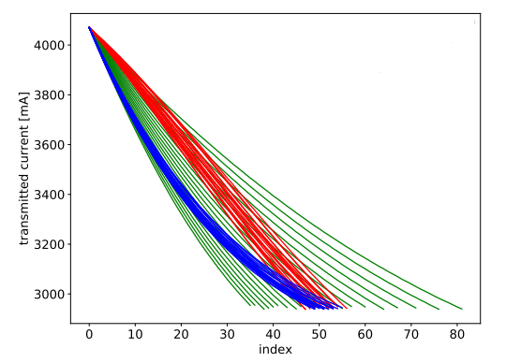
Clustering application in railway
Can we have a computer/machine to automatically reveal structure of my data?
Which trains have the similar failure?
Which switch machines require similar maintenance?
Which train moves are alike?
In general, these should be 3 different types of train move profiles: constant speed trains, accelerating and decelerating trains.
Can we automatically detect different train speed types?
AI for Railway – use cases
Computation for Transportation Engineering – Hilary Term 2024

Slide 26
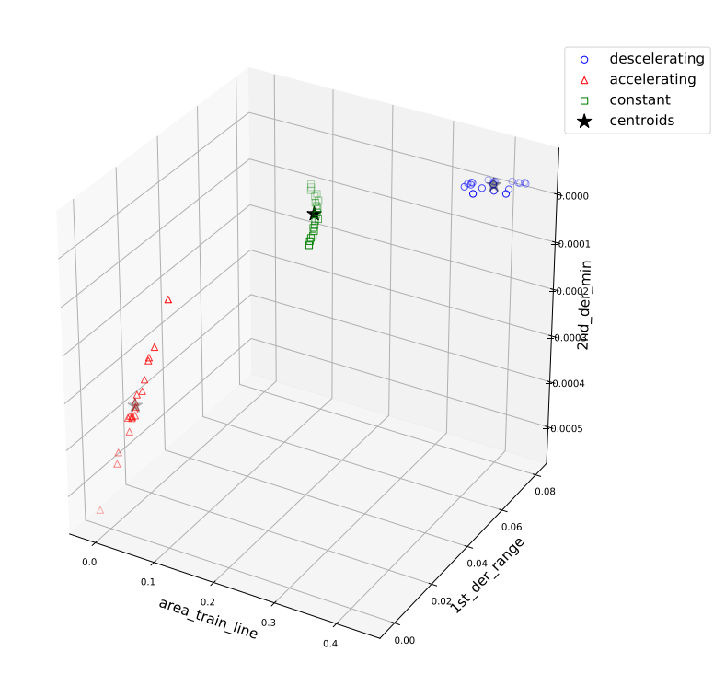
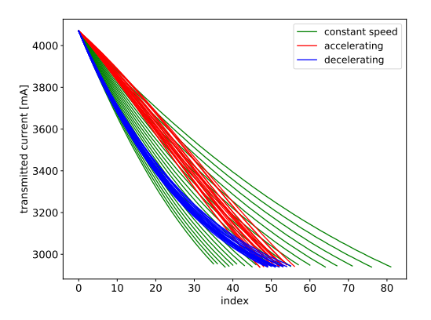
Clustering application in railway
Can we have a computer/machine to automatically reveal structure of my data?
Which trains have the similar failure?
Which switch machines require similar maintenance?
Which train moves are alike?
Feature extraction
Train moves clustering
Smart grouping in clusters
Clustering Algorithms
AI for Railway – use cases
Computation for Transportation Engineering – Hilary Term 2024

Slide 27



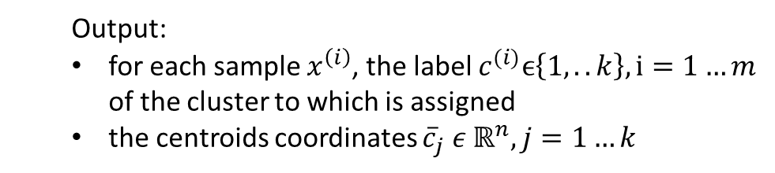

k-means clustering
2
x₂
1
Unsupervised problem: discover pattern in data from input samples alone, i.e. no labels are given
v
$${\overline{c}}_{1}$$
v
$${\overline{c}}_{2}$$
Input:
training set
number of clusters: k
v
v
$$x^{(1)},x^{(2)}, ….,x^{\left(m\right)},{ x}^{\left(i\right)}ε ℝ^{n}$$
4
v
3
Similarity metrics: distance (e.g. Euclidian) between data points and the center (centroid) of the associated cluster.
$${\overline{c}}_{4}$$
$${\overline{c}}_{3}$$
x₁
Output:
for each sample $x^{\left(i\right)}$, the label $c^{(i)}ϵ\left\{1,..k\right\},i=1…m$ of the cluster to which is assigned
the centroids coordinates ${\overline{c}}_{j} ε ℝ^{n}, j=1…k$
Unsupervised learning
Computation for Transportation Engineering – Hilary Term 2024

Slide 28
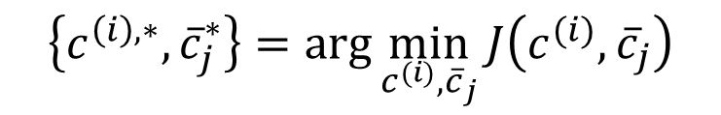


k-means algorithm
Cast (yet another) optimization problem:
$$J\left(c^{(i)},{\overline{c}}_{j}\right)=\sum_{i=1}^{m}{\sum_{j=1}^{k}{p_{i,j}}{\left\|x^{(i)}−{\overline{c}}_{j}\right\|}^{2}, }$$
Minimizing WCSS is equivalent to maximizing the BCSS (between-cluster sum of squares)
How to solve this (hard) problem?
$$\min_{c^{(i)}} \min_{{\overline{c}}_{j}}{\sum_{i=1}^{m}{\sum_{j=1}^{k}{p_{i,j}}{\left\|x^{(i)}−{\overline{c}}_{j}\right\|}^{2}, }}{}$$
Fix the centroids ${\overline{c}}_{j}$ and minimize WCSS using $c^{(i)}$ as optimization variable (i.e cluster membership)
Fix cluster membership $c^{(i)}$ and minimize with respect to ${\overline{c}}_{j}$ (i.e. update centroids so that their distance for wc points is minimal)
WCSS – Within Cluster Sum of Squares
$$p_{i,j}{ =\left\{\begin{aligned}1,{ c}^{(i)}=j \\ 0,{ c}^{(i)}≠j\end{aligned}\right.}$$
$$\left\{c^{\left(i\right), ∗},{\overline{c}}_{j}^{∗}\right\}=\arg{\min_{c^{(i)},{\overline{c}}_{j}}{J\left(c^{(i)},{\overline{c}}_{j}\right)}}$$
Unsupervised learning
Computation for Transportation Engineering – Hilary Term 2024

Slide 29
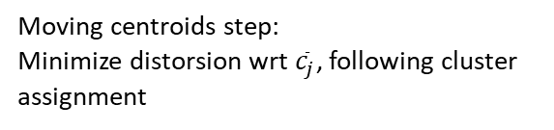


K-means algorithm
Steps of K-means algorithm:
specify the number of clusters k
randomly initialize the cluster centroids ${\overline{c}}_{j} ε ℝ^{n}, j=1…k$
repeat till exit condition is met:
for i = 1 : m
$c^{(i)}$:= label $ϵ\left\{1,..k\right\}$ : $\arg{\min_{j}{{\left\|x^{(i)}−{\overline{c}}_{j}\right\|}^{2}}}, i.e. c^{(i)}$ = index of centroid closest to $x^{(i)}$-> assign $x^{(i)}$ to its nearest centroid
for j = 1 : k
${\overline{c}}_{j}$ :=$\frac{\sum_{i=0}^{m}{p_{i,j}{ x}^{(i)}}}{\sum_{i=0}^{m}{p_{i,j}}}$ → mean of points assigned to cluster j (centroid of points belonging to cluster j)
Note: variants exist (e.g. K-medians, Soft K-means…)
Cluster assignment step:
Minimize distorsion wrt $c^{(i)}$, holding ${\overline{c}}_{j}$ fixed
Moving centroids step:
Minimize distorsion wrt ${\overline{c}}_{j}$, following cluster assignment
Unsupervised learning
Computation for Transportation Engineering – Hilary Term 2024

Slide 30

Choosing K
“Elbow” method: try different K values, plot the distortion score vs K, and pick the the point after which adding more centroids (clusters) doesn’t bring significant change to the objective function.
J
“Elbow” point
Often decay is monotonically decreasing
1
2
3
4
5
6
k
Unsupervised learning
Computation for Transportation Engineering – Hilary Term 2024

Slide 31
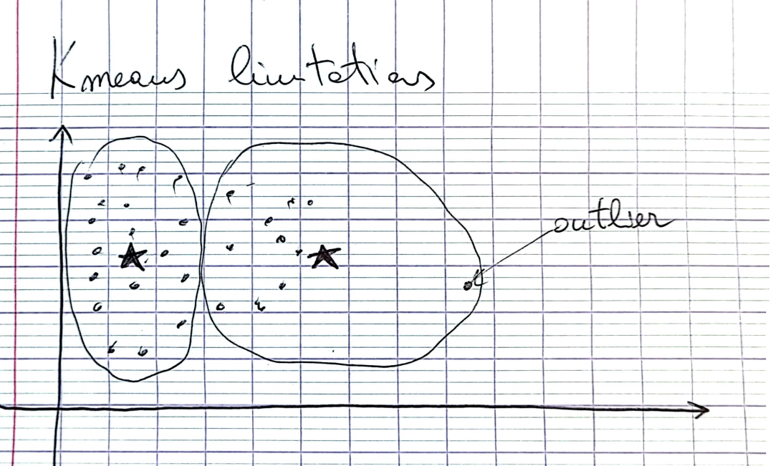
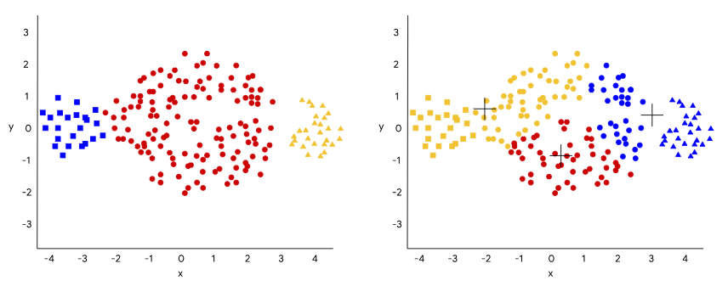
K-means limitations
High sensitivity to initialization
Slow convergence
Local optima
mitigation: try different initializations of centroids
K-means++ initialization
K-means does not work well for clusters
with significant difference in size
with significant difference in density
with non-spherical shape
K-means does not work well for data:
with outliers (why?)
Unsupervised learning
Computation for Transportation Engineering – Hilary Term 2024

Slide 32
Some conclusive notes about clustering
Normalize features to bring them on a comparable scale
K-means assumes spherical shapes of clusters
K-means works on numerical data
K-means gives more importance to bigger clusters
Unsupervised learning
Computation for Transportation Engineering – Hilary Term 2024

