Slide 1
Generative Adversarial Nets
Lim, Jin-Su
dla0830ld@gmail.com
2017-11-09

Slide 2
References
https://www.slideshare.net/NaverEngineering/1-gangenerative-adversarial-network
https://www.slideshare.net/ssuser7e10e4/wasserstein-gan-i
http://www.khshim.com/archives/20
http://jaejunyoo.blogspot.com/2017/01/generative-adversarial-nets-1.html
http://keunwoochoi.blogspot.kr/2016/12/generative-adversarial-network-gan.html
http://learnai.tistory.com/4
- 2 -

Slide 3
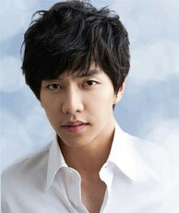
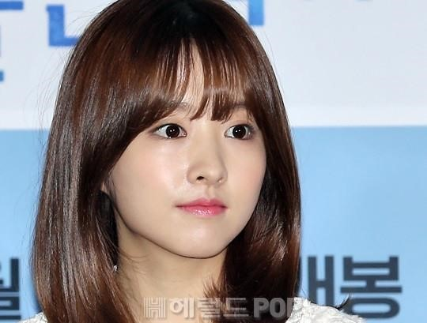
Supervised Learning
Discriminative
Model
Classification
Man?
Woman?
- 3 -
https://www.slideshare.net/NaverEngineering/1-gangenerative-adversarial-network

Slide 4
Human
Human
Man
- 4 -
https://www.slideshare.net/NaverEngineering/1-gangenerative-adversarial-network

Slide 5
Generative Model
Generative
Model
latent variable
The generative model learns the distribution of training data
- 5 -
https://www.slideshare.net/NaverEngineering/1-gangenerative-adversarial-network

Slide 6
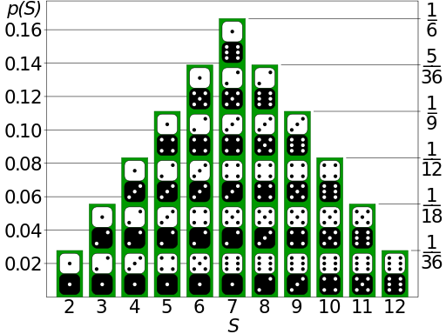
Probability distribution
https://en.wikipedia.org/wiki/Probability_distribution
- 6 -

Slide 7
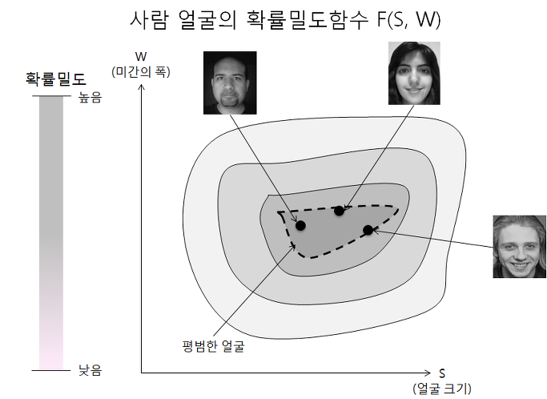
Probability distribution
http://learnai.tistory.com/4
- 7 -

Slide 8
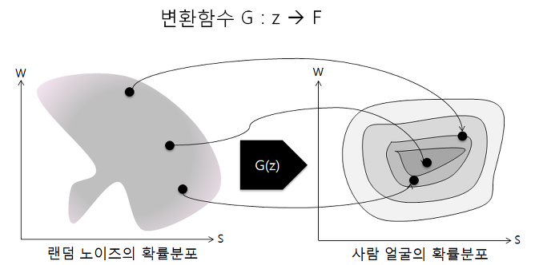
Probability distribution
http://learnai.tistory.com/4
- 8 -

Slide 9
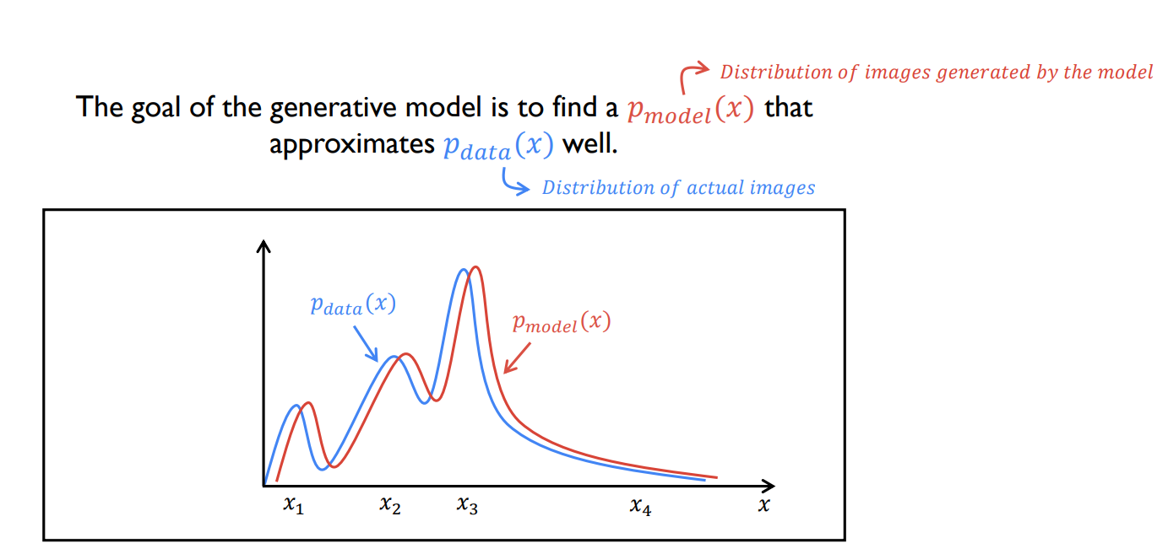
Probability distribution
- 9 -
https://www.slideshare.net/NaverEngineering/1-gangenerative-adversarial-network

Slide 10

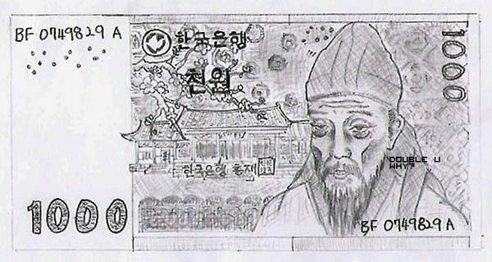

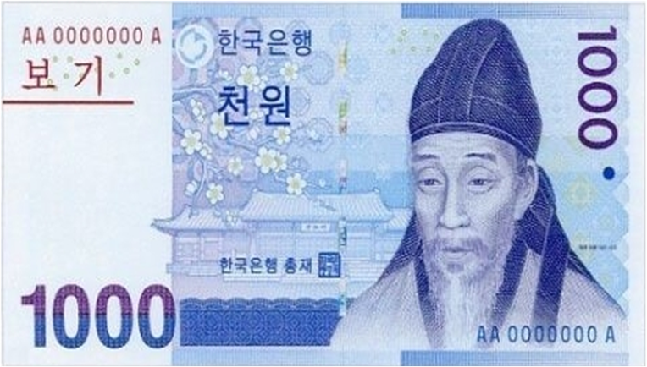
Generative Adversarial Nets
Counterfeiter
Police
http://shower0420.tistory.com/172
- 10 -

Slide 11
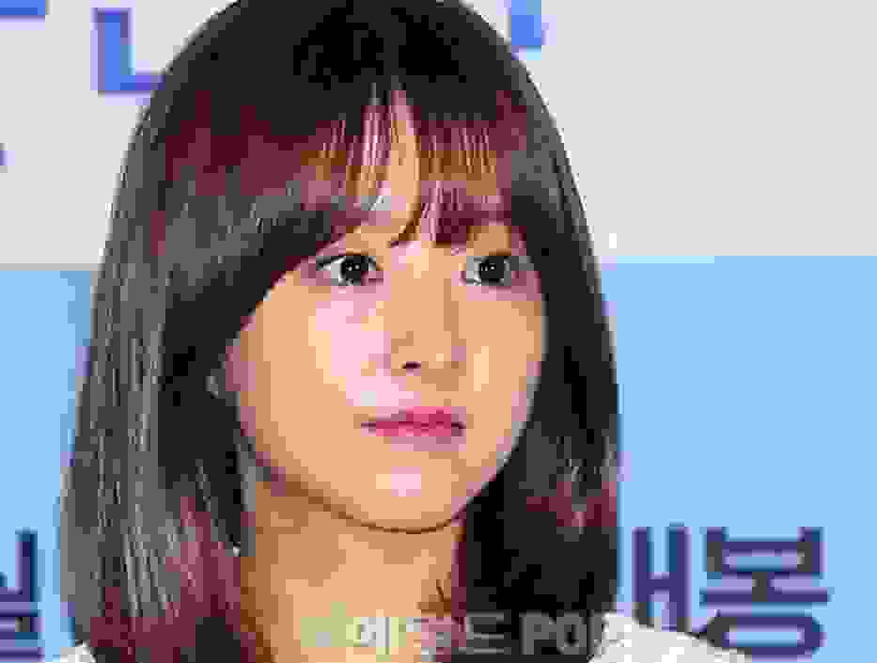
Generative Adversarial Nets
Real Image
D
D(x)
Fake Image
Latent Code
z
G
D
D(G(z))
- 11 -

Slide 12
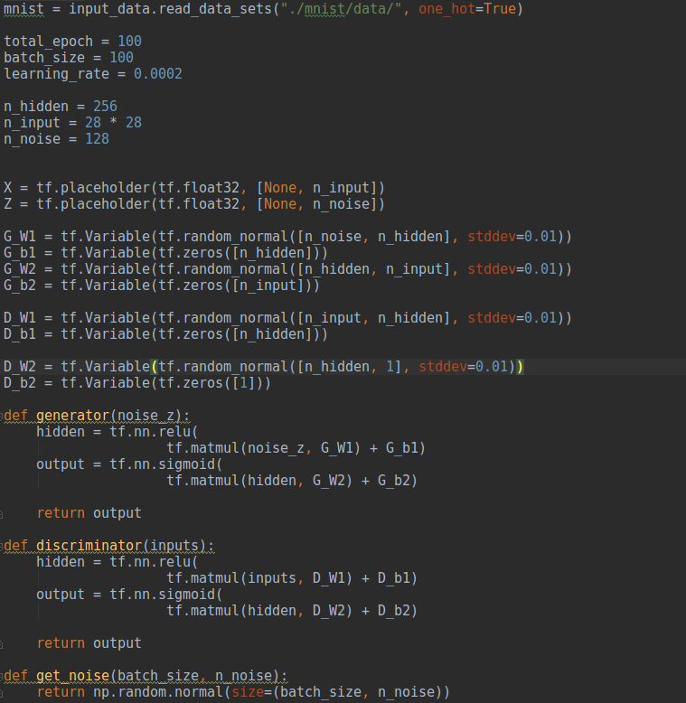
Generative Adversarial Nets
Real Image : x
Latent Code : z
Generator
Discriminator
- 12 -

Slide 13
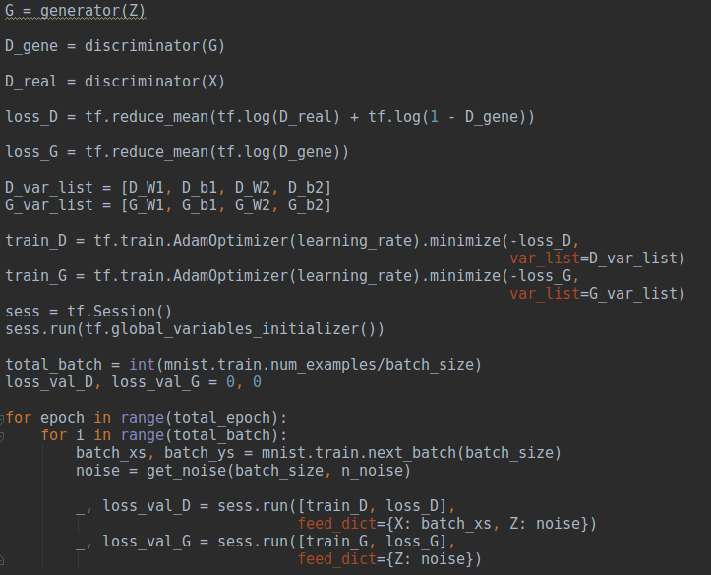
Generative Adversarial Nets
Optimizer
- 13 -

Slide 14
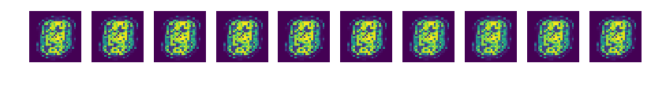
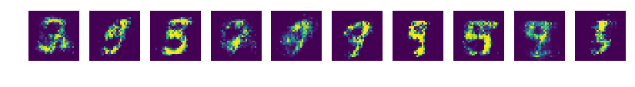
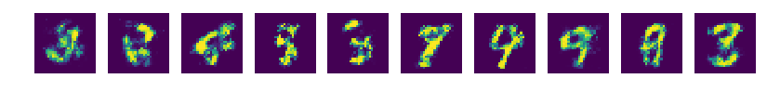
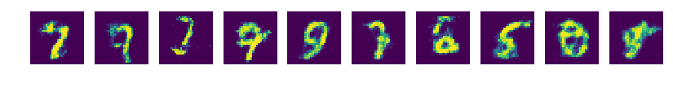
Generative Adversarial Nets
- 14 -

Slide 15
Q & A
- 15 -

