Slide 1
DATA 301: Supervised Learning, splitting the dataset
Notes:
JSF Page Navigation

Slide 2
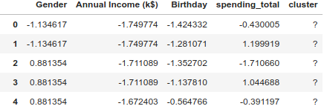
Unsupervised Learning
Unsupervised
  Unlabeled Data
  Model does not know correct result during training
  Model finds hidden patterns in data
  Goal is to train the model to detect these patterns in unseen data
  Examples: DBSCAN, HDBSCAN, Mean Shift
Algorithm has to figure this out
Notes:
You know what class it belongs to
JSF Page Navigation

Slide 3
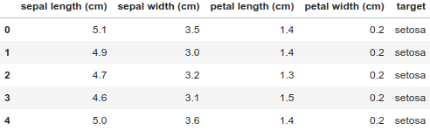
Supervised
Supervised
  Labeled Data
  Model knows correct result during training
  Uses correct result to adjust model parameters during training
  Goal is to train model to pick correct result on unseen data
  Examples: Regressions, Decision Trees, Random Forest, Neural Networks
Known Target
Notes:
JSF Page Navigation

Slide 4
Supervised Data Setup (easy part)
Still need to do pre-processing (no standardization for tree based methods needed although it does not hurt)
Additionally:
Need to divide data into 2 portions; train, test
Balance unbalanced training sets
When we get to cross validation we need 3 portions; train, test, validation
Typically 80% train 20% test (or 70-30, or 90-10 depends on amount of data you have)
Calculate standardization metrics on the train set only. Apply these IDENTICAL metrics to the test set.
If you violate this rule, test set information will leak over to the train set.
Notes:
The more data you have the larger you can make your test set

Slide 5
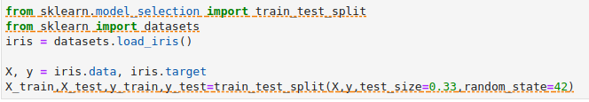
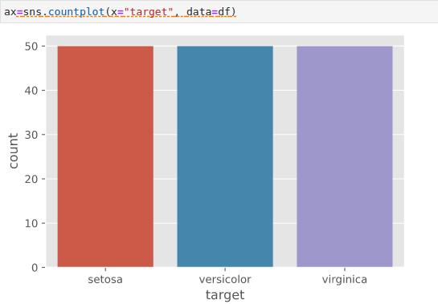
Balanced datasets
If your dataset has roughly the same number of labeled classes then its easy to do a train test split. Here we load the iris dataset, 77% of it is used to train, 33% to test.
Notice we have an equal number of iris types

Slide 6
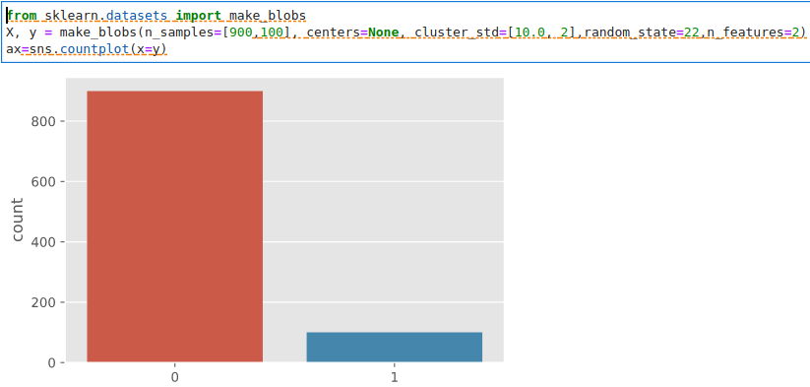
Imbalanced datasets
Dataset has more of one class than others.
This is very common, think of cancer diagnosis
Balance the train portion of the dataset only (not the test set)
Notes:
Even a modest imbalance 4to 1 can cause problems

Slide 7
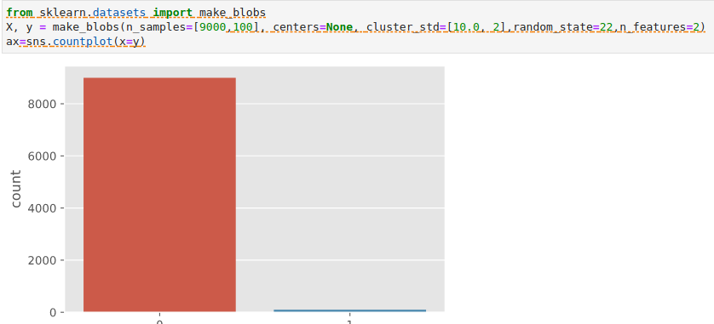
Imbalanced datasets,
What if dataset is very imbalanced?
For fraud detection, 99.9% of transactions are legitimate.
Which means a fraud dataset consists of almost all legitimate transactions.
BTW for this case, if your evaluation metric is accuracy, a model may learn to always say its not fraud (99.9% accuracy!). See notebook on website for example.
Notes:
Even a modest imbalance 4to 1 can cause problems

Slide 8
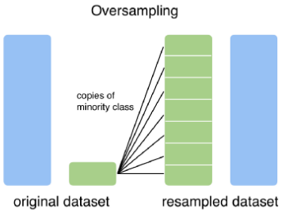
Imbalanced datasets, Guides
If you don’t have a lot of data (<10,000 samples)
oversample the minority (train set only)
* https://machinelearningmastery.com/tactics-to-combat-imbalanced-classes-in-your-machine-learning-dataset/
https://medium.com/strands-tech-corner/unbalanced-datasets-what-to-do-144e0552d9cd/

Slide 9
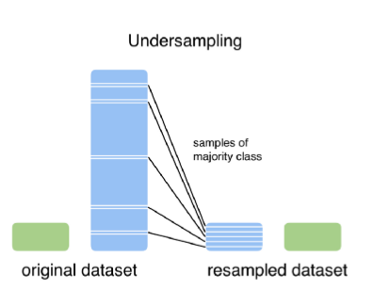
Imbalanced datasets, Guides
If you have a lot of data (>>10,000 samples)
undersample the majority (train set only)
* https://machinelearningmastery.com/tactics-to-combat-imbalanced-classes-in-your-machine-learning-dataset/
https://medium.com/strands-tech-corner/unbalanced-datasets-what-to-do-144e0552d9cd/
Notes:
10,000->100,000 or more

Slide 10
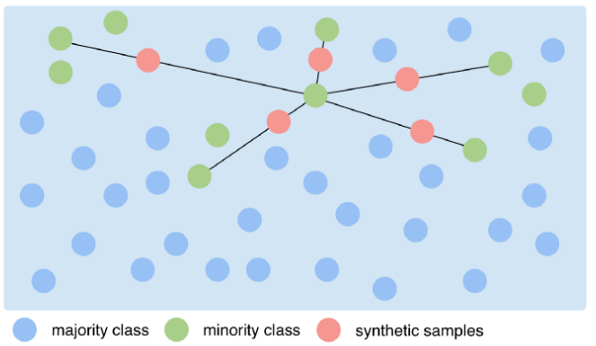
Imbalanced datasets, Guides
Try to generate synthetic samples (train set only). There SMOTE package uses kNN to generate synthetic points along lines connecting members of the minority class.
Because SMOTE selects a point between existing points, the boundary of the minority class will not grow
* https://machinelearningmastery.com/tactics-to-combat-imbalanced-classes-in-your-machine-learning-dataset/
https://medium.com/strands-tech-corner/unbalanced-datasets-what-to-do-144e0552d9cd/
Notes:
SMOTE takes the difference between an observation and its nearest neighbor. It multiplies the difference with a random number between zero and one. Then, it identifies a new point by adding the random number to the feature. This way, SMOTE does not copy observations and instead creates a new, synthetic one.

Slide 11
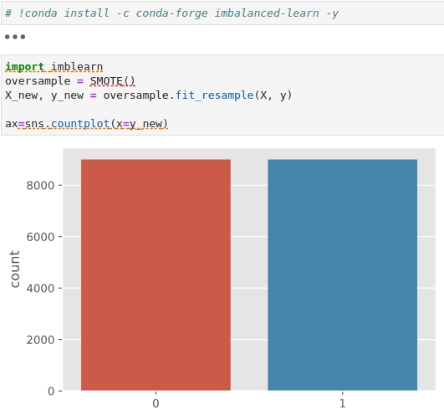
Imbalanced datasets, Guides
Try to generate synthetic samples (train set only). The SMOTE package uses kNN to generate synthetic points along lines connecting members of the minority class.
* https://machinelearningmastery.com/tactics-to-combat-imbalanced-classes-in-your-machine-learning-dataset/
https://medium.com/strands-tech-corner/unbalanced-datasets-what-to-do-144e0552d9cd/

Slide 12
Imbalanced datasets, Guides
Maybe the easiest (or hardest) of all;
Collect more data from the minority class
* https://machinelearningmastery.com/tactics-to-combat-imbalanced-classes-in-your-machine-learning-dataset/
https://medium.com/strands-tech-corner/unbalanced-datasets-what-to-do-144e0552d9cd/
Notes:
10,000->100,000 or more

Slide 13
Imbalanced datasets, Guides
Train
Test
Balance this part only!
The model will learn what distinguishes each class
It will not base decisions on relative class size
DO NOT BALANCE
THIS PART
* https://machinelearningmastery.com/tactics-to-combat-imbalanced-classes-in-your-machine-learning-dataset/
https://medium.com/strands-tech-corner/unbalanced-datasets-what-to-do-144e0552d9cd/
Notes:
10,000->100,000 or more

Slide 14
Train/Test split – temporal or time series data
Time series data such as:
Daily or Weekly sales
Stock closing prices
Daily temperature fluctuations
Temporal data has a lot of complexity, there is generally an underlying seasonality and a trend.
You can not randomly sample train/test splits with temporal data. The test set must come from the latest data, or you risk information from later data leaking into earlier data.
We will (hopefully) address temporal data later
Notes:
Even a modest imbalance 4to 1 can cause problems

Slide 15
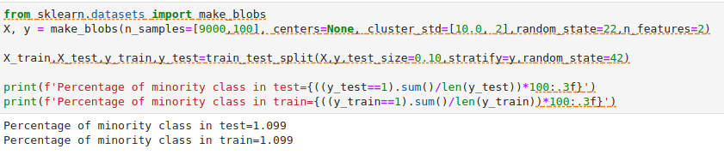
Train/Test split – prefer stratified splits for classification
sklearns train_test_split randomly samples from a dataset to form the train and test set. Make sure test set has same class percentages as train set by specifying a stratified sample.
Stratified sampling aims at splitting a data set so that each split is similar with respect to something. In a classification setting, it is often chosen to ensure that the train and test sets have approximately the same percentage of samples of each target class as the complete dataset.
This is especially important for unbalanced datasets to ensure that the test set has a representative sample of all classes.
Notes:
10,000->100,000 or more

Slide 16
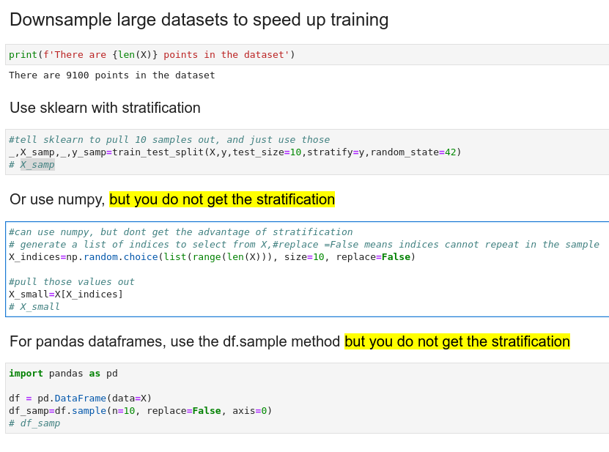
Datasets, Guides
Downsample large datasets to speed up experimental training
* https://machinelearningmastery.com/tactics-to-combat-imbalanced-classes-in-your-machine-learning-dataset/
https://medium.com/strands-tech-corner/unbalanced-datasets-what-to-do-144e0552d9cd/
Notes:
10,000->100,000 or more

Slide 17
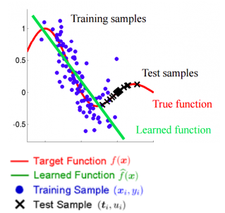
And even if you do everything right
Dataset shift often occurs when data is collected over a long period of time. Without careful curation, your training set may no longer be predictive of your test set. This is especially common in temporal datasets.
*https://www.analyticsvidhya.com/blog/2017/07/covariate-shift-the-hidden-problem-of-real-world-data-science
Notes:
Even a modest imbalance 4to 1 can cause problems

Slide 18
Summary
Calculate all metrics on train set only
Use these metrics to normalize test set(mean, std_dev)
Dealing with unbalanced datasets (balance train set only!)
Use stratified splits for classification
Downsample large datasets to speed training
Dataset shift- it’s probably going to happen

