Slide 1
DATA 301: Linear Regression review
Ordinary Least Squares (OLS)
Notes:
JSF Page Navigation

Slide 2
Topics
Training Overview
OLS Linear Regression – outline
OLS Linear Regression - scikit-learn

Slide 3
Training a Model - Soon
Processed Data Set
Train Set
Test Set
Train Set
Validation Set
Test Set
Iterative
training
Machine
Learning
Algorithm
Predictive Model
Final performance estimate
Figure from 'Python Machine Learning' by Sebastian Raschka
Notes:
The more data you have the larger you can make your test set

Slide 4
Training a Model - Soon
Processed Data Set
Train Set
Test Set
Train Set
Validation Set
Test Set
Cross
Validation
Iterative
training
Machine
Learning
Algorithm
Predictive Model
Final performance estimate
Figure from 'Python Machine Learning' by Sebastian Raschka
Notes:
The more data you have the larger you can make your test set

Slide 5
Training a Model - Today
Processed Data Set
Train Set
Validation Set
Calculate mean and std on Train set only
Use these metrics to standardize BOTH train and
Validation sets
Iterative
training
Machine
Learning
Algorithm
Predictive Model
Final performance estimate
Figure from 'Python Machine Learning' by Sebastian Raschka
Notes:
The more data you have the larger you can make your test set

Slide 6

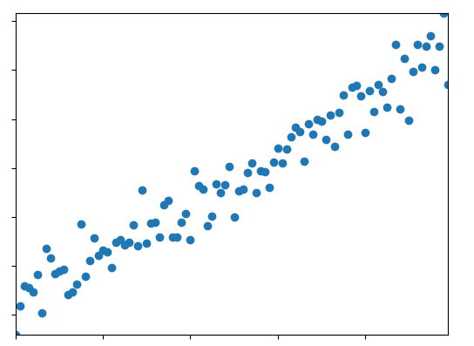
Training a Model
Ex. Linear regression iteratively estimates w terms in this equation
Notes:
The more data you have the larger you can make your test set

Slide 7

Training a Model
Ex. Linear regression iteratively estimates w terms in this equation
By reducing the error between actual and predicted values using this equation
Notes:
The more data you have the larger you can make your test set

Slide 8
Training a Model
Ex. Linear regression iteratively estimates w terms in this equation
By reducing the error between actual and predicted values using this equation
To generate a best fit line
Notes:
The more data you have the larger you can make your test set

Slide 9
Training a Model
Split data
Notes:
The more data you have the larger you can make your test set

Slide 10
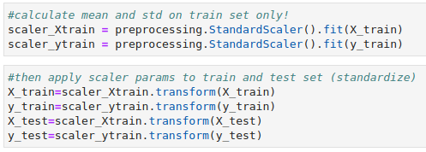
Training a Model
Standardize data
Calculate std and mean on train set only
Use these metrics to standardize train and test sets
Notes:
The more data you have the larger you can make your test set

Slide 11
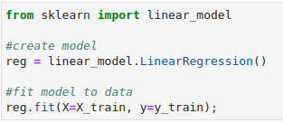
Training a Model
Create a model and fit it to train data, this is where linear regression parameters are calculated
Notes:
The more data you have the larger you can make your test set

Slide 12

Training a Model
Use trained model to predict on unseen data
Linear regression parameters are fixed when predicting
Notes:
The more data you have the larger you can make your test set

Slide 13
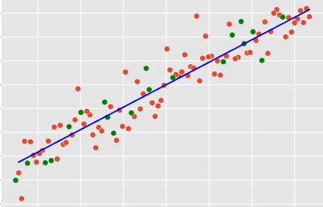

Training a Model
Graphs;
train points
Regression line
Test points
Notes:
The more data you have the larger you can make your test set

Slide 14
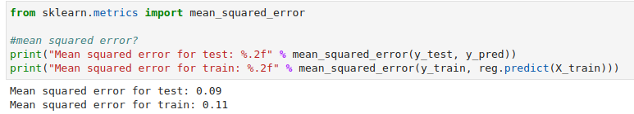
Training a Model
And finally the
errors for train
and test sets
Notes:
The more data you have the larger you can make your test set

Slide 15
Summary
Standardize on train set only
Scikitlearn StandardScaler usage
Scikitlearn LinearRegression

