Slide 1
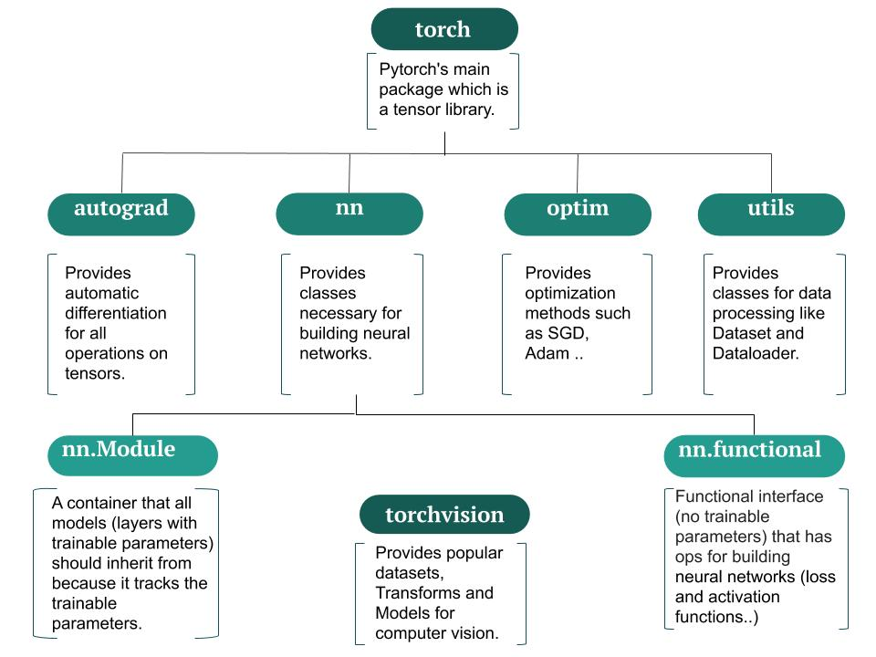

Slide 2
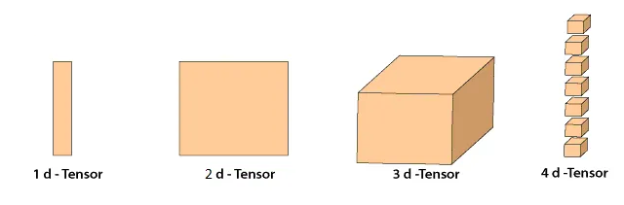

Used a lot when sending
Batches of images to NN for training
Shape=[1,n]
shape=[n,1]
shape=[n,m]
shape=[n,m,o]
shape=[n,m,o,p]

Slide 3
b1
1
O1 = w11*x1 + w21*x2 + b1
w11
X shape=[1,2]
W shape=[2,3]
B shape=[1,3]
X@w shape[1,3]
X@w+b shape [1,3]
What if X has 32 rows?
(This is a minibatch)
X@w shape=[32,3]
The b term is broadcast over the 0th dimension (rows) to a shape of [32,3]. Then added
To X@W
w21
X1
w12
b2
b2
X2
w22
2
...
w13
b3
w23
3
...

Slide 4
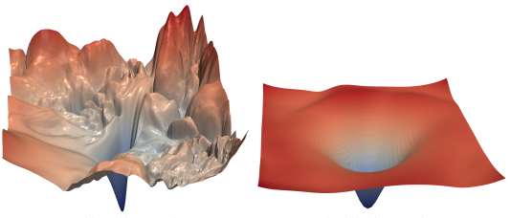
2 Function error surfaces
Local Minima: A ‘hole’ in the error surface
that SGD could wind up in and have trouble
getting out of. It’s not the smallest error
Global Minima:where you want SGD to wind up.
Its the smallest error on the surface

Slide 5
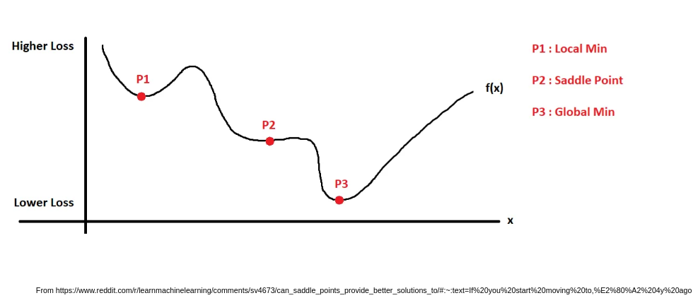

Slide 6















Slide 7
Standard Fine-tuning configuration
Replace the final fully connected layer with a custom MLP head. Appropriate when you have only images for training and inference (i.e., no auxiliary metadata or tabular features).
Input
Model
Loss
Img.jpg
Vision model backbone
that is without the final fc layer
MLP
Predict label
Crossentropy(predict label)
Total
loss
Label
Logits

Slide 8
Multi Head Fine-tuning – multiple training heads and custom loss function Use when inference inputs are images only, but additional metadata or tabular features are available during training. Incorporate these features during training, while deploying an image-only model.
Input
Model
Multitask Loss
MLP
Predict label
Crossentropy(predict label)
*
w1
Img.jpg
Original model backbone
that is without the final fc layer
MLP
Predict variety
+
Crossentropy(predict variety)
*
w2
Total
loss
MLP
Predict age
MSEloss(predict age)
*
w3

Slide 9
Multi Input Fine-tuning – adding additional training information
Replace the final fully connected layer with a custom MLP head. Appropriate when you have images and auxiliary metadata or tabular features for both training and inference.
Input
Model
Loss
Img.jpg
Vision model backbone
that is without the final fc layer
variety
concatenate
MLP
Predict label
Crossentropy(predict label)
Total
loss
age
Label
Logits

Slide 10
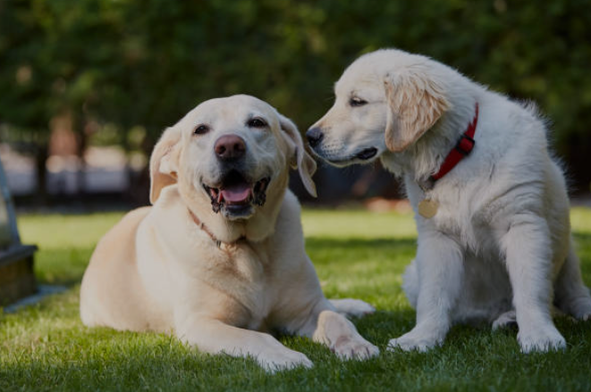

Slide 11
0.91
.91
0.92
0.90
0.91
0.70
0.55

Slide 12
0.91
.91
0.92
0.91

Slide 13
0.91
.91
0.92
0.91
0.70
0.55

Slide 14
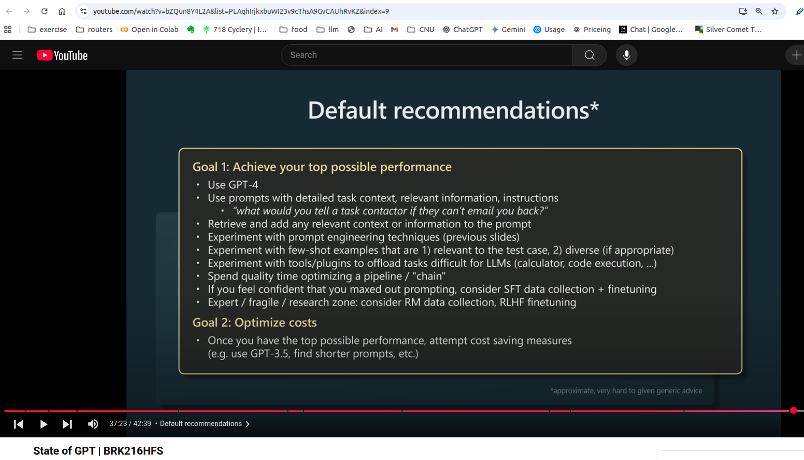

Slide 15
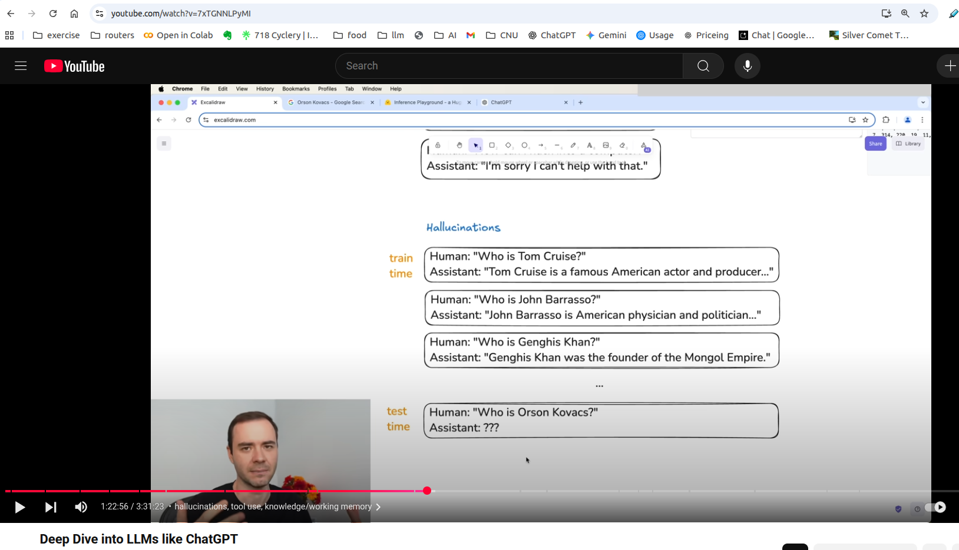

Slide 16
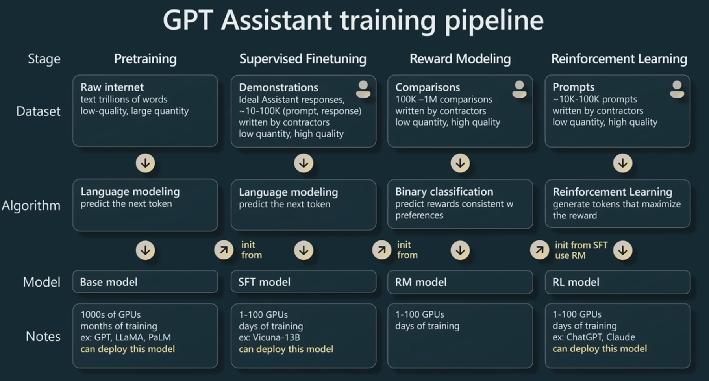
From https://www.youtube.com/watch?v=bZQun8Y4L2A

Slide 17
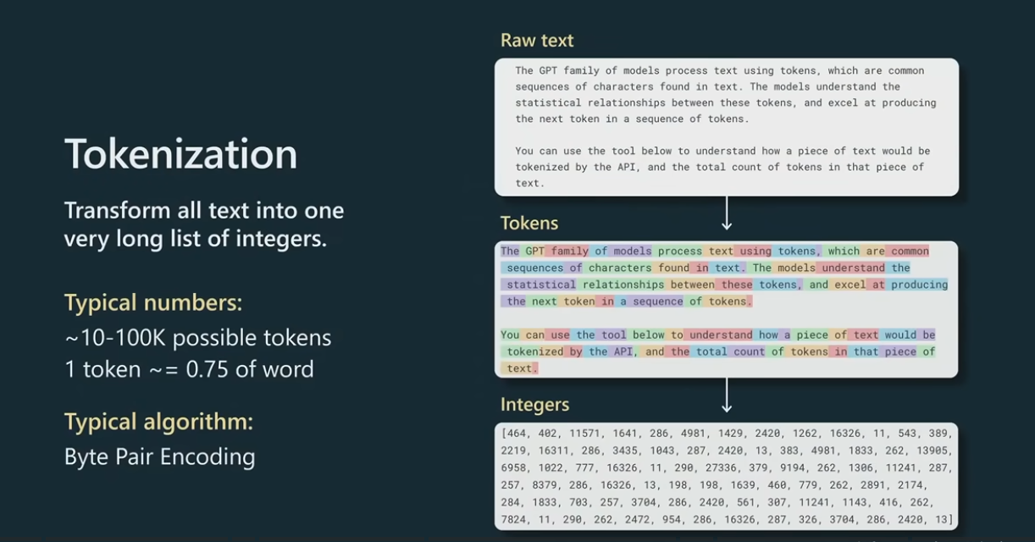

Slide 18
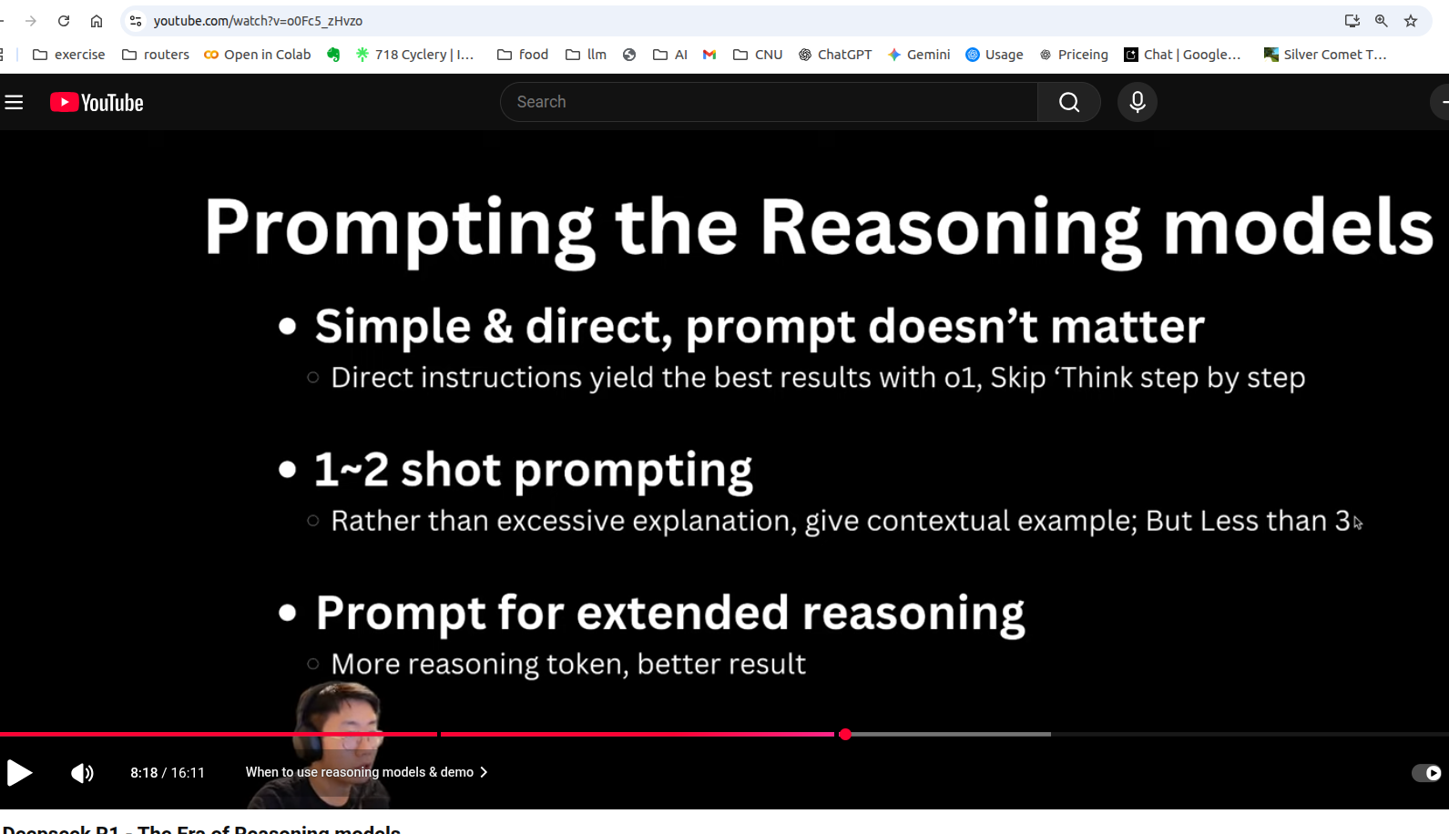

Slide 19
Start
compute base vocabulary
compute unique set of words and frequencies in corpus
Split each word into base vocabulary
Merge pairs with max occurrences
Update vocabulary
Reached desired vocabulary size?
Stop

Slide 20
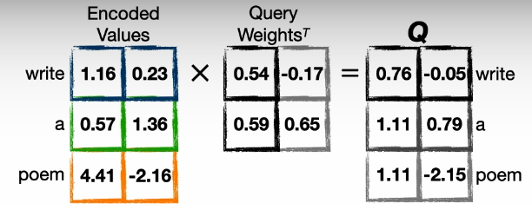
Attention
How to represent this in Pytorch?
A Linear Layer!
Go to notebook
These are the
embeddings
for each token
These are
trainable
weights
These are
Encoded
embeddings

Slide 21
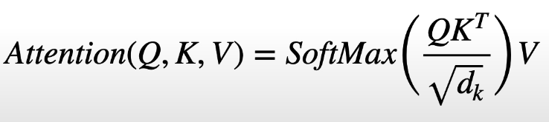
Attention
How to represent this in Pytorch?
A Linear Layer! (See notebook)
How to do this calculation?
(See notebook)
These are the
embeddings
for each token
These are
trainable
weights
These are
Encoded
embeddings

Slide 22
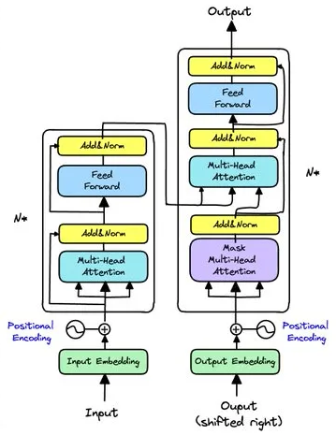
Attention
The left side is the decoder
Used to generate context aware embeddings (RAG)
Also can be fine tuned for
Examples (BERT, ModernBERT, SBERT...there are a lot)
The river bank
The money in the bank

Slide 23
Attention
This is the original transformer

Slide 24
Attention
There are several kinds of attention
  The one we learned
  Masked
  Cross
See the DeepLearning AI lecture series on the course website for details

Slide 25
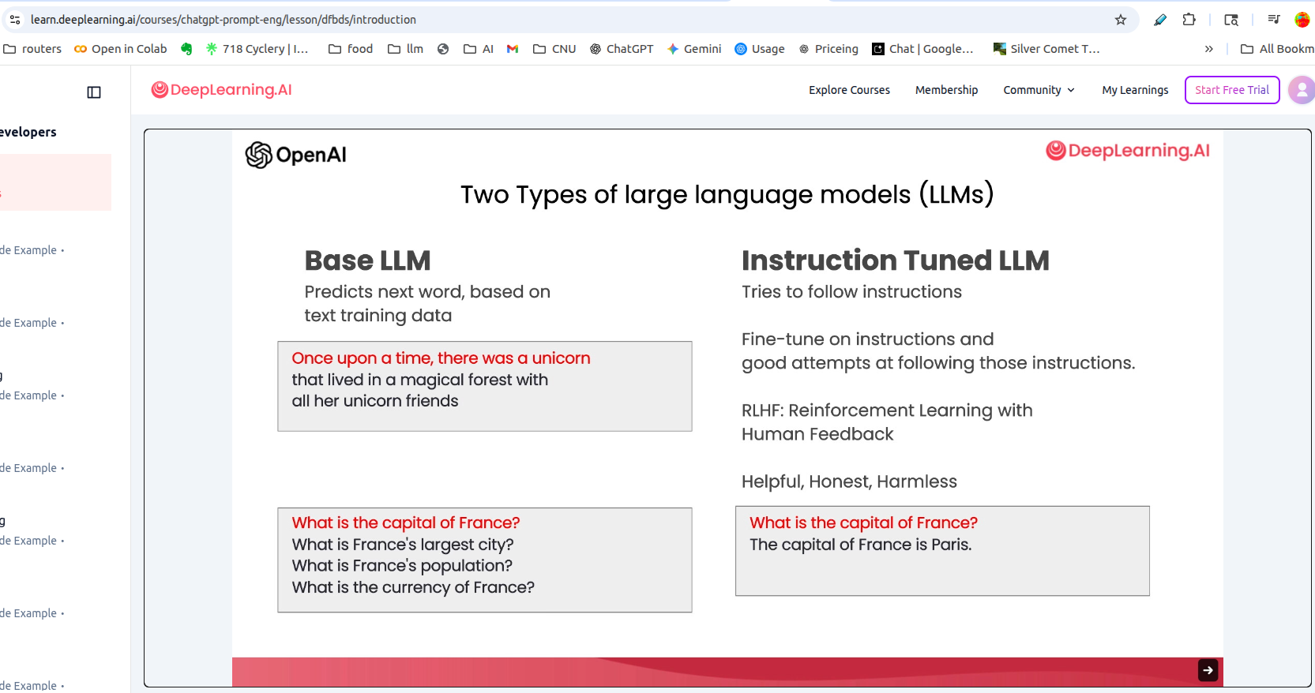

Slide 26
