Slide 1
DAI 0.9 Reporting - Architecture Implementation

Slide 2
Overall Approach
0.9 Requirements
Assumptions
Logical Components
Process And Data-Flow View
Architecture Considerations ,Trade-offs, and Decisions

Slide 3
0.9 Requirements (Summary)
Campaign Proof-Of-Performance (on-screen)
By Campaign, Ad, MSO, ServiceGroup.
For any given date range, Campaign, MSO, ServiceGroup.
Campaign Proof-Of-Performance (scheduled)
Run daily, for the previous day count by Campaign, Ad.
For any given date range, Campaign, MSO, ServiceGroup.
Programmer Proof-Of-Performance (on-screen)
For a given Programmer , Campaign and month range.
Group by month, network, sum up insertions and views.
Programmer Proof-Of-Performance (scheduled)
Run monthly, for the previous month.
For each programmer and group by campaign, network.
Advertiser Proof-Of-Performance (on-screen)
Just like Programmer PoP, only display view counts.
Advertiser Proof-Of-Performance (scheduled)
Just like Programmer PoP, only display view counts.
Data Encryption

Slide 4
Assumptions
A01: Infrastructure
Oracle Standard Edition, execution at VM environment
ETL and Report App Servers in VM environment
A02: Data Storage
Local disk for SCTE log files.
SAN storage for split XML log files.
A03: Support for TW data volume
A04: Parsed data in Reporting Operational DataStore (ODS) for SA monitoring
A05: Parsed data stored for historical research
A06: XML log files to be stored and archived per data retention policy
A07: No external user for 0.9 release
A08: Reporting solution should be preferment, scalable, traceable.
A09: Should separate SCTE data storage (both file and database) separately from reporting.
A10: Should handle duplicate data transmission.

Slide 5
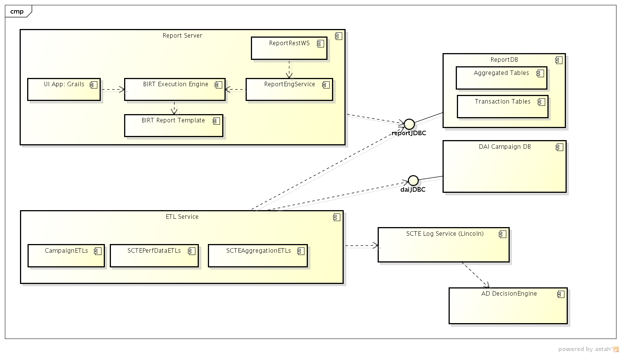
Logical Components

Slide 6
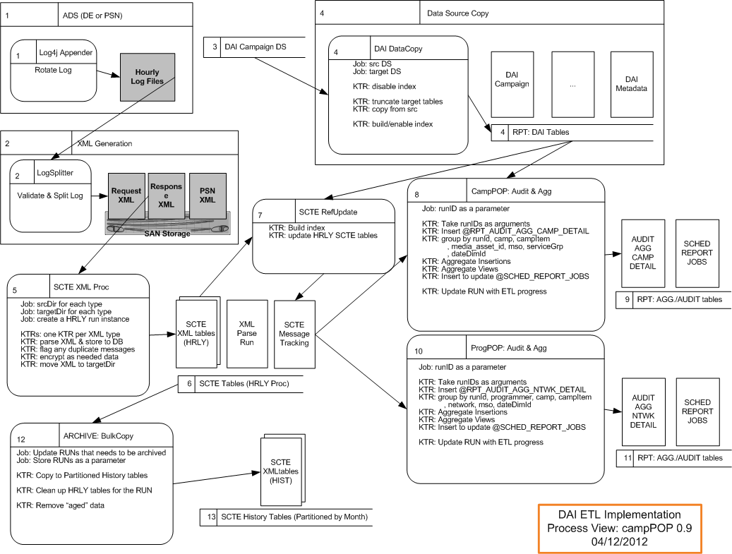
Process And Data-Flow View (ETL)

Slide 7
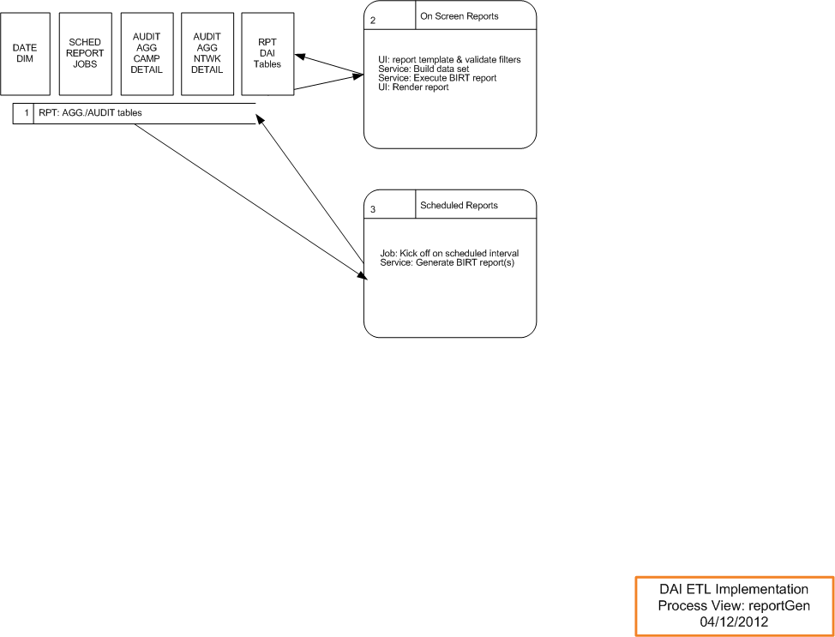
Process And Data-Flow View (Report Server)

Slide 8
Architecture Considerations ,Trade-offs and Decisions (1)
Data Size x Multiplier:
Should use x (e.g. 3) multiplier for all sizing numbers so that an operational safe margin can be achieved.
General assumption for 5 Programmers @ Full TW footprint deployment.
Data Volume
SCTE ADS for TW, 5 Programmer/Full footprint:
To Process Hourly Messages |  | Avg PerHr | AvgByteSizePerRow | MB Per Hr | GB Per Day | GB Per Mo | TB Per Yr
PlacementRequest |  | 128,425 | 4,444 | 544.3 | 12.8 | 383 | 5
PlacementResponse |  | 128,425 | 4,232 | 518.3 | 12.1 | 364 | 4
PSN |  | 128,425 | 11,646 | 1,426.3 | 33.4 | 1,003 | 12
 | sum |  |  |  | 58.3 | 1,750.0 | 20.8

Slide 9
Architecture Considerations ,Trade-offs and Decisions (2)
SCTE Table Growth
Store each message and perform aggregation calculations hourly:
TableName | AvgPerDay | PerMon | # of Month | Est. Total
Request | 3,082,200 | 92,466,000 | 6 | 554,796,000
RequestOppo | 6,164,400 | 184,932,000 | 6 | 1,109,592,000
Response | 3,082,200 | 92,466,000 | 6 | 554,796,000
ResponseDecision | 6,164,400 | 184,932,000 | 6 | 1,109,592,000
PSN(PlayData) | 30,822,000 | 924,660,000 | 6 | 5,547,960,000
XML _PROC_RUN | 24 | 720 | 24 | 17,280
XML _PROC_RUN_File | 72 | 2,160 | 24 | 51,840
XML_MSG_ID_TRACKING | 9,246,600
AUDIT_AGG_CAMP_DETAIL | 205,480 | 6,164,400 | 12 | 73,972,800
AUDIT_AGG_PROG_DETAIL | 123,288 | 3,698,640 | 12 | 44,383,680

Slide 10
Architecture Considerations ,Trade-offs and Decisions (3)
Reporting Table Growth (for SCTE)
Store aggregated results for reporting. SCTE aggregated results will be transmitted/stored along with SaFI performance data:
TableName | AvgPerDay | PerMon | # of Month | Est. Total
RPT_AGG_CAMP_DETAIL | 205,480 | 6,164,400 | 12 | 73,972,800
RPT_AGG_PROG_DETAIL | 123,288 | 3,698,640 | 12 | 44,383,680

Slide 11
Architecture Considerations ,Trade-offs and Decisions (4)
Data That Are “Really” Needed
Audit
Aggregation Results
SCTE xml run – Yes.
SCTE monthly – Yes, for 6 month?
SCTE complete history – No?
PSN older than 72 hours will be discarded
MessageID tracking (uniqueness): by MSO, 1 days
Database Server
Design 2 schemas: 1 for SCTE, 1 for Combined SCTE and SaFI Reporting
File Storage for XML files
Use “gzip -9” to store hourly files
Estimate file size for 1 yr: 300GB
Current Performance and Scale
Local ETL xml parsing test on a laptop: 120K xml messages in 100 seconds.
Need to verify in a VM setup/standalone setup for both ETL and db server performance.
Need to verify performance under load.
To scale, setup multiple ADSs, and pair each ADS with a logSplit and an ETL xml parser.

Slide 12
Architecture Considerations ,Trade-offs and Decisions (5)
Treat Late Data
As a part of aggregation ETL for each XML parsing, it should insert or update a scheduled report run to reflect data impact:
A daily Campaign POP should be re-generated
Or A monthly Program POP should be re-generated
Or A monthly Advertiser POP should be re-generated
SA monitoring
On each XML parse run:
Metrics?
Anomalies?
On daily campaign execution
Metrics?
Challenges due to data volume/size
Monitor performance by ServiceGroup in near term and long term

