Slide 1
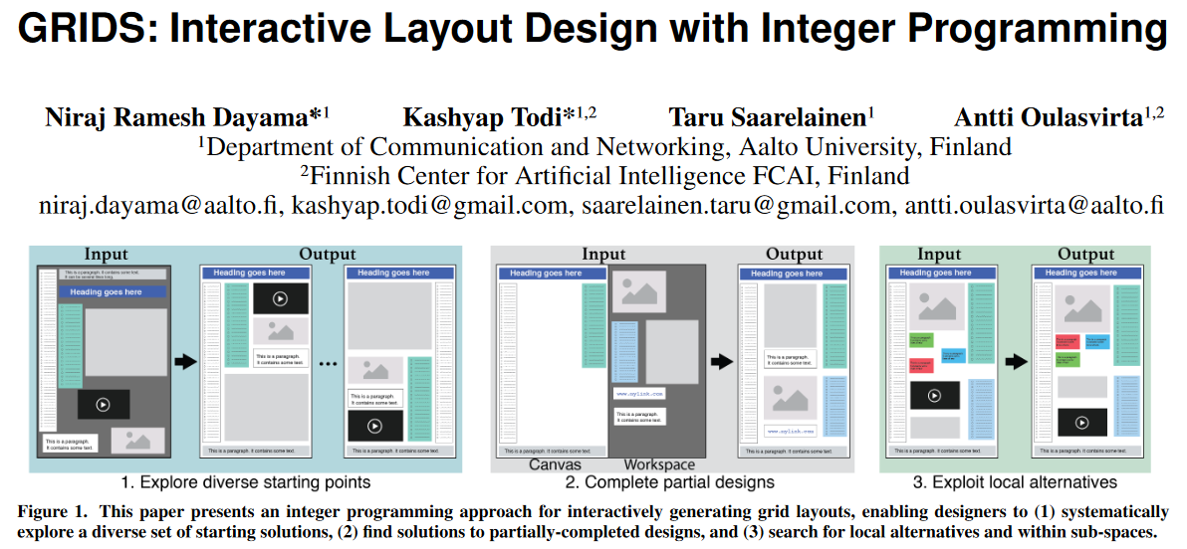

Slide 2
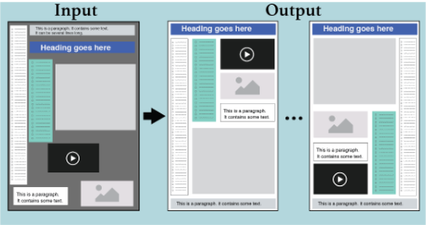
Problem description
Given a set of rectangular elements that must be placed onto a fixed size canvas with specified widths and heights, find feasible solutions where all elements are properly packed in a non-overlapping and non-overflowing layout.

Slide 3
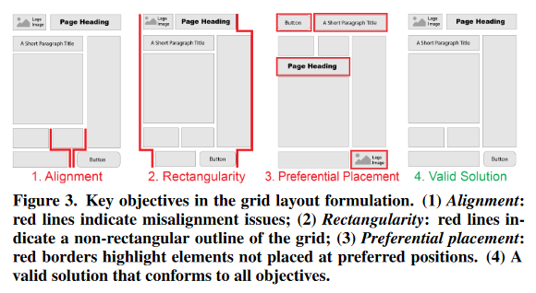
Objectives
Overall alignment
Rectangular outline
Placement
Traversal Distance
Grouping
Preferential Placement

Slide 4
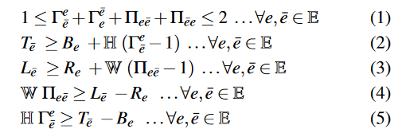

Core MILP formulation for grid skeletons
Continuous decision variables $L_{e},R_{e},T_{e},B_{e}$
Two binary decision variables${ Γ}_{\overline{e}}^{e}{, Π}_{e\overline{e}}$
to prevent overlap of any pair of elements:

Slide 5
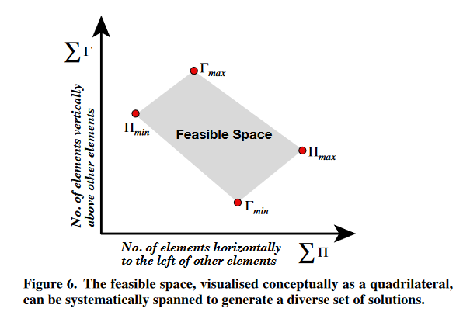
Generating controllably diverse solutions
Maximize and minimize${ Γ}_{ }^{ }{, Π}_{ }$to get a 2-D space.

Slide 6
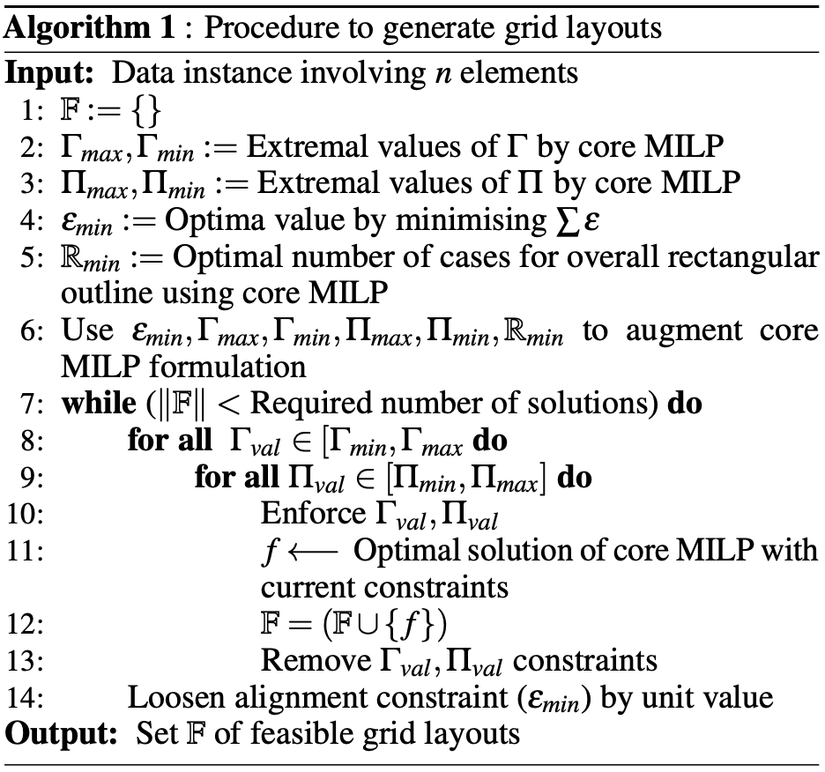

Summary
Steps 2–5 execute the MILP with different objectives to compute the logical bounds of all governing parameters.
Step 6 restricts the feasible search-space using these bounds.
Steps 7–14 enforce suitable constraints.
Steps 8–10 enable spanning across the design space as identified by .
Step 11 computes the optimal grid layout solutions.
Step 14 gradually loosens the alignment constraint if required to ensure that sufficient solutions are generated.

Slide 7


Results
Input
Output

Slide 8
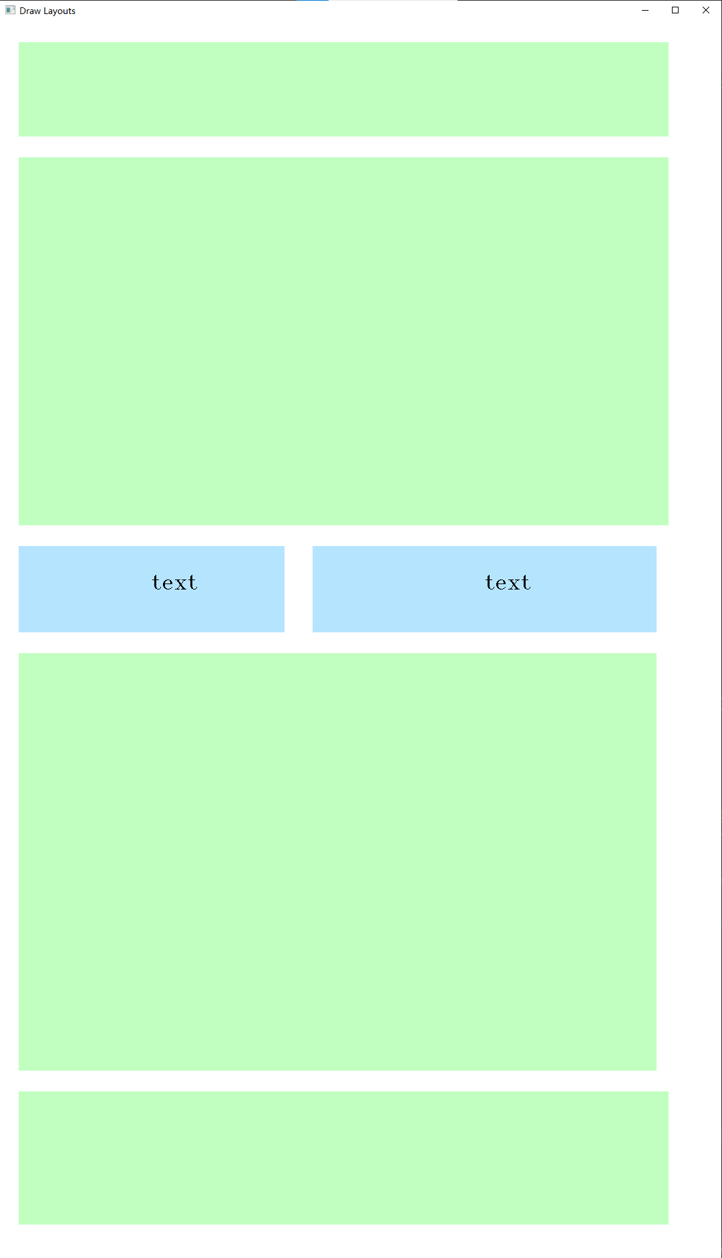
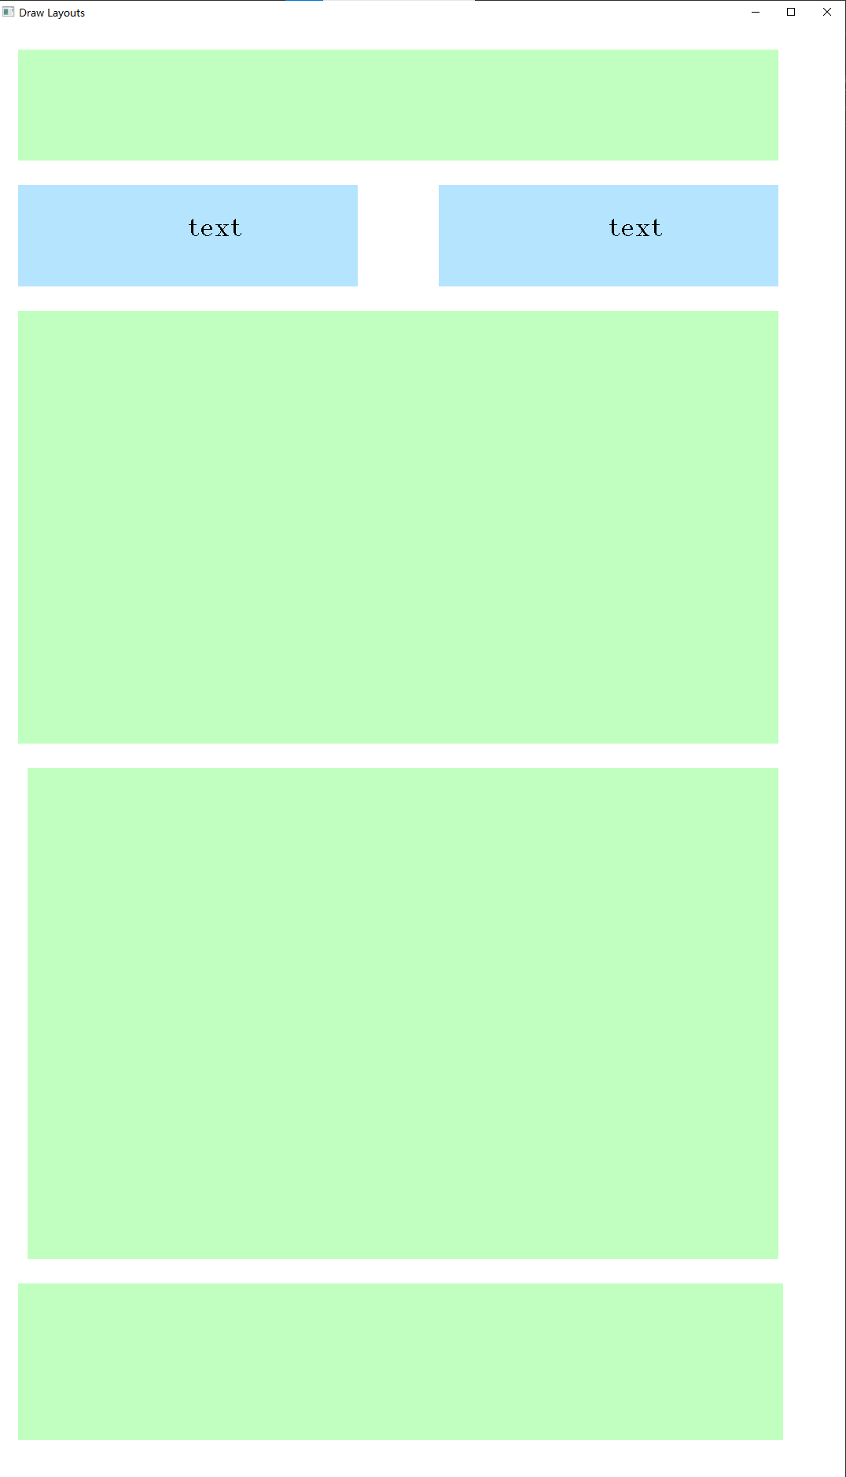
Improvement
Text width equal constraint
…

Slide 9
Thanks for your attention！

