Slide 1
Trento, 03 February 2023
Chiara Nardin, Ph.D.
chiara.nardin@unitn.it
Lecture #4
Probabilistic Seismic Hazard Analysis
Chiara Nardin – Ph.D., M.Sc., Eng. in Civil Engineering
https://github.com/CNardin

Slide 2
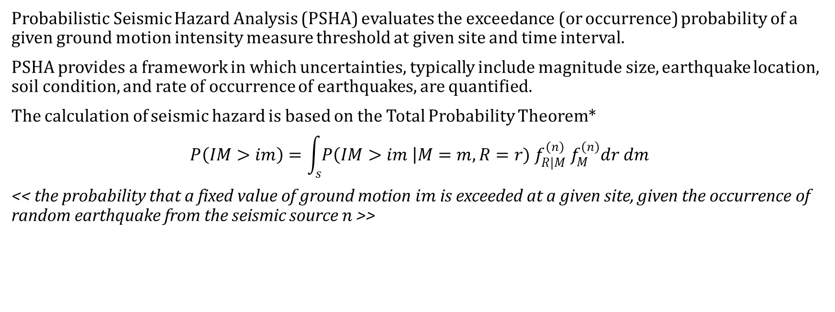
Trento, 03 February 2023
Chiara Nardin, Ph.D.
chiara.nardin@unitn.it
Introduction Probabilistic Hazard Model Laboratory
PSHA
Probabilistic Seismic Hazard Analysis (PSHA) evaluates the exceedance (or occurrence) probability of a given ground motion intensity measure threshold at given site and time interval.
PSHA provides a framework in which uncertainties, typically include magnitude size, earthquake location, soil condition, and rate of occurrence of earthquakes, are quantified.
The calculation of seismic hazard is based on the Total Probability Theorem*
$$P\left(IM>im\right)=\int_{s}{P\left(IM>im \right|M=m, R=r){ f}_{R|M}^{(n)} f_{M}^{(n)}dr dm}$$
<< the probability that a fixed value of ground motion$im$is exceeded at a given site, given the occurrence of random earthquake from the seismic source $n$ >>
(1)
*see Lecture Notes

Slide 3
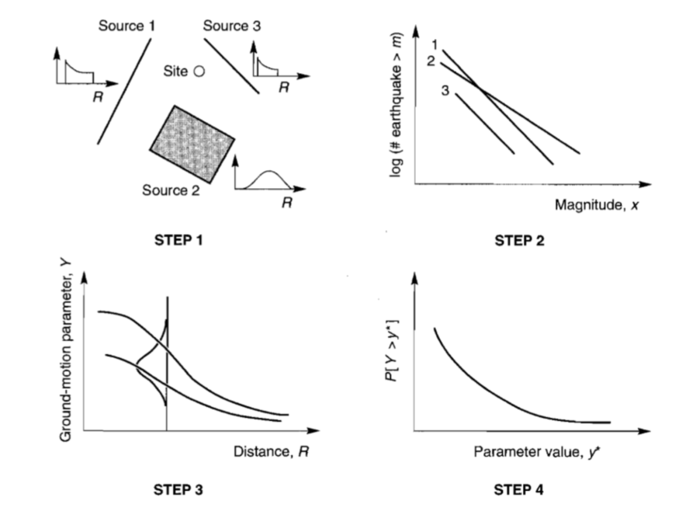
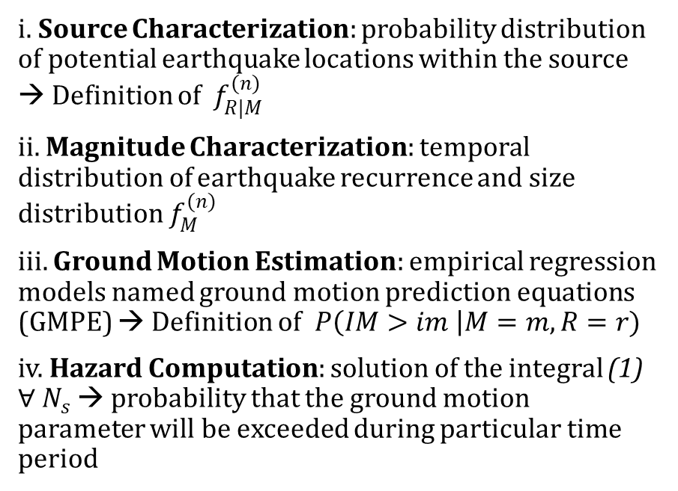
Trento, 03 February 2023
Chiara Nardin, Ph.D.
chiara.nardin@unitn.it
Introduction Probabilistic Hazard Model Laboratory
PSHA - Steps
i. Source Characterization: probability distribution of potential earthquake locations within the source → Definition of ${ f}_{R|M}^{(n)}$
ii. Magnitude Characterization: temporal distribution of earthquake recurrence and size distribution $f_{M}^{(n)}$
iii. Ground Motion Estimation: empirical regression models named ground motion prediction equations (GMPE) → Definition of$P\left(IM>im \right|M=m, R=r)$
iv. Hazard Computation: solution of the integral (1) $∀ N_{s}$ → probability that the ground motion parameter will be exceeded during particular time period

Slide 4
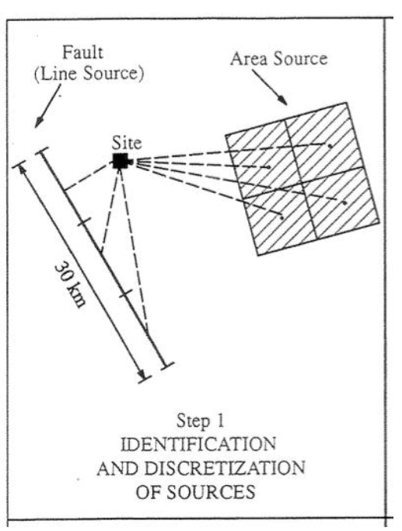
Trento, 03 February 2023
Chiara Nardin, Ph.D.
chiara.nardin@unitn.it
Introduction Probabilistic Hazard Model Laboratory
PSHA – Step 1: Earthquake source characterization
Goal: to identify
Fault sources: individual or multiple identified faults
Area sources: defined by polygons in which seismicity is assumed uniform
(Identification based upon the interpretation of geological, geophysical and seismological – historical data)
SOURCES

Slide 5
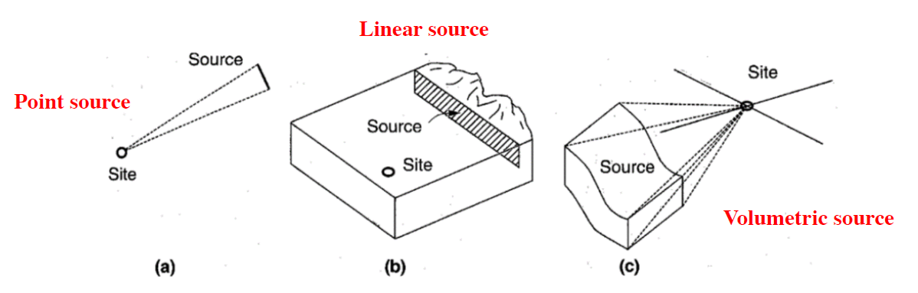
Trento, 03 February 2023
Chiara Nardin, Ph.D.
chiara.nardin@unitn.it
Introduction Probabilistic Hazard Model Laboratory
PSHA – Step 1: Earthquake source characterization
and to characterize seismic sources
Point source
Linear source
Area source
(the geometry of the source is used to identify the probability distribution of source-to-site distances)
DISTANCES

Slide 6
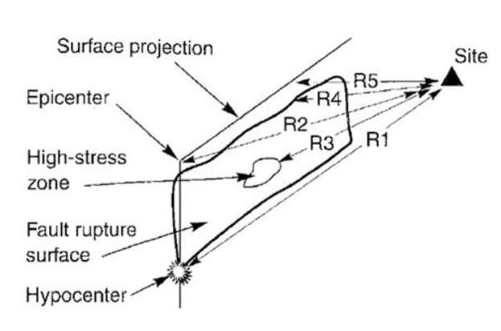
Trento, 03 February 2023
Chiara Nardin, Ph.D.
chiara.nardin@unitn.it
Introduction Probabilistic Hazard Model Laboratory
PSHA – Step 1: Earthquake source characterization
The geometry of the source is used to identify the probability distribution of source-to-site distances
R1: hypocentral distance
R2: epicentral distance
R3: distance to the zone of highest energy release.
R4: closest distance to the zone of rupture
R5: closest distance to the surface projection of the
fault rupture (also known as Joyner-Boore distance)
DISTANCES

Slide 7
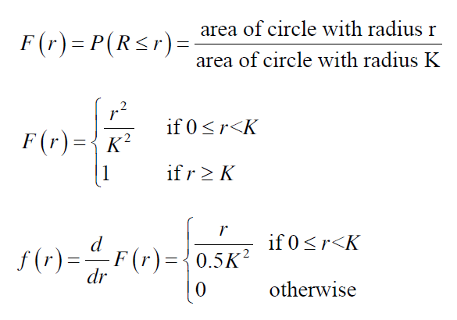
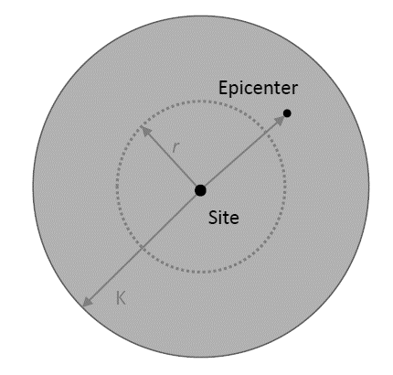
Trento, 03 February 2023
Chiara Nardin, Ph.D.
chiara.nardin@unitn.it
Introduction Probabilistic Hazard Model Laboratory
PSHA – Step 1: Earthquake source characterization
EXAMPLE
Earthquakes are equally likely to occur anywhere in the area within K km of the site.

Slide 8
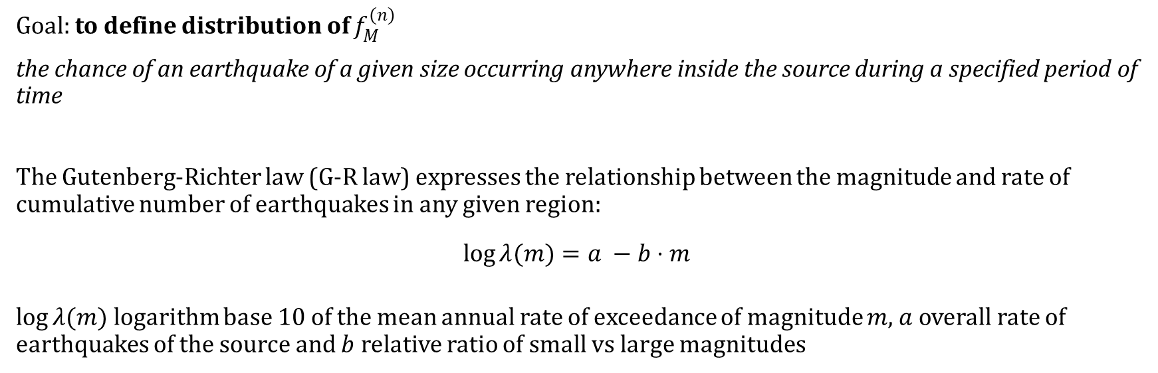
Trento, 03 February 2023
Chiara Nardin, Ph.D.
chiara.nardin@unitn.it
Introduction Probabilistic Hazard Model Laboratory
PSHA – Step 2: Earthquake size (Recurrence law)
Goal: to define distribution of $f_{M}^{(n)}$
the chance of an earthquake of a given size occurring anywhere inside the source during a specified period of time
The Gutenberg-Richter law (G-R law) expresses the relationship between the magnitude and rate of cumulative number of earthquakes in any given region:
$$\log{λ(m)}=a −b⋅m$$
$\log{λ(m)}$logarithm base 10 of the mean annual rate of exceedance of magnitude $m$, $a$overall rate of earthquakes of the source and $b$ relative ratio of small vs large magnitudes

Slide 9
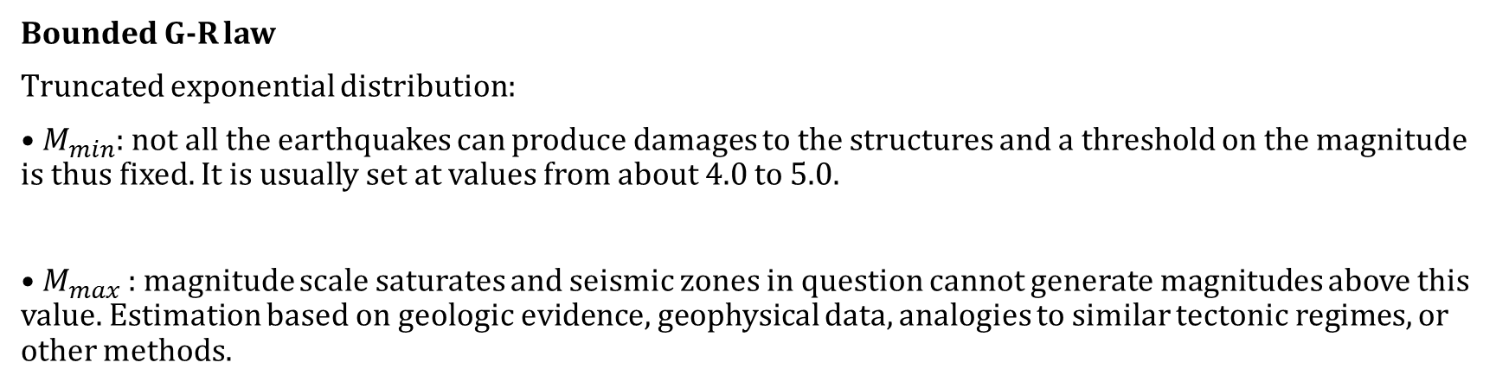
Trento, 03 February 2023
Chiara Nardin, Ph.D.
chiara.nardin@unitn.it
Introduction Probabilistic Hazard Model Laboratory
PSHA – Step 2: Earthquake size (Recurrence law)
Bounded G-R law
Truncated exponential distribution:
• $M_{min}$: not all the earthquakes can produce damages to the structures and a threshold on the magnitude is thus fixed. It is usually set at values from about 4.0 to 5.0.
• $M_{max}$: magnitude scale saturates and seismic zones in question cannot generate magnitudes above this value. Estimation based on geologic evidence, geophysical data, analogies to similar tectonic regimes, or other methods.

Slide 10
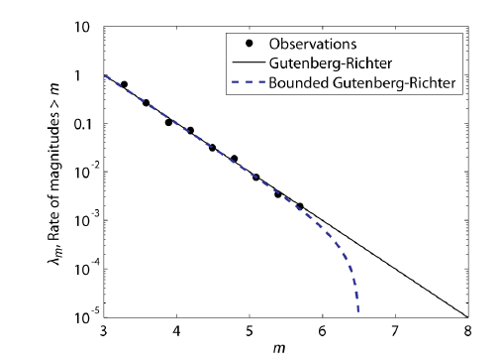
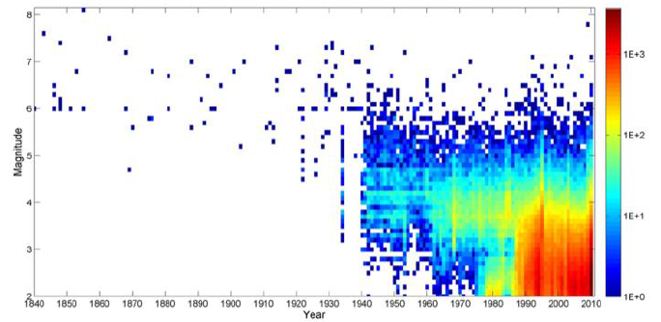
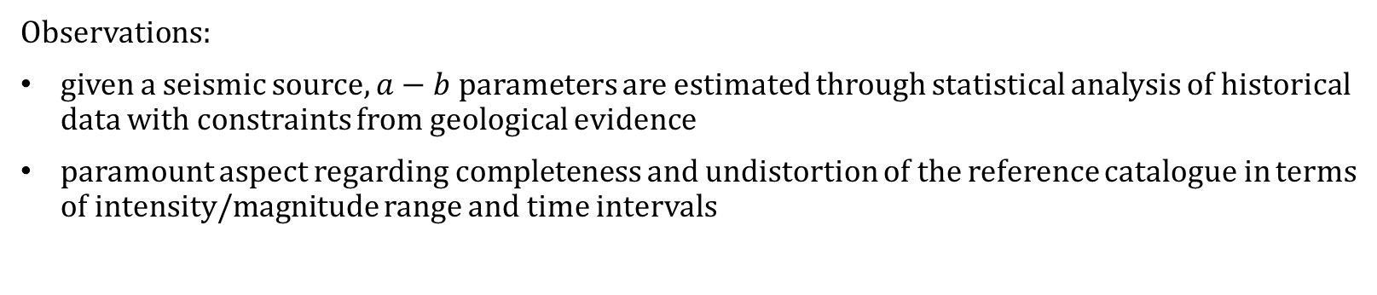
Trento, 03 February 2023
Chiara Nardin, Ph.D.
chiara.nardin@unitn.it
Introduction Probabilistic Hazard Model Laboratory
PSHA – Step 2: Earthquake size (Recurrence law)
Observations:
given a seismic source, $a−b$ parameters are estimated through statistical analysis of historical data with constraints from geological evidence
paramount aspect regarding completeness and undistortion of the reference catalogue in terms of intensity/magnitude range and time intervals

Slide 11
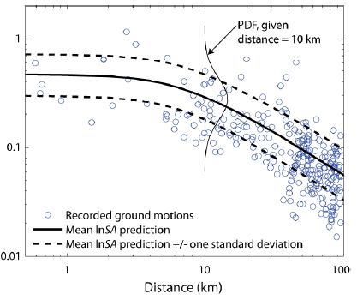
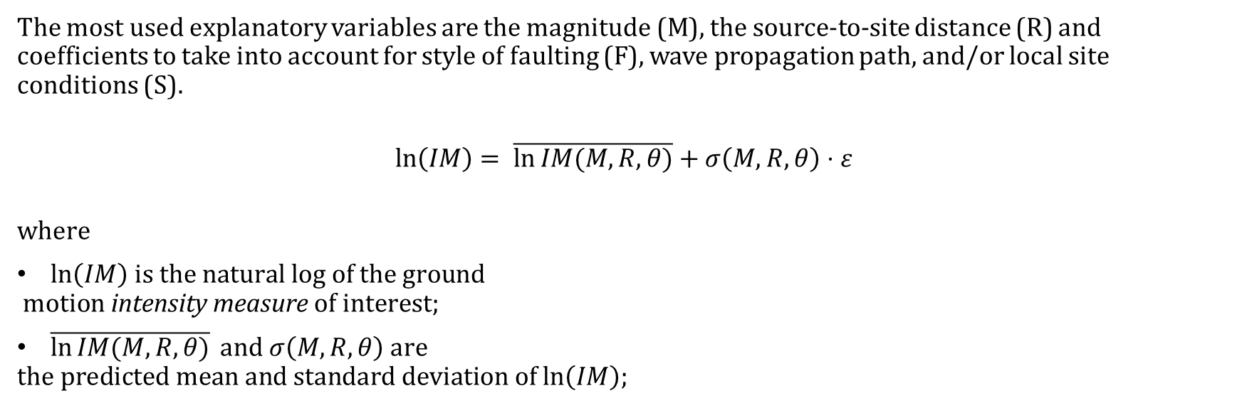
Trento, 03 February 2023
Chiara Nardin, Ph.D.
chiara.nardin@unitn.it
Introduction Probabilistic Hazard Model Laboratory
PSHA – Step 3: Ground motion predictive equations (GMPE)
The most used explanatory variables are the magnitude (M), the source-to-site distance (R) and coefficients to take into account for style of faulting (F), wave propagation path, and/or local site conditions (S).
$$\ln\left(IM\right)= \overline{\ln{IM(M,R,θ)}}+σ\left(M,R,θ\right)⋅ε$$
$$\text{where}$$
$ln\left(IM\right) \text{is} \text{the} \text{natural} \text{log} \text{of} \text{the} \text{ground}$
$$\text{motion} \text{intensity} \text{measure} \text{of} \text{interest}\text{;}$$
$\overline{\ln{IM(M,R,θ)}} \text{and} σ\left(M,R,θ\right) \text{are}$
$$\text{the} \text{predicted} \text{mean} \text{and} \text{standard} \text{deviation} \text{of} ln\left(IM\right)\text{;}$$

Slide 12
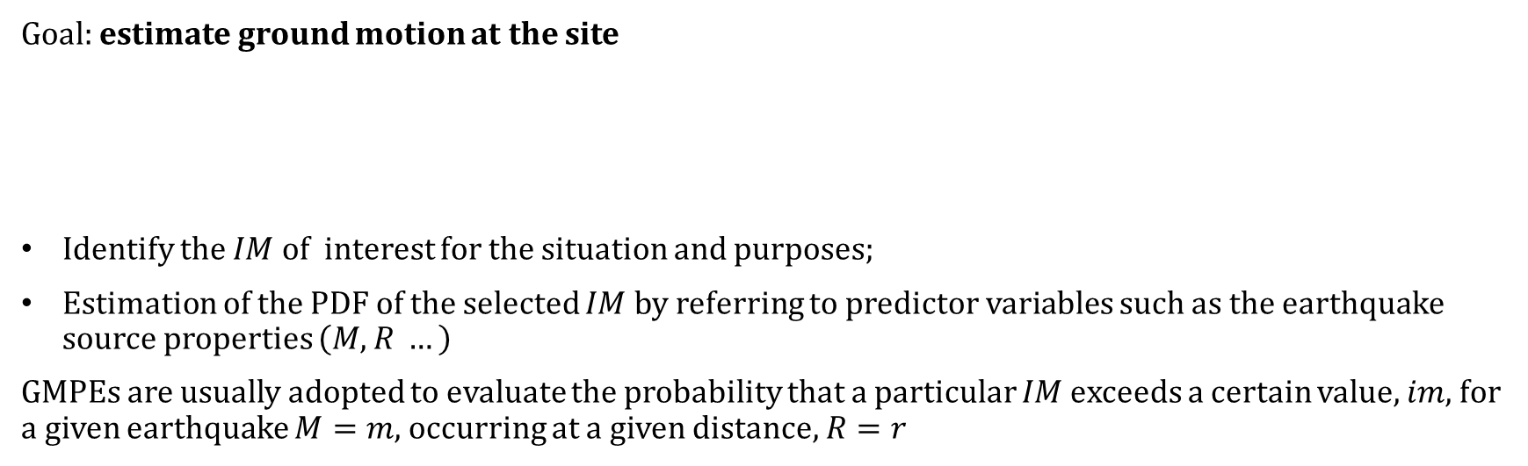

Trento, 03 February 2023
Chiara Nardin, Ph.D.
chiara.nardin@unitn.it
Introduction Probabilistic Hazard Model Laboratory
PSHA – Step 3: Ground motion predictive equations (GMPE)
Goal: estimate ground motion at the site
Identify the $IM$of interest for the situation and purposes;
Estimation of the PDF of the selected $IM$by referring to predictor variables such as the earthquake source properties $\left(M,R …\right)$
GMPEs are usually adopted to evaluate the probability that a particular $IM$ exceeds a certain value, $im$, for a given earthquake $M=m$, occurring at a given distance, $R=r$
$$\ln\left(IM\right)= \overline{\ln{IM(M,R,θ)}}+σ\left(M,R,θ\right)⋅ε$$

Slide 13
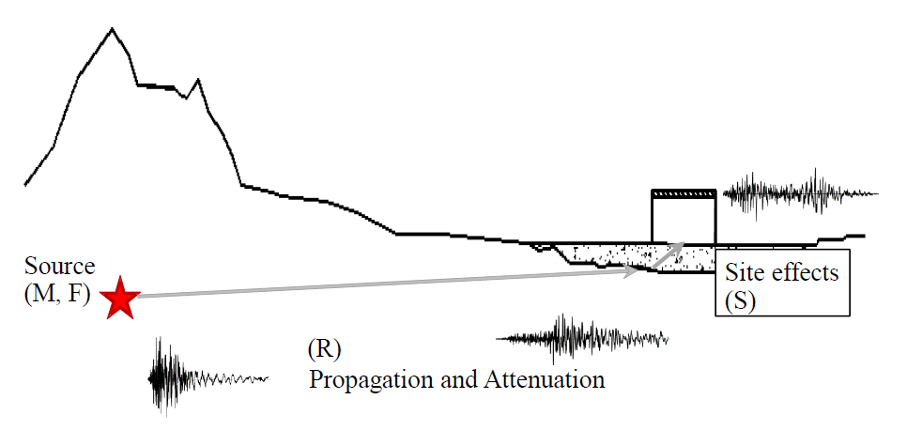
Trento, 03 February 2023
Chiara Nardin, Ph.D.
chiara.nardin@unitn.it
Introduction Probabilistic Hazard Model Laboratory
PSHA – Step 3: Ground motion predictive equations (GMPE)
The most used explanatory variables are the magnitude (M), the source-to-site distance (R) and coefficients to take into account for style of faulting (F), wave propagation path, and/or local site conditions (S).
$$\ln\left(IM\right)= \overline{\ln{IM(M,R,θ)}}+σ\left(M,R,θ\right)⋅ε$$
$$\text{where}$$
$ln\left(IM\right) \text{is} \text{the} \text{natural} \text{log} \text{of} \text{the} \text{ground}$
$$\text{motion} \text{intensity} \text{measure} \text{of} \text{interest}\text{;}$$
$\overline{\ln{IM(M,R,θ)}} \text{and} σ\left(M,R,θ\right) \text{are}$
$$\text{the} \text{predicted} \text{mean} \text{and} \text{standard} \text{deviation} \text{of} ln\left(IM\right)\text{;}$$

Slide 14
Trento, 03 February 2023
Chiara Nardin, Ph.D.
chiara.nardin@unitn.it
Introduction Probabilistic Hazard Model Laboratory
PSHA – Step 3: Ground motion predictive equations (GMPE)
Goal: Identify the 𝐼𝑀 of interest for the situation and purposes
Ground motion parameters (also called Intensity Measures, IMs) describe the most important characteristics of strong ground motion in compact and quantitative form:
• Amplitude – how large is the shaking?
• Frequency content – what frequencies are particularly prevalent in the ground motion?
• Duration – how long does the strong shaking last?

Slide 15
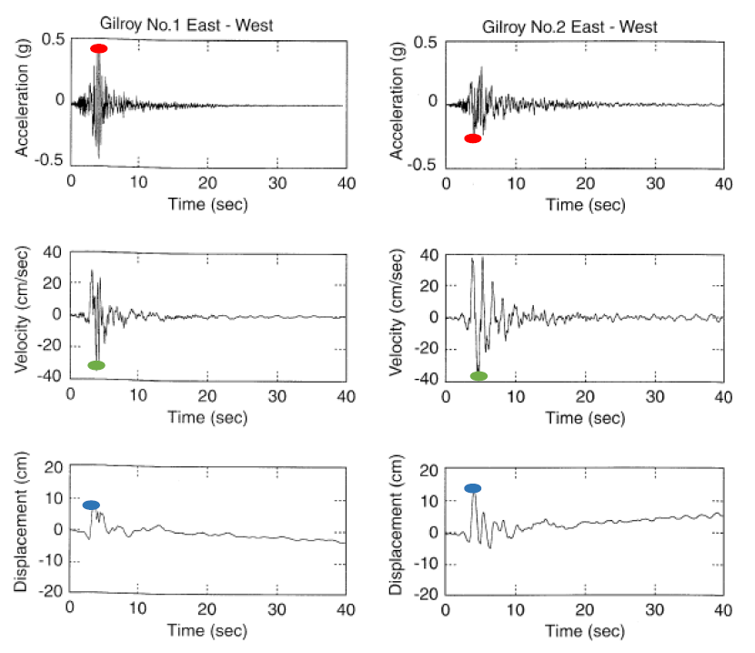
Trento, 03 February 2023
Chiara Nardin, Ph.D.
chiara.nardin@unitn.it
Introduction Probabilistic Hazard Model Laboratory
PSHA – Step 3: Ground motion predictive equations (GMPE)
Ground motion parameters
Amplitude parameters:
• Peak ground acceleration (PGA) which is the
maximum absolute value of acceleration at the
ground level;
• Peak ground velocity (PGV), the maximum
absolute value of velocity at the ground;
• Peak ground displacement (PGD) is the
maximum absolute value of displacement at the
ground

Slide 16
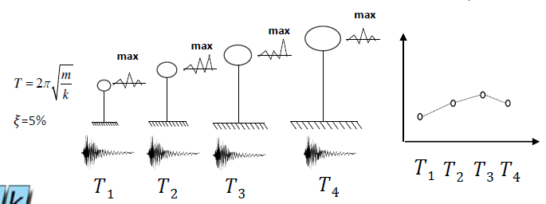
Trento, 03 February 2023
Chiara Nardin, Ph.D.
chiara.nardin@unitn.it
Introduction Probabilistic Hazard Model Laboratory
PSHA – Step 3: Ground motion predictive equations (GMPE)
Ground motion parameters
Frequency content parameters
• Response spectrum: maximum response (in
terms of displacement, velocity or acceleration,
S(𝑇, 𝜉)) of an elastic single degree- of-freedom
(SDoF) system to a particular input motion as a
function of the natural period and damping ratio.

Slide 17
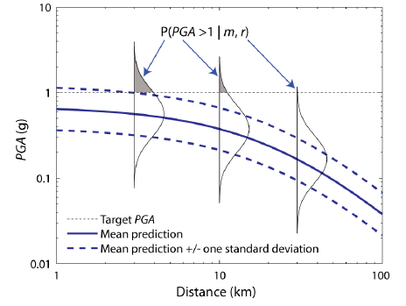
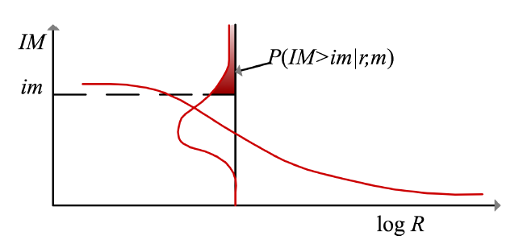
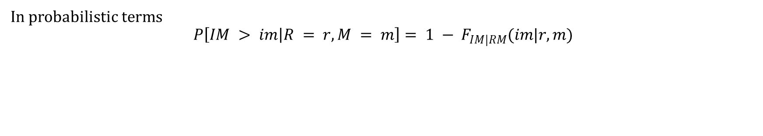
Trento, 03 February 2023
Chiara Nardin, Ph.D.
chiara.nardin@unitn.it
Introduction Probabilistic Hazard Model Laboratory
PSHA – Step 3: Ground motion predictive equations (GMPE)
In probabilistic terms
$$P\left[IM > im | R = r,M = m\right]= 1 − F_{IM|RM}(im|r,m)$$

Slide 18
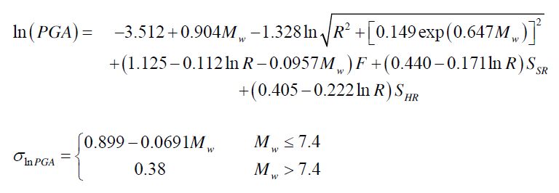
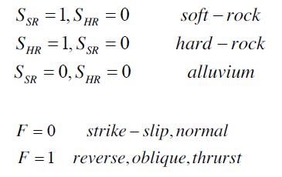
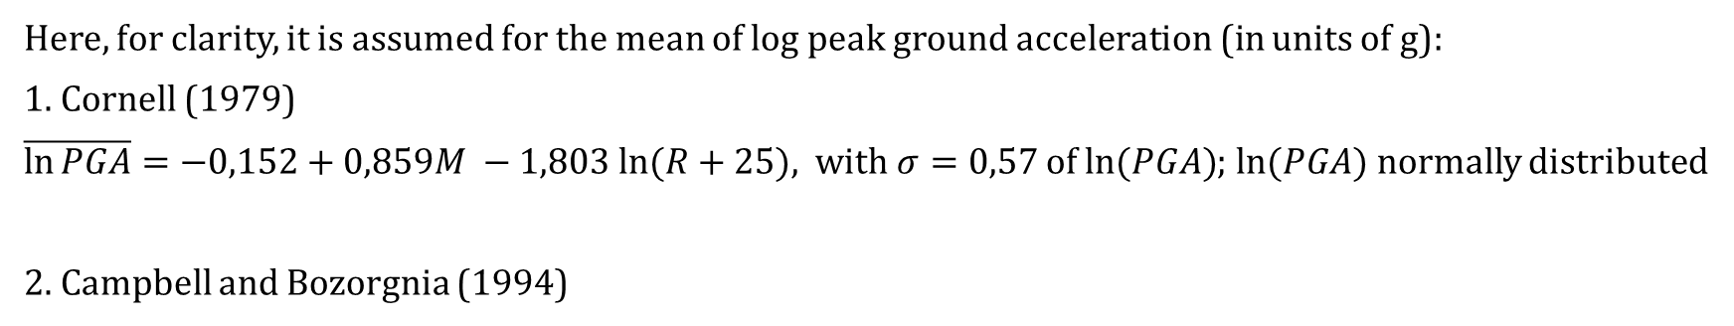
Trento, 03 February 2023
Chiara Nardin, Ph.D.
chiara.nardin@unitn.it
Introduction Probabilistic Hazard Model Laboratory
PSHA – Step 3: Ground motion predictive equations (GMPE)
Here, for clarity, it is assumed for the mean of log peak ground acceleration (in units of g):
1. Cornell (1979)
$\overline{\ln{PGA}}=−0,152+0,859M −1,803 ln⁡(R+25)$, with$σ=0,57$ of $ln⁡(PGA)$;$ln⁡(PGA)$ normally distributed
2. Campbell and Bozorgnia (1994)

Slide 19
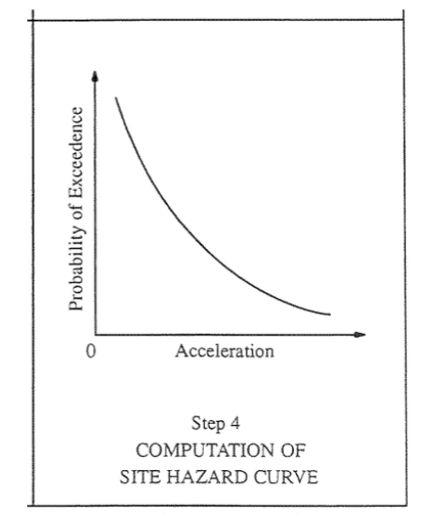
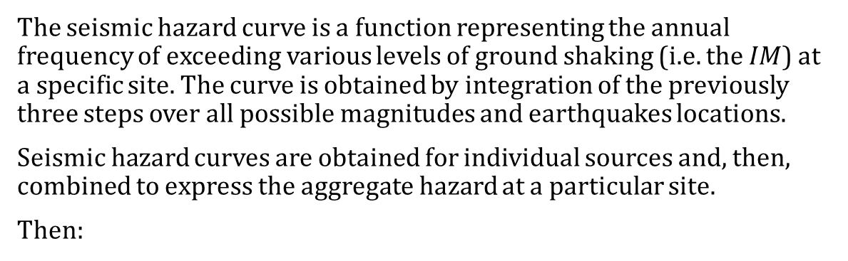
Trento, 03 February 2023
Chiara Nardin, Ph.D.
chiara.nardin@unitn.it
Introduction Probabilistic Hazard Model Laboratory
PSHA – Step 4: Hazard Computation
The seismic hazard curve is a function representing the annual frequency of exceeding various levels of ground shaking (i.e. the $IM$) at a specific site. The curve is obtained by integration of the previously three steps over all possible magnitudes and earthquakes locations.
Seismic hazard curves are obtained for individual sources and, then, combined to express the aggregate hazard at a particular site.
Then:
(2)
$$λ\left(im\right)=\sum_{n=1}^{N_{s}}{λ_{min}^{(n)}}\left[\int_{r_{min}}^{r_{max}}{\int_{m_{min}}^{m_{max}}{P\left(IM>im \right|M=m , R=r)}} f_{R}^{\left(n\right)}\left(r\right)f_{M}^{\left(n\right)}\left(m\right)drdm] \right]$$

Slide 20
Trento, 03 February 2023
Chiara Nardin, Ph.D.
chiara.nardin@unitn.it
Introduction Probabilistic Hazard Model Laboratory
References
Baker J. W. (2008). An Introduction to Probabilistic Seismic Hazard Analysis (PSHA), White Paper, Version 1.3, 72 pp.
Kramer, S.L. (1996) Geotechnical earthquake engineering. Prentice Hall, Upper Saddle River, N.J.
Wells, D.L. and Coppersmith, K.J. (1994) New empirical relationships among magnitude, rupture length, rupture width, rupture area, and surface displacement. Bull. Seism. Soc. Am., 84, 974-1002.
Cornell, C.A. (1968). Engineering seismic risk analysis, Bull. Seism. Soc. Am., 58, 1583-1606.
Broccardo, M. (2018) Probabilistic seismic risk analysis for civil systems, Lecture Notes

Slide 21
Trento, 03 February 2023
Chiara Nardin, Ph.D.
chiara.nardin@unitn.it

