Slide 1
Trento, 03 February 2023
Ph.D. Chiara Nardin
chiara.nardin@unitn.it
Lecture #4
Fragility analysis
Chiara Nardin – Ph.D., M.Sc., Eng. in Civil Engineering
https://github.com/CNardin/Lecture/tree/2021/ISPS

Slide 2
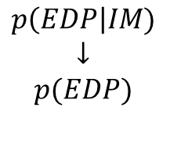


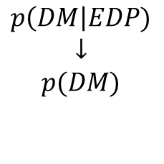
Trento, 03 February 2023
Ph.D. Chiara Nardin
chiara.nardin@unitn.it
Fragility Analysis
Hazard analysis
intensity measure
Loss analysis
decision variable
HAZARD
VULNERABILITY
Damage analysis
damage measure
DECISION MAKING
VULNERABILITY
Vulnerability analysis
engineering demand par.
Fragility (or Vulnerability) Analysis is the second step of the PBEE-PEER framework
Useful definitions:
seismic fragility function := the conditional probability of an event (e.g. a defined limit/damage state) given the observation of an intensity measure which describe the seismic event.
$$p\left(IM\right|M,R)$$
$$↓$$
$$p(IM)$$
$$p\left(EDP\right|IM)$$
$$↓$$
$$p(EDP)$$
$$p\left(DM\right|EDP)$$
$$↓$$
$$p(DM)$$
$$p\left(DV\right|DM)$$
$$↓$$
$$p(DV)$$

Slide 3
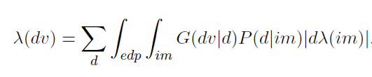
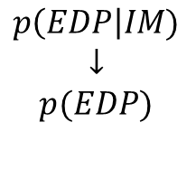
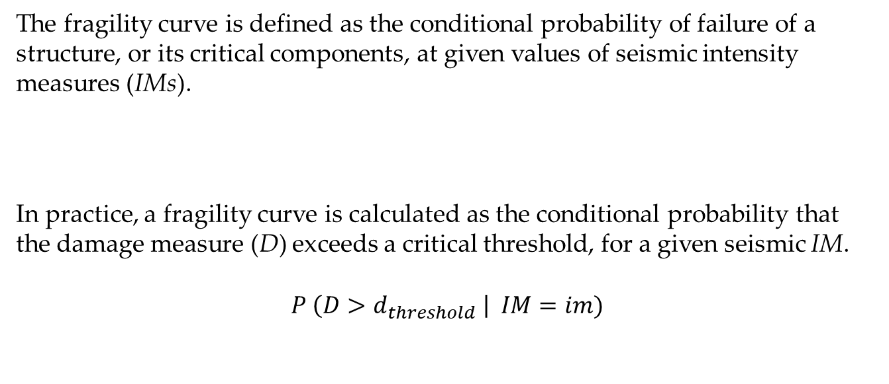
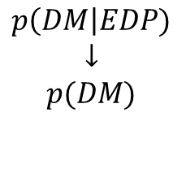
Trento, 03 February 2023
Ph.D. Chiara Nardin
chiara.nardin@unitn.it
Fragility Analysis
Vulnerability analysis
engineering demand par.
The fragility curve is defined as the conditional probability of failure of a structure, or its critical components, at given values of seismic intensity measures (IMs).
In practice, a fragility curve is calculated as the conditional probability that the damage measure (D) exceeds a critical threshold, for a given seismic IM.
$$P \left(D>d_{threshold} \right| IM=im)$$
VULNERABILITY
$$p\left(EDP\right|IM)$$
$$↓$$
$$p(EDP)$$
Damage analysis
damage measure
VULNERABILITY
$$p\left(DM\right|EDP)$$
$$↓$$
$$p(DM)$$

Slide 4
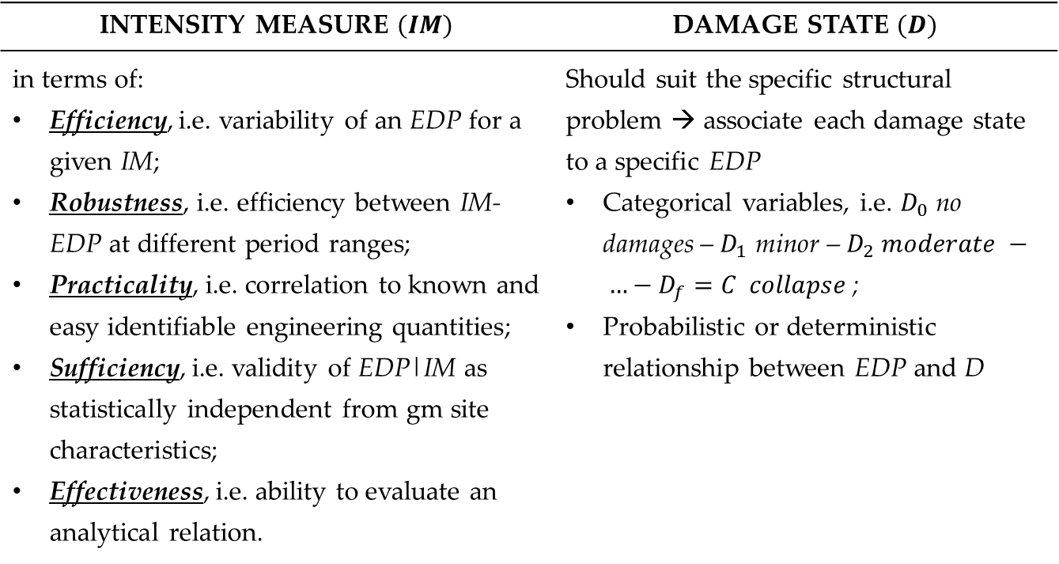
Trento, 03 February 2023
Ph.D. Chiara Nardin
chiara.nardin@unitn.it
Fragility Analysis: key aspects
Vulnerability analysis
engineering demand par.
INTENSITY MEASURE $(IM)$ | DAMAGE STATE $(D)$
in terms of: Efficiency, i.e. variability of an EDP for a given IM; Robustness, i.e. efficiency between IM-EDP at different period ranges; Practicality, i.e. correlation to known and easy identifiable engineering quantities; Sufficiency, i.e. validity of EDP|IM as statistically independent from gm site characteristics; Effectiveness, i.e. ability to evaluate an analytical relation. | Should suit the specific structural problem → associate each damage state to a specific EDP Categorical variables, i.e. $D_{0}$ no damages – $D_{1}$ minor – $D_{2} moderate − …−D_{f}=C collapse$; Probabilistic or deterministic relationship between EDP and D
VULNERABILITY
$$p\left(EDP\right|IM)$$
$$↓$$
$$p(EDP)$$
Damage analysis
damage measure
VULNERABILITY
$$p\left(DM\right|EDP)$$
$$↓$$
$$p(DM)$$

Slide 5
Trento, 03 February 2023
Ph.D. Chiara Nardin
chiara.nardin@unitn.it
Class of fragilities
EMPIRICAL | ANALYTICAL | EXPERT OPINION | HYBRID
by fitting a function to observational data from past earthquakes or lab tests collections pairs of level of excitation and categorical variables of damage or collapse | by defining analytical structural model and analyzing its performance under different levels of the seismic hazard static, i.e. hazard as response spectrum and push-over analysis vs dynamic, i.e. collection of gms and simulations on FEM via NLA | by polling one or more experts of the given structural asset to guess or estimate the failure probability for a given hazard level | based on combination of the different methods

Slide 6
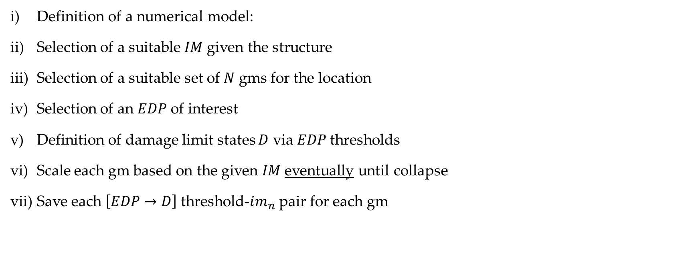
Trento, 03 February 2023
Ph.D. Chiara Nardin
chiara.nardin@unitn.it
Analytical fragility functions: steps
Definition of a numerical model:
Selection of a suitable $IM$given the structure
Selection of a suitable set of $N$ gms for the location
Selection of an $EDP$ of interest
Definition of damage limit states $D$ via $EDP$thresholds
Scale each gm based on the given $IM$eventually until collapse
Save each $\left[EDP→D\right]$ threshold-$im_{n}$ pair for each gm
Full IDA
Truncated IDA

Slide 7


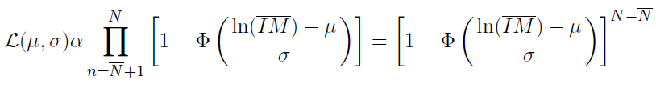

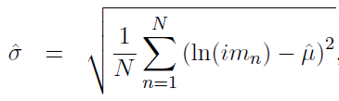

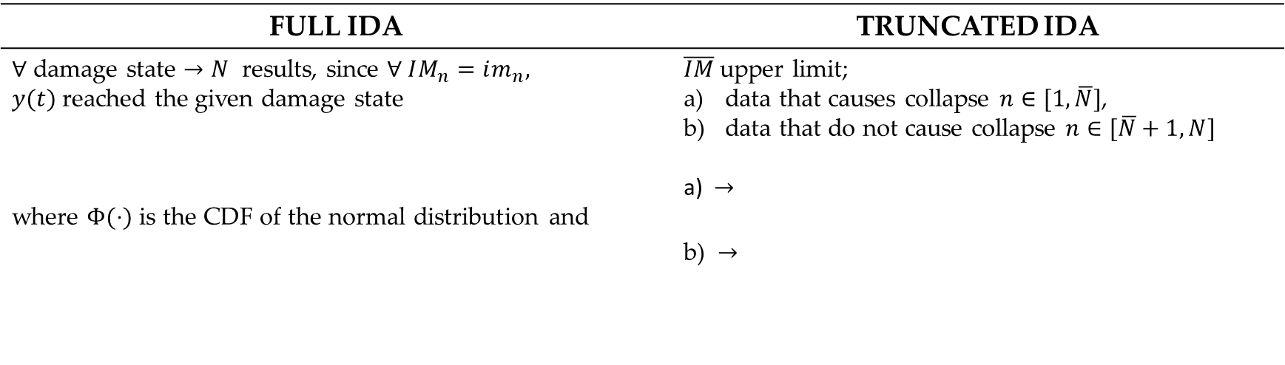
Trento, 03 February 2023
Ph.D. Chiara Nardin
chiara.nardin@unitn.it
Computation of fragility function
Hp: - assume a lognormal probability distribution for the random variable $IM$ associated with given $D$
FULL IDA | TRUNCATED IDA
$∀$ damage state $→N$ results, since $∀ IM_{n}=im_{n}, y(t)$reached the given damage state where $Φ(⋅)$ is the CDF of the normal distribution and | $\overline{IM}$upper limit; data that causes collapse $n∈[1,\overline{N}]$, data that do not cause collapse $n∈[\overline{N}+1,N]$ a) $→$ b) $→$

Slide 8


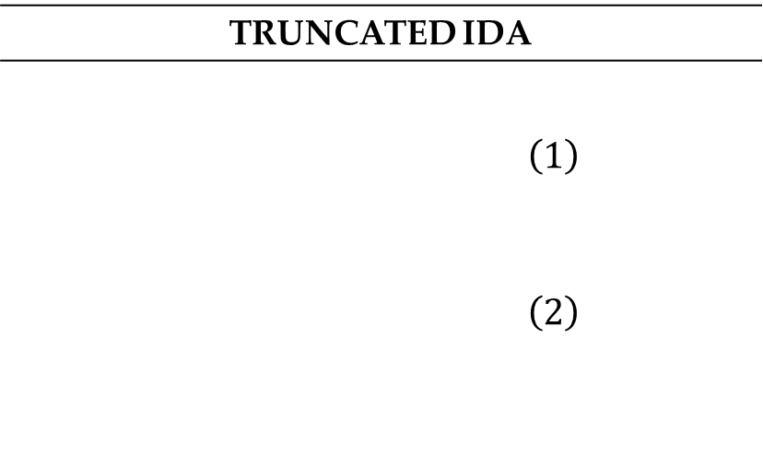
Trento, 03 February 2023
Ph.D. Chiara Nardin
chiara.nardin@unitn.it
Computation of fragility function
TRUNCATED IDA
$$\left(1\right)$$ $$\left(2\right)$$
The likelihood for the entire set of data
And the log likelihood
Estimation of parameters by optimization

Slide 9


Lecture #4
Fragility Analysis – MatLab Tutorial
Chiara Nardin – Ph.D., M.Sc., Eng. in Civil Engineering
https://github.com/CNardin/ISPS.git

Slide 10
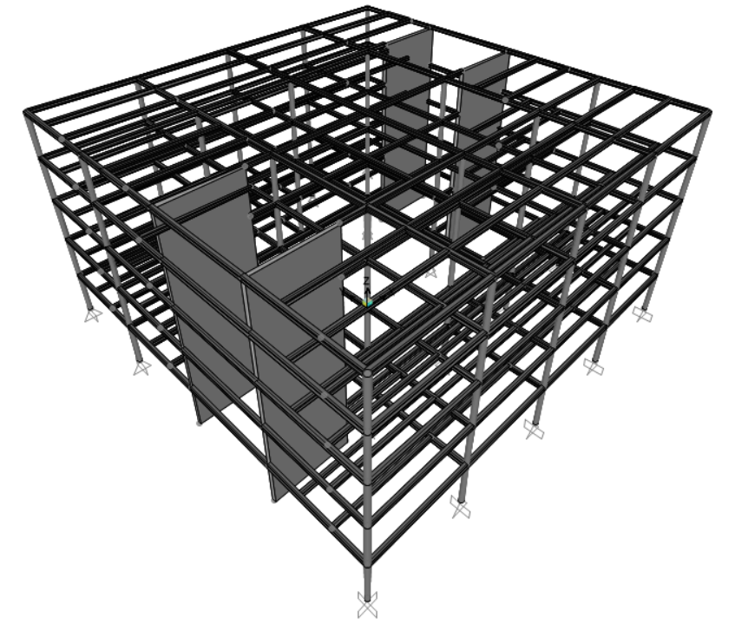
Trento, 03 February 2023
Ph.D. Chiara Nardin
chiara.nardin@unitn.it
Fragility Analysis | MatLab | References
Goal: to perform fragility analysis
Given the provided set of ground motions, perform a classical and truncated incremental dynamic analysis (IDA) and determine fragility curves for:
ATTEL – moment resistant frame (MRF);
ATTEL – braced frame (BF)
by considering both
Linear elastic behaviour
Bouc – Wen model for hysteresis
3D model of the case study ATTEL – SERA project.

Slide 11
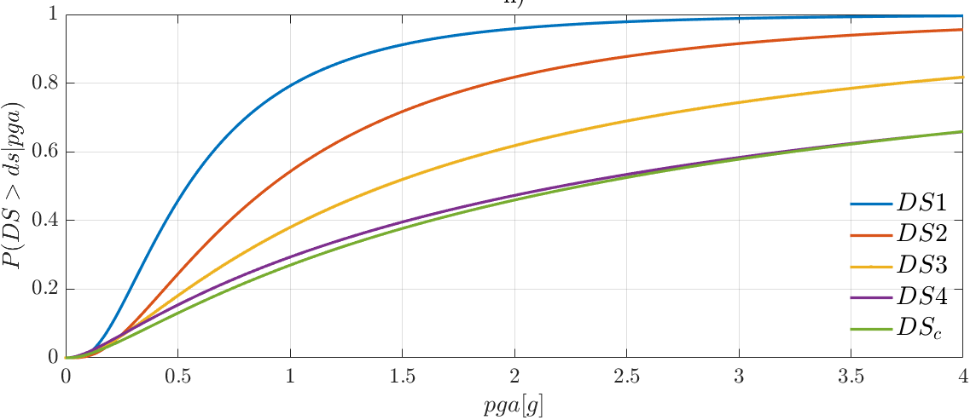
Trento, 03 February 2023
Ph.D. Chiara Nardin
chiara.nardin@unitn.it
Fragility Analysis | MatLab | References
Main steps:
Definition of the numerical model
Input and IM selection
Definition of damage limit states and reference EDP
Performing non-linear time histories analysis (IDA, truncated IDA, cloud, MSA …)
Collecting results pairs and computing fragility
3D model of the case study ATTEL – SERA project.

Slide 12
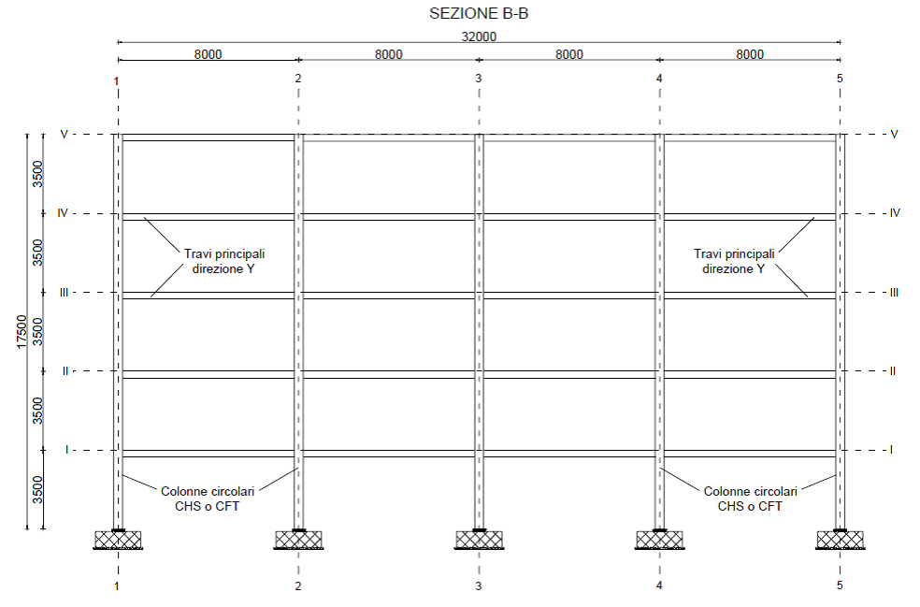
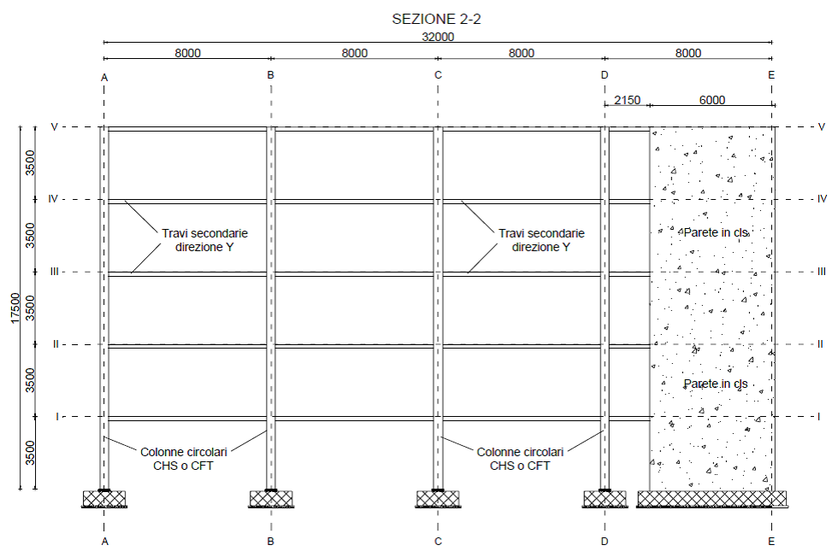
Trento, 03 February 2023
Ph.D. Chiara Nardin
chiara.nardin@unitn.it
Fragility Analysis | MatLab | References
Step 1: the case study ATTEL⁽¹⁾
^{[1]}BURSI, PUCINOTTI, TONDINI, ZANON, Tests and model calibration of high strength steel tubular beam-to-column and column-base composite joints for moment-resisting structures, Earthquake Engineering and Structural Dynamics, (2015).
T₁ = 2.79 s
T₁ = 0.46 s
3D model of the case study ATTEL – SERA project.
Main sections of the moment resistent frame and the braced one.

Slide 13
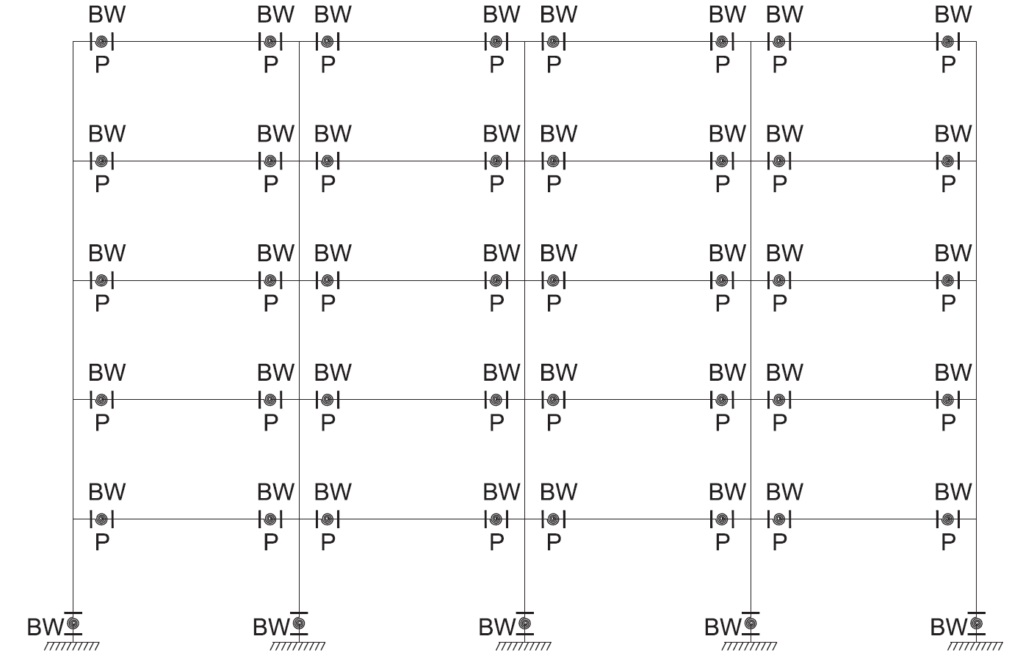
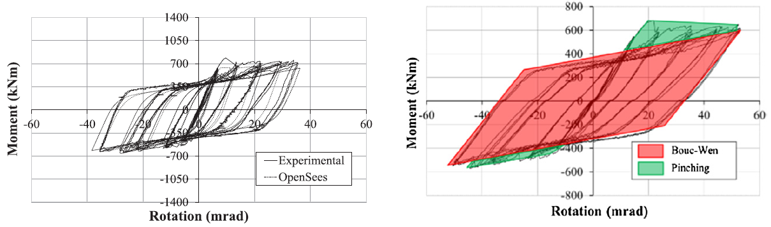

Trento, 03 February 2023
Ph.D. Chiara Nardin
chiara.nardin@unitn.it
Fragility Analysis | MatLab | References
Designed according to EC8 and modelled in OS:
beam and column elements with linear elastic behavior
mechanical nonlinearities
geometric nonlinearities
Model of the structure in OpenSees.

Slide 14
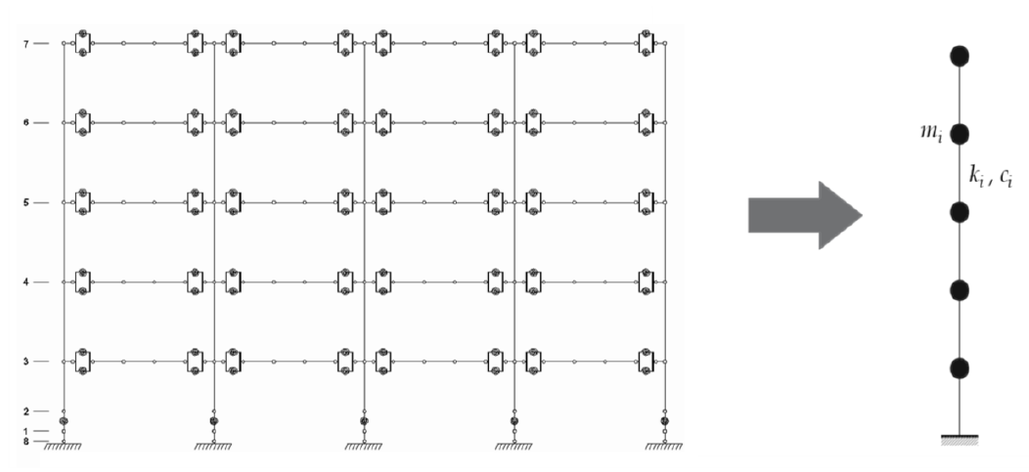
Trento, 03 February 2023
Ph.D. Chiara Nardin
chiara.nardin@unitn.it
Fragility Analysis | MatLab | References
to reduce computational burden
to reduce required simulation times
High number of analysis
for seismic simulations
Calibration oriented to correspondence of:
main periods
modes of vibrating
dissipative behavior
high fidelity model in OpenSees - OS
simplified model MDOF in MATLAB ® - ML

Slide 15
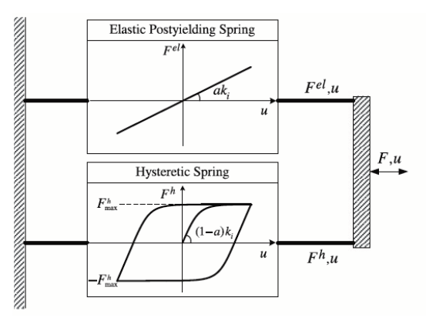


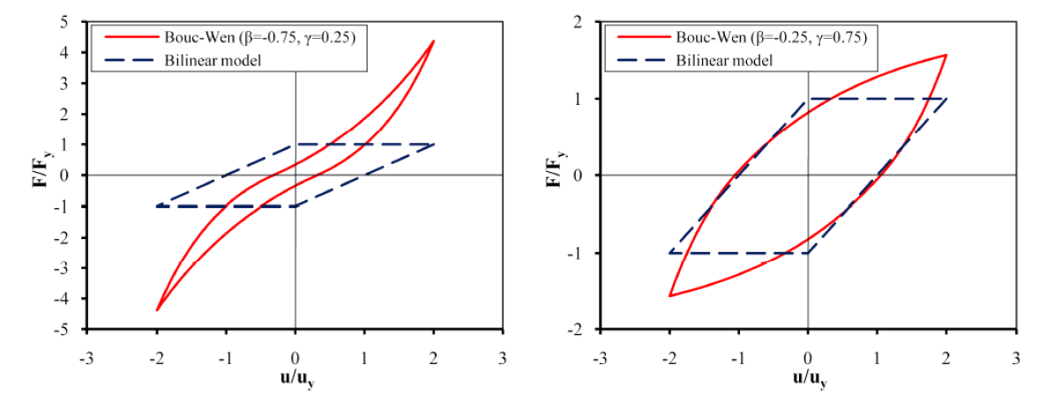
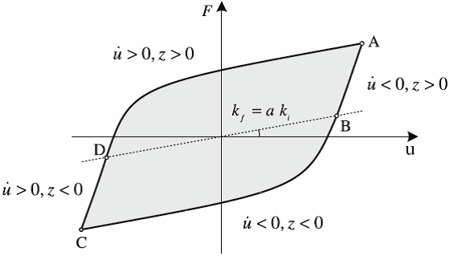
Trento, 03 February 2023
Ph.D. Chiara Nardin
chiara.nardin@unitn.it
Fragility Analysis | MatLab | References
Hysteretic model of Bouc Wen
Hysteretic model of Bouc Wen.
Formulation of the problem and examples of hysteretic cycles.

Slide 16
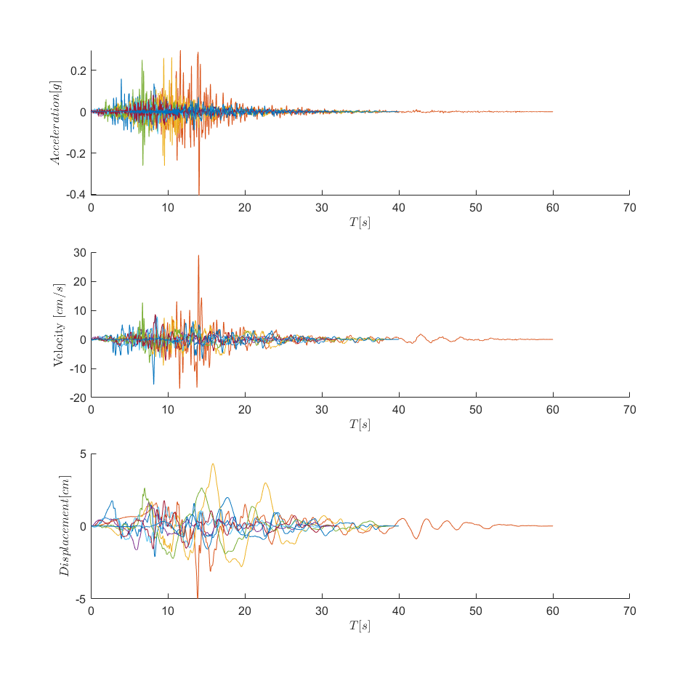
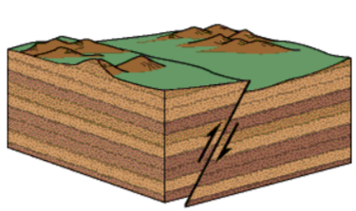
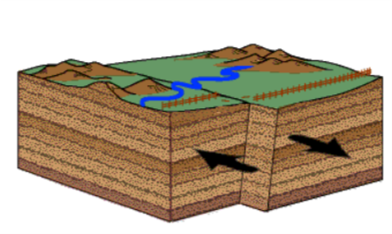
Trento, 03 February 2023
Ph.D. Chiara Nardin
chiara.nardin@unitn.it
Fragility Analysis | MatLab | References
Step 2: input and IM selection
Dataset NGA-WEST 2
206 ground motions
crustal earthquakes
M_{w} > 6
R_{rup} > 10 km
V_{s30} > 600 m/s
fault mechanism
reverse REV
strike slip SS
main features
IMs investigated
PGA [g]
PGV [cm/s]
PGD [cm]
Sa (T₁) [g rad²]
Sv (T₁) [cm rad/s]
Sd (T₁) [cm]
PSa (T₁) [g rad²]
PSv (T₁) [cm rad/s]

Slide 17
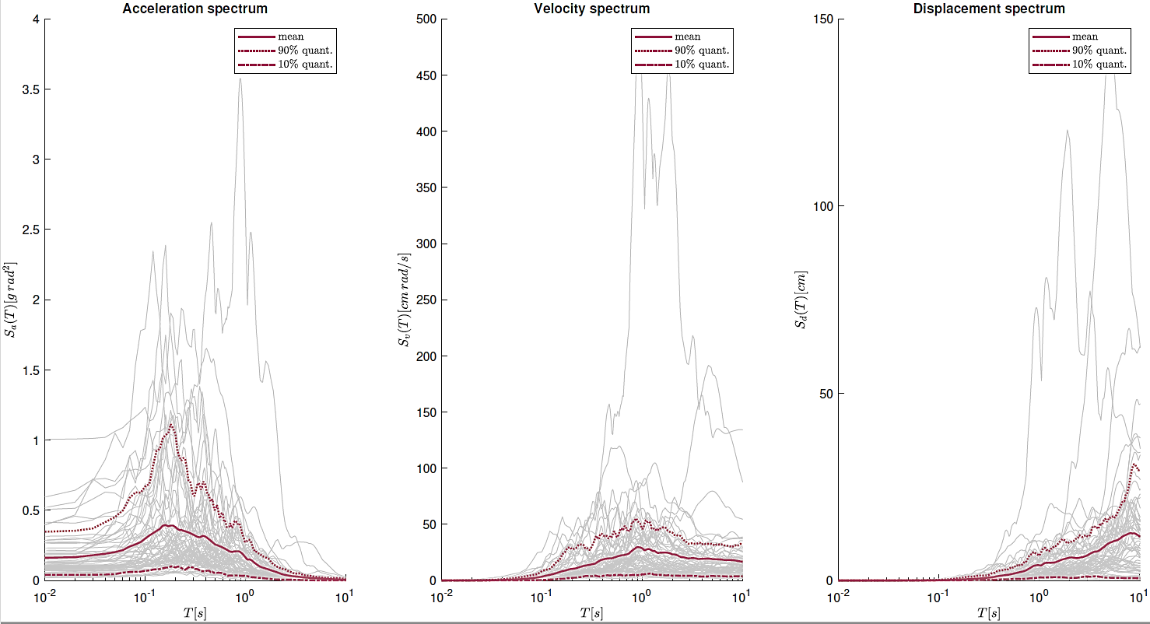
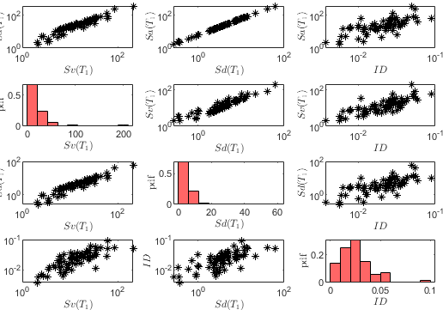
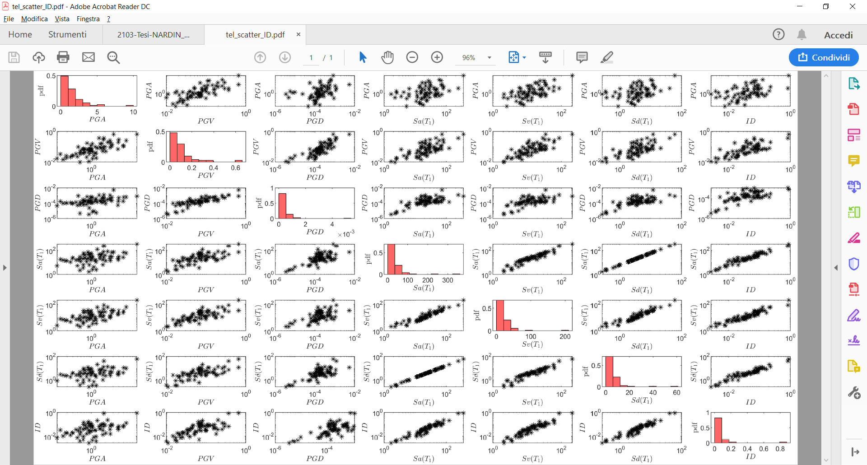
Trento, 03 February 2023
Ph.D. Chiara Nardin
chiara.nardin@unitn.it
Fragility Analysis | MatLab | References
Data exploration of recorded gms
Scatter plot and statistic tools to evaluate proper IM
Step 2: input and IM selection
Acceleration, velocity and displacement response spectra with mean value, 10^{-th} and 90^{-th} quantile.
Scatter plot for correlation.

Slide 18
Trento, 03 February 2023
Ph.D. Chiara Nardin
chiara.nardin@unitn.it
Fragility Analysis | MatLab | References
Step 2: input and IM selection
Codes:
%% Ground motions
Ground_motions = load('accelrot_cellarray.mat');
%
NN = [1, 2, 3, 4, 5, 6, 7, 8, 9, 10, 11, 12, 13, 14, 16, 17, 19, 21, 23, 24,...
25, 26, 28, 29, 30, 31, 32, 33, 34, 36, 37]; % number ID of the SS ground motions
DT = [0.01 , 0.01 , 0.005, 0.005, 0.005, 0.005, 0.02 , 0.02, 0.02, 0.01,...
0.01 , 0.01 , 0.02 , 0.02 , 0.02 , 0.02 , 0.02 , 0.02, 0.01, 0.01,...
0.005, 0.005, 0.005, 0.005, 0.02 , 0.005, 0.005, 0.01, 0.01, 0.01,...
0.01 , 0.005, 0.005, 0.02 , 0.005, 0.01 , 0.01]; % integration time step
https://github.com/CNardin/Lecture/tree/2021/ISPS

Slide 19
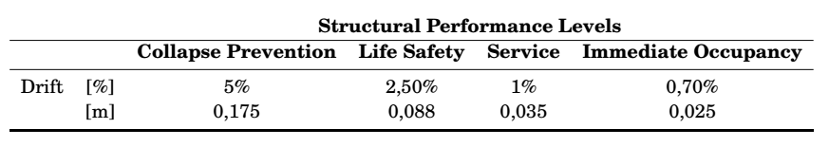
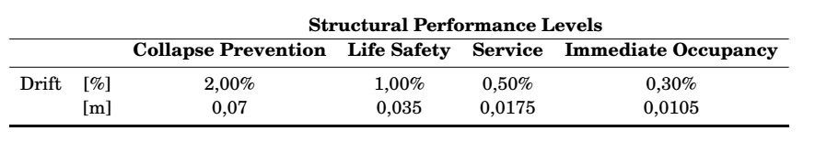
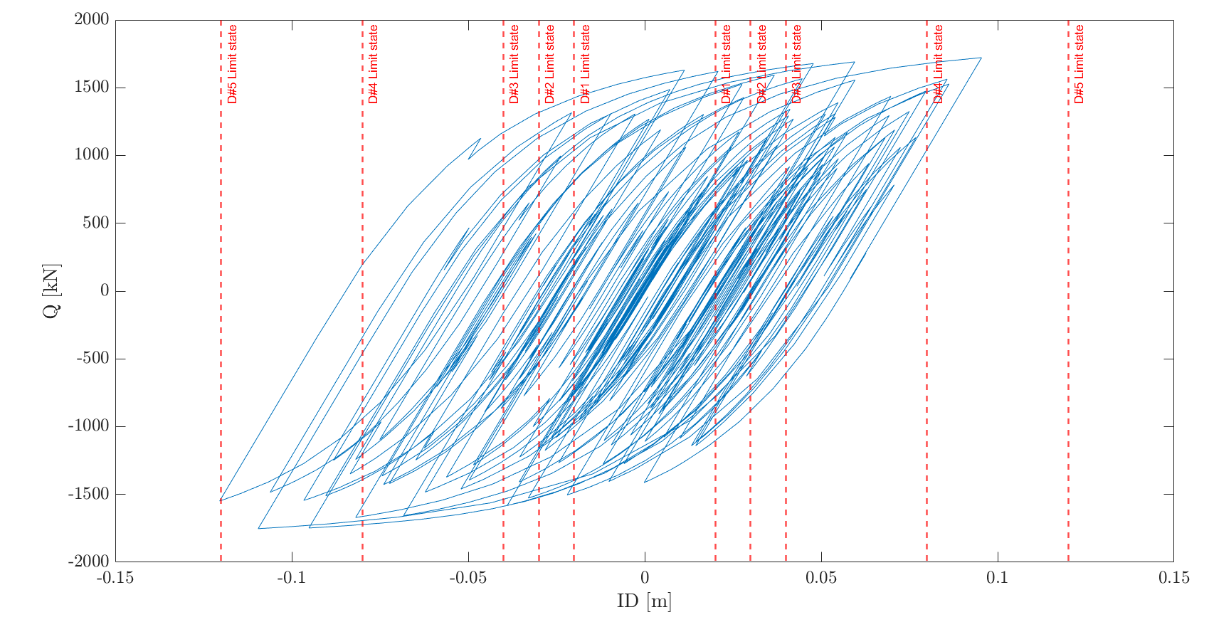
Trento, 03 February 2023
Ph.D. Chiara Nardin
chiara.nardin@unitn.it
Fragility Analysis | MatLab | References
Step 3: Definition of damage limit states and reference EDP
MRF
BF
Document FEMA 356 - Prestandard and Commentary for the Seismic Rehabilitation of Buildings; Table C1-3 - Structural Performance Levels and Damage.

Slide 20
Trento, 03 February 2023
Ph.D. Chiara Nardin
chiara.nardin@unitn.it
Fragility Analysis | MatLab | References
Step 3: Definition of damage limit states and reference EDP
Codes:
%% MDOF Properties
% Choose between the structural system
MDOF_properties_BW_MRF
MDOF_properties_BW_BF
% and between linear or hysteretic behaviour
%% Structural behaviour
System_type = ‘le’; % ‘bw’
% bw = bouc-wen
% le = linear elastic
…
%% Limit States
LS = [0.50 0.75 1 2 3]*4/100;
for ls_i = 1:numel(LS)
ls_val = LS(ls_i)
Main_IDA_o_t
ls_i = ls_i + 1;
end

Slide 21
Trento, 03 February 2023
Ph.D. Chiara Nardin
chiara.nardin@unitn.it
Fragility Analysis | MatLab | References
Step 4: Performing non-linear time histories analysis
Codes:
%% Initial condition
Mat.dFe=zeros(Mat.NDOF,numel(a_g_norm)); % Preallocation for the load for the time series
a_g = a_g_norm*scale; % Scaled ground motion
Mat.Fe=Mat.M*Mat.r'*a_g'*g;
%% Computation response
[HistVarBw]=ResponceMDF_Bw(Mat);
edp = max(abs(HistVarBw.eps(1,:)));
EDP(i) = edp; %store the EDP for each time history analysis
SCALE(i) = scale; %store the scale factor for each time history analysis…

Slide 22

Trento, 03 February 2023
Ph.D. Chiara Nardin
chiara.nardin@unitn.it
Fragility Analysis | MatLab | References
Step 5: Computing fragilities
Codes:
%% Untruncated IDA
[parmhat,parmci] = lognfit(IM_t_c ,0.01);
mu_IDA = parmhat(1);
sigma_IDA = parmhat(2);
%% Truncated IDA
IM_max = 2.2;
IM_trunc = IM_t_c(IM_t_c < IM_max); % take only the results with IM < IM_max
eq_over = sum(IM_t_c >= IM_max); % number of analyses reached IM_max without collapsing
% Maximum likelihood fit, using equation (1) and (2) of previously slides
[mu_IDA_t, sigma_IDA_t ] = truncated_ida(IM_trunc, IM_max, eq_over);

Slide 23
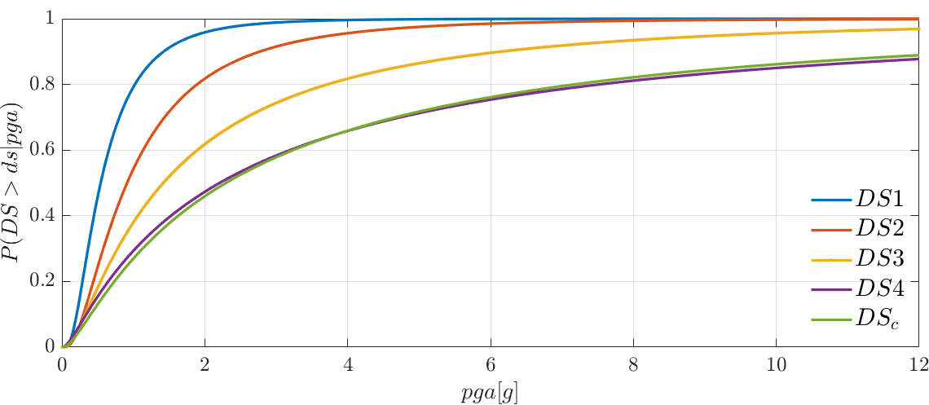
Trento, 03 February 2023
Ph.D. Chiara Nardin
chiara.nardin@unitn.it
Fragility Analysis | MatLab | References
Step 5: Computing fragilities - Results

Slide 24
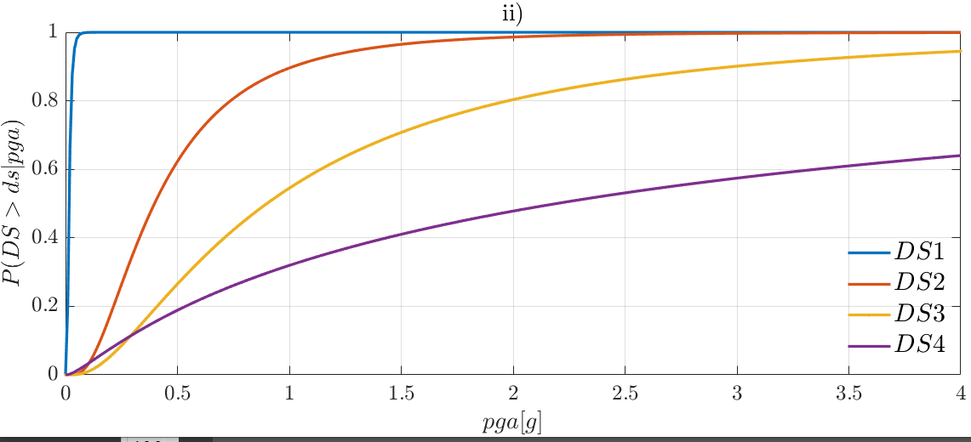
Trento, 03 February 2023
Ph.D. Chiara Nardin
chiara.nardin@unitn.it
Fragility Analysis | MatLab | References
Step 5: Computing fragilities - Results

Slide 25
Trento, 03 February 2023
Ph.D. Chiara Nardin
chiara.nardin@unitn.it
Fragility Analysis | MatLab | References
References:
Baker J. W. (2008). An Introduction to Probabilistic Seismic Hazard Analysis (PSHA), White Paper, Version 1.3, 72 pp.
Kramer, S.L. (1996) Geotechnical earthquake engineering. Prentice Hall, Upper Saddle River, N.J.
Wells, D.L. and Coppersmith, K.J. (1994) New empirical relationships among magnitude, rupture length, rupture width, rupture area, and surface displacement. Bull. Seism. Soc. Am., 84, 974-1002.
Cornell, C.A. (1968). Engineering seismic risk analysis, Bull. Seism. Soc. Am., 58, 1583-1606.
Broccardo, M. (2018) Probabilistic seismic risk analysis for civil systems, Lecture Notes
Stucchi M., Meletti C., Montaldo V., Akinci A., Faccioli E., Gasperini P., Malagnini L., Valensise G. (2004). Pericolosità sismica di riferimento per il territorio nazionale MPS04. Istituto Nazionale di Geofisica e Vulcanologia (INGV). https://doi.org/10.13127/sh/mps04/agKramer, S.L. (1996) Geotechnical earthquake engineering. Prentice Hall, Upper Saddle River, N.J.
http://zonesismiche.mi.ingv.it/ → Italian database

Slide 26
Trento, 03 February 2023
Ph.D. Chiara Nardin
chiara.nardin@unitn.it
Fragility Analysis | MatLab | References
References:
Mackie, K & Stojadinovic, Bozidar. (2003). Seismic Demands for Performance-Based Design of Bridges.
Bursi, Pucinotti, Tondini, Zanon, Tests and model calibration of high strength steel tubular beam-to-column and column-base composite joints for moment-resisting structures, Earthquake Engineering and Structural Dynamics, (2015).
Broccardo, M. (2018) Probabilistic seismic risk analysis for civil systems, Lecture Notes
Charalampakis, A. & Koumousis,V. (2010). Parameters of Bouc–Wen Model Revisited, Applied Mechanics.
Haukaas, T. & Der Kiureghian, A. (2004). Finite Element Reliability and Sensitivity Methods for Performance-Based Earthquake Engineering, tech. rep., PEER - Pacific Earthquake Engineering Research Center.

Slide 27
Trento, 03 February 2023
Ph.D. Chiara Nardin
chiara.nardin@unitn.it
Thanks for the attention!
Chiara Nardin – Ph.D., M.Sc., Eng. in Civil Engineering
https://github.com/CNardin

