Slide 1
Trento, 03 February 2023
Chiara Nardin, Ph.D.
chiara.nardin@unitn.it
Lecture #4
Probabilistic Seismic Risk Analysis for building and industrial systems
Chiara Nardin – Ph.D., M.Sc., Eng. in Civil Engineering
https://github.com/CNardin

Slide 2
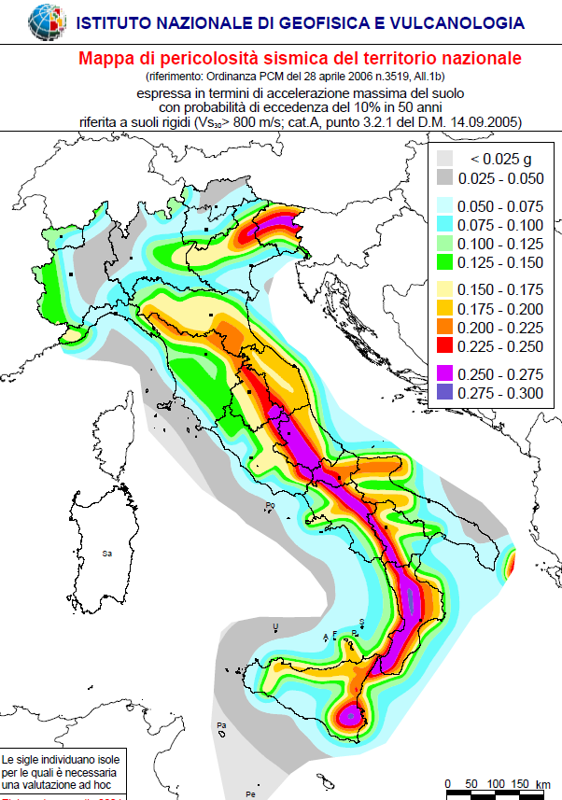
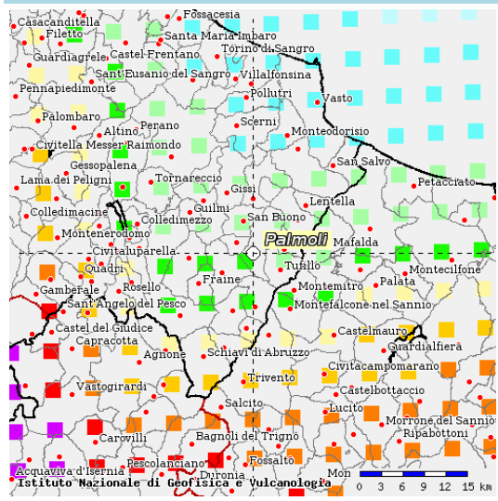
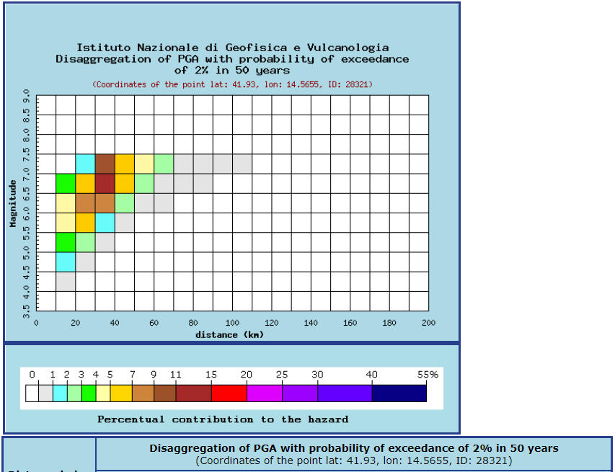
Trento, 03 February 2023
Chiara Nardin, Ph.D.
chiara.nardin@unitn.it
Outline | Seismic Risk | PBEE-PEER Framework | Lecture Plan
Outline:
Motivations: earthquake and losses
Hazard curves and fragility functions
PBEE-PEER framework
Lecture Plan
http://zonesismiche.mi.ingv.it/

Slide 3
Trento, 03 February 2023
Chiara Nardin, Ph.D.
chiara.nardin@unitn.it
Outline | Seismic Risk | PBEE-PEER Framework | Lecture Plan
seismic risk
«Risk has been defined, for management purposes, as the potential economic, social and environmental consequences of hazardous events that may occur in a specified period of time. »
Seismic risk evaluation for an urban centre, M.L.Carreno, O.D.Cardona, A.H.Barbat, 250th Anniversary of the 1755 Lisbon Earthquake
«Con la parola rischio si intende esprimere un concetto generale che comprende sia la probabilità di un evento, sia le conseguenze che l’evento stesso potrebbe produrre.»
Fondamenti di ingegneria sismica in 80 lezioni, A.Parducci, Liguori Ed.

Slide 4
Trento, 03 February 2023
Chiara Nardin, Ph.D.
chiara.nardin@unitn.it
Outline | Seismic Risk | PBEE-PEER Framework | Lecture Plan
seismic risk ≠ seismic hazard
«A seismic hazard is the probability that an earthquake will occur in a given geographic area, within a given window of time, and with ground motion intensity exceeding a given threshold. »
Probabilistic seismic hazard analysis: Early history, McGuire, R. Earthquake Engng Struct. Dyn., 2008
«La pericolosità sismica corrisponde alla frequenza delle intensità dei terremoti che si prevede possano interessare il territorio in questione. Può essere definita come la probabilità che un evento potenzialmente dannoso si manifesti in questo territorio entro un determinato periodo di tempo.»
Fondamenti di ingegneria sismica in 80 lezioni, A.Parducci, Liguori Ed.

Slide 5
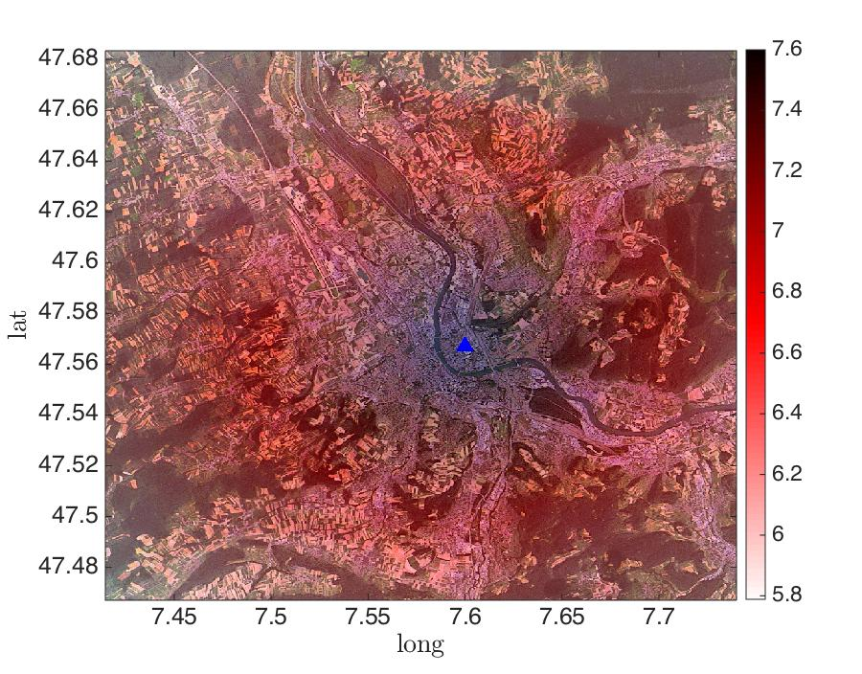
Trento, 03 February 2023
Chiara Nardin, Ph.D.
chiara.nardin@unitn.it
Outline | Seismic Risk | PBEE-PEER Framework | Lecture Plan
hazard map

Slide 6
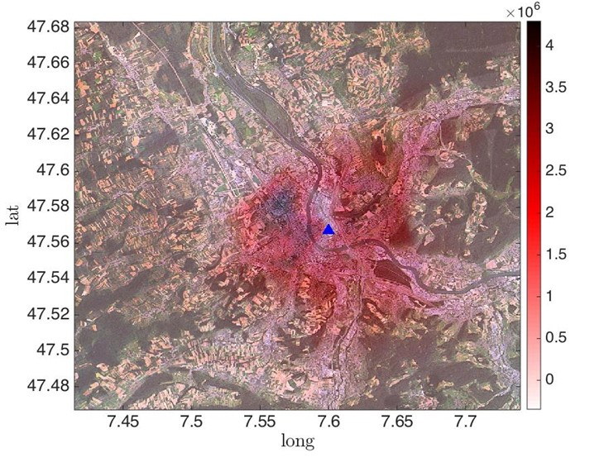
Trento, 03 February 2023
Chiara Nardin, Ph.D.
chiara.nardin@unitn.it
Outline | Seismic Risk | PBEE-PEER Framework | Lecture Plan
risk map

Slide 7
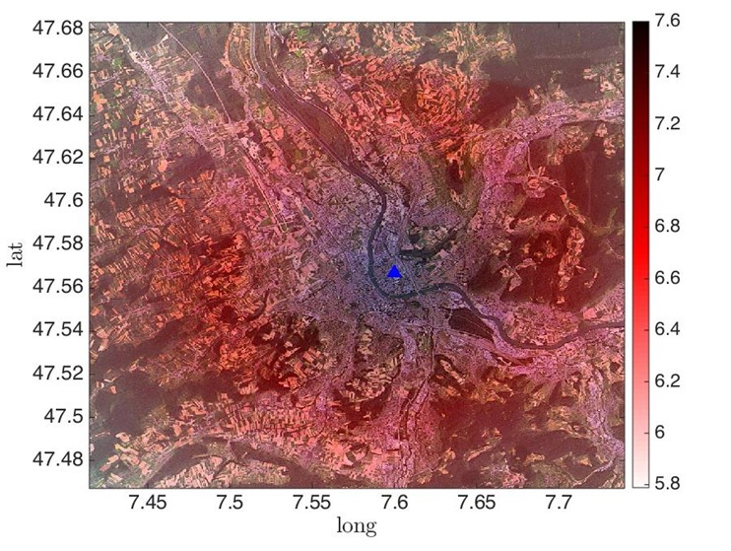
Trento, 03 February 2023
Chiara Nardin, Ph.D.
chiara.nardin@unitn.it
Outline | Seismic Risk | PBEE-PEER Framework | Lecture Plan
hazard map
risk map

Slide 8
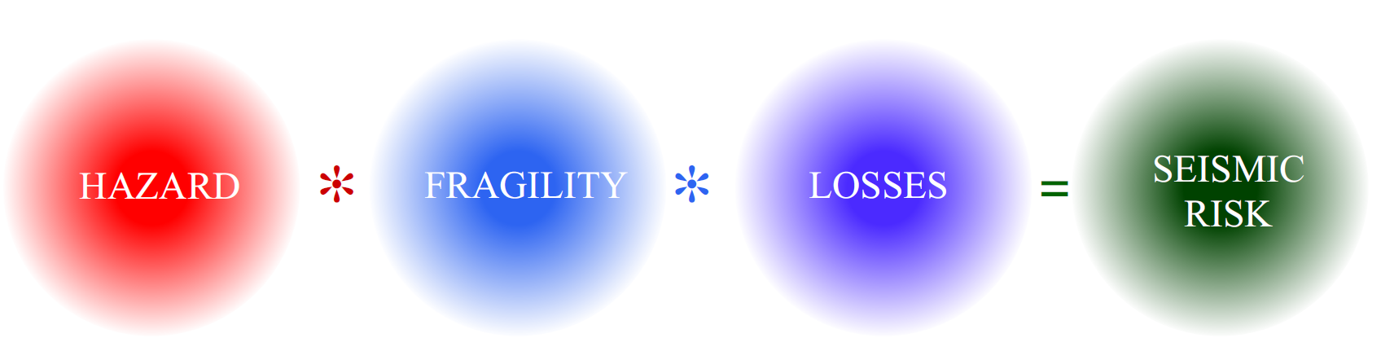
Trento, 03 February 2023
Chiara Nardin, Ph.D.
chiara.nardin@unitn.it
Outline | Seismic Risk | PBEE-PEER Framework | Lecture Plan
SEISMIC
RISK
HAZARD
FRAGILITY
LOSS

Slide 9
Trento, 03 February 2023
Chiara Nardin, Ph.D.
chiara.nardin@unitn.it
Outline | Seismic Risk | PBEE-PEER Framework | Lecture Plan
SEISMIC
RISK
HAZARD
FRAGILITY
LOSS

Slide 10
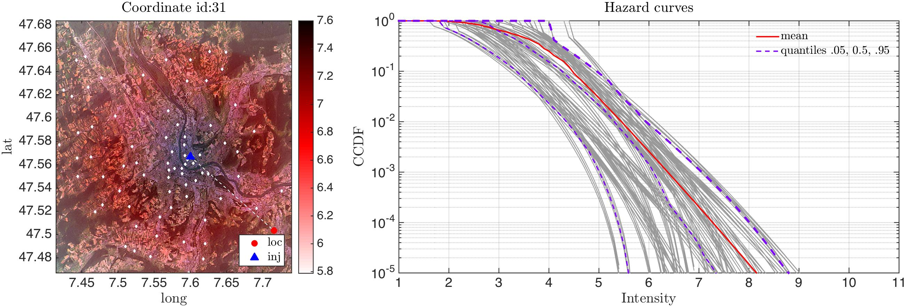
Trento, 03 February 2023
Chiara Nardin, Ph.D.
chiara.nardin@unitn.it
Outline | Seismic Risk | PBEE-PEER Framework | Lecture Plan

Slide 11
Trento, 03 February 2023
Chiara Nardin, Ph.D.
chiara.nardin@unitn.it
Outline | Seismic Risk | PBEE-PEER Framework | Lecture Plan
SEISMIC
RISK
HAZARD
FRAGILITY
LOSS

Slide 12
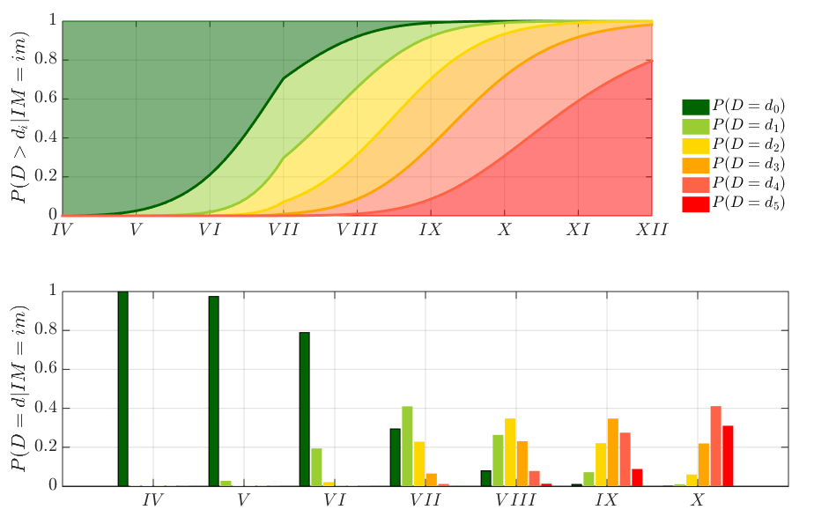
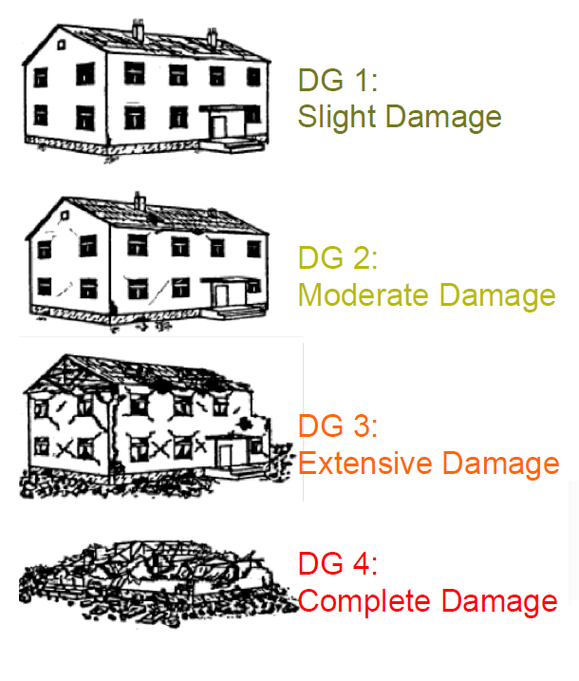
Trento, 03 February 2023
Chiara Nardin, Ph.D.
chiara.nardin@unitn.it
Outline | Seismic Risk | PBEE-PEER Framework | Lecture Plan
Slight
Moderate
Extensive
Collapse

Slide 13
Trento, 03 February 2023
Chiara Nardin, Ph.D.
chiara.nardin@unitn.it
Outline | Seismic Risk | PBEE-PEER Framework | Lecture Plan
PBEE-PEER framework

Slide 14
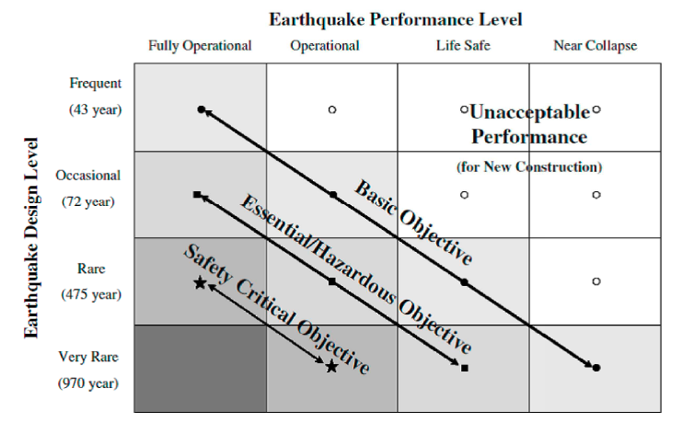
Trento, 03 February 2023
Chiara Nardin, Ph.D.
chiara.nardin@unitn.it
Outline | Seismic Risk | PBEE-PEER Framework | Lecture Plan
PBEE: Performance Based Earthquake Engineering
PBEE concept: seismic performance objectives vs seismic hazard level. ©Poland et al.,(1995)-Vision 2000: Performance Based Earthquake Engineering of buildings. Structural Engineers Association of California, Sacramento, CA.

Slide 15


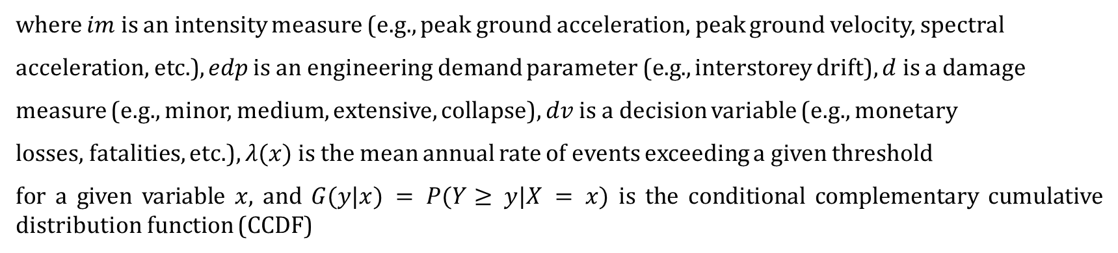
Trento, 03 February 2023
Chiara Nardin, Ph.D.
chiara.nardin@unitn.it
Outline | Seismic Risk | PBEE-PEER Framework | Lecture Plan
The PEER-PBEE Framework
where $im$ is an intensity measure (e.g., peak ground acceleration, peak ground velocity, spectral
acceleration, etc.), $edp$ is an engineering demand parameter (e.g., interstorey drift), $d$ is a damage
measure (e.g., minor, medium, extensive, collapse), $dv$ is a decision variable (e.g., monetary
losses, fatalities, etc.), $λ(x)$ is the mean annual rate of events exceeding a given threshold
for a given variable $x$, and $G(y|x) = P(Y≥ y|X = x)$ is the conditional complementary cumulative distribution function (CCDF)

Slide 16
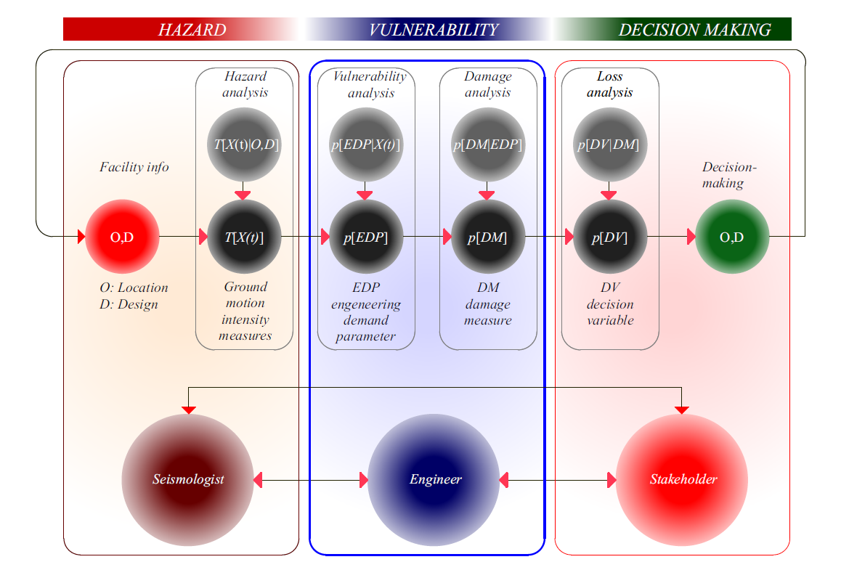
Trento, 03 February 2023
Chiara Nardin, Ph.D.
chiara.nardin@unitn.it
Outline | Seismic Risk | PBEE-PEER Framework | Lecture Plan

Slide 17


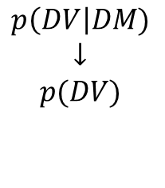
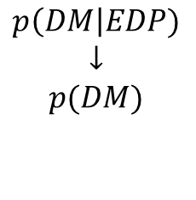
Trento, 03 February 2023
Chiara Nardin, Ph.D.
chiara.nardin@unitn.it
Outline | Seismic Risk | PBEE-PEER Framework | Lecture Plan
The PEER-PBEE Framework
Hazard analysis
intensity measure
Loss analysis
decision variable
HAZARD
VULNERABILITY
Damage analysis
damage measure
DECISION MAKING
VULNERABILITY
Vulnerability analysis
engineering demand par.
$$p\left(IM\right|M,R)$$
$$↓$$
$$p(IM)$$
$$p\left(EDP\right|IM)$$
$$↓$$
$$p(EDP)$$
$$p\left(DM\right|EDP)$$
$$↓$$
$$p(DM)$$
$$p\left(DV\right|DM)$$
$$↓$$
$$p(DV)$$
seismologist
engineer
stakeholder

Slide 18
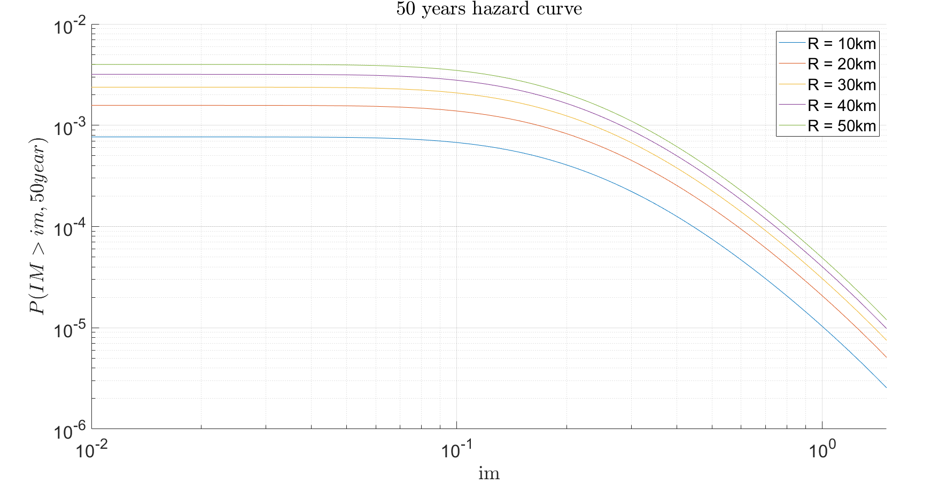


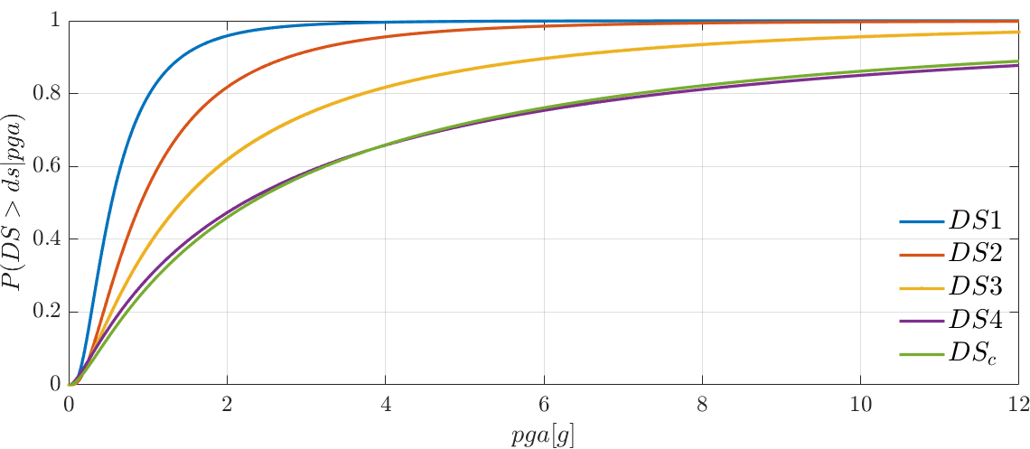
Trento, 03 February 2023
Chiara Nardin, Ph.D.
chiara.nardin@unitn.it
Outline | Seismic Risk | PBEE-PEER Framework | Lecture Plan
Objectives & Lecture Plan:
(1h00) Probabilistic seismic hazard (C.Nardin)
  Definition and time scales
  Models of earthquake occurrence and hazard integral
  LAB → PSHA
(0h45) Vulnerability (C.Nardin)
  Fragility functions: methods and applications
  LAB → Computation of probability of damage state of a building

