Slide 1
Trento, 15 December 2021
Ph.D. Student: Chiara Nardin
chiara.nardin@unitn.it
Fragility Analysis
Formulation and MatLab Computation
Ph.D. Student Chiara Nardin – M.Sc., Eng. in Civil Engineering
Prof. Marco Broccardo – Ph.D., M.Sc., Eng. in Civil Engineering
https://github.com/CNardin/Lecture/tree/2021/ISPS

Slide 2
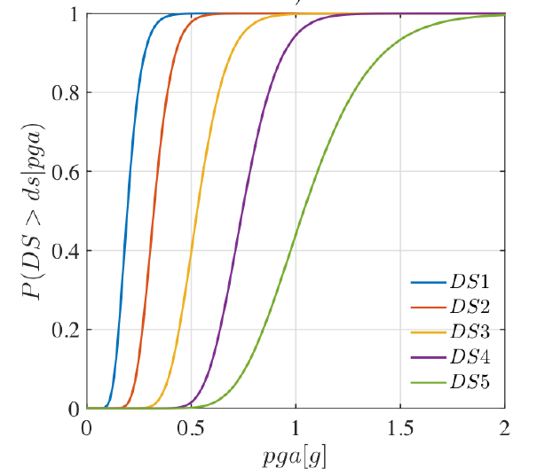
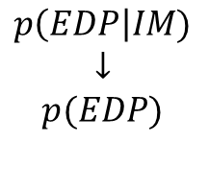
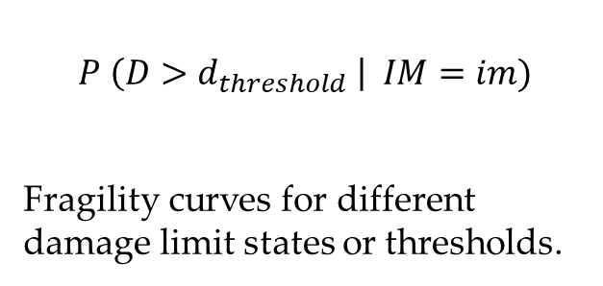
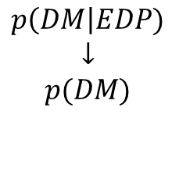
Fragility Analysis | MatLab | References
Fragility Analysis
Vulnerability analysis
engineering demand par.
$$P \left(D>d_{threshold} \right| IM=im)$$
Fragility curves for different damage limit states or thresholds.
VULNERABILITY
$$p\left(EDP\right|IM)$$
$$↓$$
$$p(EDP)$$
Damage analysis
damage measure
VULNERABILITY
$$p\left(DM\right|EDP)$$
$$↓$$
$$p(DM)$$

Slide 3
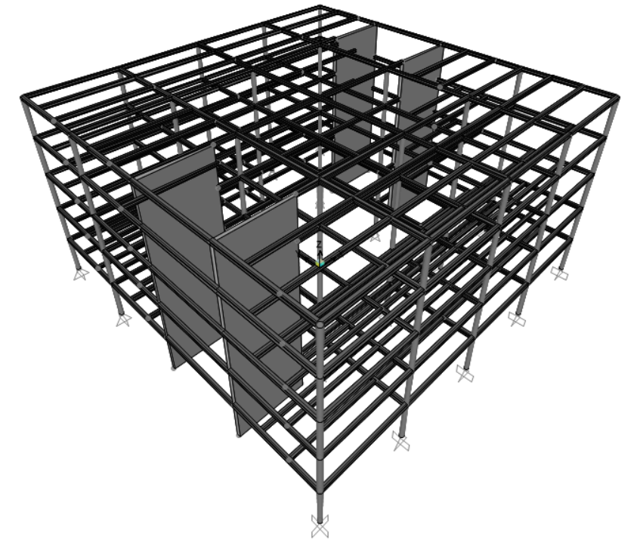
Fragility Analysis | MatLab | References
Goal: to perform fragility analysis
Given the provided set of ground motions, perform a classical and truncated incremental dynamic analysis (IDA) and determine fragility curves for:
ATTEL – moment resistant frame (MRF);
ATTEL – braced frame (BF)
by considering both
Linear elastic behaviour
Bouc – Wen model for hysteresis
3D model of the case study ATTEL – SERA project.

Slide 4
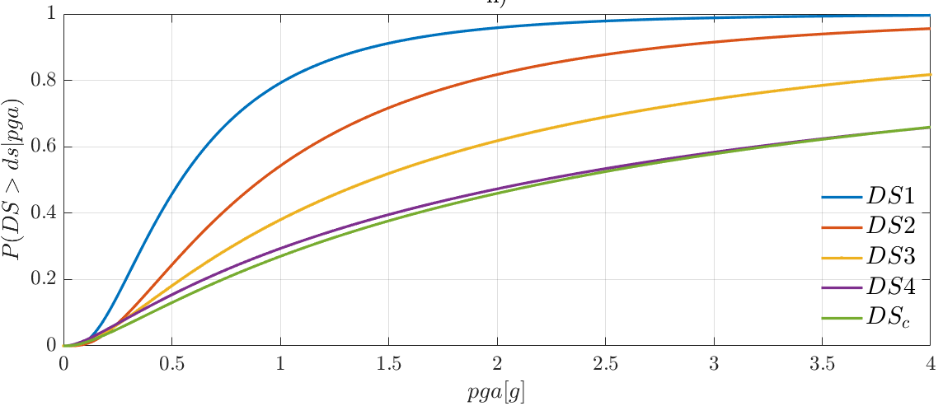
Fragility Analysis | MatLab | References
Main steps:
Definition of the numerical model
Input and IM selection
Definition of damage limit states and reference EDP
Performing non-linear time histories analysis (IDA, truncated IDA, cloud, MSA …)
Collecting results pairs and computing fragility
3D model of the case study ATTEL – SERA project.

Slide 5
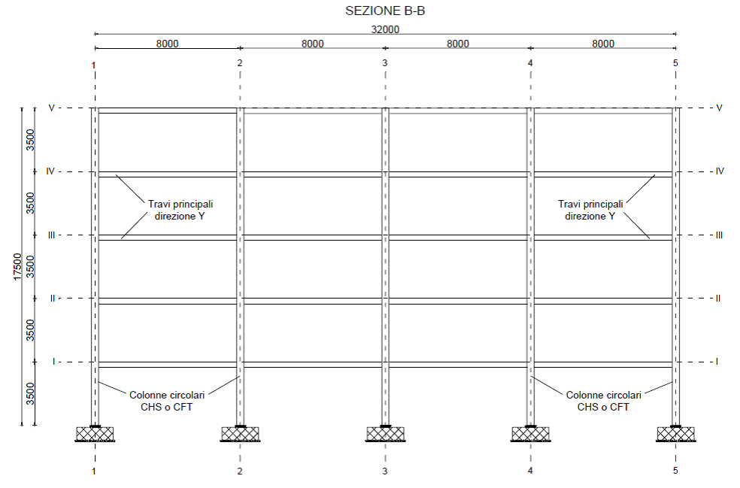
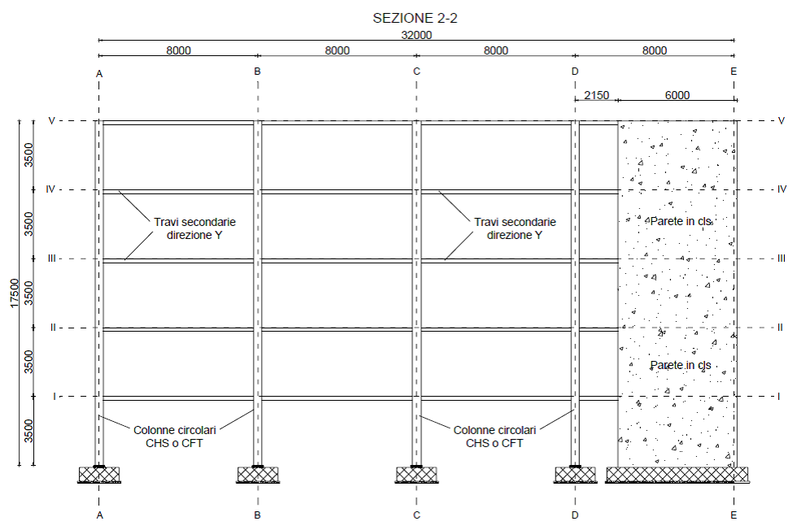
Fragility Analysis | MatLab | References
Step 1: the case study ATTEL⁽¹⁾
^{[1]}BURSI, PUCINOTTI, TONDINI, ZANON, Tests and model calibration of high strength steel tubular beam-to-column and column-base composite joints for moment-resisting structures, Earthquake Engineering and Structural Dynamics, (2015).
T₁ = 2.79 s
T₁ = 0.46 s
3D model of the case study ATTEL – SERA project.
Main sections of the moment resistent frame and the braced one.

Slide 6
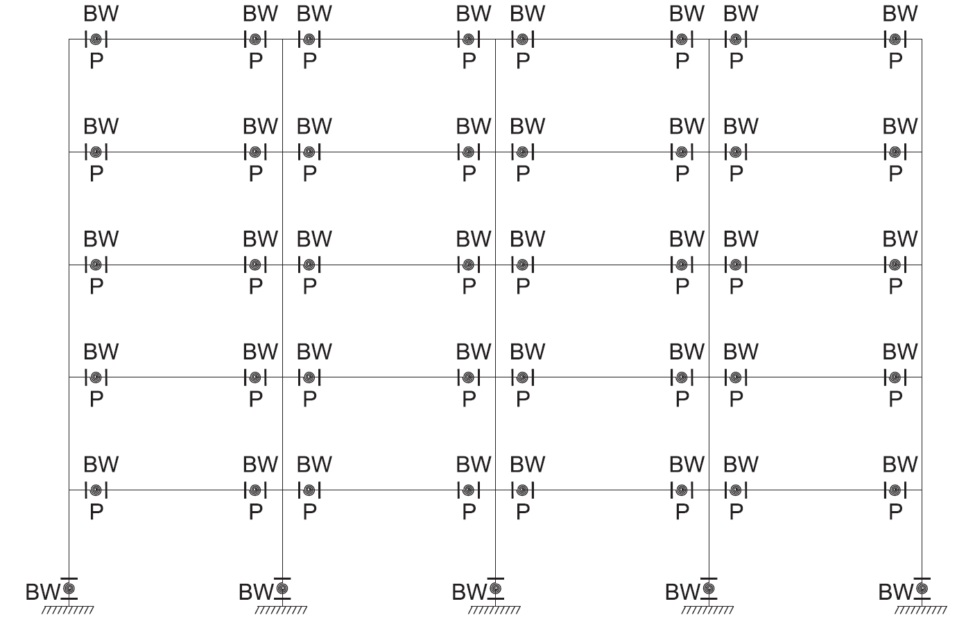
Fragility Analysis | MatLab | References
Designed according to EC8 and modelled in OS:
beam and column elements with linear elastic behavior

Slide 7
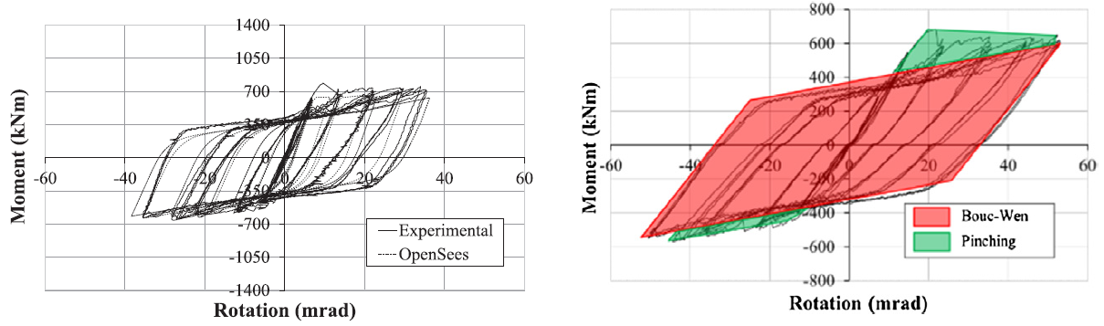

Fragility Analysis | MatLab | References
Designed according to EC8 and modelled in OS:
beam and column elements with linear elastic behavior
mechanical nonlinearities
geometric nonlinearities

Slide 8
Fragility Analysis | MatLab | References
Designed according to EC8 and modelled in OS:
beam and column elements with linear elastic behavior
mechanical nonlinearities
geometric nonlinearities
Model of the structure in OpenSees.

Slide 9
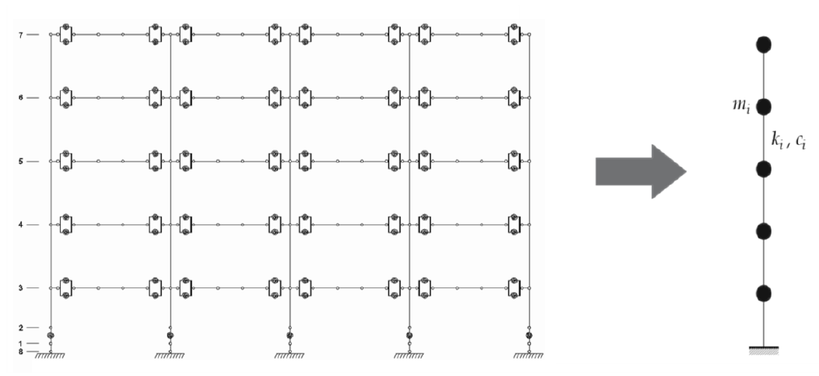
Fragility Analysis | MatLab | References
to reduce computational burden
to reduce required simulation times
High number of analysis
for seismic simulations
Calibration oriented to correspondence of:
main periods
modes of vibrating
dissipative behavior
high fidelity model in OpenSees - OS
simplified model MDOF in MATLAB ® - ML

Slide 10
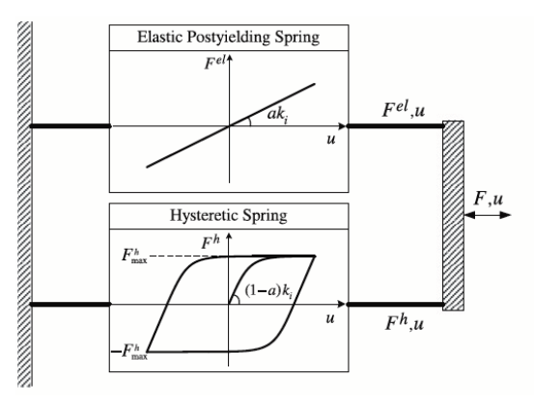


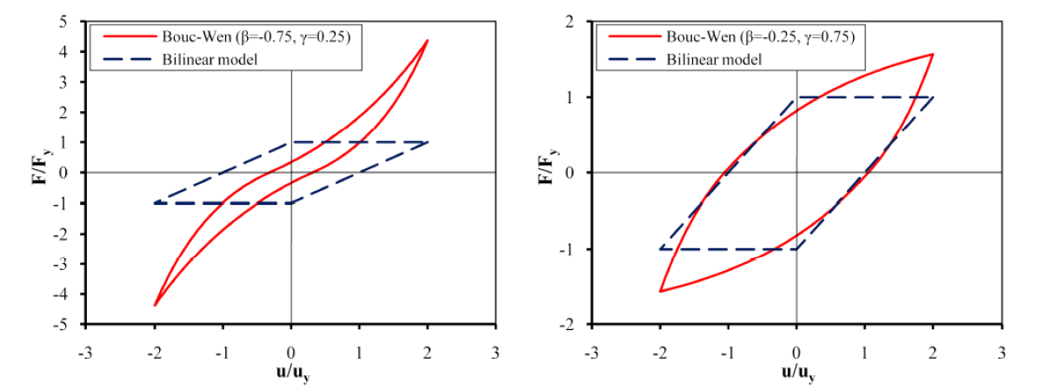
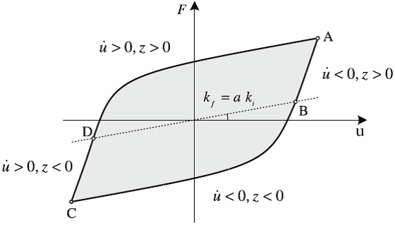
Trento, 02 December 2020
Ph.D. Student: Chiara Nardin
chiara.nardin@unitn.it
Fragility Analysis | MatLab | References
Hysteretic model of Bouc Wen
Hysteretic model of Bouc Wen.
Formulation of the problem and examples of hysteretic cycles.

Slide 11
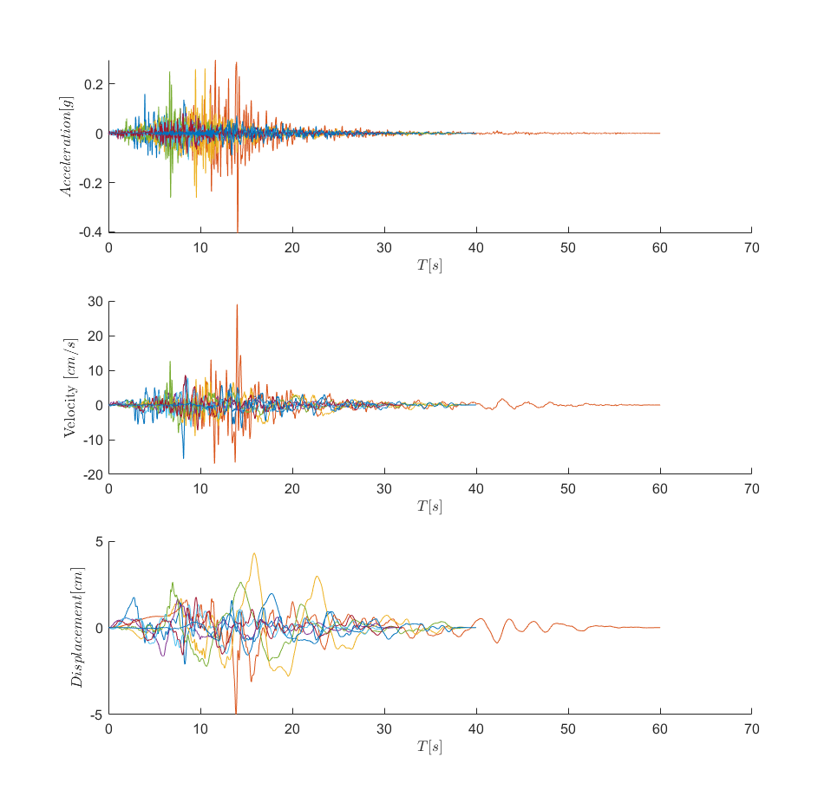
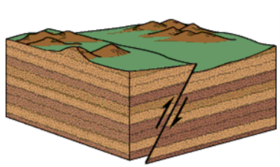
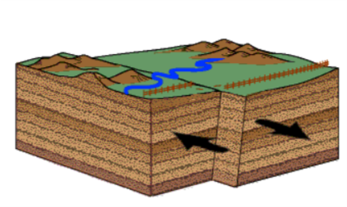
Fragility Analysis | MatLab | References
Step 2: input and IM selection
Dataset NGA-WEST 2
206 ground motions
crustal earthquakes
M_{w} > 6
R_{rup} > 10 km
V_{s30} > 600 m/s
fault mechanism
reverse REV
strike slip SS
main features

Slide 12
Fragility Analysis | MatLab | References
Step 2: input and IM selection
Dataset NGA-WEST 2
206 ground motions
crustal earthquakes
M_{w} > 6
R_{rup} > 10 km
V_{s30} > 600 m/s
fault mechanism
reverse REV
strike slip SS
main features
IMs investigated
PGA [g]
PGV [cm/s]
PGD [cm]
Sa (T₁) [g rad²]
Sv (T₁) [cm rad/s]
Sd (T₁) [cm]
PSa (T₁) [g rad²]
PSv (T₁) [cm rad/s]

Slide 13
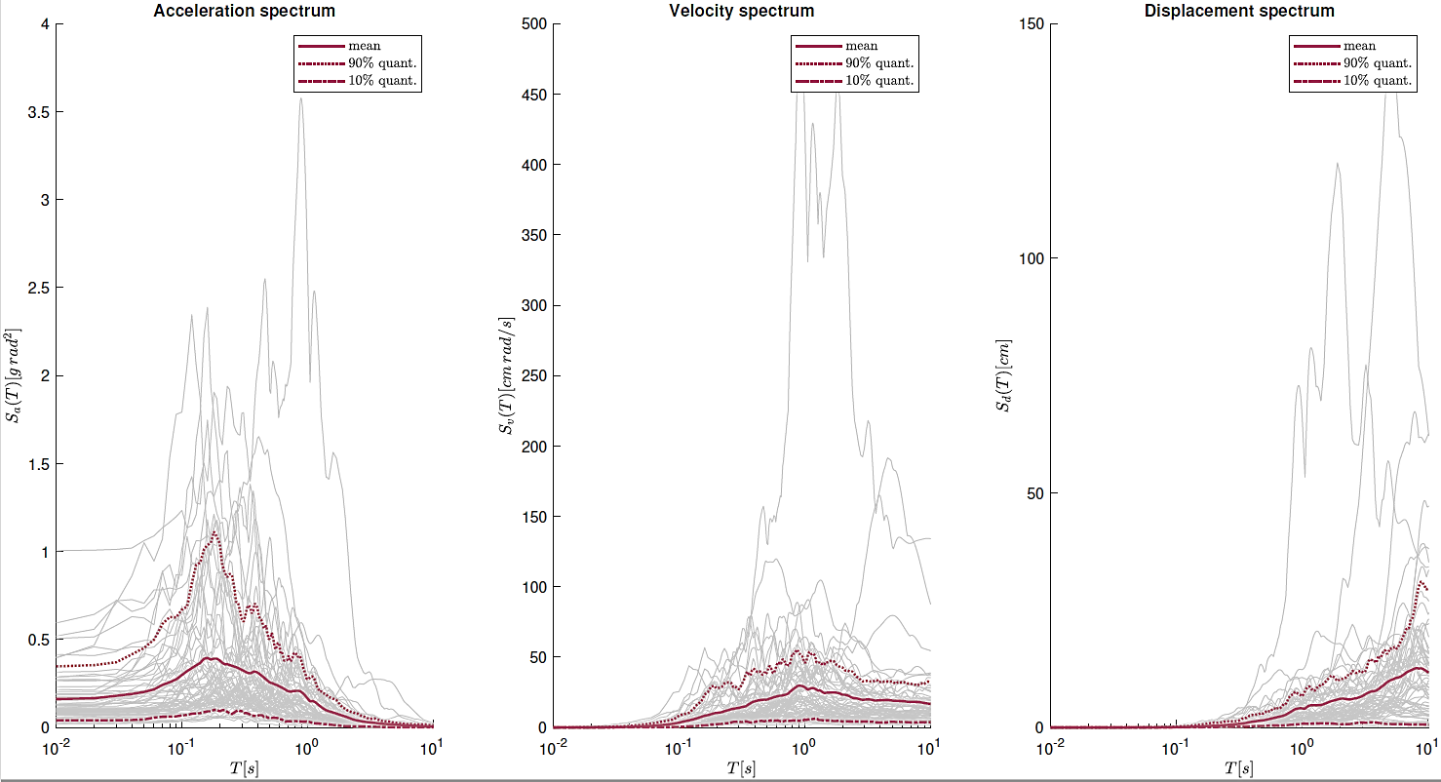
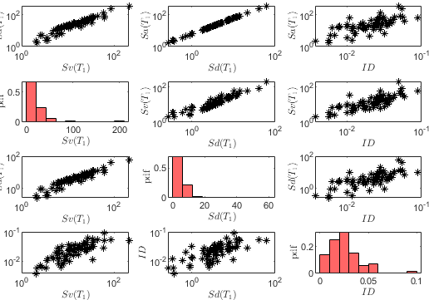
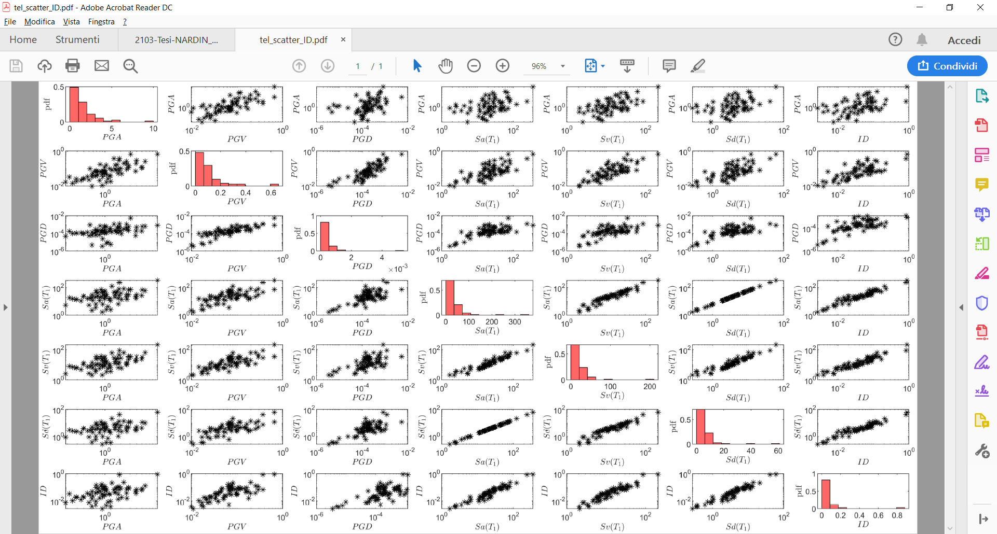
Fragility Analysis | MatLab | References
Data exploration of recorded gms
Scatter plot and statistic tools to evaluate proper IM
Step 2: input and IM selection
Acceleration, velocity and displacement response spectra with mean value, 10^{-th} and 90^{-th} quantile.
Scatter plot for correlation.

Slide 14
Fragility Analysis | MatLab | References
Step 2: input and IM selection
Codes:
%% Ground motions
Ground_motions = load('accelrot_cellarray.mat');
%
NN = [1, 2, 3, 4, 5, 6, 7, 8, 9, 10, 11, 12, 13, 14, 16, 17, 19, 21, 23, 24,...
25, 26, 28, 29, 30, 31, 32, 33, 34, 36, 37]; % number ID of the SS ground motions
DT = [0.01 , 0.01 , 0.005, 0.005, 0.005, 0.005, 0.02 , 0.02, 0.02, 0.01,...
0.01 , 0.01 , 0.02 , 0.02 , 0.02 , 0.02 , 0.02 , 0.02, 0.01, 0.01,...
0.005, 0.005, 0.005, 0.005, 0.02 , 0.005, 0.005, 0.01, 0.01, 0.01,...
0.01 , 0.005, 0.005, 0.02 , 0.005, 0.01 , 0.01]; % integration time step
https://github.com/CNardin/Lecture/tree/2021/ISPS

Slide 15
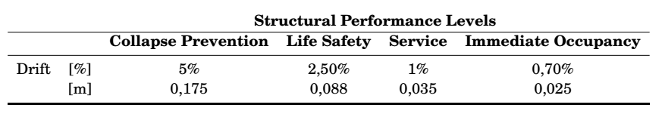
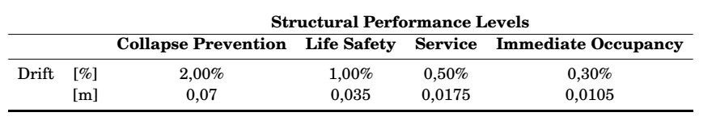
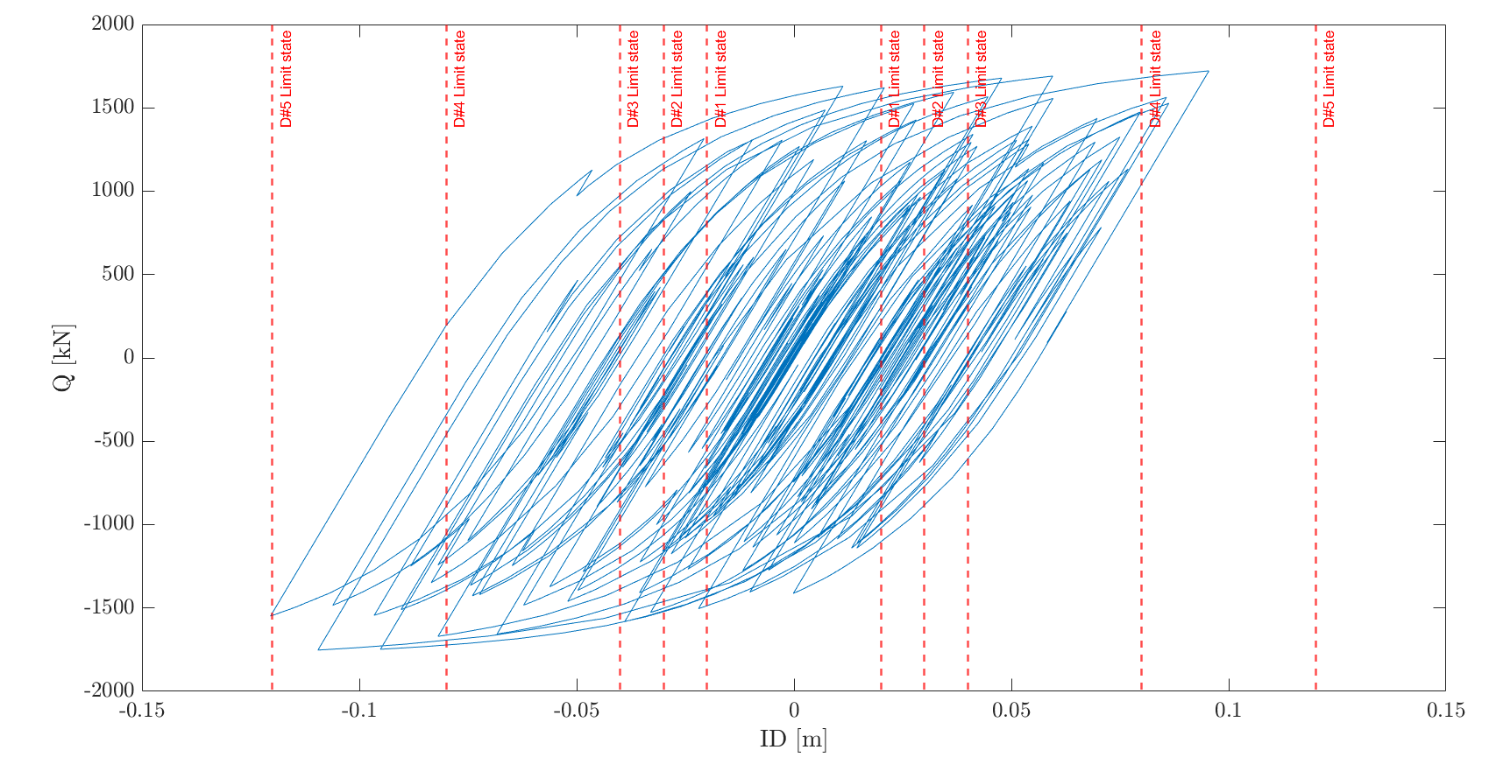
Fragility Analysis | MatLab | References
Step 3: Definition of damage limit states and reference EDP
MRF
BF
Document FEMA 356 - Prestandard and Commentary for the Seismic Rehabilitation of Buildings; Table C1-3 - Structural Performance Levels and Damage.

Slide 16
Fragility Analysis | MatLab | References
Step 3: Definition of damage limit states and reference EDP
Codes:
%% MDOF Properties
% Choose between the structural system
MDOF_properties_BW_MRF
MDOF_properties_BW_BF
% and between linear or hysteretic behaviour
%% Structural behaviour
System_type = ‘le’; % ‘bw’
% bw = bouc-wen
% le = linear elastic
…
%% Limit States
LS = [0.50 0.75 1 2 3]*4/100;
for ls_i = 1:numel(LS)
ls_val = LS(ls_i)
Main_IDA_o_t
ls_i = ls_i + 1;
end

Slide 17
Fragility Analysis | MatLab | References
Step 4: Performing non-linear time histories analysis
Codes:
%% Initial condition
Mat.dFe=zeros(Mat.NDOF,numel(a_g_norm)); % Preallocation for the load for the time series
a_g = a_g_norm*scale; % Scaled ground motion
Mat.Fe=Mat.M*Mat.r'*a_g'*g;
%% Computation response
[HistVarBw]=ResponceMDF_Bw(Mat);
edp = max(abs(HistVarBw.eps(1,:)));
EDP(i) = edp; %store the EDP for each time history analysis
SCALE(i) = scale; %store the scale factor for each time history analysis…

Slide 18

Fragility Analysis | MatLab | References
Step 5: Computing fragilities
Codes:
%% Untruncated IDA
[parmhat,parmci] = lognfit(IM_t_c ,0.01);
mu_IDA = parmhat(1);
sigma_IDA = parmhat(2);
%% Truncated IDA
IM_max = 2.2;
IM_trunc = IM_t_c(IM_t_c < IM_max); % take only the results with IM < IM_max
eq_over = sum(IM_t_c >= IM_max); % number of analyses reached IM_max without collapsing
% Maximum likelihood fit, using equation (1) and (2) of previously slides
[mu_IDA_t, sigma_IDA_t ] = truncated_ida(IM_trunc, IM_max, eq_over);

Slide 19
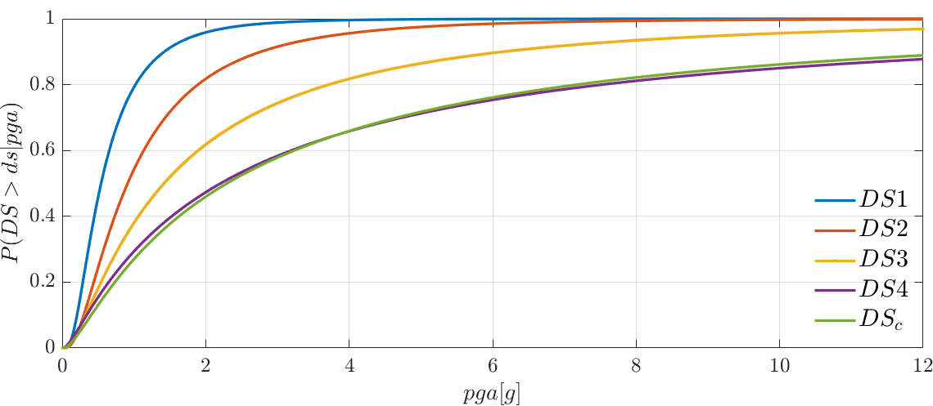
Fragility Analysis | MatLab | References
Step 5: Computing fragilities - Results

Slide 20
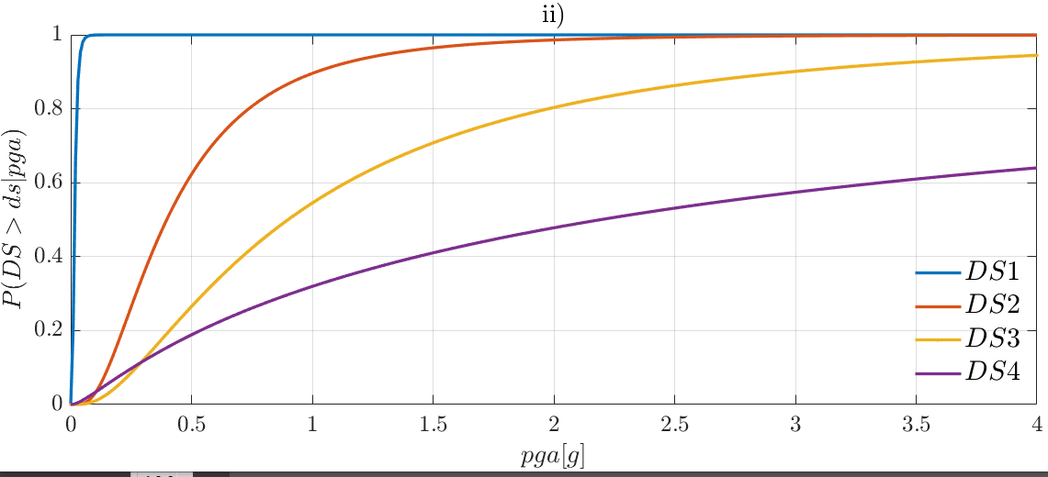
Fragility Analysis | MatLab | References
Step 5: Computing fragilities - Results

Slide 21
Fragility Analysis | MatLab | References
References:
Baker J. W. (2008). An Introduction to Probabilistic Seismic Hazard Analysis (PSHA), White Paper, Version 1.3, 72 pp.
Kramer, S.L. (1996) Geotechnical earthquake engineering. Prentice Hall, Upper Saddle River, N.J.
Wells, D.L. and Coppersmith, K.J. (1994) New empirical relationships among magnitude, rupture length, rupture width, rupture area, and surface displacement. Bull. Seism. Soc. Am., 84, 974-1002.
Cornell, C.A. (1968). Engineering seismic risk analysis, Bull. Seism. Soc. Am., 58, 1583-1606.
Broccardo, M. (2018) Probabilistic seismic risk analysis for civil systems, Lecture Notes
Stucchi M., Meletti C., Montaldo V., Akinci A., Faccioli E., Gasperini P., Malagnini L., Valensise G. (2004). Pericolosità sismica di riferimento per il territorio nazionale MPS04. Istituto Nazionale di Geofisica e Vulcanologia (INGV). https://doi.org/10.13127/sh/mps04/agKramer, S.L. (1996) Geotechnical earthquake engineering. Prentice Hall, Upper Saddle River, N.J.
http://zonesismiche.mi.ingv.it/ → Italian database

Slide 22
Fragility Analysis | MatLab | References
References:
Mackie, K & Stojadinovic, Bozidar. (2003). Seismic Demands for Performance-Based Design of Bridges.
Bursi, Pucinotti, Tondini, Zanon, Tests and model calibration of high strength steel tubular beam-to-column and column-base composite joints for moment-resisting structures, Earthquake Engineering and Structural Dynamics, (2015).
Broccardo, M. (2018) Probabilistic seismic risk analysis for civil systems, Lecture Notes
Charalampakis, A. & Koumousis,V. (2010). Parameters of Bouc–Wen Model Revisited, Applied Mechanics.
Haukaas, T. & Der Kiureghian, A. (2004). Finite Element Reliability and Sensitivity Methods for Performance-Based Earthquake Engineering, tech. rep., PEER - Pacific Earthquake Engineering Research Center.

Slide 23
Thanks for the attention!
Ph.D. Student Chiara Nardin – M.Sc., Eng. in Civil Engineering
Prof. Marco Broccardo – Ph.D., M.Sc., Eng. in Civil Engineering
https://github.com/CNardin

