Slide 1
Trento, 14 December 2021
Ph.D. Student: Chiara Nardin
chiara.nardin@unitn.it
Ingegneria Sismica e Progettazione Strutturale
Probabilistic Seismic Risk Analysis for Civil Systems
Prof. Marco Broccardo – Ph.D., M.Sc., Eng. in Civil Engineering
Ph.D. Student Chiara Nardin – M.Sc., Eng. in Civil Engineering

Slide 2
Marco Broccardo
About me:
.
.
Research Topics:
.
.
Interests:
.
.
. ☺
More about:
https://www.marco-broccardo.com/

Slide 3
Chiara Nardin
About me:
Ph.D. student on Modelling and Simulation at the Department of Civil, Environmental and Mechanical Engineering of UniTn
Received M.Sc. degree in Structural Civil Engineering in 2019, with a thesis on Evaluation of fragility functions of structural systems for risk analysis based on Markovian processes
Research Topics:
FE modeling for evaluation of seismic risk analysis of industrial plants
Development of a stochastic ground motion model in frequency domain
Interests:
CWT applied to time histories
Coding, modern literature
Hiking and traveling with a lightweight backpack ☺
More about:
https://cnardin.github.io/

Slide 4
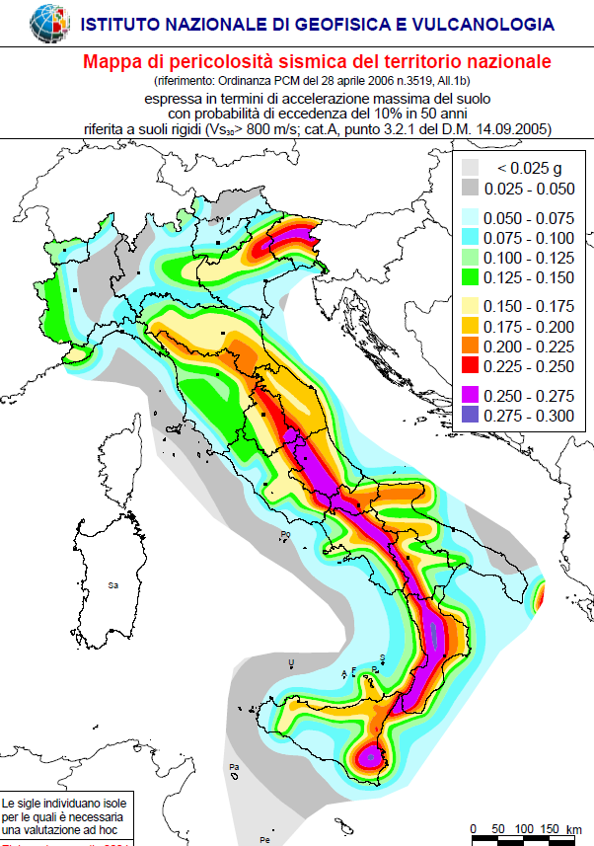
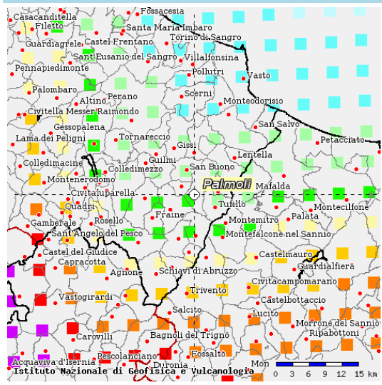
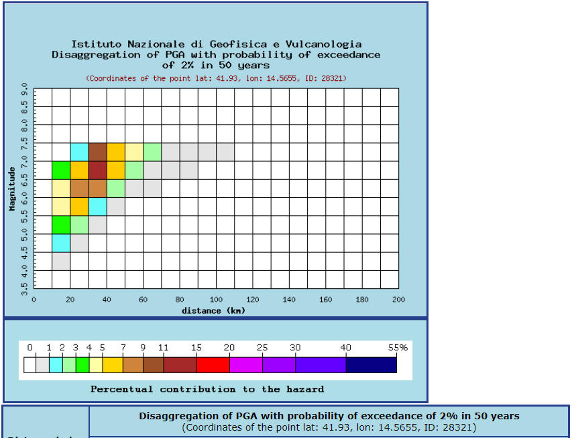
Outline | Seismic Risk | PBEE-PEER Framework | Lecture Plan
Outline:
Motivations: earthquake and losses
Hazard curves and fragility functions
PBEE-PEER framework
Lecture Plan
http://zonesismiche.mi.ingv.it/

Slide 5
Outline | Seismic Risk | PBEE-PEER Framework | Lecture Plan
seismic risk
«Con la parola rischio si intende esprimere un concetto generale che comprende sia la probabilità di un evento, sia le conseguenze che l’evento stesso potrebbe produrre.»
Fondamenti di ingegneria sismica in 80 lezioni, A.Parducci, Liguori Ed.
«Risk has been defined, for management purposes, as the potential economic, social and environmental consequences of hazardous events that may occur in a specified period of time. »
Seismic risk evaluation for an urban centre, M.L.Carreno, O.D.Cardona, A.H.Barbat, 250th Anniversary of the 1755 Lisbon Earthquake

Slide 6
Outline | Seismic Risk | PBEE-PEER Framework | Lecture Plan
seismic risk ≠ seismic hazard
«Con la parola rischio si intende esprimere un concetto generale che comprende sia la probabilità di un evento, sia le conseguenze che l’evento stesso potrebbe produrre.»
Fondamenti di ingegneria sismica in 80 lezioni, A.Parducci, Liguori Ed.
«Risk has been defined, for management purposes, as the potential economic, social and environmental consequences of hazardous events that may occur in a specified period of time. »
Seismic risk evaluation for an urban centre, M.L.Carreno, O.D.Cardona, A.H.Barbat, 250th Anniversary of the 1755 Lisbon Earthquake

Slide 7
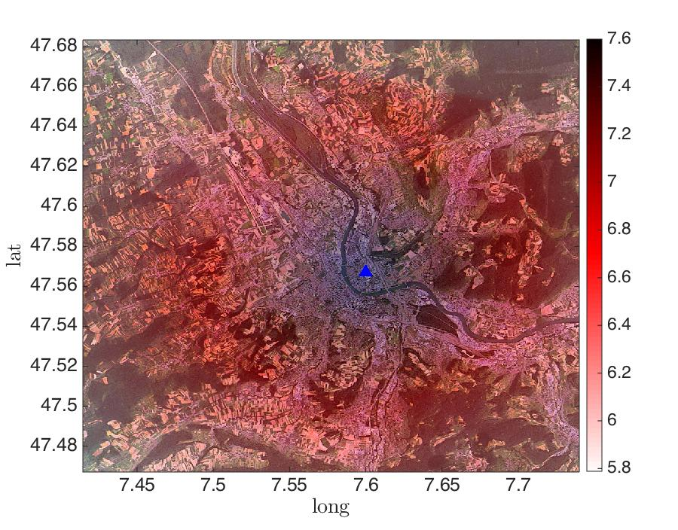
Outline | Seismic Risk | PBEE-PEER Framework | Lecture Plan
hazard map

Slide 8
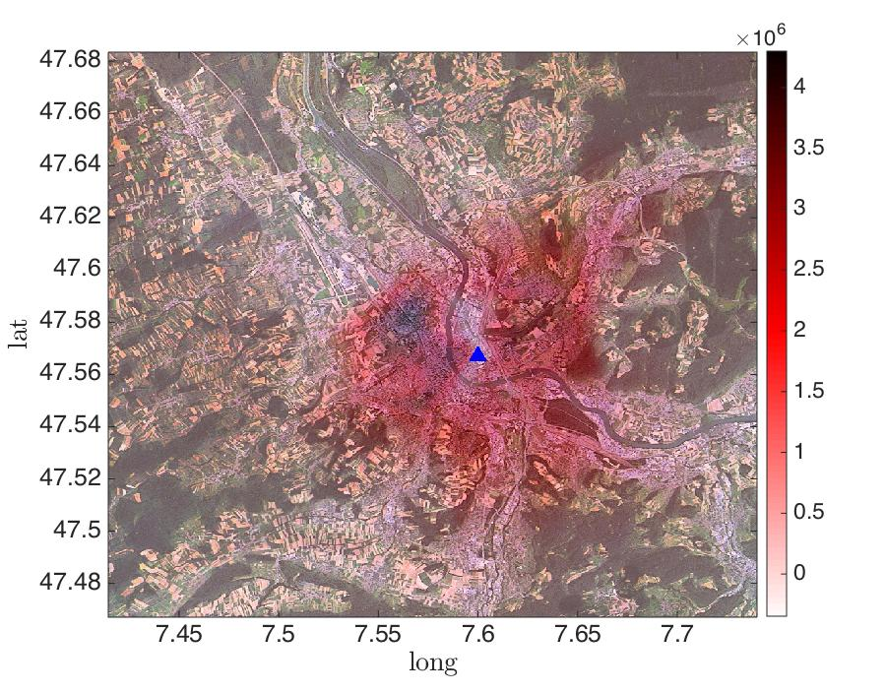
Outline | Seismic Risk | PBEE-PEER Framework | Lecture Plan
risk map

Slide 9
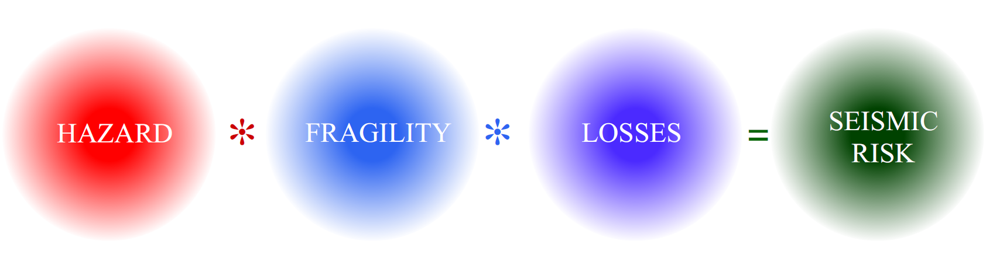
Outline | Seismic Risk | PBEE-PEER Framework | Lecture Plan
SEISMIC
RISK
HAZARD
FRAGILITY
LOSS

Slide 10
Outline | Seismic Risk | PBEE-PEER Framework | Lecture Plan
SEISMIC
RISK
HAZARD
FRAGILITY
LOSS

Slide 11
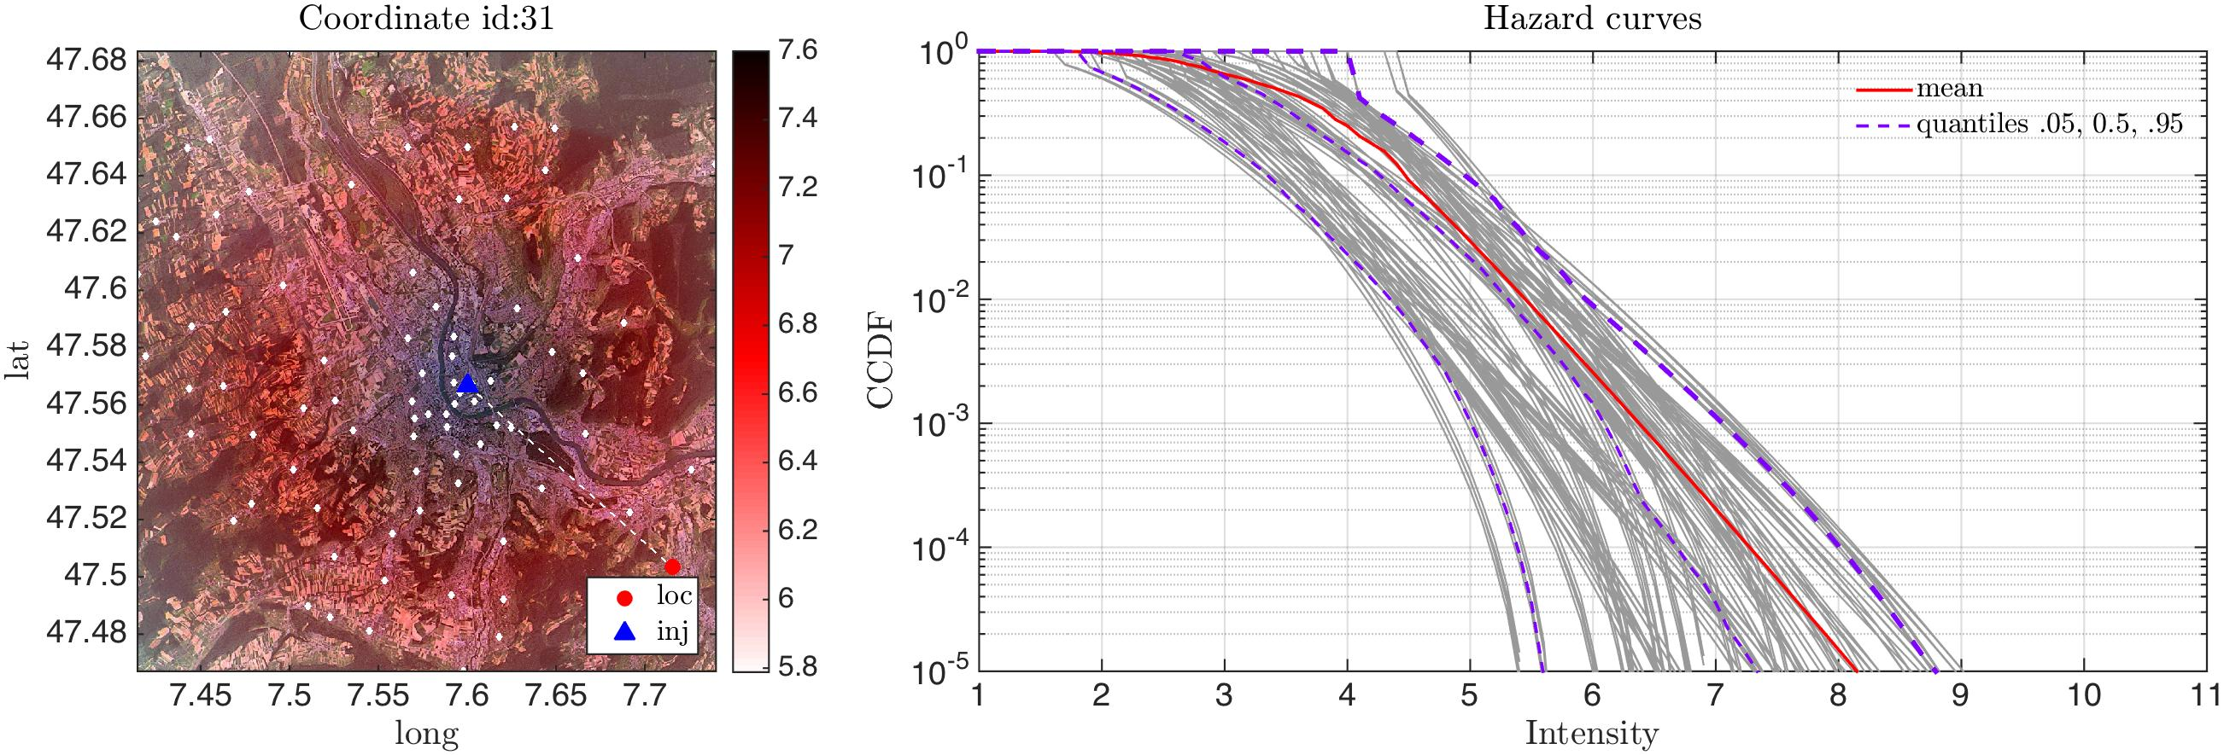
Outline | Seismic Risk | PBEE-PEER Framework | Lecture Plan

Slide 12
Outline | Seismic Risk | PBEE-PEER Framework | Lecture Plan
SEISMIC
RISK
HAZARD
FRAGILITY
LOSS

Slide 13
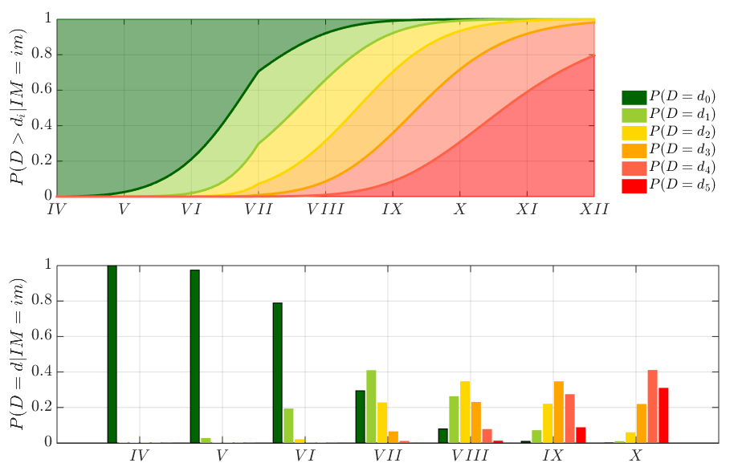
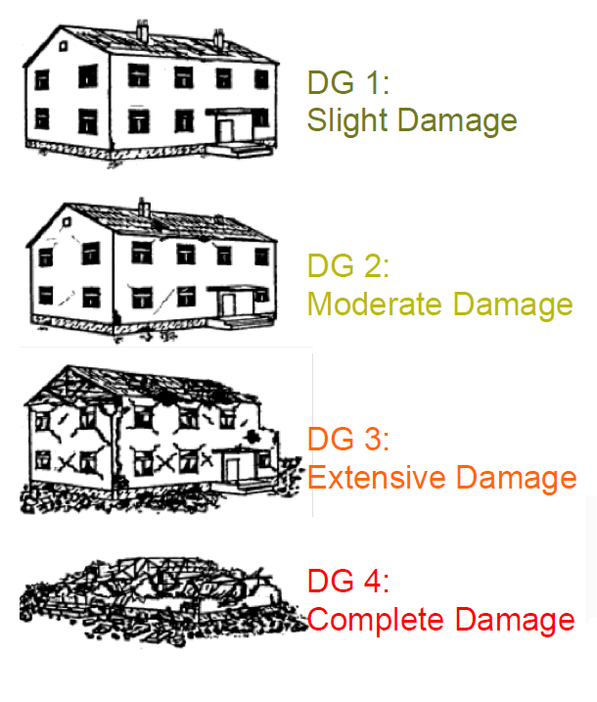
Outline | Seismic Risk | PBEE-PEER Framework | Lecture Plan
Slight
Moderate
Extensive
Collapse

Slide 14
Outline | Seismic Risk | PBEE-PEER Framework | Lecture Plan
PBEE-PEER framework

Slide 15



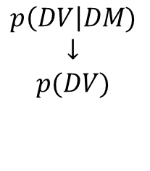
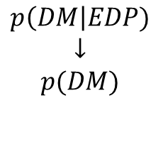
Outline | Seismic Risk | PBEE-PEER Framework | Lecture Plan
The PEER-PBEE Framework
Hazard analysis
intensity measure
Loss analysis
decision variable
HAZARD
VULNERABILITY
Damage analysis
damage measure
DECISION MAKING
VULNERABILITY
Vulnerability analysis
engineering demand par.
(i) hazard analysis
(ii) fragility analysis
(iii) damage analysis
(iv) loss analysis
$$p\left(IM\right|M,R)$$
$$↓$$
$$p(IM)$$
$$p\left(EDP\right|IM)$$
$$↓$$
$$p(EDP)$$
$$p\left(DM\right|EDP)$$
$$↓$$
$$p(DM)$$
$$p\left(DV\right|DM)$$
$$↓$$
$$p(DV)$$
seismologist
engineer
stakeholder

Slide 16

Outline | Seismic Risk | PBEE-PEER Framework | Lecture Plan
The PEER-PBEE Framework
Hazard analysis
intensity measure
Loss analysis
decision variable
HAZARD
VULNERABILITY
Damage analysis
damage measure
DECISION MAKING
VULNERABILITY
Vulnerability analysis
engineering demand par.
(i) hazard analysis
(ii) fragility analysis
(iii) damage analysis
(iv) loss analysis
$$p\left(IM\right|M,R)$$
$$↓$$
$$p(IM)$$
$$p\left(EDP\right|IM)$$
$$↓$$
$$p(EDP)$$
$$p\left(DM\right|EDP)$$
$$↓$$
$$p(DM)$$
$$p\left(DV\right|DM)$$
$$↓$$
$$p(DV)$$

Slide 17
Outline | Seismic Risk | PBEE-PEER Framework | Lecture Plan
The PEER-PBEE Framework
Hazard analysis
intensity measure
Loss analysis
decision variable
HAZARD
VULNERABILITY
Damage analysis
damage measure
DECISION MAKING
VULNERABILITY
Vulnerability analysis
engineering demand par.
(i) hazard analysis
(ii) fragility analysis
(iii) damage analysis
(iv) loss analysis
$$p\left(IM\right|M,R)$$
$$↓$$
$$p(IM)$$
$$p\left(EDP\right|IM)$$
$$↓$$
$$p(EDP)$$
$$p\left(DM\right|EDP)$$
$$↓$$
$$p(DM)$$
$$p\left(DV\right|DM)$$
$$↓$$
$$p(DV)$$

Slide 18
Outline | Seismic Risk | PBEE-PEER Framework | Lecture Plan
The PEER-PBEE Framework
Hazard analysis
intensity measure
Loss analysis
decision variable
HAZARD
VULNERABILITY
Damage analysis
damage measure
DECISION MAKING
VULNERABILITY
Vulnerability analysis
engineering demand par.
(i) hazard analysis
(ii) fragility analysis
(iii) damage analysis
(iv) loss analysis
$$p\left(IM\right|M,R)$$
$$↓$$
$$p(IM)$$
$$p\left(EDP\right|IM)$$
$$↓$$
$$p(EDP)$$
$$p\left(DM\right|EDP)$$
$$↓$$
$$p(DM)$$
$$p\left(DV\right|DM)$$
$$↓$$
$$p(DV)$$

Slide 19
Outline | Seismic Risk | PBEE-PEER Framework | Lecture Plan
The PEER-PBEE Framework
Hazard analysis
intensity measure
Loss analysis
decision variable
HAZARD
VULNERABILITY
Damage analysis
damage measure
DECISION MAKING
VULNERABILITY
Vulnerability analysis
engineering demand par.
(i) hazard analysis
(ii) fragility analysis
(iii) damage analysis
(iv) loss analysis
$$p\left(IM\right|M,R)$$
$$↓$$
$$p(IM)$$
$$p\left(EDP\right|IM)$$
$$↓$$
$$p(EDP)$$
$$p\left(DM\right|EDP)$$
$$↓$$
$$p(DM)$$
$$p\left(DV\right|DM)$$
$$↓$$
$$p(DV)$$

Slide 20
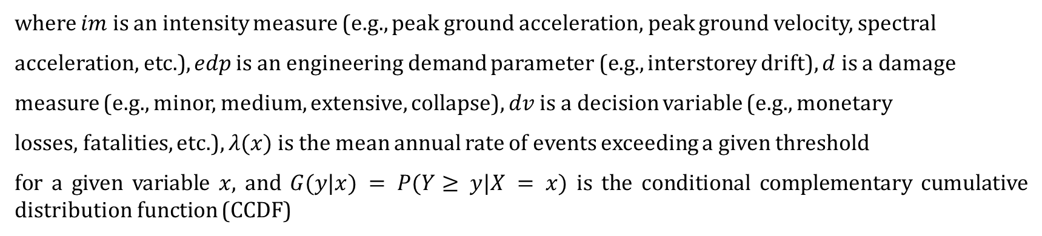
Outline | Seismic Risk | PBEE-PEER Framework | Lecture Plan
where $im$ is an intensity measure (e.g., peak ground acceleration, peak ground velocity, spectral
acceleration, etc.), $edp$ is an engineering demand parameter (e.g., interstorey drift), $d$ is a damage
measure (e.g., minor, medium, extensive, collapse), $dv$ is a decision variable (e.g., monetary
losses, fatalities, etc.), $λ(x)$ is the mean annual rate of events exceeding a given threshold
for a given variable $x$, and $G(y|x) = P(Y≥ y|X = x)$ is the conditional complementary cumulative distribution function (CCDF)

Slide 21
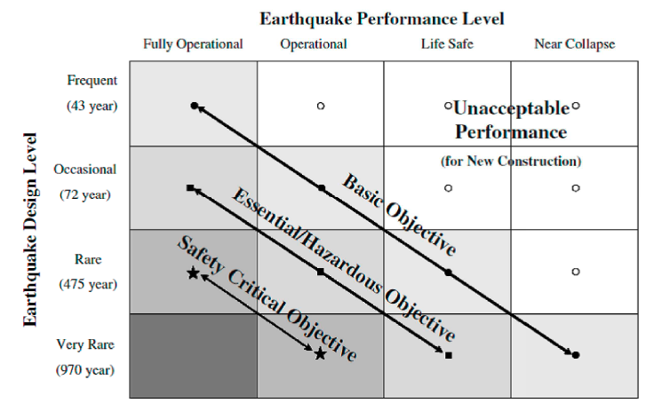
Outline | Seismic Risk | PBEE-PEER Framework | Lecture Plan
PBEE: Performance Based Earthquake Engineering
PBEE concept: seismic performance objectives vs seismic hazard level. ©Poland et al.,(1995)-Vision 2000: Performance Based Earthquake Engineering of buildings. Structural Engineers Association of California, Sacramento, CA.

Slide 22
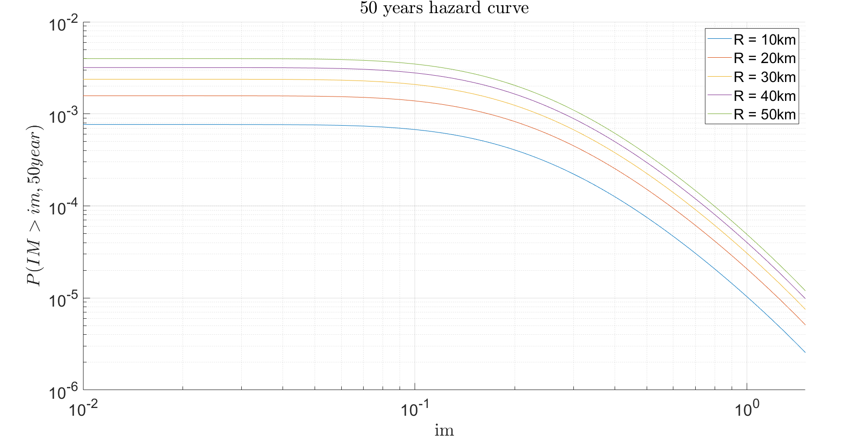
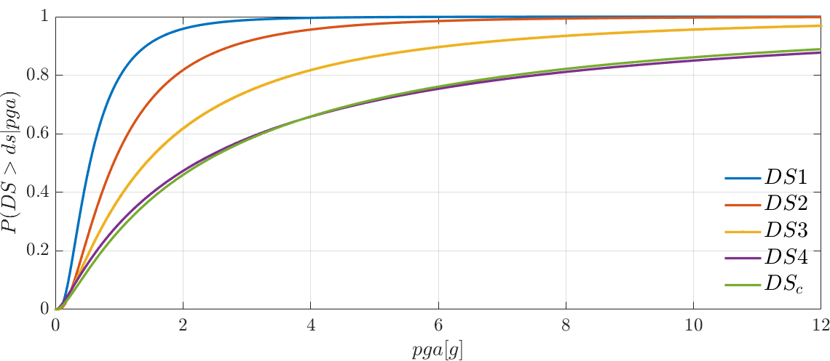
Outline | Seismic Risk | PBEE-PEER Framework | Lecture Plan
Objectives & Lecture Plan:
(1h30) Element of statistics and probability (M.Broccardo)
  Set theory
  Random variables
  Probability distributions
(1h00) Probabilistic seismic hazard (C.Nardin)
  Definition and time scales
  Models of earthquake occurrence and hazard integral
  LAB → PSHA with MatLab
(2h00) Vulnerability (M.Broccardo, C.Nardin)
  Logistic regression models
  Fragility functions: methods and applications
  LAB → Computation of probability of damage state of a building

