Slide 1
Ingegneria Sismica e Progettazione Strutturale
Probabilistic Seismic Hazard Analysis
Prof. Marco Broccardo – Ph.D., M.Sc., Eng. in Civil Engineering
Ph.D. Student Chiara Nardin – M.Sc., Eng. in Civil Engineering

Slide 2
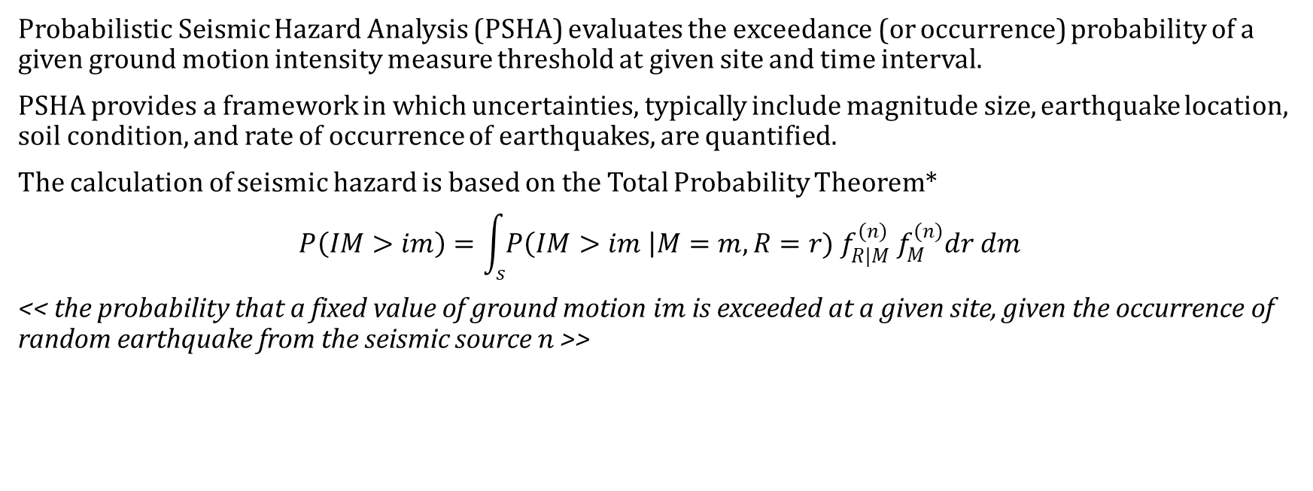
Introduction Probabilistic Hazard Model Laboratory
PSHA
Probabilistic Seismic Hazard Analysis (PSHA) evaluates the exceedance (or occurrence) probability of a given ground motion intensity measure threshold at given site and time interval.
PSHA provides a framework in which uncertainties, typically include magnitude size, earthquake location, soil condition, and rate of occurrence of earthquakes, are quantified.
The calculation of seismic hazard is based on the Total Probability Theorem*
$$P\left(IM>im\right)=\int_{s}{P\left(IM>im \right|M=m, R=r){ f}_{R|M}^{(n)} f_{M}^{(n)}dr dm}$$
<< the probability that a fixed value of ground motion$im$is exceeded at a given site, given the occurrence of random earthquake from the seismic source $n$ >>
(1)
*see Lecture Notes

Slide 3
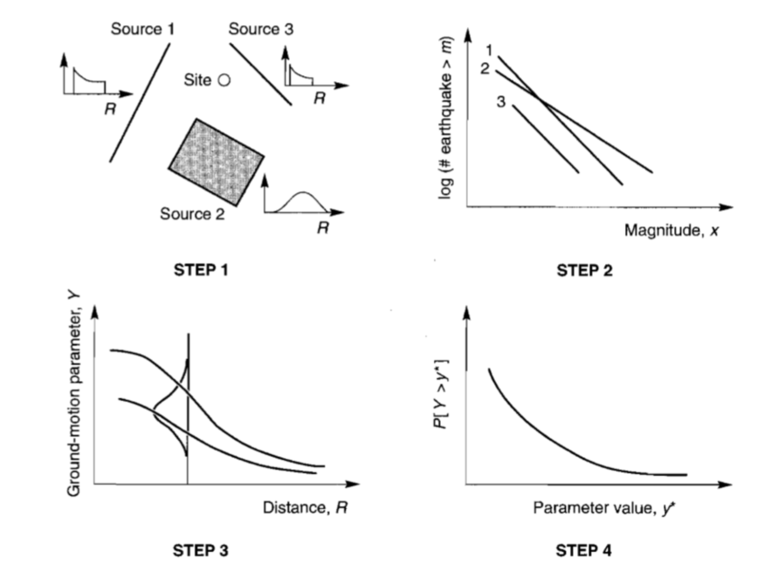
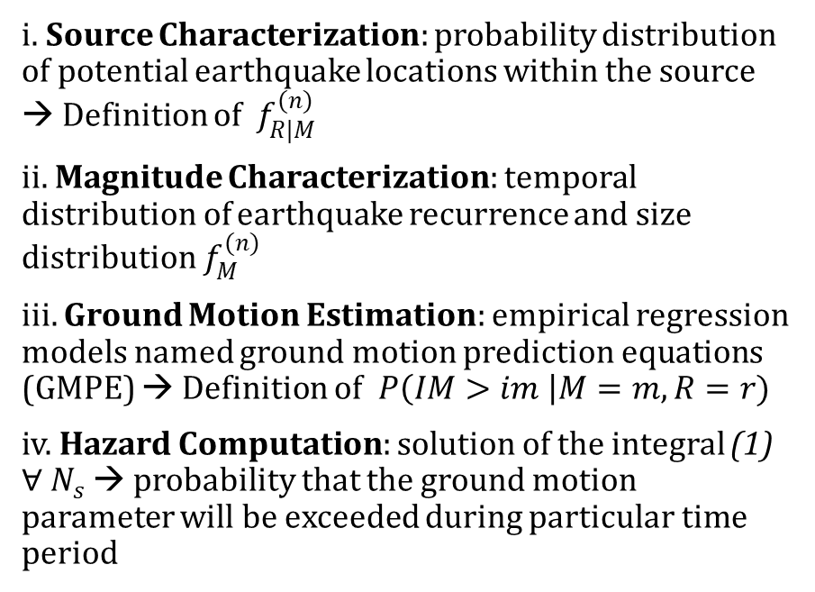
Introduction Probabilistic Hazard Model Laboratory
PSHA - Steps
i. Source Characterization: probability distribution of potential earthquake locations within the source → Definition of ${ f}_{R|M}^{(n)}$
ii. Magnitude Characterization: temporal distribution of earthquake recurrence and size distribution $f_{M}^{(n)}$
iii. Ground Motion Estimation: empirical regression models named ground motion prediction equations (GMPE) → Definition of$P\left(IM>im \right|M=m, R=r)$
iv. Hazard Computation: solution of the integral (1) $∀ N_{s}$ → probability that the ground motion parameter will be exceeded during particular time period

Slide 4
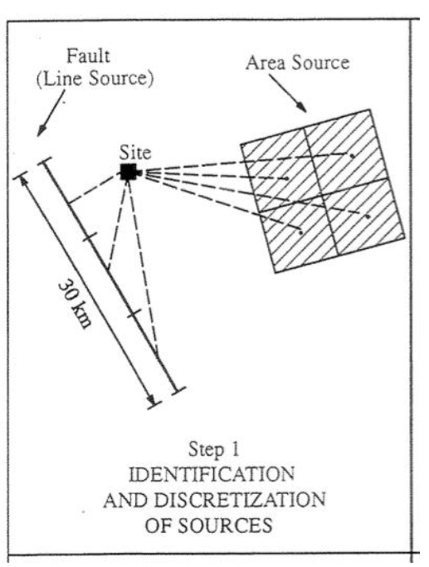
Introduction Probabilistic Hazard Model Laboratory
PSHA – Step 1: Earthquake source characterization
Goal: to identify
Fault sources: individual or multiple identified faults
Area sources: defined by polygons in which seismicity is assumed uniform
(Identification based upon the interpretation of geological, geophysical and seismological – historical data)
SOURCES

Slide 5
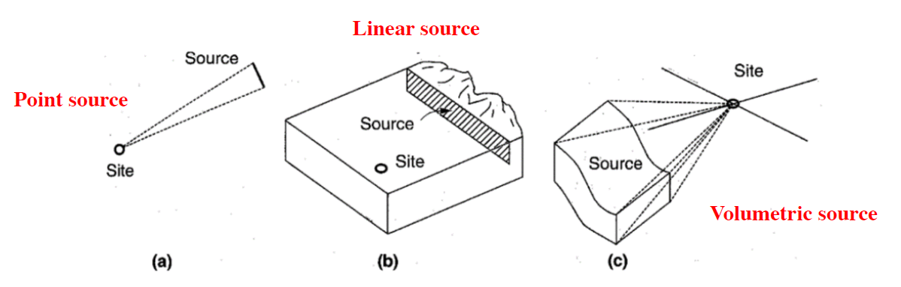
Introduction Probabilistic Hazard Model Laboratory
PSHA – Step 1: Earthquake source characterization
and to characterize seismic sources
Point source
Linear source
Area source
(the geometry of the source is used to identify the probability distribution of source-to-site distances)
DISTANCES

Slide 6
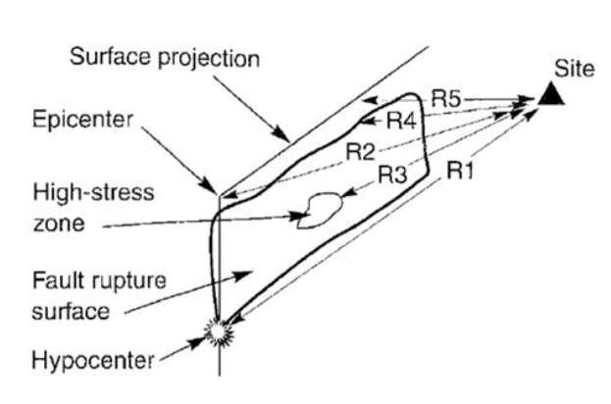
Introduction Probabilistic Hazard Model Laboratory
PSHA – Step 1: Earthquake source characterization
The geometry of the source is used to identify the probability distribution of source-to-site distances
R1: hypocentral distance
R2: epicentral distance
R3: distance to the zone of highest energy release.
R4: closest distance to the zone of rupture
R5: closest distance to the surface projection of the
fault rupture (also known as Joyner-Boore distance)
DISTANCES

Slide 7
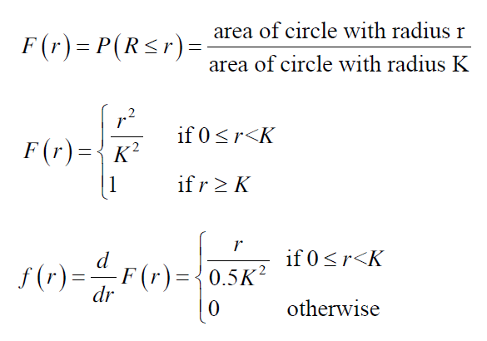
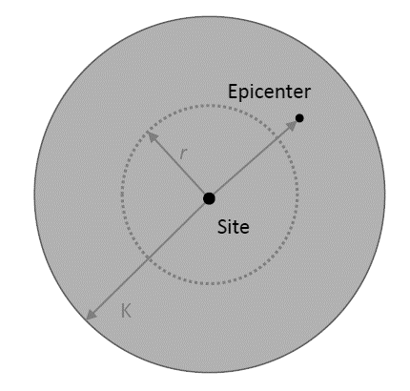
Introduction Probabilistic Hazard Model Laboratory
PSHA – Step 1: Earthquake source characterization
EXAMPLE
Earthquakes are equally likely to occur anywhere in the area within K km of the site.

Slide 8
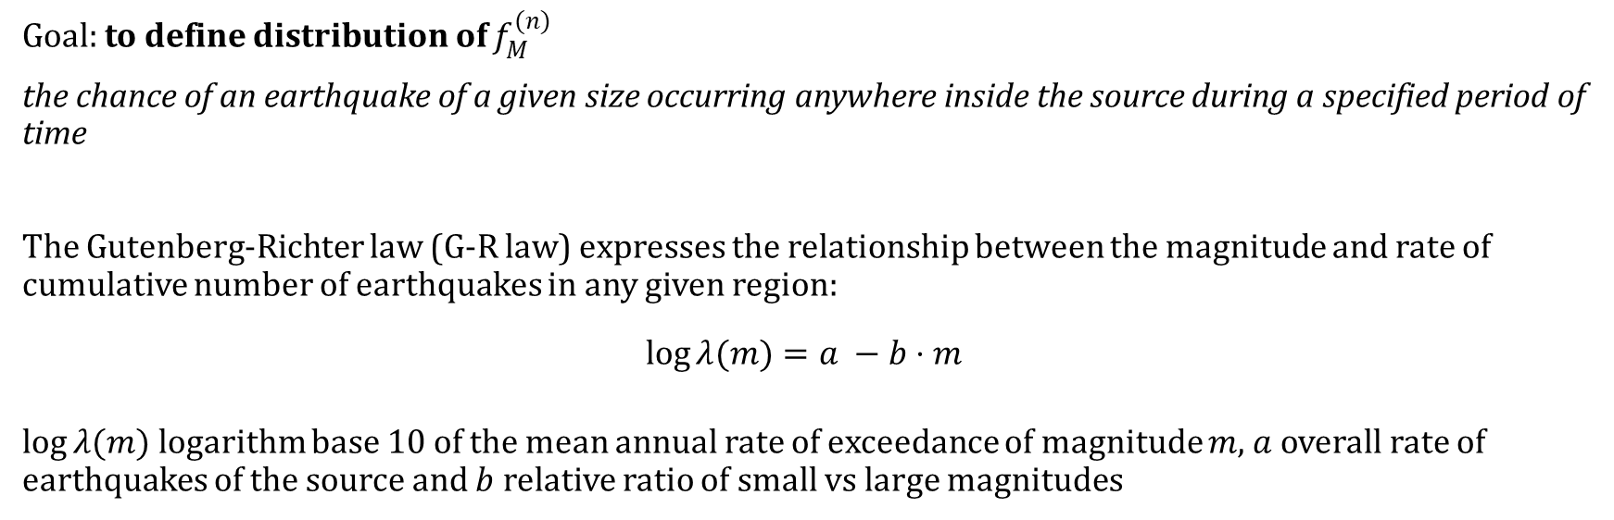
Introduction Probabilistic Hazard Model Laboratory
PSHA – Step 2: Earthquake size (Recurrence law)
Goal: to define distribution of $f_{M}^{(n)}$
the chance of an earthquake of a given size occurring anywhere inside the source during a specified period of time
The Gutenberg-Richter law (G-R law) expresses the relationship between the magnitude and rate of cumulative number of earthquakes in any given region:
$$\log{λ(m)}=a −b⋅m$$
$\log{λ(m)}$logarithm base 10 of the mean annual rate of exceedance of magnitude $m$, $a$overall rate of earthquakes of the source and $b$ relative ratio of small vs large magnitudes

Slide 9
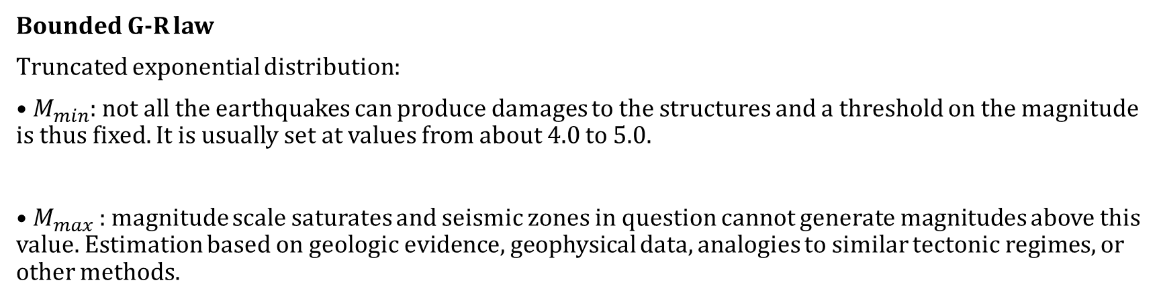
Introduction Probabilistic Hazard Model Laboratory
PSHA – Step 2: Earthquake size (Recurrence law)
Bounded G-R law
Truncated exponential distribution:
• $M_{min}$: not all the earthquakes can produce damages to the structures and a threshold on the magnitude is thus fixed. It is usually set at values from about 4.0 to 5.0.
• $M_{max}$: magnitude scale saturates and seismic zones in question cannot generate magnitudes above this value. Estimation based on geologic evidence, geophysical data, analogies to similar tectonic regimes, or other methods.

Slide 10
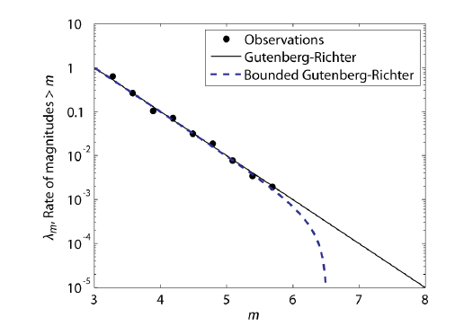
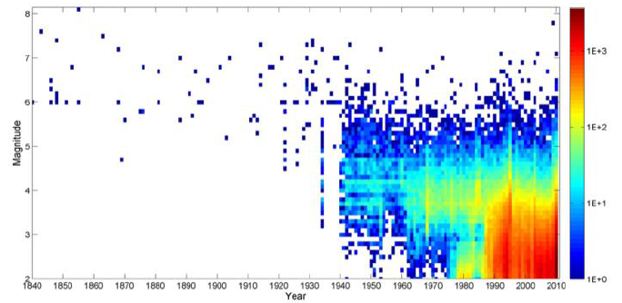
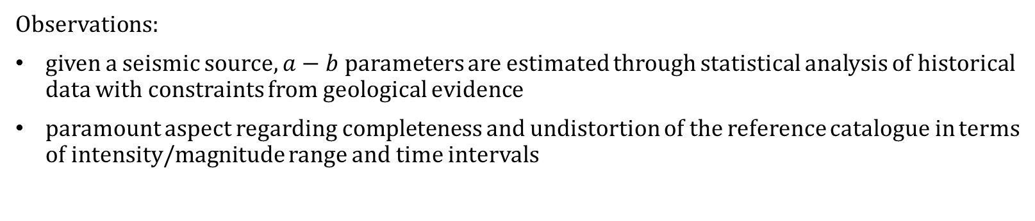
Introduction Probabilistic Hazard Model Laboratory
PSHA – Step 2: Earthquake size (Recurrence law)
Observations:
given a seismic source, $a−b$ parameters are estimated through statistical analysis of historical data with constraints from geological evidence
paramount aspect regarding completeness and undistortion of the reference catalogue in terms of intensity/magnitude range and time intervals

Slide 11
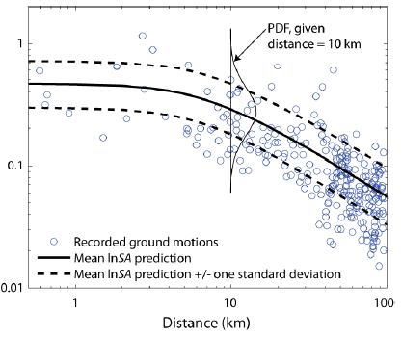
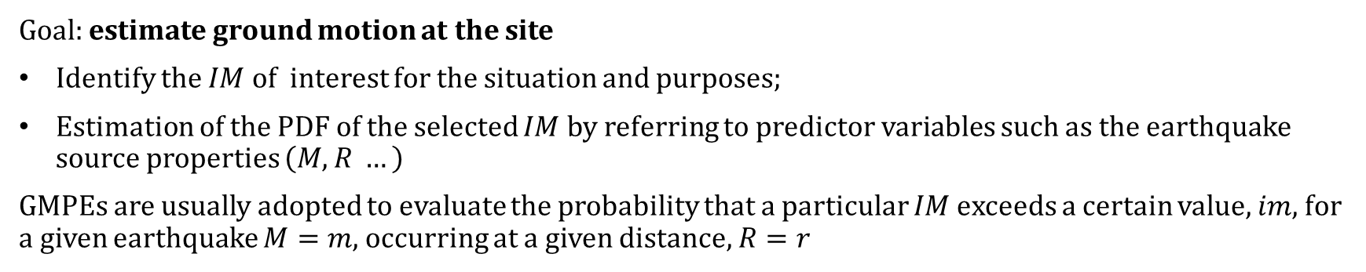
Introduction Probabilistic Hazard Model Laboratory
PSHA – Step 3: Ground motion predictive equations (GMPE)
Goal: estimate ground motion at the site
Identify the $IM$of interest for the situation and purposes;
Estimation of the PDF of the selected $IM$by referring to predictor variables such as the earthquake source properties $\left(M,R …\right)$
GMPEs are usually adopted to evaluate the probability that a particular $IM$ exceeds a certain value, $im$, for a given earthquake $M=m$, occurring at a given distance, $R=r$

Slide 12
Introduction Probabilistic Hazard Model Laboratory
PSHA – Step 3: Ground motion predictive equations (GMPE)
Ground motion parameters
Ground motion parameters (also called Intensity Measures, IMs) describe the most important characteristics of strong ground motion in compact and quantitative form:
• Amplitude – how large is the shaking?
• Frequency content – what frequencies are particularly prevalent in the ground motion?
• Duration – how long does the strong shaking last?

Slide 13
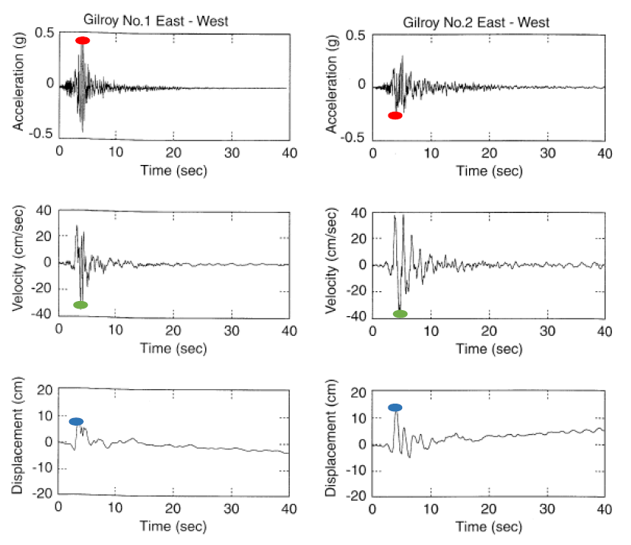
Introduction Probabilistic Hazard Model Laboratory
PSHA – Step 3: Ground motion predictive equations (GMPE)
Ground motion parameters
Amplitude parameters:
• Peak ground acceleration (PGA) which is the
maximum absolute value of acceleration at the
ground level;
• Peak ground velocity (PGV), the maximum
absolute value of velocity at the ground;
• Peak ground displacement (PGD) is the
maximum absolute value of displacement at the
ground

Slide 14
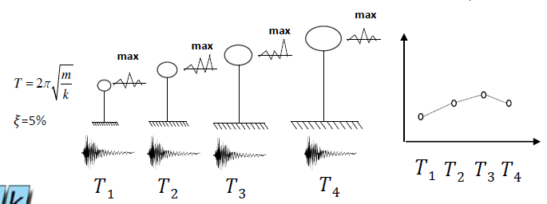
Introduction Probabilistic Hazard Model Laboratory
PSHA – Step 3: Ground motion predictive equations (GMPE)
Ground motion parameters
Frequency content parameters
• Response spectrum: maximum response (in
terms of displacement, velocity or acceleration,
S(𝑇, 𝜉)) of an elastic single degree- of-freedom
(SDoF) system to a particular input motion as a
function of the natural period and damping ratio.

Slide 15
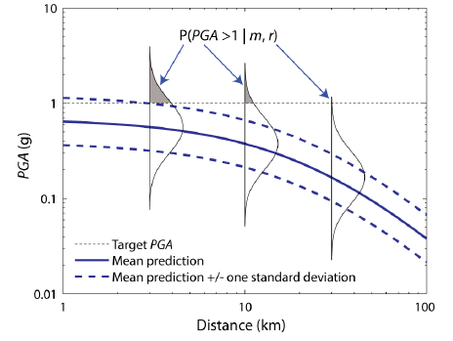
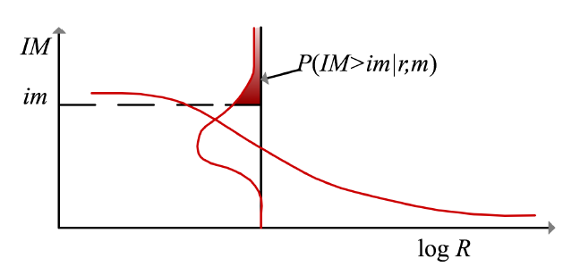
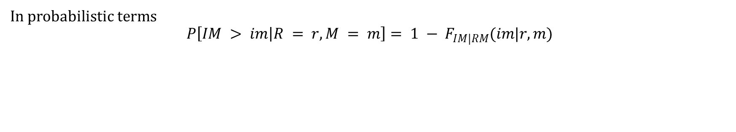
Introduction Probabilistic Hazard Model Laboratory
PSHA – Step 3: Ground motion predictive equations (GMPE)
In probabilistic terms
$$P\left[IM > im | R = r,M = m\right]= 1 − F_{IM|RM}(im|r,m)$$

Slide 16
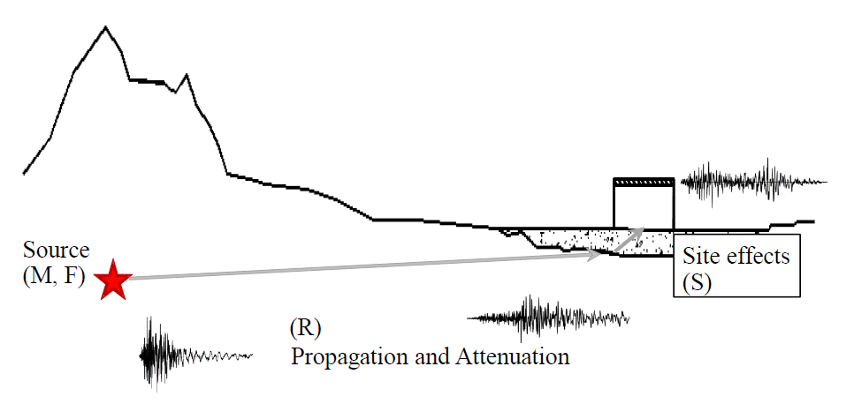
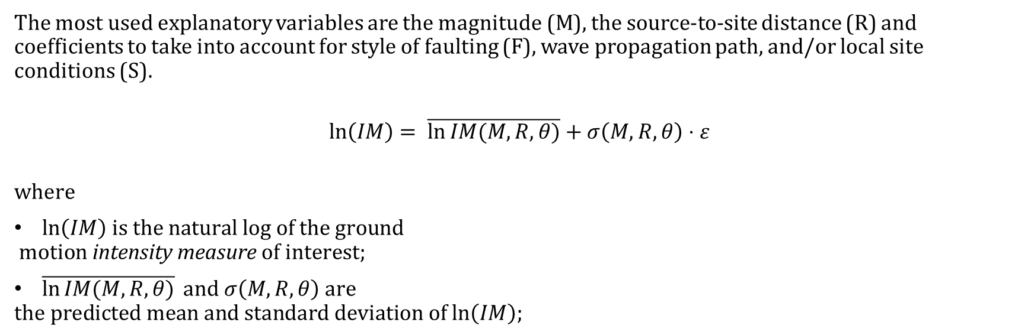
Introduction Probabilistic Hazard Model Laboratory
PSHA – Step 3: Ground motion predictive equations (GMPE)
The most used explanatory variables are the magnitude (M), the source-to-site distance (R) and coefficients to take into account for style of faulting (F), wave propagation path, and/or local site conditions (S).
$$\ln\left(IM\right)= \overline{\ln{IM(M,R,θ)}}+σ\left(M,R,θ\right)⋅ε$$
$$\text{where}$$
$ln\left(IM\right) \text{is} \text{the} \text{natural} \text{log} \text{of} \text{the} \text{ground}$
$$\text{motion} \text{intensity} \text{measure} \text{of} \text{interest}\text{;}$$
$\overline{\ln{IM(M,R,θ)}} \text{and} σ\left(M,R,θ\right) \text{are}$
$$\text{the} \text{predicted} \text{mean} \text{and} \text{standard} \text{deviation} \text{of} ln\left(IM\right)\text{;}$$

Slide 17
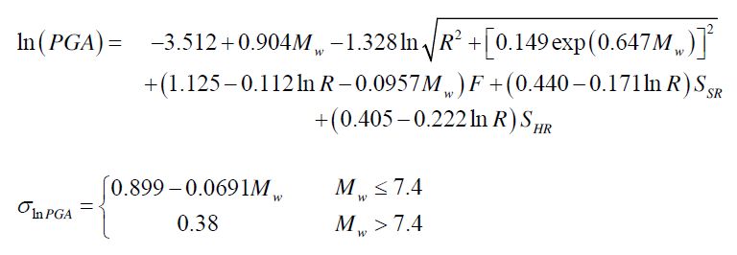
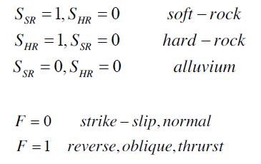
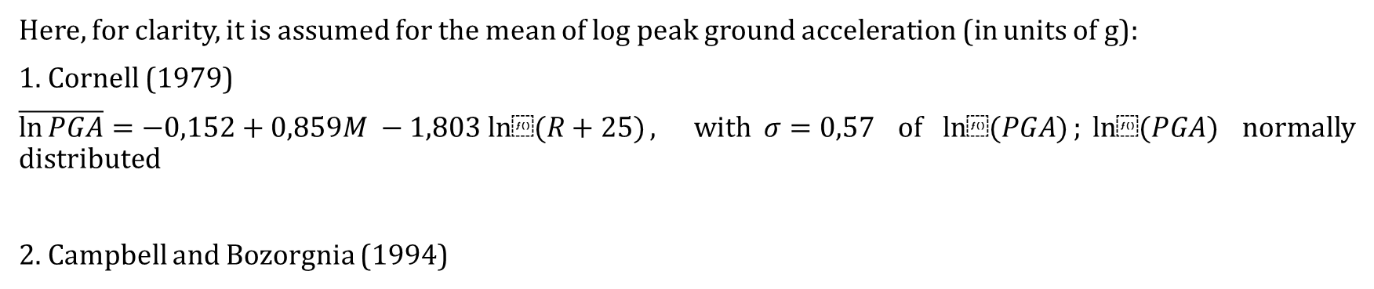
Introduction Probabilistic Hazard Model Laboratory
PSHA – Step 3: Ground motion predictive equations (GMPE)
Here, for clarity, it is assumed for the mean of log peak ground acceleration (in units of g):
1. Cornell (1979)
$\overline{\ln{PGA}}=−0,152+0,859M −1,803 ln⁡(R+25)$, with$σ=0,57$ of $ln⁡(PGA)$;$ln⁡(PGA)$ normally distributed
2. Campbell and Bozorgnia (1994)

Slide 18
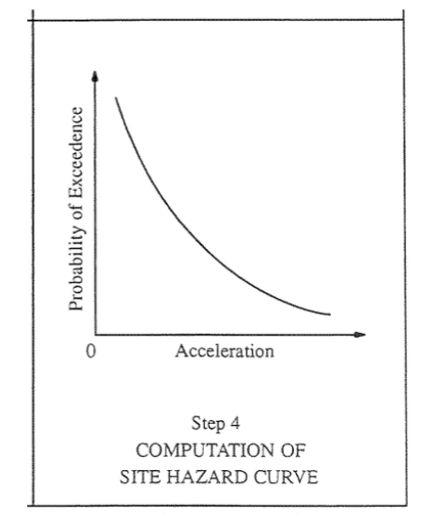
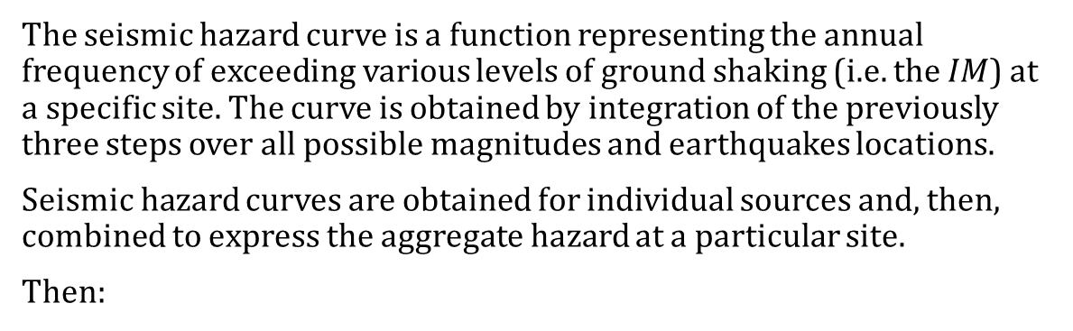
Introduction Probabilistic Hazard Model Laboratory
PSHA – Step 4: Hazard Computation
The seismic hazard curve is a function representing the annual frequency of exceeding various levels of ground shaking (i.e. the $IM$) at a specific site. The curve is obtained by integration of the previously three steps over all possible magnitudes and earthquakes locations.
Seismic hazard curves are obtained for individual sources and, then, combined to express the aggregate hazard at a particular site.
Then:
(2)
$$λ\left(im\right)=\sum_{n=1}^{N_{s}}{λ_{min}^{(n)}}\left[\int_{r_{min}}^{r_{max}}{\int_{m_{min}}^{m_{max}}{P\left(IM>im \right|M=m , R=r)}} f_{R}^{\left(n\right)}\left(r\right)f_{M}^{\left(n\right)}\left(m\right)drdm] \right]$$

Slide 19
Introduction Probabilistic Hazard Model Laboratory
References
Baker J. W. (2008). An Introduction to Probabilistic Seismic Hazard Analysis (PSHA), White Paper, Version 1.3, 72 pp.
Kramer, S.L. (1996) Geotechnical earthquake engineering. Prentice Hall, Upper Saddle River, N.J.
Wells, D.L. and Coppersmith, K.J. (1994) New empirical relationships among magnitude, rupture length, rupture width, rupture area, and surface displacement. Bull. Seism. Soc. Am., 84, 974-1002.
Cornell, C.A. (1968). Engineering seismic risk analysis, Bull. Seism. Soc. Am., 58, 1583-1606.
Broccardo, M. (2018) Probabilistic seismic risk analysis for civil systems, Lecture Notes

Slide 20

Ingegneria Sismica e Progettazione Strutturale
PSHA – Assignment 1
Ph.D. Candidate Chiara Nardin – M.Sc., Eng. in Civil Engineering
https://github.com/kia13nn/ISPS.git

Slide 21
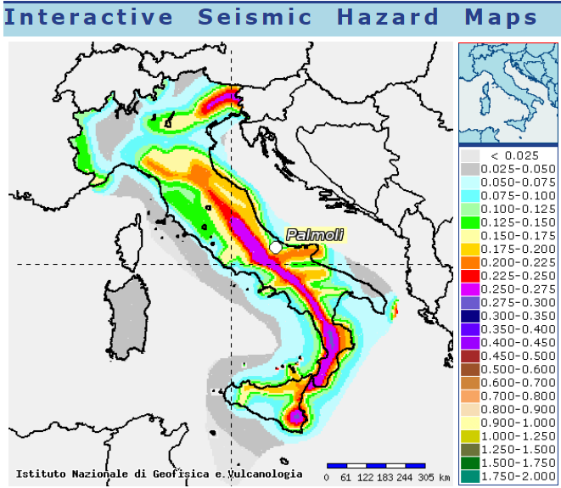
Introduction Probabilistic Hazard Model Laboratory
Goal: to perform a PSHA analysis
Through the scheme depicted in (1), compute:
the annual hazard curve for each fault;
the 50 years hazard curve for each fault;
the 475 years hazard curve for each fault
for the highlighted seismic site.
http://esse1-gis.mi.ingv.it/
Seismic hazard map: shaking parameter PGA, site Palmoli (CH) Latitude 41,527 – Longitude 14,483.

Slide 22
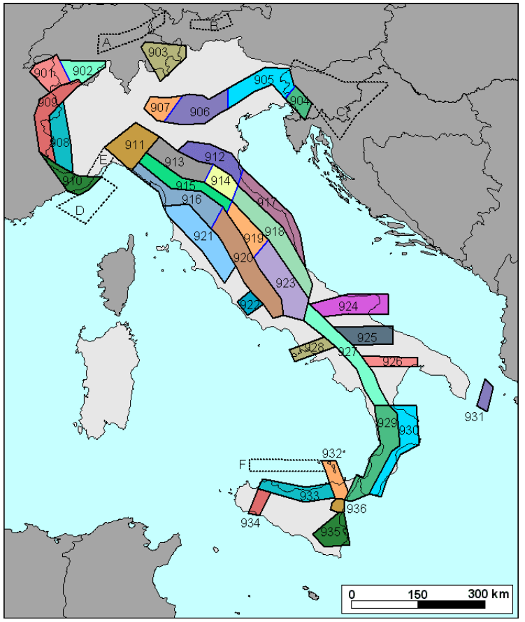
Introduction Probabilistic Hazard Model Laboratory
Step 1: Source characterization
Localize seismogenetic zones: Italian ZS9* model for application of the attenuation law
Different characteristics of zonation by:
Seismogenetic faults and mechanisms (direct, inverse, strike-slip …)
Hypocenter depth (shallow, intermediate, deep)
ect.
Italian database and catalogue of the overall seismicity
http://zonesismiche.mi.ingv.it/

Slide 23
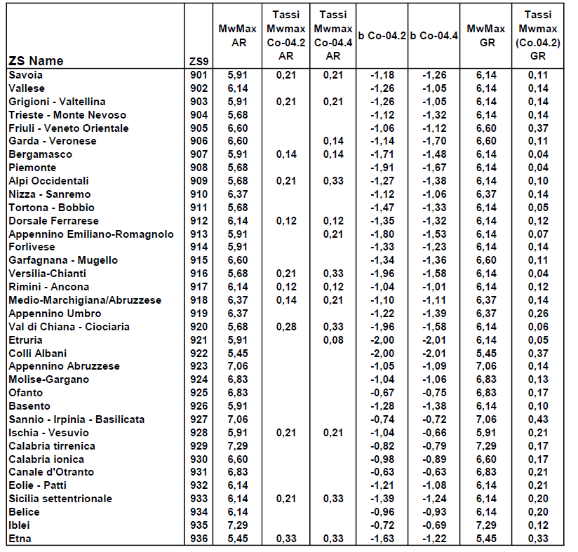
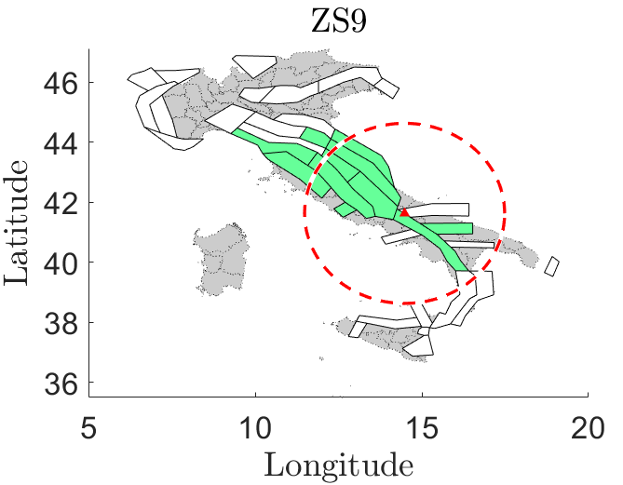
Introduction Probabilistic Hazard Model Laboratory
Step 1: Source characterization
Localize seismogenetic zones: Italian ZS9* model for application of the attenuation law
http://zonesismiche.mi.ingv.it/

Slide 24
Introduction Probabilistic Hazard Model Laboratory
Step 1: Source characterization
Extrapolate information regarding the source and its bound limits: convert coordinates from deg2utm for each sources
 | Coordinates
 | WGS 84 |  | UTM |  | UTM-Z
Location | long (x) | lat (y)
Palmoli | 14,48 | 41,63 | 465.293 | 4643124 | 33 T
ZS9-918 | S1
WGS 84 |  | UTM |  | UTM-Z | UTM-INPORT
12,11651 | 43,79397 | 268015,9 | 4853032 | 33 T | -197.277 | 209.907
12,27012 | 44,10645 | 281523,5 | 4887320 | 33 T | -183.769 | 244.196
13,54116 | 43,2943 | 381660,3 | 4794530 | 33 T | -83.633 | 151.405
14,181 | 42,47483 | 432678,9 | 4702824 | 33 T | -32.614 | 59.699
14,37249 | 42,14993 | 448153,3 | 4666614 | 33 T | -17.140 | 23.489
14,27923 | 41,85719 | 440174,4 | 4634171 | 33 T | -25.118 | -8.953
13,1518 | 43,02822 | 349423 | 4765606 | 33 T | -115.870 | 122.481
12,11651 | 43,79397 | 268015,9 | 4853032 | 33 T | -197.277 | 209.907
Source | b | Mw Max | Mw Min | Rate
S1 | -1,11 | 6,37 | 4,76 | 0,21
S2 | -1,09 | 7,06 | 4,76 | 0,14
… | … | … | … | …

Slide 25
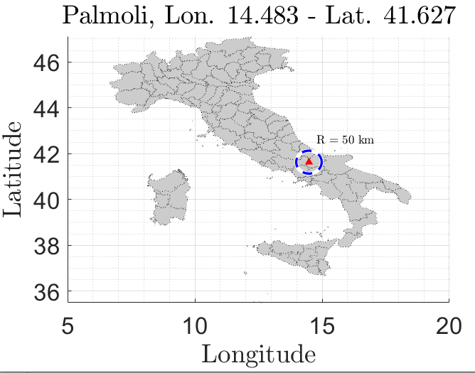
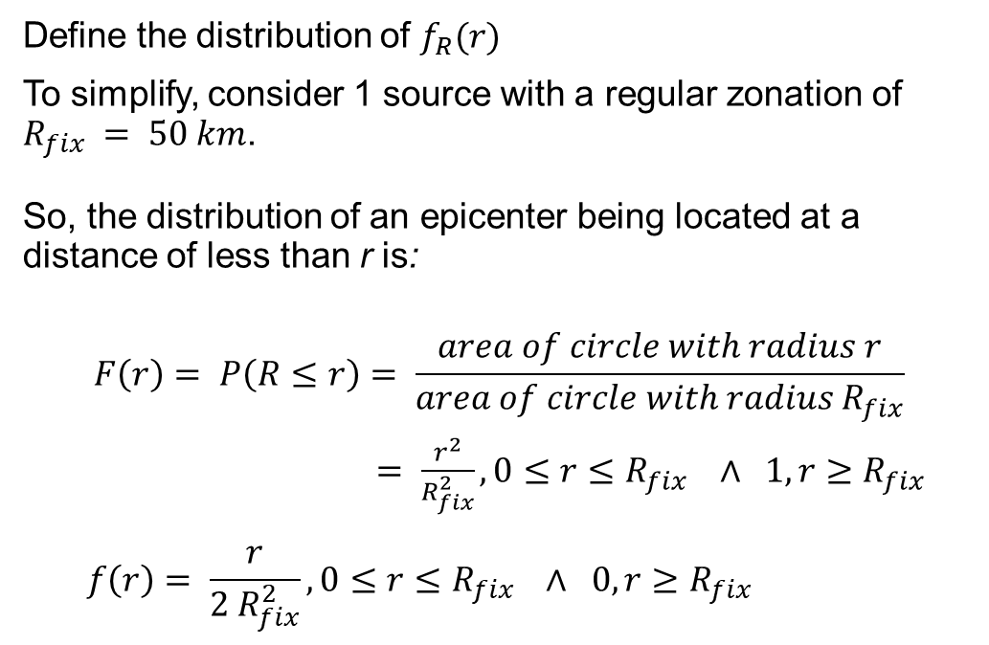
Introduction Probabilistic Hazard Model Laboratory
Step 1: Source characterization - Location
Define the distribution of $f_{R}(r)$
To simplify, consider 1 source with a regular zonation of $R_{fix} = 50 km$.
So, the distribution of an epicenter being located at a distance of less than r is:
$$F\left(r\right)= P\left(R≤r\right)= \frac{area of circle with radius r}{area of circle with radius R_{fix}}$$
$= \frac{r^{2}}{R_{fix}^{2}}, 0≤r≤R_{fix} ∧ 1, r≥R_{fix}$
$$f\left(r\right)= \frac{r}{{2 R}_{fix}^{2}}, 0≤r≤R_{fix} ∧ 0, r≥R_{fix}$$
CDF:
PDF:

Slide 26
Introduction Probabilistic Hazard Model Laboratory
Step 1: Source characterization
Codes:
Read source.xls file
Run section Earthquake source characterization in the attached Matlab code or load variable seismic_source.mat already prepared with the previously seen data

Slide 27
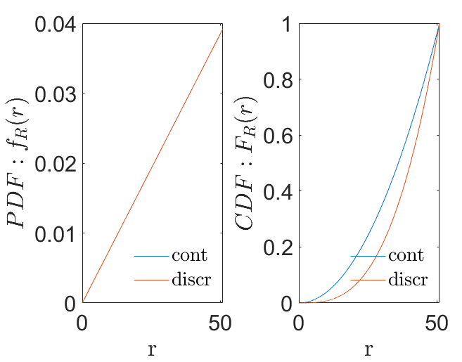
Introduction Probabilistic Hazard Model Laboratory
Step 1: Source characterization - Location
Codes:
% PDF of R
rmax = Rmax*100; % 50km
rmin = Rmin.*100; % site
r_step = R_step;
r = rmin:r_step:(rmax-r_step);
Fr = r.^2./rmax.^2;
fr = 2*r./rmax.^2;
DFr = r_step;
frdiscr = zeros(1,numel(Fr));
Frdiscr = zeros(1,numel(Fr));
for idr = 2:numel(Fr)
frdiscr(idr) = -(Fr(idr-1)-Fr(idr))./(DFr);
Frdiscr(idr) = Frdiscr(idr-1)+Fr(idr);
end

Slide 28

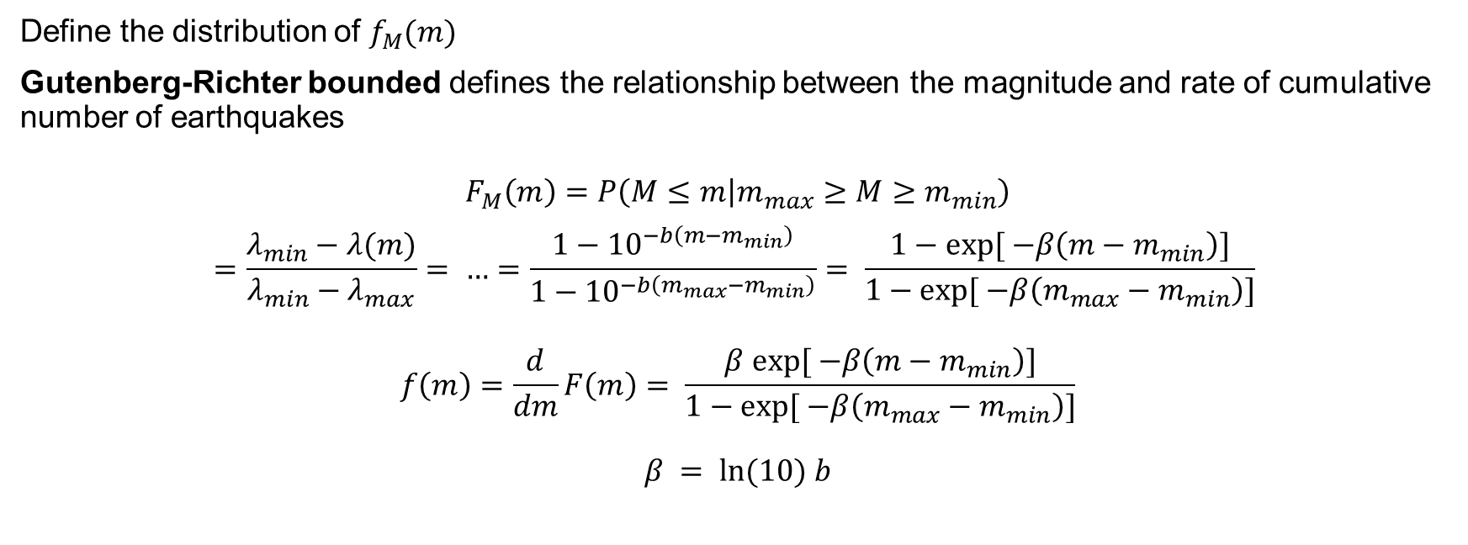
Introduction Probabilistic Hazard Model Laboratory
Step 2: Earthquake size
$λ(m)=exp⁡( a −b⋅m$)
Define the distribution of $f_{M}(m)$
Gutenberg-Richter bounded defines the relationship between the magnitude and rate of cumulative number of earthquakes
$$F_{M}\left(m\right)=P\left(M≤m | m_{max}≥M≥m_{min}\right)$$
$$=\frac{λ_{min}−λ(m)}{λ_{min}−λ_{max}}= …=\frac{1−{10}^{−b\left(m−m_{min}\right)}}{1−{10}^{−b\left(m_{max}−m_{min}\right)}}= \frac{1−exp⁡[ −β\left(m−m_{min}\right)]}{1−exp⁡[ −β\left(m_{max}−m_{min}\right)]}$$
$$f\left(m\right)=\frac{d}{dm}F\left(m\right)= \frac{β exp⁡[ −β\left(m−m_{min}\right)]}{1−exp⁡[ −β\left(m_{max}−m_{min}\right)]}$$
$$β = ln⁡(10) b$$
CDF:
PDF:

Slide 29
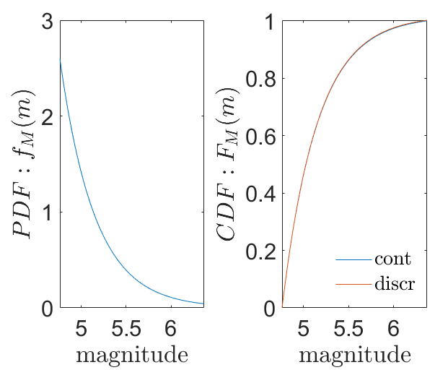

Introduction Probabilistic Hazard Model Laboratory
Step 2: Earthquake size
Define the distribution of $f_{M}(m)$: Discretize
Converting the continuous distribution of magnitudes into a discrete set of magnitudes holds
$$P\left(M=m_{j}\right)=F_{M}\left(m_{j+1}\right)−F_{M}(m_{j})$$
where $m_{j}$ are the discrete set of magnitudes ordered so that $m_{j+1}<m_{j}$
Codes:
% PDF of M
Nm = 1000; % No. of discretized points between m0 and mu for numerical integration
M = linspace(m0,mu,Nm); %mo = m_min
fM = beta*exp(-beta*(M-m0))/(1-exp(-beta*(mu-m0)));
dM=M(2)-M(1);
Mdiscr=fM*dM;

Slide 30
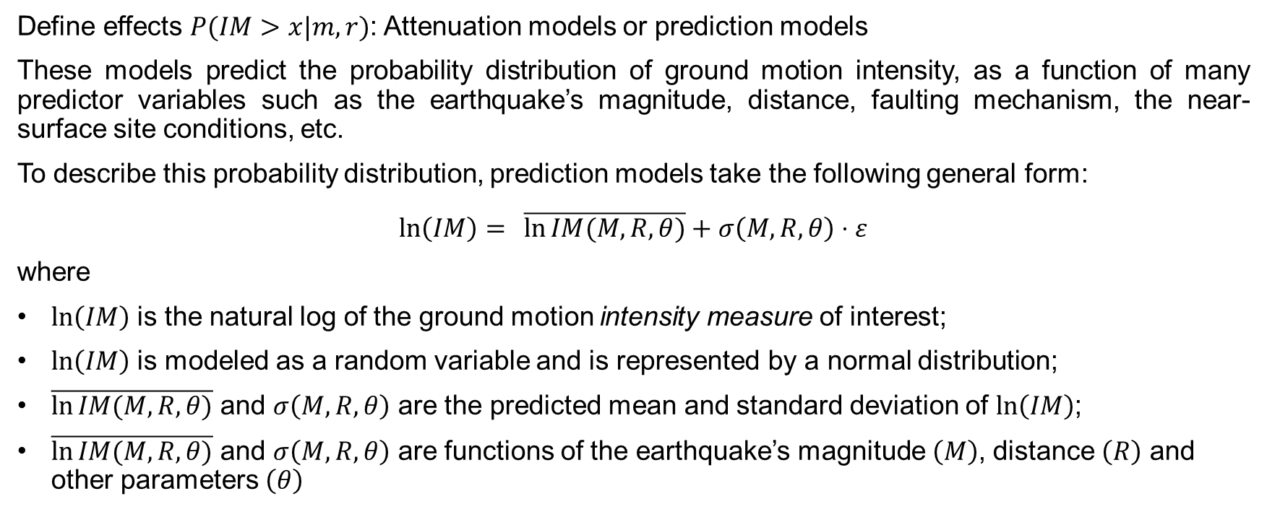
Introduction Probabilistic Hazard Model Laboratory
Step 3: Ground motion estimation
Define effects $P(IM>x|m,r)$: Attenuation models or prediction models
These models predict the probability distribution of ground motion intensity, as a function of many predictor variables such as the earthquake’s magnitude, distance, faulting mechanism, the near-surface site conditions, etc.
To describe this probability distribution, prediction models take the following general form:
$$\ln\left(IM\right)= \overline{\ln{IM(M,R,θ)}}+σ\left(M,R,θ\right)⋅ε$$
where
$ln\left(IM\right)$ is the natural log of the ground motion intensity measure of interest;
$ln\left(IM\right)$ is modeled as a random variable and is represented by a normal distribution;
$\overline{\ln{IM(M,R,θ)}}$ and $σ\left(M,R,θ\right)$ are the predicted mean and standard deviation of $ln\left(IM\right)$;
$\overline{\ln{IM(M,R,θ)}}$ and $σ\left(M,R,θ\right)$ are functions of the earthquake’s magnitude $\left(M\right)$, distance $\left(R\right)$ and other parameters $\left(θ\right)$

Slide 31

Introduction Probabilistic Hazard Model Laboratory
Step 3: Ground motion estimation
Define effects $P(IM>x|m,r)$: Attenuation models or prediction models
Here, for clarity, it is assumed Cornell (1979) for the mean of log peak ground acceleration (in units of g):
$$\overline{\ln{PGA}}=−0,152+0,859M −1,803 ln⁡(R+25)$$
with
$σ=0,57$ of $ln⁡(PGA)$;
$ln⁡(PGA)$ normally distributed

Slide 32

Introduction Probabilistic Hazard Model Laboratory
Step 3: Ground motion estimation
Define effects $P(IM>x|m,r)$: Attenuation models or prediction models
We can thereby compute the probability of exceeding any PGA level using knowledge of this mean and standard deviation:
$$P\left(PGA>x | m,r\right)=1−Φ\left(\frac{\ln{x −\ln{\overline{PGA}}}}{σ_{\ln\left(PGA\right)}}\right)$$
where $Φ\left( \right)$is the standard normal cumulative distribution function.
N.B.: these probabilities correspond to the fraction
of the corresponding PDFs that are shaded.

Slide 33

Introduction Probabilistic Hazard Model Laboratory
Step 3: Ground motion estimation
Define effects $P(IM>x|m,r)$: Attenuation models or prediction models
Codes:
function [mean_im, sigma_im] = GMPE(magnitude,R_distance)
%Cornell et al. (1979): Ground motion predictive equation for PGA
mean_lnPGA = -0.152+0.859*magnitude -1.803*log(R_distance+25);
mean_PGA = exp(mean_lnPGA);
mean_im = mean_PGA;
sigma_im = 0.57;
end

Slide 34

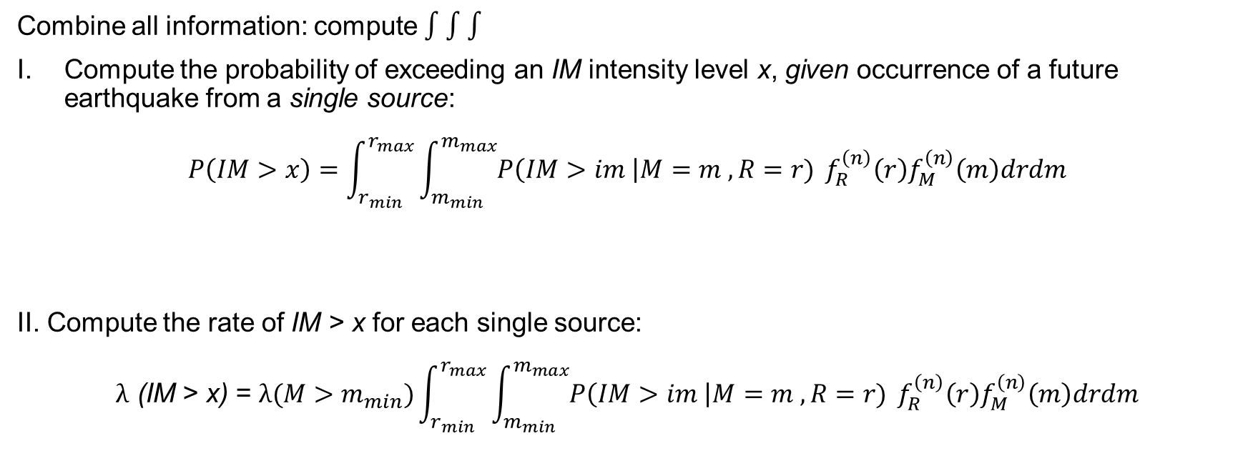


Introduction Probabilistic Hazard Model Laboratory
Step 4: Hazard Computation
Combine all information: compute $∫∫∫$
Compute the probability of exceeding an IM intensity level x, given occurrence of a future earthquake from a single source:
$$P\left(IM>x\right)=\int_{r_{min}}^{r_{max}}{\int_{m_{min}}^{m_{max}}{P\left(IM>im \right|M=m , R=r)}} f_{R}^{\left(n\right)}\left(r\right)f_{M}^{\left(n\right)}\left(m\right)drdm$$
II. Compute the rate of IM > x for each single source:
$$λ \text{(}\text{IM} \text{> }\text{x}\text{)} \text{=} λ(M>m_{min})\int_{r_{min}}^{r_{max}}{\int_{m_{min}}^{m_{max}}{P\left(IM>im \right|M=m , R=r)}} f_{R}^{\left(n\right)}\left(r\right)f_{M}^{\left(n\right)}\left(m\right)drdm$$
$$from GMPE$$
$$PDF of R$$
$$PDF of M$$

Slide 35
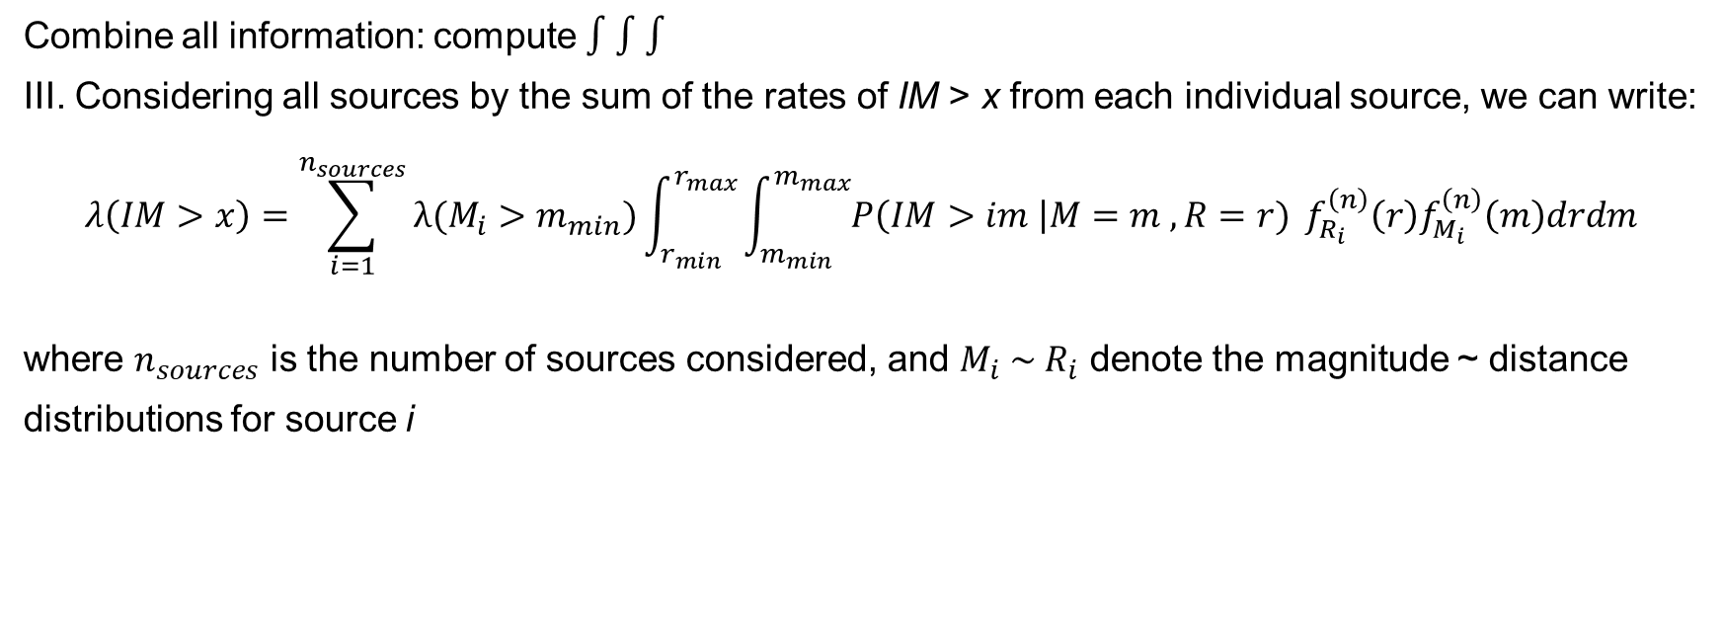
Introduction Probabilistic Hazard Model Laboratory
Step 4: Hazard Computation
Combine all information: compute $∫∫∫$
III. Considering all sources by the sum of the rates of IM > x from each individual source, we can write:
$$λ\left(IM>x\right)=\sum_{i=1}^{n_{sources}}{λ(M_{i}>m_{min})\int_{r_{min}}^{r_{max}}{\int_{m_{min}}^{m_{max}}{P\left(IM>im \right|M=m , R=r)}} f_{R_{i}}^{\left(n\right)}\left(r\right)f_{M_{i}}^{\left(n\right)}\left(m\right)drdm }$$
where $n_{sources}$ is the number of sources considered, and $M_{i} \sim R_{i}$ denote the magnitude ~ distance
distributions for source i
Notes:
$$λ(M>m_{min})\int_{r_{min}}^{r_{max}}{\int_{m_{min}}^{m_{max}}{P\left(IM>im \right|M=m , R=r)}} f_{R}^{\left(n\right)}\left(r\right)f_{M}^{\left(n\right)}\left(m\right)drdm$$

Slide 36
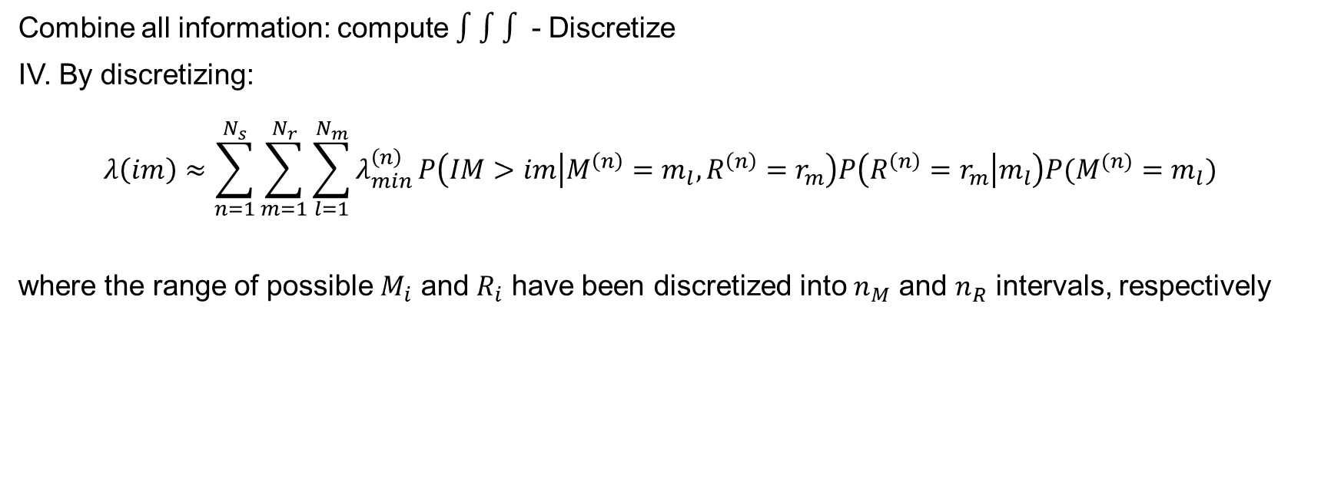
Introduction Probabilistic Hazard Model Laboratory
Step 4: Hazard Computation
Combine all information: compute $∫∫∫$ - Discretize
IV. By discretizing:
$${λ\left(im\right)≈\sum_{n=1}^{N_{s}}{\sum_{m=1}^{N_{r}}{\sum_{l=1}^{N_{m}}{λ_{min}^{\left(n\right)}}P\left(IM>im | M^{\left(n\right)}=m_{l}, R^{\left(n\right)}=r_{m}\right)P\left(R^{\left(n\right)}=r_{m} | m_{l}\right)P(M^{(n)}=m_{l})} }}_{}$$
where the range of possible $M_{i}$ and $R_{i}$ have been discretized into $n_{M}$ and $n_{R}$ intervals, respectively
Notes:
$$λ(M>m_{min})\int_{r_{min}}^{r_{max}}{\int_{m_{min}}^{m_{max}}{P\left(IM>im \right|M=m , R=r)}} f_{R}^{\left(n\right)}\left(r\right)f_{M}^{\left(n\right)}\left(m\right)drdm$$

Slide 37
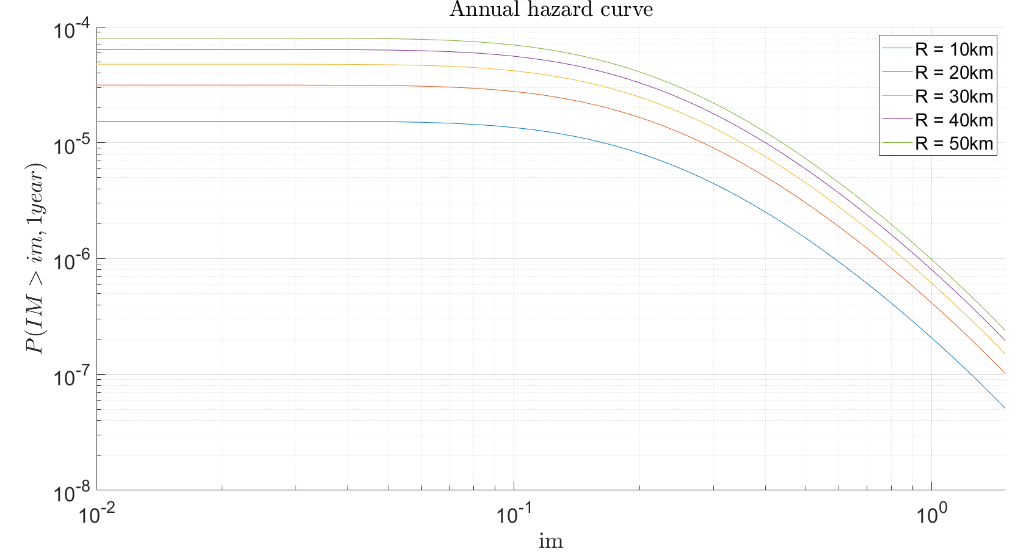
Introduction Probabilistic Hazard Model Laboratory
Step 4: Hazard Computation
Goal and results
Through the scheme depicted in (1), compute:
the annual hazard curve for each fault;
the 50 years hazard curve for each fault;
the 475 years hazard curve for each fault
for the highlighted seismic site.
Notes:
$$λ(M>m_{min})\int_{r_{min}}^{r_{max}}{\int_{m_{min}}^{m_{max}}{P\left(IM>im \right|M=m , R=r)}} f_{R}^{\left(n\right)}\left(r\right)f_{M}^{\left(n\right)}\left(m\right)drdm$$

Slide 38
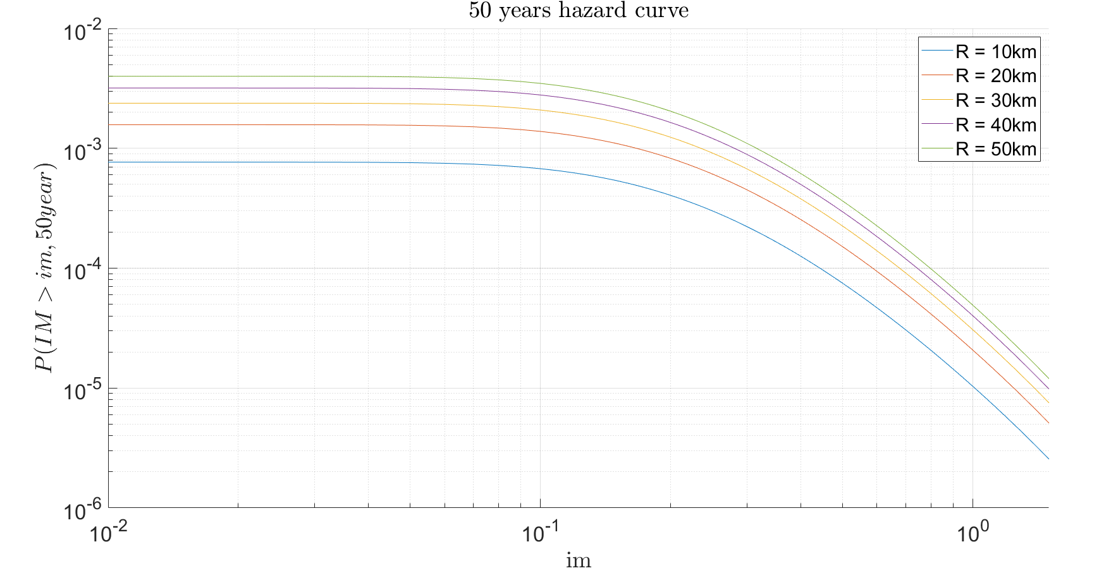
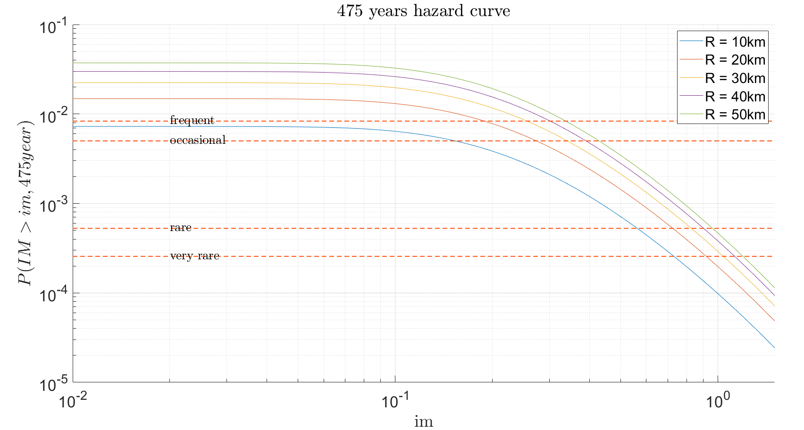
Introduction Probabilistic Hazard Model Laboratory
Step 4: Hazard Computation
Notes:
$$λ(M>m_{min})\int_{r_{min}}^{r_{max}}{\int_{m_{min}}^{m_{max}}{P\left(IM>im \right|M=m , R=r)}} f_{R}^{\left(n\right)}\left(r\right)f_{M}^{\left(n\right)}\left(m\right)drdm$$

Slide 39
Introduction Probabilistic Hazard Model Laboratory
Summary
Location
$P=1−e^{−λt}$ Poisson model
𝑃=1−𝑒^(−𝜆𝑡) Poisson model
Size
Time
$f_{R}\left(r\right)$ source site distance
𝑓_𝑅 (𝑟) source site distance
GMPE
$f_{M}\left(m\right)$ magnitude distribution
𝑓_𝑀 (𝑚) magnitude distribution
$P\left(IM>im \right|M=m , R=r)$ attenuation law
𝑃(𝐼𝑀>𝑖𝑚 ┤|𝑀=𝑚 , 𝑅=𝑟) attenuation law
Notes:
$$λ(M>m_{min})\int_{r_{min}}^{r_{max}}{\int_{m_{min}}^{m_{max}}{P\left(IM>im \right|M=m , R=r)}} f_{R}^{\left(n\right)}\left(r\right)f_{M}^{\left(n\right)}\left(m\right)drdm$$

Slide 40
Introduction Probabilistic Hazard Model Laboratory
References
Stucchi M., Meletti C., Montaldo V., Akinci A., Faccioli E., Gasperini P., Malagnini L., Valensise G. (2004). Pericolosità sismica di riferimento per il territorio nazionale MPS04. Istituto Nazionale di Geofisica e Vulcanologia (INGV). https://doi.org/10.13127/sh/mps04/agKramer, S.L. (1996) Geotechnical earthquake engineering. Prentice Hall, Upper Saddle River, N.J.
http://zonesismiche.mi.ingv.it/ → Italian database

