Slide 1

Personal Finance Tracker

Slide 2

Introduction
What is a Personal Finance Tracker?
  A Personal Finance Tracker is a tool or software that helps individuals manage their income, expenses, and savings.
Key Points:
  It helps you track how much you earn, spend, and save.
  It supports better budgeting and financial planning.

Slide 3
Importance of Finance Tracker
Why is it Important?
  A finance tracker keeps you in control of your finances and supports smarter money decisions.
Key Points:
  Prevents overspending by showing where your money goes.
  Helps achieve financial goals like saving, investing, or reducing debt.

Slide 4
Features of a Personal Finance Tracker
  User registration and login
  Dashboard to view balance and spending
  Expense categorization
  Monthly savings tracking
  Data backup using database (MySQL)

Slide 5
Benefits to Users
  Easy to monitor spending habits
  Encourages savings
  Reduces financial stress
  Builds financial discipline

Slide 6
Technologies Used
  Java (Frontend & Logic)
  MySQL (Database)
  JDBC for connectivity
  Swing components for GUI

Slide 7
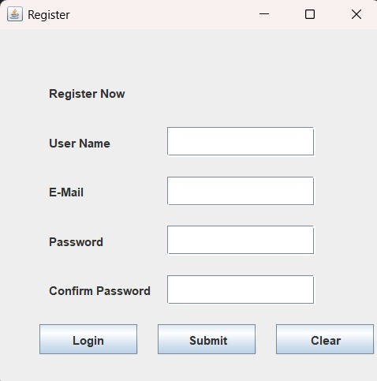
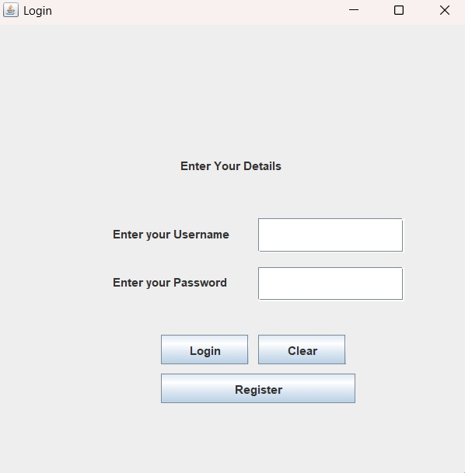
Implementation (Screenshots)
Login Page -:
Registration Page -:

Slide 8
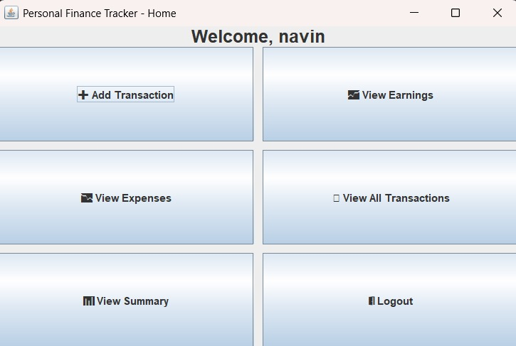
Home page -:

Slide 9
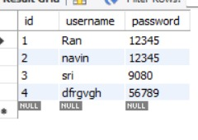
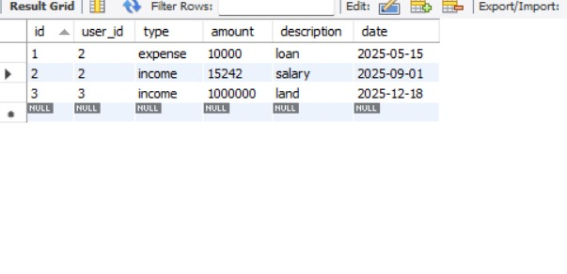

Slide 10
Thank you
PROJECT BY : NAVIN KUMAR , SRIRAM , MAHESH
DEPARTMENT : INFORMATION TECHNOLOGY
COLLEGE : SVHEC

