Slide 1
组会汇报 2/2-2/9
科技2204 田进

Slide 2
本周主要工作
1. An Output Feedback Tracking Control based on Neural Sliding Mode and High Order Sliding Mode Observer
2.control of robot
3.论文

Slide 3
一、 An Output Feedback Tracking Control based on Neural Sliding Mode and High Order Sliding Mode Observer
In this paper, a novel output feedback tracking control scheme based on neural sliding mode without joint velocity measurement and the high order sliding mode observer for the uncertainty of robot manipulators are presented.
The second order sliding mode observer (SOSM) among them is the best observer in terms of the estimation error. Therefore, this observer would be used in this output feedback control scheme
For the identification of the manipulator dynamic uncertainties, the conventional sliding mode observer makes high-frequency switching so that it requires an additional filter to reduce chattering. .-------The application of a filter causes time delay and error. To overcome this obstacle, a second order sliding mode nonlinear observer (SOSM) was reported.

Slide 4
一. In this paper, a novel output feedback tracking control scheme based on neural sliding mode without joint velocity measurement and the high order sliding mode observer for the uncertainty of robot manipulators are presented.
to estimate the state vector in a finite time without filtration.
To estimate the uncertainties without filtration,
the resulting observer can theoretically obtain exact estimations of both joint velocities and dynamic uncertainties.
They are used to design an output feedback tracking control scheme based on neural sliding mode controller.

Slide 6
problems
1. modeling uncertainty?
2.文本问题
(3) (4) y=x1
3.速度信息

Slide 7
二、control of robot
Properties of the Dynamic Model
The Centrifugal and Coriolis Forces Matrix
The Residual Dynamics
construct non-negative functions and occasionally,Lyapunov functions to study stability and convergence properties for equilibria in robot control systems.

Slide 8
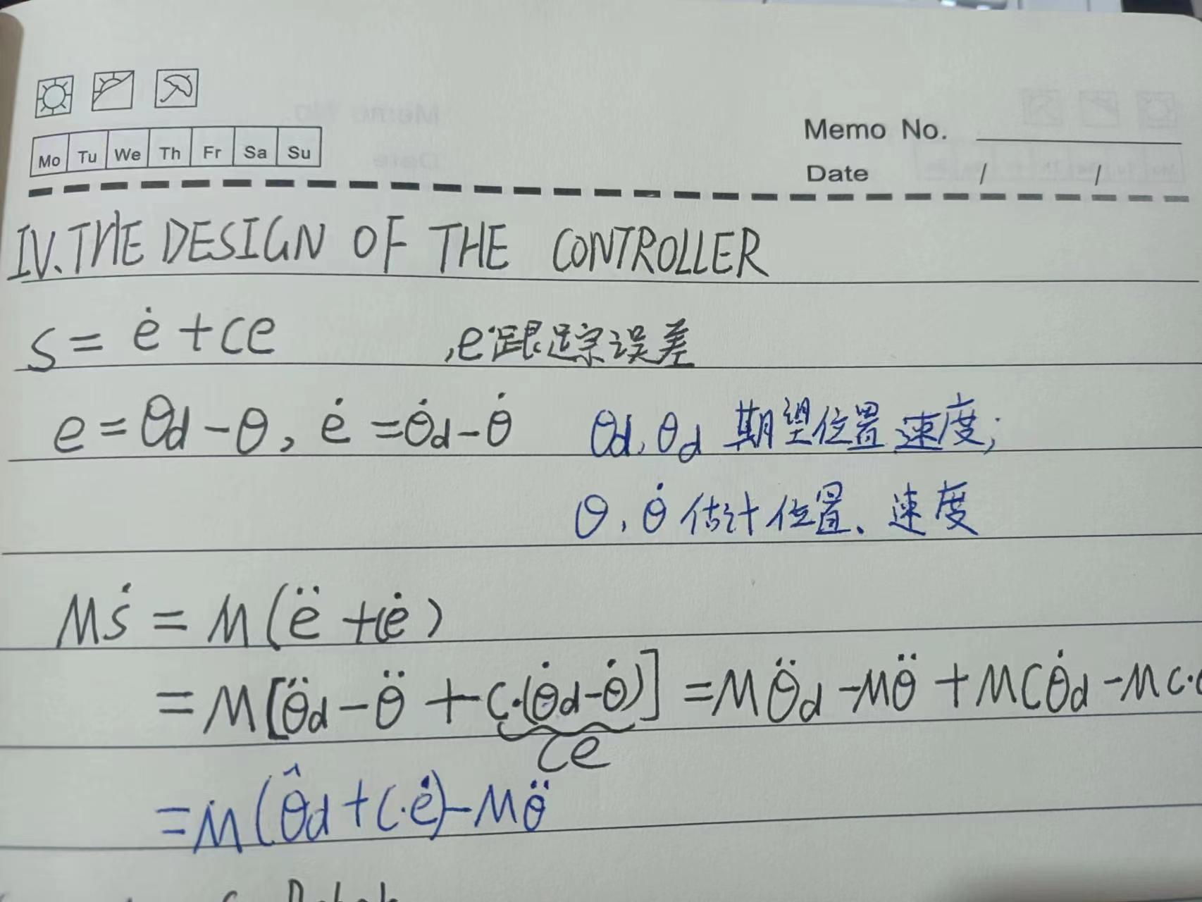
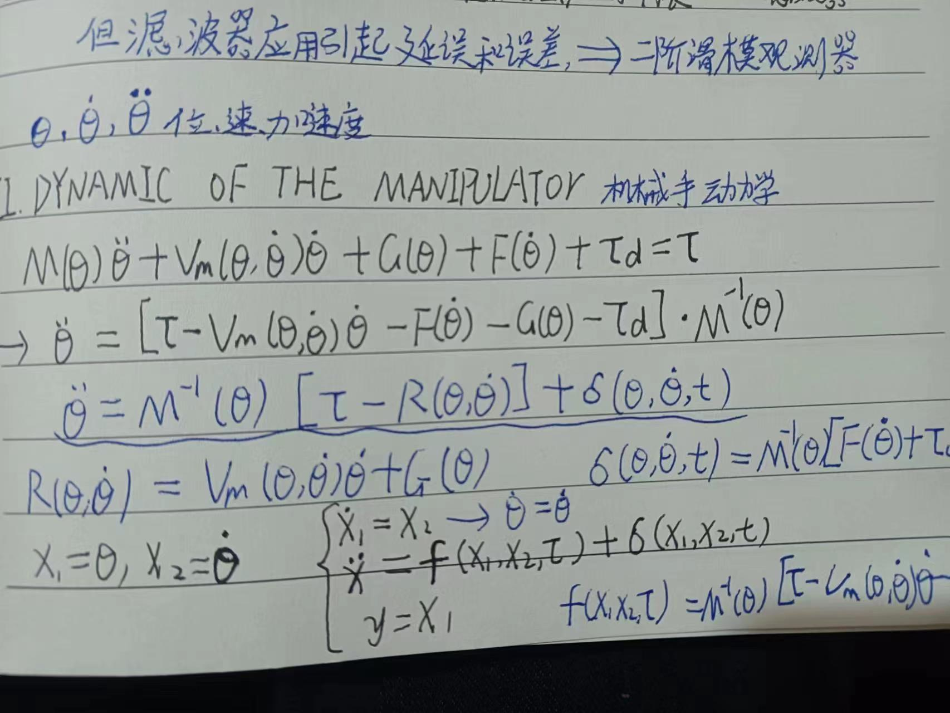
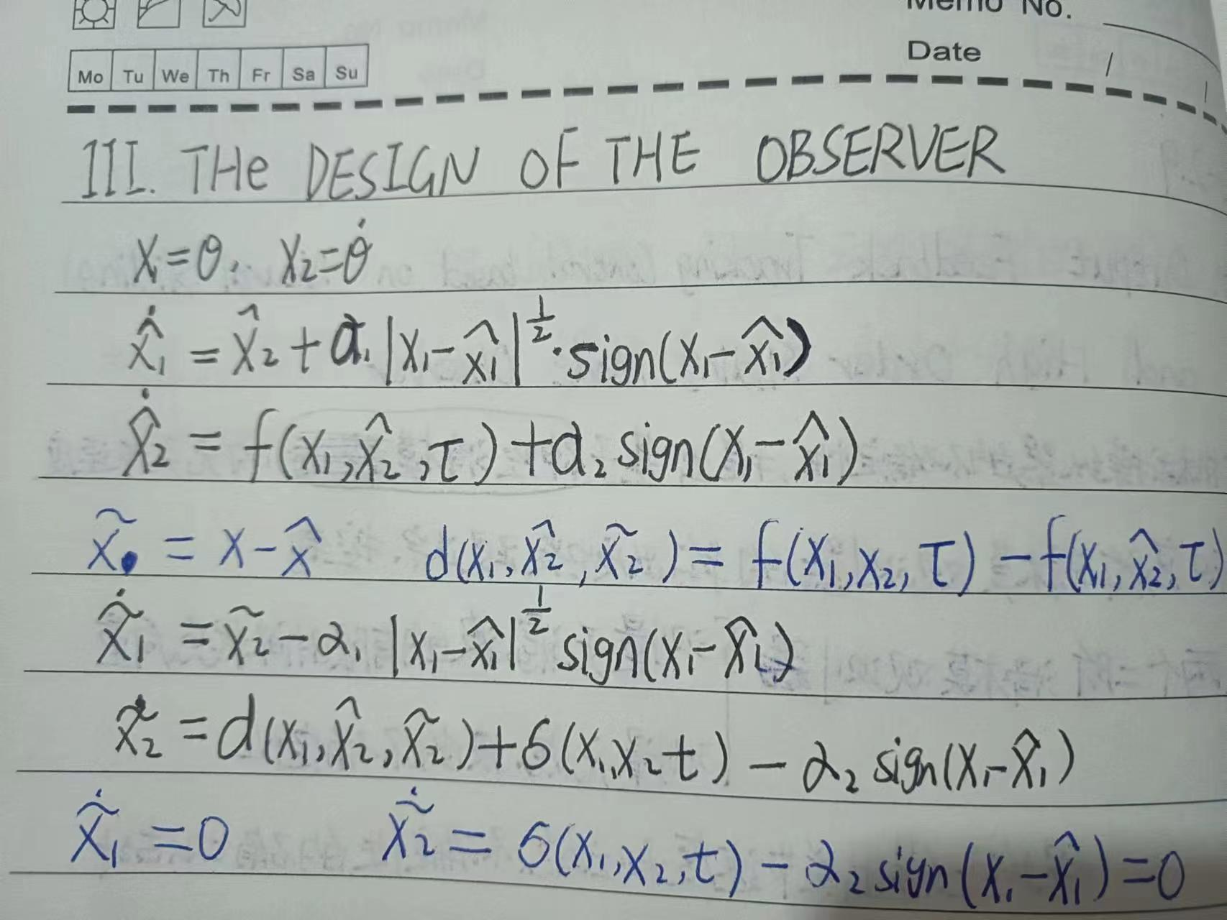

Slide 9
三、论文

