Slide 1
Dst = 0.1 Sweeps
Static

Slide 2
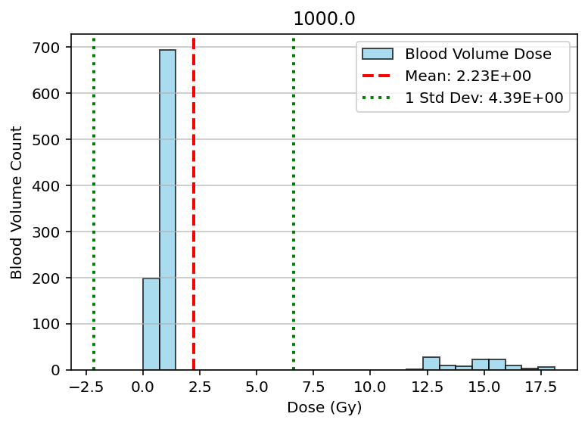
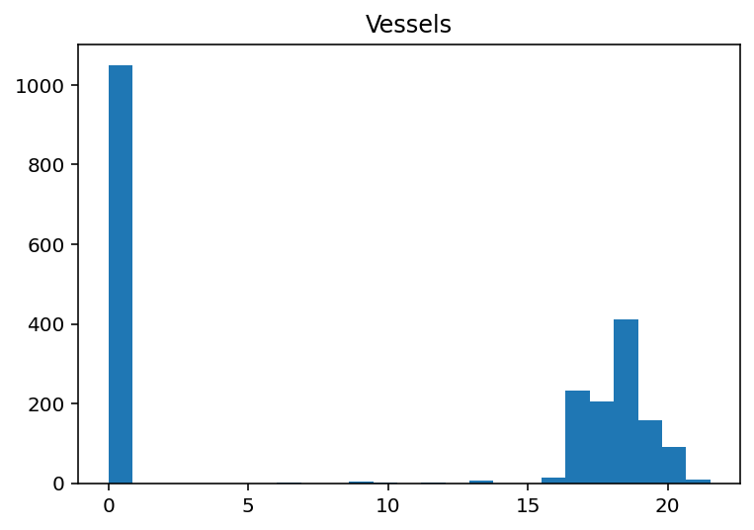
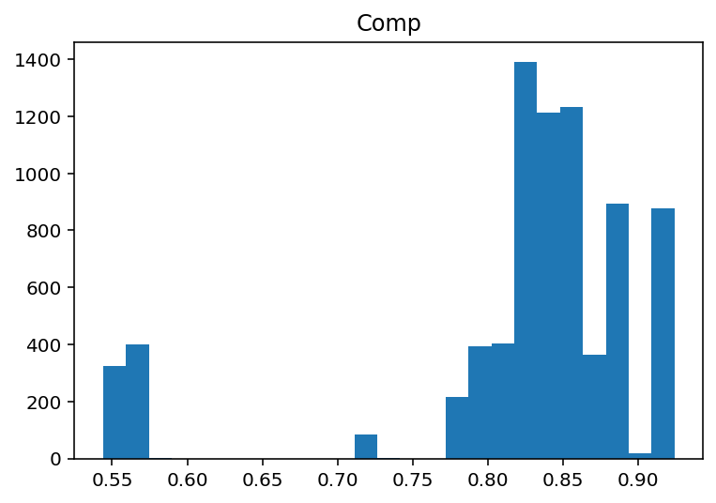

Slide 3
Dst = 0.25 Sweeps
Static

Slide 4
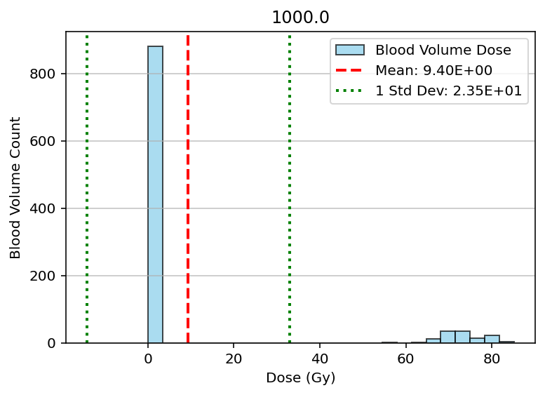
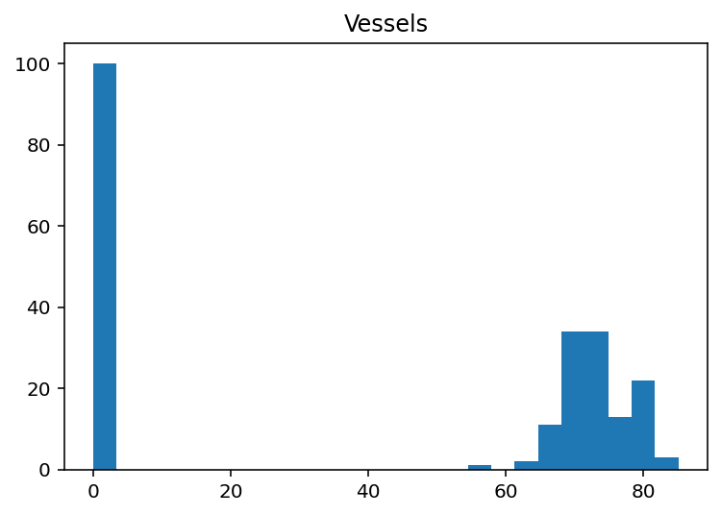
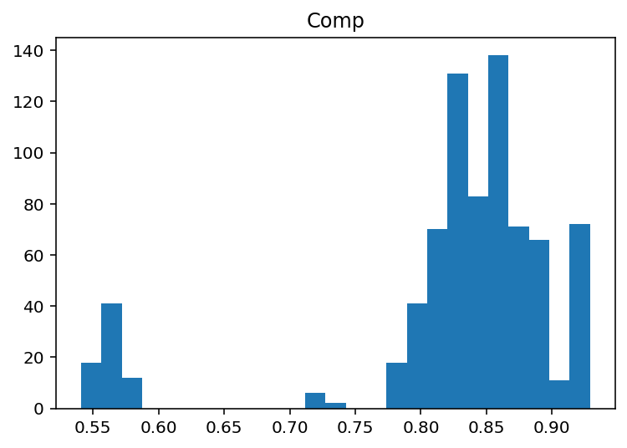

Slide 5
Dst = 0.5 (all in)
Static

Slide 6
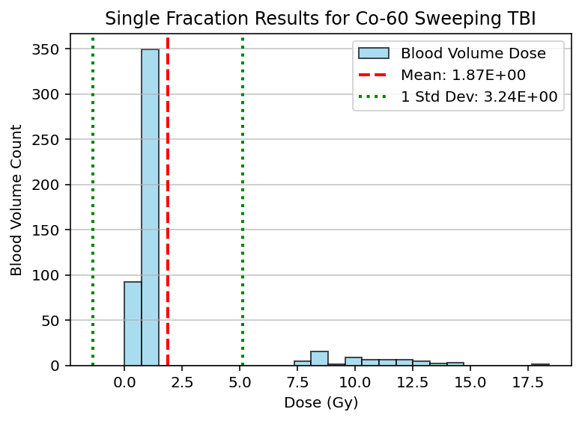
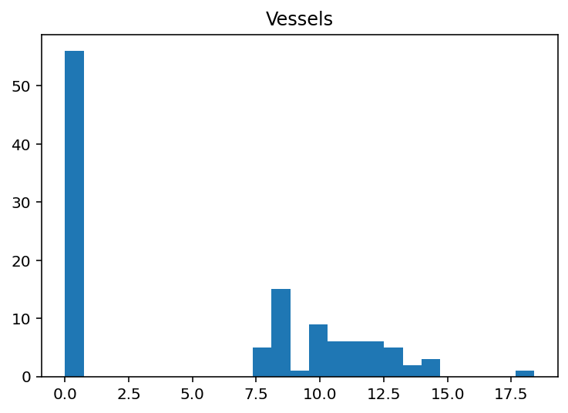
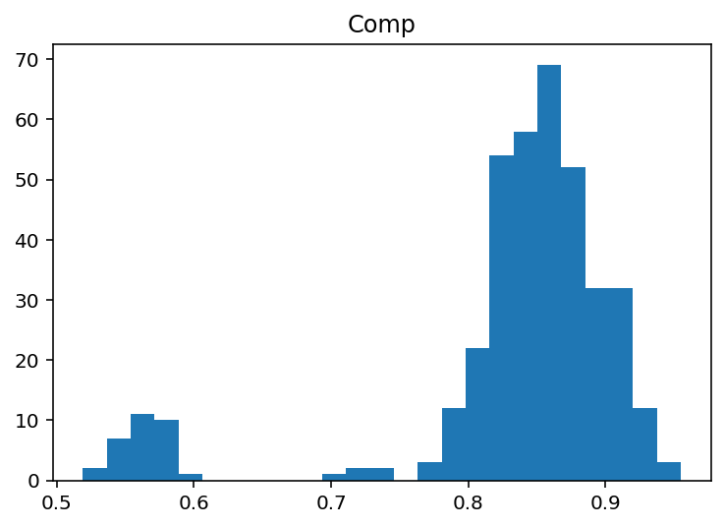

Slide 7
Dst = 0.1 Sweeps
NOT Static

Slide 8
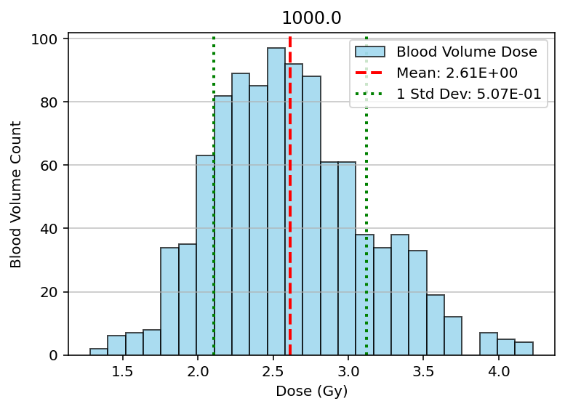

Slide 9
Dst = 0.25 Sweeps
NOT Static

Slide 10
