Slide 1
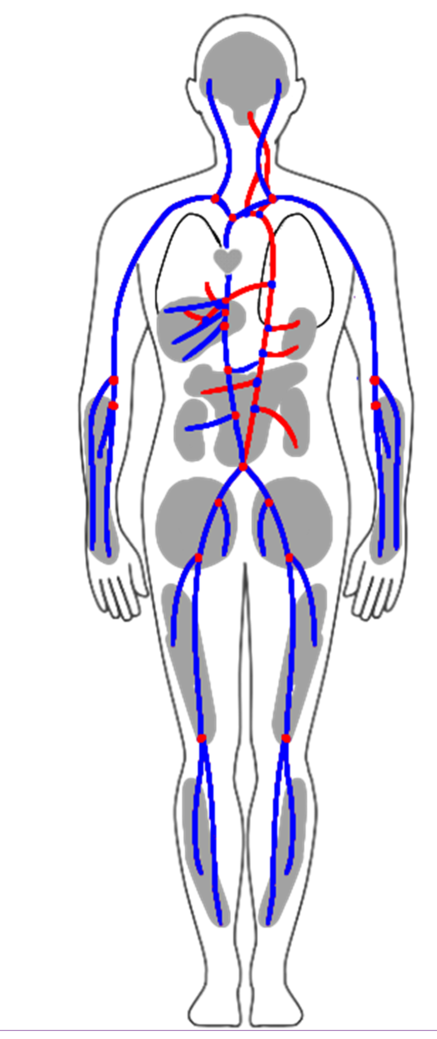
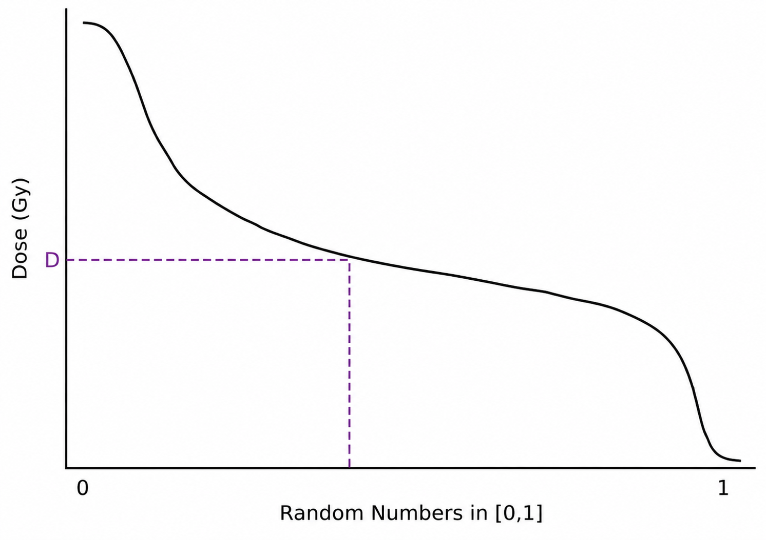
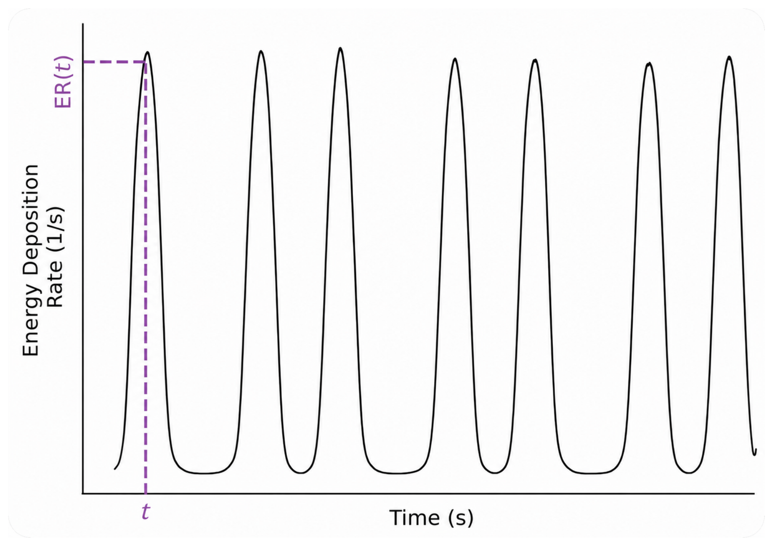
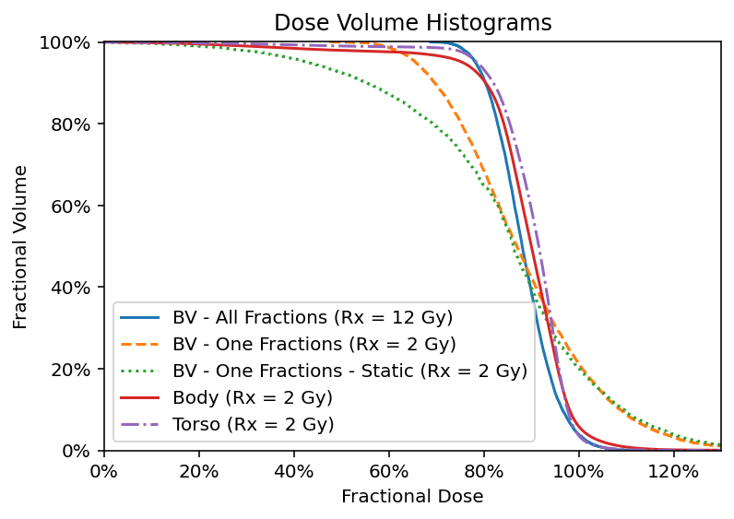
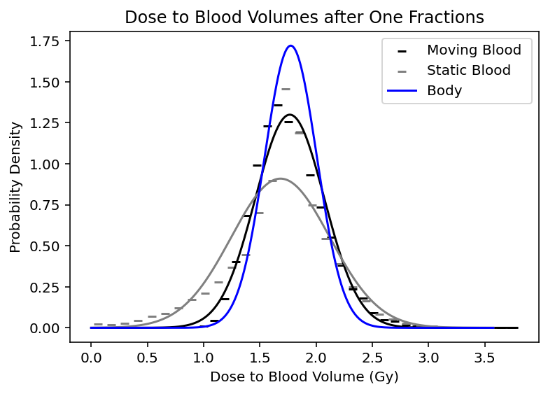
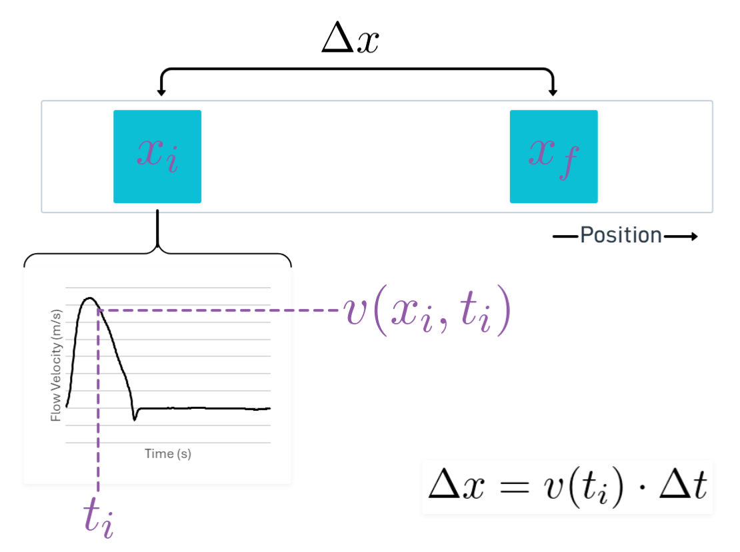
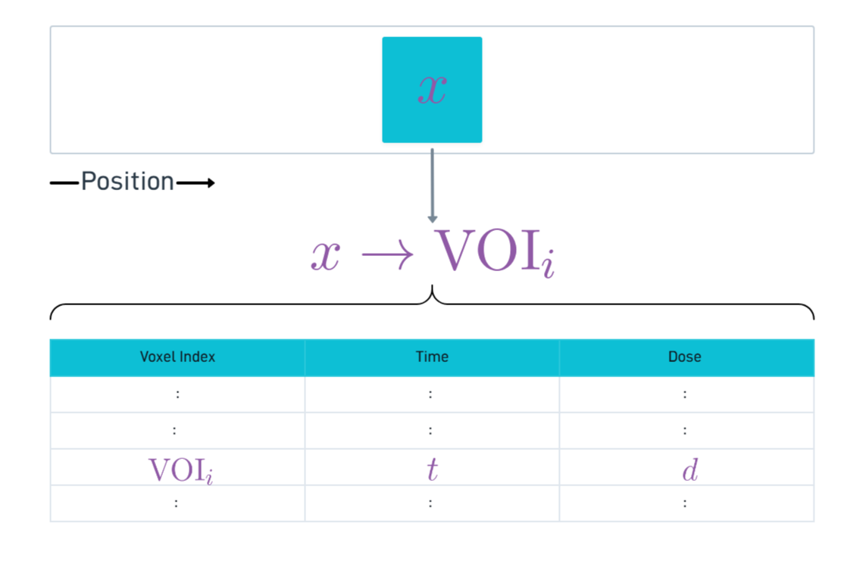
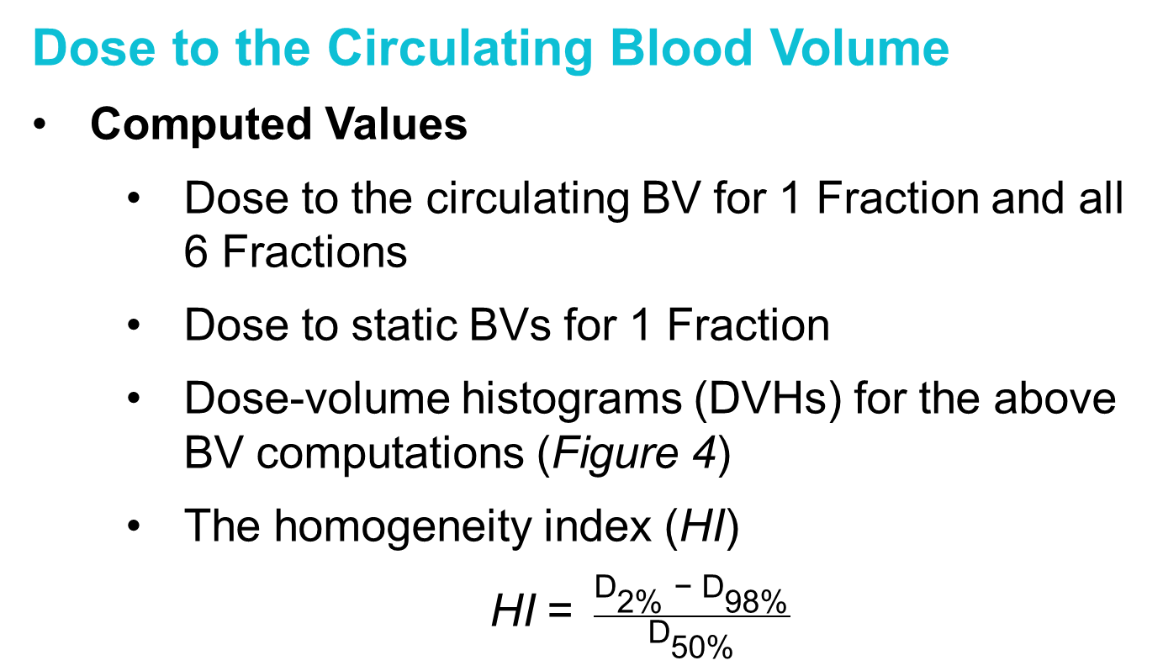

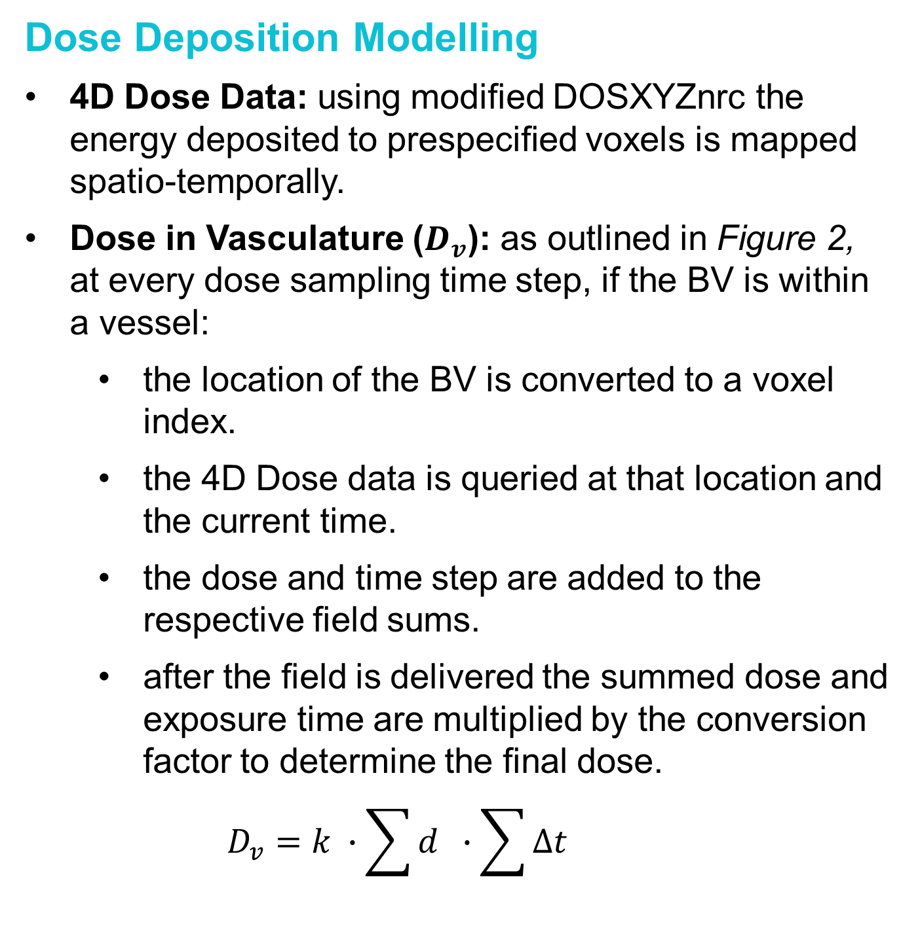

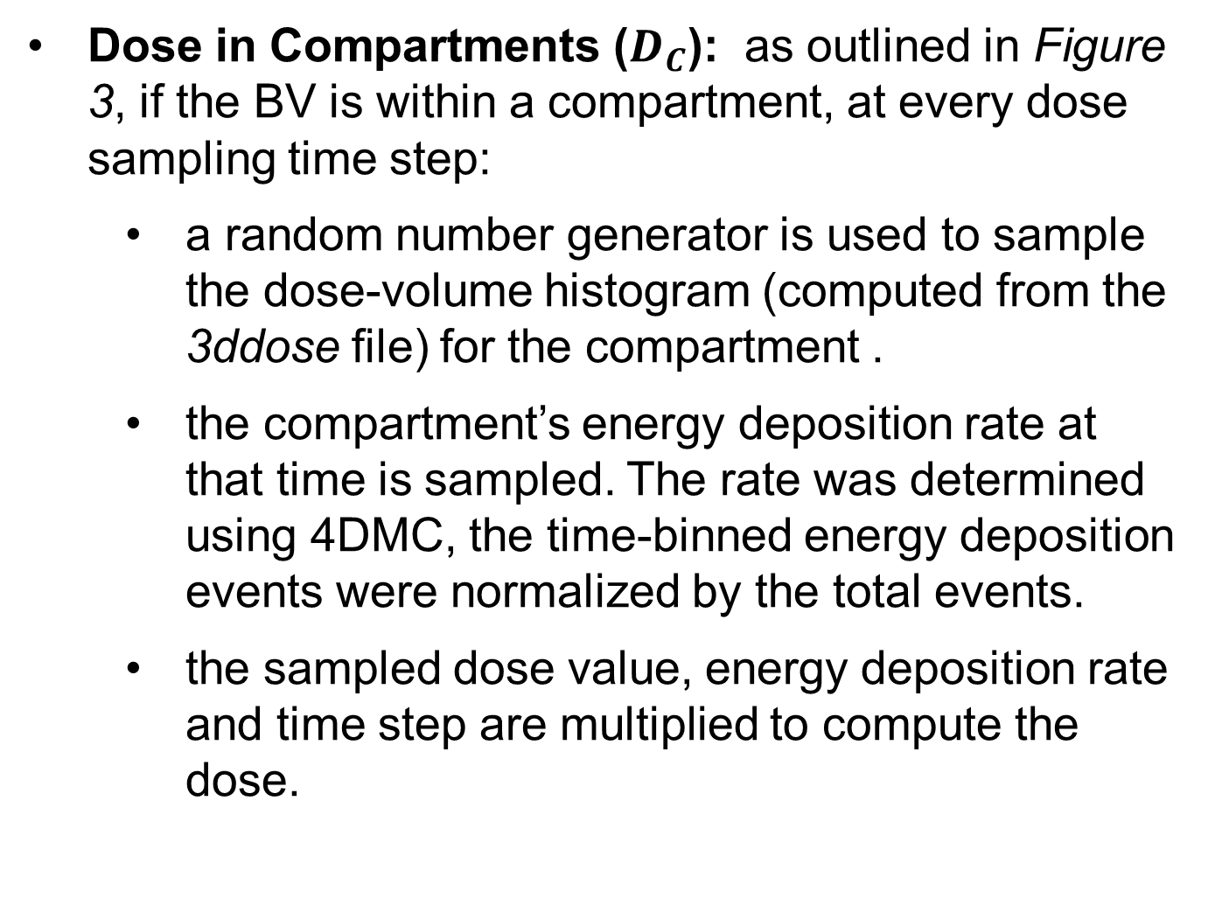
Assessing the Homogeneity Of Dose Delivered To Circulating Blood During Sweeping Cobalt-60 Total Body Irradiation
Names of
Title of the Research Project
Names of Presenters, Associates and Collaborators
How homogenous is the dose to the circulating blood volume achieved by sweeping Cobalt-60 Total Body Irradiation?
Sweeping Co-60 TBI
Delivery Technique: an extended source-to-surface distance treatment, where the patient lies first supine and then prone while the treatment head is swept over a 90-degree angle. A polystyrene flattening filter and lead lung compensators are placed above the patient to achieve as uniform a dose as possible throughout the patient.
Phantom Modelling for EGSnrc: a synthetic CT of the 4D XCAT phantom, along with the beam modulating components discussed above, were converted to an egsphant file.
DOSXYZnrc Simulation: using Source 20 and a phase space generated below the jaws of the modelled Theratron 780C, 200 billion particles were simulated for each individual sweep.
Conversion Factor (k): by recreating the TG-51 geometry in EGSnrc and utilizing the measured dose rate, an absolute calibration factor was computed. The calibration factor converts the Gy/particle output of a DOSXYZnrc simulation to Gy.
Dose in Compartments ($D_{C}$): as outlined in Figure 3, if the BV is within a compartment, at every dose sampling time step:
a random number generator is used to sample the dose-volume histogram (computed from the 3ddose file) for the compartment .
the compartment’s energy deposition rate at that time is sampled. The rate was determined using 4DMC, the time-binned energy deposition events were normalized by the total events.
the sampled dose value, energy deposition rate and time step are multiplied to compute the dose.
Introduction
Total body irradiation (TBI) : the entire body is irradiated to prepare the patient for stem cell transplant.
AAPM Report No 17: questioned whether moving beam or junctioned-field TBI techniques, which do not simultaneously irradiate the entire body, evenly dose residual cancer cells in the circulating blood [1].
Variables:
$$D_{c}=D∙ER∙∆t$$
Prescription: 12 Gy / 6 Frac / 2 Fields (AP & PA)
Blood flow simulation Δt = 2 ms
Dose deposition simulation Δt = 200 ms
Methods
4D Extended Cardiac-Torso (XCAT) Phantom: a virtual phantom [2] which provides both the interaction medium for the 4D dose calculations and the vasculature models through which blood volumes (BVs) are transported by the blood flow model.
One-Dimensional (1D) Blood Flow Model: determines the flow velocity as a function of time and displacement along the length of each vessel and has been validated against clinical measurements.
Four-Dimensional (4D) Dose: computed using in-house modified EGSnrc [3], dose deposition events binned by time and voxel location.
Dose to the Circulating Blood Volume
Computed Values
Dose to the circulating BV for 1 Fraction and all 6 Fractions
Dose to static BVs for 1 Fraction
Dose-volume histograms (DVHs) for the above BV computations (Figure 4)
The homogeneity index ($\text{HI}$)
HI = $\frac{{\text{D}}_{\text{2\% }}\text{− }{\text{D}}_{\text{98\%}}}{{\text{D}}_{\text{50\%}}}$
Dose Deposition Modelling
4D Dose Data: using modified DOSXYZnrc the energy deposited to prespecified voxels is mapped spatio-temporally.
Dose in Vasculature ($D_{v}$): as outlined in Figure 2, at every dose sampling time step, if the BV is within a vessel:
the location of the BV is converted to a voxel index.
the 4D Dose data is queried at that location and the current time.
the dose and time step are added to the respective field sums.
after the field is delivered the summed dose and exposure time are multiplied by the conversion factor to determine the final dose.
$$D_{v}=k ∙\sum{d }∙\sum{∆t}$$
Results
Figure 3: Diagrams of how both the dose is sampled
from the compartment DVH and the compartment
energy deposition rate is sampled.
Blood Flow Model
Vascular Network: a subset of vessels was extracted from the 4D XCAT phantom and their contours were used to determine the length and radius of the vessels. Vessels were subdivided into segments at all branching points.
Compartments: act as zero-dimensional (OD) representations of small vessels that feed and drain organs and large gross volumes of tissue and which are not modelled in detail.
Arterial Flow: sourced from Nektar 1D [4], which generates pulsatile flow rates for major arteries in the form of two-dimensional (2D) arrays containing flow velocities computed at even spatial and time increments.
Venous Flow: sourced from in-vivo measurements reported across the literature. Interpolation and the confluences rule were used to populate the network with non-pulsatile flow rates.
Transporting the BVs: outlined in Figure 1, the BVs are explicitly transported through the vascular network. When the BVs reach the end of the arterial network, they enter a compartment where they remain for a specified time before moving into the venous network.
Dwell Times: constants, on the order of seconds, that specify how long BVs spend in a compartment.
Figure 4: The result of the dose deposition simulations presented as: (Left) dose-volume histograms for the single fraction dose to the blood volumes, torso and body and all fraction dose to blood volumes. (Right) Dose delivered to both circulating and static blood volumes, as well as the body, receiving a single fraction of sweeping Cobalt-60 TBI. The density histograms are marked by the dashed lines, and a Gaussian distribution was fitted to the results.
Simulation | $D_{BV}$ (Gy) | ${HI}_{BV}$
One Fraction | $$1.77 ±0.31$$ | 0.72
One Static Fraction | $$1.68 ±0.44$$ | 1.13
Six Fractions | $$10.60 ±0.76$$ | 0.30
Key Results and Discussion
A novel method by which to determine dose to the circulating blood volume during TBI has been developed.
Sweeping Co-60 TBI more evenly doses the blood when fractionated, < 7%.
The static dose over-estimates the heterogeneity of the dose
Figure 1: A diagram representing the BV transport algorithm for pulsatile flow.
References
[1] Van Dyk, J., Galvin, J.M., Glasgow, G.P., et al. (1986) The Physical Aspects of Total and Half Body Photon Irradiation. AAPM Report No. 17, American Association of Physicists in Medicine.
[2] Segars, W. P., Sturgeon, G., Mendonca, S., Grimes, J., & Tsui, B. M. (2010). 4D XCAT phantom for multimodality imaging research. Medical physics, 37(9), 4902–4915. https://doi.org/10.1118/1.3480985
[3] Su, S., Atwal, P., Lobo, J., Duzenli, C., & Popescu, I. A. (2021). A new DOSXYZnrc method for Monte Carlo simulations of 4D dose distributions. Physics in medicine and biology, 66(24).
[4] Alastruey, Jordi & Parker, Kim & Sherwin, Spencer. (2012). Arterial pulse wave haemodynamics.
Conclusions
A blood flow model was developed, in conjunction with a dose calculation methodology, to determine the dose to the circulating blood volume. The dose to the blood during sweeping Co-60 TBI was computed.
Acknowledgments
This research was supported by a grant from Lymphoma Canada and utilized the Digital Research Alliance of Canada’s Advanced Research Computing resources.
Figure 2: A diagram representing how the 4D dose data is queried at every time step (t).
1 – Department of Physics & Astronomy, University of British Columbia, Vancouver, BC, Canada. 2 – Medical Physics Department, BC Cancer Agency, Vancouver, BC, Canada. 3 - Medical Physics Department, BC Cancer Agency, Abbotsford, BC, Canada. 4 - Department of Surgery, University of British Columbia, Vancouver, BC, Canada.
Notes:
LINE SPACING IS 12
1[] vandyk icrp
[2] su 4ddose
[3] perdikaris et al 2016
[4] segars 2010
[5] alastruely 2012

