Slide 1
T-Test
By: Tanveer Singh (CO18353)

Slide 2
A little bit history...
Developed by William Sealy Gosset in 1900s.
He worked at Guinness Brewery.
To determine the difference between barley yield.
Published this statistical test under the pseudonym “Student”.
Because the brewery feared they might loose a competitive advantage.

Slide 3
What is t-test?
A t-test is a type of inferential statistic which is used to determine if there is a significant difference between the means of two groups which may be related in certain features.
Mathematically, the t-test takes a sample from each of the two sets and establishes the problem statement by assuming a null hypothesis that the two means are equal. Based on the applicable formulas, certain values are calculated and compared against the standard values, and the assumed null hypothesis is accepted or rejected accordingly.
If the null hypothesis qualifies to be rejected, it indicates that data readings are strong and are probably not due to chance.
Notes:
We come to a conclusion for a population based on sample dataset.

Slide 4
An example...
Consider you have cold. You take some homeopathic medicine and recover in a week. Next time when you have a cold, you decide to take allopathic medicine and recover within 3 days.
You survey your friends and they all tell you that their colds were of a shorter duration (an average of 3 days) when they took the allopathic remedy.
Can we say allopathic medicine is more effective than homeopathic?
It does seems that way. But…we simply looked patterns from our friends, which may not represent true results.
A t test can tell you by comparing the means of the two groups and letting you know the probability of those results happening by chance.

Slide 5
Assumptions
Normal Distribution- bell shaped curve.
Continuous or ordinal scale of measurement.
Homogeneity of variance- the standard deviations of samples are approximately equal.
Sample should be randomly chosen.

Slide 6
Types
There are three main types of t-test depending upon whether the groups being compared come from a single population or two different populations:
An Independent Samples t-test compares the means for two groups.
A Paired sample t-test compares means from the same group at different times (say, one year apart).
A One sample t-test tests the mean of a single group against a known mean.

Slide 7
T-value/ t-score
Ratio between signal and noise.
Signal- difference between the two groups.
Noise- difference within the groups (variability of the groups).
A large t-value tells you that the groups are different.
A small t-value tells you that the groups are similar.
When you run a t test, the bigger the t-value, the more likely it is that the results are repeatable.

Slide 8
P-value
It is the probability for the “null hypothesis" to be true.
A p-value is a probability associated with your critical value. It is the probability that the results from your sample data occurred by chance.
Low p-values are good; They indicate your data did not occur by chance.
For example, a p-value of .01 means there is only a 1% probability that the results from an experiment happened by chance.
In most cases, a p-value of 0.05 (5%) is accepted to mean the data is valid.

Slide 9






Formulas for finding t-value
Independent Sample Test df=nA+nB−2
Paired Sample Test df = n - 1
One Sample Test df = n - 1

Slide 10
T-test
Null Hypothesis (H0): There is no statistically significant difference between the samples.
Determine a confidence level (usually 0.05 is chosen).
Find t-value and df.
Identify critical t-value from the T-Distribution Table.
If |t-value| > critical value then the hypothesis is wrong.
Alternatively compare p value with confidence level.
Note: You can ignore the minus sign when comparing the two t-values, as ± indicates the direction; the p-value remains the same for both directions.

Slide 11
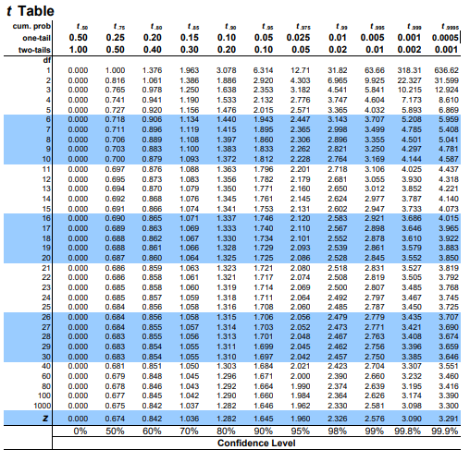
The T-Distribution Table is available in one-tail and two-tails formats. The former is used for assessing cases which have a fixed value or range with a clear direction (positive or negative). For instance, what is the probability of output value remaining below -3, or getting more than seven when rolling a pair of dice? The latter is used for range bound analysis, such as asking if the coordinates fall between -2 and +2.
Degrees of freedom refers to the values in a study that has the freedom to vary.
Src: https://www.sjsu.edu/faculty/gerstman/StatPrimer/t-table.pdf
Notes:
One tailed- hypothesis greater or less
Two tailed- Equal to

Slide 12
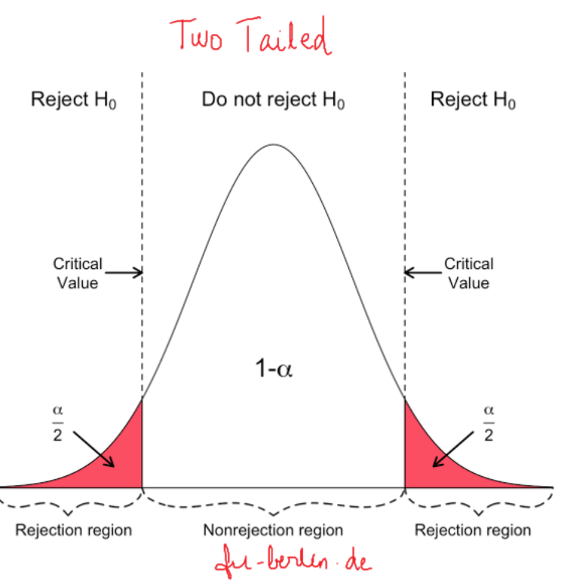
P value = 2*Pr(T > | tvalue |)
Src: https://www.machinelearningplus.com/wp-content/uploads/2020/10/two_tailed_test_rejection_region-min.png

Slide 13
References
https://www.statisticshowto.com/probability-and-statistics/t-test/
https://www.analyticsvidhya.com/blog/2019/05/statistics-t-test-introduction-r-implementation/
https://libguides.library.kent.edu/SPSS/OneSampletTest
https://www.scribbr.com/statistics/t-test/
https://blog.minitab.com/en/statistics-and-quality-data-analysis/what-are-t-values-and-p-values-in-statistics
https://www.machinelearningplus.com/statistics/one-sample-t-test/
https://www.investopedia.com/terms/t/t-test.asp#:~:text=Key%20Takeaways-,A%20t%2Dtest%20is%20a%20type%20of%20inferential%20statistic%20used,of%20hypothesis%20testing%20in%20statistics.

