Slide 1
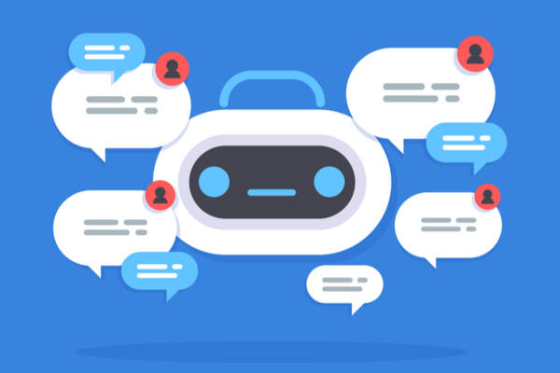

Slide 2





Why are we here?

Slide 3

Who is this guy?
Software Engineer at Insight
Born and Raised in Columbus
Bishop Ready High School (Westside, Best side)
Ohio State Graduate 2010
Married in April 2016 to Wife, Liz
Expecting First Child in June

Slide 4
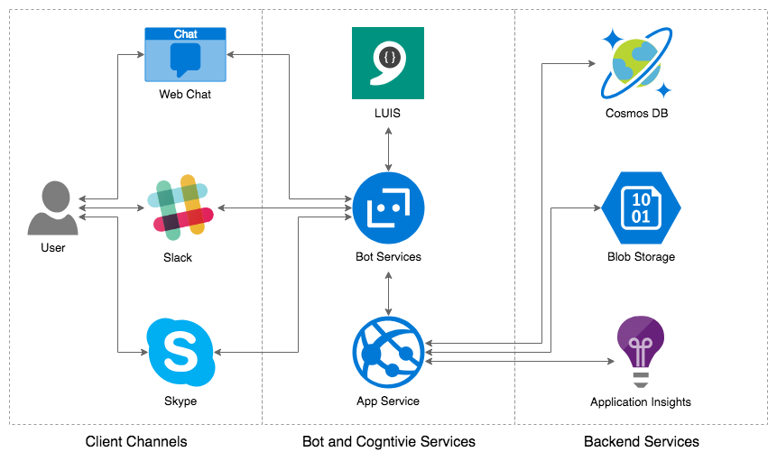
Azure Bot Service

Slide 5
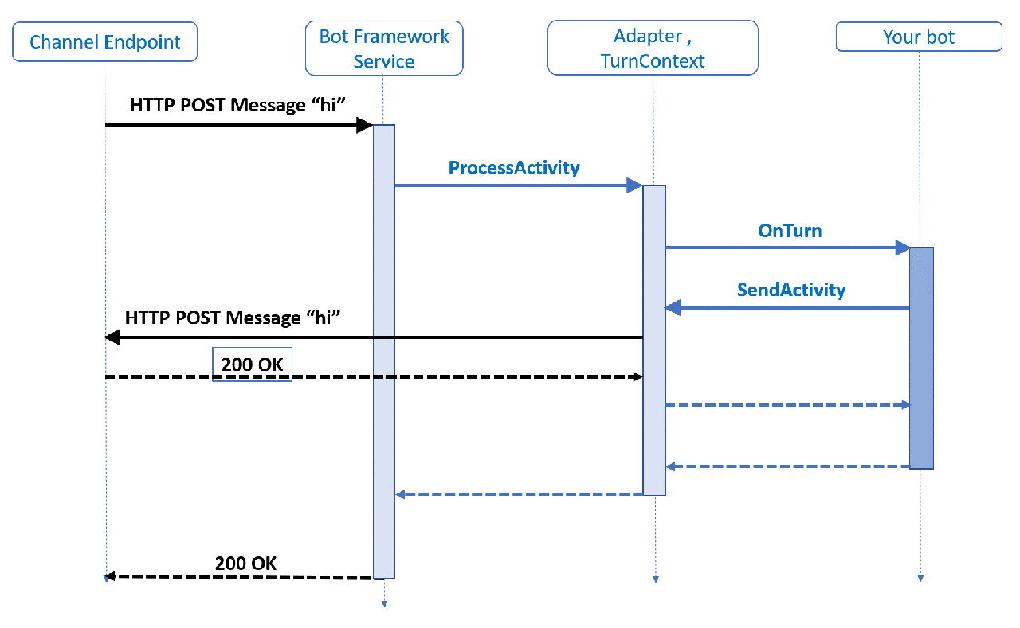
Bot Builder SDK – What is it all about
Controllers
Adapters
Middleware
Activities
Activity Handlers
Dialogs
Turn Context
Conversation State

Slide 6
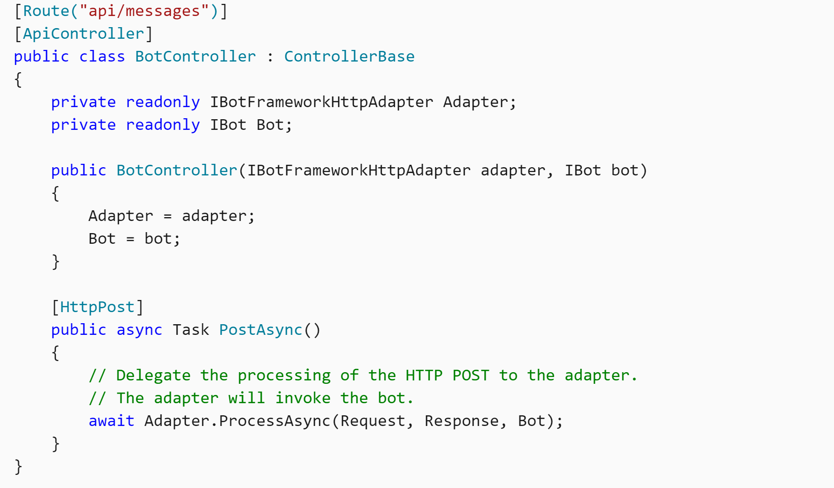
Controllers
MVC Controller
Handoff to Adapter Logic
Default Routes – Extend ControllerBase
Custom Routes for Custom Channels – I.E. Twilio Voice

Slide 7
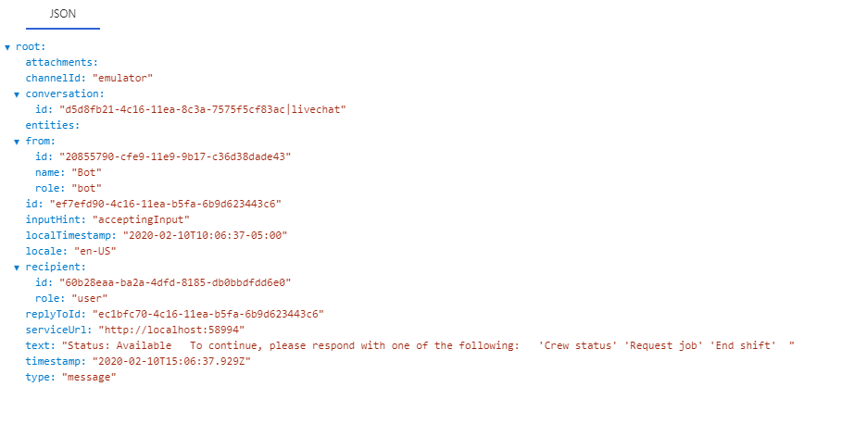
Activities
Activity Constants
Details of the Event
Sender Details
Recipient Details
Type of Activity
Activity Channel Information
Activity Types:
Message
Members Added
Members Removed
Conversation Update
End of Conversation
Message Reaction

Slide 8
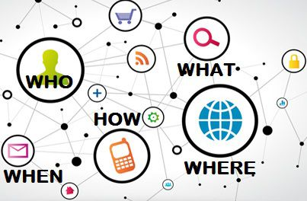
Turn Context
Provides info about the activity (Sender, Receiver, channel, etc)
Turn consists of incoming User message and message(s) response from Bot
Allows the Bot to respond back to the user
Notes:
Is this done?

Slide 9

Dialogs
Prompts
Component Dialogs
Router Dialog
Waterfall Dialogs

Slide 10
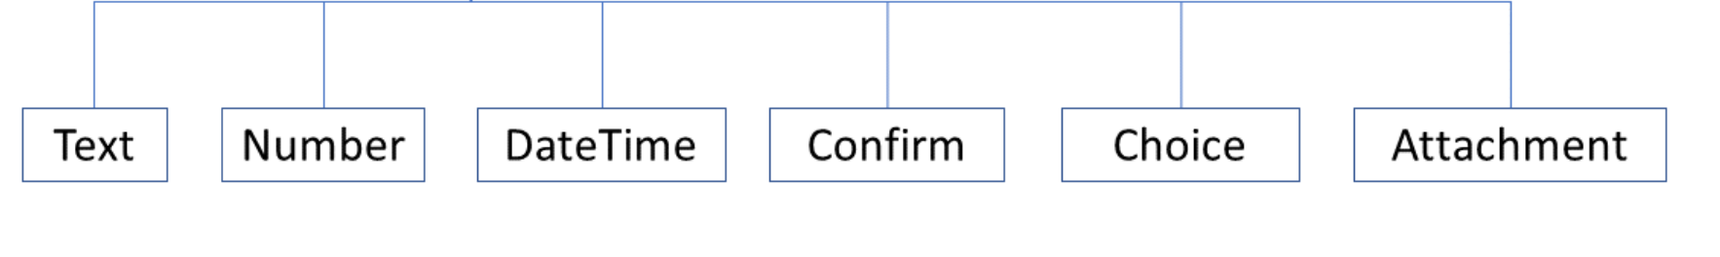
Prompt Dialog
Way to ask user for input
Validate user’s input
Leverage LUIS potentially
Ability to retry the prompt if the user’s input isn’t valid
Locale can be used to determine language specific behavior

Slide 11

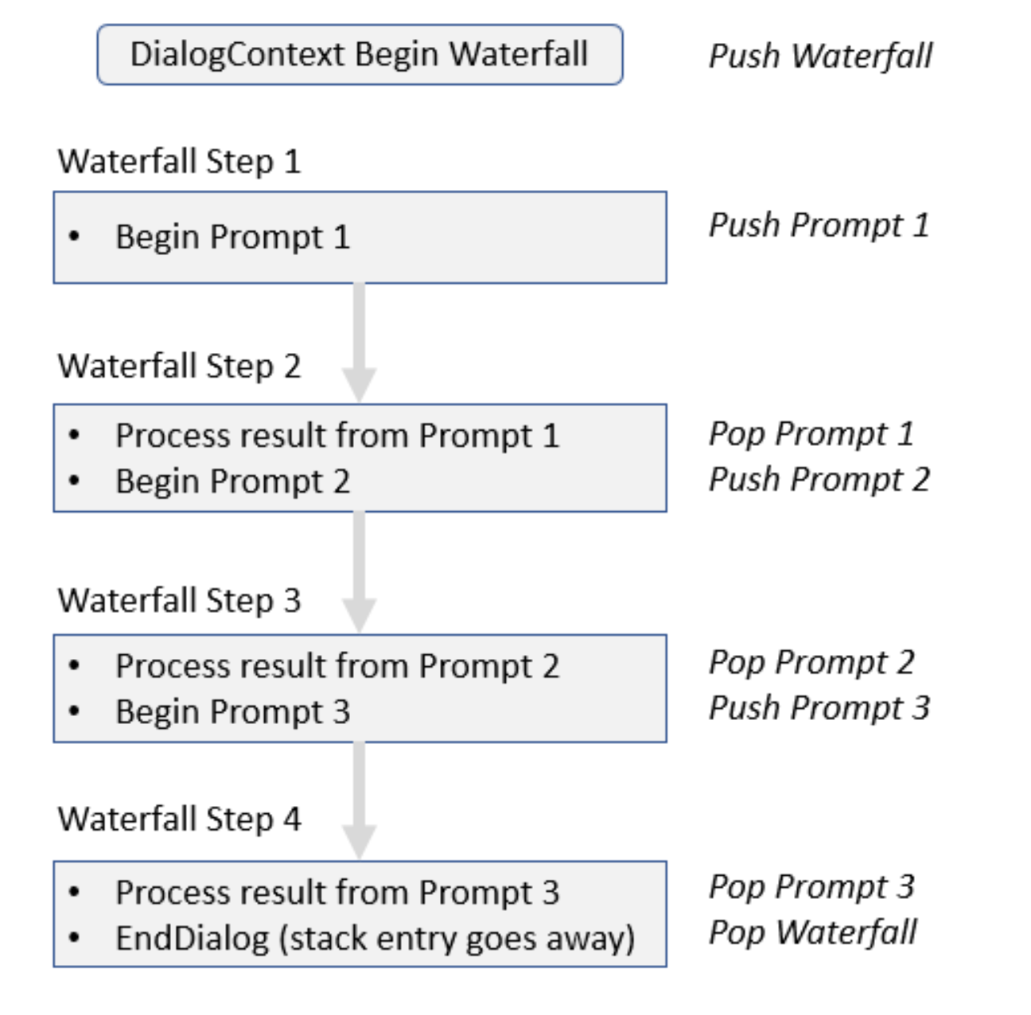
Waterfall Dialog
A series of steps within a conversation
Can be used in combo with Prompt dialogs
Ask question, validate response, ask next question
Dialog context contains results of previous step

Slide 12
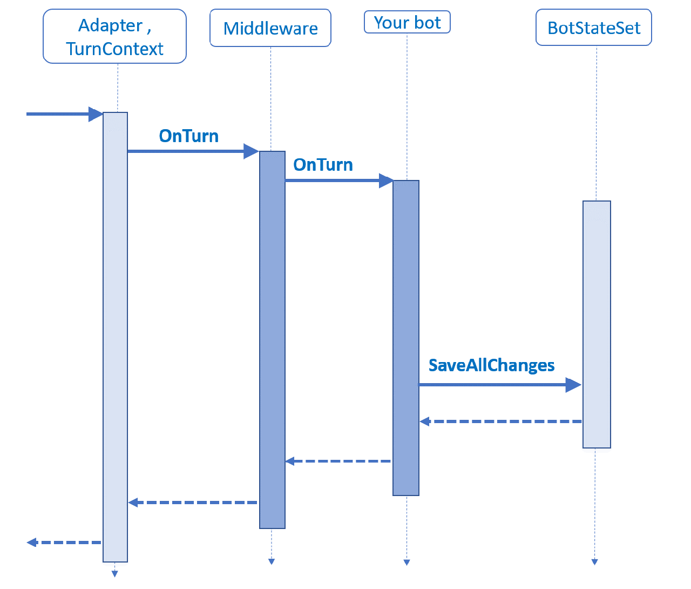
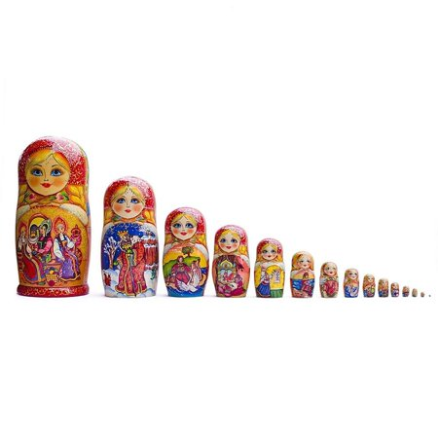
Middleware
Logic that sits between the adapter and bot logic
Custom/already created middleware can be added
Order of adding Middleware matters
Russian Nesting Doll
Common uses – transcript, logging, modify the turn context, etc.

Slide 13

Type of Bot to Build
Q&A Maker
Knowledge Bases
FAQs
Main purpose of the Bot is to return known answers to questions asked by User
Leverage QnA Maker Service
Virtual Assistant
Free Form Conversation
Speech is dissected to determine the intent of what the user is saying
Leverage LUIS to determine Intents / Entities (more to come)

Slide 14

DEMO

Slide 15
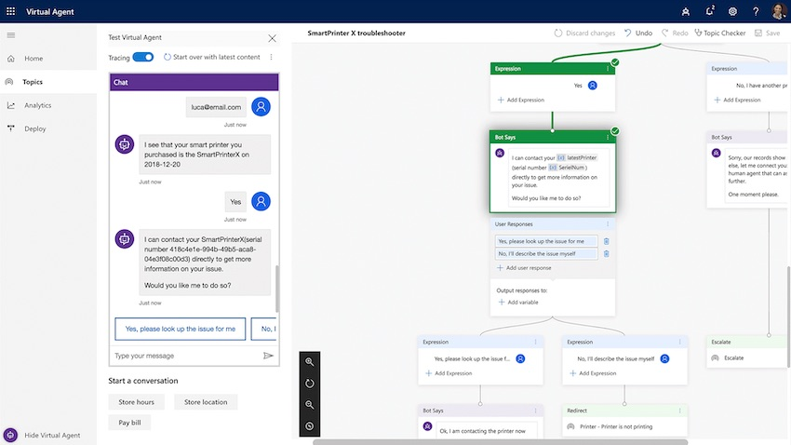
Power Virtual Agents
No Code / Low Code Bot Builder
Drag & Drop / WISIG
Part of the “Power” Platform
Power Automate (Flow)
Power BI
Power Virtual Agents
Power Apps

Slide 16
DEMO

Slide 17

LUIS – Language Understanding
Natural Language Processing
Prediction Score
Intents
Utterances
Entities
“Active” Learning
JSON
Tools – LUIS CLI, LUISGen, LUDown

Slide 18

Utterances
The words a user speaks/types/texts while communicating that your bot needs to interpret
“Hello my name is Corry”
“Hi, you may refer to me as Corry”
“Greetings, my good friend, I tend to go by Corry”

Slide 19
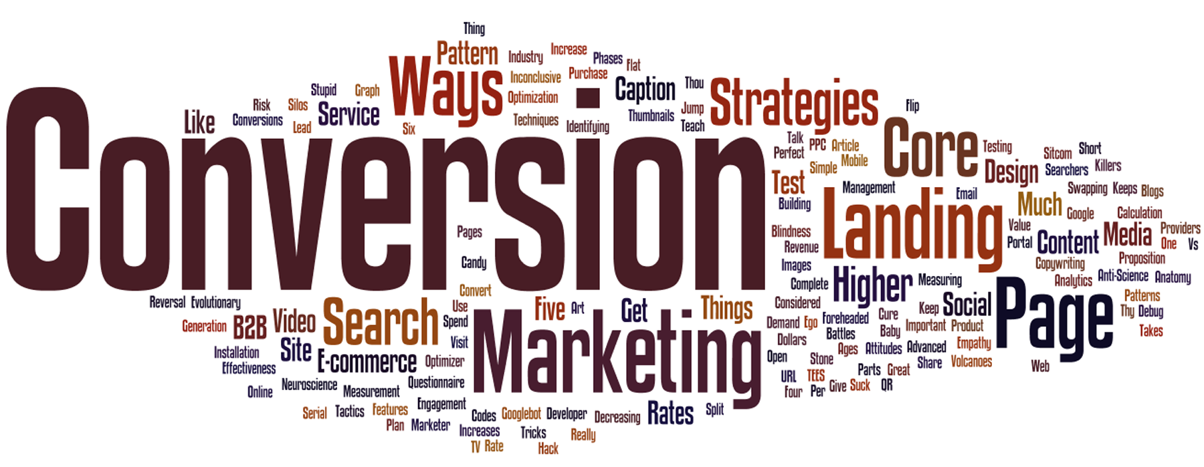
Intents
The underlying action or task the user wants to perform
Utterances are used to determine intents
Intent = Book Flight
“I would like to book a flight”
“I need a plane ticket from Columbus, Ohio to San Diego California”
“I want to fly somewhere warm”

Slide 20
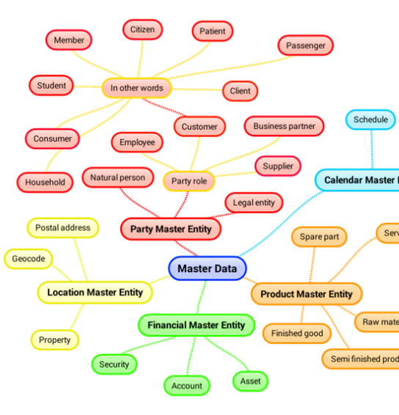
Entities
Entities represent data found within utterances
“Hello, my name is Corry” – Corry = Name Entity
Entity Types
Machine Learned, List, Pattern.any, Prebuilt, Regular Expression
Prebuilt Entities
Number, DateTime, Geography, PhoneNumber

Slide 21
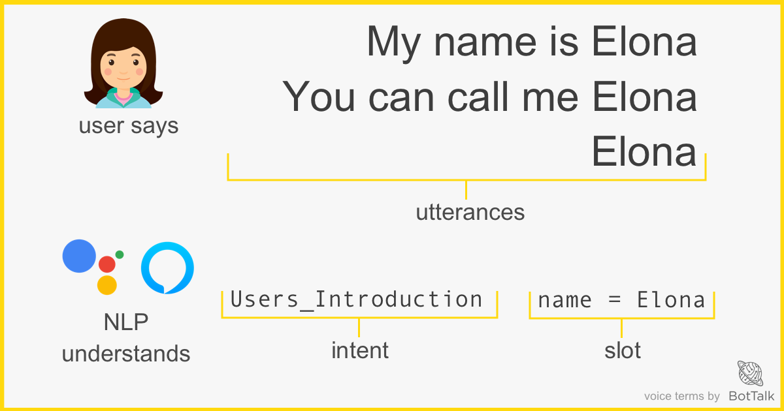
Intents, Utterances and Entities...
Intents = what the user is trying to say
Utterances = the words the user uses while communicating
Entities = data pulled from an utterance
Entities are optional

Slide 22
DEMO

Slide 23


Is this guy going to talk about Azure?

Slide 24
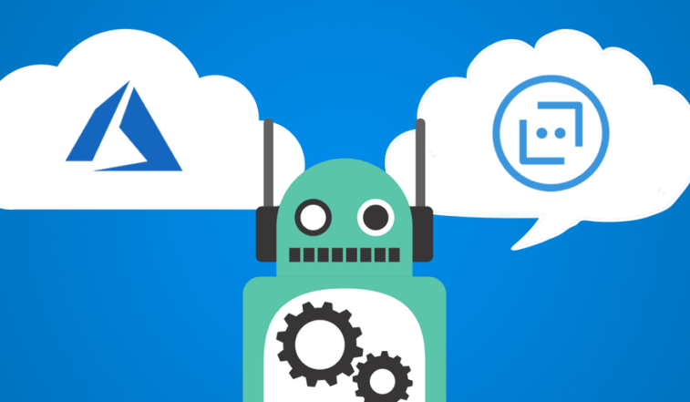
Services
App Service Plan
App Service
Web App Bot
Cosmos DB
App Insights

Slide 25
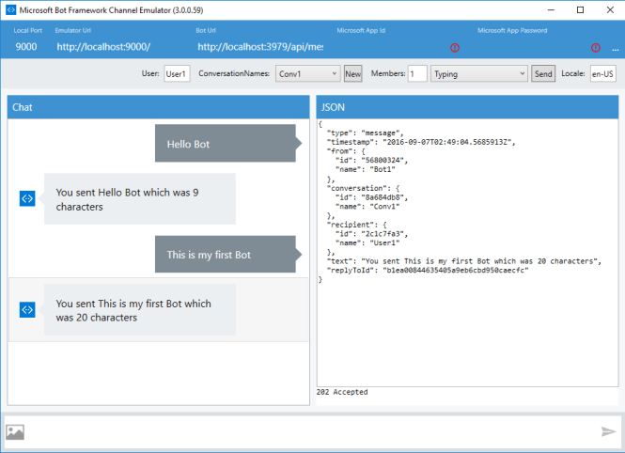
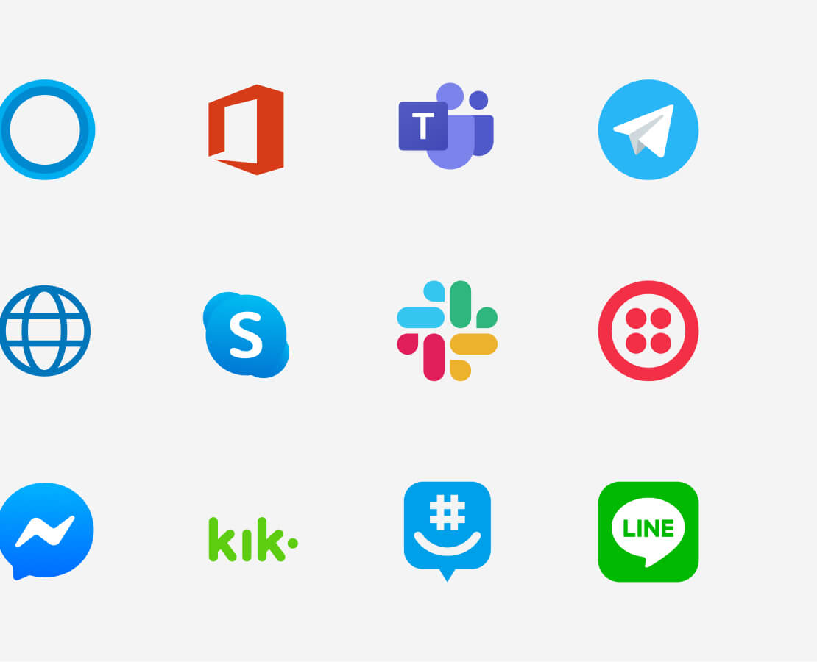
Deploy / Testing Bot
Bot Framework Emulator
Azure Web Chat
Channel configuration
Cortana, Teams, Direct Line, Facebook, GroupMe Slack, Twilio, Email

Slide 26
DEMO

Slide 27

Resources
https://github.com/microsoft/BotBuilder-Samples/tree/master/samples/csharp_dotnetcore
https://docs.microsoft.com/en-us/azure/cognitive-services/luis/
https://docs.microsoft.com/en-us/azure/bot-service/?view=azure-bot-service-4.0
https://docs.microsoft.com/en-us/azure/bot-service/bot-service-channel-connect-slack?view=azure-bot-service-4.0&tabs=abs

