Slide 1
Azure Serverless Updates
What’s New from BUILD 2019
Michael S. Collier
13 May 2019
Principal SDE, Microsoft

Slide 2
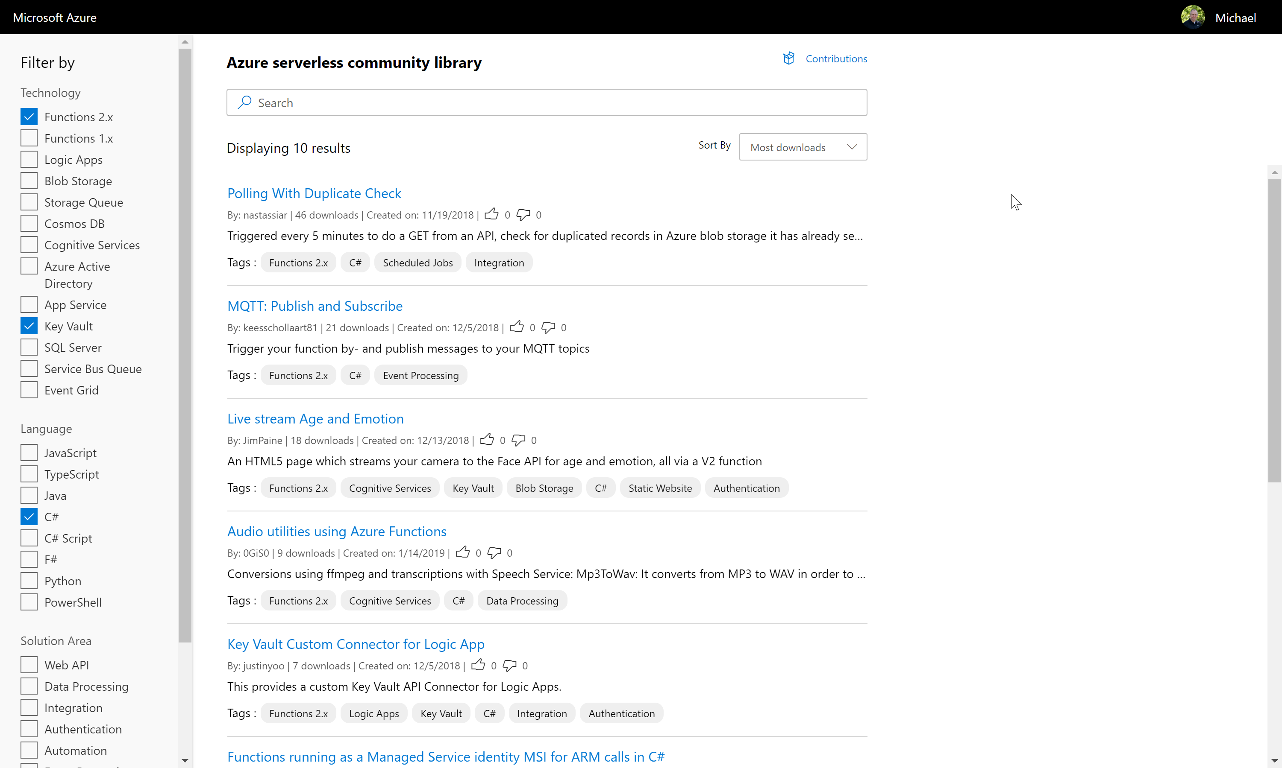
ServerlessLibrary.net
Notes:
Login to contribute with GitHub, directly on the site!
More details about each sample
New tagging system
Search and filter relevant samples

Slide 3
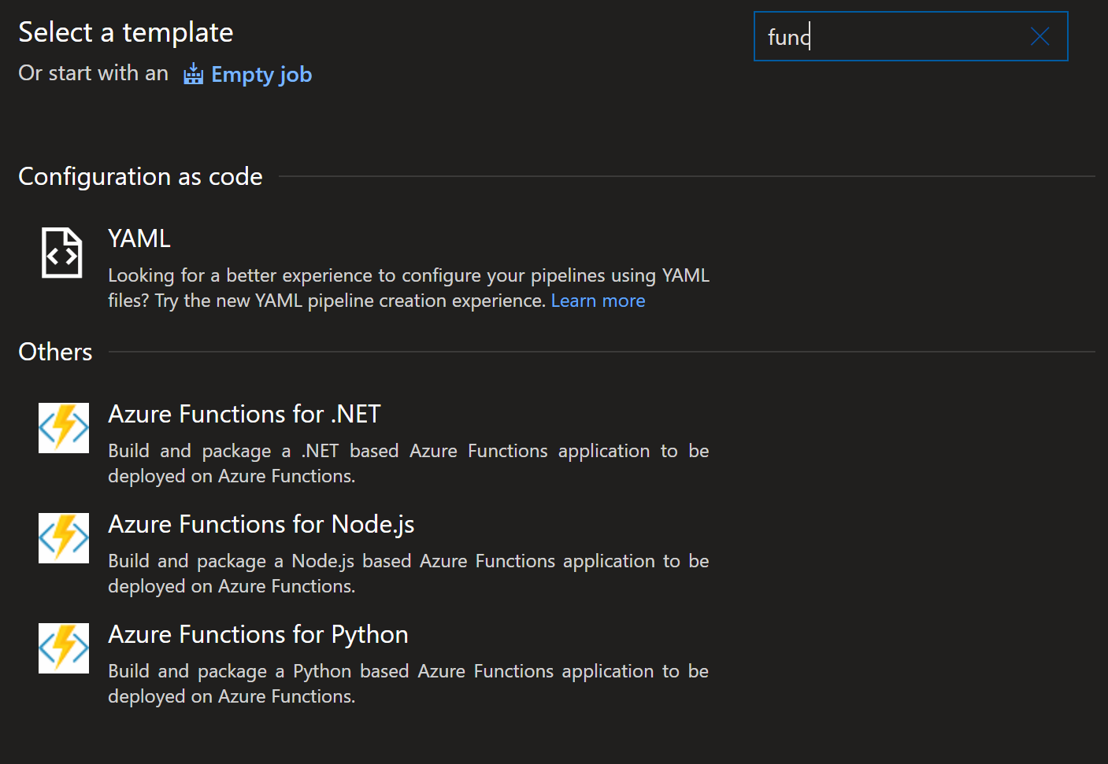
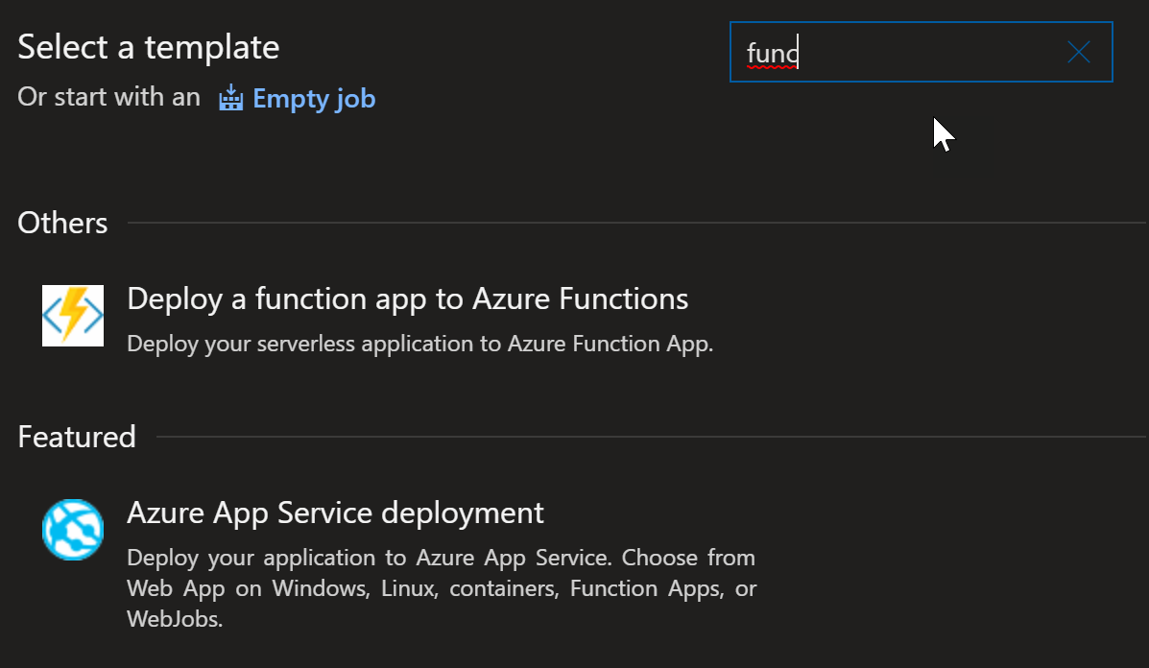
Azure Pipelines
Streamlined Build and Release experience
Create pipeline via Azure CLI
Notes:
https://aka.ms/functions-azure-devops

Slide 4
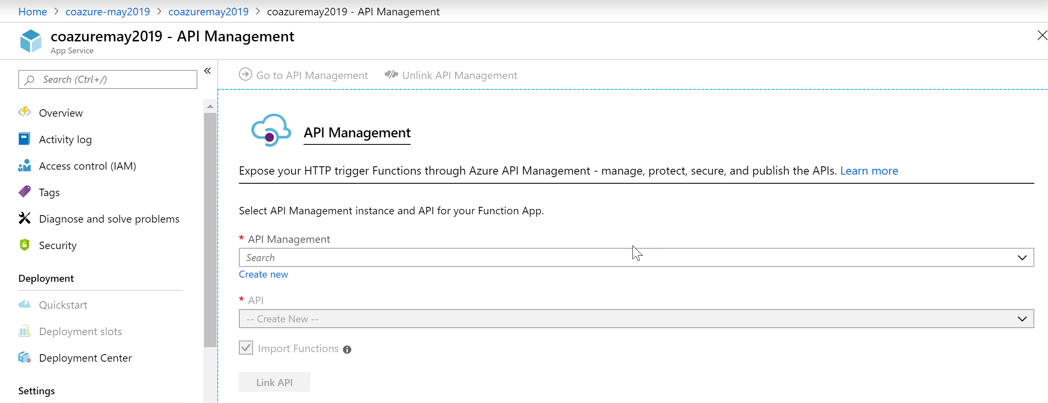
Functions + API Management
Simplified experience to exposed Functions via API Management
Notes:
https://aka.ms/functionstoapim

Slide 5
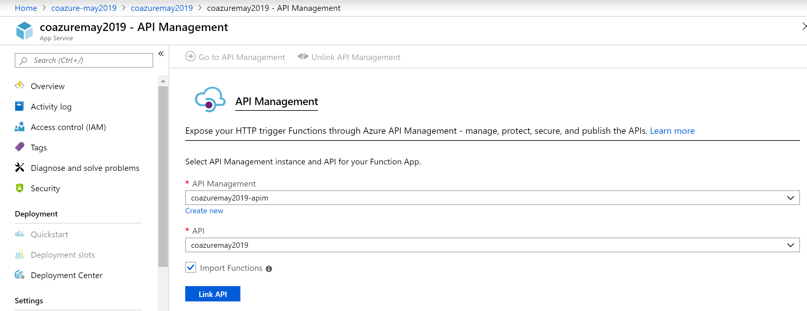
Functions + API Management
Simplified experience to exposed Functions via API Management
Notes:
https://aka.ms/functionstoapim

Slide 6
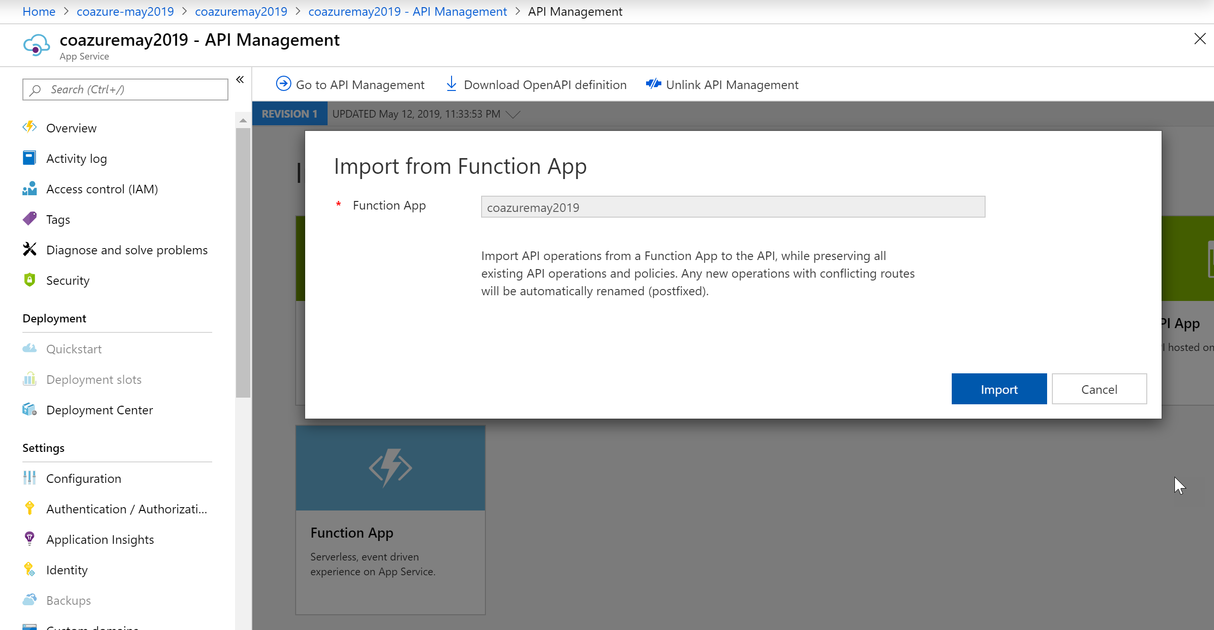
Functions + API Management
Simplified experience to exposed Functions via API Management
Notes:
https://aka.ms/functionstoapim

Slide 7
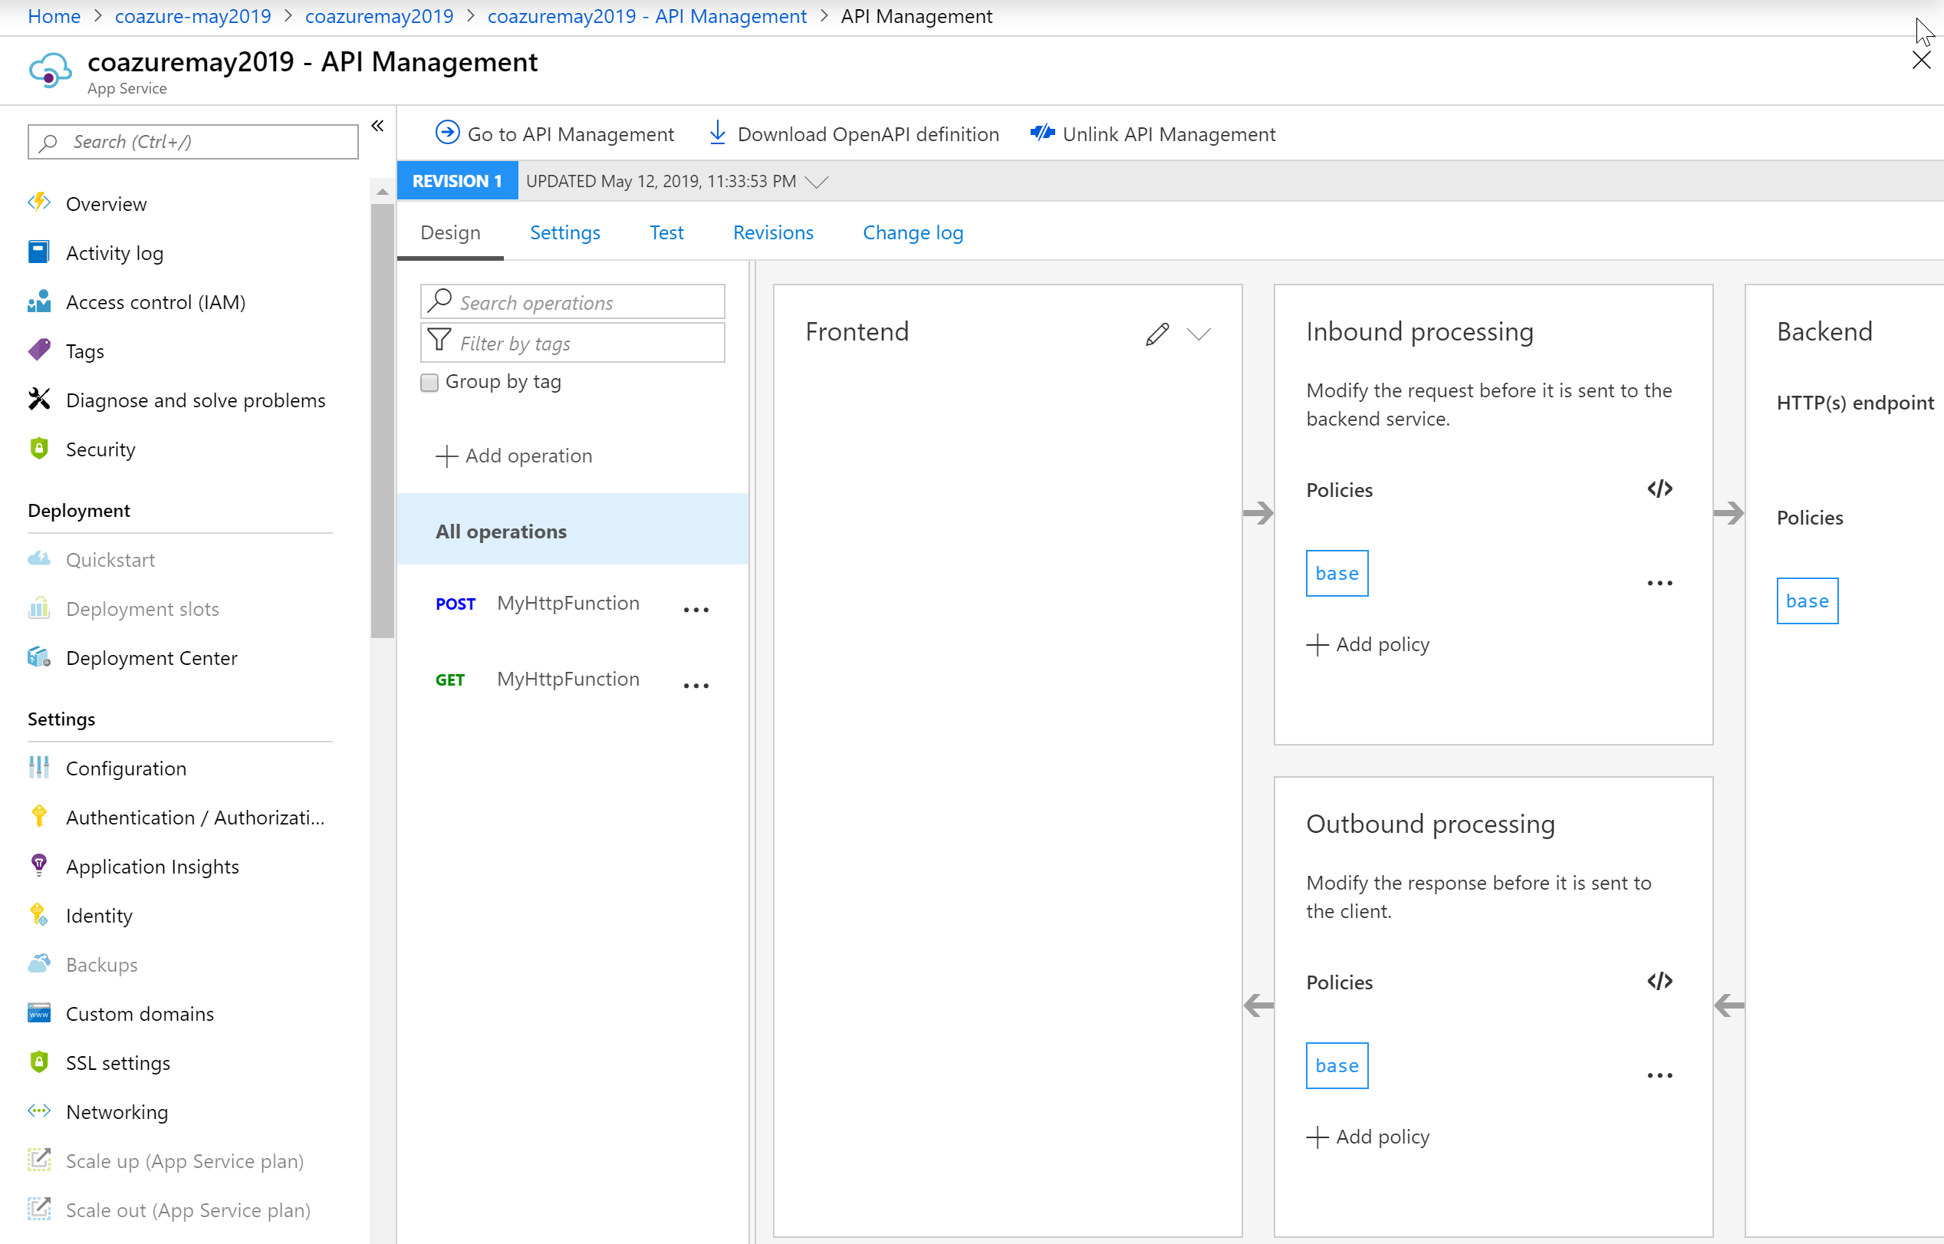
Functions + API Management
Simplified experience to exposed Functions via API Management
Notes:
https://aka.ms/functionstoapim

Slide 8
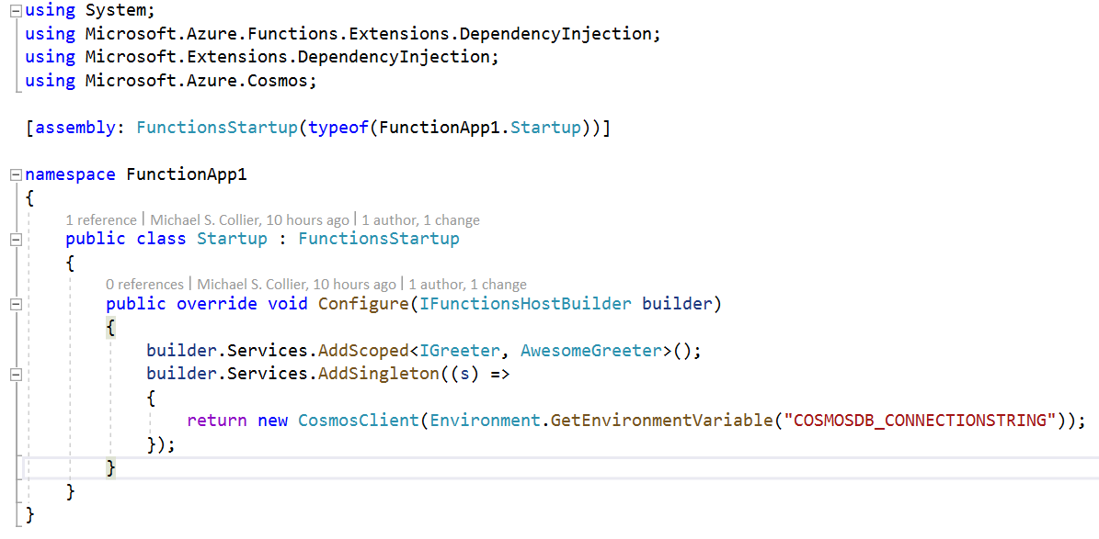
Durable Functions – Dependency Injection
Builds on top of ASP.NET Core DI
Install-Package Microsoft.Azure.Functions.
Extensions
Notes:
https://github.com/Azure/azure-functions-dotnet-extensions/tree/master/src/samples/DependencyInjection

Slide 9
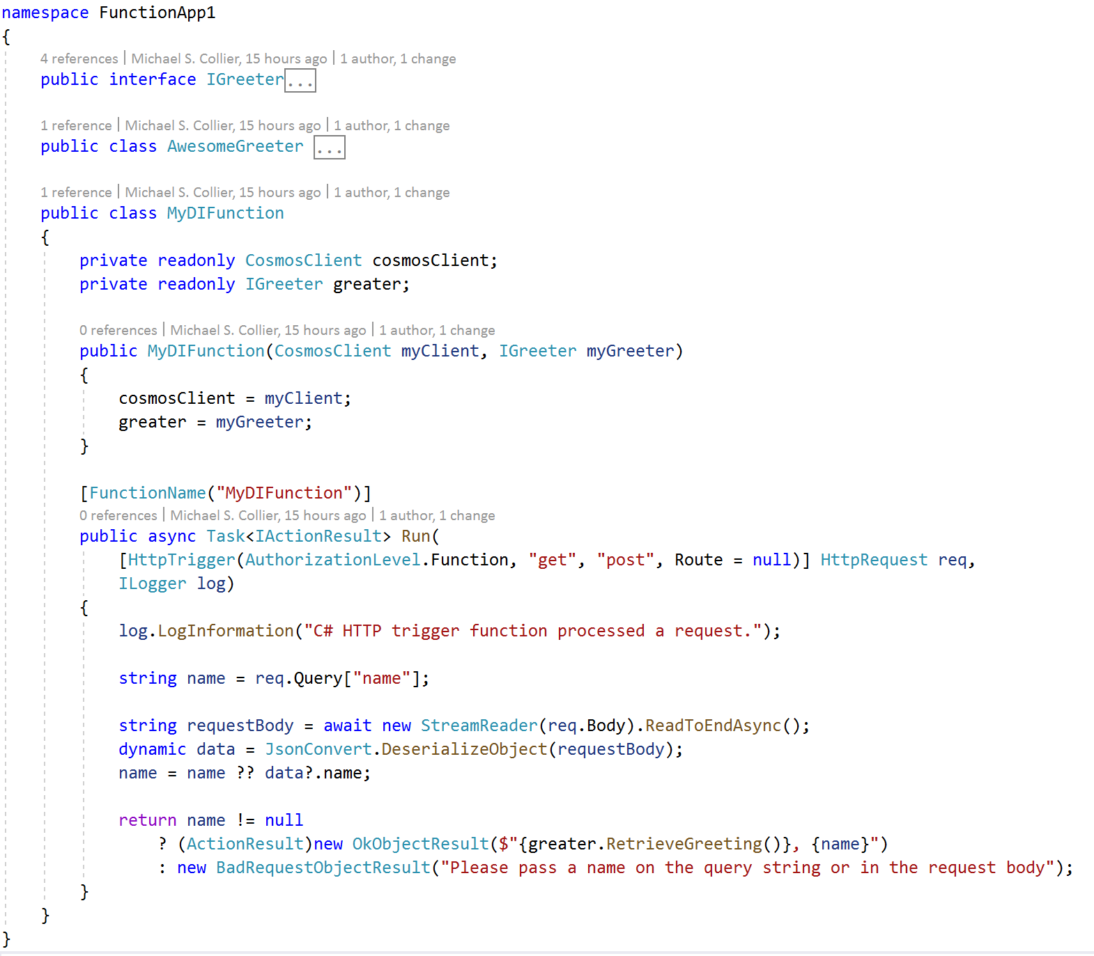
https://docs.microsoft.com/en-us/azure/azure-functions/functions-dotnet-dependency-injection
More examples at https://github.com/Azure/azure-functions-dotnet-extensions/tree/master/src/samples/DependencyInjection
Notes:
https://github.com/Azure/azure-functions-dotnet-extensions/tree/master/src/samples/DependencyInjection

Slide 10
Durable Functions 2.0 PREVIEW
Alpha-builds; not suitable for production & may change in significant ways
{
"version": "2.0",
"extensions": {
"durableTask": {
"hubName": <string>,
"storageProvider": {
"azureStorage": {
"connectionStringName": <string>,
"controlQueueBatchSize": <int?>,
"partitionCount": <int?>,
"controlQueueVisibilityTimeout": <hh:mm:ss?>,
"workItemQueueVisibilityTimeout": <hh:mm:ss?>,
"trackingStoreConnectionStringName": <string?>,
"trackingStoreNamePrefix": <string?>,
"maxQueuePollingInterval": <hh:mm:ss?>
}
},
"maxConcurrentActivityFunctions": <int?>,
"maxConcurrentOrchestratorFunctions": <int?>,
"traceInputAndOutputs": <bool?>,
"eventGridTopicEndpoint": <string?>,
"eventGridKeySettingName": <string?>,
"eventGridPublishRetryCount": <string?>,
"eventGridPublishRetryInterval": <hh:mm:ss?>,
"eventGridPublishRetryHttpStatus": <int[]?>,
"eventgridPublishEventTypes": <string[]?>,
"customLifeCycleNotificationHelperType"
"extendedSessionsEnabled": <bool?>,
"extendedSessionIdleTimeoutInSeconds": <int?>,
"logReplayEvents": <bool?>
}
}
Breaking Changes
Dropping .NET Framework support
Abstract base classes replaced with interfaces.
host.json schema
Alternate storage providers
Azure Storage, Azure Service Bus, in-memory emulator, Redis
Entity functions
https://docs.microsoft.com/en-us/azure/azure-functions/durable/durable-functions-preview
Notes:
DF 2.0 not coming to Functions 1.0
Better support for non-Windows platforms (maxOS & Linux)

Slide 11
Durable Functions – Entity Functions
[FunctionName("Counter")]
public static async Task Counter(
[EntityTrigger] IDurableEntityContext ctx)
{
int currentValue = ctx.GetState<int>();
int operand = ctx.GetInput<int>();
switch (ctx.OperationName)
{
case "add":
currentValue += operand;
break;
case "subtract":
currentValue -= operand;
break;
case "reset":
await SendResetNotificationAsync();
currentValue = 0;
break;
}
ctx.SetState(currentValue);
}
Get State
Mutate State

Slide 12
Durable Functions – Entity Functions
Developing Entity Functions
Entities process one operation at a time.
An entity will be automatically created if it does not yet exist.
Operations can be non-deterministic.
Entity functions can perform external calls (preferably w/ async APIs).
Entities can invoke other entities, but only one-way communication.
Notes:
https://twitter.com/cgillum/status/1125851294848016384?s=11
https://mybuild.techcommunity.microsoft.com/sessions/77334

Slide 13
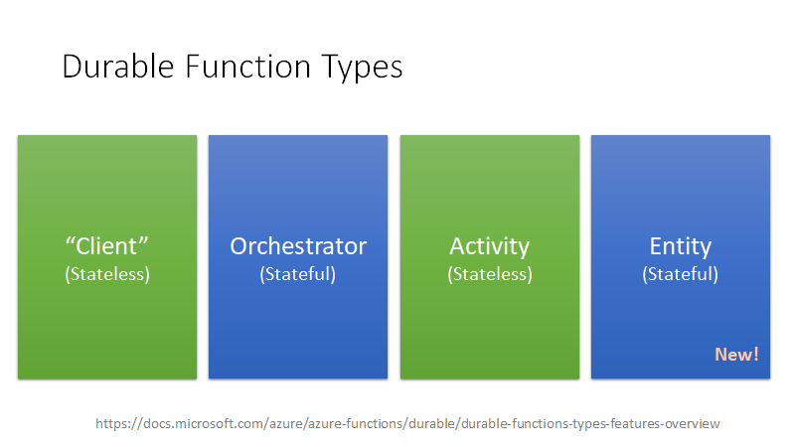
Durable Functions – Entity Functions
locking
Notes:
https://twitter.com/cgillum/status/1125851294848016384?s=11
https://mybuild.techcommunity.microsoft.com/sessions/77334

Slide 14
KEDA

Slide 15
Extension Bundle
Include all Microsoft Azure Functions’ team extensions.
{
"version": "2.0",
"exensionBundle": {
"id": "Microsoft.Azure.Functions.ExtensionBundle",
"version": "[1.*, 2.0.0)"
}
}
Package | Version
Microsoft.Azure.WebJobs.Extensions.CosmosDB | 3.0.3
Microsoft.Azure.WebJobs.Extensions.DurableTask | 1.8.0
Microsoft.Azure.WebJobs.Extensions.EventGrid | 2.0.0
Microsoft.Azure.WebJobs.Extensions.EventHubs | 3.0.3
Microsoft.Azure.WebJobs.Extensions.SendGrid | 3.0.0
Microsoft.Azure.WebJobs.Extensions.ServiceBus | 3.0.3
Microsoft.Azure.WebJobs.Extensions.SignalRService | 1.0.0
Microsoft.Azure.WebJobs.Extensions.Storage | 3.0.4
Microsoft.Azure.WebJobs.Extensions.Twilio | 3.0.0
Include in host.json file.
Notes:
https://aka.ms/functions-extensionbundle

Slide 16
Azure Functions
Durable Functions for JavaScript 1.2.0
Session-enabled Service Bus trigger
Notes:
https://github.com/Azure/azure-functions-durable-js/releases/tag/1.2.0
https://aka.ms/functions-sbextension

Slide 17
Azure App Service
App Service on Linux
Free Tier
New build system (Oryx)
Virtual network integration
Java 11 for both Linux and Windows App Service
UX updates for application creation (full screen)
Notes:
https://azure.microsoft.com/en-us/blog/azure-app-service-update-free-linux-tier-python-and-java-support-and-more/

Slide 18
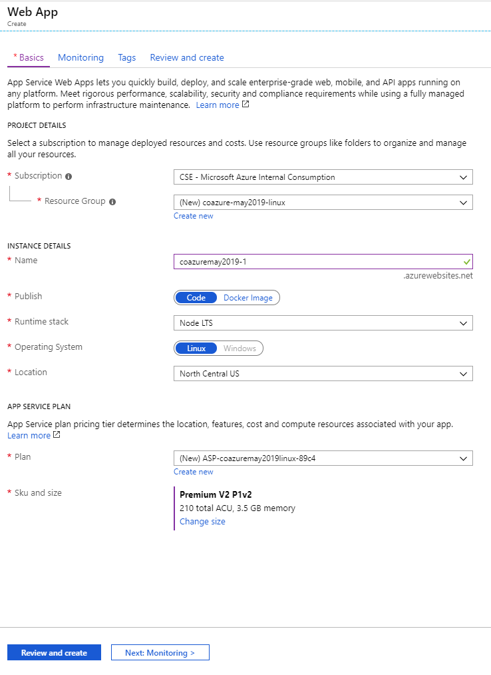
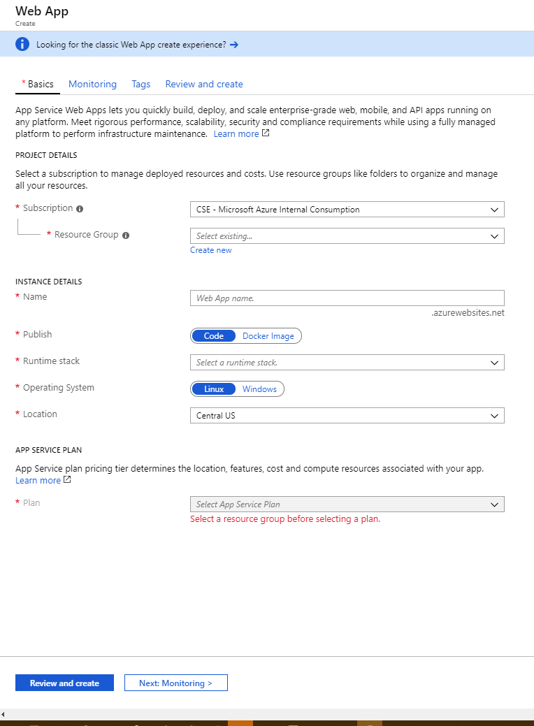
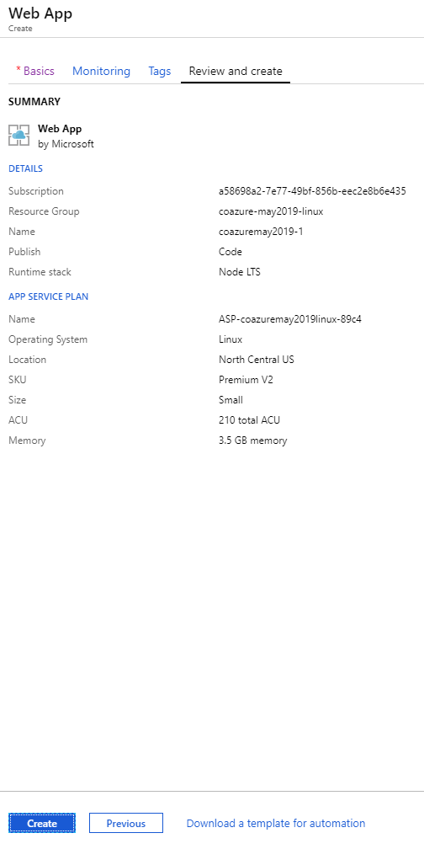
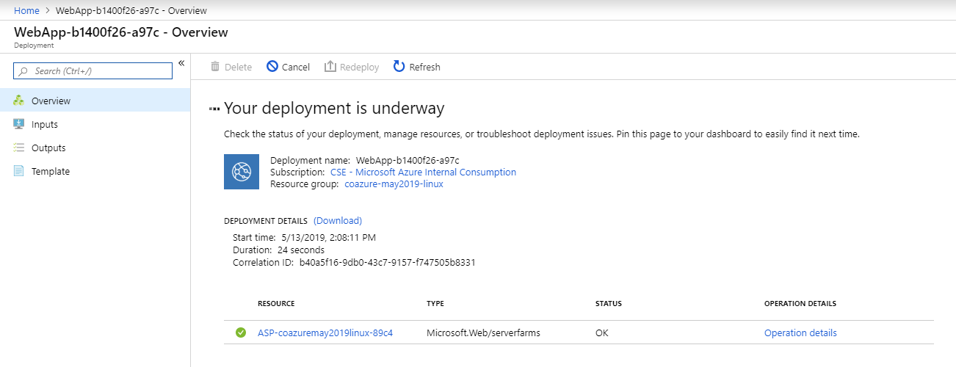
https://channel9.msdn.com/Shows/Azure-Friday/Azure-Friday-Live-Azure-App-Service-full-screen-create-experience

Slide 19
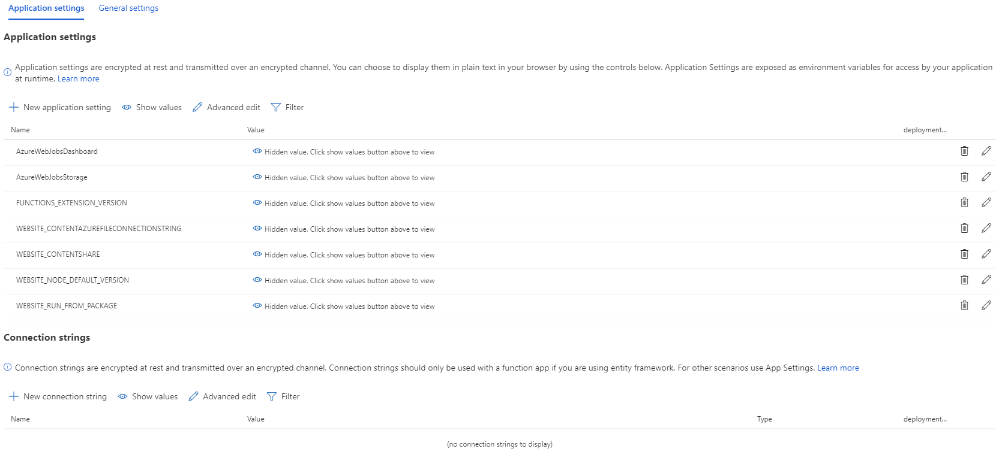

Slide 20
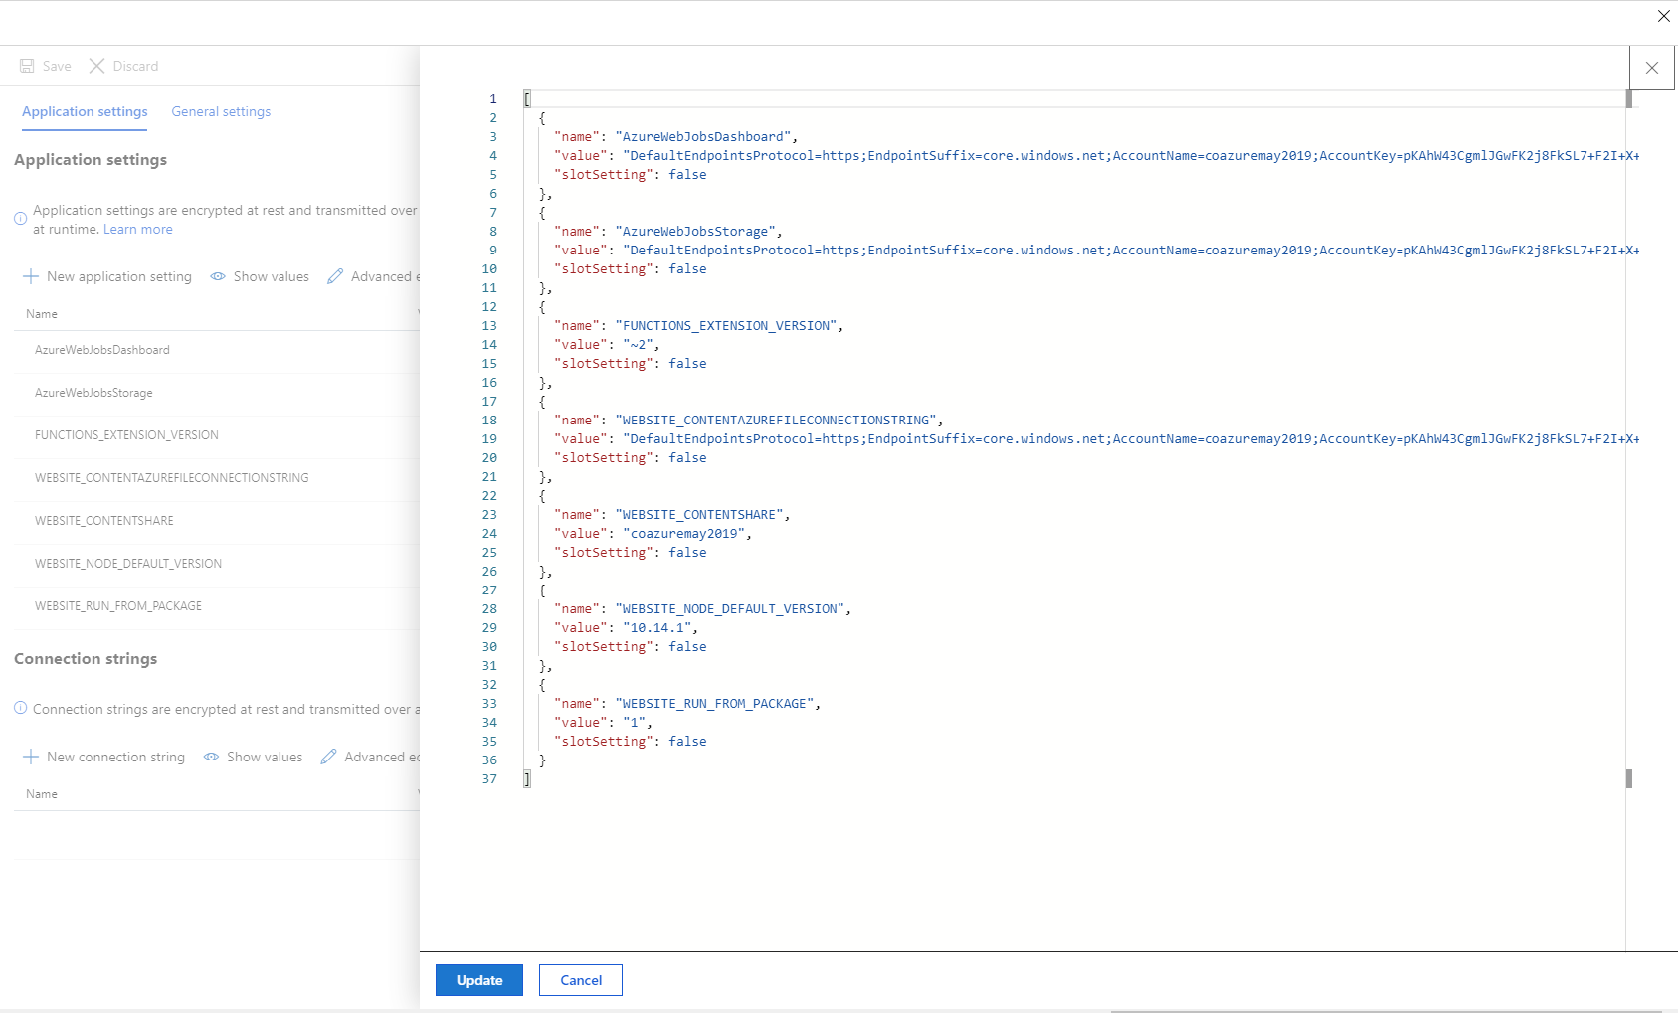

Slide 21
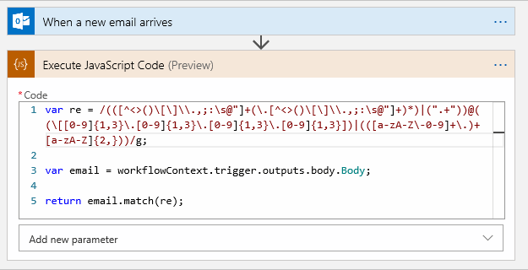
Logic Apps
Inline code snippets
Runs in JavaScript. More languages coming soon.
Finishes running in five seconds or fewer.
Handles data up to 50 MB in size.
Uses Node.js version 8.11.1
Integration Account required.
Notes:
https://docs.microsoft.com/en-us/azure/logic-apps/logic-apps-add-run-inline-code
Inline Code is designed when you want to write a few lines of code to do very simple tasks, e.g. RegEx parsing, arithmetic. Functions and other solutions are still what you should use to do heavy lifting. See doc for more at aka.ms/inlinecode.

Slide 22
Resources
Follow these links to learn more!
Azure Functions BUILD 2019
https://hackmd.io/s/Bk5gtA-nN (sessions)
http://aka.ms/FunctionsBuild2019 (blog post)

